Slide 1


Introduction to Operating Systems CS 1550
Spring 2023
Sherif Khattab
ksm73@pitt.edu
(Some slides are from Silberschatz, Galvin and Gagne ©2013)

Slide 2
Announcements
Upcoming deadlines:
Lab 3: due on 4/1
Homework 9: due on 4/4
Project 3: due on 4/11

Slide 3
Previous lecture …
The problem of large page tables

Slide 4
Muddiest Points (1/2)
How to determine number of bits (2^n) from day 4gb or 4kb
Calculating the PTE frame number size.
calculating the number of frames
userspace page replacement
For the final top hat question, how did we get 24 in the answer 24*(2^20)? I understand that we did log(2^20) to get 20, but where did the extra 4 come from?
I don't understand the last two examples about calculating the PTE s and frames, what information (values) do we need to look at in terms of different questions?
Could you list the formulas for page table entries?

Slide 5
Muddiest Points (2/2)
In the OPT simulation, why do we only re order the pages above the one we want? Wouldn't it be better to re order everything?
OPT trace was slightly confusing of what switches where
How to find the number of writes for LRU and OPT?
How to calculate the distance in the tables we made
Are local or global selection policies more common in modern OS’s?

Slide 6
Problem of the Day
How to keep track of larger page tables that can store more pages
How big can a page table be?
64-bit machine
4 KB page size
How many pages?
How many PTE?
How big is a PTE?
How big is the page table of one process?

Slide 7
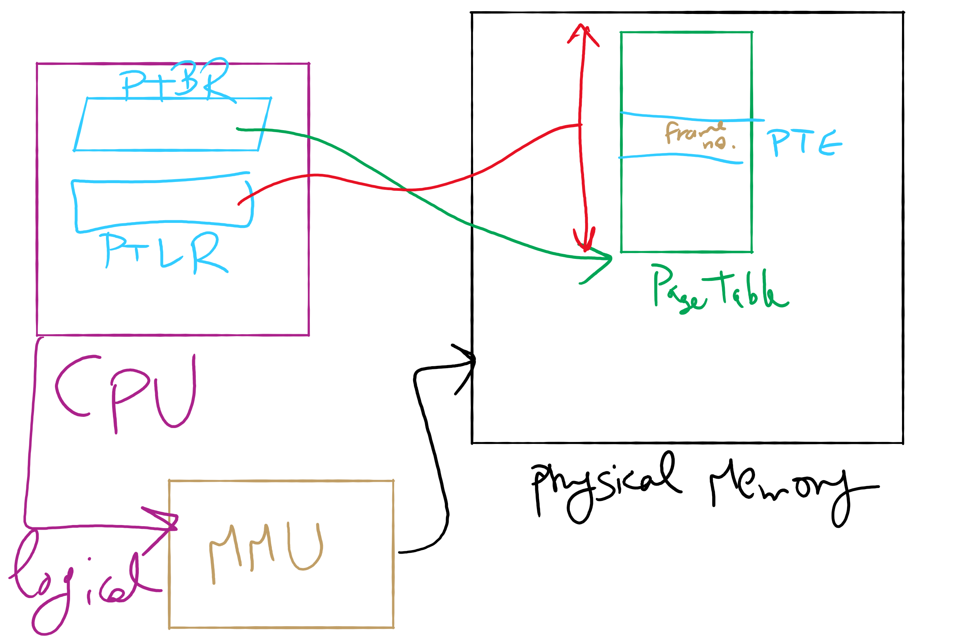
Address Translation Structures

Slide 8
Memory & paging structures
Physical memory
Page frame number
Page 0
6
Page 1
3
0
Page 1 (P1)
Page 2
4
1
Page 3
9
2
Page 4 (P0)
Page 4
2
3
Page 1 (P0)
Free
pages
4
Page 2 (P0)
Logical memory (P0)
Page table (P0)
5
6
Page 0 (P0)
Page 0
8
7
Page 1
0
8
Page 0 (P1)
9
Page 3 (P0)
Logical memory (P1)
Page table (P1)

Slide 9
Mapping logical => physical address
Split address from CPU into two pieces
Page number (p)
Page offset (d)
Page number
Index into page table
Page table contains base address of page in physical memory
Page offset
Added to base address to get actual physical memory address
Page size = 2^{d} bytes
Example:
• 4 KB (=4096 byte) pages
• 32 bit logical addresses
2^{d} = 4096
d = 12
32-12 = 20 bits
12 bits
p
d
32 bit logical address

Slide 10
Address translation architecture
page number
Page frame number
Page frame number
page offset
0
CPU
p
d
f
d
1
. . .
0
f-1
1
f
. . .
f+1
p-1
f+2
p
f
. . .
p+1
physical memory
page table

Slide 11
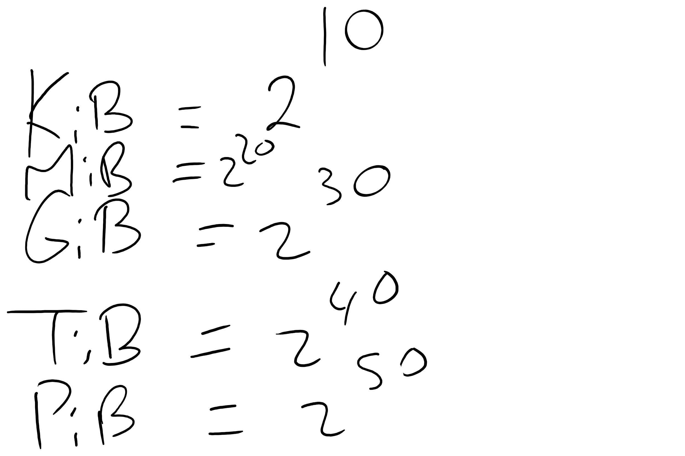
Memory Sizes

Slide 12
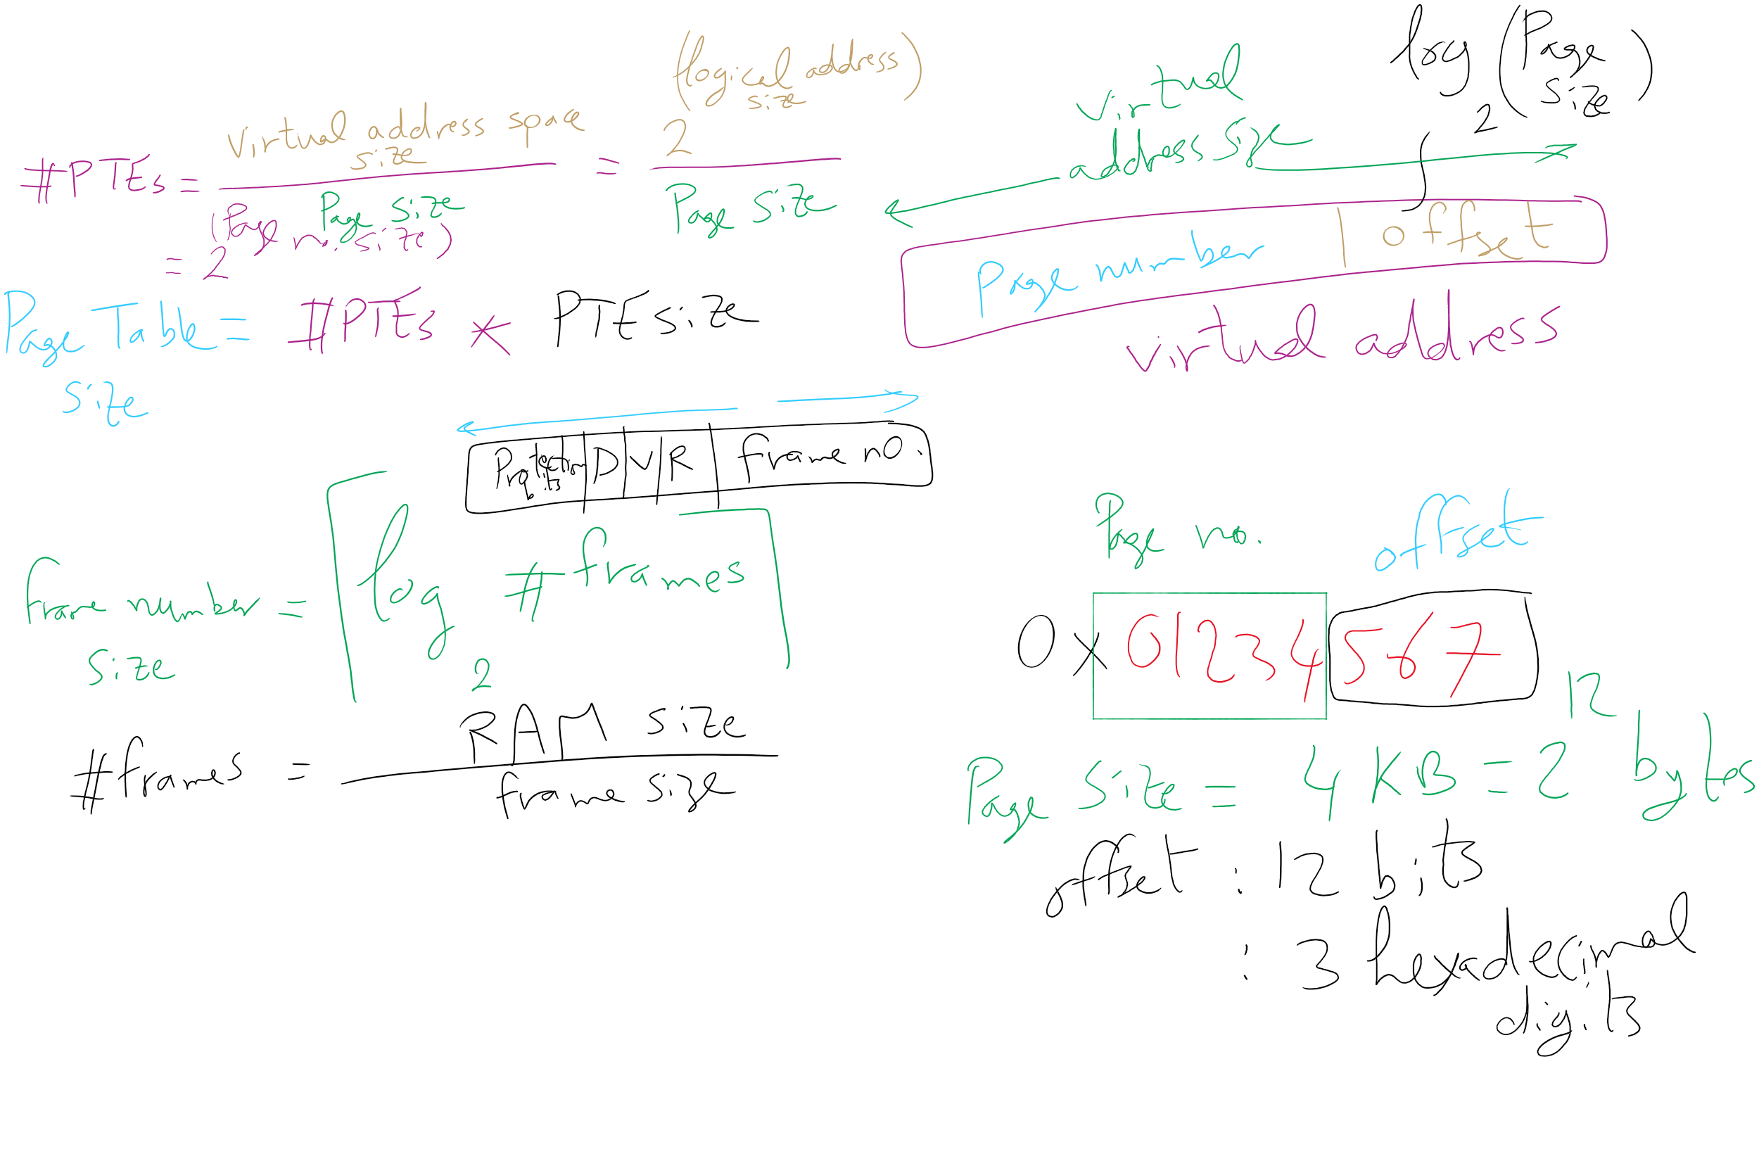
Address Translation Relations

Slide 13
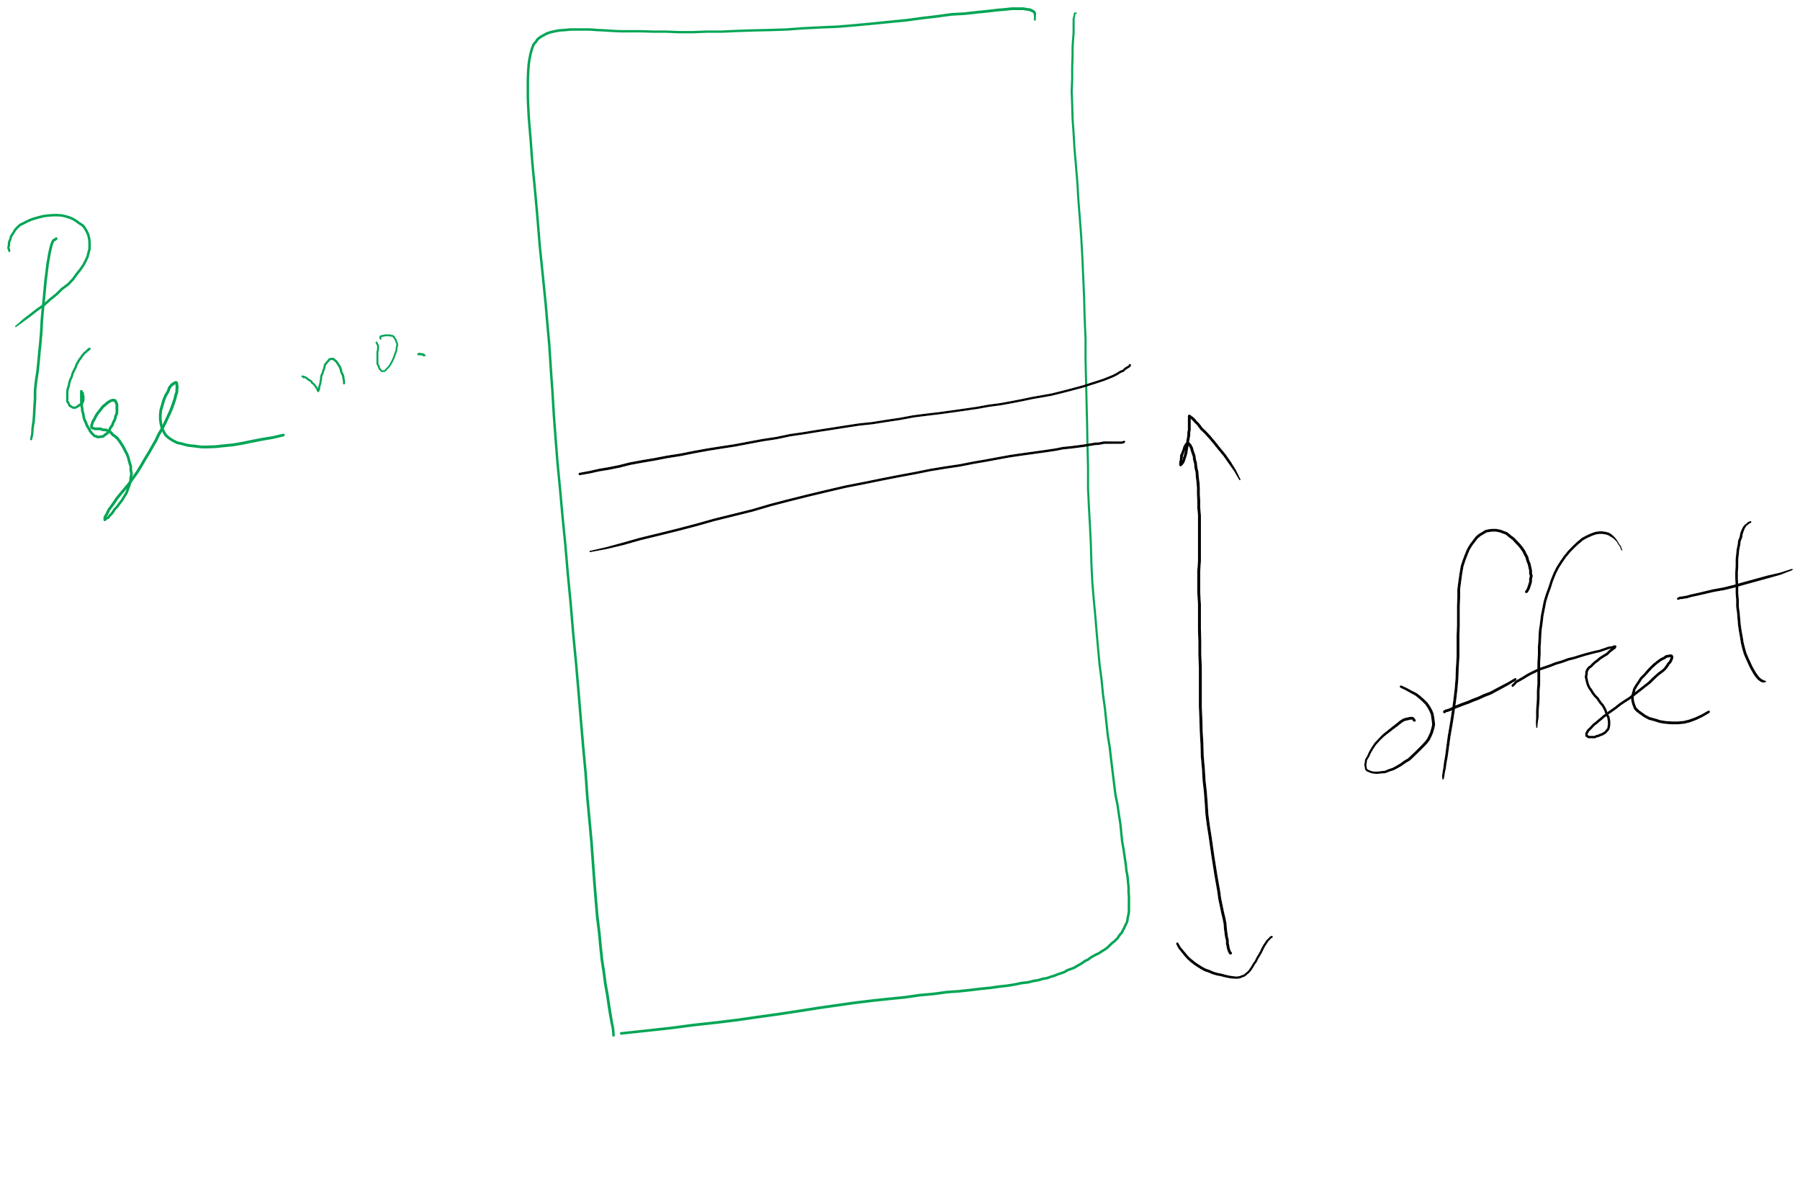
Page number vs. Offset

Slide 14
Solution 1: Two-level page tables
Problem: page tables can be too large
2³² bytes in 4KB pages need 1 million PTEs
Solution: use multi-level page tables
“Page size” in first page table is large (megabytes)
PTE marked invalid in first page table needs no 2nd level page table
1st level page table has pointers to 2nd level page tables
2nd level page table has actual physical page numbers in it
. . .
220
. . .
657
. . .
. . .
401
. . .
. . .
. . .
125
613
. . .
. . .
. . .
1st level page table
961
. . .
884
960
. . .
2nd level page tables
. . .
main memory
955

Slide 15
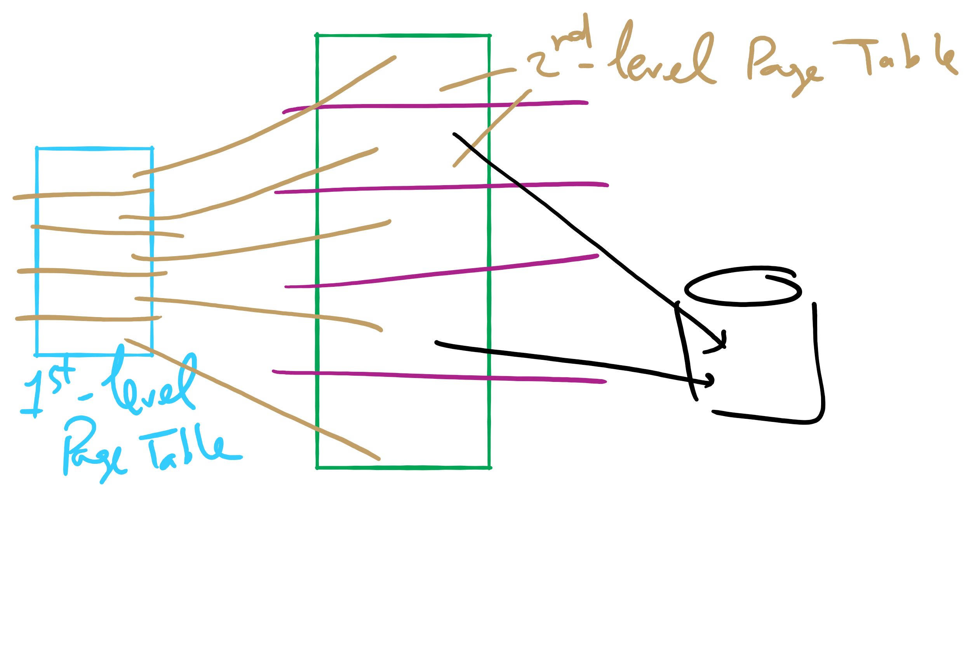
Two-level Page Table

Slide 16
More on two-level page tables
Tradeoffs between 1st and 2nd level page table sizes
Total number of bits indexing 1st and 2nd level table is constant for a given page size and logical address length
Tradeoff between number of bits indexing 1st and number indexing 2nd level tables
More bits in 1st level: fine granularity at 2nd level
Fewer bits in 1st level: maybe less wasted space?
All addresses in table are physical addresses
Protection bits kept in 2nd level table

Slide 17
Two-level paging: example
System characteristics
8 KB pages
32-bit logical address divided into 13 bit page offset, 19 bit page number
Page number divided into:
10 bit page number
9 bit page offset
Logical address looks like this:
p₁ is an index into the 1st level page table
p₂ is an index into the 2nd level page table pointed to by p₁
page number
page offset
p₁ = 10 bits
p₂ = 9 bits
offset = 13 bits

Slide 18
2-level address translation example
page number
page offset
p₁ = 10 bits
p₂ = 9 bits
offset = 13 bits
frame number
0
Page table base
physical address
1
0
19
13
. . .
1
. . .
0
1
p₁
. . .
. . .
. . .
p₂
main memory
1st level page table
. . .
2nd level page table

Slide 19
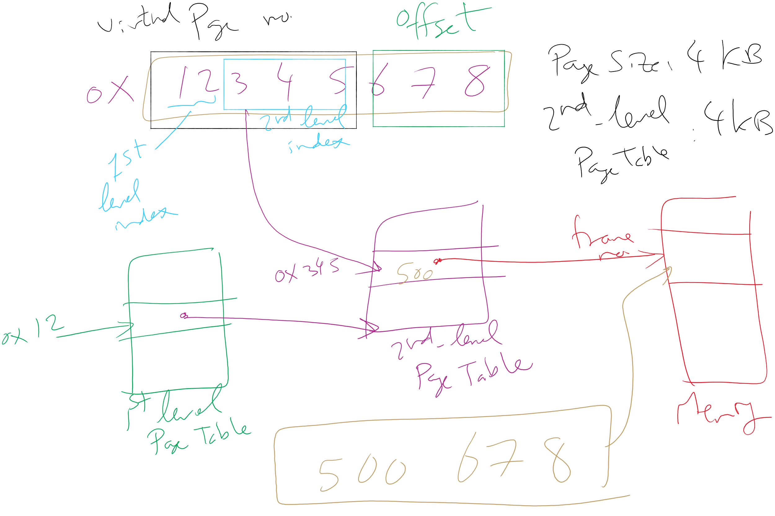
Address Translation: 2-level Page Table

Slide 20
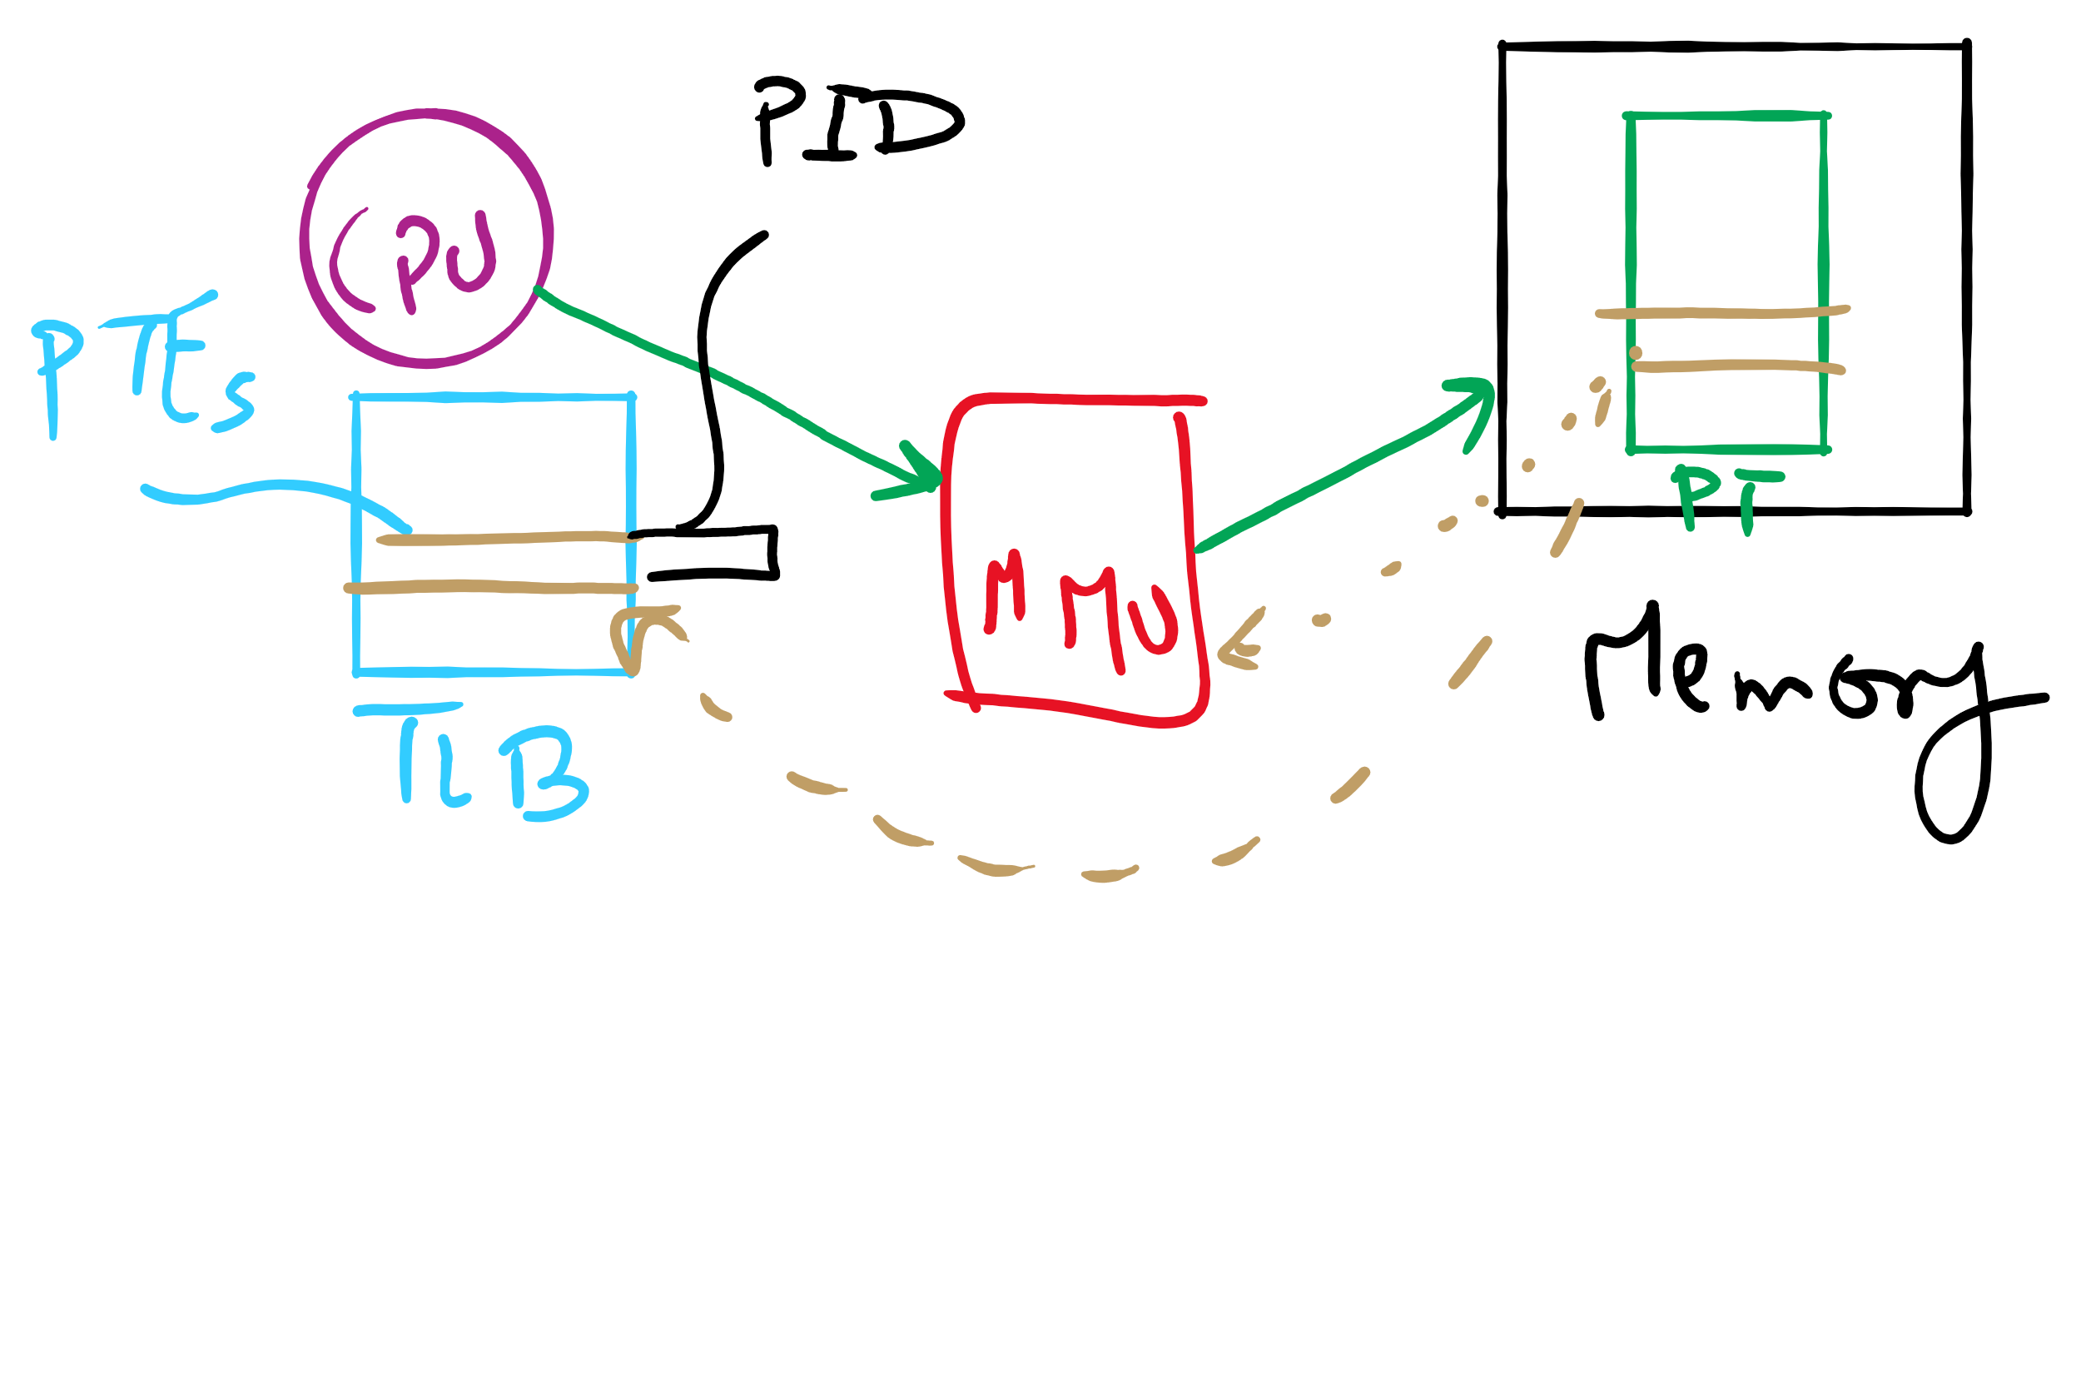
TLB

Slide 21
Translation Lookaside Buffer (TLB)
Search the TLB for the desired logical page number
Search entries in parallel
Use standard cache techniques
If desired logical page number is found, get frame number from TLB
If desired logical page number isn’t found
Get frame number from page table in memory
Replace an entry in the TLB with the logical & physical page numbers from this reference
Logical page #
Physical frame #
8
3
unused
2
1
3
0
12
12
29
6
22
11
7
4
Example TLB

Slide 22
Handling TLB misses
If PTE isn’t found in TLB, OS needs to do the lookup in the page table
Lookup can be done in hardware or software
Hardware TLB replacement
CPU hardware does page table lookup
Can be faster than software
Less flexible than software, and more complex hardware
Software TLB replacement
OS gets TLB exception
Exception handler does page table lookup & places the result into the TLB
Program continues after return from exception
Larger TLB (lower miss rate) can make this feasible

Slide 23
How long do memory accesses take?
Assume the following times:
TLB lookup time = a (often zero - overlapped in CPU)
Memory access time = m
Hit ratio (h) is percentage of time that a logical page number is found in the TLB
Larger TLB usually means higher h
TLB structure can affect h as well
Effective access time (an average) is calculated as:
EAT = (m + a)h + (m + m + a)(1-h)
EAT =a + (2-h)m
Interpretation
Reference always requires TLB lookup, 1 memory access
TLB misses also require an additional memory reference

Slide 24
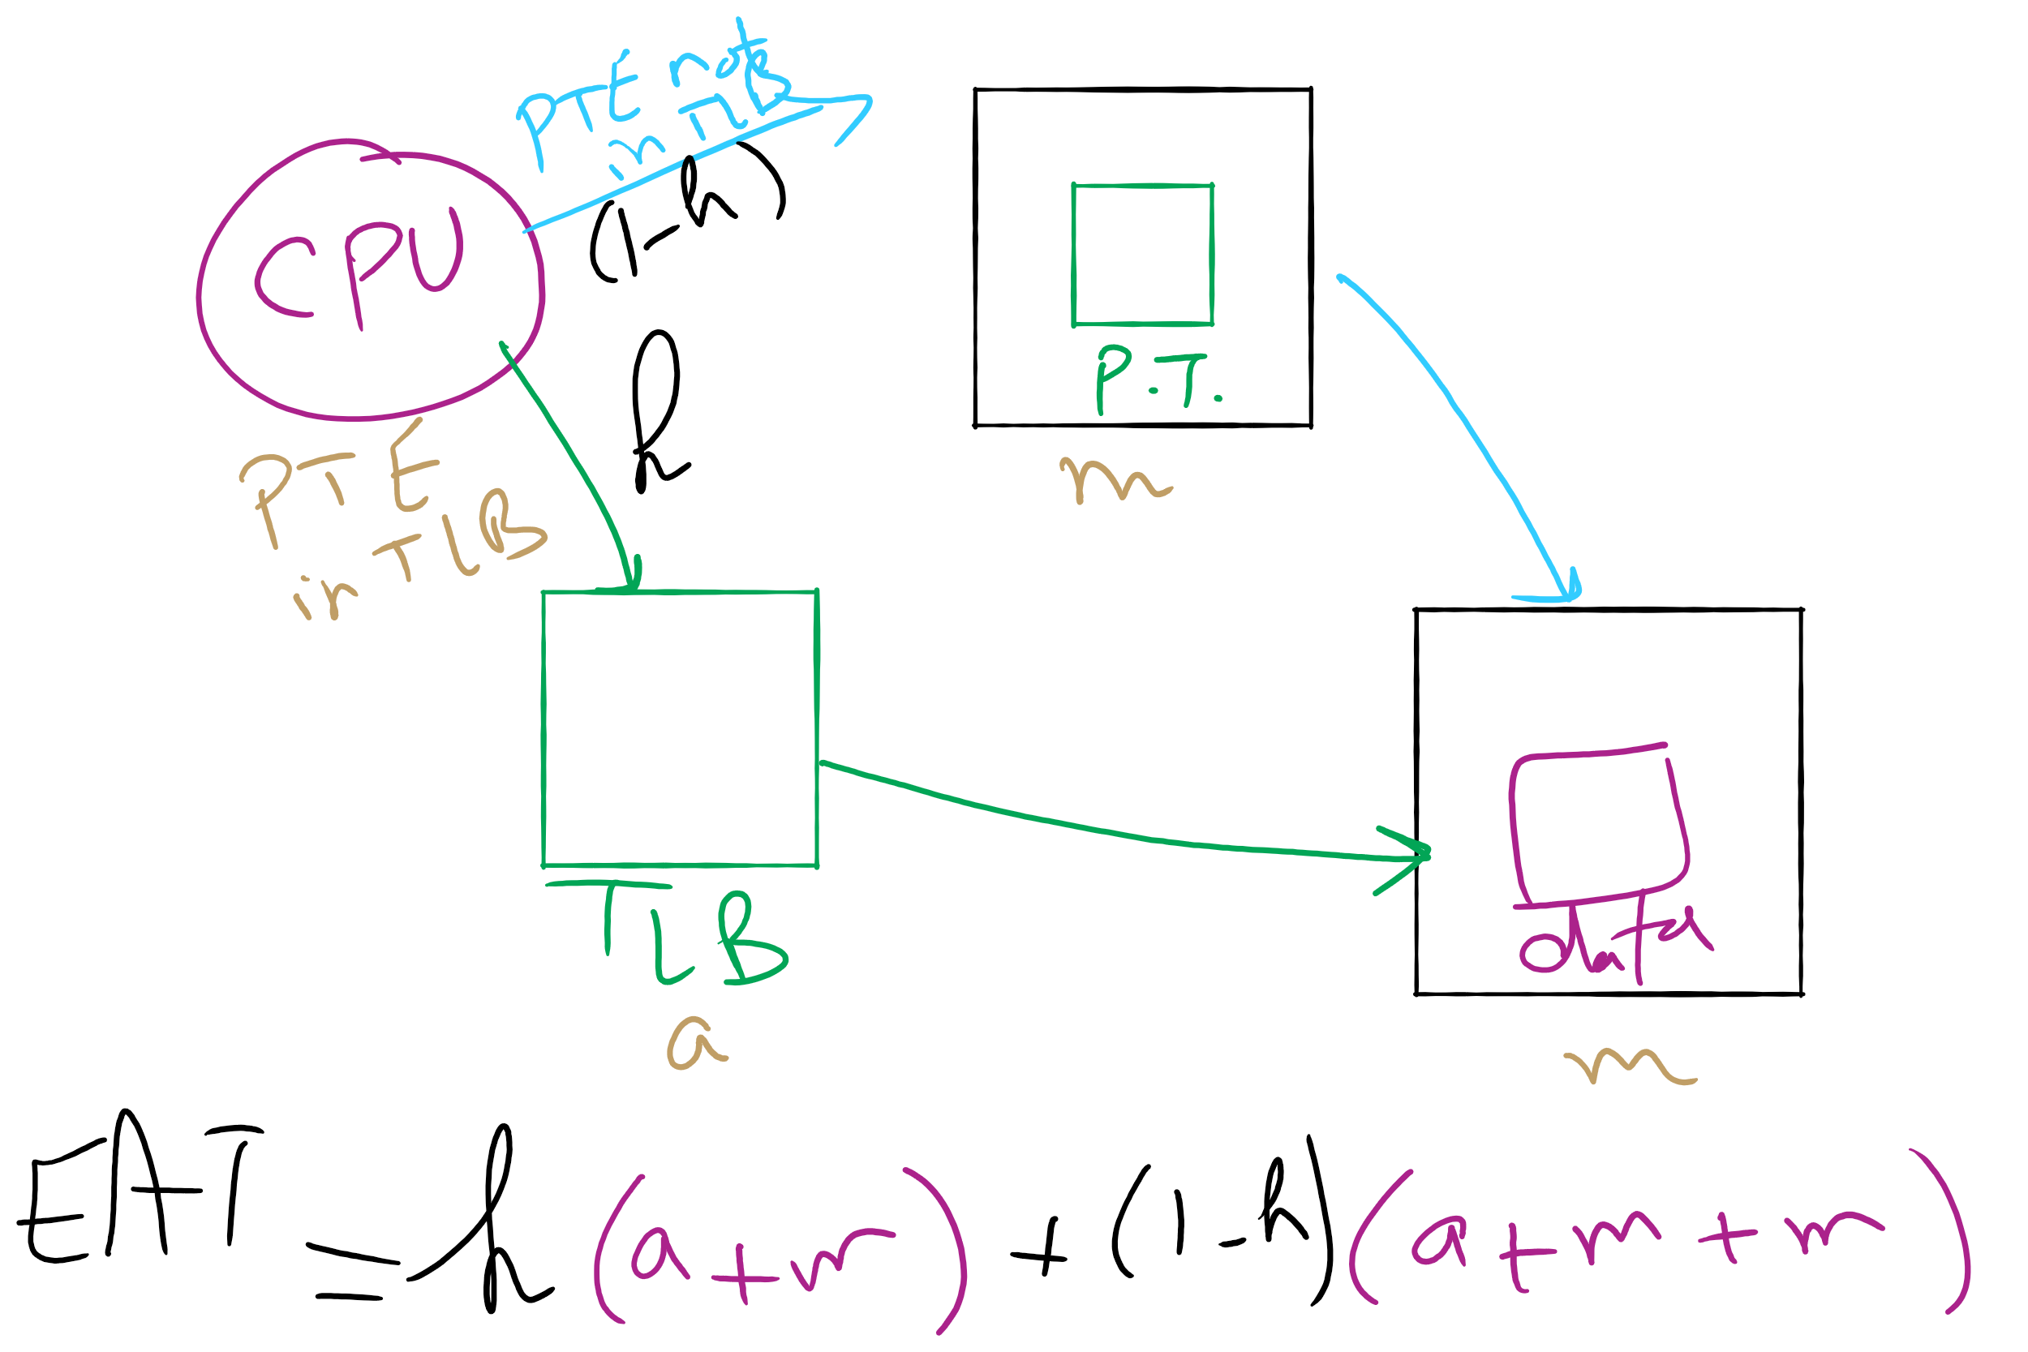
Effective Access Time

Slide 25
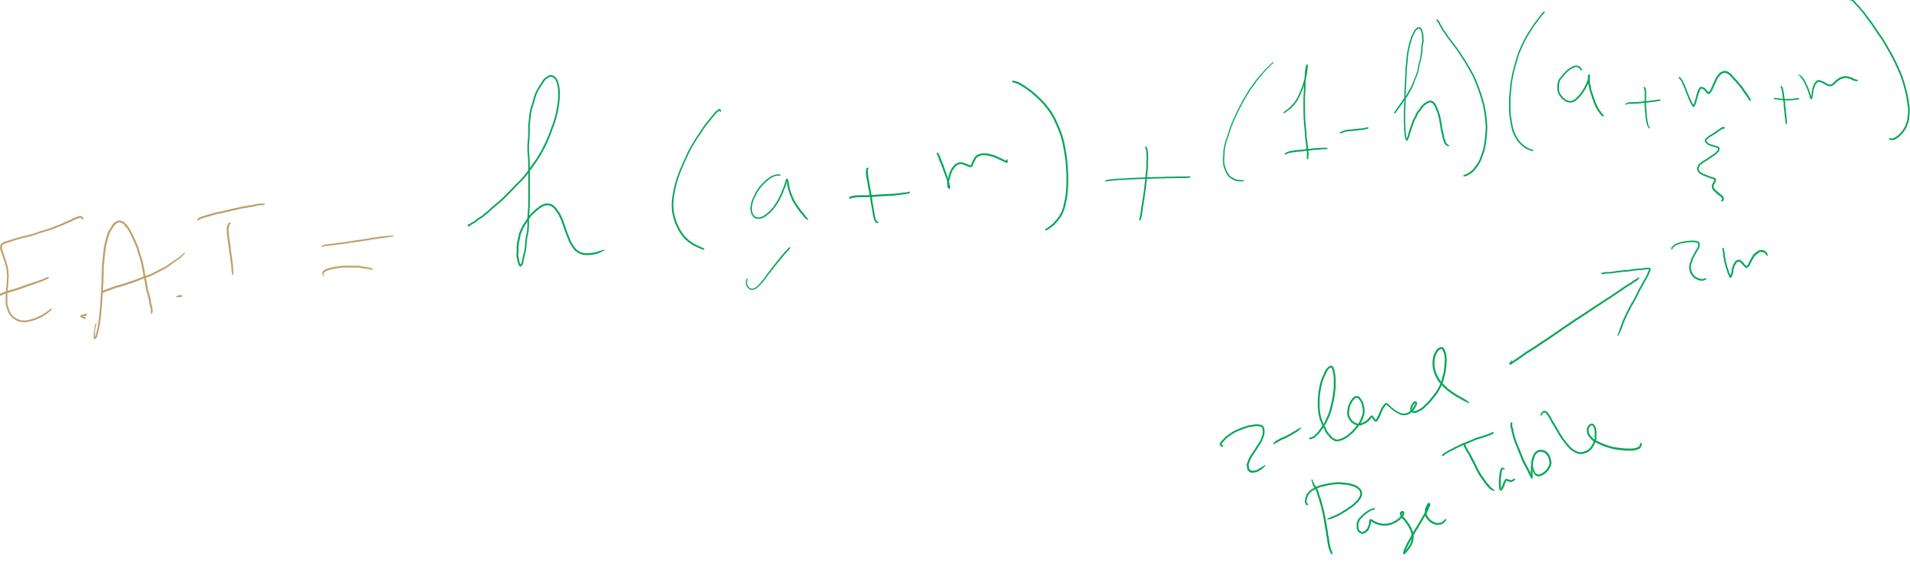
EAT Calculation

Slide 26
Solution 2: Inverted page table
Reduce page table size further: keep one entry for each frame in memory
PTE contains
Virtual address pointing to this frame
Information about the process that owns this page
Search page table by
Hashing the virtual page number and process ID
Starting at the entry corresponding to the hash result
Search until either the entry is found or a limit is reached
Page frame number is index of PTE
Improve performance by using more advanced hashing algorithms

Slide 27
Inverted page table architecture
page number
page offset
process ID
p = 19 bits
offset = 13 bits
Page frame number
0
pid
p
physical address
1
19
13
. . .
search
0
pid₀
p₀
1
pid₁
p₁
. . .
. . .
k
k
pid_{k}
p_{k}
main memory
. . .
inverted page table

Slide 28
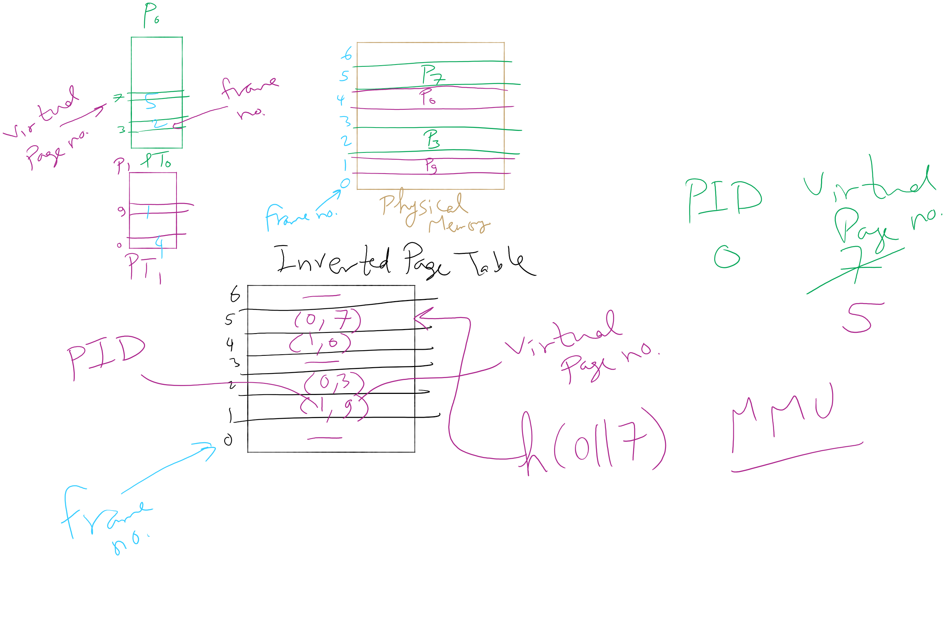
Inverted Page Table Example

