Slide 1


Introduction to Operating Systems CS 1550
Process Synchronization - 1
Spring 2023
Sherif Khattab
ksm73@pitt.edu
(Some slides are from Silberschatz, Galvin and Gagne ©2013)

Slide 2
Announcements
Homework 1 is due next Monday at 11:59 pm
Recitations started last week
Please watch the videos
Lab 1 is due on 2/4 at 11:59 pm
Distributed using GitHub Classroom
Explained in this week’s recitations
Steps of a syscall posted on Canvas
TA Office hours available on the syllabus page
Muddiest points will be anonymous and not seen to students

Slide 3
Muddiest Points
storage/access of the mode bits
syscalls
idt/isr vs syscall table
Difference between f1~f7(what to call them?) and f8~f10(syscall functions)
the beginning of the syscall process
syscall steps
eax register relevance to interrupts/syscall
How user programs need to be changed for new syscalls
How high level code interacts with syscalls
xv6 walkthrough
Array of functions syntax in C
monolithic vs micro

Slide 4
Problem: race conditions
R is a CPU register
X is a variable stored in memory
P1
x++
P2
x++
x=3
R <= x
R = R+1
R => x
R <= x
R = R+1
R => x
x=5
R <= x
R <= x
R = R+1
R = R+1
R => x
R => x
x=6!

Slide 5
Race conditions
Cooperating processes share storage (memory)
Both may read and write the shared memory
Problem: can’t guarantee that read followed by write is atomic
Atomic means uninterruptible
Ordering matters!
This can result in erroneous results!
We need to eliminate race conditions…

Slide 6
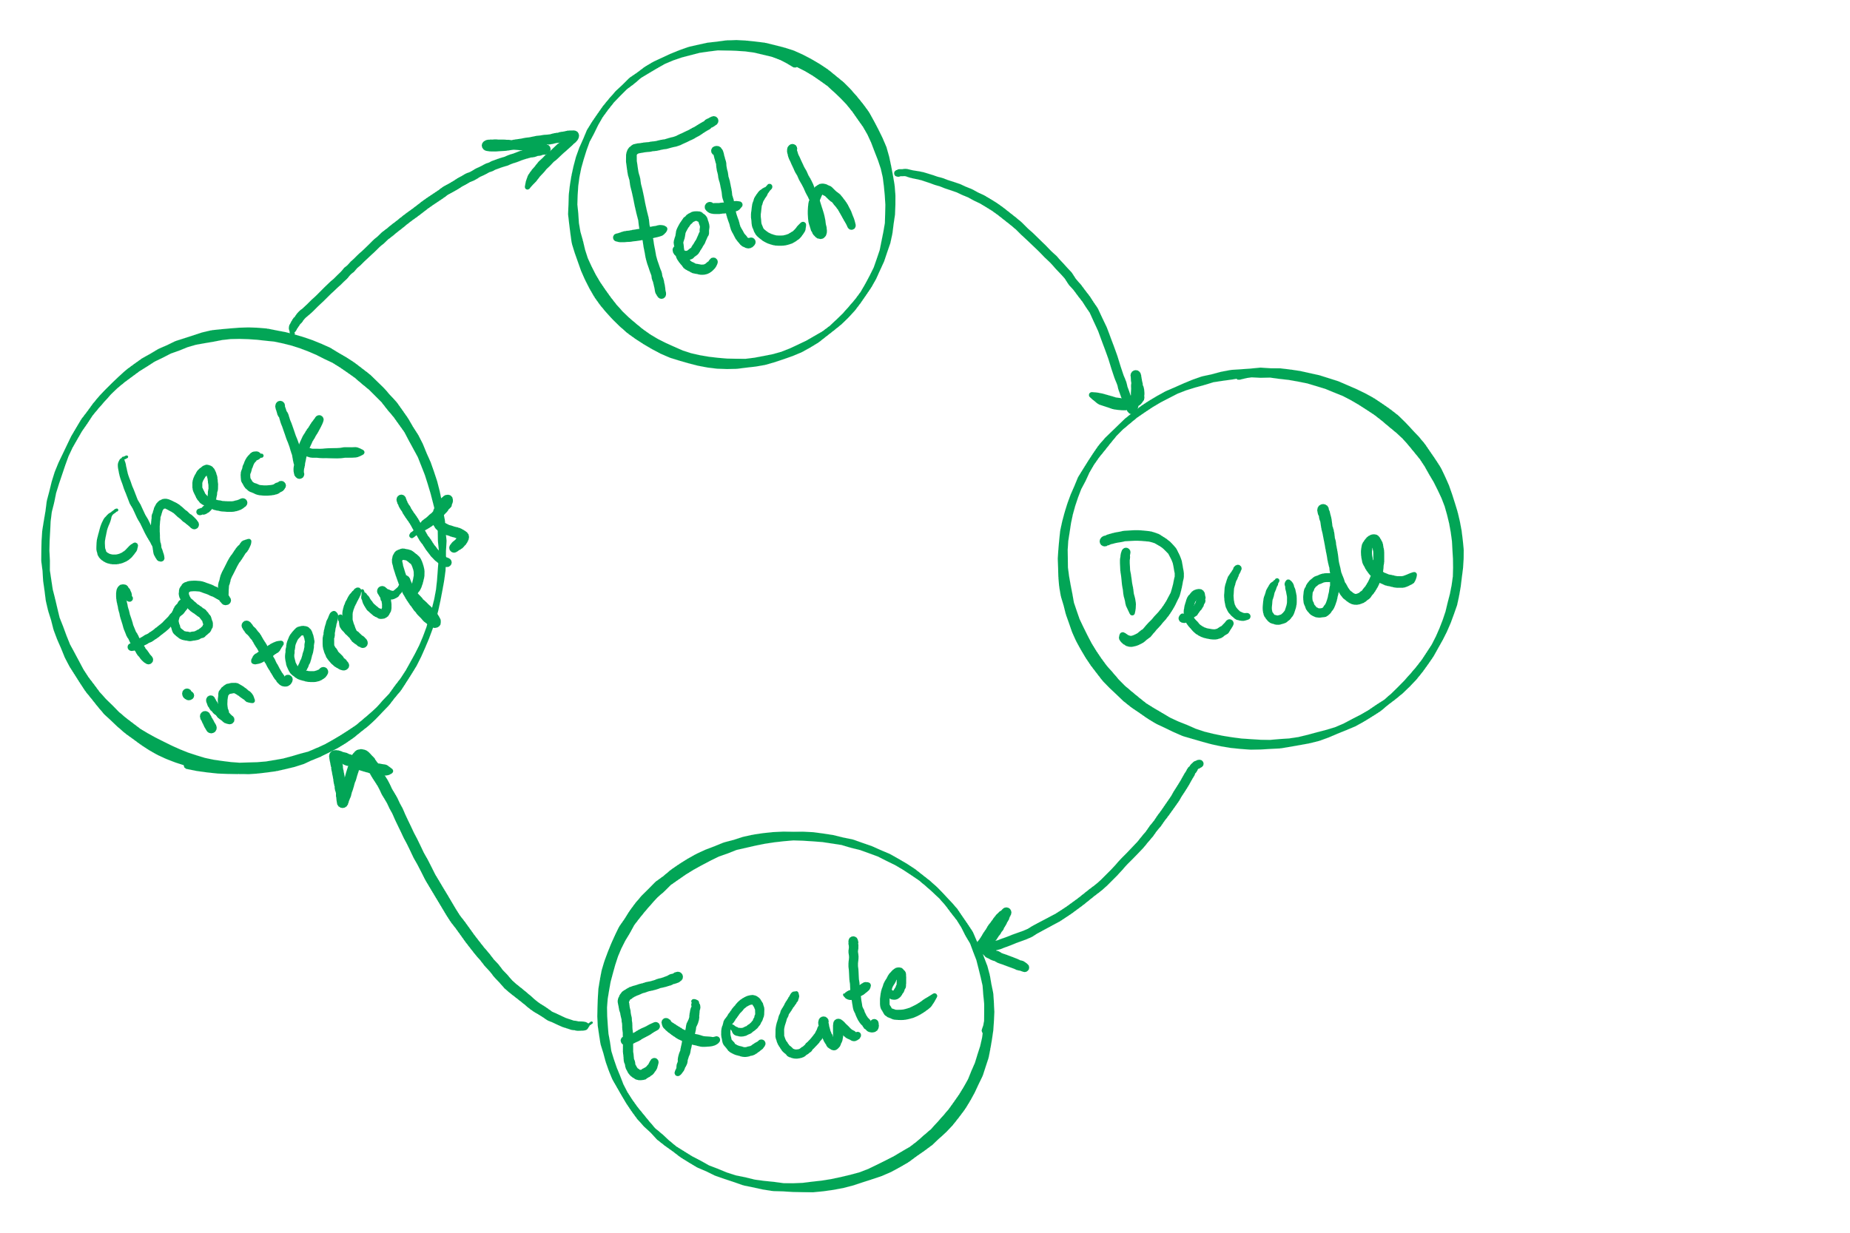
Atomic operations
If done in one instruction, then not interruptible

Slide 7
Context Switching
How did the CPU switch from P1 to P2 then to P1 then to P2 again …?

Slide 8
Process Control Block
``Active entities are data structures when viewed from a lower level.’’
Raphael Finkel, University of Kentucky

Slide 9
Process Control Block (PCB)
Information associated with each process
(also called task control block)
Process state – running, waiting, etc
Program counter – location of instruction to execute next
CPU registers – contents of all process-centric registers
CPU scheduling information- priorities, scheduling queue pointers
Memory-management information – memory allocated to the process
Accounting information – CPU used, clock time elapsed since start, time limits
I/O status information – I/O devices allocated to process, list of open files

Slide 10
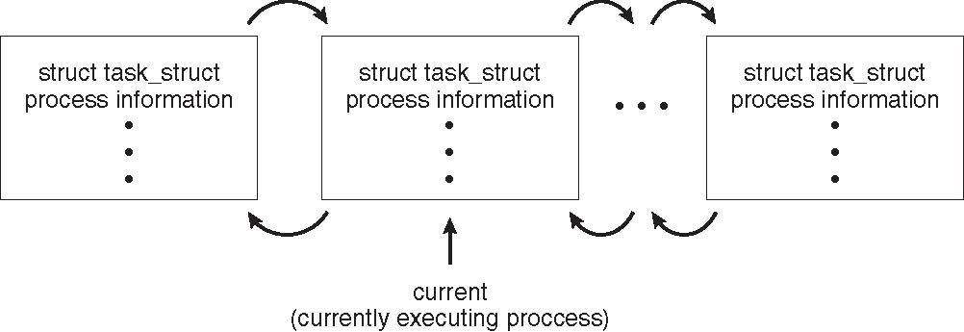
Process Representation in Linux
Represented by the C structure task_struct
pid_t pid; /* process identifier */ long state; /* state of the process */ unsigned int time_slice /* scheduling information */ struct task_struct *parent; /* this process’s parent */ struct list_head children; /* this process’s children */ struct files_struct *files; /* list of open files */ struct mm_struct *mm; /* address space of this process */

Slide 11
Context Switch
When CPU switches to another process, the system must save the state of the old process and load the saved state for the new process via a context switch
Context of a process represented in the PCB
Context-switch time is overhead; the system does no useful work while switching
The more complex the OS and the PCB ➔ the longer the context switch
Time dependent on hardware support
Some hardware provides multiple sets of registers per CPU ➔ multiple contexts loaded at once

Slide 12
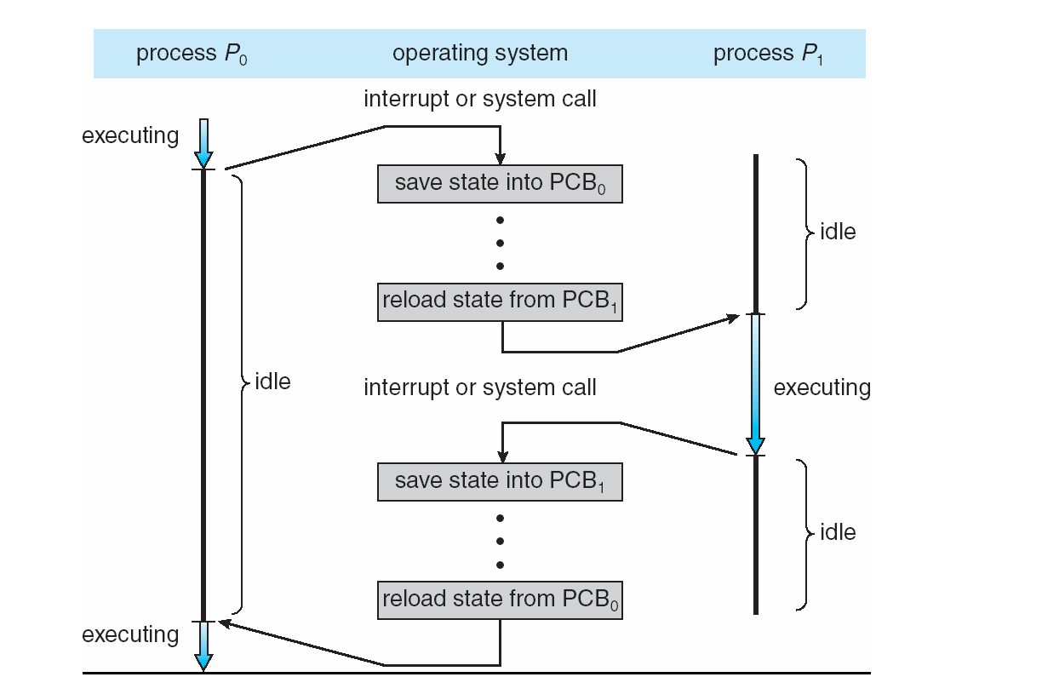
Context Switching

Slide 13
Xv6 Code Walkthrough
PCB and process table
Context switching
Calling of the swtch routine

Slide 14
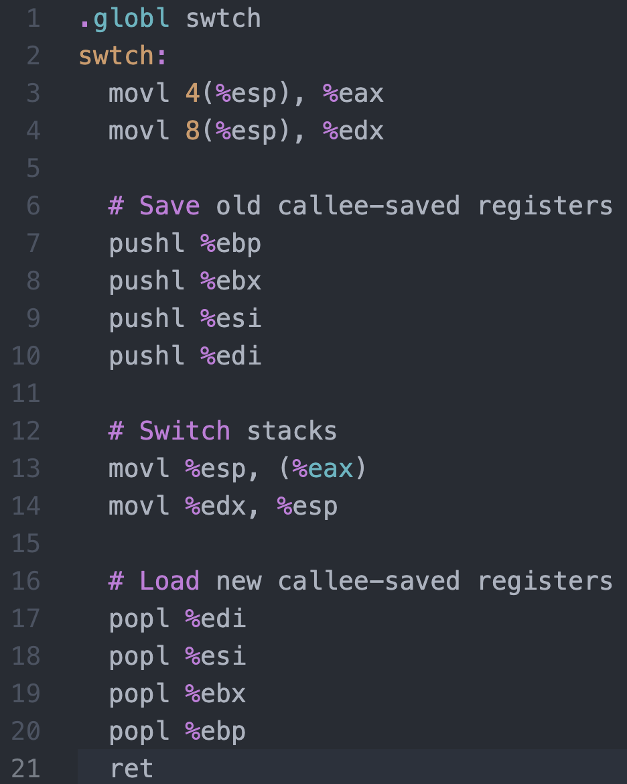




Context Switching in Xv6
%eax
%edx
context
PCB of Process${ P}_{0}$
Return address
%esp
%eip
Stack of Process${ P}_{0}$
Return address
Return address
CPU
context
PCB of Process${ P}_{1}$
Stack of Process${ P}_{1}$
Memory

Slide 15
Critical regions
Back to the race conditions problem
Use critical regions to provide mutual exclusion and help fix race conditions
Let’s put the statement x++ in a critical region
P1 enters critical region
P1 leaves critical region
Process P1
P2 enters critical region
P2 leaves critical region
P2 tries to enter critical region
Process P2
P2 blocked
Time

Slide 16
How to implement critical regions?
Turn-based solutions
Spinlocks
Semaphores
Monitors

Slide 17
Using Spinlocks
Spinlock lock;
Code for process P_{i}
While(1){
Lock(lock)
// critical section
Unlock(lock);
// remainder of code
}
}

Slide 18
Spinlock implementation (1/2)
Solution: use hardware
Several hardware methods
Test & set: test a variable and set it in one instruction
Atomic swap: switch register & memory in one instruction
Turn off interrupts: process won’t be switched out unless it asks to be suspended
The first two methods can be implemented in user land
Why can’t we implement the third method in user land?

