Slide 1


Introduction to Operating Systems CS 1550
Spring 2023
Sherif Khattab
ksm73@pitt.edu
(Some slides are from Silberschatz, Galvin and Gagne ©2013)

Slide 2
Announcements
Upcoming deadlines:
Lab 3: due on 4/1
Homework 9: due on 4/4
Project 3: due on 4/11

Slide 3
Previous lecture …
Large Page Table problem
multi-level page tables
inverted page tables

Slide 4
Muddiest Points
EAT
Inverted page tables
Would you please solve a problem about Inertial Page Table? Thank you so much
why again will there be multiple memory accesses using a TLB?
Two level page tables and how they are better than single page tables (take up less space)
Where are the second and third level page tables stored? Are they paged in and out of memory like a normal page?
when will we get our midterm grades

Slide 5
How big should a page be?
Smaller pages have advantages
Less internal fragmentation
Better fit for various data structures, code sections
Less unused physical memory (some pages have 20 useful bytes and the rest isn’t needed currently)
Larger pages are better because
Less overhead to keep track of them
Smaller page tables
TLB can point to more memory (same number of pages, but more memory per page)
Faster paging algorithms (fewer table entries to look through)
More efficient to transfer larger pages to and from disk

Slide 6
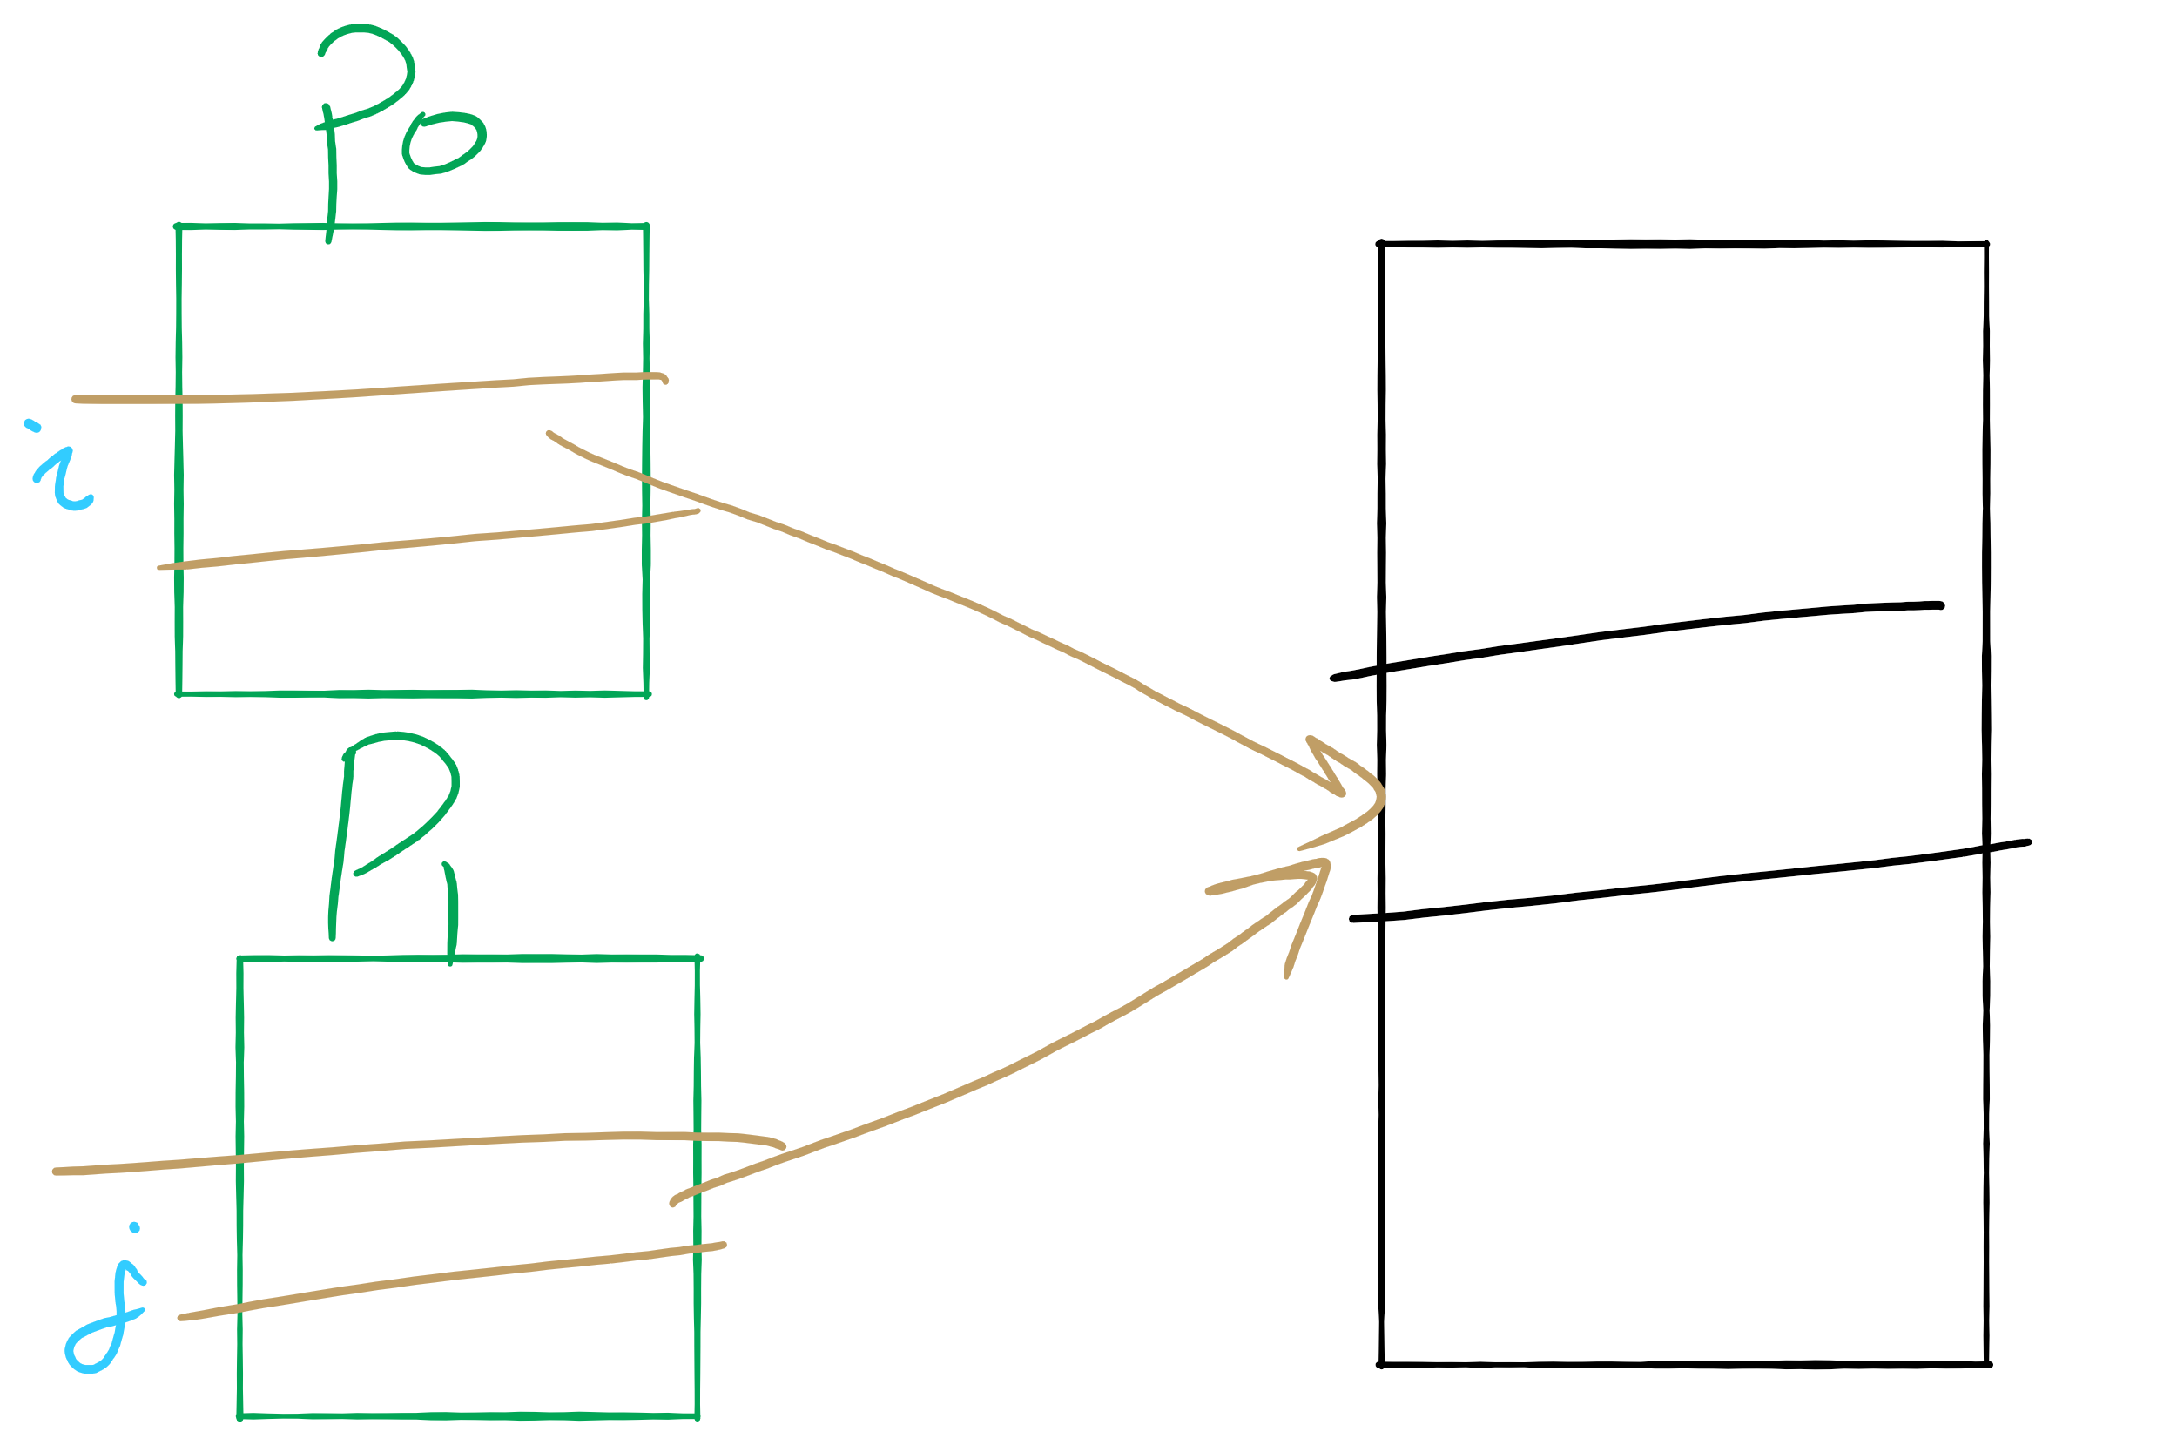
Sharing Pages

Slide 7
Sharing pages
Processes can share pages
Entries in page tables point to the same physical page frame
Easier to do with code: no problems with modification
Virtual addresses in different processes can be…
The same: easier to exchange pointers, keep data structures consistent
Different: may be easier to actually implement
Not a problem if there are only a few shared regions
Can be very difficult if many processes share regions with each other

Slide 8
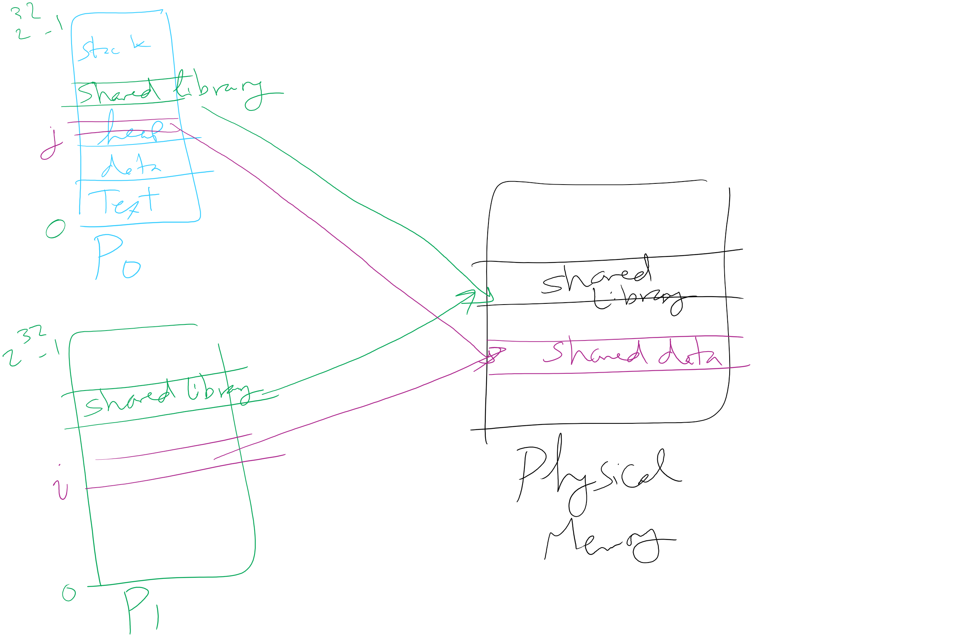
Page Sharing

Slide 9
Implementation issues
Four times when OS involved with paging
Process creation
Determine program size
Create page table
During process execution
Reset the MMU for new process
Flush the TLB (or reload it from saved state)
Page fault time
Determine virtual address causing fault
Swap target page out, needed page in
Process termination time
Release page table
Return pages to the free pool

Slide 10
How is a page fault handled?
Hardware causes a page fault
General registers saved (as on every exception)
OS determines which virtual page needed
Actual fault address in a special register
Address of faulting instruction in register
Page fault was in fetching instruction, or
Page fault was in fetching operands for instruction
OS must figure out which…
OS checks validity of address
Process killed if address was illegal
OS finds a place to put new page frame
If frame selected for replacement is dirty, write it out to disk
OS requests the new page from disk
Page tables updated
Faulting instruction backed up so it can be restarted
Faulting process scheduled
Registers restored
Program continues

Slide 11
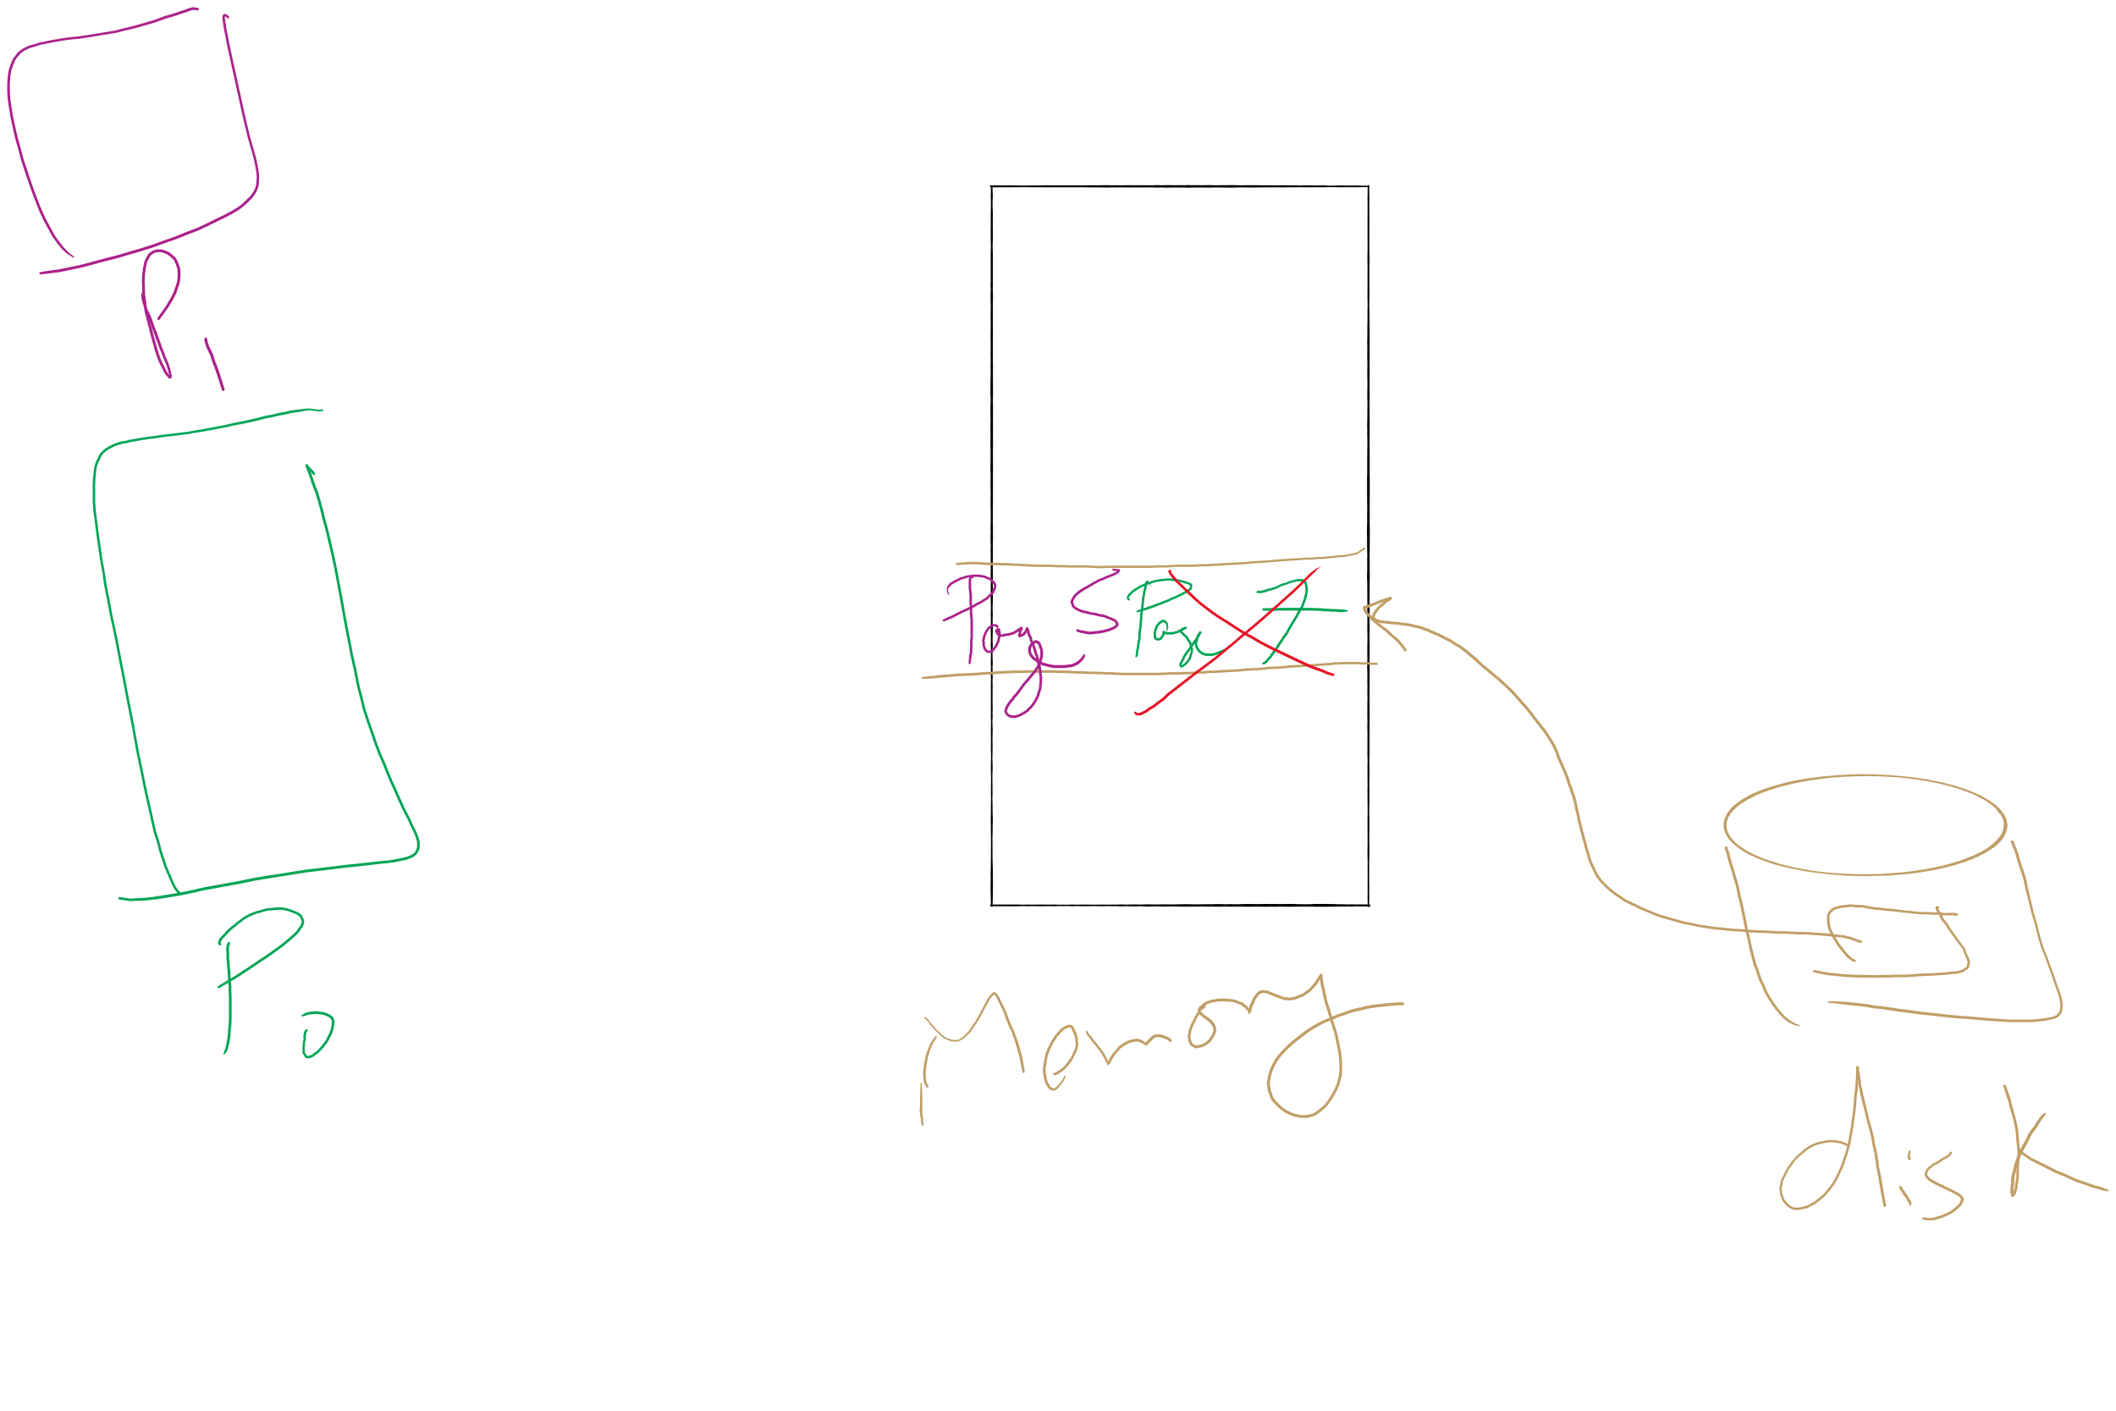
Page locking

Slide 12
Locking pages in memory
Virtual memory and I/O occasionally interact
P1 issues call for read from device into buffer
While it’s waiting for I/O, P2 runs
P2 has a page fault
P1’s I/O buffer might be chosen to be paged out
This can create a problem because an I/O device is going to write to the buffer on P1’s behalf
Solution: allow some pages to be locked into memory
Locked pages are immune from being replaced
Pages only stay locked for (relatively) short periods

Slide 13
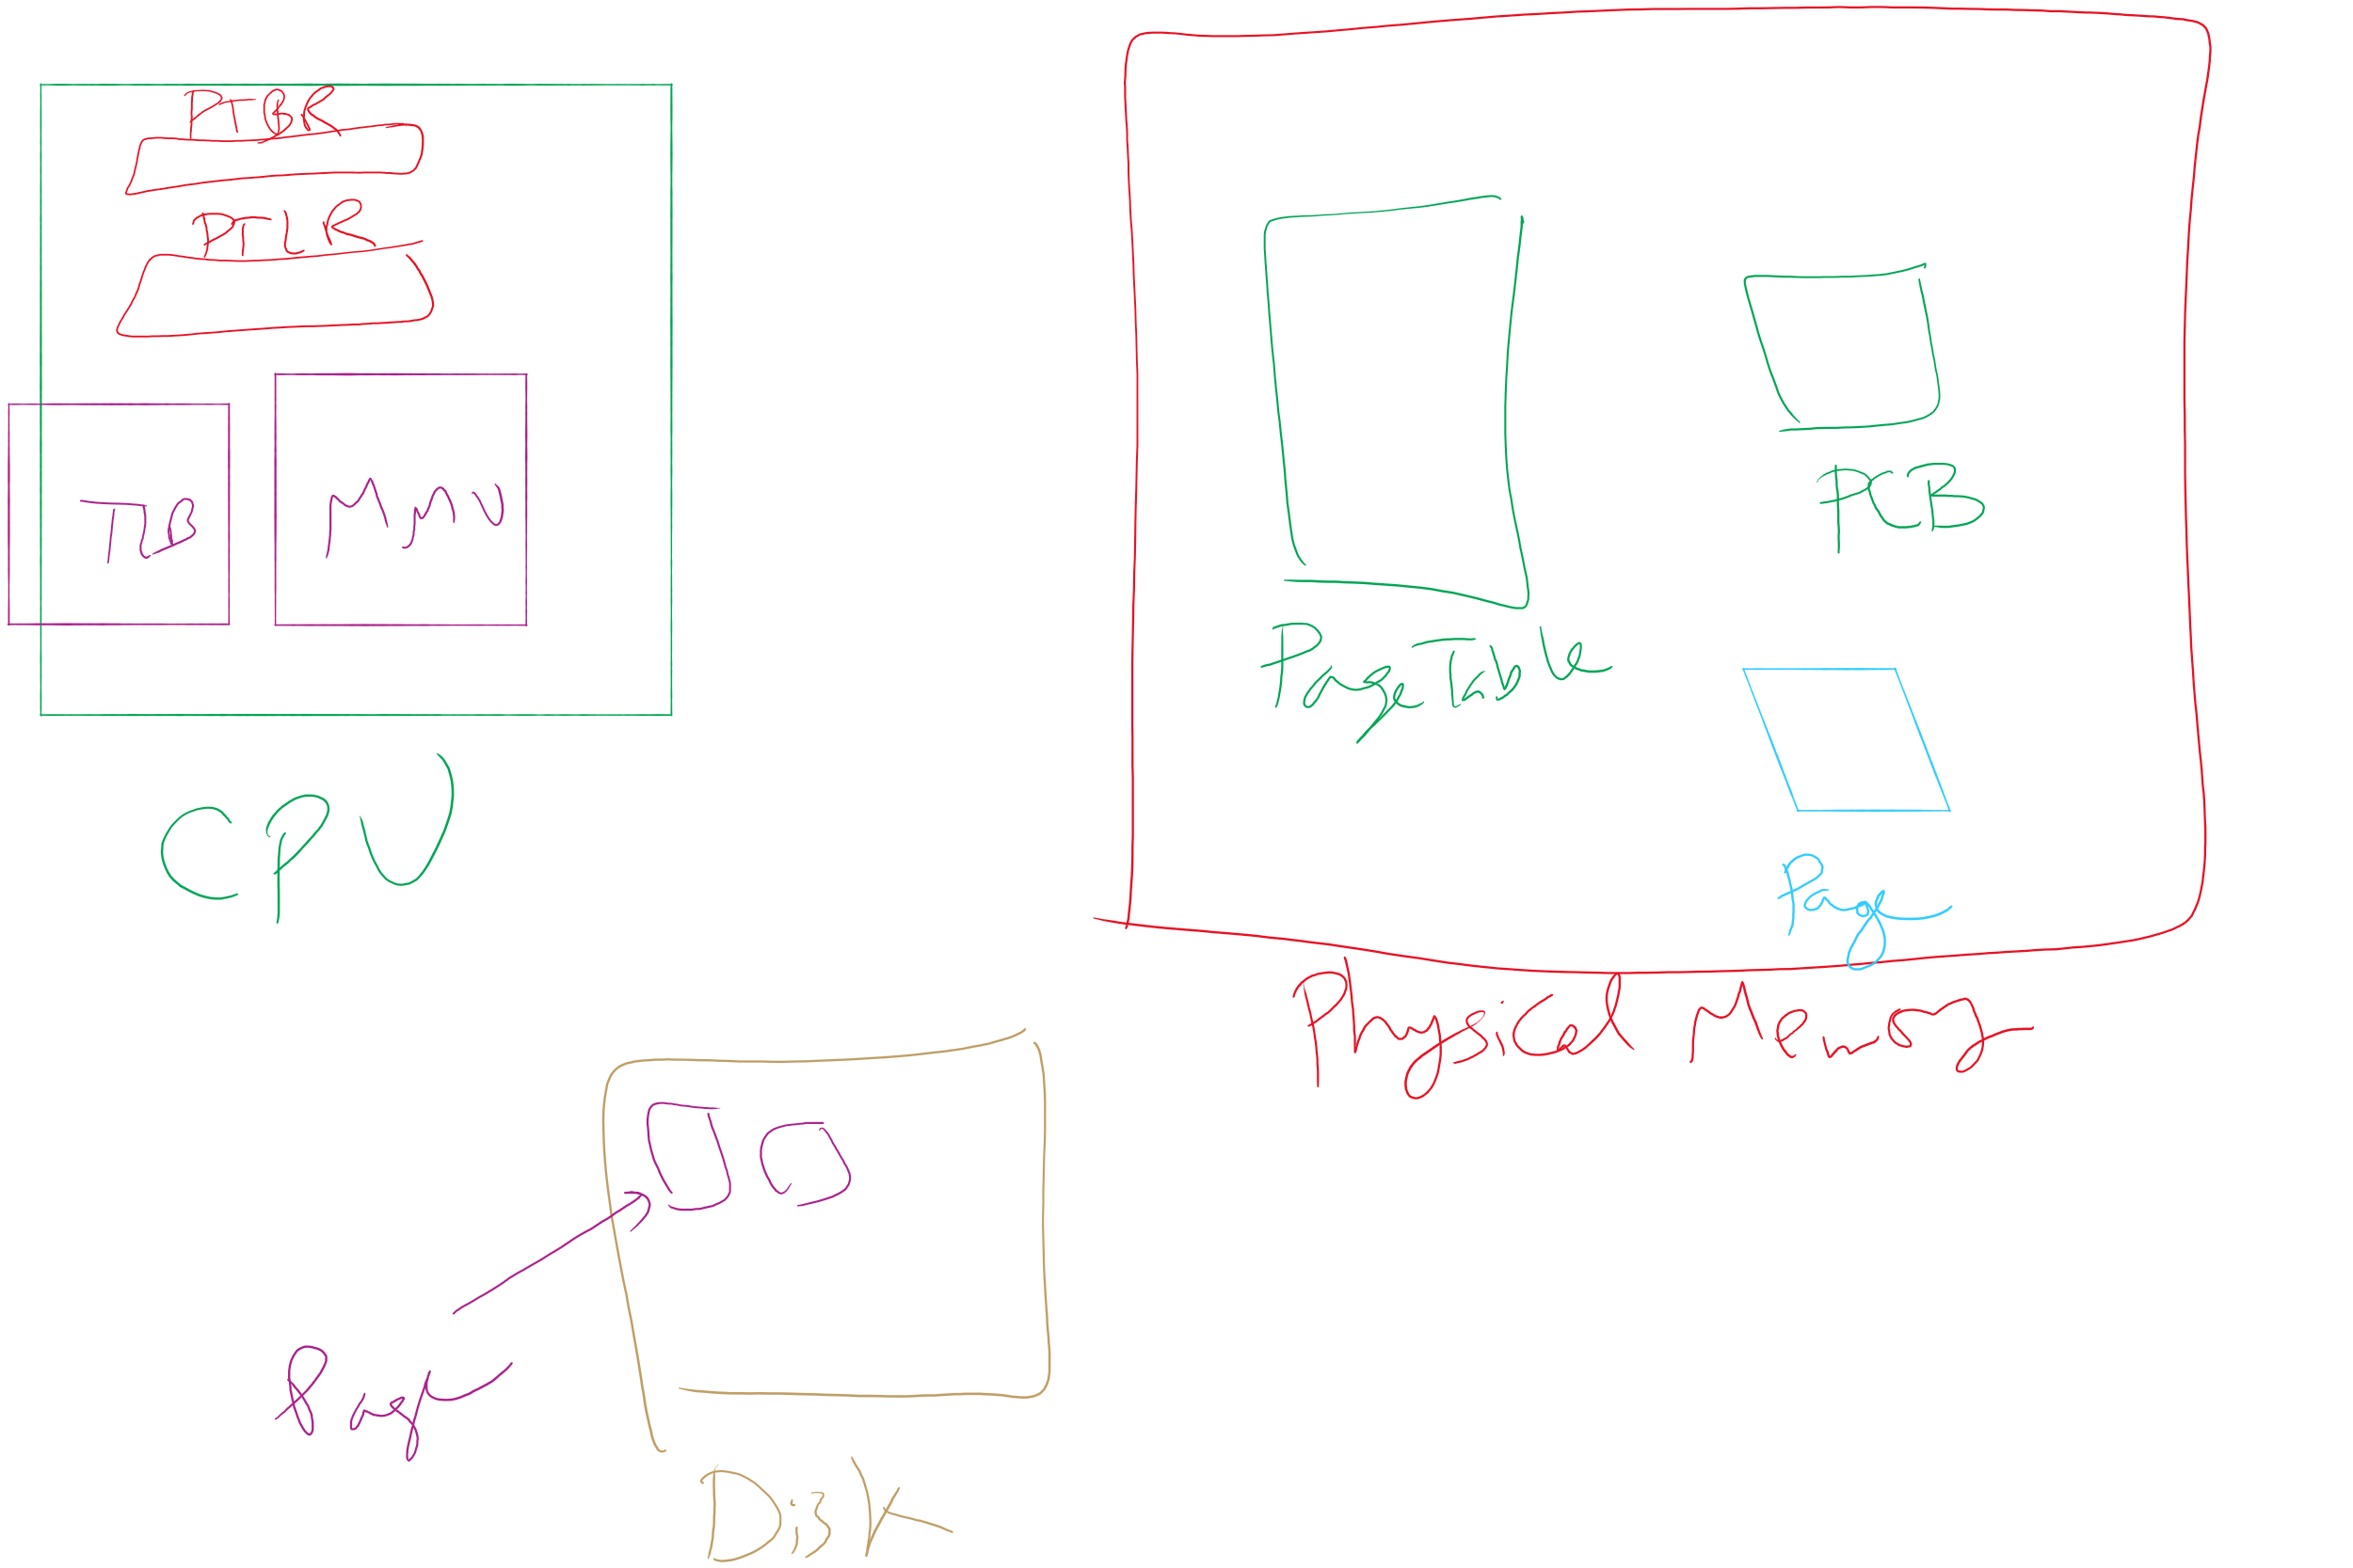
Map of MMU, TLB, Page Table, etc.

Slide 14
When are dirty pages written to disk?
On demand (when they’re replaced)
Fewest writes to disk
Slower: replacement takes twice as long (must wait for disk write and disk read)
Periodically (in the background)
Background process scans through page tables, writes out dirty pages that are pretty old
Background process also keeps a list of pages ready for replacement
Page faults handled faster: no need to find space on demand
Cleaner may use the same structures discussed earlier (clock, etc.)

Slide 15
Problem of the Day
How to allocate disk blocks to files and directories?

Slide 16
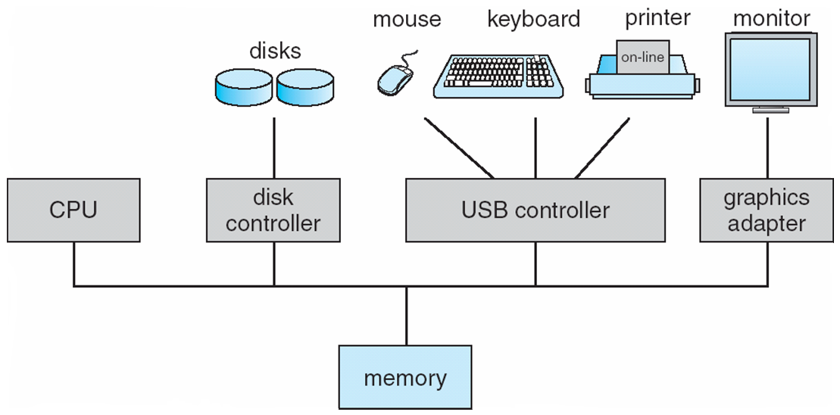
How complex is the OS’s job?
Let’s look at one of the resources managed by the OS: I/O devices

Slide 17
Carving up the disk
Entire disk
Partition table
Master boot record
Partition 1
Partition 2
Partition 3
Partition 4
Boot block
Super block
Free space management
Index nodes
Files & directories

Slide 18
Contiguous allocation for file blocks
Contiguous allocation requires all blocks of a file to be consecutive on disk
Problem: deleting files leaves “holes”
Similar to memory allocation issues
Compacting the disk can be a very slow procedure…
A
B
C
D
E
F
A
Free
C
Free
E
F

Slide 19
Contiguous allocation
Data in each file is stored in consecutive blocks on disk
Simple & efficient indexing
Starting location (block #) on disk (start)
Length of the file in blocks (length)
Random access well-supported
Difficult to grow files
Must pre-allocate all needed space
Wasteful of storage if file isn’t using all of the space
Logical to physical mapping is easy blocknum = (pos / 1024) + start; offset_in_block = pos % 1024;
0
1
2
3
4
5
6
7
8
9
10
11
Start=5
Length=2902

Slide 20
Linked allocation
File is a linked list of disk blocks
Blocks may be scattered around the disk drive
Block contains both pointer to next block and data
Files may be as long as needed
New blocks are allocated as needed
Linked into list of blocks in file
Removed from list (bitmap) of free blocks
0
1
2
3
4
6
4
5
6
7
x
x
8
9
10
11
0
Start=9
End=4
Length=2902
Start=3
End=6
Length=1500

Slide 21
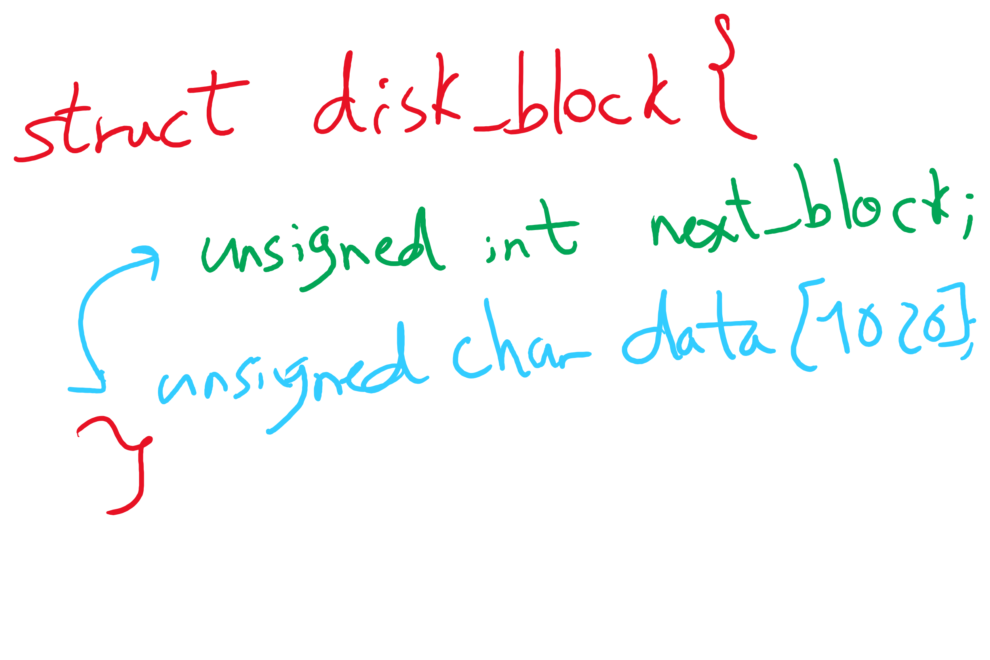
Data Structures for Linked Allocation

Slide 22
Finding blocks with linked allocation
Directory structure is simple
Starting address looked up from directory
Directory only keeps track of first block (not others)
No wasted blocks - all blocks can be used
Random access is difficult: must always start at first block!
Logical to physical mapping is done by block = start; offset_in_block = pos % 1020; for (j = 0; j < pos / 1020; j++) { block = block->next; }
Assumes that next pointer is stored at end of block
May require a long time for seek to random location in file

Slide 23
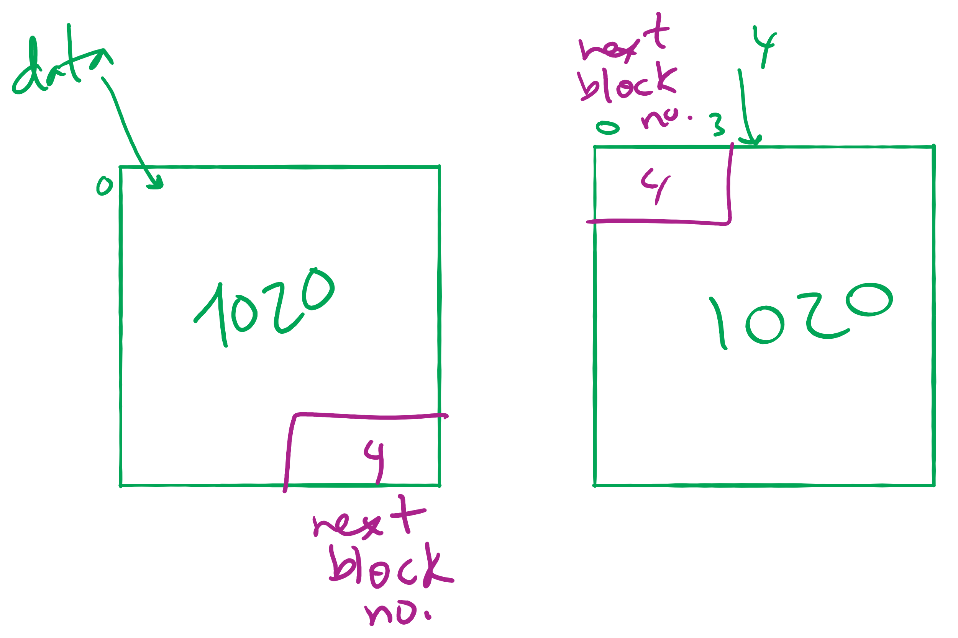
Offset Calculation

Slide 24
File Allocation Table (FAT)
Links on disk are slow
Keep linked list in memory
Advantage: faster
Disadvantages
Have to copy it to disk at some point
Have to keep in-memory and on-disk copy consistent
0
4
1
-1
2
-1
3
-2
4
-2
5
-1
6
3
B
7
-1
8
-1
9
0
A
10
-1
11
-1
12
-1
13
-1
14
-1
15
-1

