Slide 1


Introduction to Operating Systems CS 1550
Spring 2023
Sherif Khattab
ksm73@pitt.edu
(Some slides are from Silberschatz, Galvin and Gagne ©2013)

Slide 2
Announcements
Upcoming deadlines:
Homework 10: due on 4/11
Project 3: due on 4/11
Lab 4: due on 4/15

Slide 3
Previous Lecture …
Indexed Allocation
Directory contents
Free block tracking
bitmap
linked list of free blocks

Slide 4
Muddiest Points (1/3)
Bitmapping for free blocks
It seems that directories have a limit to the number of files / subdirectories they contain based on the size of a disk block. Is / how is this limit overcome?
Everything
are the index nodes for the directories stored on the heap? is this different than the index nodes from the file allocation table?
Variable sized file name structures’ pros and cons
what exactly is an i-node and where is it stored?
Might need some recap on inode. So inode contains information for a specific file and block index is a block storing only the addresses of all the file block?

Slide 5
Muddiest Points (2/3)
a little confused about Fast File System indexing
For FFS, all the files will be kept in one directoriy (or many directories?) and then we adopt the direct pointers or one-level or multi-level pointers to point to their data based on their size?
Typically one directory per index block? What about a subdirectory in a parent directory? Would there be another block index (for the subdirectory) stored in the parent directory?
Can you explain why smaller page size leads to more page fault?
Linked allocation versus contiguous and when is it optimal to use linked

Slide 6
Muddiest Points (3/3)
how do we do midterm corrections
Top hat question about partition
Still a but confused on indexing for the Page Table Allocation
structure of a disk section

Slide 7
Problem of the Day – Part 1
How does a file system handle errors?
Answer: Defense in Depth
multiple layers of error detection/correction

Slide 8
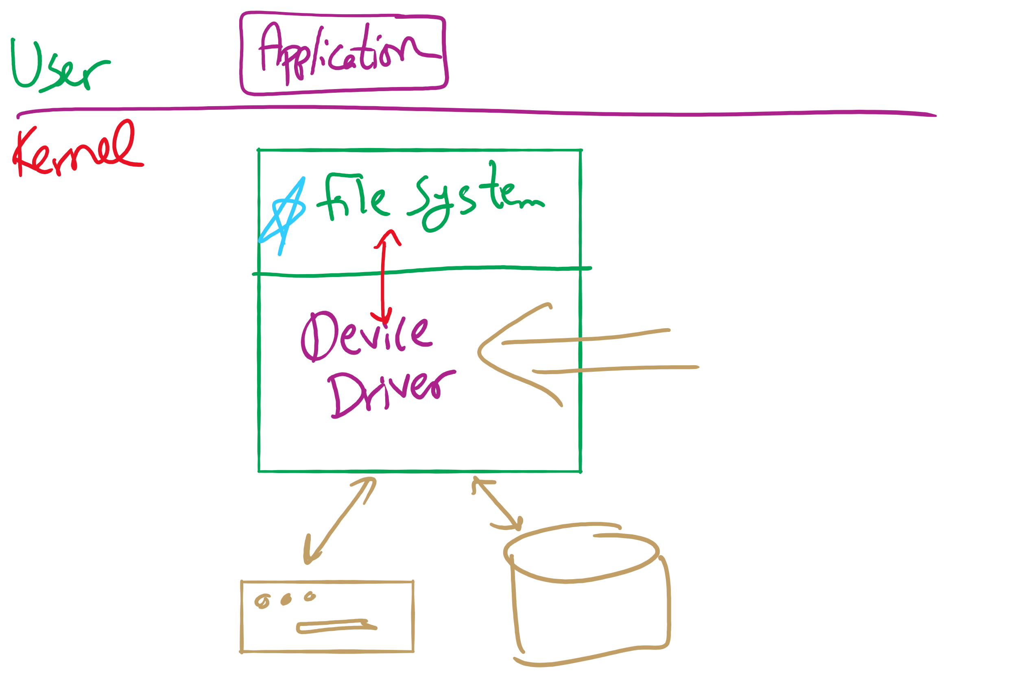
Software Stack

Slide 9
Device drivers
Device drivers go between device controllers and rest of OS
Drivers standardize interface to widely varied devices
Device drivers communicate with controllers over bus
Controllers communicate with devices themselves
User space
User program
Kernel space
Rest of the OS
Keyboard driver
Disk driver
Keyboard controller
Disk controller

Slide 10
Layers of I/O software
User-level I/O software & libraries
User
Device-independent OS software
Operating system (kernel)
Device drivers
Interrupt handlers
Hardware

Slide 11
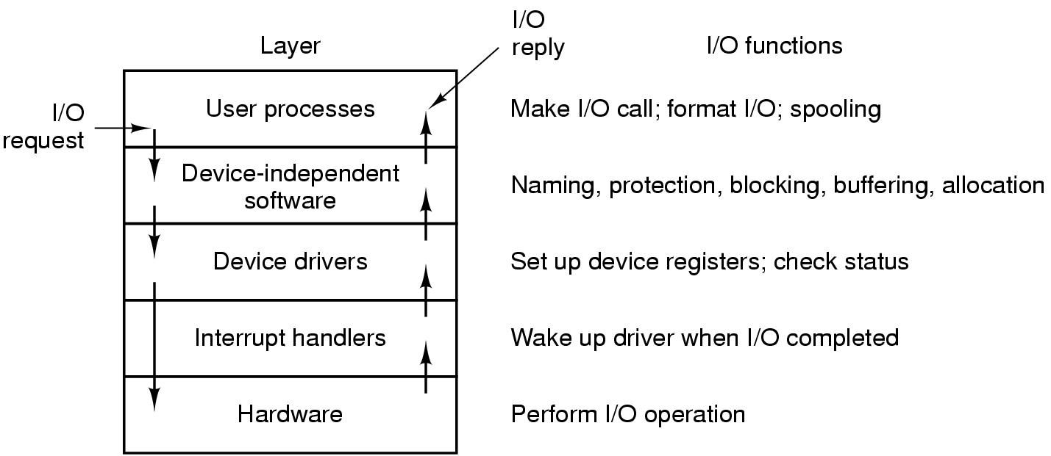
Anatomy of an I/O request

Slide 12
Device Driver goals
Device independence
Programs can access any I/O device
No need to specify device in advance
Uniform naming
Name of a file or device is a string or an integer
Doesn’t depend on the machine (underlying hardware)
Error handling
Done as close to the hardware as possible
Isolate from higher-level software
Synchronous vs. asynchronous transfers
Blocked transfers vs. interrupt-driven
Buffering
Data coming off a device cannot be stored in final destination
Sharable vs. dedicated devices

Slide 13
Disk drive structure
Data stored on surfaces
Up to two surfaces per platter
One or more platters per disk
Data in concentric tracks
Tracks broken into sectors
256B-1KB per sector
Cylinder: corresponding tracks on all surfaces
Data read and written by heads
Actuator moves heads
Heads move in unison
head
sector
platter
track
cylinder
surfaces
spindle
actuator

Slide 14
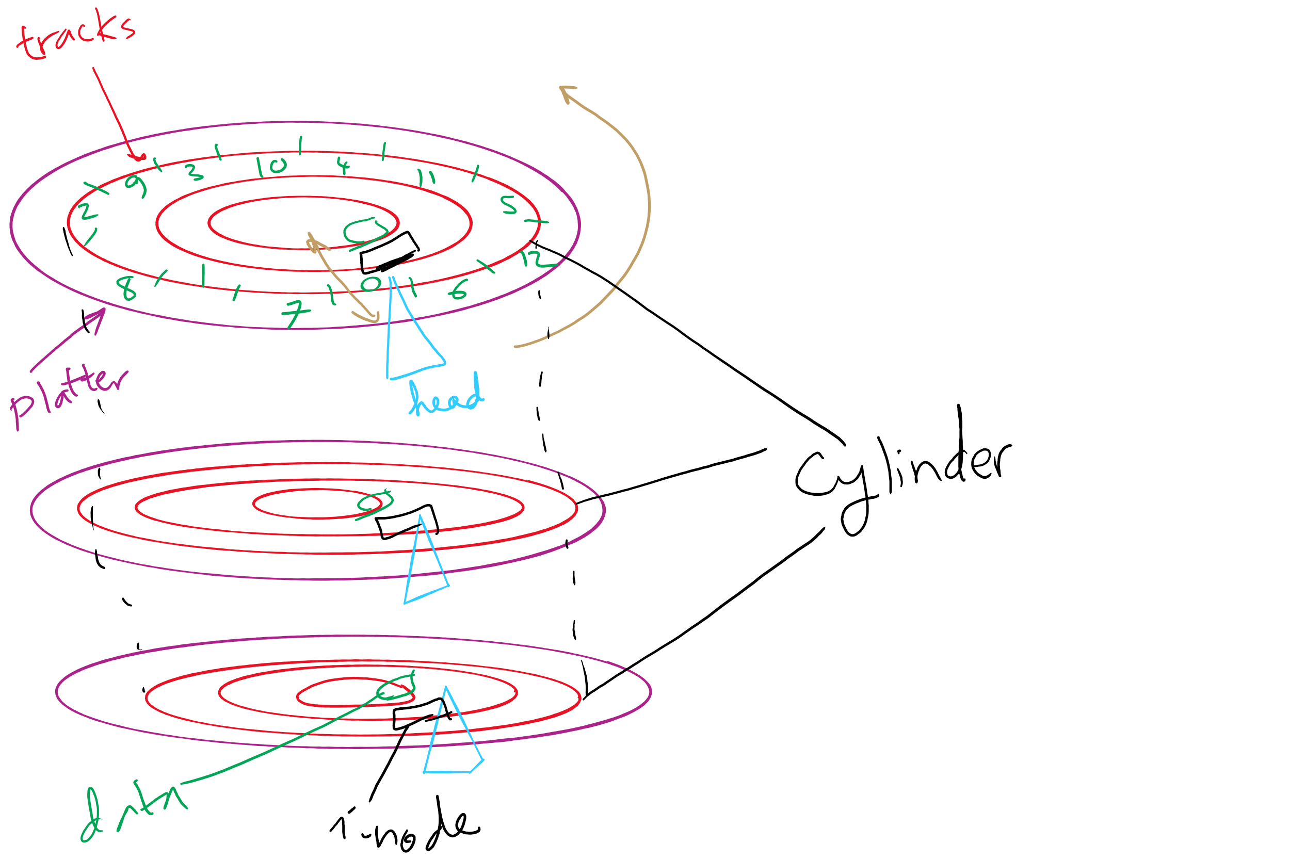
Disks, cylinders, cylinder groups

Slide 15
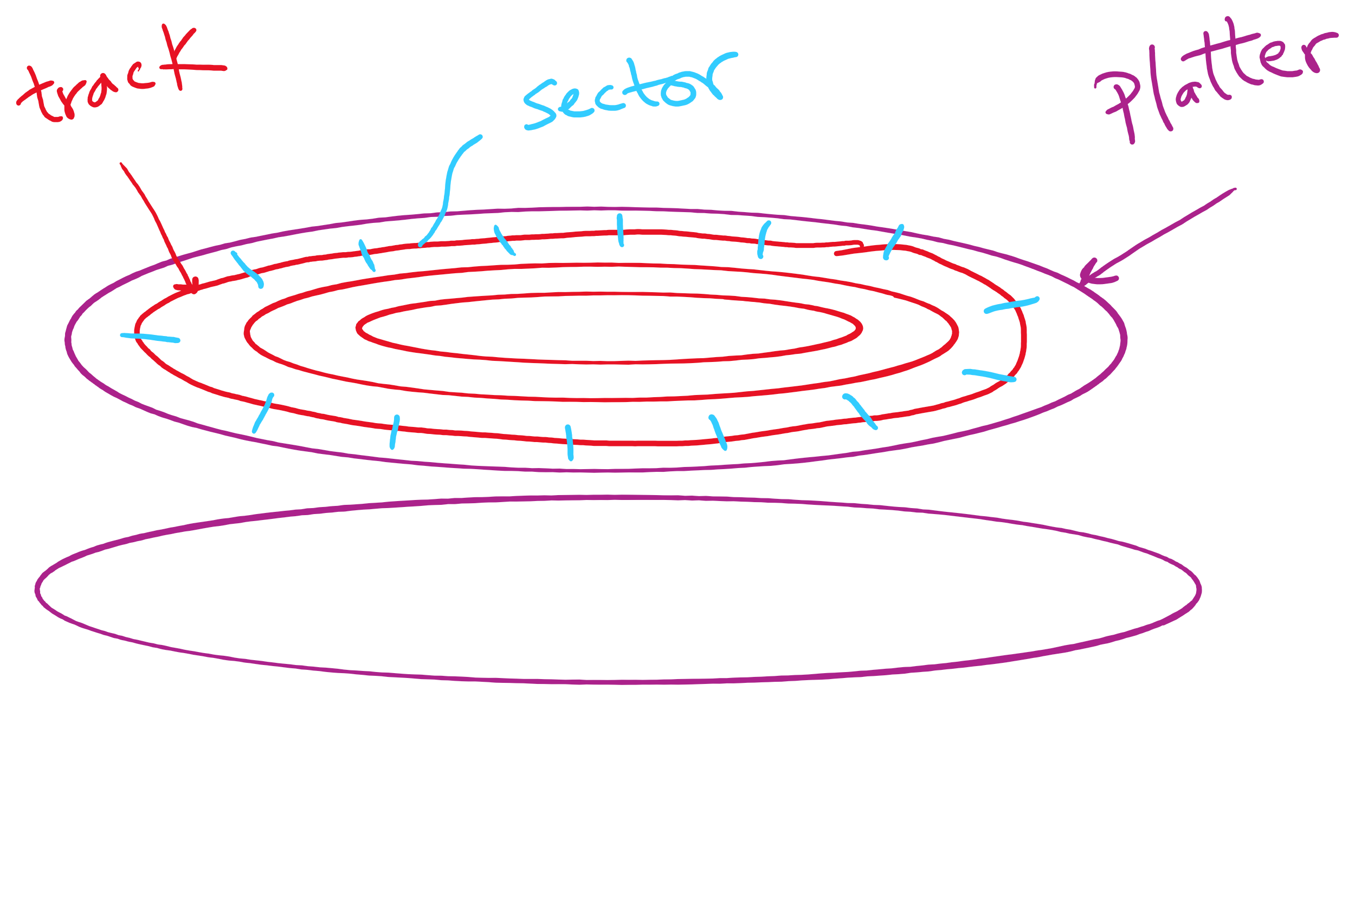
Disk Sector

Slide 16
What’s in a disk request?
Time required to read or write a disk block determined by 3 factors
Seek time
Rotational delay
Average delay = 1/2 rotation time
Example: rotate in 10ms, average rotation delay = 5ms
Actual transfer time
Transfer time = time to rotate over sector
Example: rotate in 10ms, 200 sectors/track => 10/200 ms = 0.05ms transfer time per sector
Seek time dominates, with rotation time close
Error checking is done by controllers

Slide 17
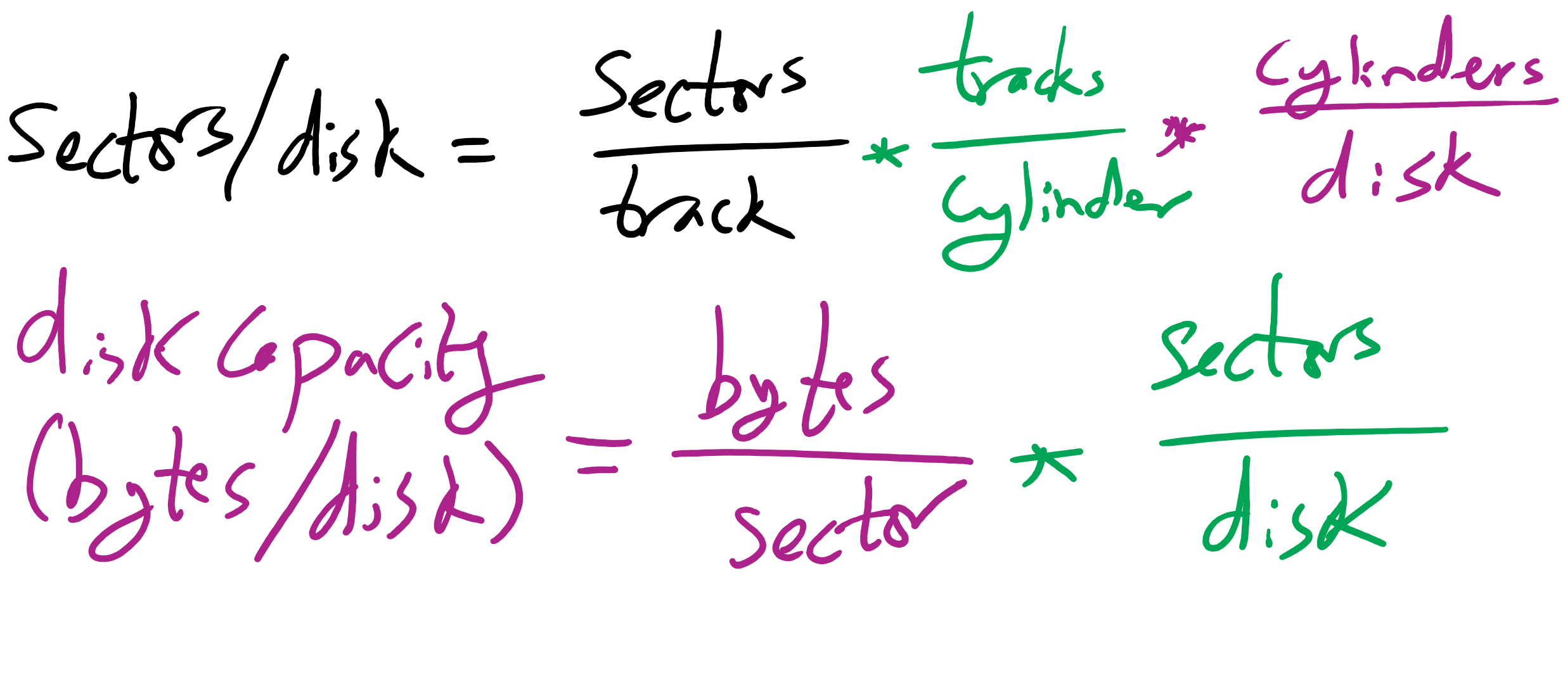
Disk drive specifics
 | IBM 360KB floppy | WD 18GB HD
Cylinders | 40 | 10601
Tracks per cylinder | 2 | 12
Sectors per track | 9 | 281 (average)
Sectors per disk | 720 | 35742000
Bytes per sector | 512 | 512
Capacity | 360 KB | 18.3 GB
Seek time (minimum) | 6 ms | 0.8 ms
Seek time (average) | 77 ms | 6.9 ms
Rotation time | 200 ms | 8.33 ms
Spinup time | 250 ms | 20 sec
Sector transfer time | 22 ms | 17 μsec

Slide 18
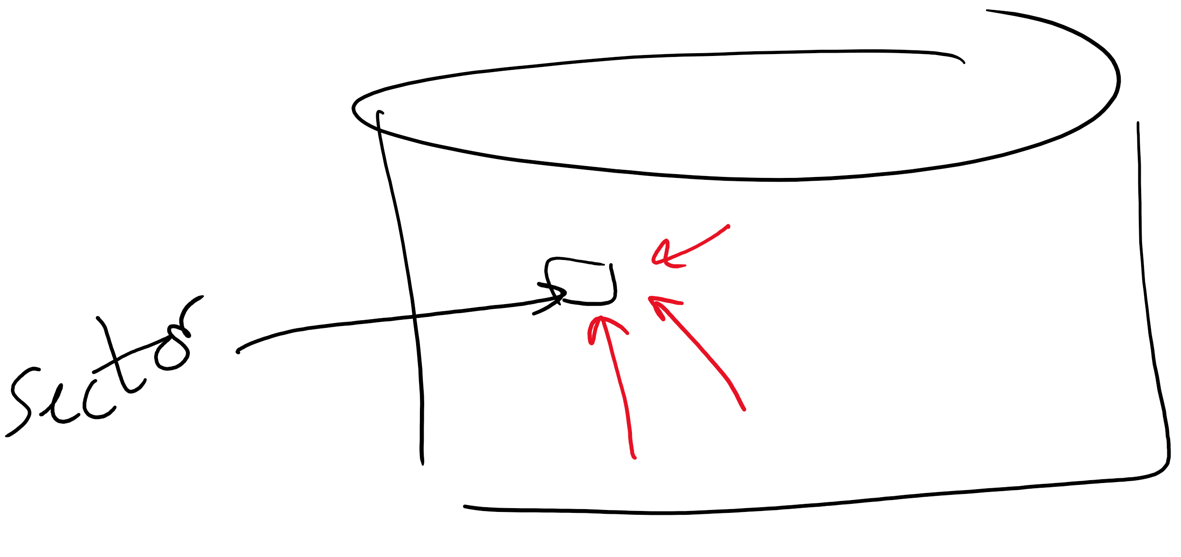
Structure of a disk sector
Preamble contains information about the sector
Sector number & location information
Data is usually 256, 512, or 1024 bytes
ECC (Error Correcting Code) is used to detect & correct minor errors in the data
Preamble
Data
ECC

Slide 19
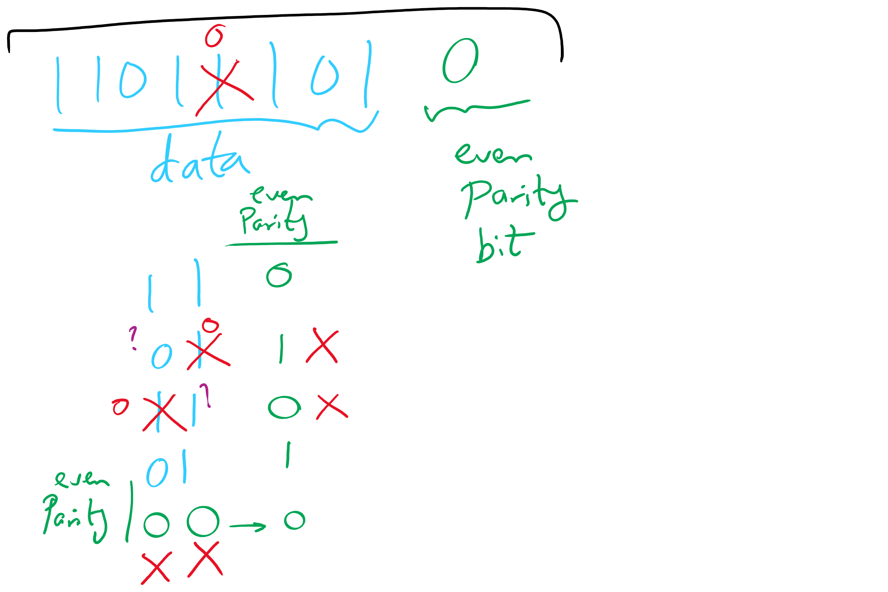
Parity Examples

Slide 20
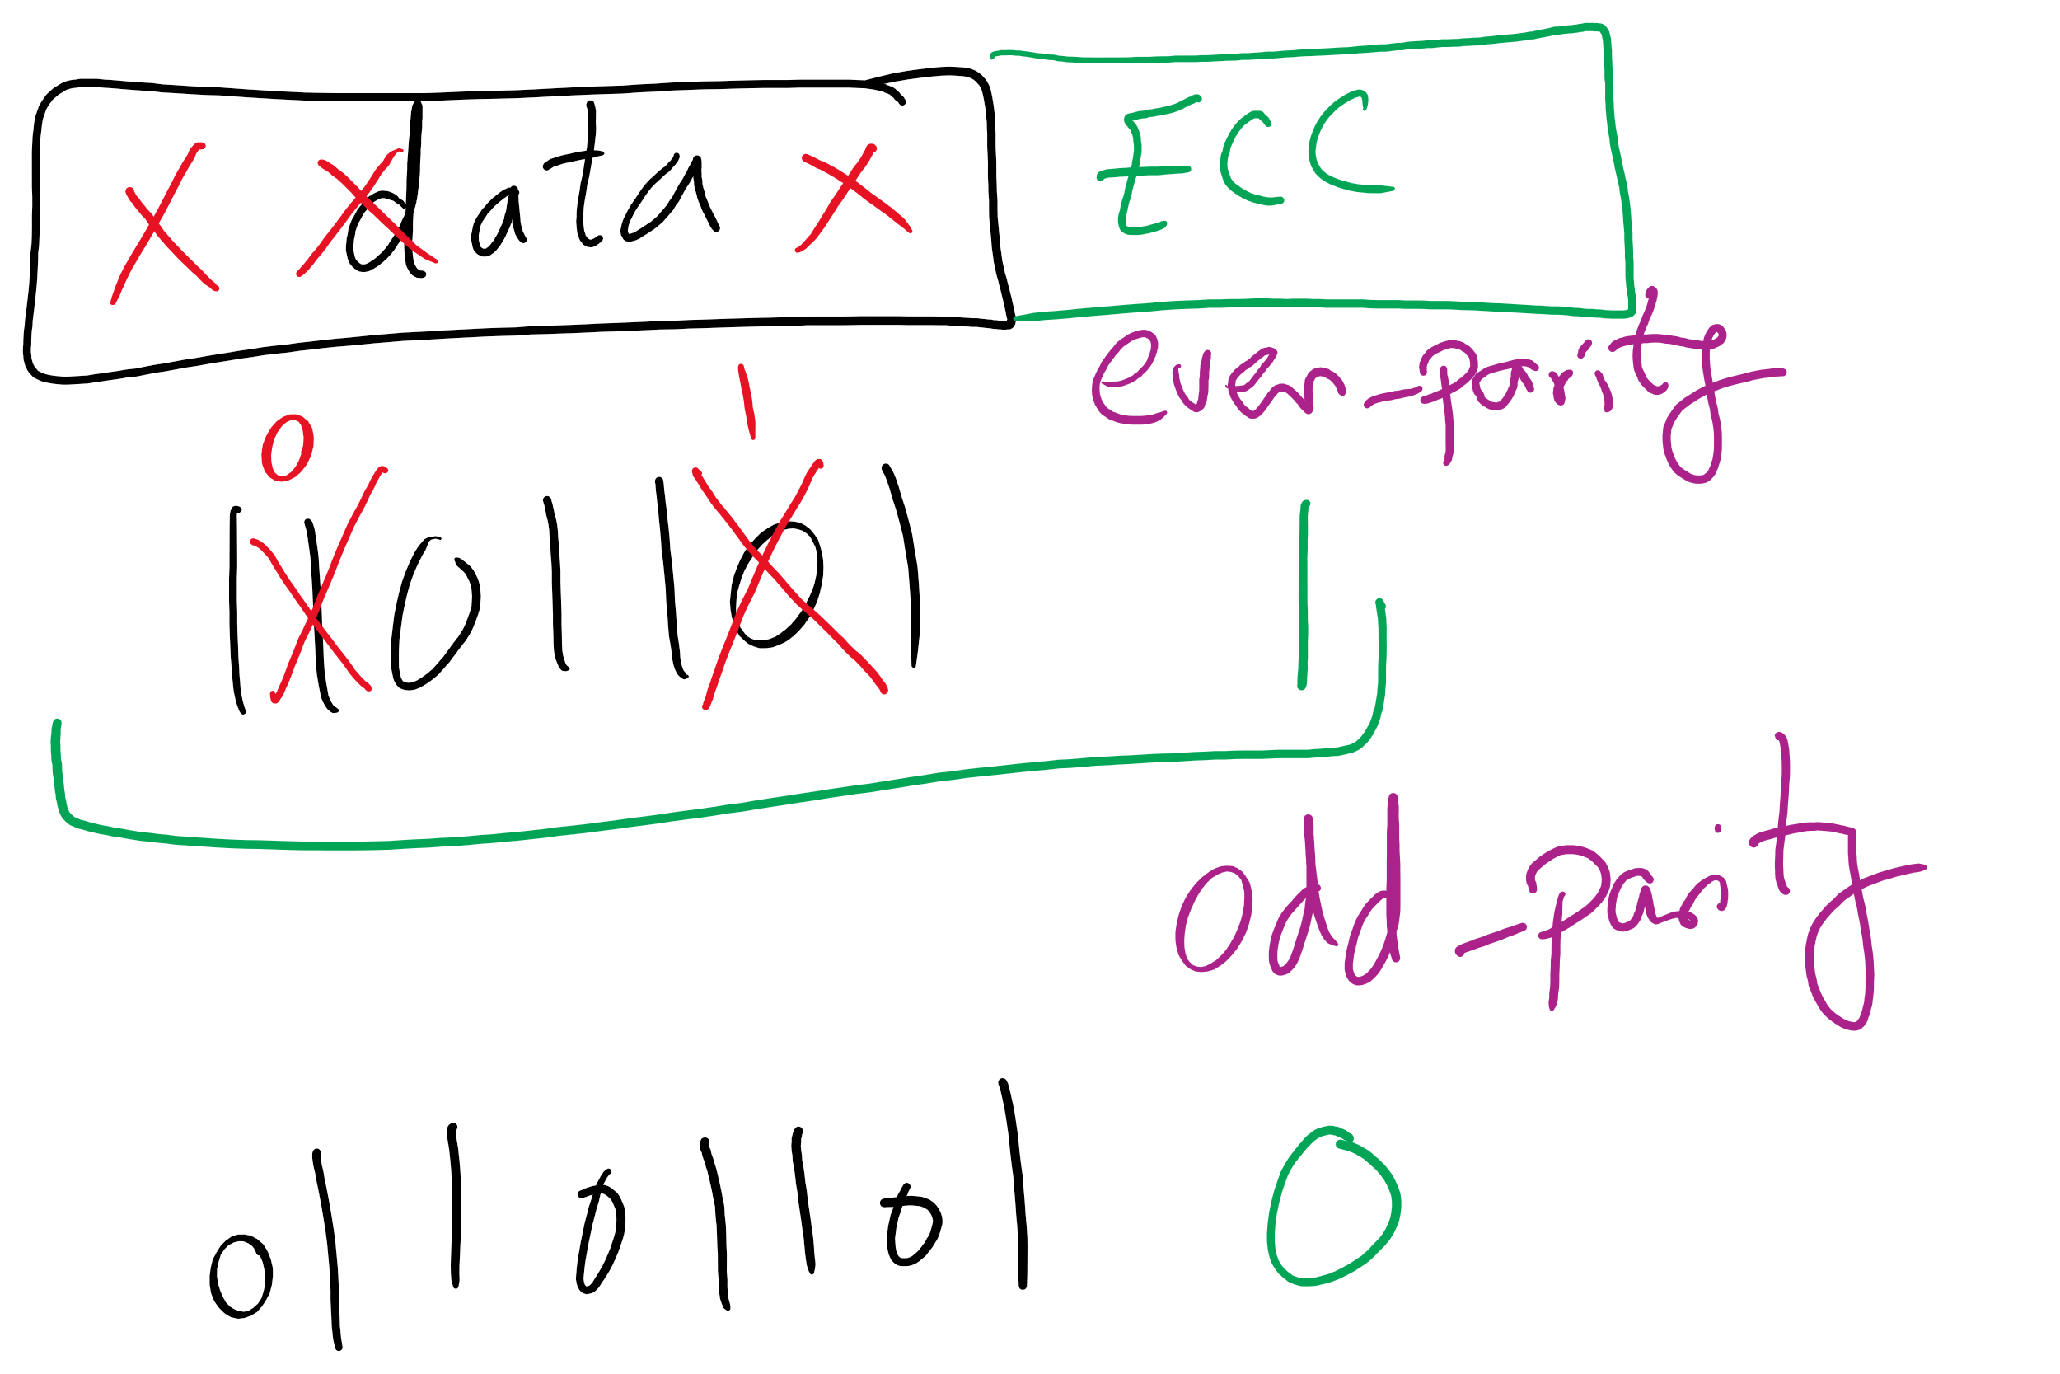
1-d parity

Slide 21
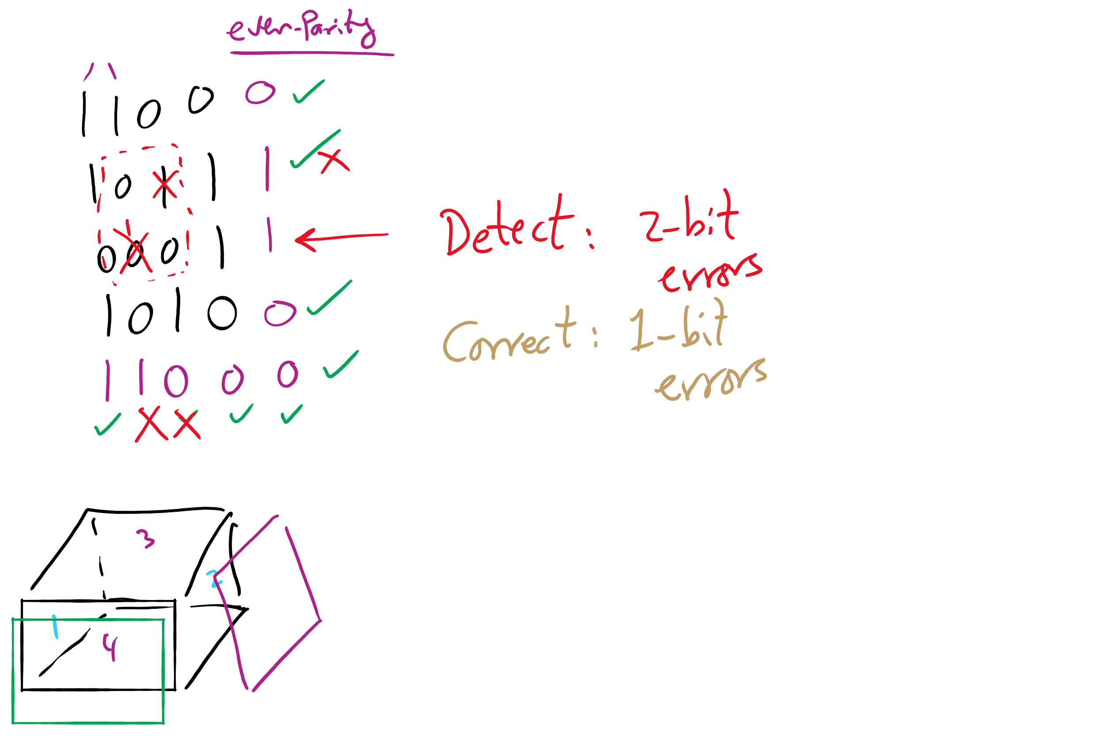
2-d parity

Slide 22
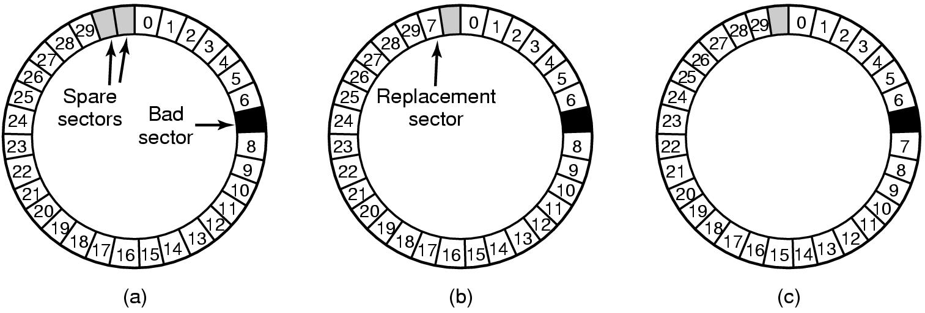
When good disks go bad…
Disks have defects
In 3M+ sectors, this isn’t surprising!
ECC helps with errors, but sometimes this isn’t enough
Disks keep spare sectors (normally unused) and remap bad sectors into these spares
If there’s time, the whole track could be reordered…

Slide 23
RAIDs, RAIDs, and more RAIDs
Stripe
strip
strip
RAID 0
(Redundant Array of Inexpensive Disks
RAID 1
(Mirrored copies)
RAID 4
(Striped with parity)
RAID 5
(Parity rotates through disks)

