Slide 1


Introduction to Operating Systems CS 1550
Spring 2023
Sherif Khattab
ksm73@pitt.edu
(Some slides are from Silberschatz, Galvin and Gagne ©2013)

Slide 2
Announcements
Upcoming deadlines:
Homework 11: due on 4/18
Project 3: Late due date on 4/13
Late penalty waived
Lab 4: due on 4/15
Quiz 3: due on 4/15
Homework 12: due on 4/25
Lab 5: due on 5/2
Project 4 and Quiz 4: due on 5/2
Bonus Opportunities
Bonus Homework: due on 5/2
Course Post-Test: due on 5/2
Bonus point for all when OMET response rate >= 80%

Slide 3
Previous lecture …
How do device drivers program I/O devices?
Answer: three methods
polling
Interrupts
DMA

Slide 4
Muddiest Points (1/2)
RAIDs
Difference between RAID 4 and 5
So is the log-structured file system the same as journaling, or is that different? If it is the same, does that mean all journaling systems also track file version histories?
Interrupt driven I/O
polling
Other situations like that bug/feature example? Seems interesting.
In file block cache data structures slide, how do you track hash table collisions to make the chains?
voltage about 0/1 on solid state disk
Can you explain again why SSDs degrade over time?
Single bus versus dual-bus
What tradeoff exists having larger disk caches?
memory mapped and separate io spaces

Slide 5
Muddiest Points (2/2)
can you please release final preparation material a bit earlier? i’m nervous for the final and want to start studying ahead of time
not about the lecture specifically but in general: are we allowed to work with each other on midterm exam corrections or should they be done alone?
Are we really going to having 8am final?
Everything was clear
Nothing good. Need to review myself
All good this lecture, though things went a bit fast

Slide 6
Polling
copy_from_user (buffer, p, count); // copy into kernel buffer
for (j = 0; j < count; j++) { // loop for each char
while (*printer_status_reg != READY)
; // wait for printer to be ready
*printer_data_reg = p[j]; // output a single character
}
return_to_user();

Slide 7
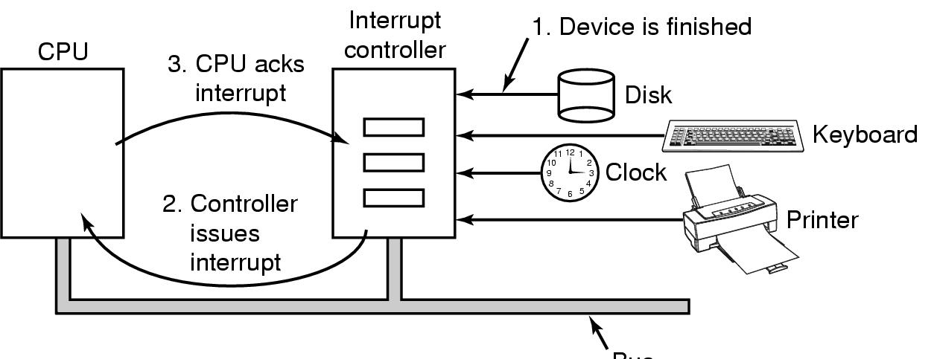
Hardware’s view of interrupts
Bus

Slide 8
Interrupt-driven I/O
copy_from_user (buffer, p, count);
j = 0;
enable_interrupts();
while (*printer_status_reg != READY)
;
*printer_data_reg = p[0];
scheduler(); // and block user
Code run by system call
if (count == 0) {
unblock_user();
} else {
j++;
*printer_data_reg = p[j];
count--;
}
acknowledge_interrupt();
return_from_interrupt();
Code run at interrupt time
(Interrupt handler)

Slide 9
What happens on an interrupt
Set up stack for interrupt service procedure
Ack interrupt controller, reenable interrupts
Copy registers from where saved
Run service procedure
(optional) Pick a new process to run next
Set up MMU context for process to run next
Load new process' registers
Start running the new process

Slide 10
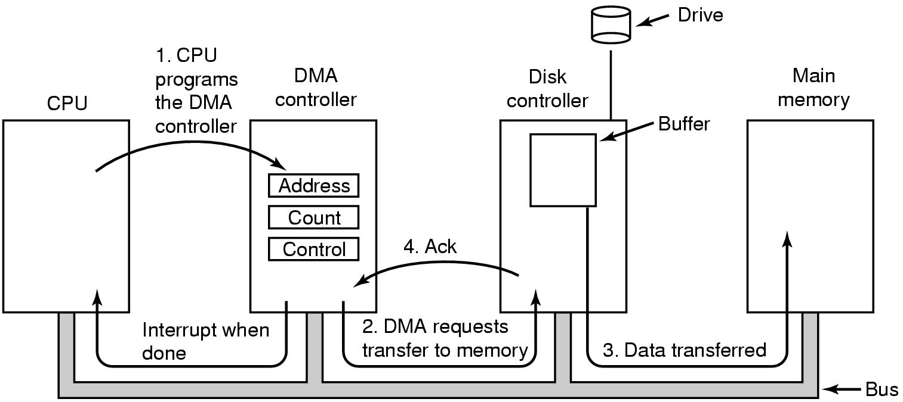
Direct Memory Access (DMA) operation

Slide 11
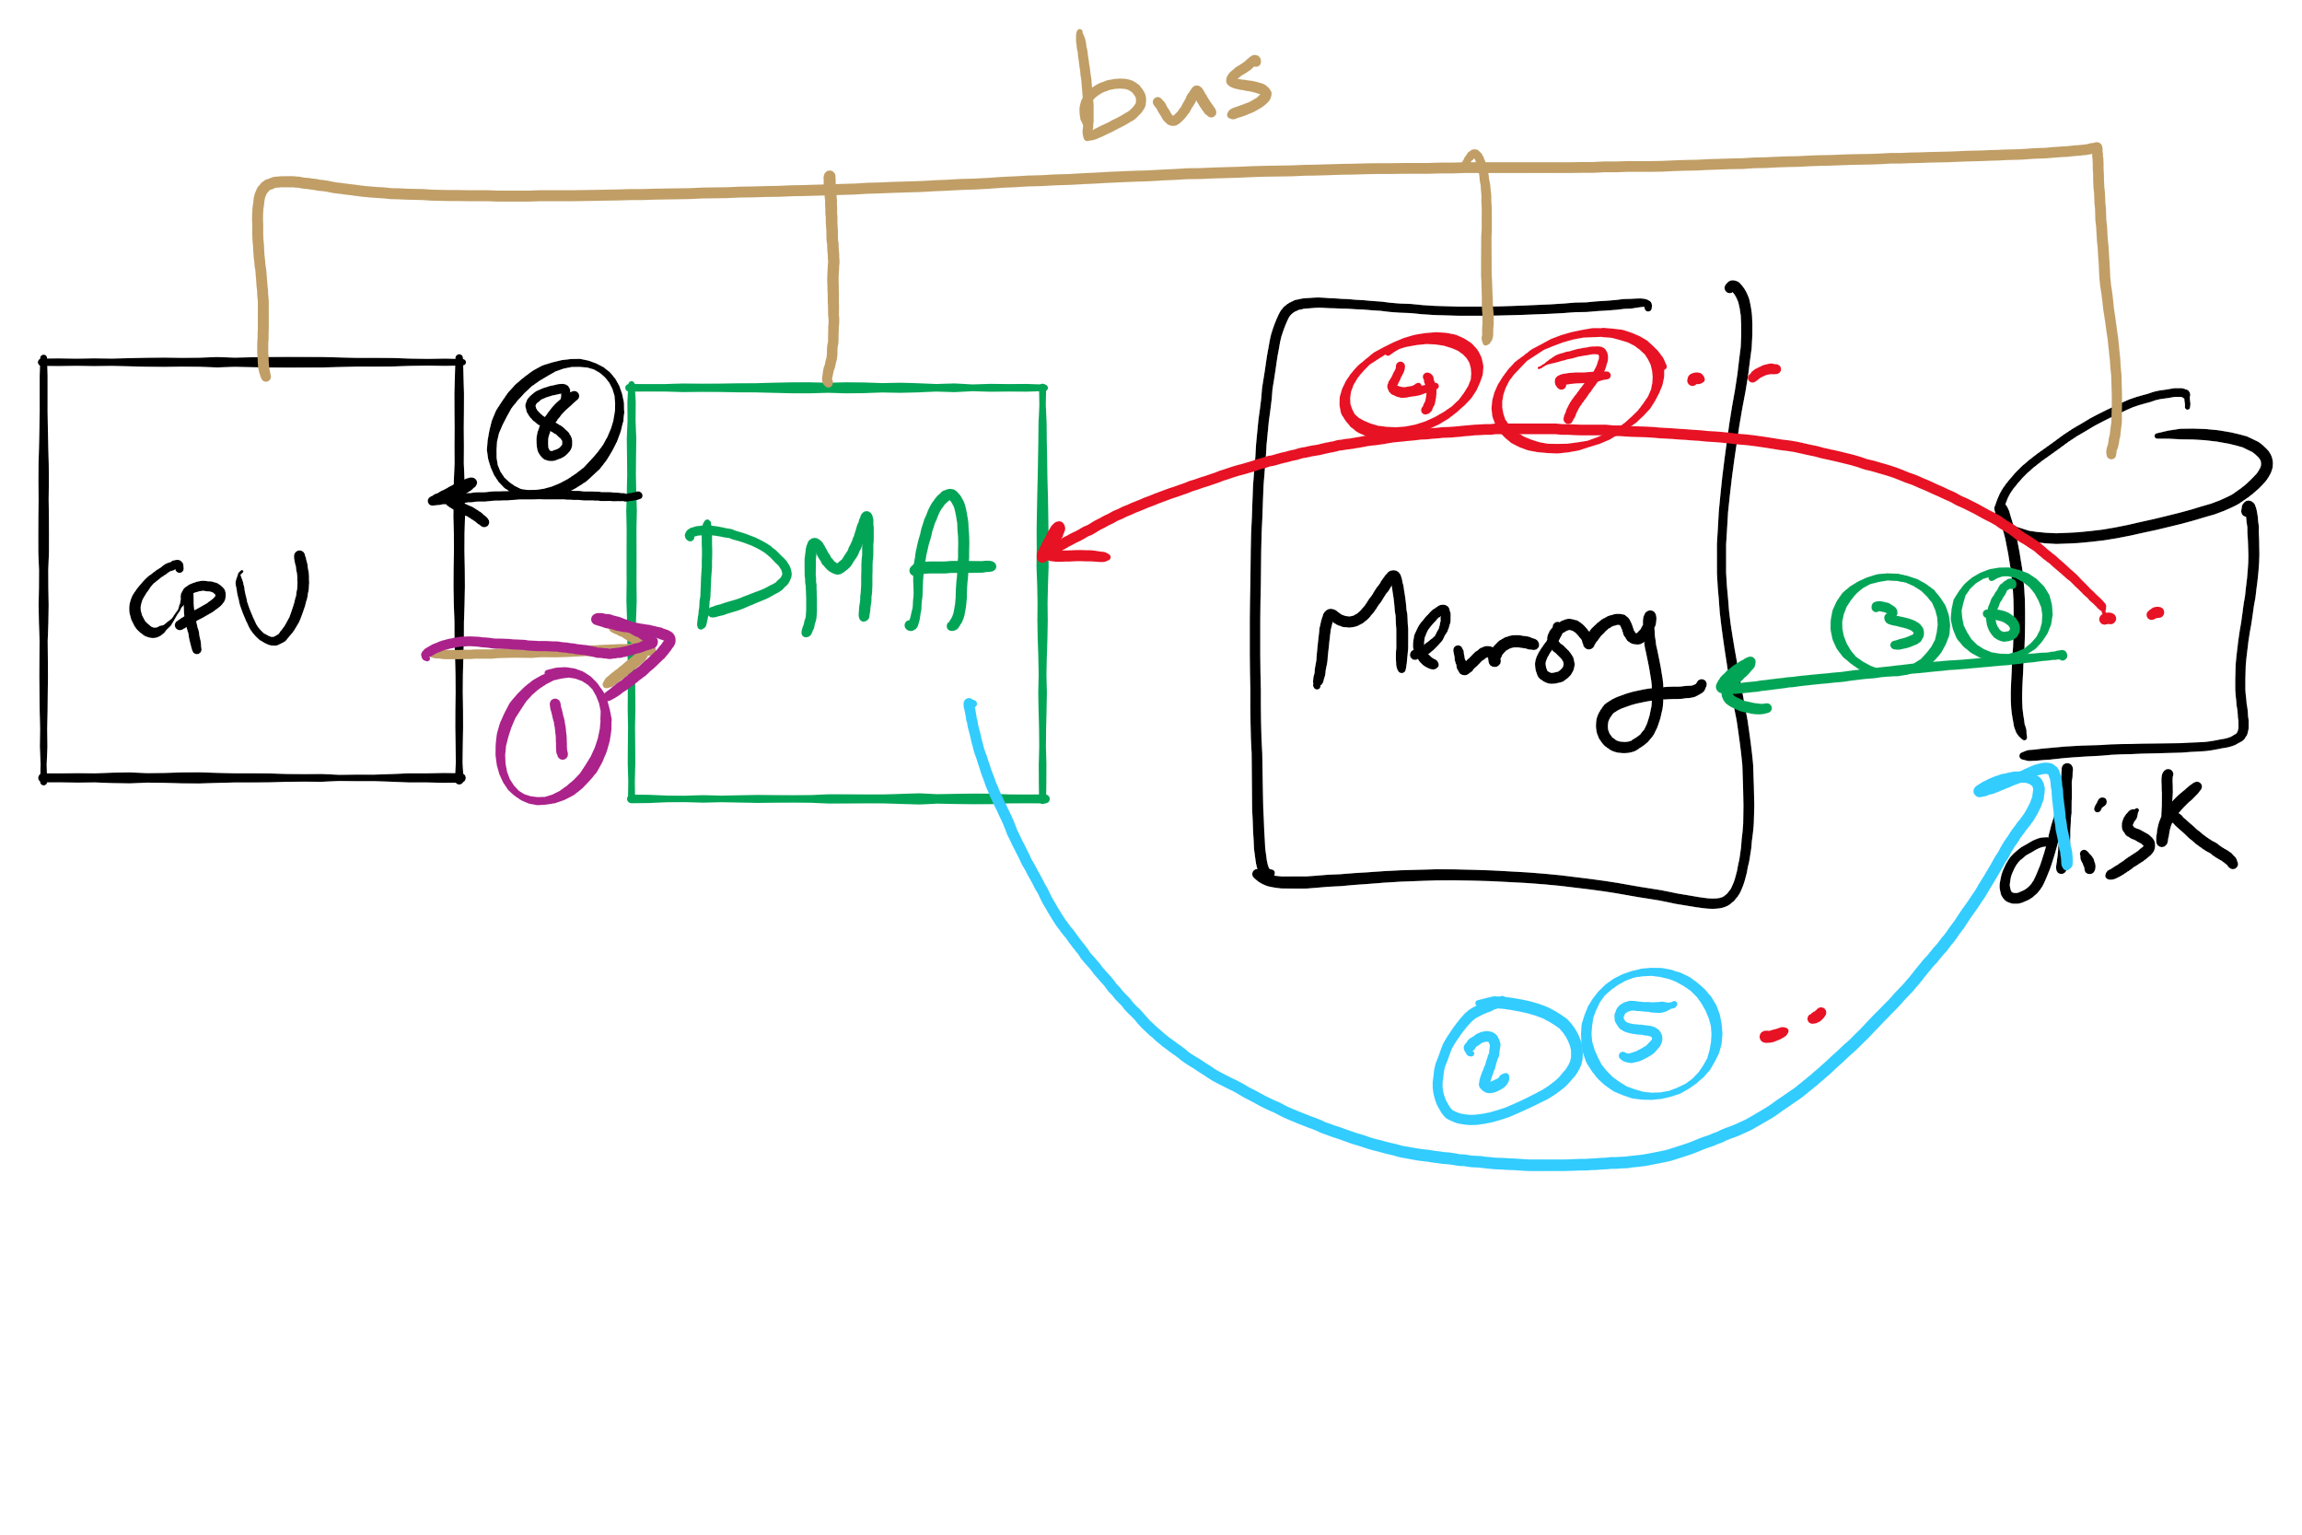
DMA

Slide 12
I/O using DMA
copy_from_user (buffer, p, count);
set_up_DMA_controller();
scheduler(); // and block user
Code run by system call
acknowledge_interrupt();
unblock_user();
return_from_interrupt();
Code run at interrupt time

Slide 13
Disk drive structure
Data stored on surfaces
Up to two surfaces per platter
One or more platters per disk
Data in concentric tracks
Tracks broken into sectors
256B-1KB per sector
Cylinder: corresponding tracks on all surfaces
Data read and written by heads
Actuator moves heads
Heads move in unison
head
sector
platter
track
cylinder
surfaces
spindle
actuator

Slide 14
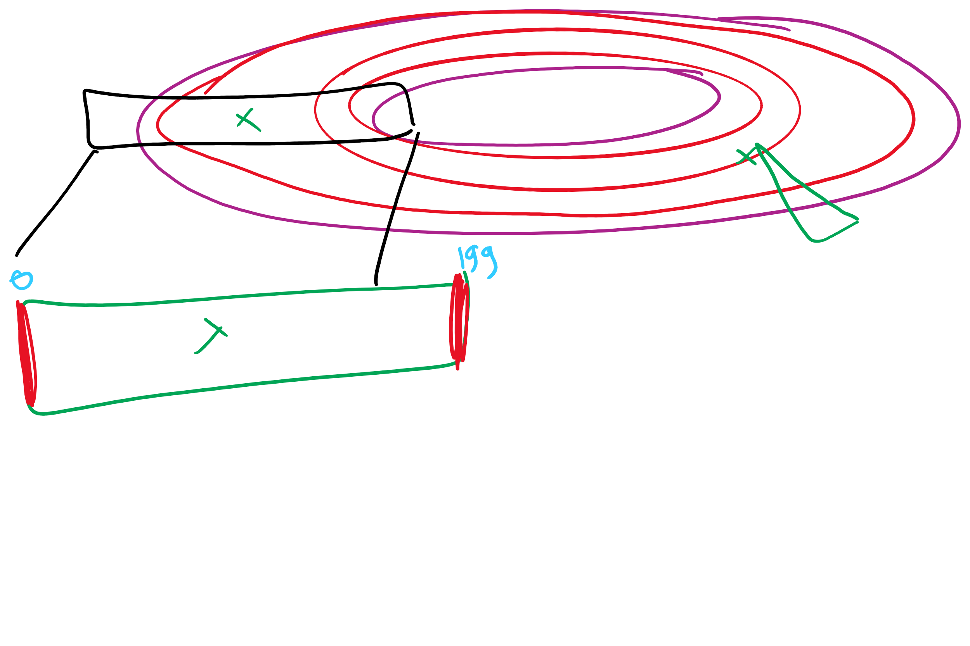
Disk scheduling algorithms
Schedule disk requests to minimize disk seek time
Seek time increases as distance increases (though not linearly)
Minimize seek distance -> minimize seek time
Disk seek algorithm examples assume a request queue & head position (disk has 200 cylinders)
Queue = 100, 175, 51, 133, 8, 140, 73, 77
Head position = 63
Outside edge
Inside edge
8
51
73
100
133
175
77
140
read/write head position
disk requests
(cylinder in which block resides)

Slide 15
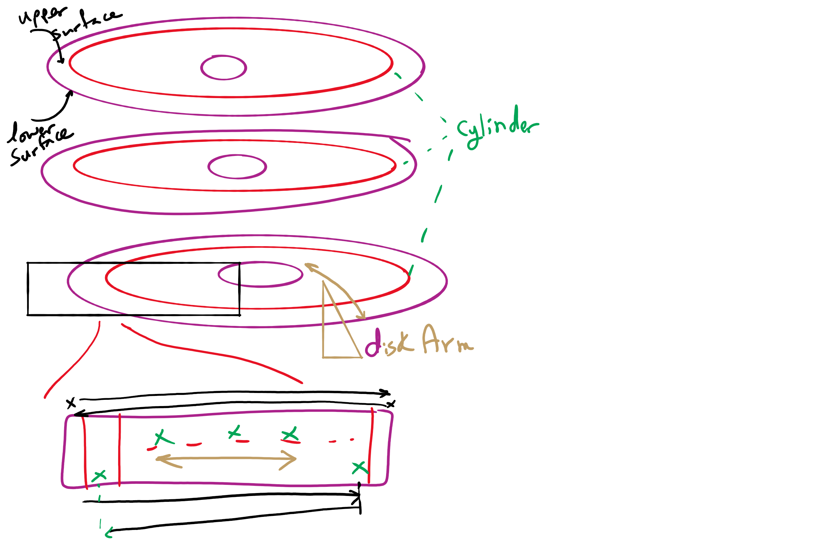
Disk Arm Scheduling

Slide 16
First-Come-First Served (FCFS)
Requests serviced in the order in which they arrived
Easy to implement!
May involve lots of unnecessary seek distance
Seek order = 100, 175, 51, 133, 8, 140, 73, 77
Seek distance = (100-63) + (175-100) + (175-51) + (133-51) + (133-8) + (140-8) + (140-73) + (77-73) = 646 cylinders
read/write head start
100
175
51
133
8
140
73
77

Slide 17
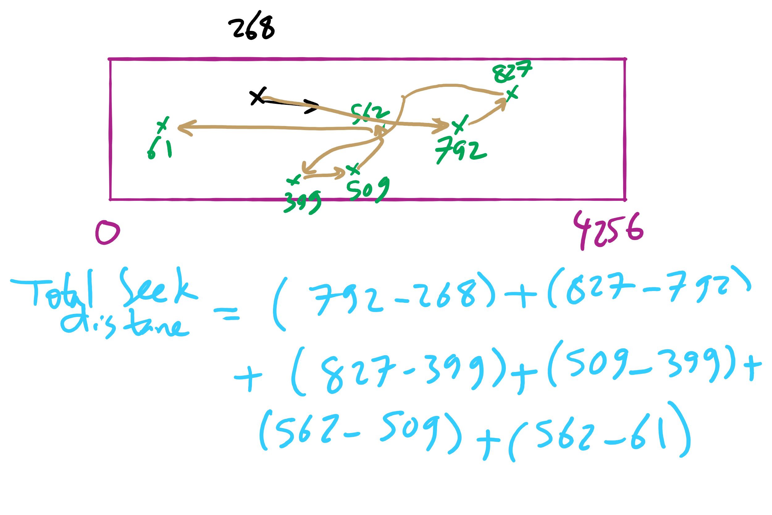
FCFS Example 2

Slide 18
Shortest Seek Time First (SSTF)
Service the request with the shortest seek time from the current head position
Form of SJF scheduling
May starve some requests
Seek order = 73, 77, 100, 133, 140, 175, 51, 8
Seek distance = 10 + 4 + 23 + 33 + 7 + 35 + 124 + 43 = 279 cylinders
read/write head start
73
77
51
8
133
100
140
175

Slide 19
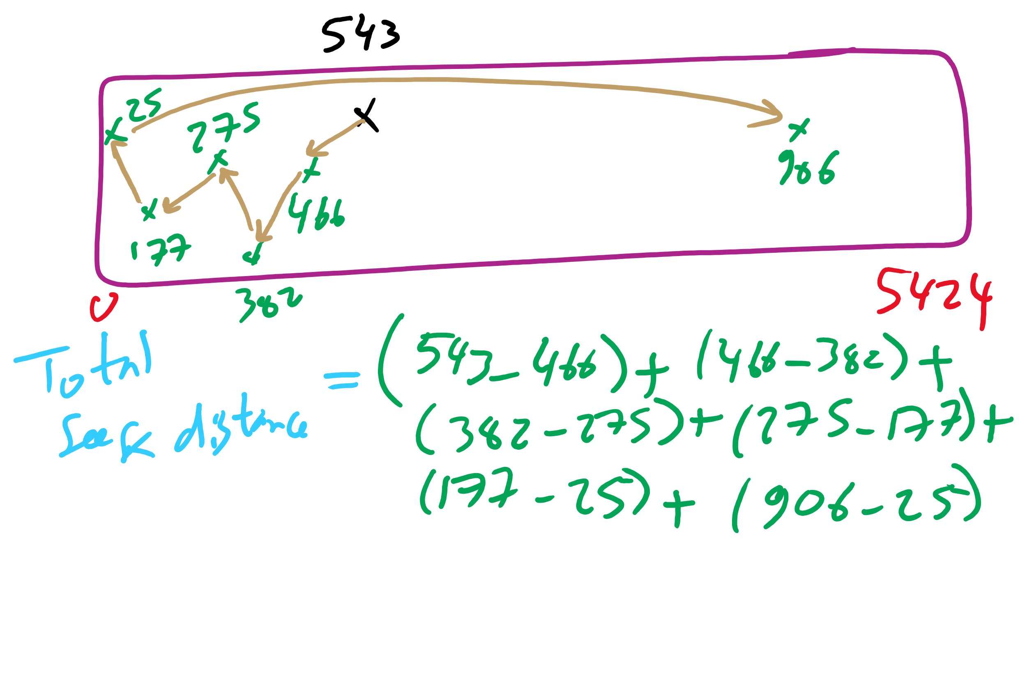
SSTF Example 2

Slide 20
SCAN (elevator algorithm)
Disk arm starts at one end of the disk and moves towards the other end, servicing requests as it goes
Reverses direction when it gets to end of the disk
Also known as elevator algorithm
Seek order = 51, 8, 0 , 73, 77, 100, 133, 140, 175
Seek distance = 12 + 43 + 8 + 73 + 4 + 23 + 33 + 7 + 35 = 238 cyls
read/write head start
51
8
73
77
100
133
140
175

Slide 21
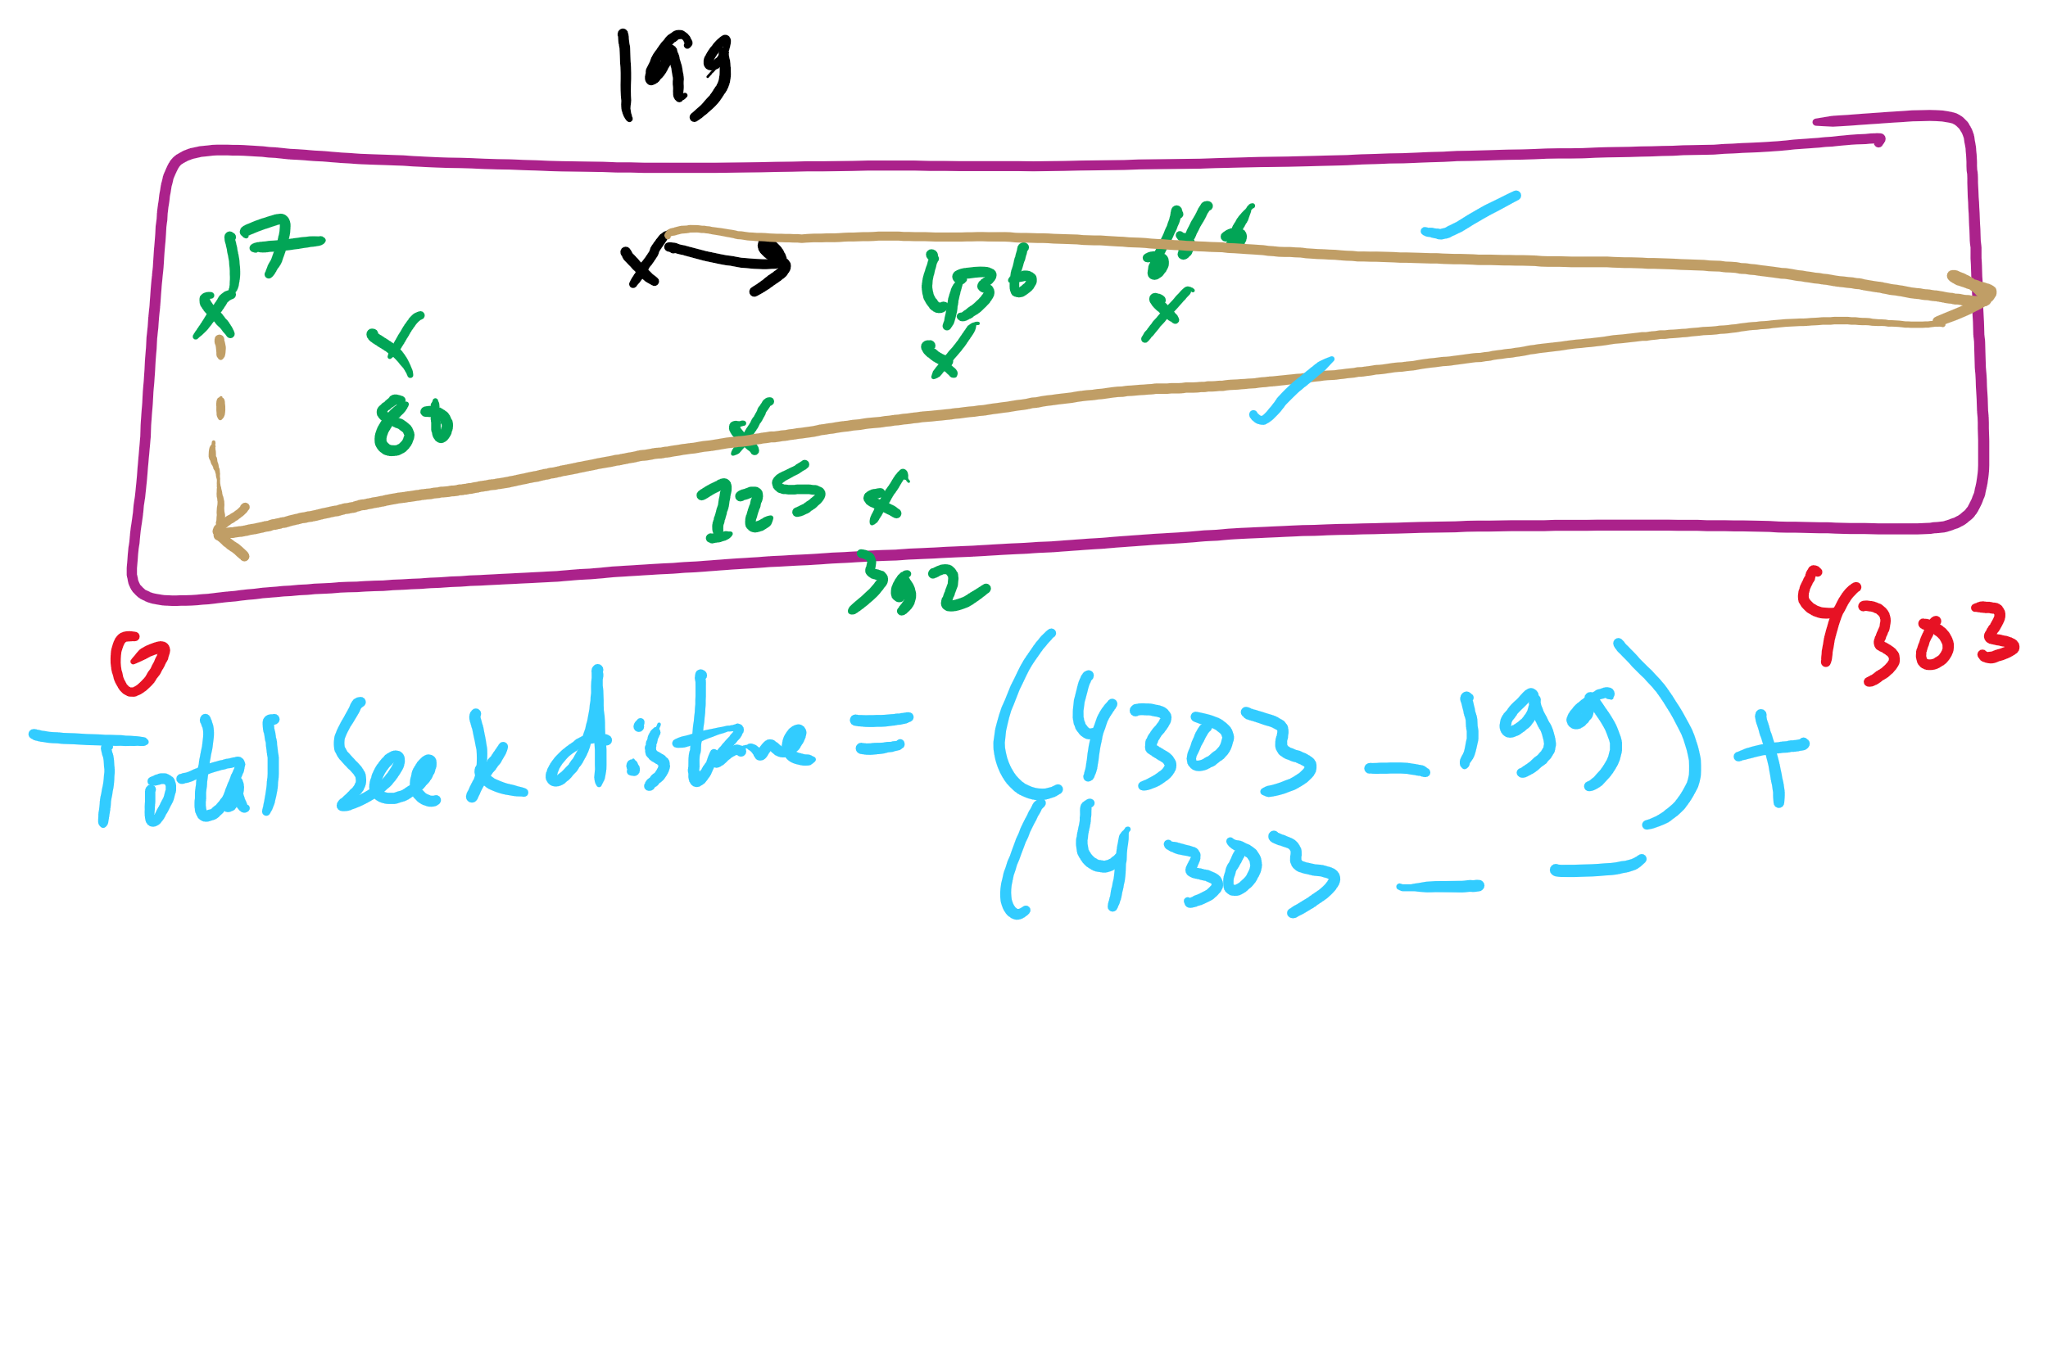
SCAN Example 2

Slide 22
C-SCAN
Identical to SCAN, except head returns to cylinder 0 when it reaches the end of the disk
Treats cylinder list as a circular list that wraps around the disk
Waiting time is more uniform for cylinders near the edge of the disk
Seek order = 73, 77, 100, 133, 140, 175, 199, 0, 8, 51
Distance = 10 + 4 + 23 + 33 + 7 + 35 + 24 + 199 + 8 + 43 = 386 cyls
read/write head start
73
77
100
133
140
175
8
51

Slide 23
C-LOOK
Identical to C-SCAN, except head only travels as far as the last request in each direction
Saves seek time from last sector to end of disk
Seek order = 73, 77, 100, 133, 140, 175, 8, 51
Distance = 10 + 4 + 23 + 33 + 7 + 35 + 167 + 43 = 322 cylinders
read/write head start
73
77
100
133
140
175
8
51

Slide 24
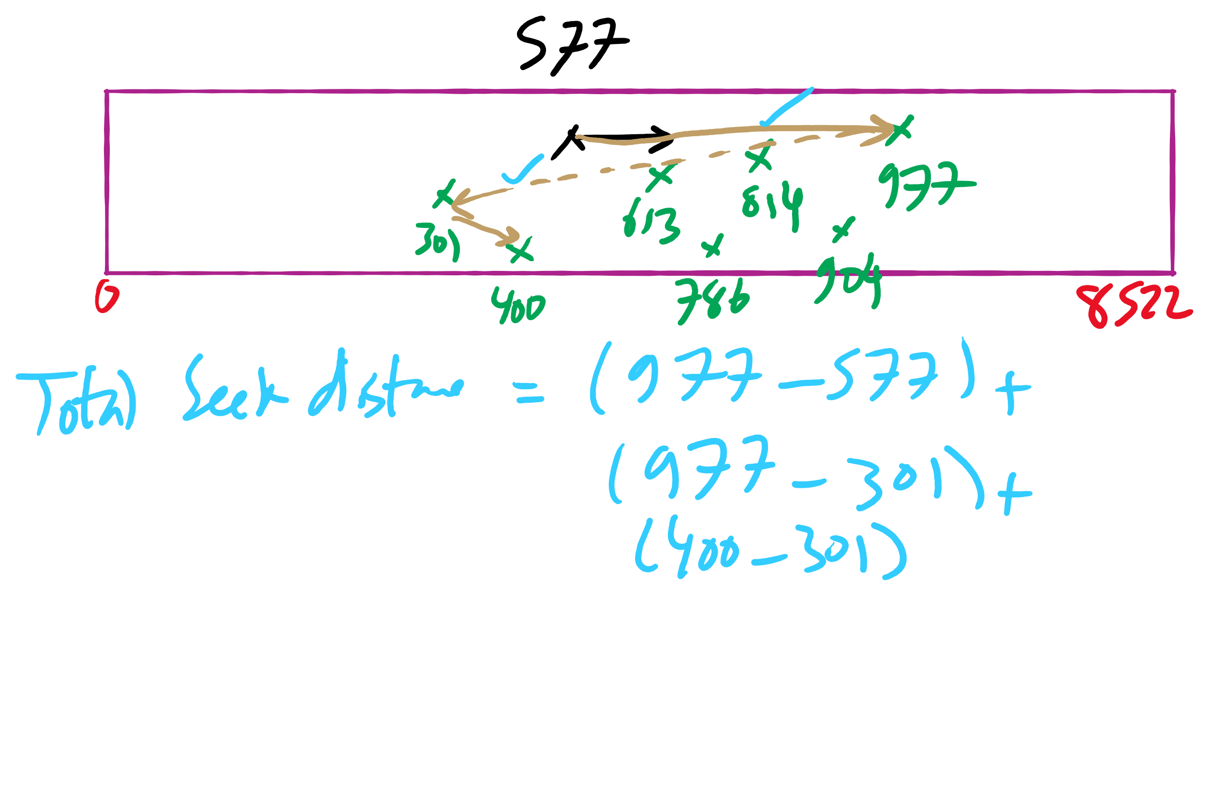
C-LOOK Example 2

Slide 25
Two-level directory system
Solves naming problem: each user has her own directory
Multiple users can use the same file name
By default, users access files in their own directories
Extension: allow users to access files in others’ directories
Root directory
A
B
C
A foo
A bar
B foo
B baz
C bar
C foo
C blah

Slide 26
Hierarchical directory system
Root directory
A
B
C
A
Papers
A foo
A
Photos
B foo
B
Papers
C bar
C foo
C blah
A os.tex
A sunset
A
Family
B foo.tex
B foo.ps
A sunset
A kids
A Mom

Slide 27
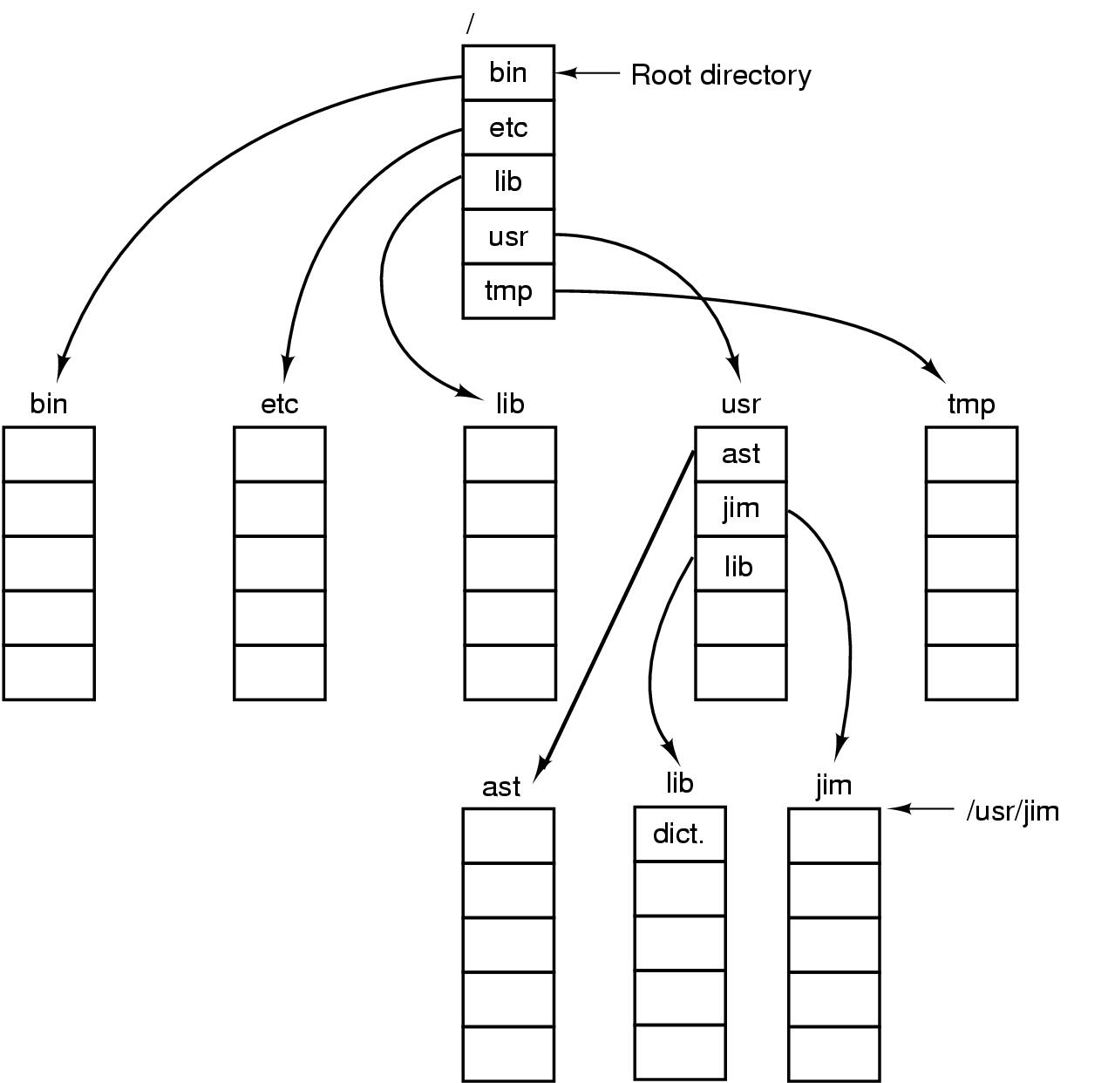
Unix directory tree

Slide 28
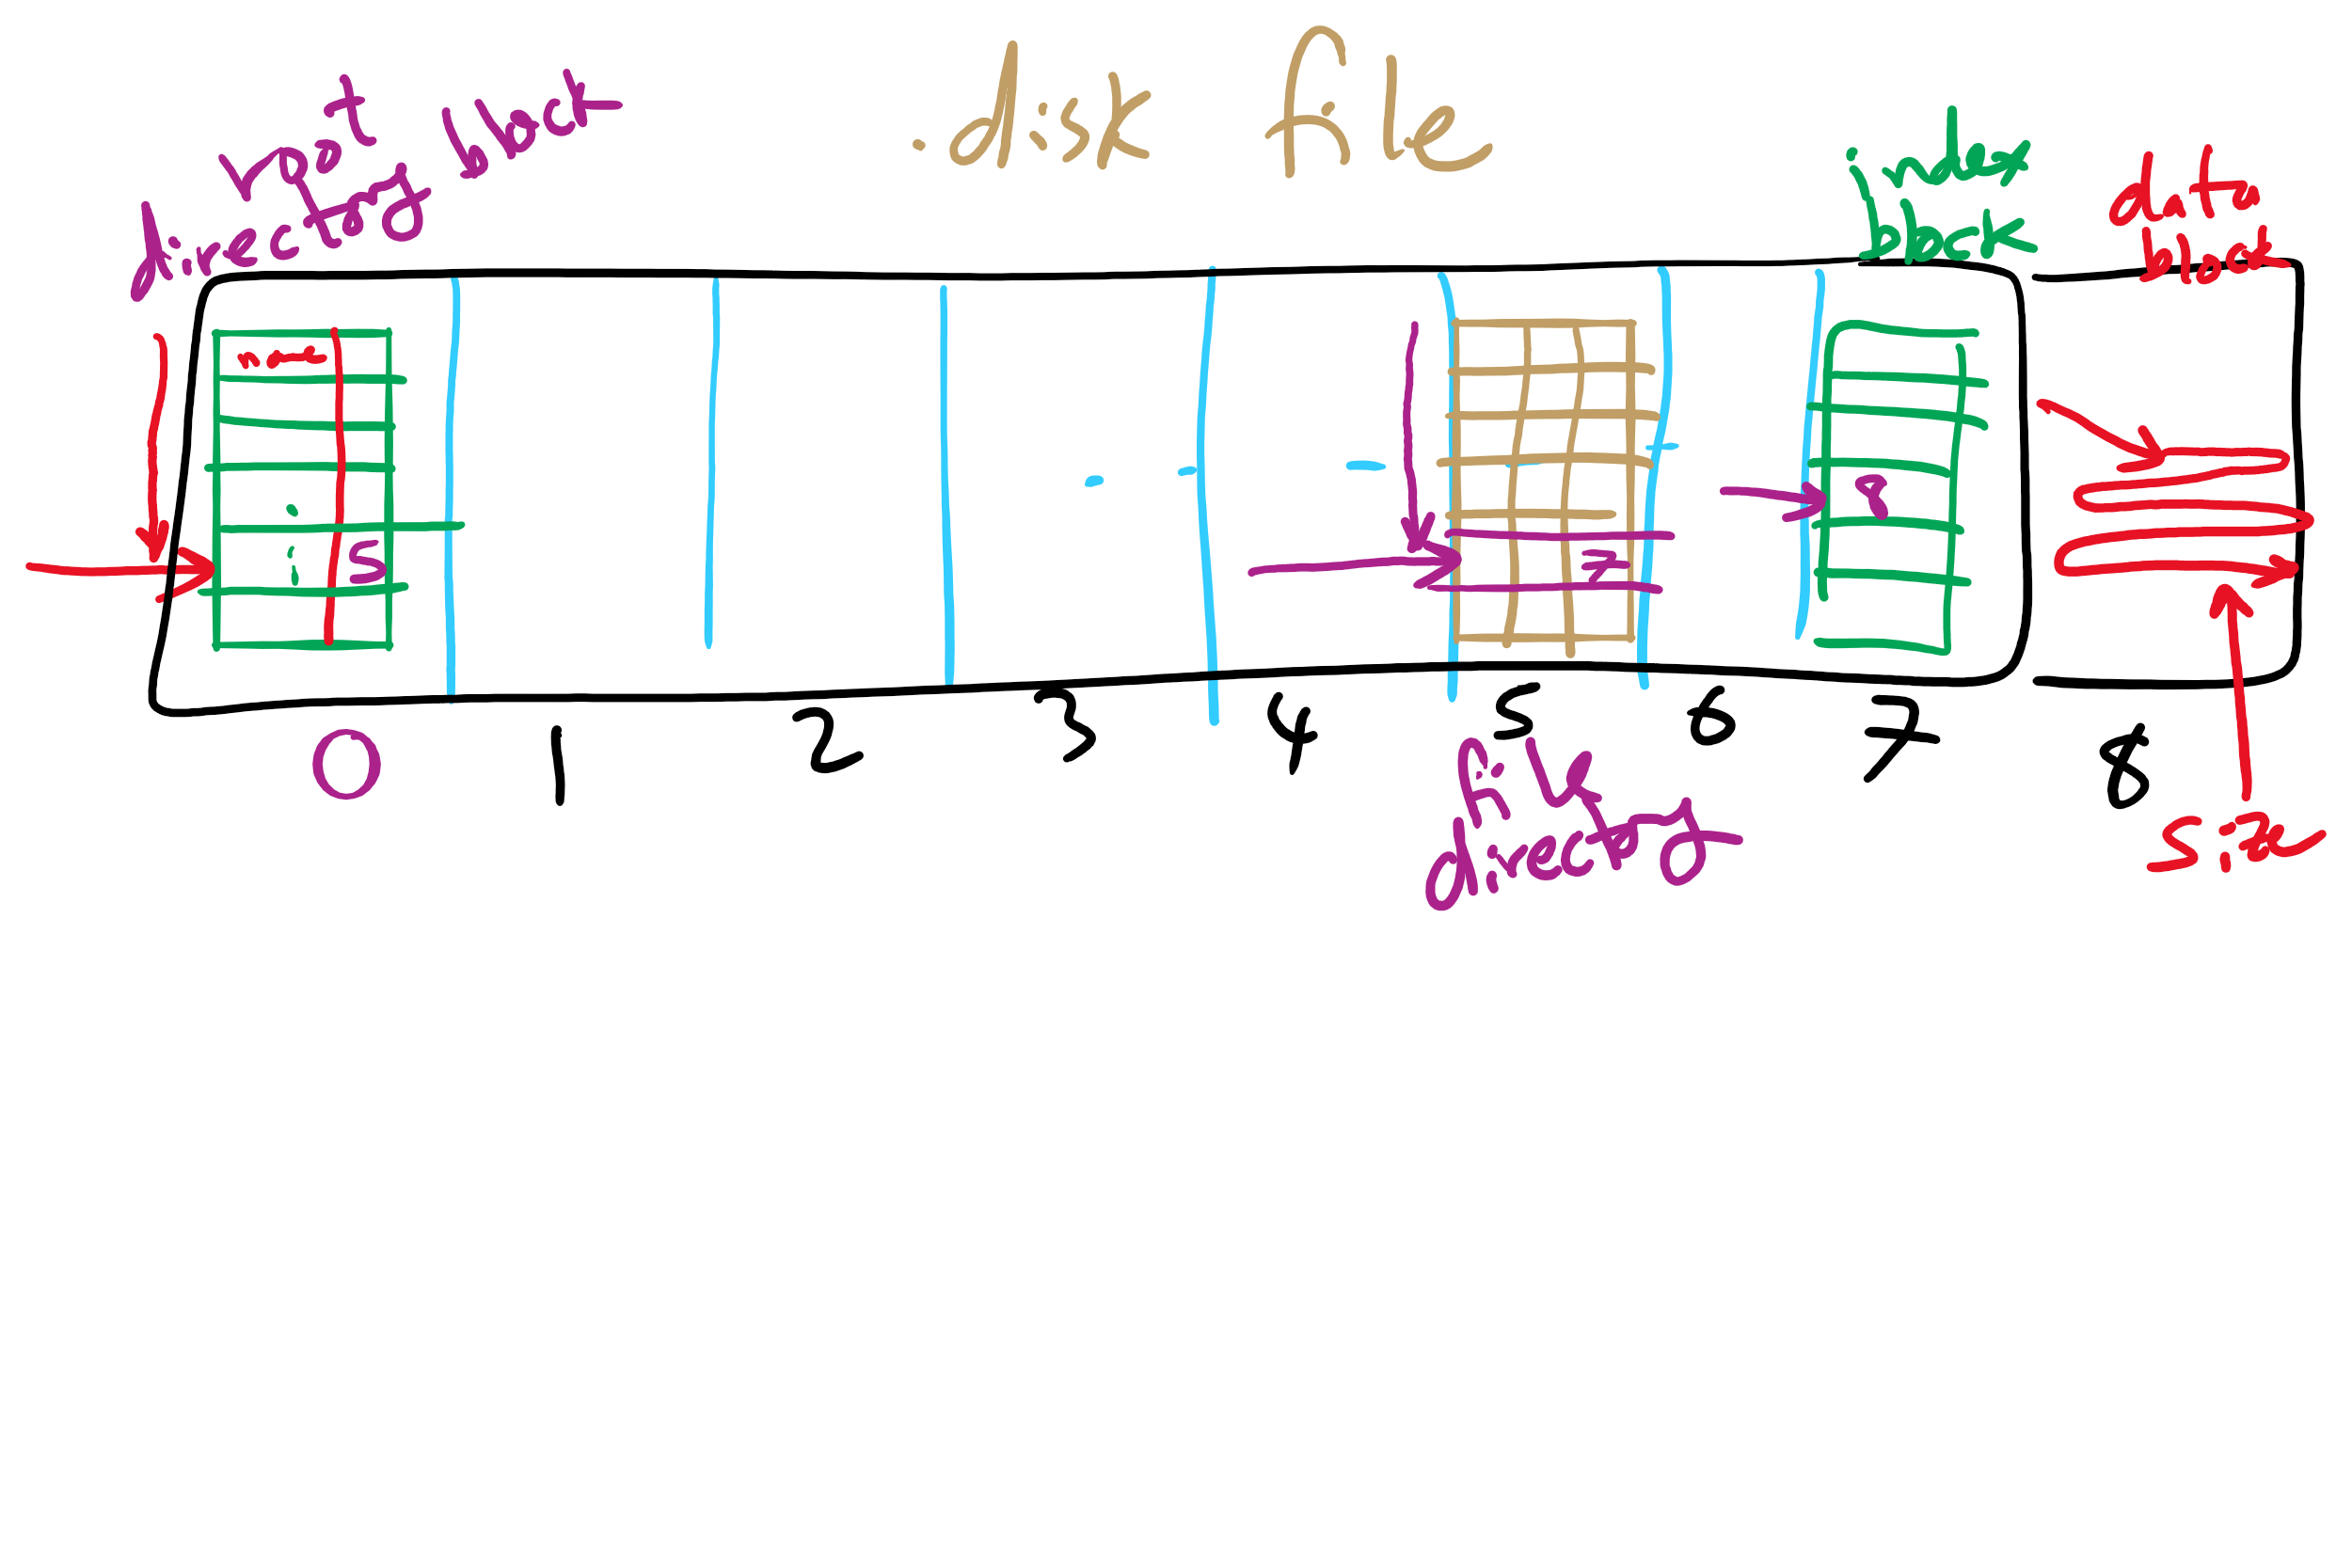
Project 4: Directory Traversal

Slide 29
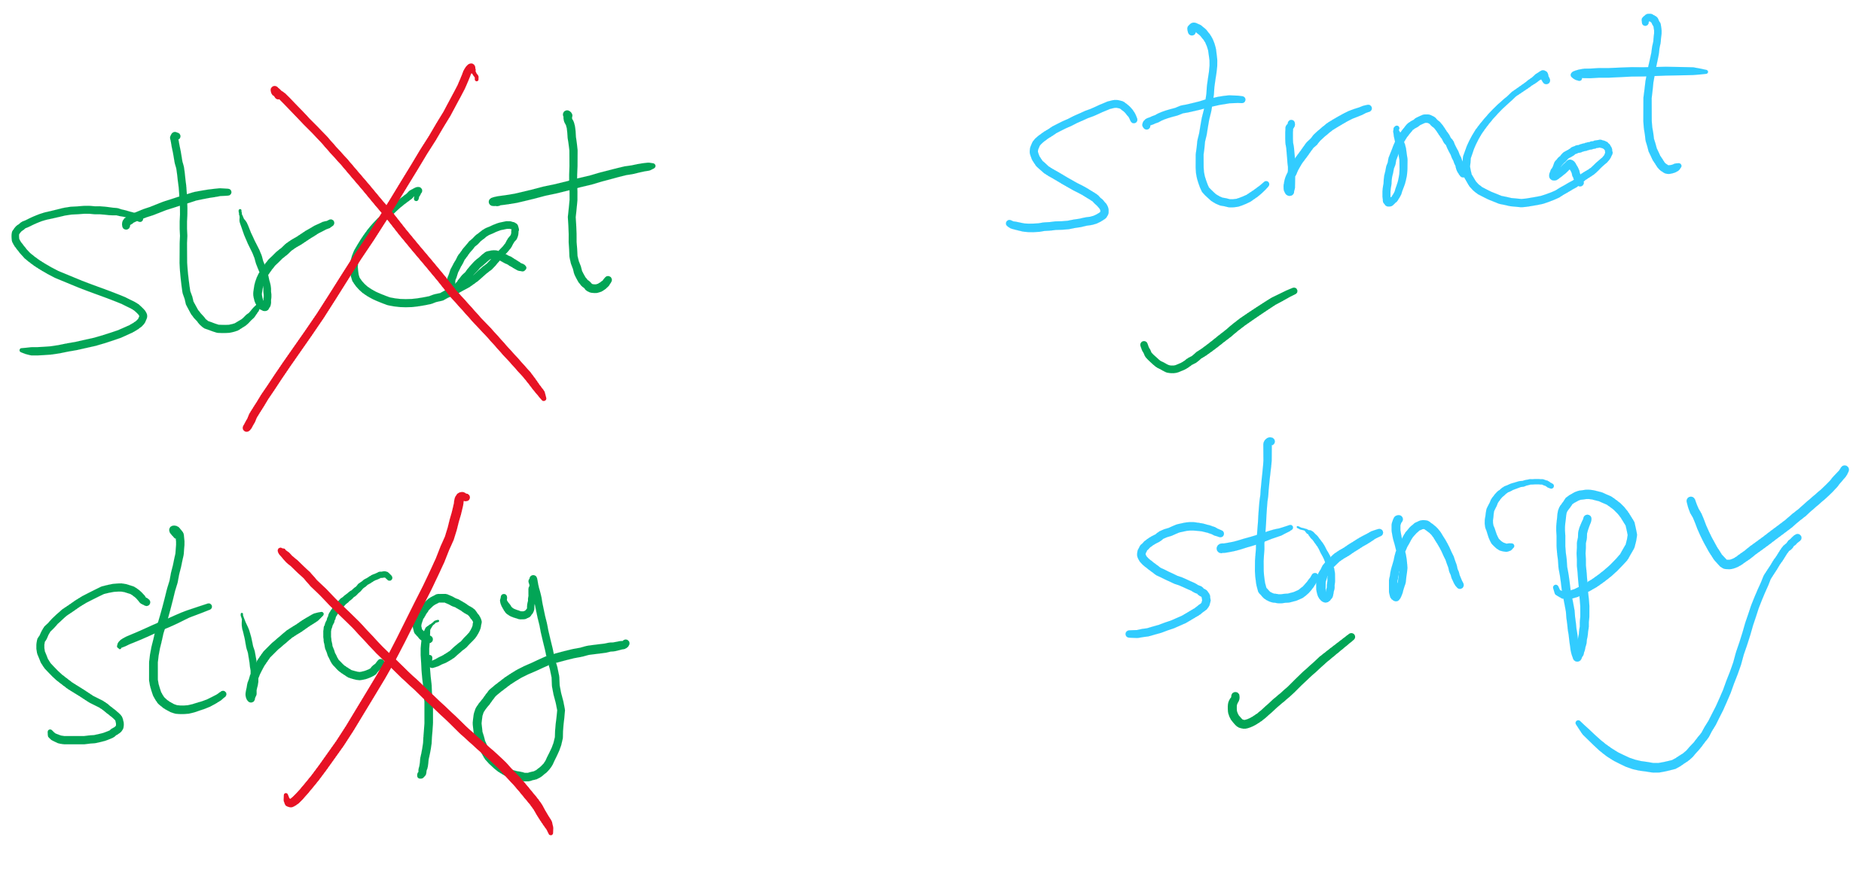
Project 4 Hint

Slide 30
Sharing files
Root directory
A
B
C
A
Papers
A foo
A
Photos
B foo
B
Photos
C bar
C foo
C blah
A os.tex
A sunset
A
Family
B lake
A sunset
A kids
? ???

Slide 31
Solution: use links
A creates a file, and inserts into her directory
B shares the file by creating a link to it
A unlinks the file
B still links to the file
Owner is still A (unless B explicitly changes it)
A
A
B
B
b.tex
b.tex
a.tex
a.tex
Owner: A Count: 1
Owner: A Count: 2
Owner: A Count: 1

