Slide 1


Introduction to Operating Systems CS 1550
Spring 2023
Sherif Khattab
ksm73@pitt.edu
(Some slides are from Silberschatz, Galvin and Gagne ©2013)

Slide 2
Announcements
Upcoming deadlines:
Homework 12: due on 4/25
Lab 5: due on 5/2
Project 4 and Quiz 4: due on 5/2
Bonus Opportunities
Bonus Homework: due on 5/2
Course Post-Test: due on 5/2
Bonus point for all when OMET response rate >= 80%
Currently at 25-28%
Deadline is Sunday 4/24

Slide 3
Previous Lecture …
Disk arm scheduling
FCFS, SSTF, SCAN, C-SCAN, LOOK, C-LOOk

Slide 4
Muddiest Points
Just need to study the material more to be honest.
DMA and CPU memory competition
hardware view of interrupt
Thanks for bringing in coffee and snacks for the final! It is much appreciated
online vs offline problem
What sort of questions about this material will be on the exam?
In Sharing file, if the directory A is owner of file "a_file" and then this file is shared by directory B, Then we delete directory A, Are all files even shared files will be deleted and not more accessible, or we have one copy of "a_file " in directory of B?
Can you please go over File Linking again?
How do you read in the blocks from the disk file for project 4? I know to use fseek and fread but I don't know where to go from there.
Can you explain the difference between CSCAN and CLOOK?

Slide 5
Journaling File System
In a regular file system, changes to files and directories result in multiple separate writes to disk
prone to power failures
Write changes twice
first to an on-disk journal
for efficiency, journal can be put on SSD or NVRAM
data may or may not be written to the journal
second to main file system
Examples
Windows NTFS
Linux ext3, ext4

Slide 6
Journaling File System
Interaction of disk arm scheduling?
out-of-order writes
ext3 and ext4 force disk to flush its cache at certain points (barriers)
Journaling vs. Log-structured file system
Journaling is not needed in LSFS

Slide 7
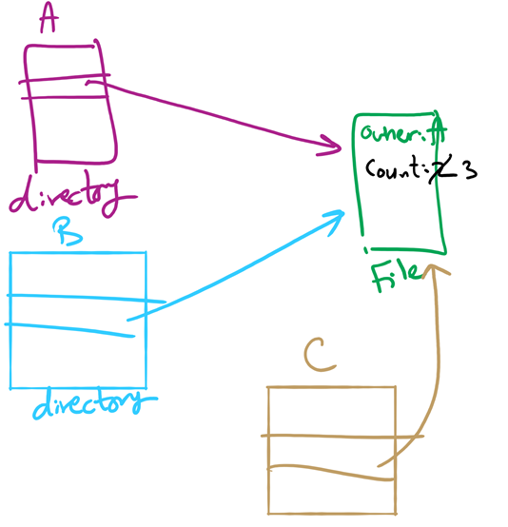
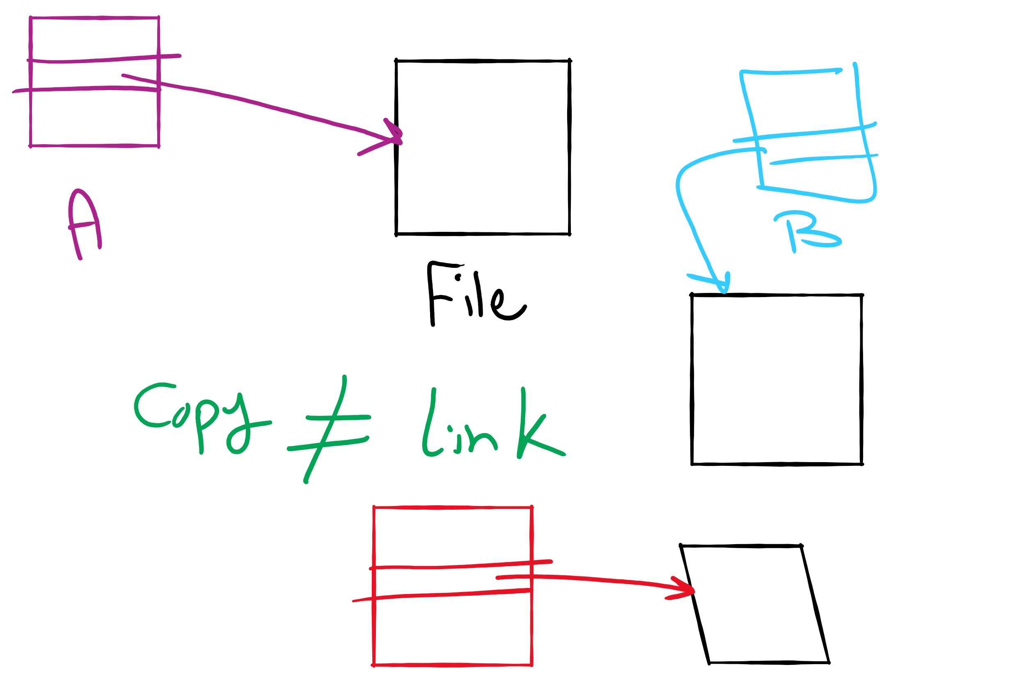
File Linking (left) vs. File Copying (right)

Slide 8
Max Partition Size
Block size | FAT-12 | FAT-16 | FAT-32
0.5 KB | 2 MB
1 KB | 4 MB
2 KB | 8 MB | 128 MB
4 KB | 16 MB | 256 MB | 1 TB
8 KB |  | 512 MB | 2 TB
16 KB |  | 1024 MB | 2 TB
32 KB |  | 2048 MB | 2 TB

Slide 9
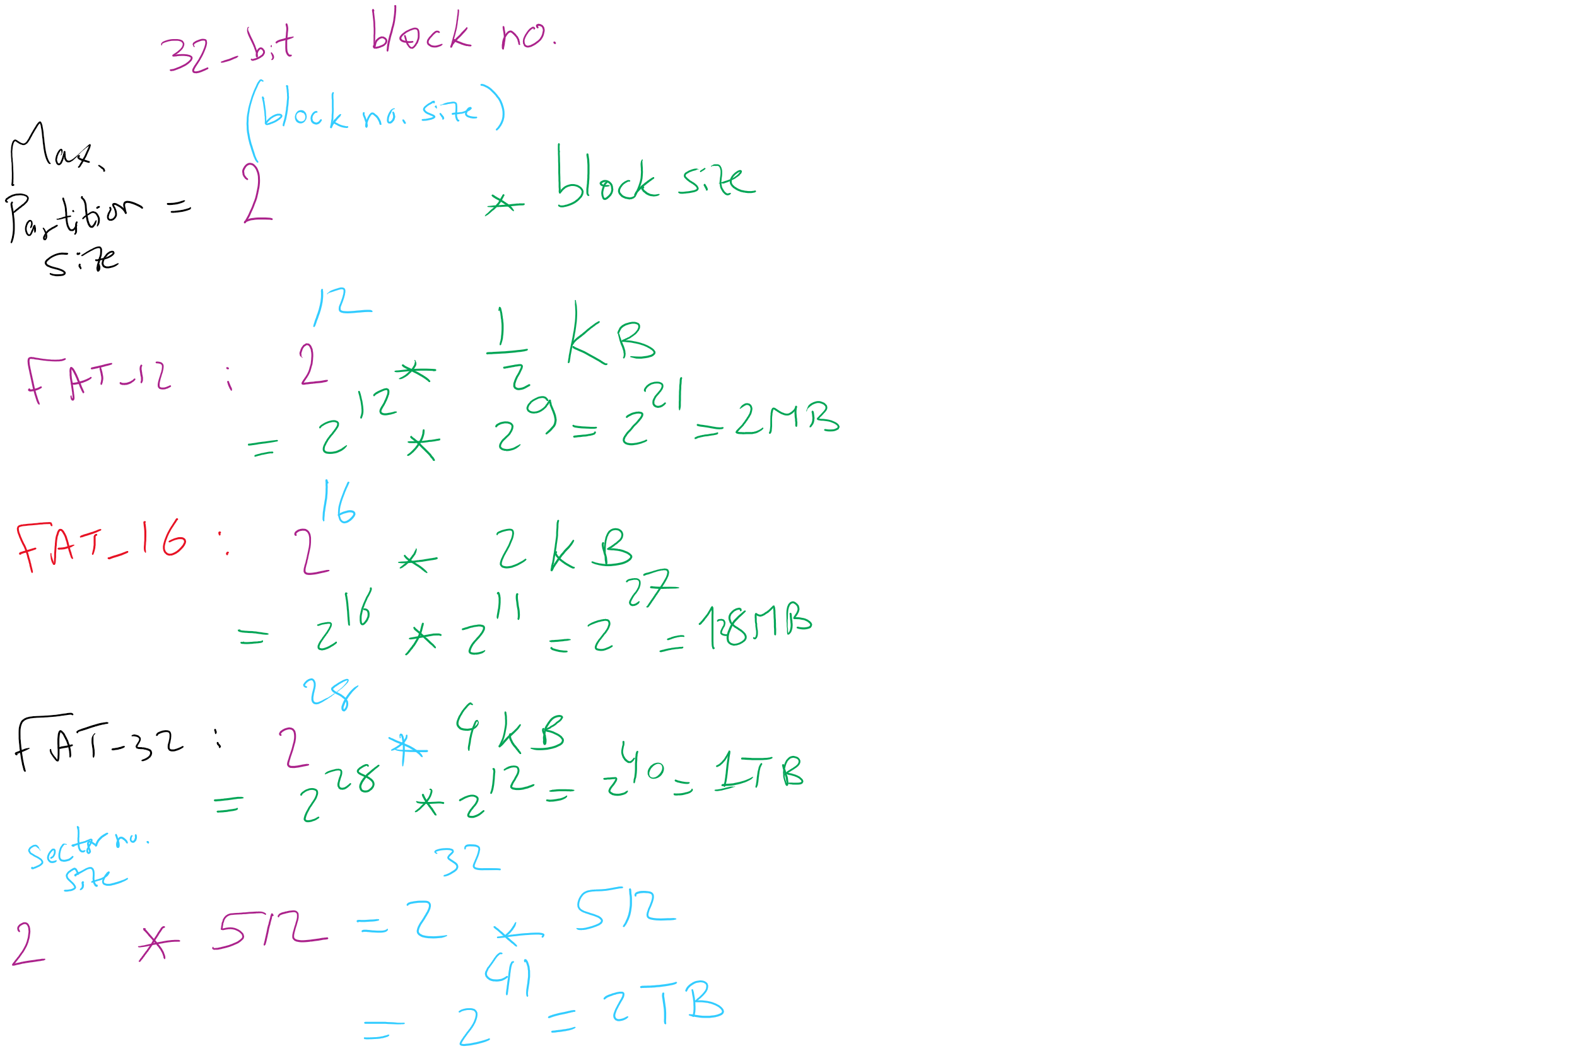
Max Partition Size

Slide 10
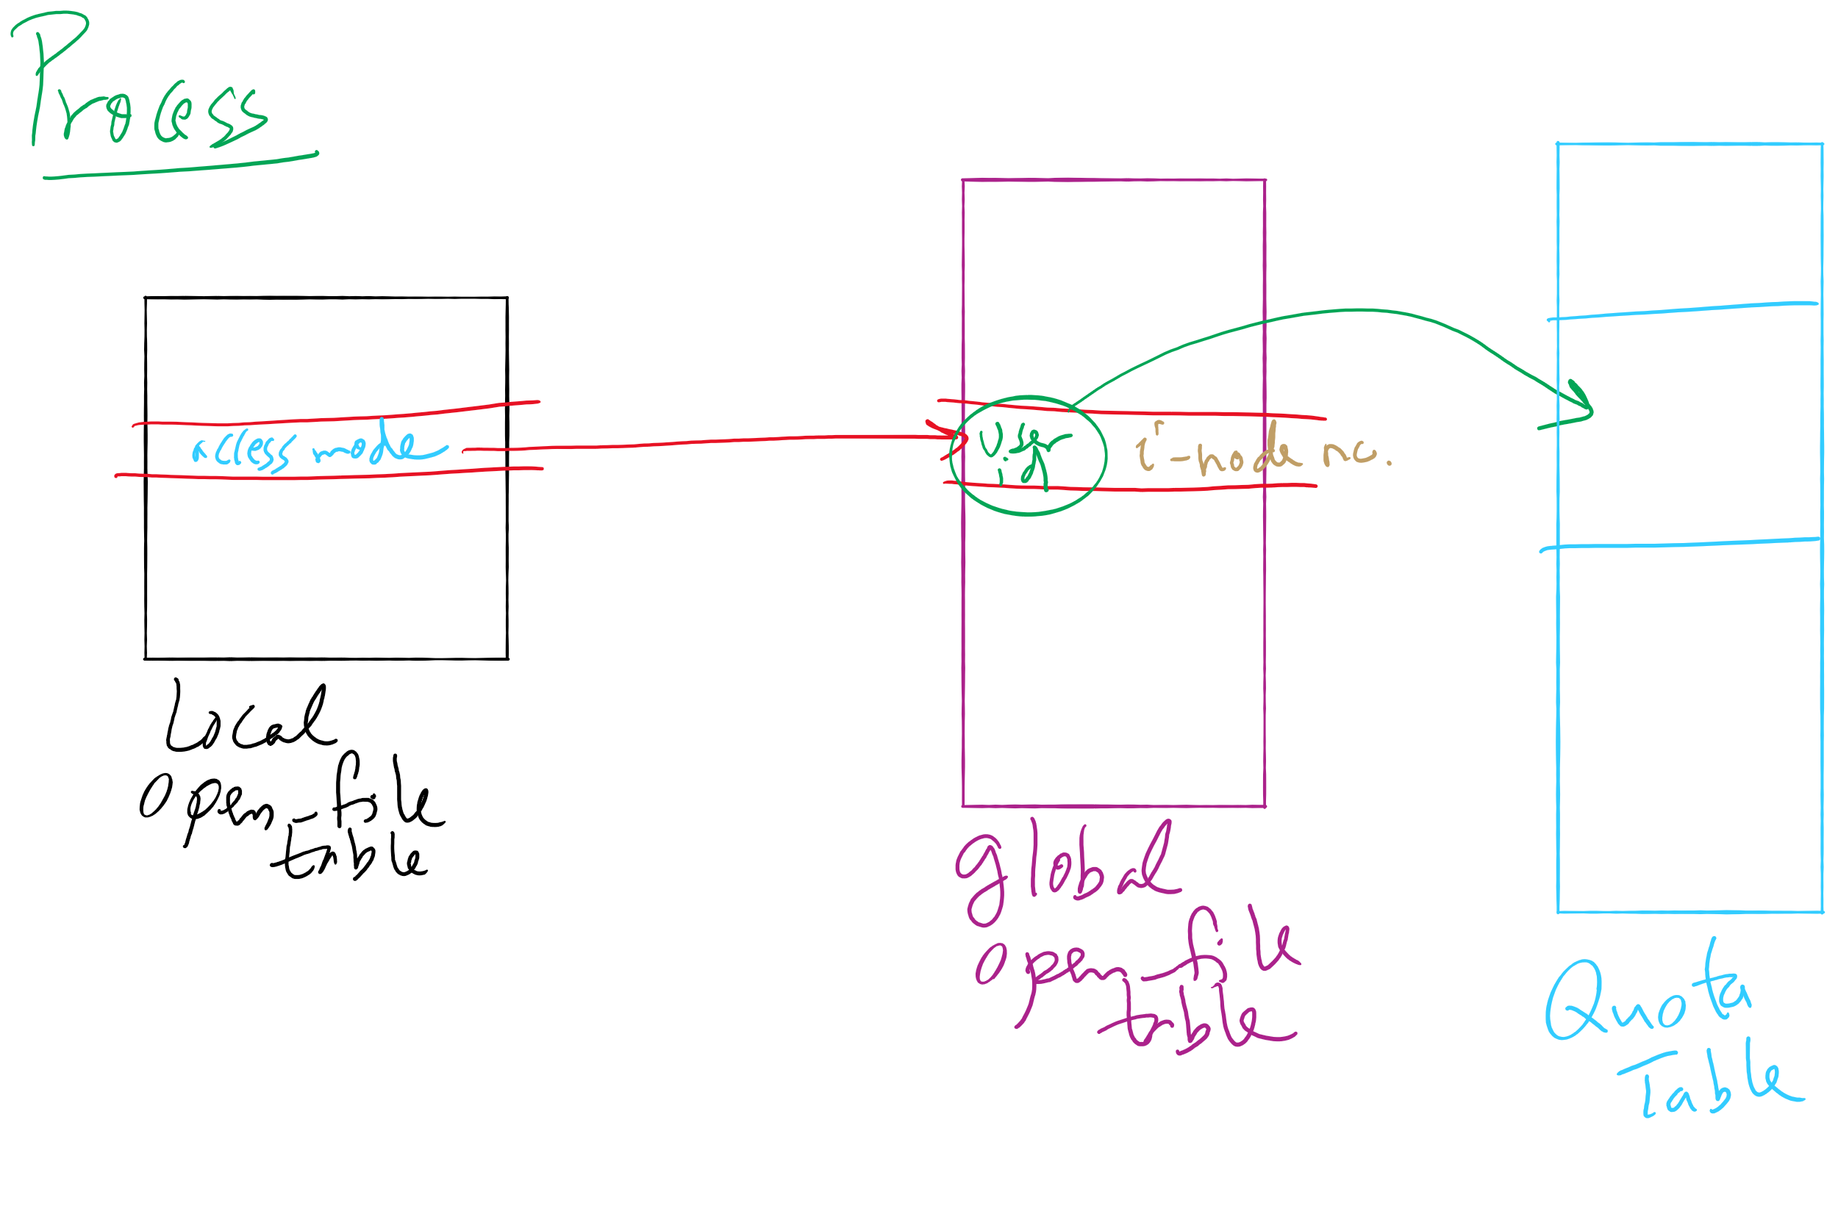
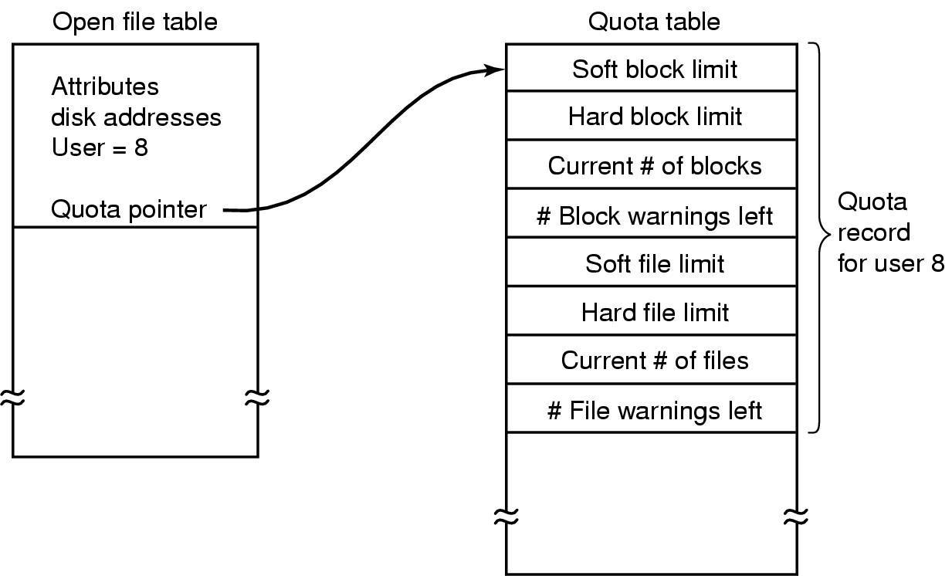
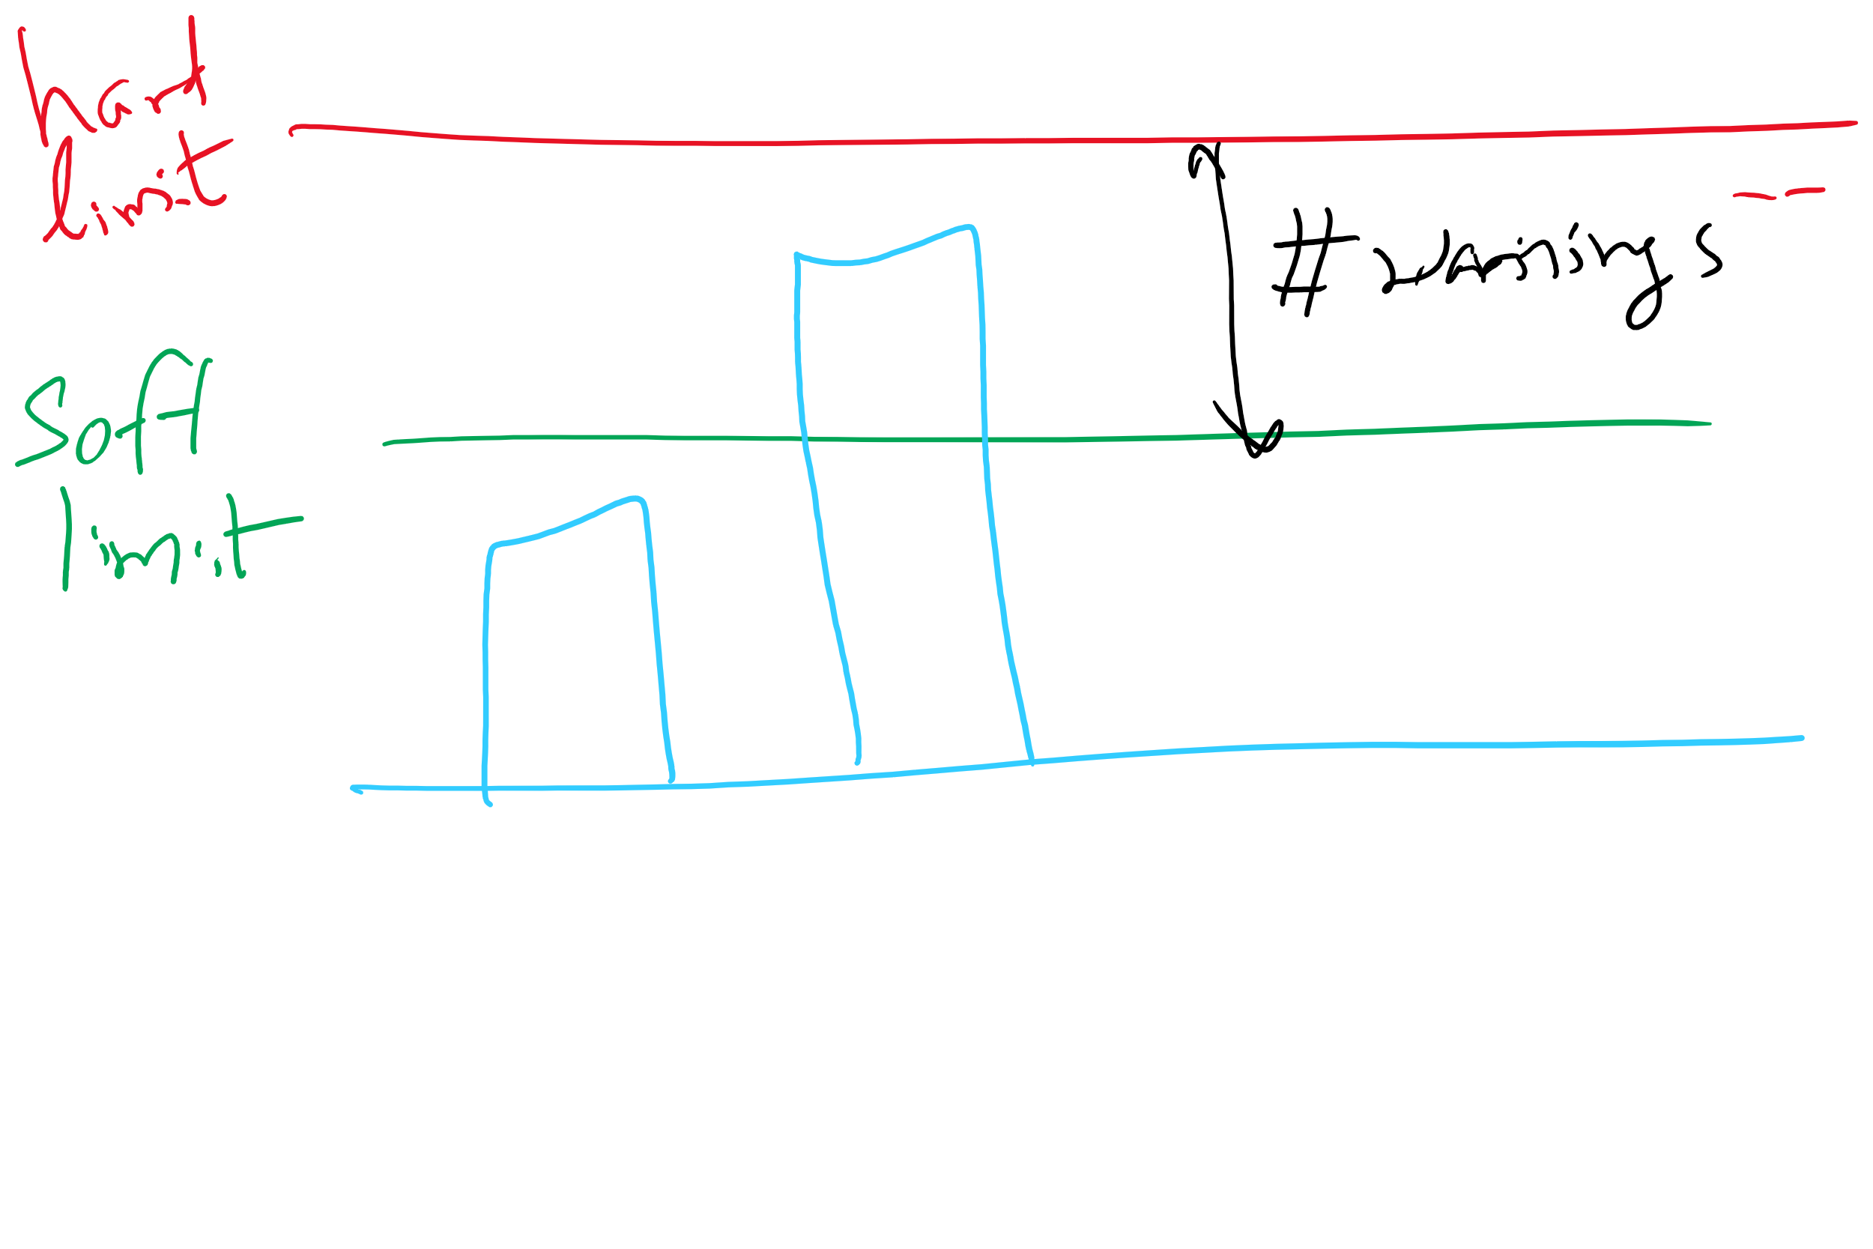
File-related kernel structures: open file tables and disk quotas

Slide 11
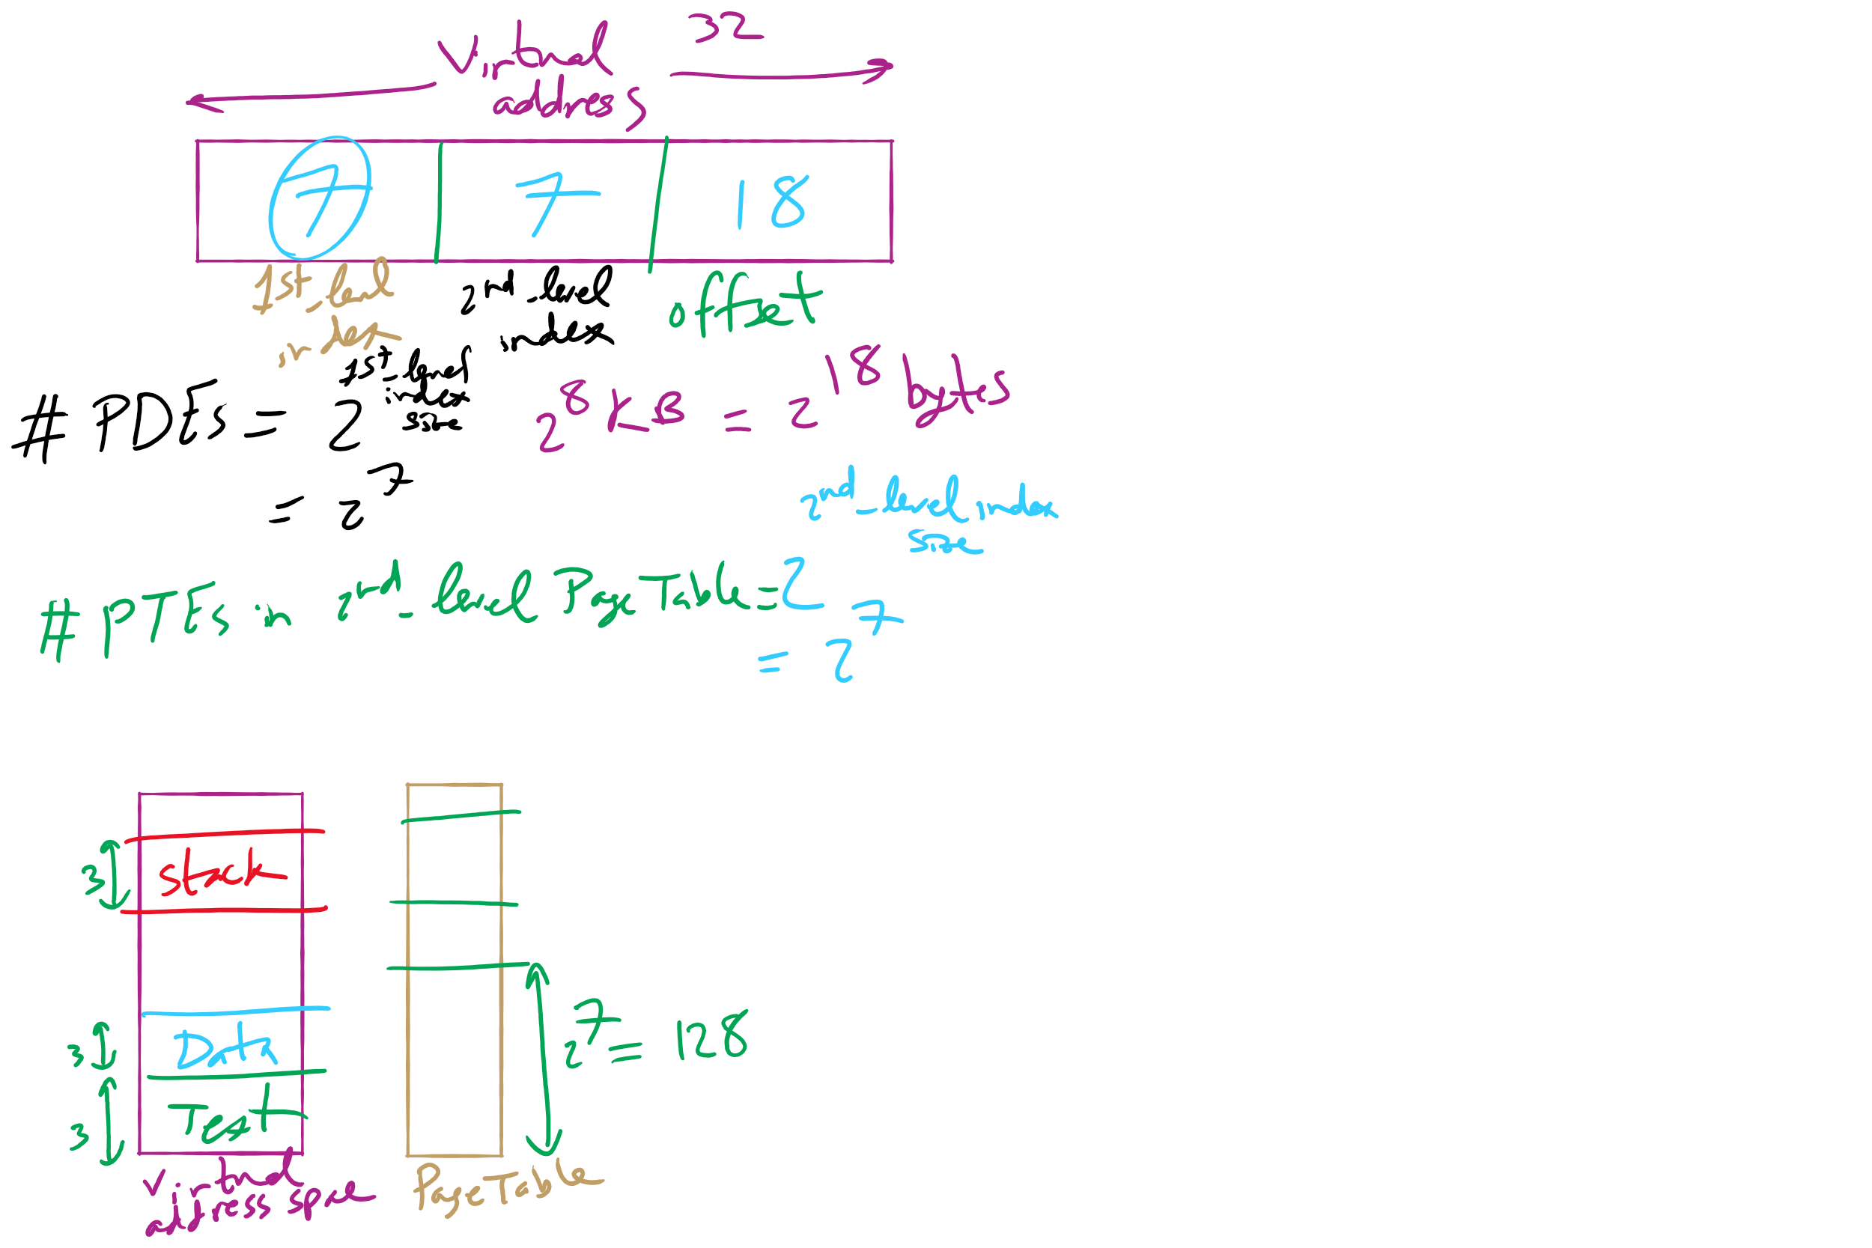
HW 10: Q 2-4

Slide 12
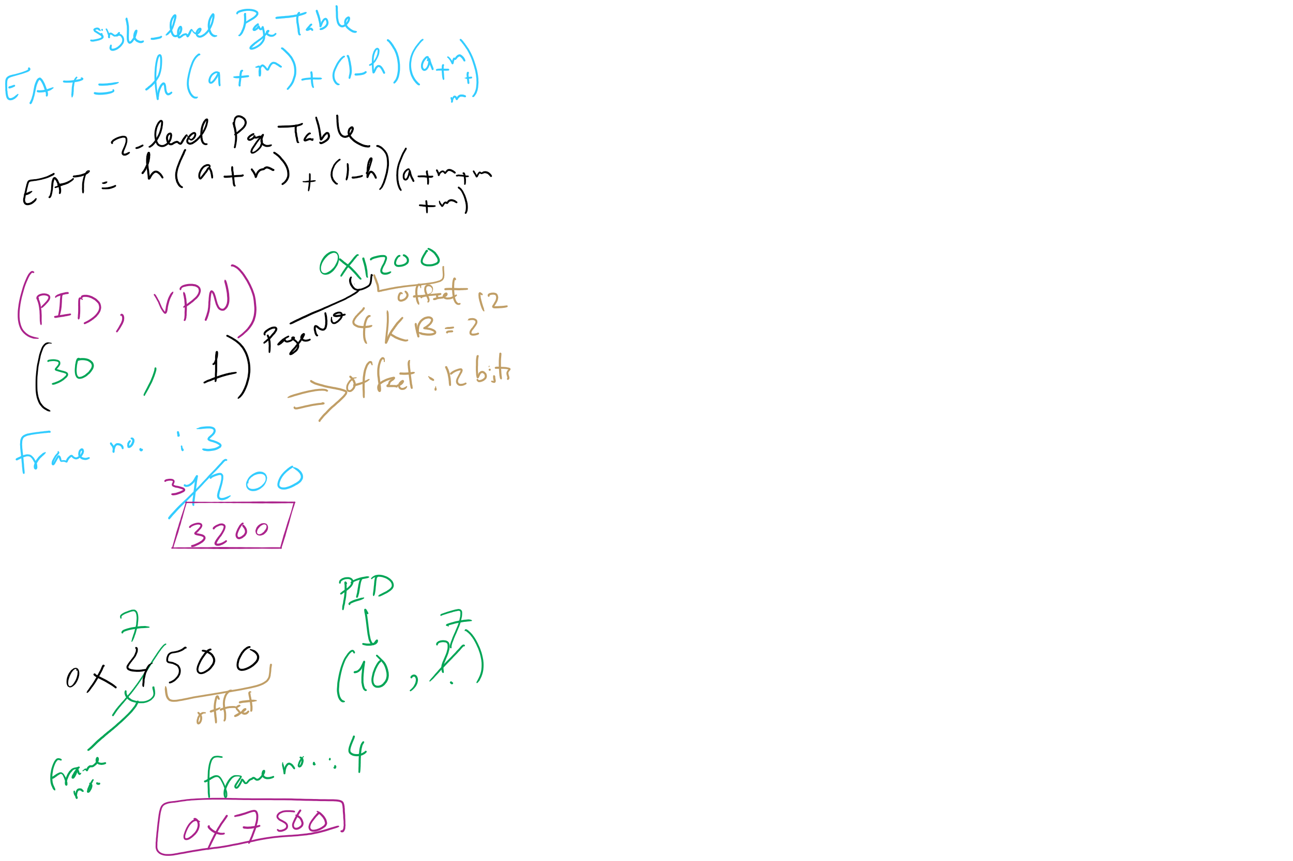
HW 10: Q 10-13

Slide 13
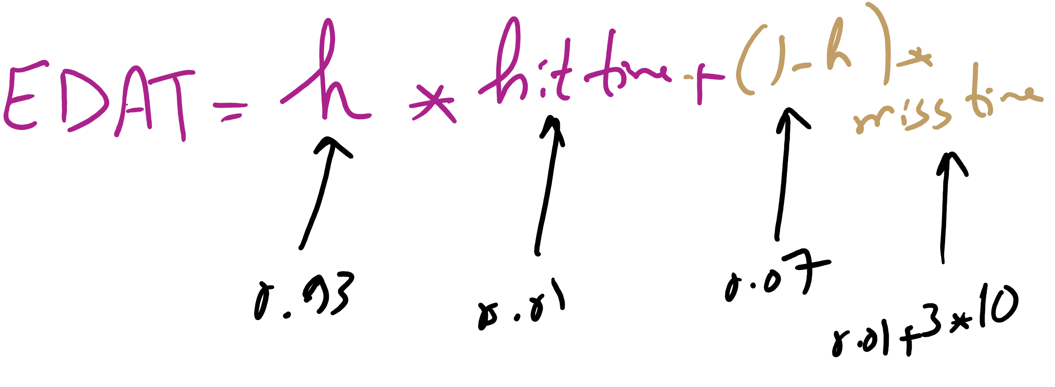
Effective Disk Access Time

Slide 14
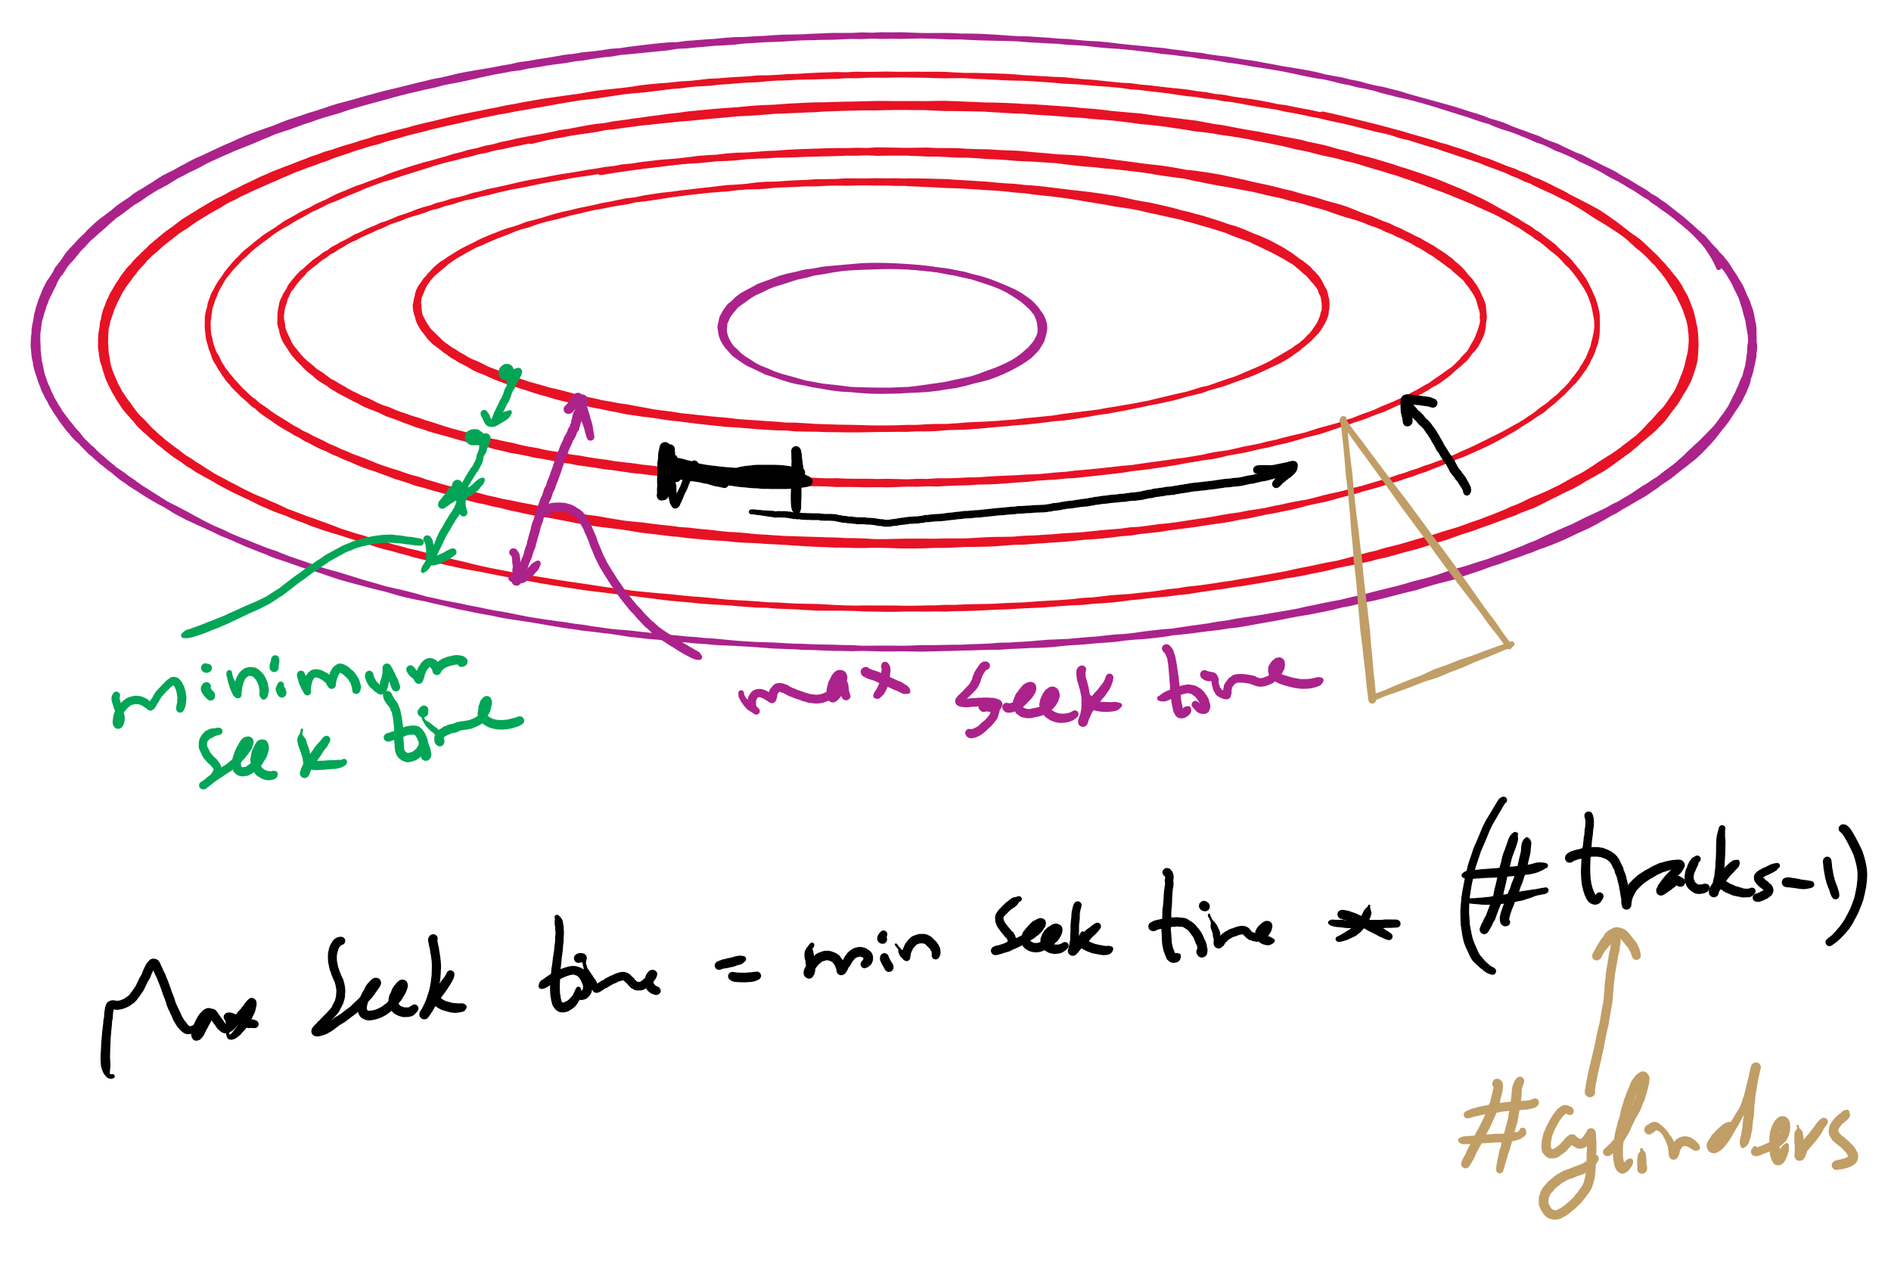
Minimum and Maximum Seek Time

Slide 15
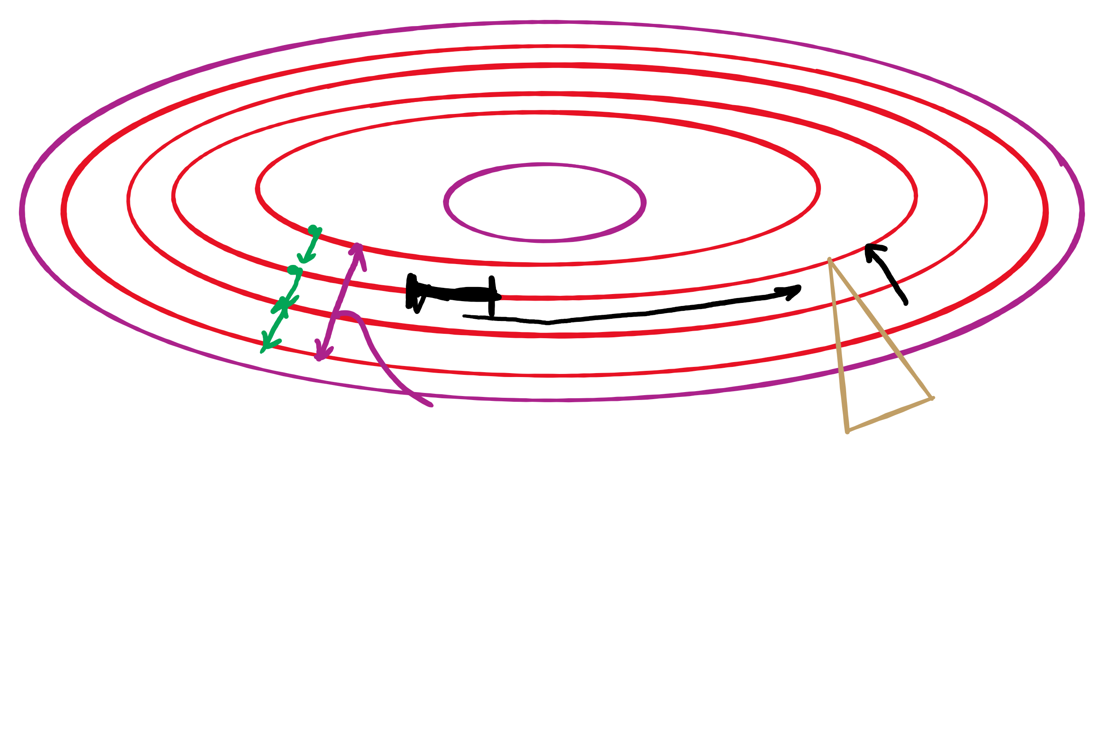
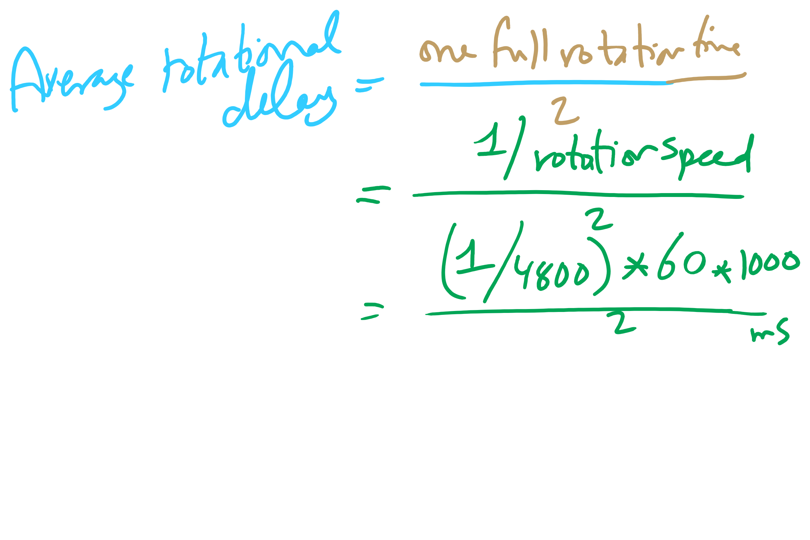
Average Rotational Delay

Slide 16
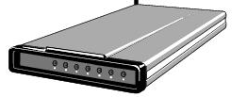
Buffering device input
User space
User space
User space
User space
Kernel space
Kernel space
Kernel space
Kernel space
2
2
1
1
3
Unbuffered input
Buffering in user space
Buffer in kernel Copy to user space
Double buffer in kernel

Slide 17
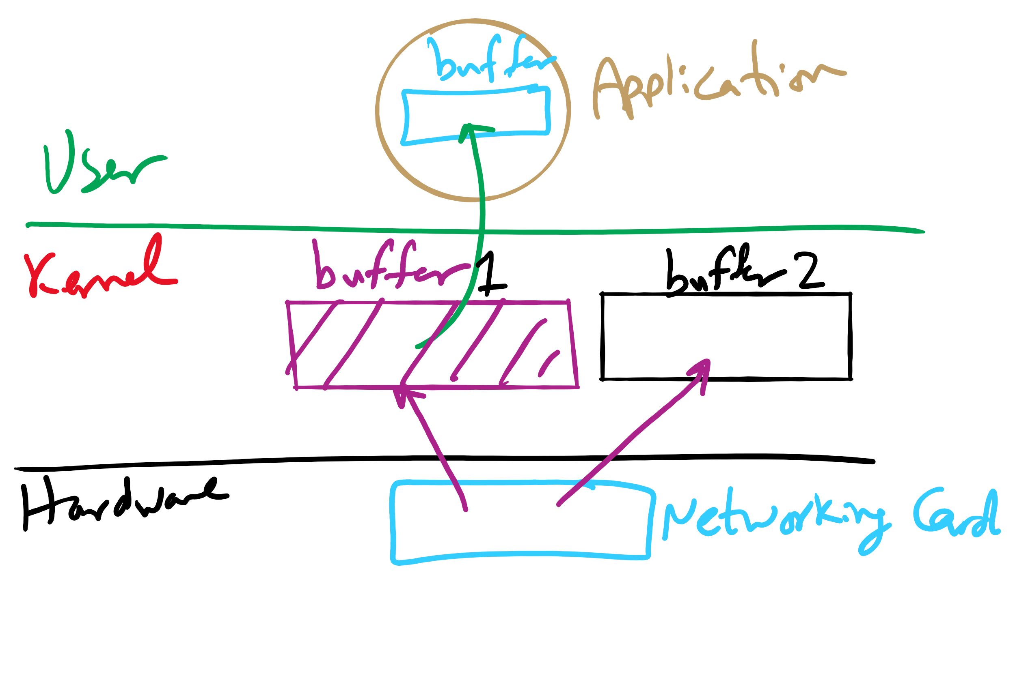
I/O Buffering

Slide 18
Problem of the Day: Protection
Protection is about controlling access of programs, processes, or users to the system resources (e.g., memory pages, files, devices, CPUs)
How to decide who can access what?
Specifications must be
Correct
Efficient
Easy to use (or nobody will use them!)

Slide 19
Protection domains
A process operates within a protection domain
resources accessible by the process
each domain lists objects with permitted operations
Domains can share objects & permissions
Objects can have different permissions in different domains
There need be no overlap between object permissions in different domains
How can this arrangement be specified more formally?
File1 [R] File2 [RW]
File3 [R]
File4 [RWX]
File5 [RW]
File3 [W]
Screen1 [W]
Mouse [R]
Printer [W]
Domain 1
Domain 2
Domain 3

Slide 20
Protection matrix
 | File1 | File2 | File3 | File4 | File5 | Printer1 | Camera
Domain1 | Read | Read Write
Domain2 |  |  | Read | Read Write Execute | Read Write | Write
Domain3 |  |  | Write |  |  | Write | Read
Each domain has a row in the matrix
Each object (resource) has a column in the matrix
Entry for <object, column> has the permissions
Who’s allowed to modify the protection matrix?
What changes can they make?
How is this implemented efficiently?

Slide 21
Domains as objects in the protection matrix
Domain | File1 | File2 | File3 | File4 | File5 | Printer1 | Camera | Dom1 | Dom2 | Dom3
1 | Read | Read Write |  |  |  |  |  | Modify
2 |  |  | Read | Read Write Execute | Read Write | Write |  | Modify
3 |  |  | Write |  |  | Write | Read |  | Enter
Specify permitted operations on domains in the matrix
Domains may (or may not) be able to modify themselves
Domains can modify other domains
Some domain transfers (switching) permitted, others not
Doing this allows flexibility in specifying domain permissions
Retains ability to restrict modification of domain policies

Slide 22
Representing the protection matrix
Need to find an efficient representation of the protection matrix (also called the access matrix)
Most entries in the matrix are empty!
Compress the matrix by:
Associating permissions with each object: access control list
Associating permissions with each domain: capabilities
How is this done, and what are the tradeoffs?

Slide 23
Access control lists (ACLs)
Each object has a list attached to it
List has
Protection domain (User name, Group of users, Other)
Access rights (Read, Write, Execute, Others)
No entry for domain => no rights for that domain
Operating system checks permissions when access is needed
File1
File2
elm: <R,W> znm: <R> root: <R,W,X>
elm: <R,X> uber: <R,W> root: <R,W> all: <R>

Slide 24
Access control lists in the real world
Unix file system
Access list for each file has exactly three domains on it
User (owner)
Group
Others
Rights include read, write, execute: interpreted differently for directories and files
AFS
Access lists only apply to directories: files inherit rights from the directory they’re in
Access list may have many entries on it with possible rights:
read, write, lock (for files in the directory)
lookup, insert, delete (for the directories themselves),
administer (ability to add or remove rights from the ACL)

Slide 25
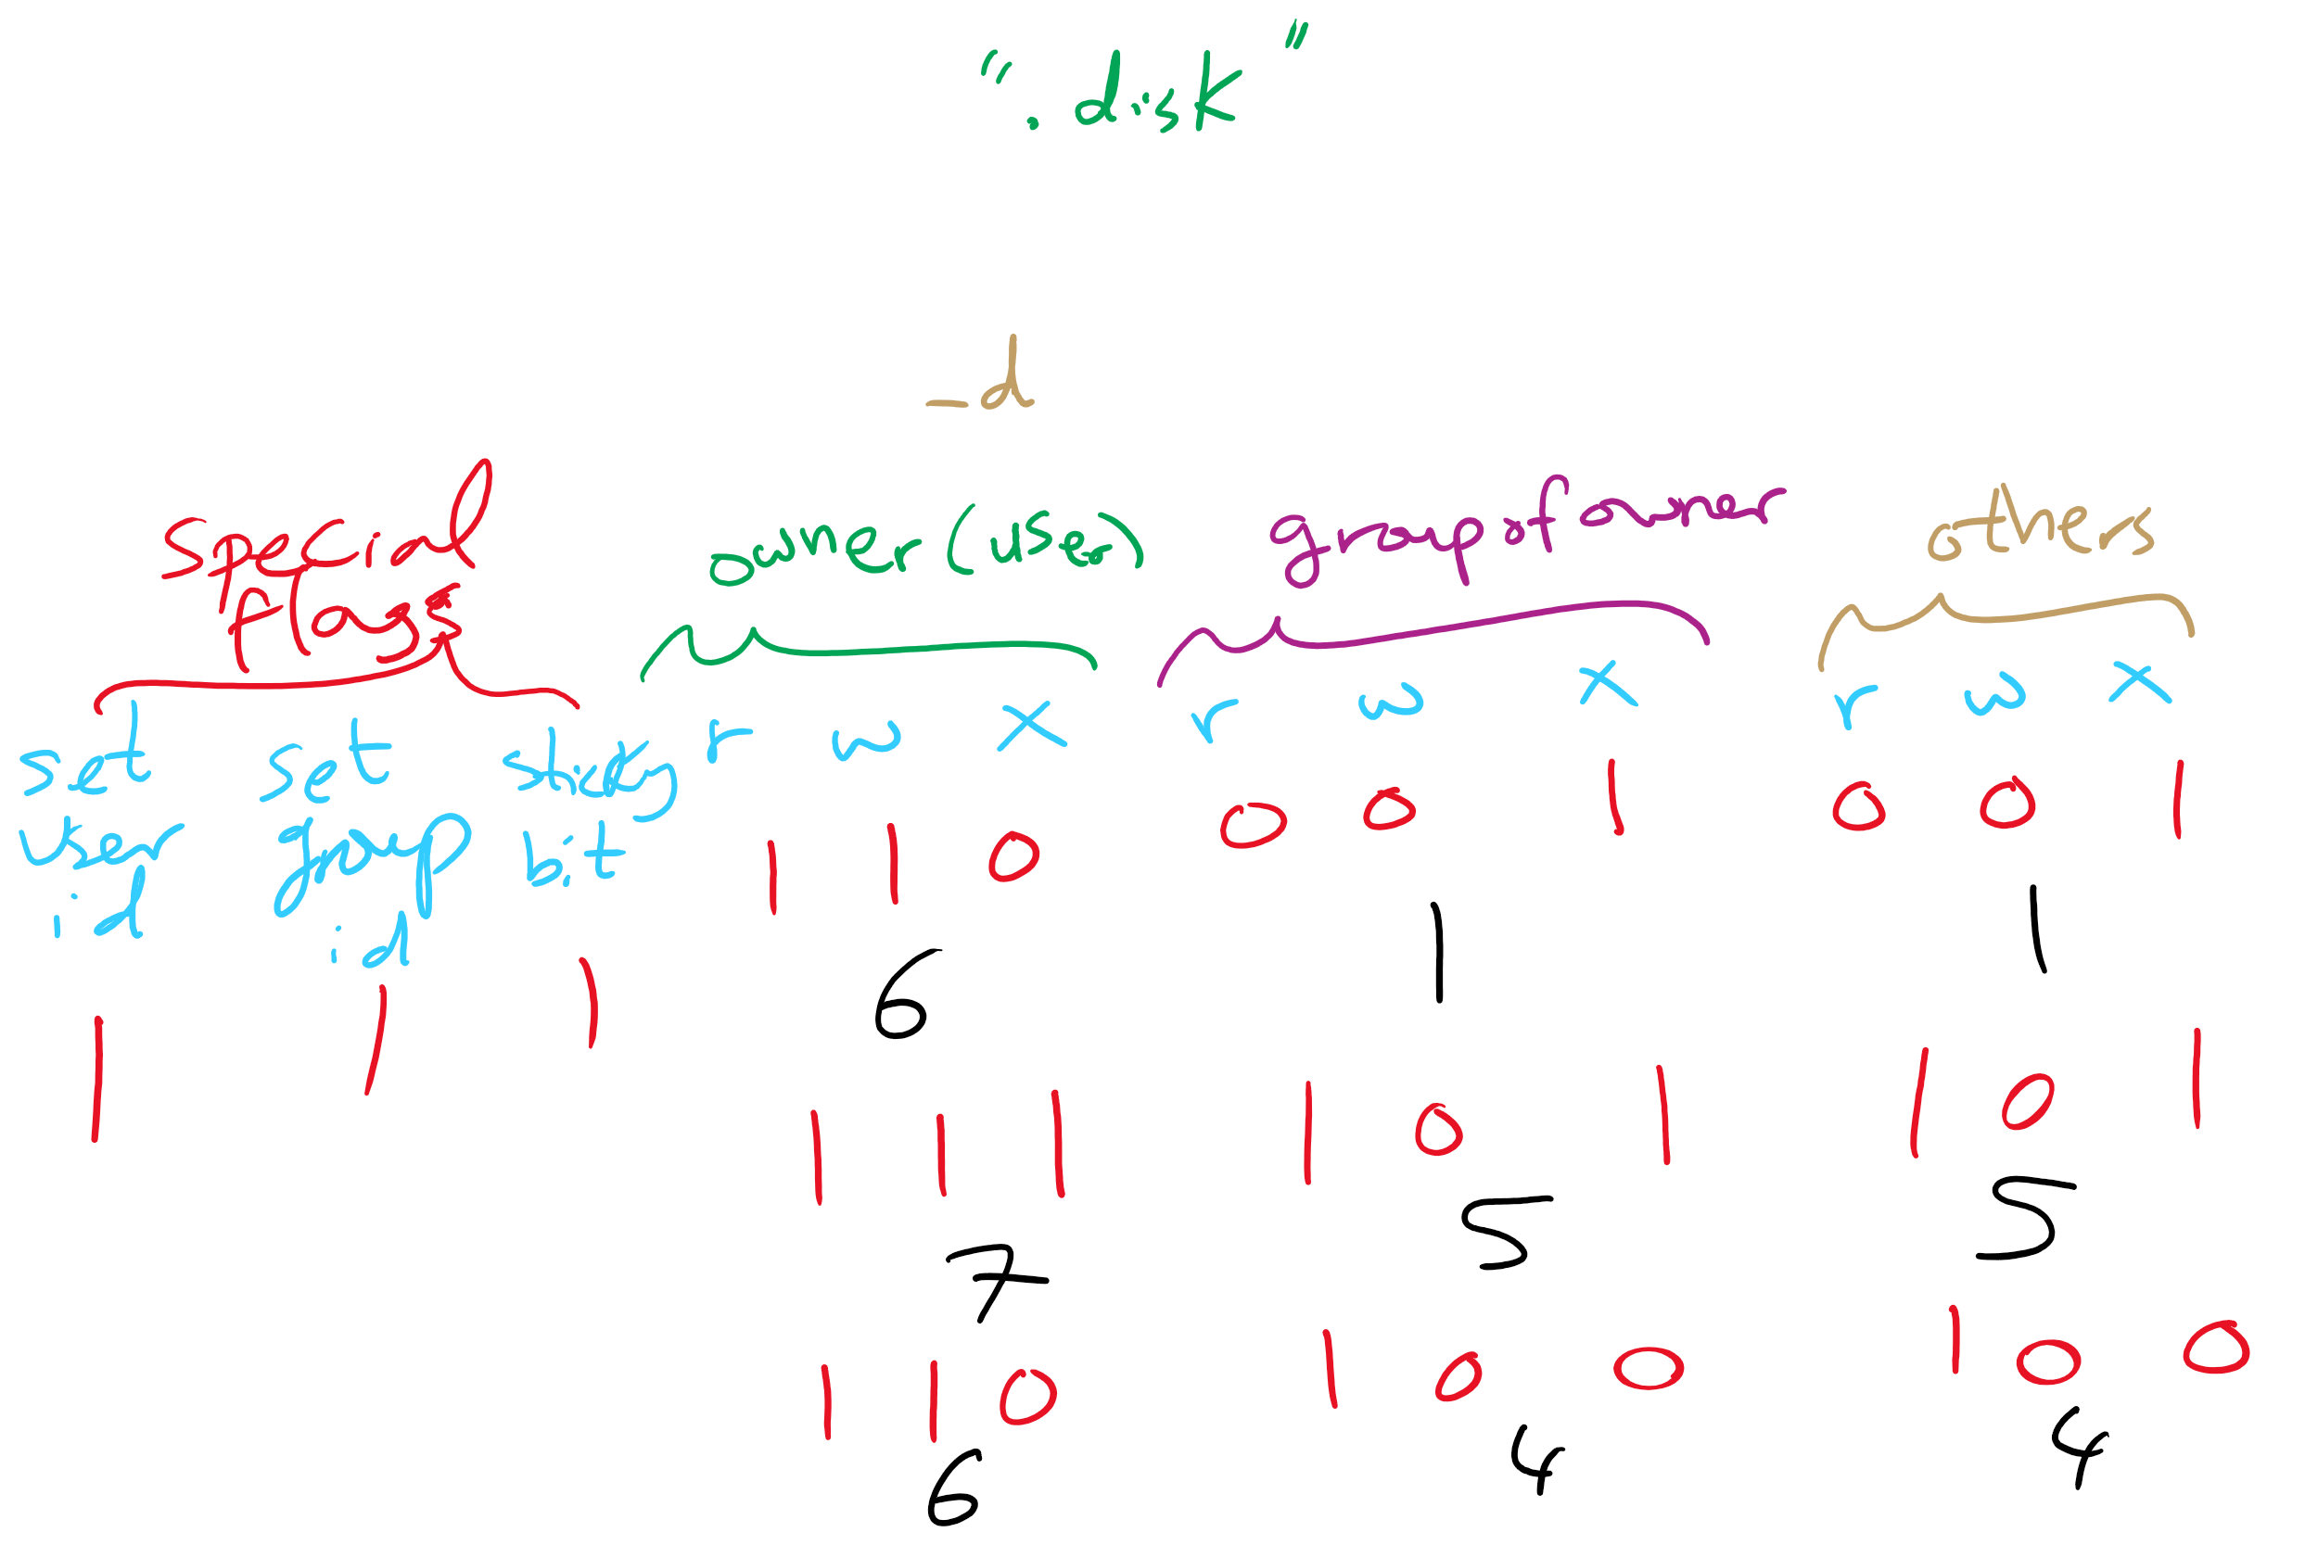
ACL in UNIX

