Slide 1


Introduction to Operating Systems CS 1550
Spring 2023
Sherif Khattab
ksm73@pitt.edu
(Some slides are from Silberschatz, Galvin and Gagne ©2013)

Slide 2
Announcements
Lectures and recitations are back in-person
Upcoming deadlines
Homework 2 is due next Monday at 11:59 pm
Lab 1 is due on 2/4 at 11:59 pm
Project 1 is due on 2/18 at 11:59 pm
Explained in this week’s recitations

Slide 3
Previous Lecture …
Three-usage problems of Semaphores
compromising mutual exclusion
Solution: Mutex
deadlock
Solution: Not yet discussed
priority inversion
Solution: priority inheritance

Slide 4
Muddiest Points (basic concepts)
Deadlock
mutual exclusion

Slide 5
Muddiest Points (semaphore)
What the semaphore value means.
Can we see a process that utilizes a semaphore/spinlock and trace it?
Where we move after down is called

Slide 6
Muddiest Points (Mutex)
With mutex, what happens when a process tries to up() when it hasn't down()'d, does it skip over the instruction or does it do something else?
how does a mutex semaphore verify that the same process that called down on it in the first place is the one that called up on it?
Can a mutex have a negative value or is it only 0 or 1?
Advantages/disadvantages of Mutex

Slide 7
Muddiest Points (priority inheritance)
What is priority inheritance?
I'm confused on what the solution for priority inversion is or did we not mention it yet?
Does Priority Inheritance solve the Deadlock and Starvation problems along with the Priority Inversion problem?
Why running P1 in the priority inversion question not down the semaphore?
Does priority inversion (of semaphores) cause the lower process to run instead of the higher priority process indefinitely or does this resolve itself? If so how?

Slide 8
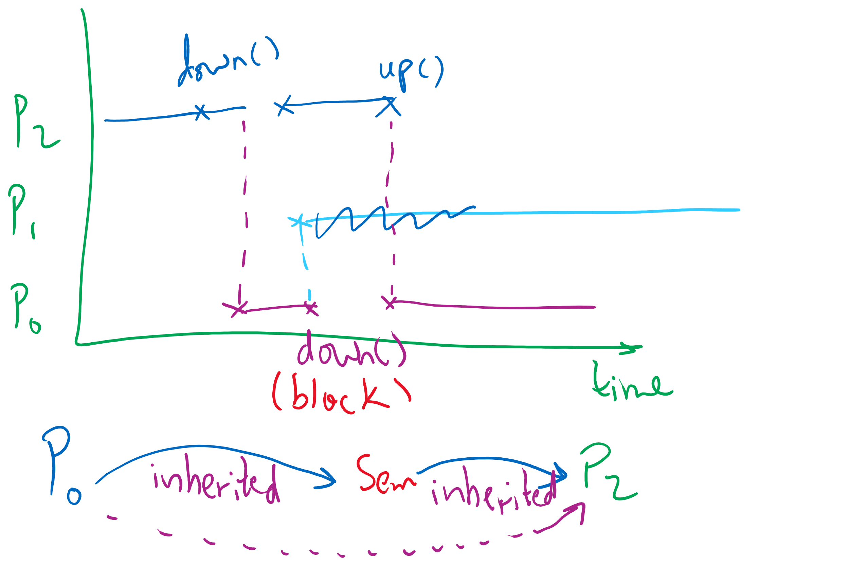
Semaphore Usage Problem: Priority Inversion

Slide 9
Muddiest Points (forking 1)
if fork creates copies of the process that called it, how can you tell which copy has priority to run first?
child processes & where they pick up in the code
Not exactly sure how semaphores are inherited between processes
In the last example, when p1 calls fork and creates the child p3, will p1’s PCB be copied to p3, which means the content of p0’s pcb will be in p3 too?
What is a PID and how is it related to the return value of fork()?
P3 is forked and created before P2 so why is it named P2? Is it simply renamed after P1 gets forked again?
Is the order of possible outcomes from a forking program the permutation of any of the leaf nodes from a forking tree?

Slide 10
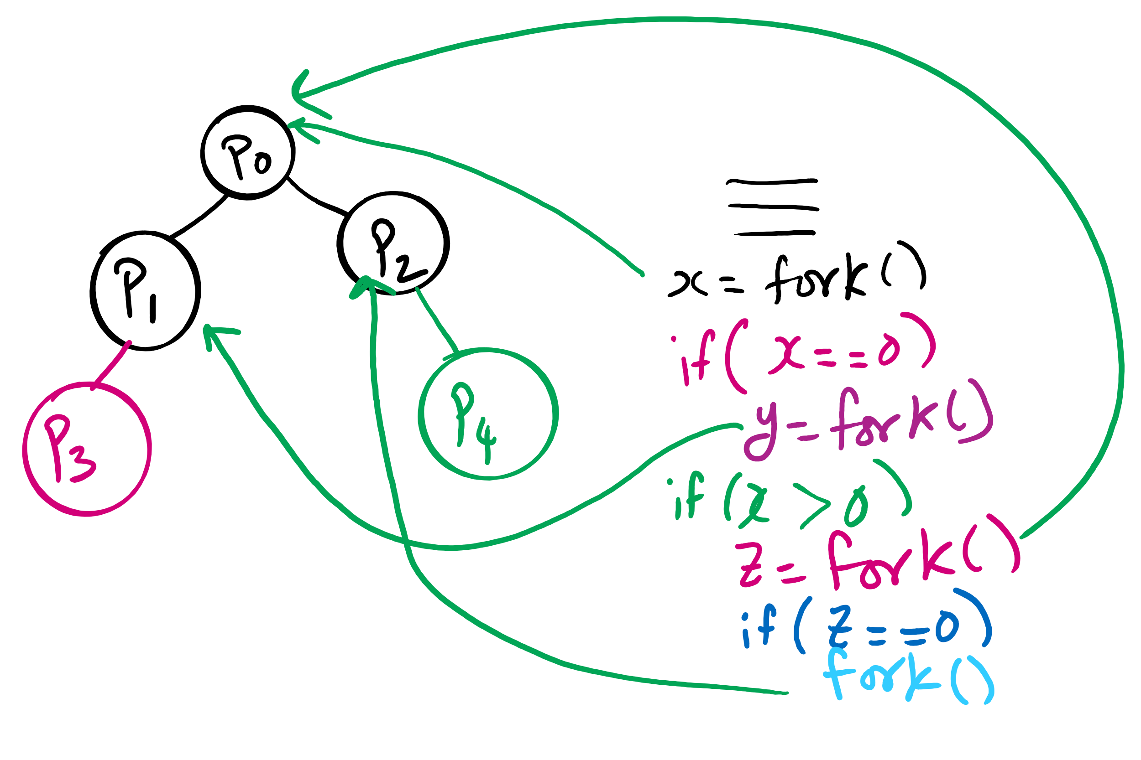
fork()’s of fork()’s

Slide 11
Muddiest Points (forking 2)
does the fork return zero for all children?
Somewhat confused about what order the various forks will actually form. I see why and from where they form, but not how it decides which one to run
how are all processes a fork of another process? i know the root of the tree is another process in the OS, but i don't get how for example a program you create and execute is a fork of something else.
the forking process with child processes. The relationship between the number of child processes created and the number of times fork() is called by the parent process
what int fork returns for the child and parent process
practical uses of forking?

Slide 12
Today’s Problem/Question
How are processes created and terminated?

Slide 13
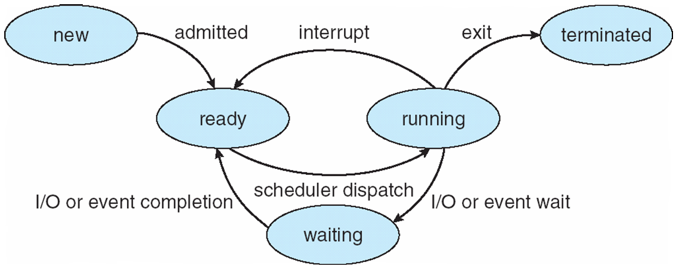
Process Lifecycle (AKA Process States)

Slide 14
Process Creation
Via fork() syscall
Parent process: the process that calls fork()
Child process: the process that gets created
Memory of parent process copied to child process
Too much copying
Even not necessary sometimes
e.g., fork() followed by exec() to run a different program
Optimization trick:
copy-on-write

Slide 15
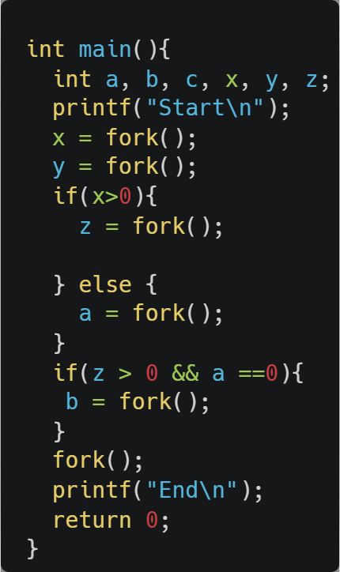
fork() example

Slide 16
Process Termination
Via exit(), abort(), or kill() syscalls
The parent process may wait for termination of a child process by using the wait()system call.The call returns status information and the pid of the terminated process
pid = wait(&status);
When a process terminates
If no parent waiting (did not invoke wait()) process is a zombie
If parent terminated without invoking wait , process is an orphan
adopted by the init process

Slide 17
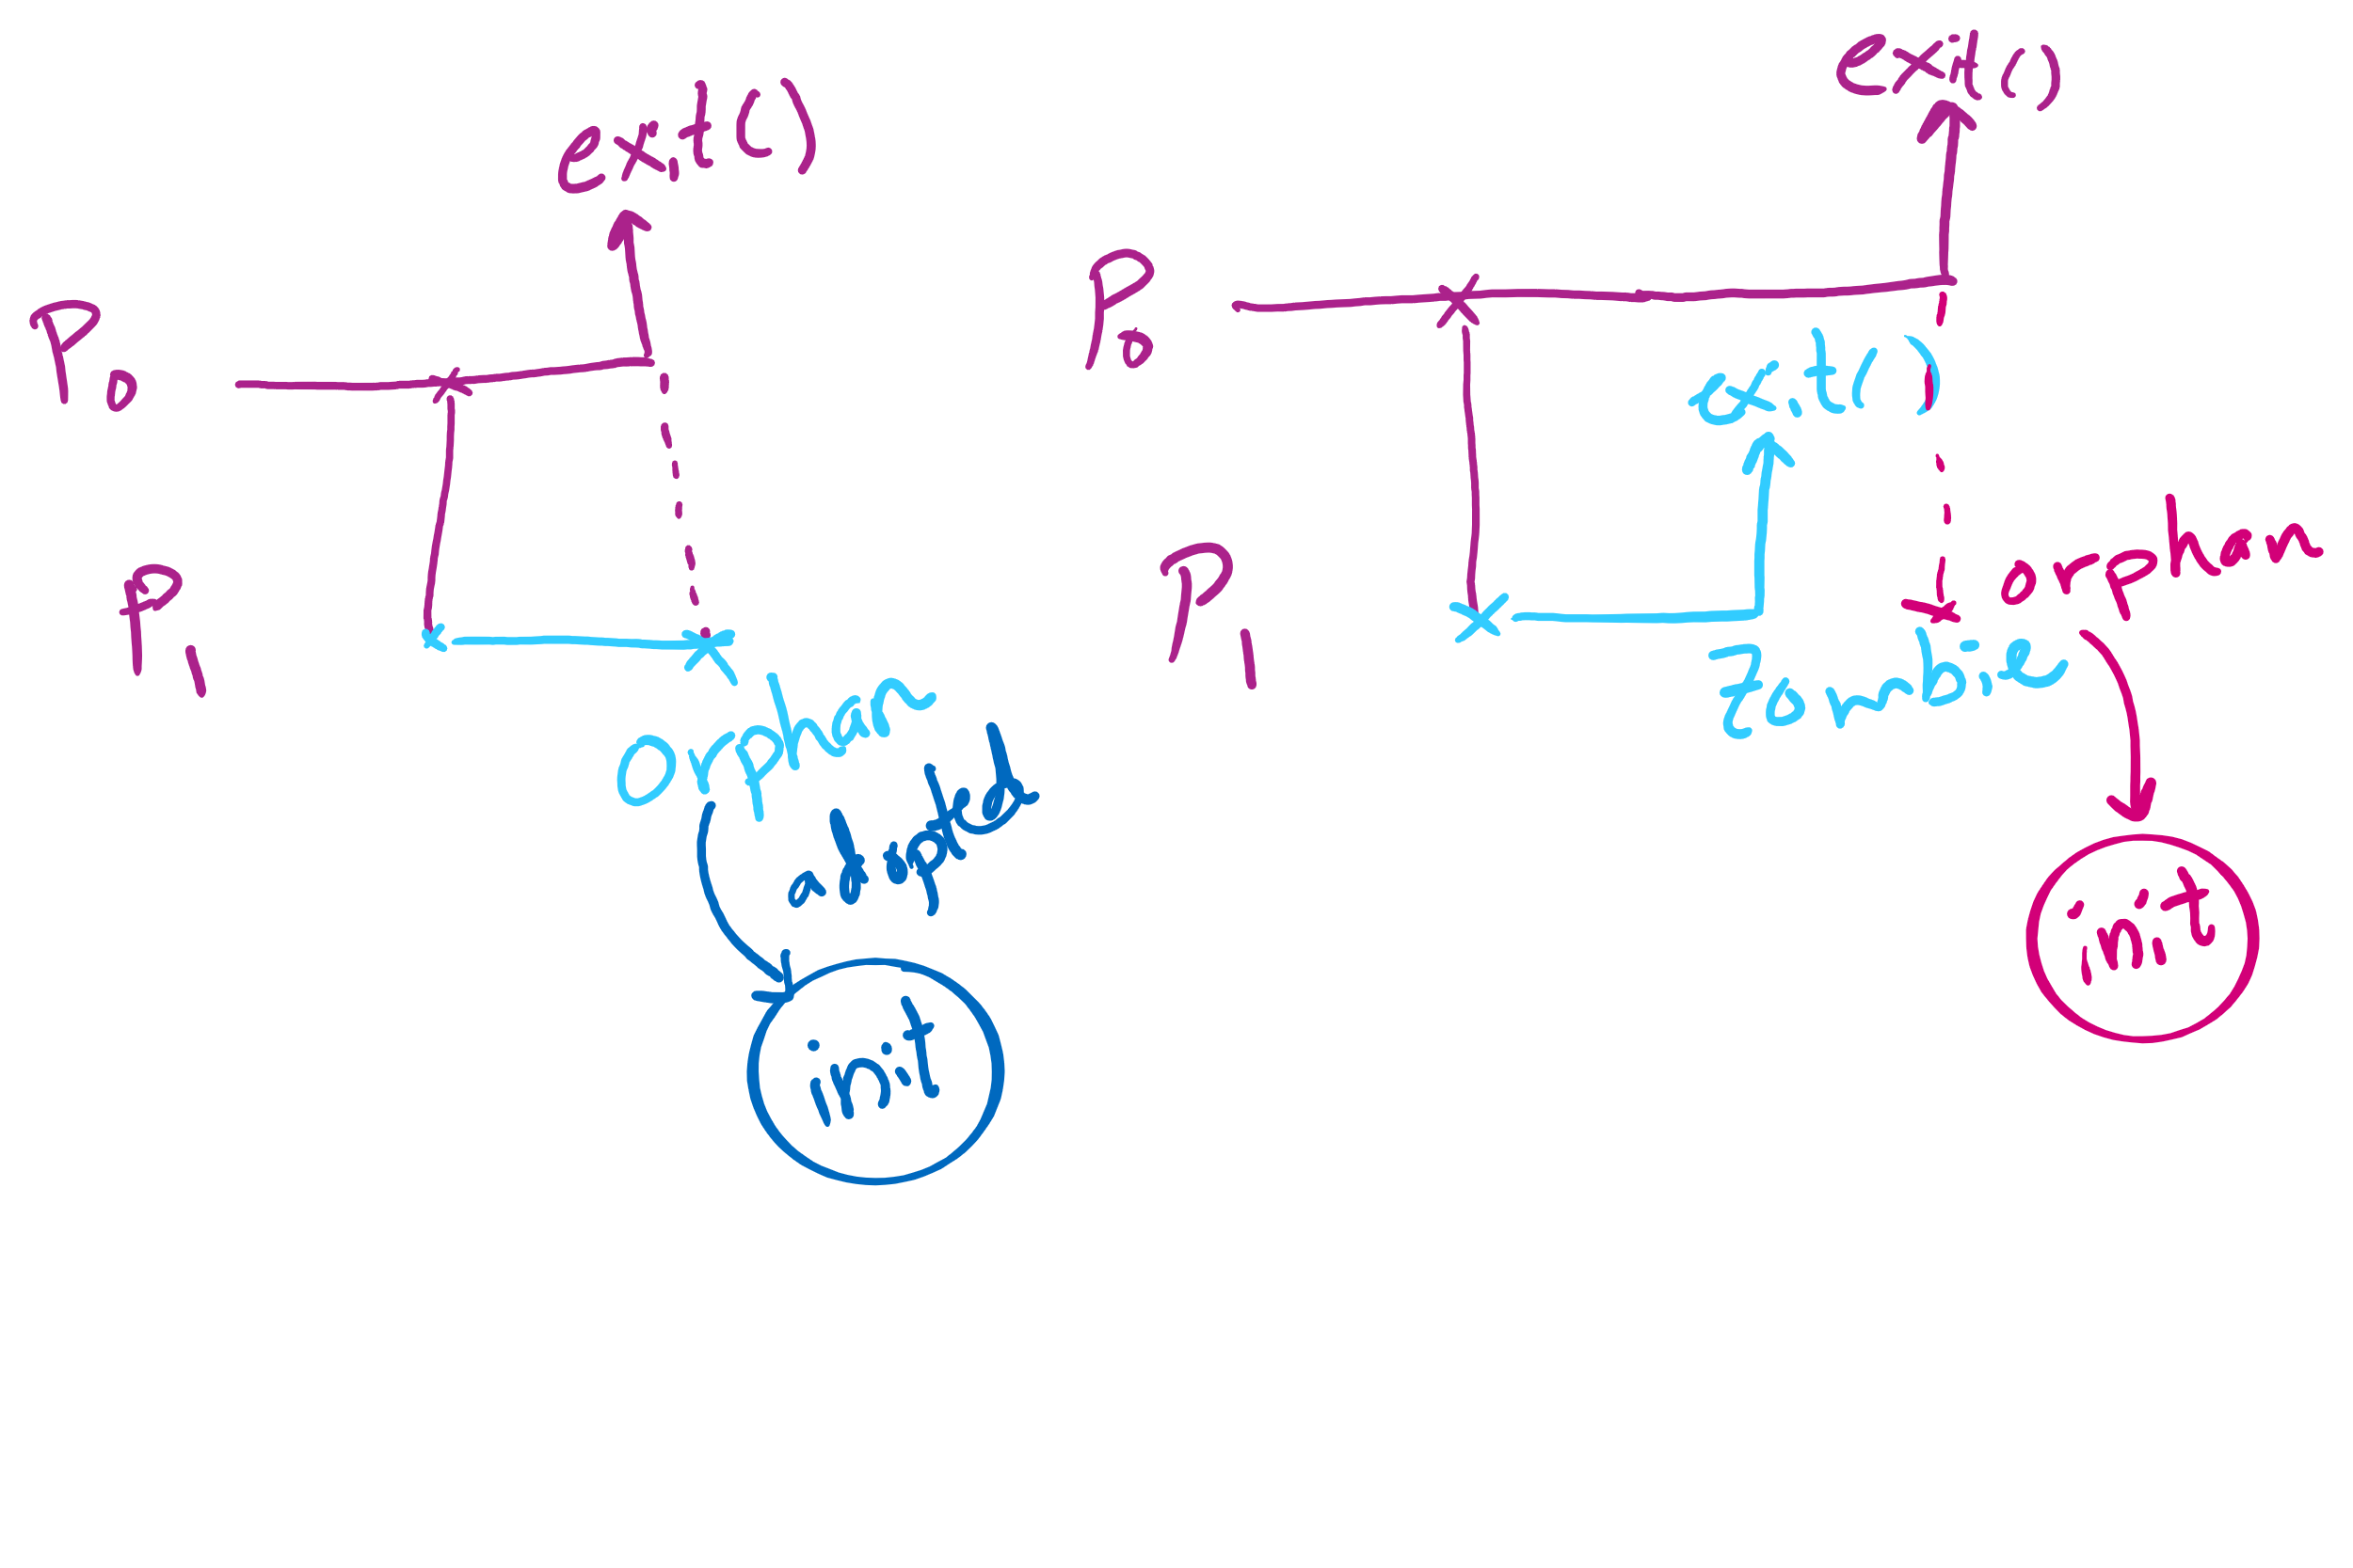
Orphan vs. Zombie Processes

Slide 18
Benefits of Orphan Processes
Allow a long-running job to continue running even after session (e.g., ssh connection) ends.
The nohup command does that
Create daemon processes
Long-running background processes adopted by the init process.

Slide 19
Thread Synchronization
Synchronization issues apply to threads as well
Threads can share data easily (same address space)
Other two issues apply to threads

Slide 20
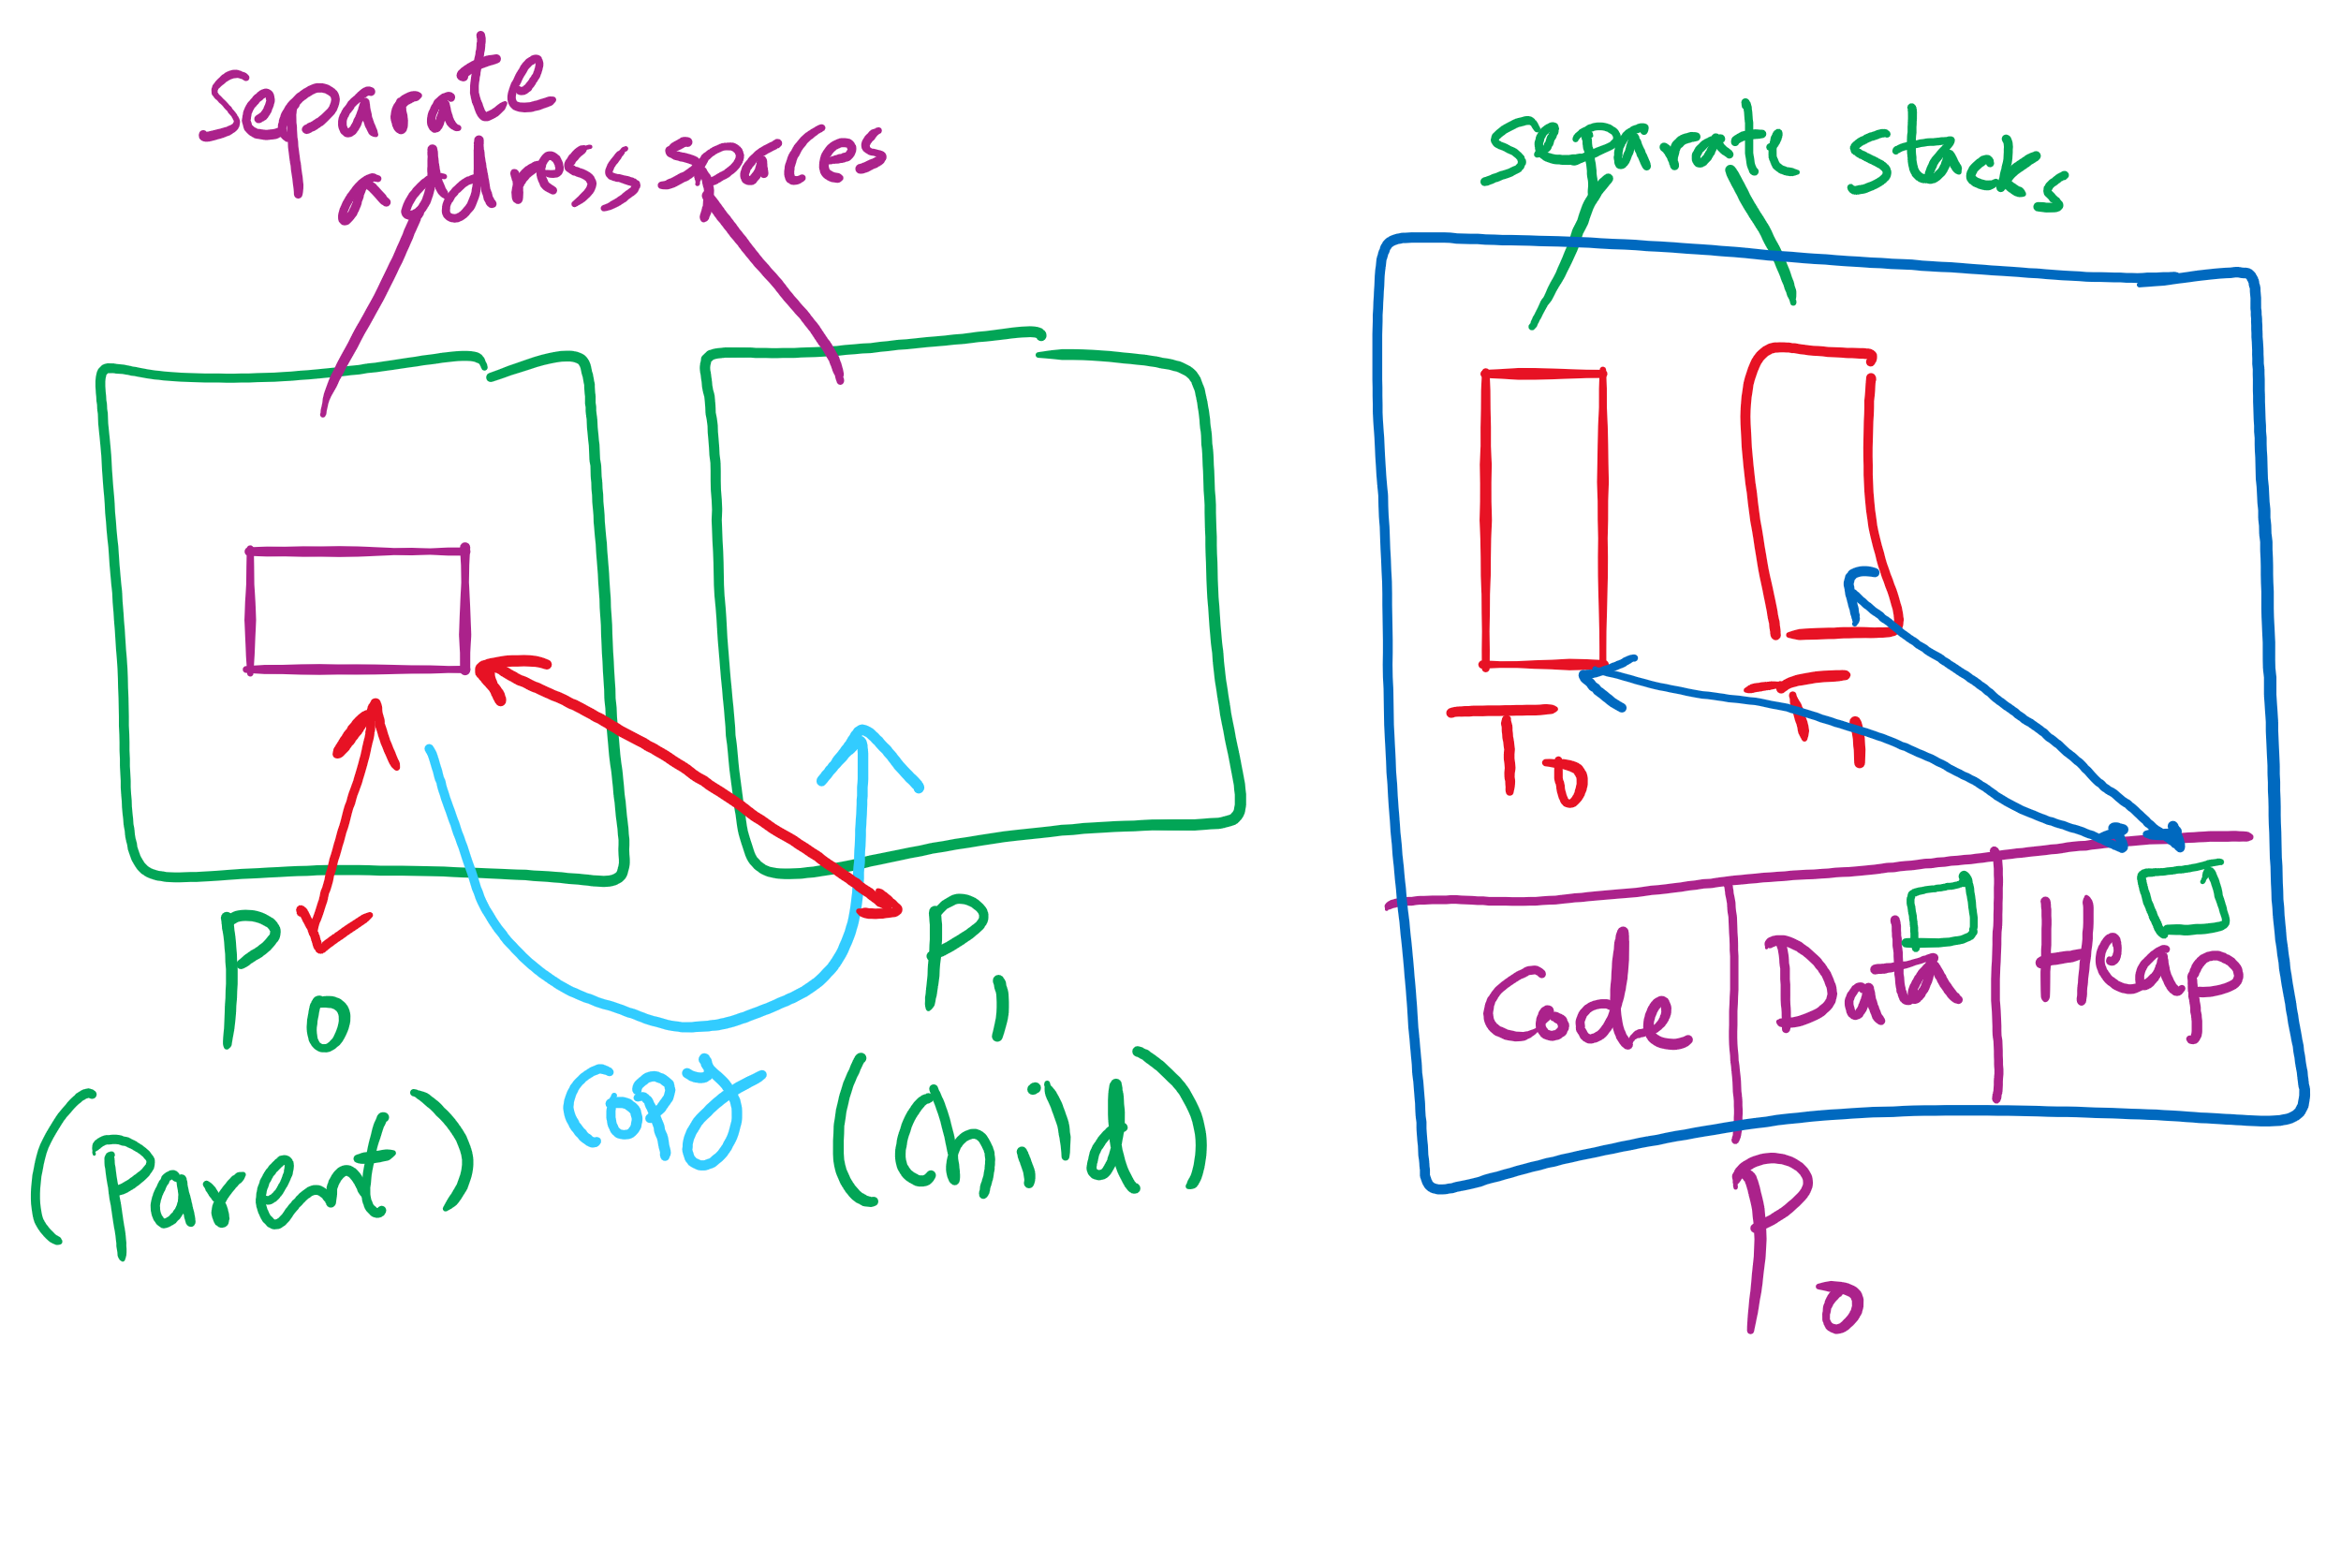
Process vs. Thread

