Slide 1


Introduction to Operating Systems CS 1550
Spring 2023
Sherif Khattab
ksm73@pitt.edu
(Some slides are from Silberschatz, Galvin and Gagne ©2013)

Slide 2
Announcements
Upcoming deadlines
Homework 3 is due next Monday 2/7
Lab 1 is due on 2/4
Project 1 due on 2/18

Slide 3
Previous lecture …
How processes (threads) are created and terminated
Tracing programs with fork() calls

Slide 4
Muddiest Points (fork)
can you clarify copy-and-write? does the memory automatically get “passed” down or not?
I was confused how fork can be assigned to variable and whether its the child or parent that gets assigned
Fork tracing example
fork tracing!!$
How can a child process run a different program than their parent?
what is exec()
What data should you track when fork tracing

Slide 5
Muddiest Points (wait())
Why can a child process become a zombie for a parent process, but not the other way around?
Does most of the parent processes invoke wait( )? Is this the system software engineers' job to ensure every process will invoke wait( ) defaultly to avoid creating zombie processes, or is OS's job and it can arbitrarily invoke wait( ) or not?
does a process actually wait when wait() is called? like stops running
Zombie vs Orphan processes
What are the differences of a zombie and orphan process? The parent doesnt invoke wait in either instance?
Implementation of how init adopts orphaned processes.
Can a process be orphan and zombie at the same time?
Orphan versus zombie processes. The difference between when the parent process calls exit()
In what situation would a child not be a copy of its parent?

Slide 6
Muddiest Points (Threads)
Similarities and differences between forks and threads
The difference between processes and threads in how they're handled by the operating system. Are threads and processes treated the same by the OS beyond the threads sharing memory? Do threads go through the same states and transitions as processes?

Slide 7
Muddiest Points (Process Termination)
what does killing a process do, or what is the action the kill program takes to kill another?
exit vs kill vs abort
The differences between the exit(), Abort() and Kill(). Specifically, the difference between kill() and abort().

Slide 8
Problem of the Day
Bounded Buffer Problem
aka Producers Consumers Problem
A shared circular-array buffer with capacity n
A set of producer processes/threads
As set of consumer processes/threads
Requirements:
Never exceed the buffer capacity
Producers wait if the buffer is full
Consumers wait if the buffer is empty

Slide 9
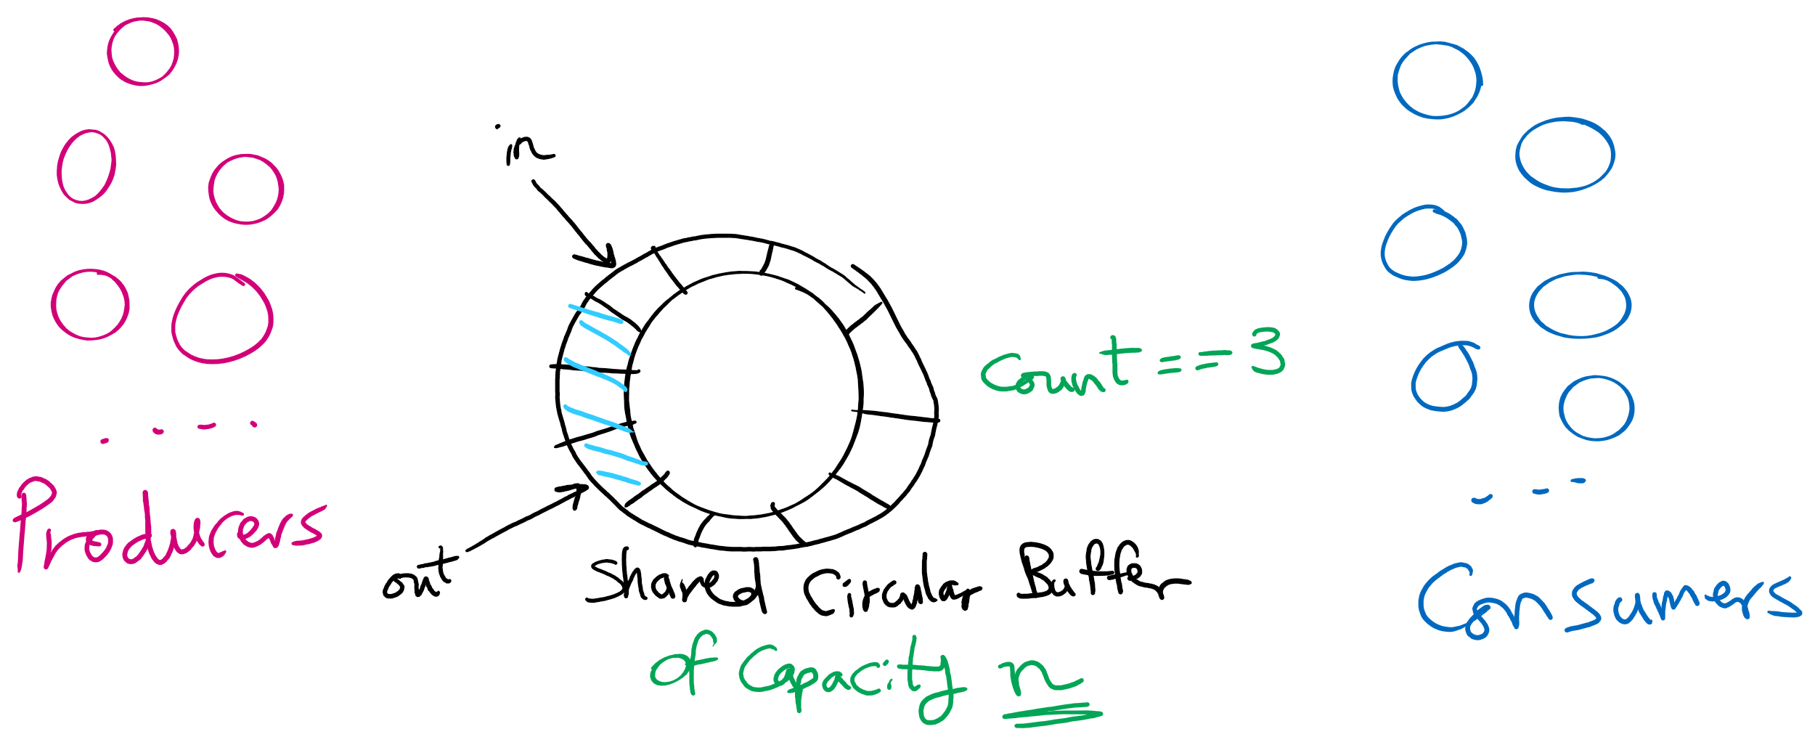
Produces Consumers Problem

Slide 10
Producers Consumers Problem is everywhere!
Access to User Interface elements in mobile applications
Main UI thread
Background threads
e.g., download files, check email on mail server
Background threads send requests to UI thread to update UI elements
Requests are stored in a shared bounded buffer
Which threads are the producers?
Who threads are the consumers?

Slide 11
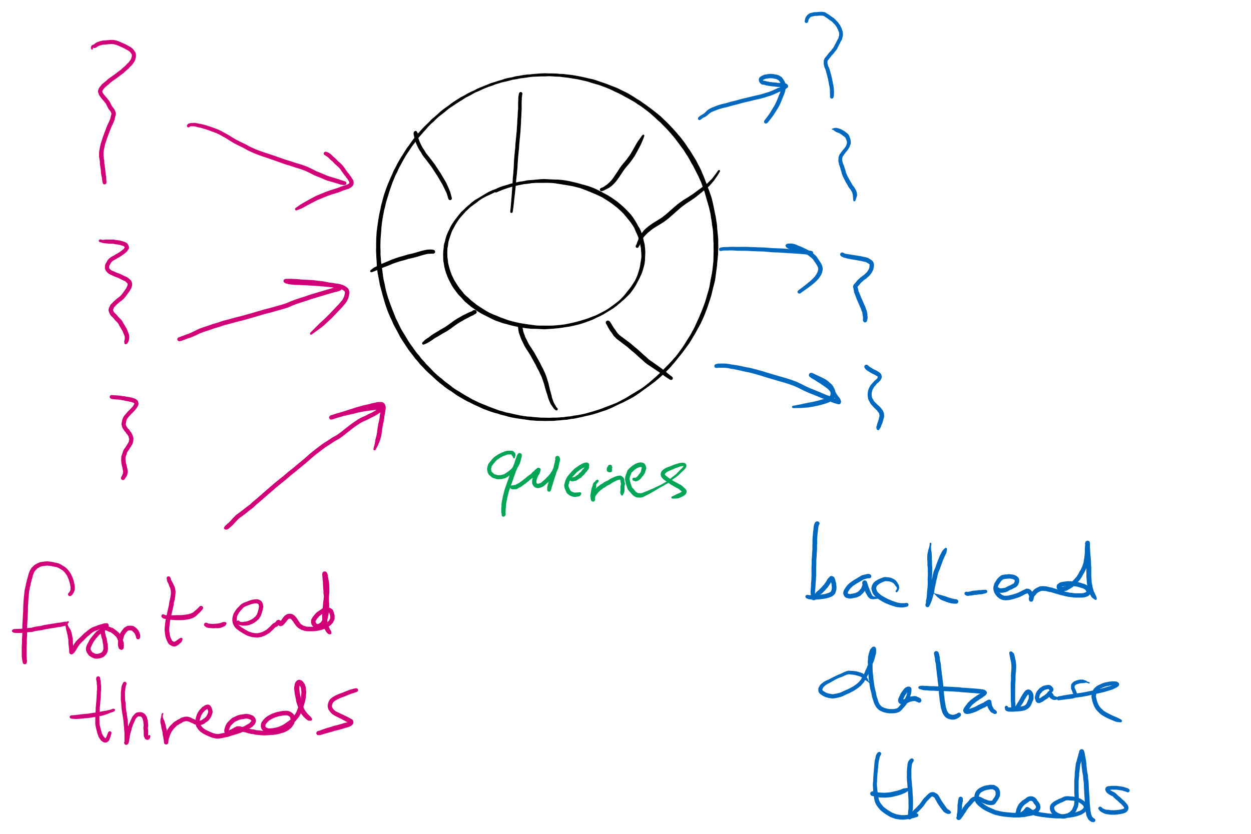
Producers Consumers Problem is everywhere!
Web Server
front-end processes/threads that interact with the HTTP connection from the client (e.g., browser)
Back-end processes/threads that execute database queries
Queries are inserted by front-end processes into a shared buffer
Which threads are the producers?
Who threads are the consumers?

Slide 12
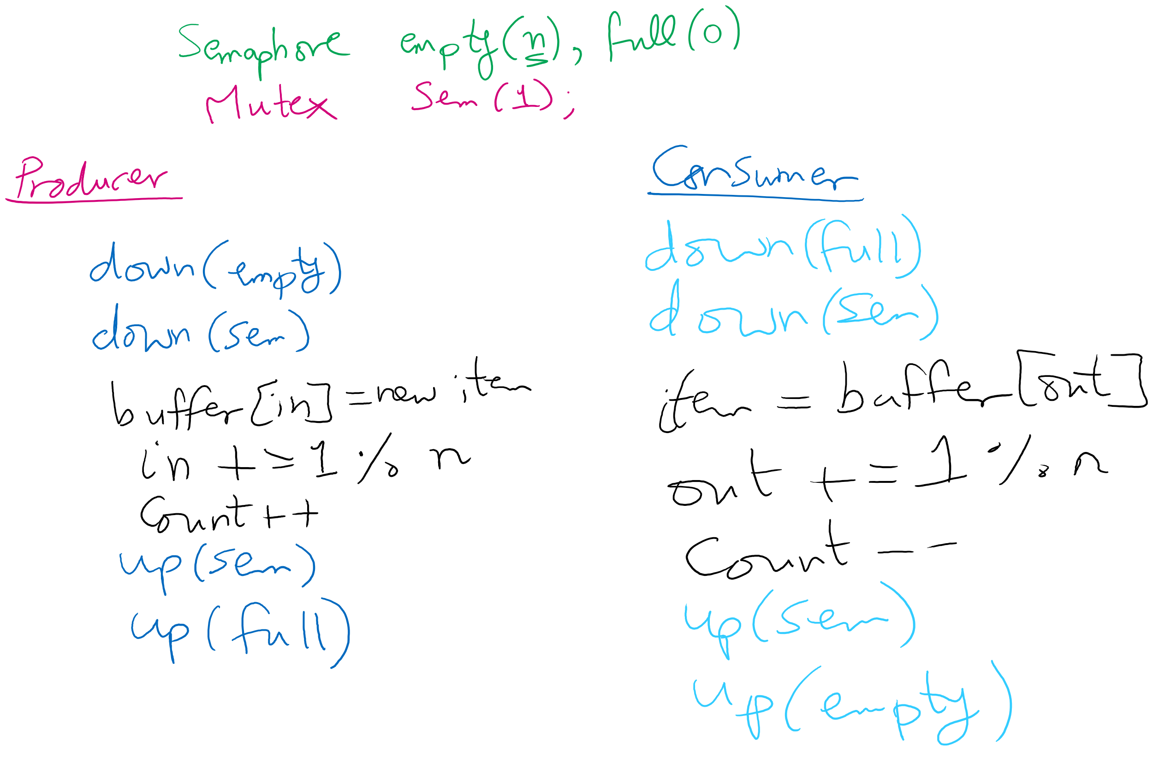
Solving Producers Consumers using Semaphores

Slide 13
How to trace the solution?
Let’s define some events.

Slide 14
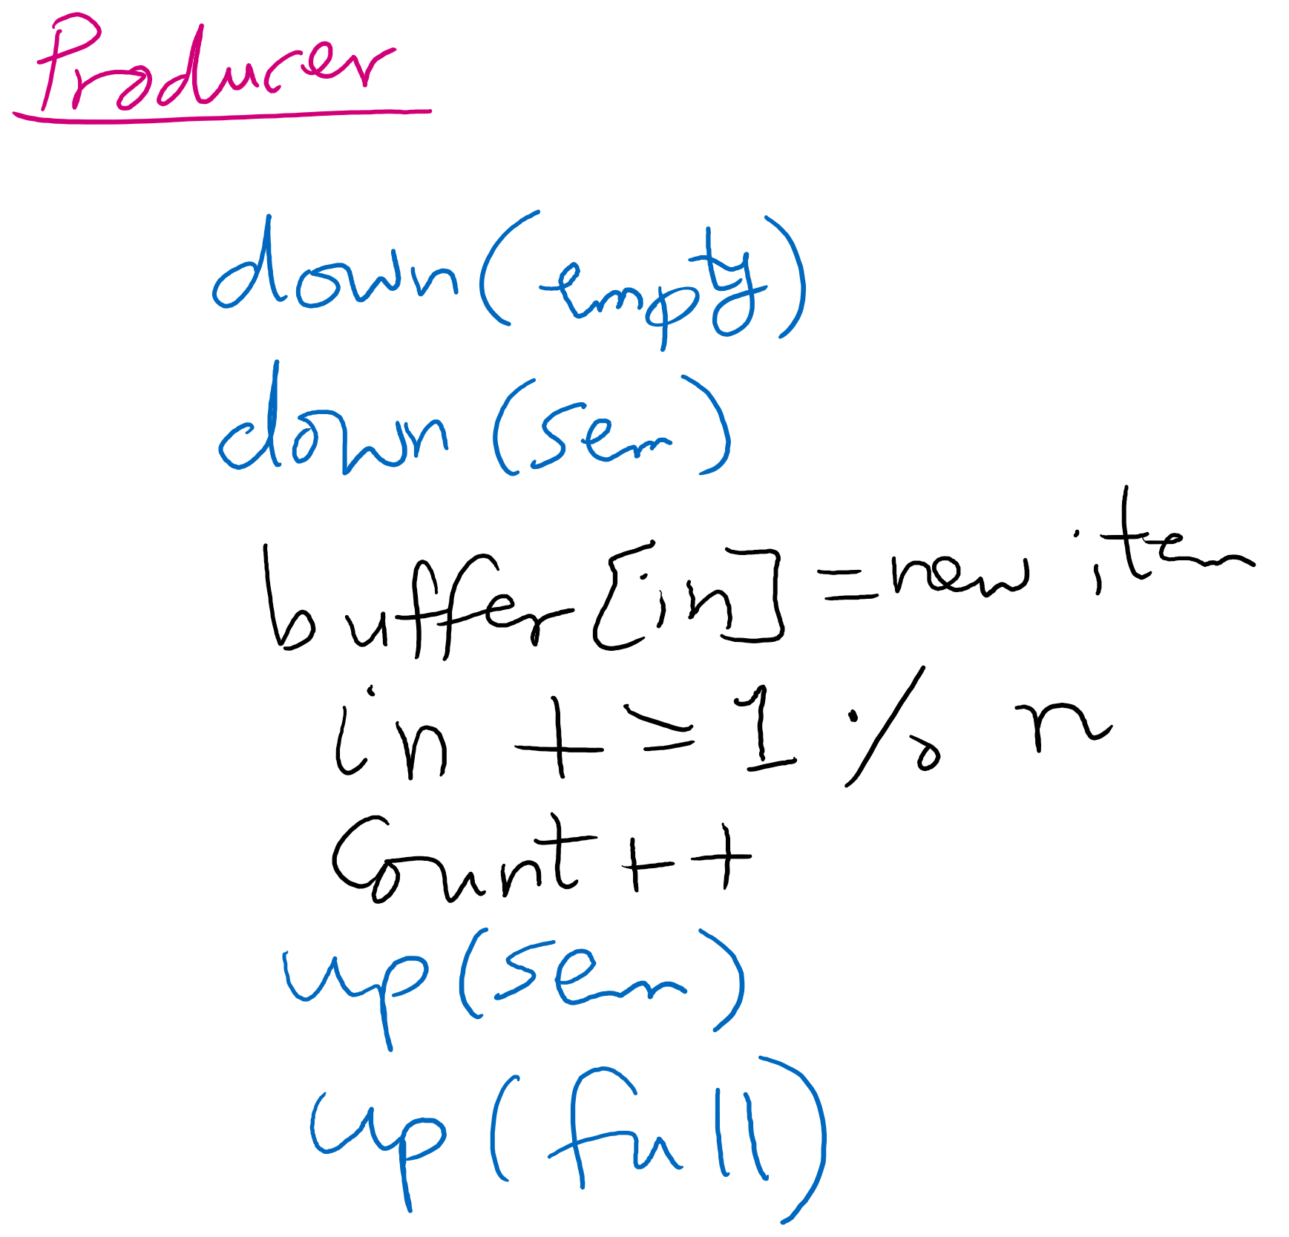
Producer arrives
Moves as far as possible until the solid line

Slide 15
Producer enters
Moves as far as possible past the solid line and until the dashed line

Slide 16
Producer leaves
Moves as far as possible until the dotted line

Slide 17
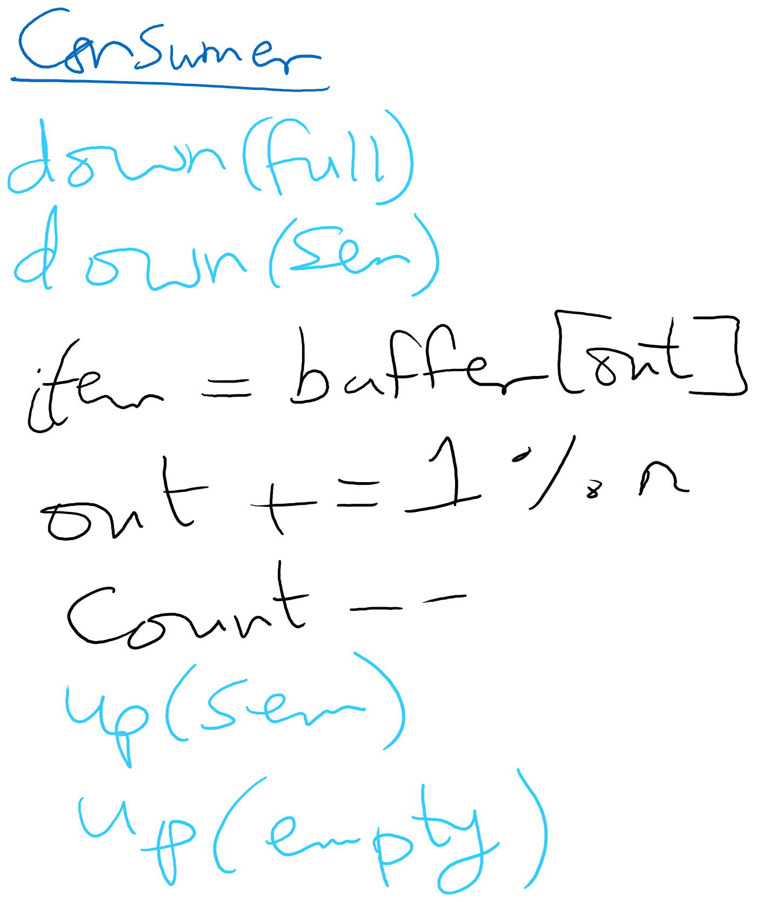
Consumer arrives
Moves as far as possible until the solid line

Slide 18
Consumer enters
Moves as far as possible past the solid line and until the dashed line

Slide 19
Consumer leaves
Moves as far as possible past the dashed line and until the dotted line

Slide 20
Tracing
Given a sequence of events, is the sequence feasible? If yes, what is the system state at the end of the sequence?

Slide 21
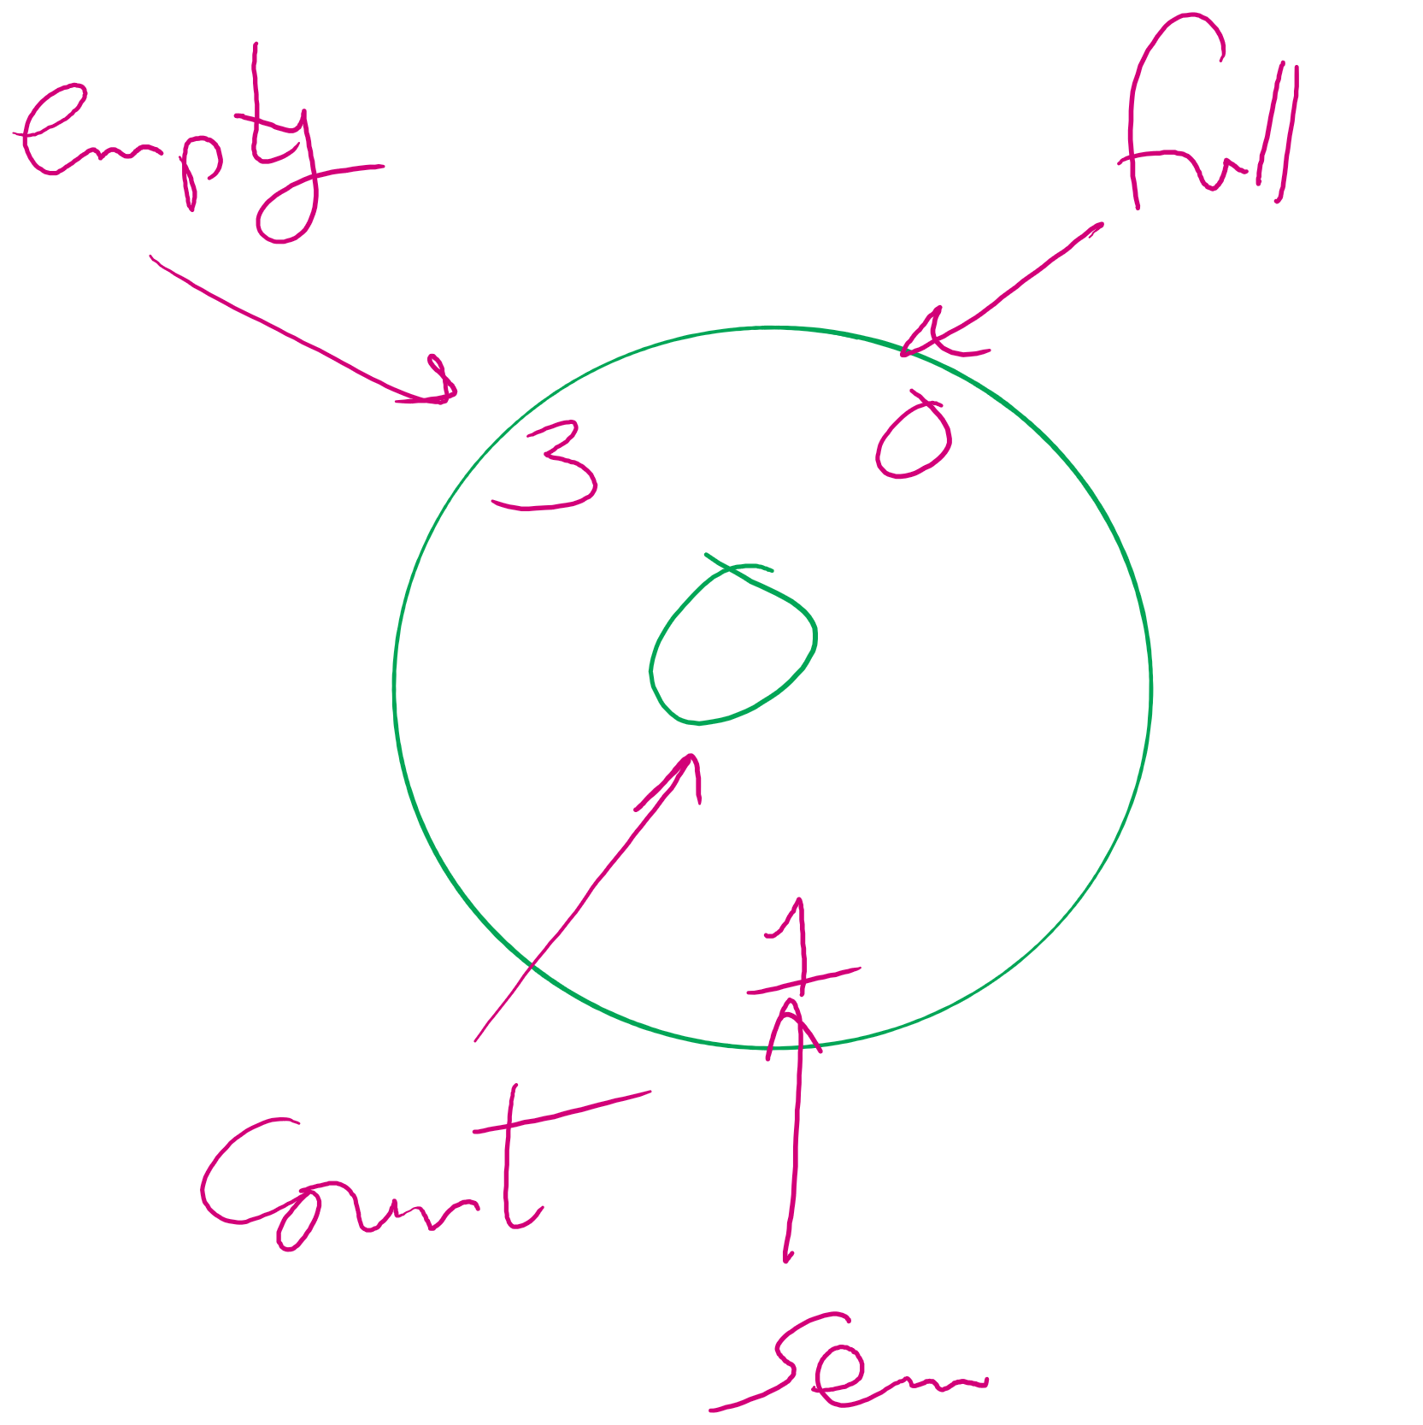
System State

Slide 22
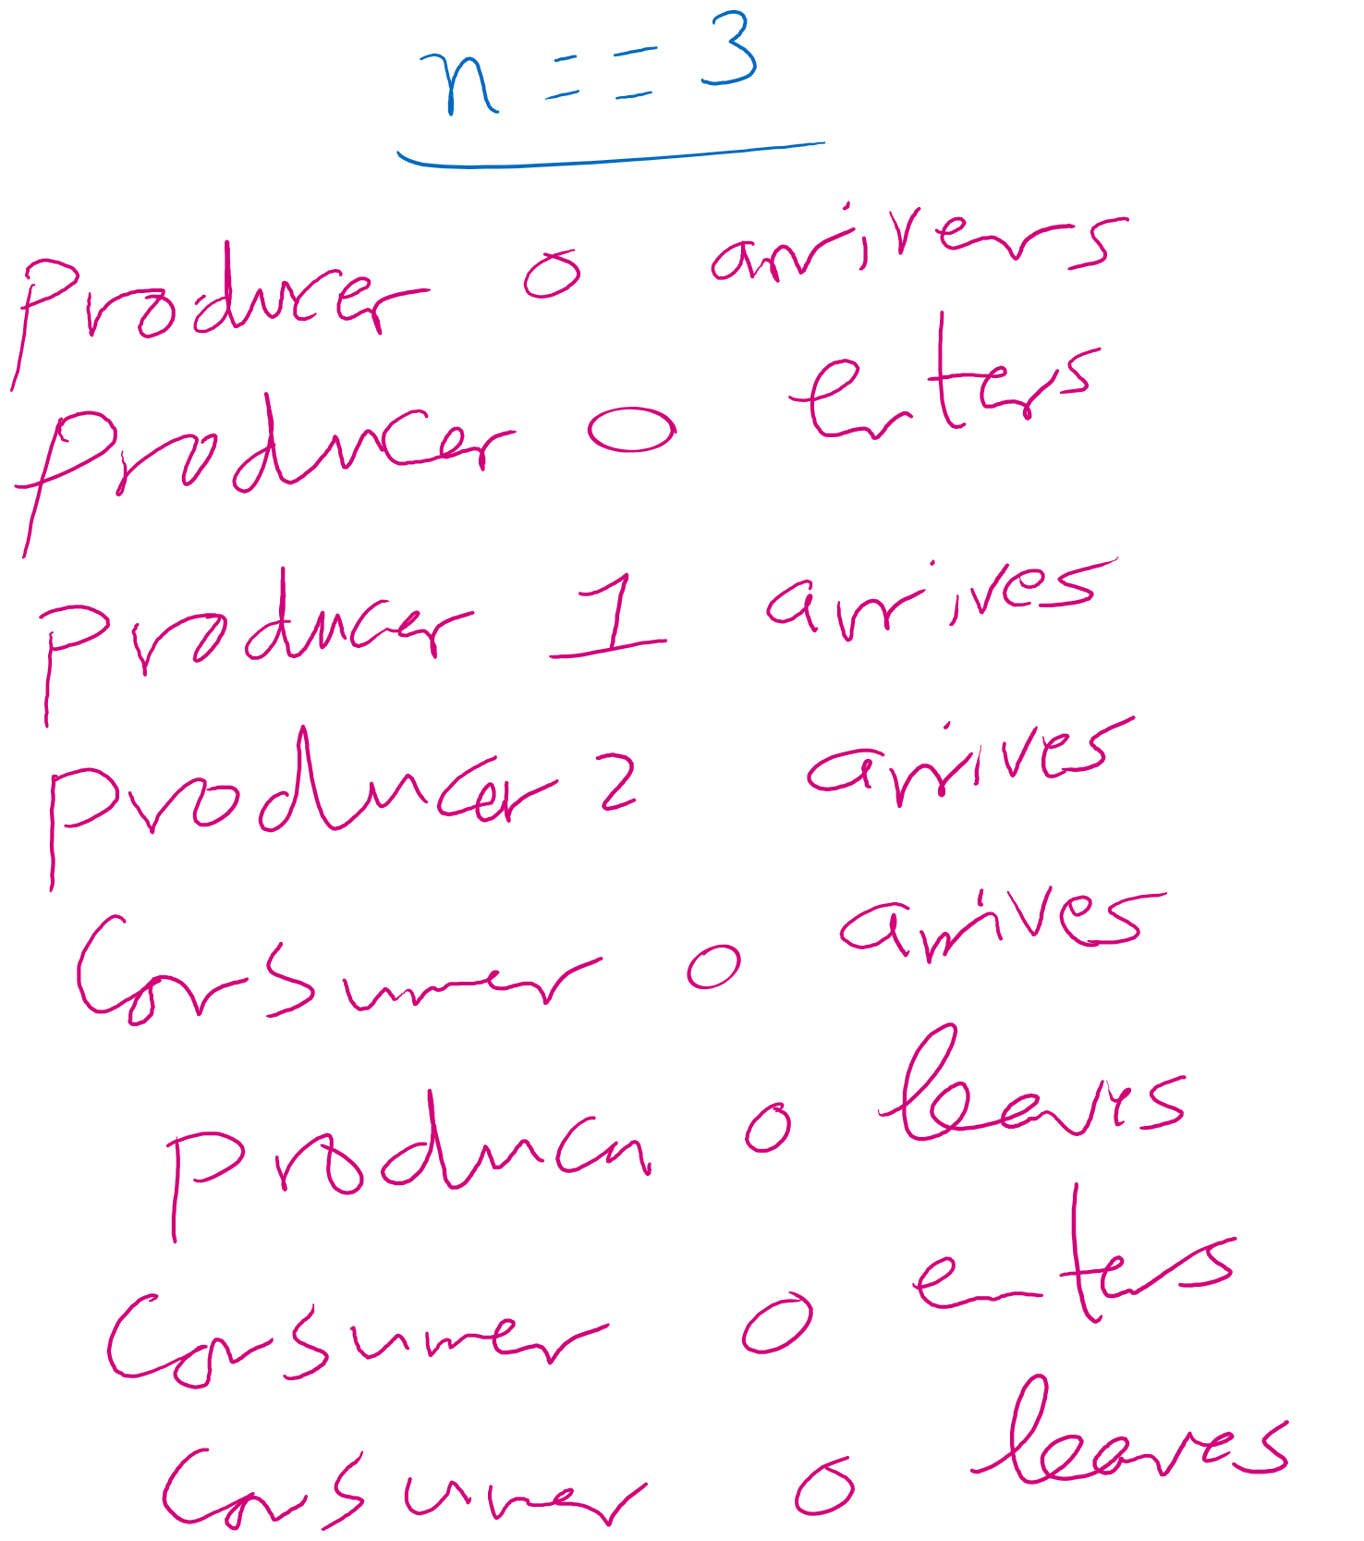
Example 1

Slide 23
Initial state
3
0
0
1

Slide 24
P0 arrives
2
0
0
0

Slide 25
P0 enters
2
0
1
0

Slide 26


P1 arrives
1
0
1
-1

Slide 27

P2 arrives
0
0
1
-2

Slide 28




C0 arrives
0
-1
1
-2

Slide 29
P0 leaves
0
-1
1
-2

Slide 30
P0 leaves
0
-1
1
-1

Slide 31
P0 leaves
0
-1
1
-1

Slide 32
P0 leaves
0
0
1
-1

Slide 33
C0 enters
0
0
1
-1

Slide 34
C0 enters
0
0
1
-2

Slide 35

C0 enters
0
0
1
-2

Slide 36
Can C0 enter?
0
0
1
-2

Slide 37
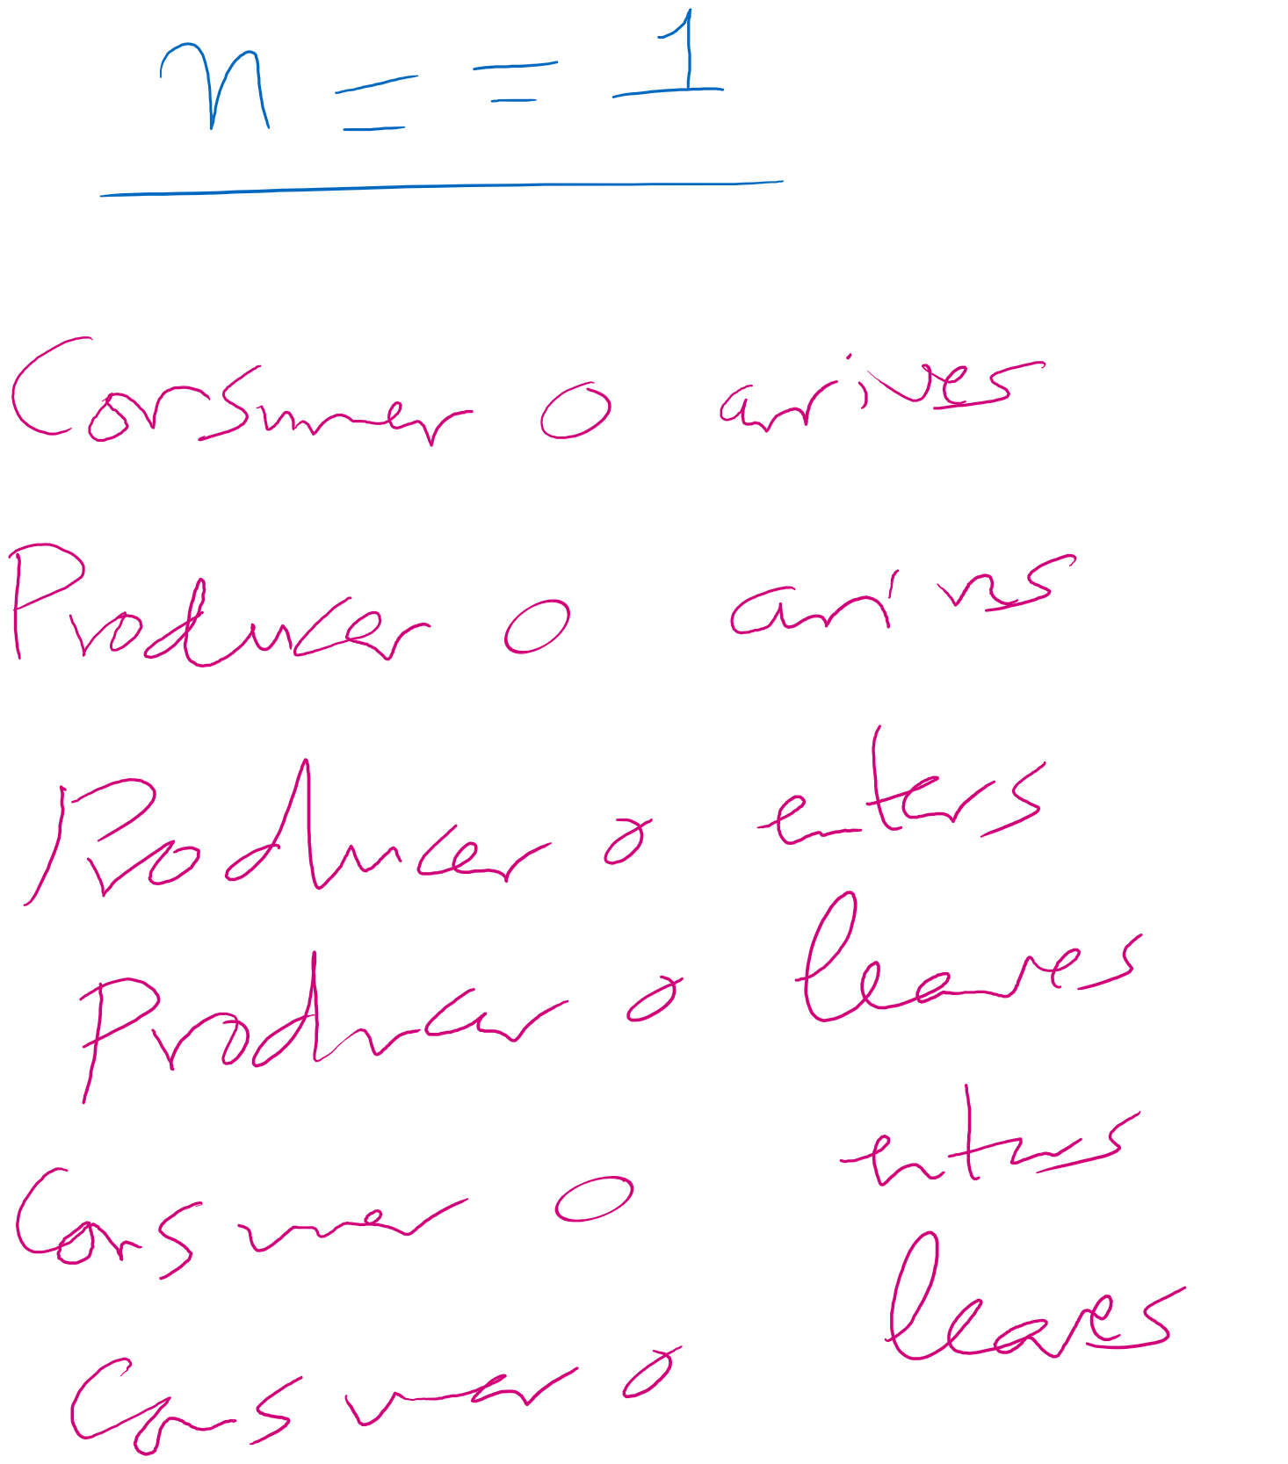
Example 2

Slide 38
Initial state
1
0
0
1

Slide 39
C0 arrives
1
0
0
1

Slide 40






C0 arrives
1
-1
0
1

Slide 41
P0 arrives
1
-1
0
1

Slide 42
P0 arrives
0
-1
0
1

Slide 43
P0 arrives
0
-1
0
0

Slide 44
P0 enters
0
-1
0
0

Slide 45
P0 enters
0
-1
1
0

Slide 46
P0 leaves
0
-1
1
0

Slide 47
P0 leaves
0
0
1
1

Slide 48
P0 leaves
0
0
1
1

Slide 49
C0 enters
0
0
1
1

Slide 50
C0 enters
0
0
1
0

Slide 51
Can C0 enter?
0
0
1
0

Slide 52
C0 enters
0
0
0
0

Slide 53
C0 leaves
0
0
0
0

Slide 54
C0 leaves
1
0
0
1

Slide 55
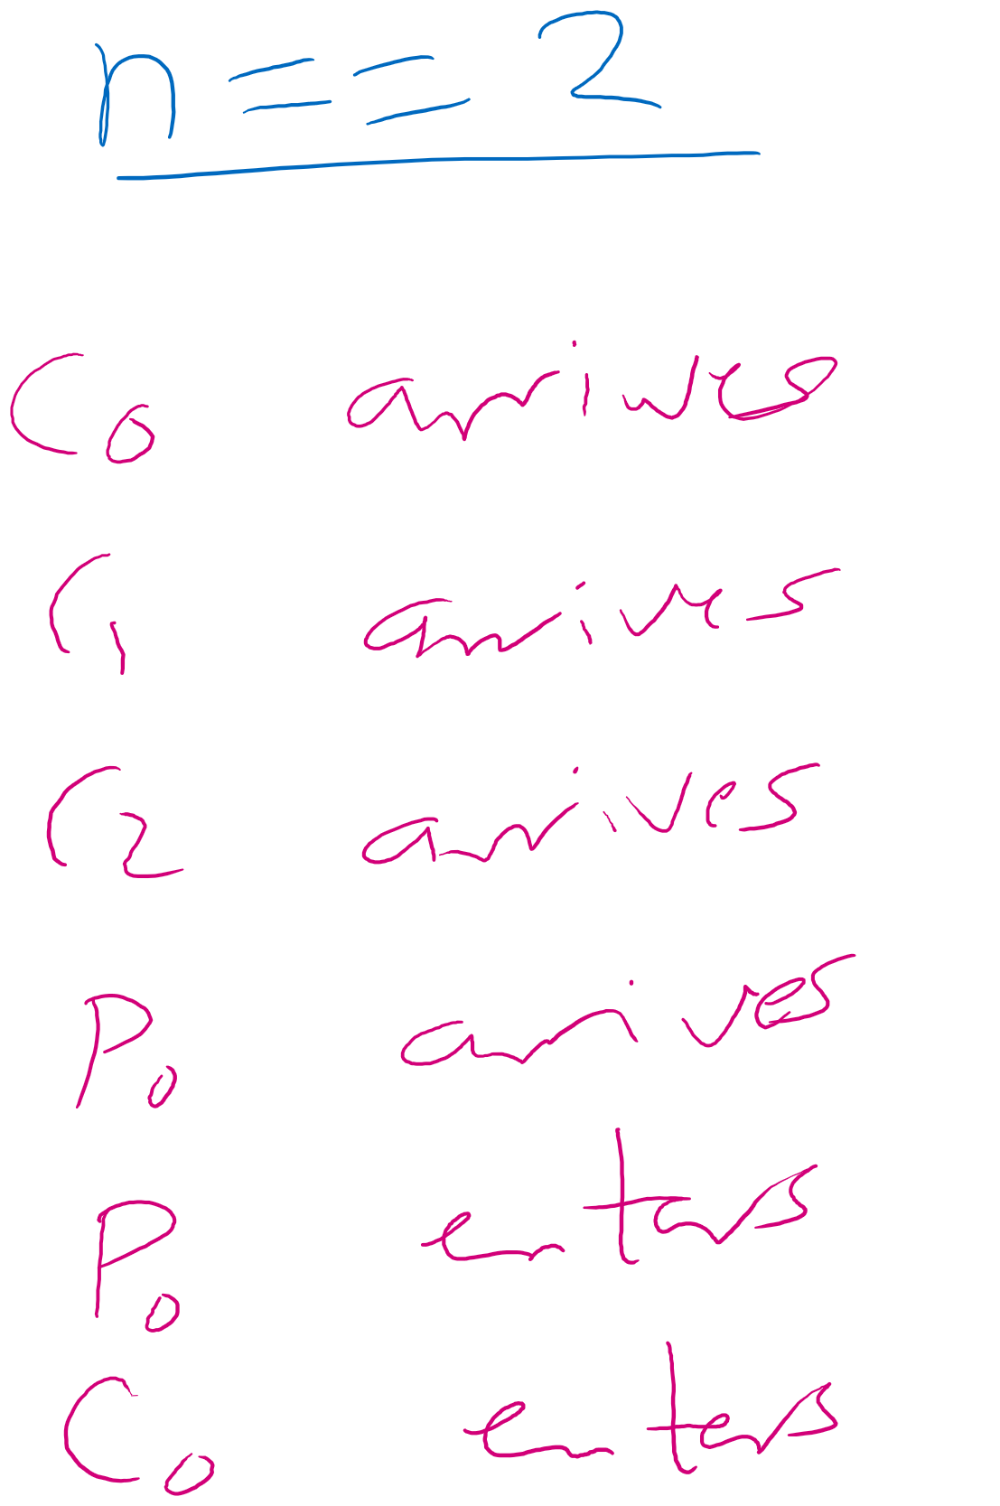
Example 3

Slide 56
Initial state
2
0
0
1

Slide 57
C0 arrives
2
0
0
1

Slide 58




C0 arrives
2
-1
0
1

Slide 59
C1 arrives
2
-1
0
1

Slide 60



C1 arrives
2
-2
0
1

Slide 61


C2 arrives
2
-2
0
1

Slide 62




C2 arrives
2
-3
0
1

Slide 63
P0 arrives
2
-3
0
1

Slide 64
P0 arrives
1
-3
0
1

Slide 65

P0 arrives
1
-3
0
0

Slide 66
P0 enters
1
-3
0
0

Slide 67
P0 enters
1
-3
1
0

Slide 68
C0 enters
1
-3
1
0

Slide 69
Can C0 enter?
1
-3
1
0

