Slide 1


Introduction to Operating Systems CS 1550
Spring 2023
Sherif Khattab
ksm73@pitt.edu
(Some slides are from Silberschatz, Galvin and Gagne ©2013)

Slide 2
Announcements
Upcoming deadlines
Homework 3 is due next Monday 2/7
Lab 1 is due this Friday 2/4
Project 1 due on 2/18

Slide 3
Previous lecture …
Bounded buffer problem
semaphore-based solution

Slide 4
Muddiest Points

Slide 5
Problem of the Day
It is easy to make mistakes when using semaphores

Slide 6
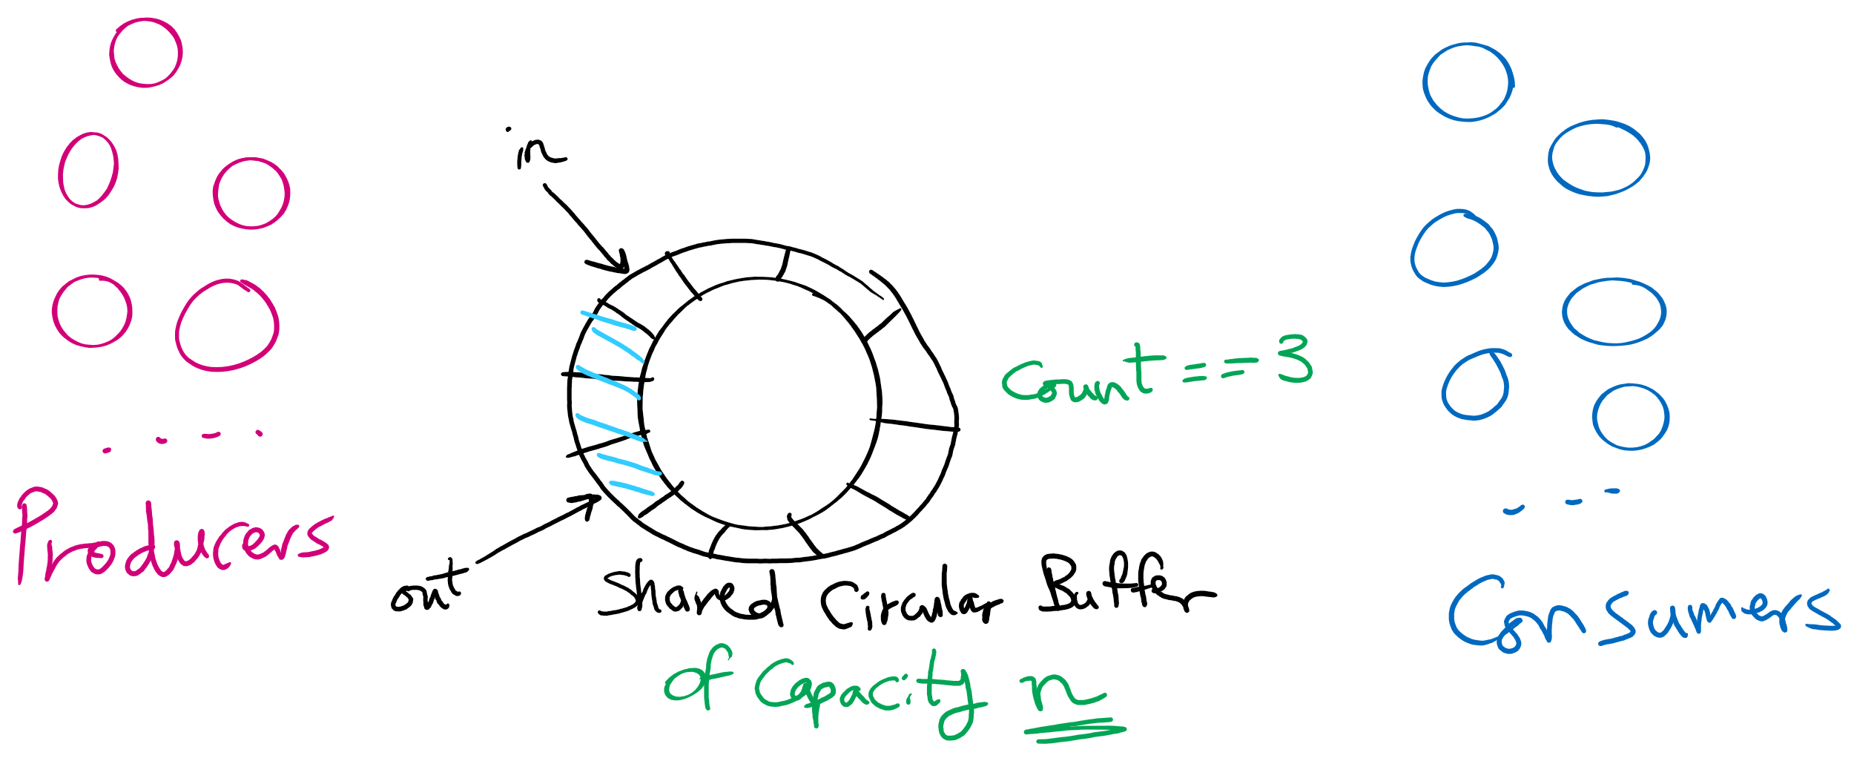
Produces Consumers Problem

Slide 7
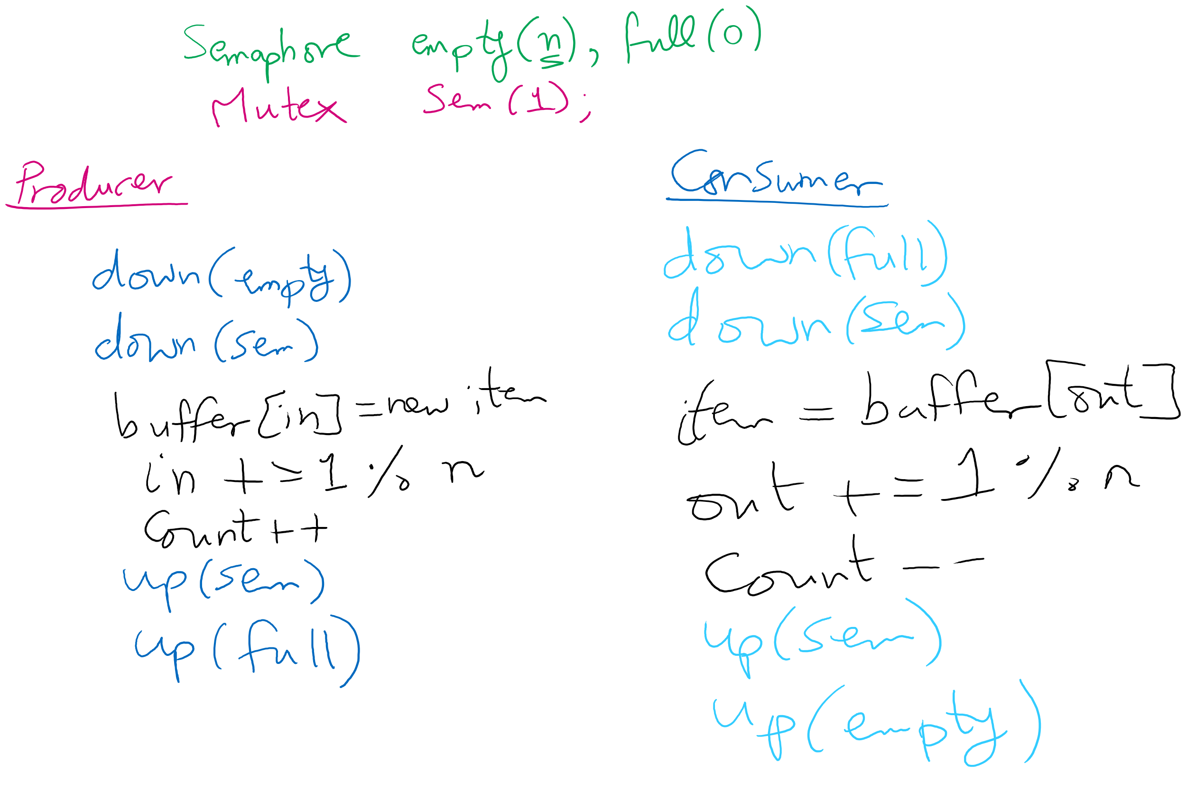
Solving Producers Consumers using Semaphores

Slide 8
Is this sequence feasible?
n == 3
for (i=0; i<3; i++){
Pi arrives
Pi enters
Pi leaves
}
P3 arrives
C0 arrives
C0 enters
C0 leaves
P3 enters
P3 leaves

Slide 9
Some thoughts
If we have one producer and one consumer
do we need count?
do we need the mutex?
For multiple producers and consumers
what benefit do we get if we have one mutex for producers and one for consumers?

Slide 10

Let’s make a “small” change

Slide 11
Let’s make a “small” change
Semaphore empty(n), full(0);
Mutex sem(1);
Producer
down(sem)
down(empty)
buffer[in] = new item
in = (in + 1) % n
count++
up(empty)
up(sem)
Consumer
down(full)
down(sem)
Item = buffer[out]
out = (out + 1) % n
count--
up(sem)
up(full)

Slide 12
Is this sequence feasible?
n == 3
for (i=0; i<3; i++){
Pi arrives
Pi enters
Pi leaves
}
P3 arrives
C0 arrives
C0 enters
C0 leaves
P3 enters
P3 leaves

Slide 13
Solution
Condition Variable
Yet another construct (Add to Spinlock and Semaphore)
Has 3 operations
These 3 operations have to be called while holding a mutex lock
wait()
unlock mutex
block process
when awake, relock mutex
when successful, return
signal()
wakeup one waiting process in the condition variable’s queue if any
broadcast()
wakeup all waiting processes in the condition variable’s queue if any
Not foreign to us at all
Every object variable in Java is a Condition Variable

Slide 14
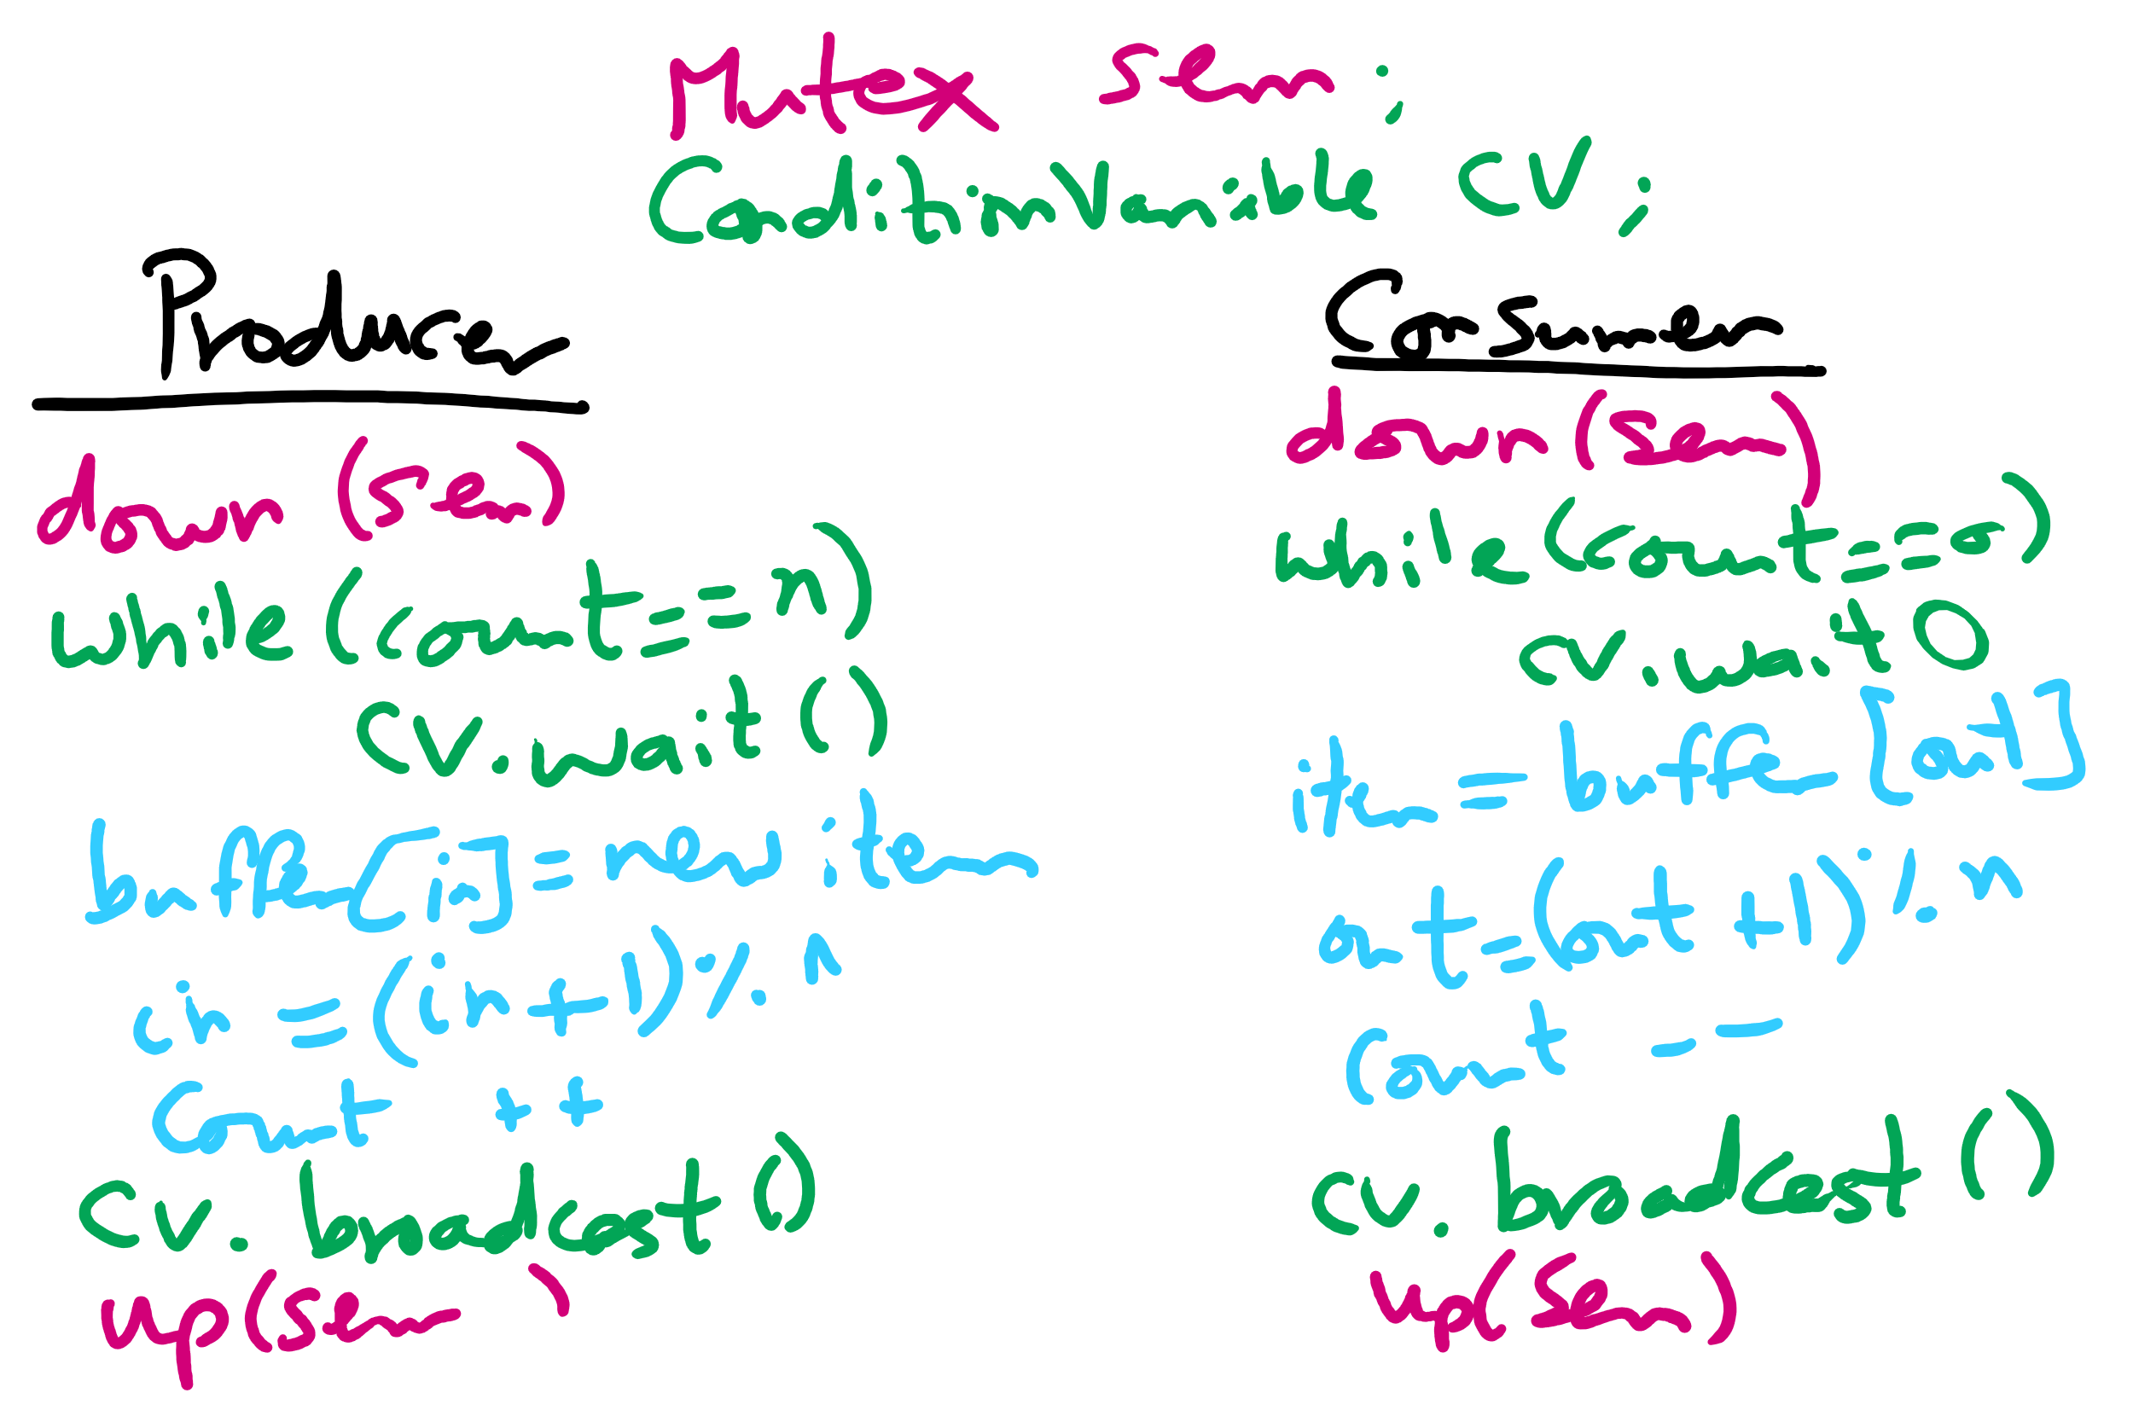
Solving Bounded Buffer Using Condition Variables

