Slide 1


Introduction to Operating Systems CS 1550
Spring 2023
Sherif Khattab
ksm73@pitt.edu
(Some slides are from Silberschatz, Galvin and Gagne ©2013)

Slide 2
Announcements
Upcoming deadlines
All deadlines moved to Monday May 1st at 11:59 pm
But please don’t wait to last minute!
Homework 11, 12, Bonus Homework
lowest two homework assignments dropped
Lab 4 and Lab 5
Quiz 3 and Quiz 4
lowest two of the labs and quizzes dropped
Project 4 (no late deadline)

Slide 3
Final Exam
Wednesday 4/26 8:00-9:50
same classroom
coffee will be served!
Same format as midterm
Non-cumulative
Study guide and practice test on Canvas
Review Session during Finals’ Week
Date and time TBD
recorded

Slide 4
Bonus Opportunities
Bonus Homework (1%)
Post-Course Quiz on Canvas (1%)
1% bonus for class when
OMETs response rate >= 80%
Currently at 46%
Deadline is Sunday 4/23

Slide 5
Previous Lecture …
Miscellaneous issues in File Systems
open-file tables
quota table
journaling file system
buffering
Max partition size
linking vs. copying
effective disk access time

Slide 6
This Lecture …
Protection and Security in operating systems

Slide 7
Problem of the Day: Protection
Protection is about controlling access of
programs, processes, or users to
system resources
(e.g., memory pages, files, devices, CPUs)
OS can enforce policies, but can’t decide what policies are appropriate
How to enforce who can access what?
Access Control Specification:
Correct
enable an implementation that is
efficient
easy to use (or nobody will use them!)

Slide 8
Protection domains
A process operates within a protection domain
defines what resources accessible by the process
Each domain lists objects with permitted operations
Objects can have different permissions in different domains
How can this arrangement be specified more formally?
File1 [R] File2 [RW]
File3 [R]
File4 [RWX]
File5 [RW]
File3 [W]
Screen1 [W]
Mouse [R]
Printer [W]
Domain 1
Domain 2
Domain 3

Slide 9
Protection matrix
 | File1 | File2 | File3 | File4 | File5 | Printer1 | Camera
Domain1 | Read | Read Write
Domain2 |  |  | Read | Read Write Execute | Read Write | Write
Domain3 |  |  | Write |  |  | Write | Read
Each domain has a row in the matrix
Each object (resource) has a column in the matrix
Entry i, j has the permissions of Domain i on Object j
Who’s allowed to modify the protection matrix?
What changes can they make?
How to efficiently enforce the matrix?

Slide 10
Domains as objects in the protection matrix
 | File1 | File2 | File3 | File4 | File5 | Printer1 | Camera | Dom1 | Dom2 | Dom3
Dom 1 | Read | Read Write |  |  |  |  |  | Modify
Dom 2 |  |  | Read | Read Write Execute | Read Write | Write |  | Modify
Dom 3 |  |  | Write |  |  | Write | Read |  | Enter
Specify permitted operations on domains in the matrix
Domains can modify other domains
Domains may (or may not) be able to modify themselves
Some domain transfers (switching) permitted, others not
Doing this allows flexibility in specifying domain permissions
Retains ability to restrict modification of domain policies

Slide 11
Representing the protection matrix
Need an efficient representation of the matrix
also called access control matrix
Most entries in the matrix are empty!
Two approaches:
Store permissions with each object
access control list
Store permissions with each domain
capabilities

Slide 12
Access control lists (ACLs)
Each object has a list attached to it
List has
Protection domain
e.g., User, Group of users, Other
Access rights
e.g., Read, Write, Execute
No entry for domain => no rights for that domain
Operating system checks permissions when access is needed
How are ACLs secured?
Kept in kernel
File1
File2
elm: <R,W> znm: <R> root: <R,W,X>
elm: <R,X> uber: <R,W> root: <R,W> all: <R>

Slide 13
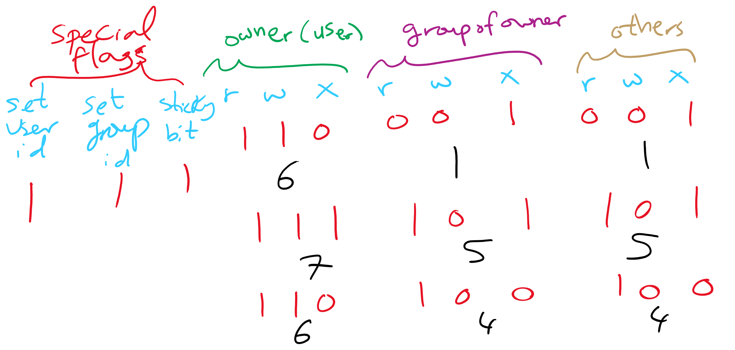
Access control lists in the real world
Unix file system
Access list for each file has exactly three domains on it
User (owner), Group, Others
Rights include read, write, execute: interpreted differently for directories and files

Slide 14
Access control lists in the real world
Andrew File System (AFS)
Access lists apply to directories
files inherit rights from the directory they’re in
what does that statement imply about AFS?
Possible rights:
read, write, lock (for files in the directory)
lookup, insert, delete (for the directories themselves)
administer (ability to add or remove rights from the ACL)

Slide 15
Capabilities
Each domain has a capability list
One entry per accessible object
Object name
Object permissions
not listed → no access
How are capabilities secured?
Kept in kernel
Cryptographically secured
Process A
Process B
File1: <R,W> File2: <R> File3: <R,W,X>
File2: <R,W> File4: <R,W,X> File7: <W> File9: <R,W>

Slide 16
Cryptographically protected capability
Server
Object
Rights
H(Object,Rights,Check)
Capability handed to processes and verified cryptographically
better for widely distributed systems where capabilities can’t be centrally checked
H() is a cryptographically secure one-way hash function
e.g., SHA-3, SHA-256
Rights include generic rights (read, write, execute) and
Copy capability, Copy object, Remove capability, Destroy object
Server has a secret (Check) and uses it to verify presented capabilities
how?
Alternatively, use public-key signature techniques

Slide 17
Reference monitor
Process A
All system calls go through the reference monitor for security checking
User space
Operating system kernel
Trusted computing base
Reference monitor
Kernel space

Slide 18
Formal models of protection
OS can enforce policies, but can’t decide what policies are authorized
Is it possible to go from an “authorized” matrix to an “unauthorized” one?
Limited set of primitive operations on access matrix
Create/delete object
Create/delete domain
Insert/remove right
Primitives can be combined into protection commands
In general, this question is undecidable
May be provable for limited cases

Slide 19
Bell-La Padula multilevel security model
Processes and objects have security levels (e.g., 1-4)
Goal: Prevent information from leaking from higher levels to lower levels
Simple security property
Process at level k can only read objects at levels k or lower
* property
Process at level k can only write objects at levels k or higher
Read down, write up
4
5
E
6
3
3
C
4
D
A writes 4
2
B
2
1
1
A

Slide 20
Biba multilevel integrity model
Goal: guarantee integrity of data
e.g., prevent planting fake information at a higher level
Simple integrity property
A process can write only objects at its security level or lower
The integrity * property
A process can read only objects at its security level or higher
Read up, write down

Slide 21
Covert channels
Circumvent security model by using more subtle ways of passing information
Send data using “side effects”
Allocating resources
Using the CPU
Locking a file
Making small changes in legal data exchange
Very difficult to plug leaks by covert channels!

Slide 22
Covert channel using file locking
Process A and Process B want to exchange information using file locking
Assume n+1 files accessible to both A and B
A sends information by
Locking files 0..n-1 according to an n-bit quantity to be conveyed to B
Locking file n to indicate that information is available
B gets information by
Reading the lock state of files 0..n+1
Unlocking file n to show that the information was received
May not even need access to the files (on some systems) to detect lock status!

Slide 23
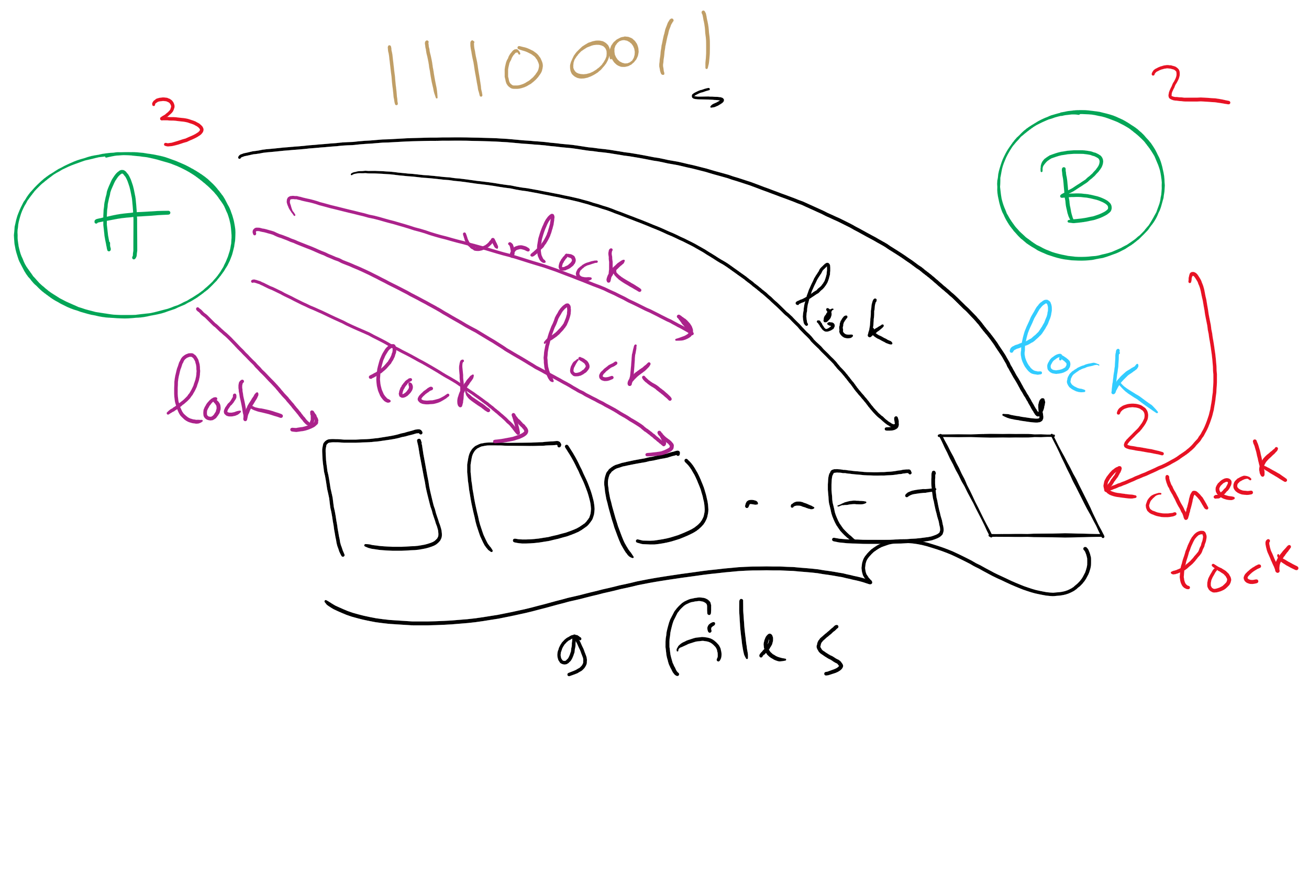
Covert Channel Using File Locking

Slide 24
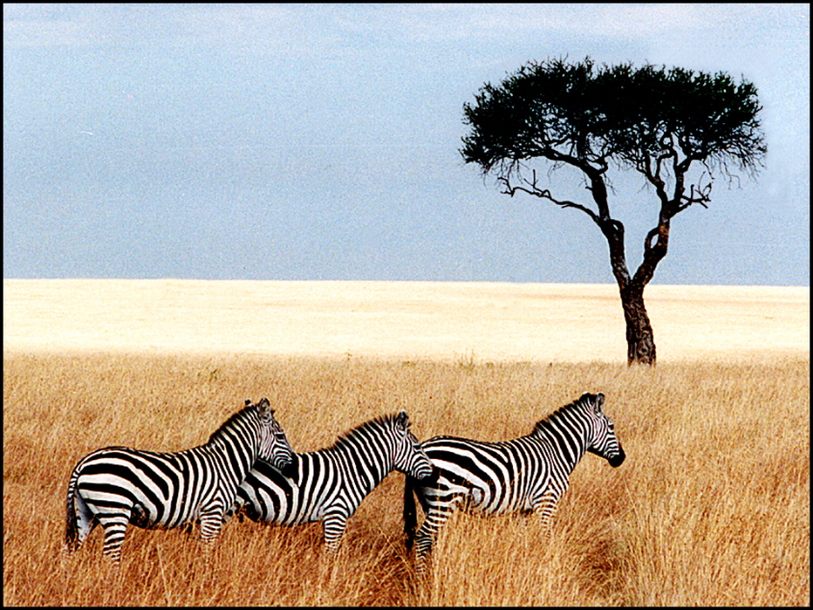
Steganography
Hide information in other data
Picture on right has text of 5 Shakespeare plays
Encrypted, inserted into low order bits of color values
Zebras
Hamlet, Macbeth, Julius Caesar
Merchant of Venice, King Lear

Slide 25
Protection vs Security
Protection is an internal problem
Assumes users are authenticated and programs are run only by authorized users
Security = Protection + defending attacks from external environment

Slide 26
Security environment: threats
Goal | Threat
Data confidentiality | Exposure of data
Data integrity | Tampering with data
System availability | Denial of service
Security goals:
Confidentiality
Integrity
Availability
Someone attempts to subvert the goals
Fun
Commercial gain

Slide 27
Security Problem 1: Password Attacks
Passwords can be
stolen,
guessed, or
cracked
How would you defend against these attacks?

Slide 28
User authentication
Problem: how does the computer know who you are?
Solution: use authentication to identify
Something the user knows
Something the user has
Something the user is
This must be done before user can use the system
Important: from the computer’s point of view…
Anyone who can duplicate your ID is you
Fooling a computer isn’t all that hard…

Slide 29
Password Stealing
Stealing the password file
Social Engineering
e.g., spoofing login screen
Key loggers
e.g., trojan horse programs

Slide 30
How should an OS store passwords?
Passwords should be memorable?
Passwords shouldn’t be stored “in the clear”
Password file is often readable by all system users!
Password must be checked against entry in this file
Solution: use hashing to hide “real” password
One-way function converting password to meaningless string of digits (Unix password hash, SHA-2)
Difficult to find another password that hashes to the same string
Knowing the hashed value and hash function gives no clue to the original password

Slide 31
Storing passwords
Some OSs use encryption algorithms to hash the passwords
Use the password as the key, not the plain text
But, what is encryption?

Slide 32
Cryptography
Goal: keep information from those who aren’t supposed to see it
Do this by “scrambling” the data
Use a well-known algorithm to scramble data
Algorithm has two inputs: data & key
Key is known only to “authorized” users
Relying upon the secrecy of the algorithm is a very bad idea (see WW2 Enigma for an example…)
Cracking codes is very difficult, Sneakers and other movies notwithstanding

Slide 33
Cryptography basics
Algorithms (E, D) are widely known
Keys (K_{E}, K_{D}) may be less widely distributed
For this to be effective, the ciphertext should be the only information that’s available to the world
Plaintext is known only to the people with the keys (in an ideal world…)
K_{E}
K_{D}
Encryption key
Decryption key
C=E(P,K_{E})
E
D
P
P
Plaintext
Ciphertext
Plaintext
Encryption
Decryption

Slide 34
Secret-key encryption
Also called symmetric-key encryption
Monoalphabetic substitution
Each letter replaced by different letter
Vigenere cipher
Use a multi-character key THEMESSAGE ELMELMELME XSQQPEWLSI
Both are easy to break!
Given the encryption key, easy to generate the decryption key
Alternatively, use different (but similar) algorithms for encryption and decryption

Slide 35
Modern encryption algorithms
Data Encryption Standard (DES)
Uses 56-bit keys
Same key is used to encrypt & decrypt
Keys used to be difficult to guess
Needed to try 2⁵⁵ different keys, on average
Modern computers can try millions of keys per second with special hardware
For $250K, EFF built a machine that broke DES quickly in 1998
Current algorithms (AES, Blowfish) use 128 bit keys
Adding one bit to the key makes it twice as hard to guess
Must try 2¹²⁷ keys, on average, to find the right one
At 10¹⁵ keys per second, this would require over 10²¹ seconds, or 1000 billion years!
Modern encryption isn’t usually broken by brute force…

Slide 36
Unbreakable codes
There is such a thing as an unbreakable code: one-time pad
Use a truly random key as long as the message to be encoded
XOR the message with the key a bit at a time
Code is unbreakable because
Key could be anything
Without knowing key, message could be anything with the correct number of bits in it
Difficulty: distributing key is as hard as distributing message
Difficulty: generating truly random bits
Can’t use computer random number generator!
May use physical processes
Radioactive decay
Leaky diode
Lava lamp (!) [https://www.atlasobscura.com/places/encryption-lava-lamps]

Slide 37
Public-key cryptography
Instead of using a single shared secret, keys come in pairs
One key of each pair distributed widely (public key), K_{p}
One key of each pair kept secret (private or secret key), K_{s}
Two keys are inverses of one another, but not identical
Encryption & decryption are the same algorithm, so E(K_{p},E(K_{s},M) = E(K_{s},E(K_{p},M) = M
Currently, most popular method involves primes and exponentiation
Difficult to crack unless large numbers can be factored
Very slow for large messages

Slide 38
Digital signatures
Original document
Original document
One-way hash function
Hash result encrypted with K_{s}
Hash
Digital signature
Digital signature
Receiver gets
Digital signature computed by
Applying one-way hash function to original document
Encrypting result with sender’s private key
Receiver can verify by
Applying one-way hash function to received document
Decrypting signature using sender’s public key
Comparing the two results: equality means document unmodified

