Slide 1


Introduction to Operating Systems CS 1550
Spring 2023
Sherif Khattab
ksm73@pitt.edu
(Some slides are from Silberschatz, Galvin and Gagne ©2013)

Slide 2
Announcements
Upcoming deadlines
All deadlines moved to Monday May 1st at 11:59 pm
But please don’t wait to last minute!
Homework 11, 12, Bonus Homework
Lab 4 and Lab 5
Quiz 3 and Quiz 4
Project 4 (no late deadline)

Slide 3
Final Exam
Wednesday 4/26 8:00-9:50
same classroom
coffee will be served!
Same format as midterm
Non-cumulative
Study guide and practice test on Canvas
Review Session during Finals’ Week
Date and time TBD
recorded

Slide 4
Bonus Opportunities
Bonus Homework
worth up to 1%
lowest two homework assignments still dropped
Post-Course Quiz on Canvas
worth 1%
bonus point for class when
OMETs response rate >= 80%
Currently at 28%
Deadline is Sunday 4/23

Slide 5
Previous Lecture …
How does a file system hide disk access delays?
How do device drivers program I/O devices?
Disk arm scheduling
FCFS, SSTF, SCAN, C-SCAN, LOOK, C-LOOK

Slide 6
Today …
Miscellaneous issues in File Systems
Protection in operating systems

Slide 7
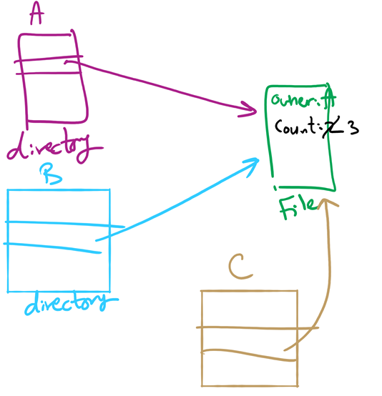
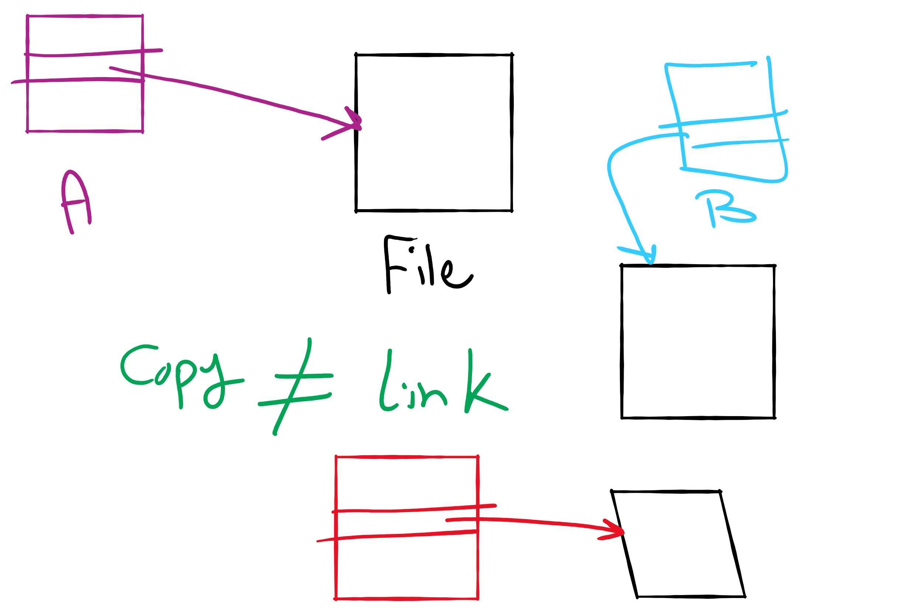
Hard Linking vs. Copying
hard linking
copying
doesn’t create a new i-node
increments the link count inside original i-node
e.g., ln command in Linux without -s
creates a new i-node
e.g., cp command in Linux
soft (symbolic linking)
creates a new i-node that contains path of original file
e.g., ln -s command in Linux

Slide 8
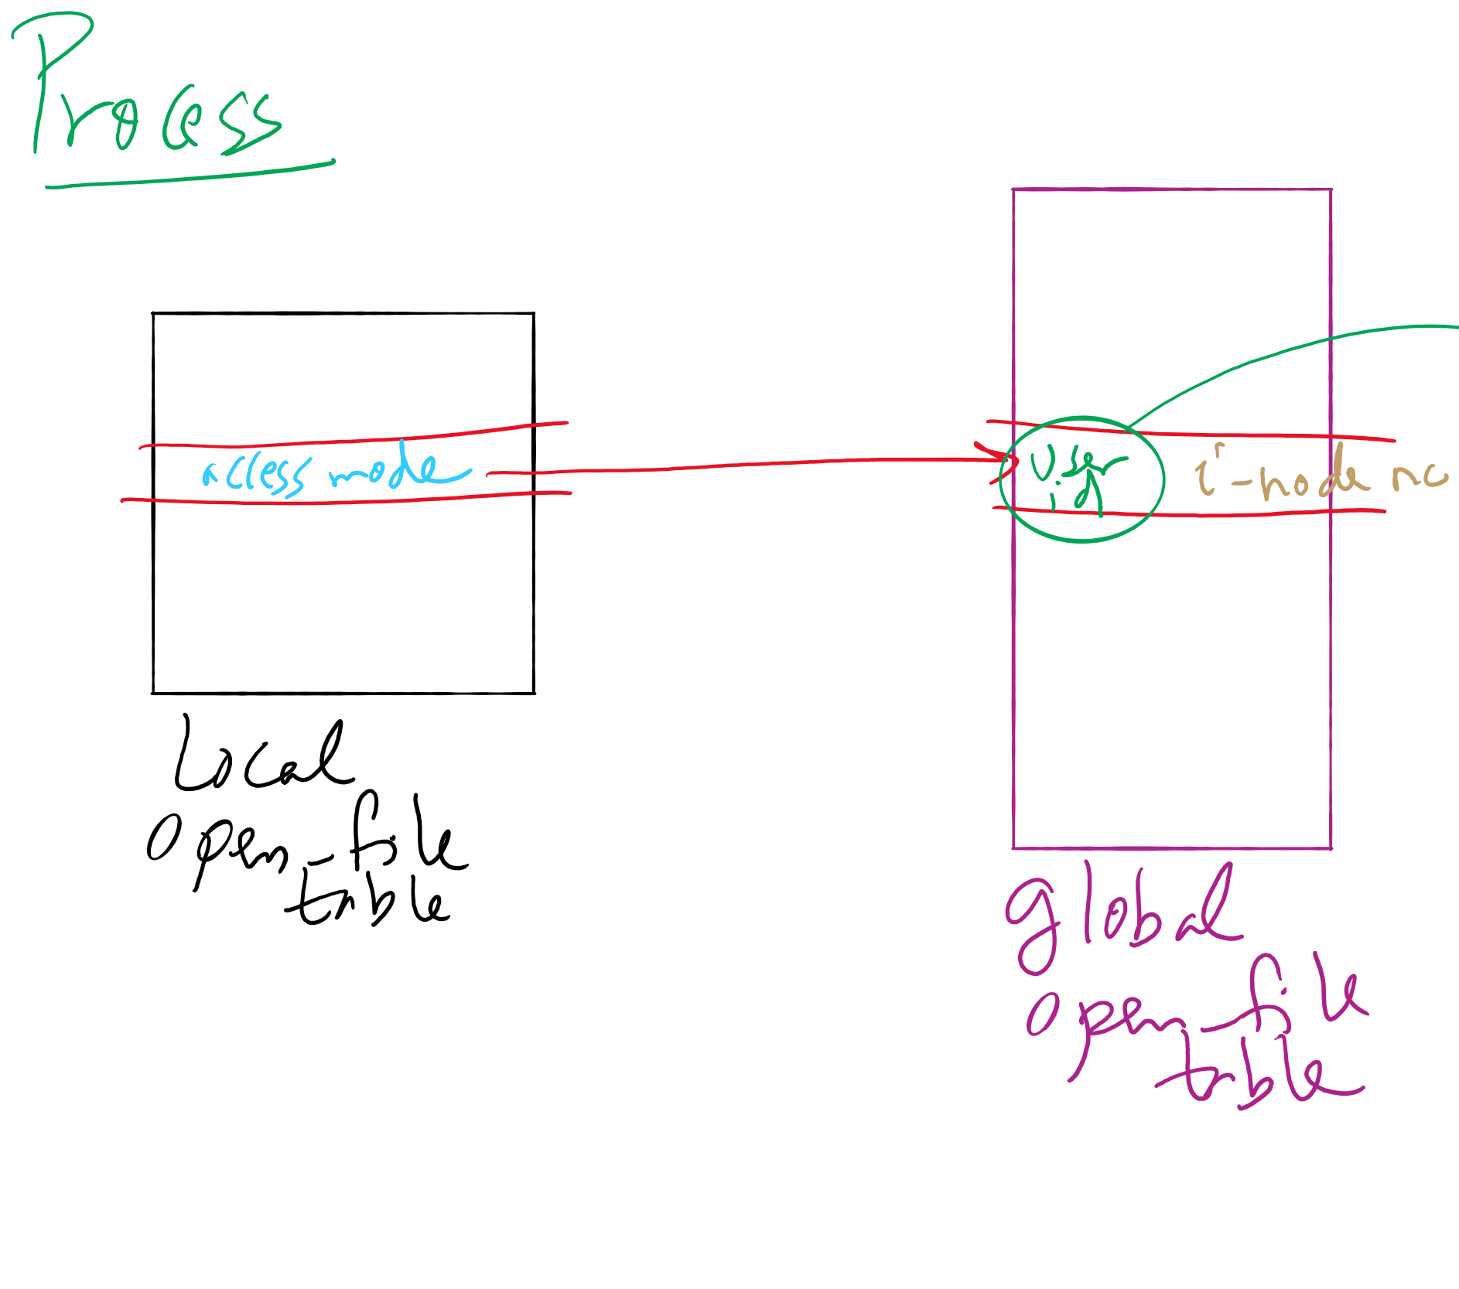
File-related kernel structures: open-file tables
per-process and global open-file tables

Slide 9
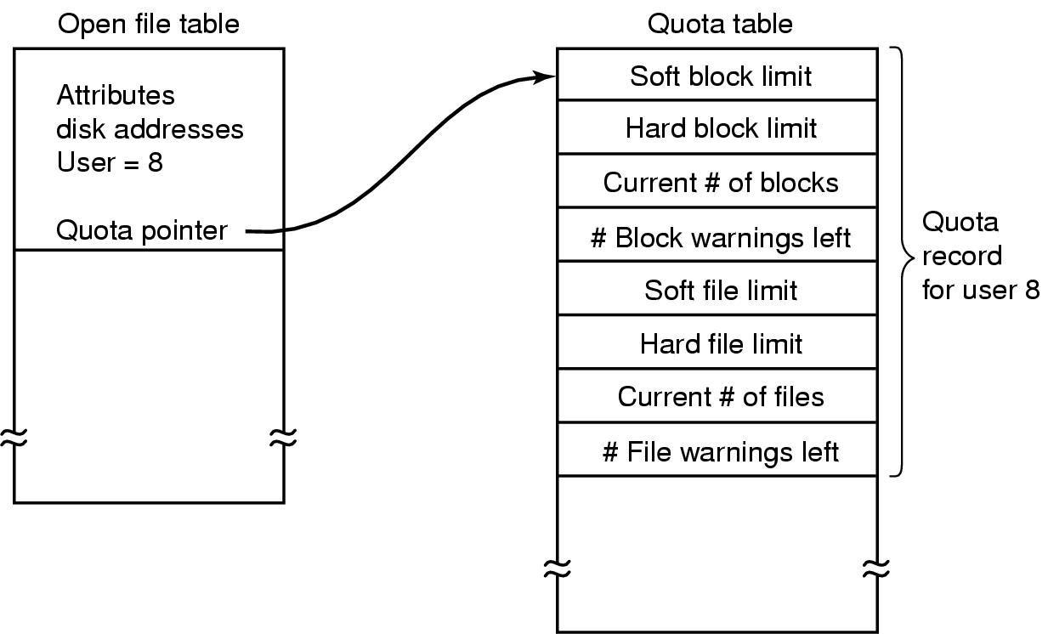
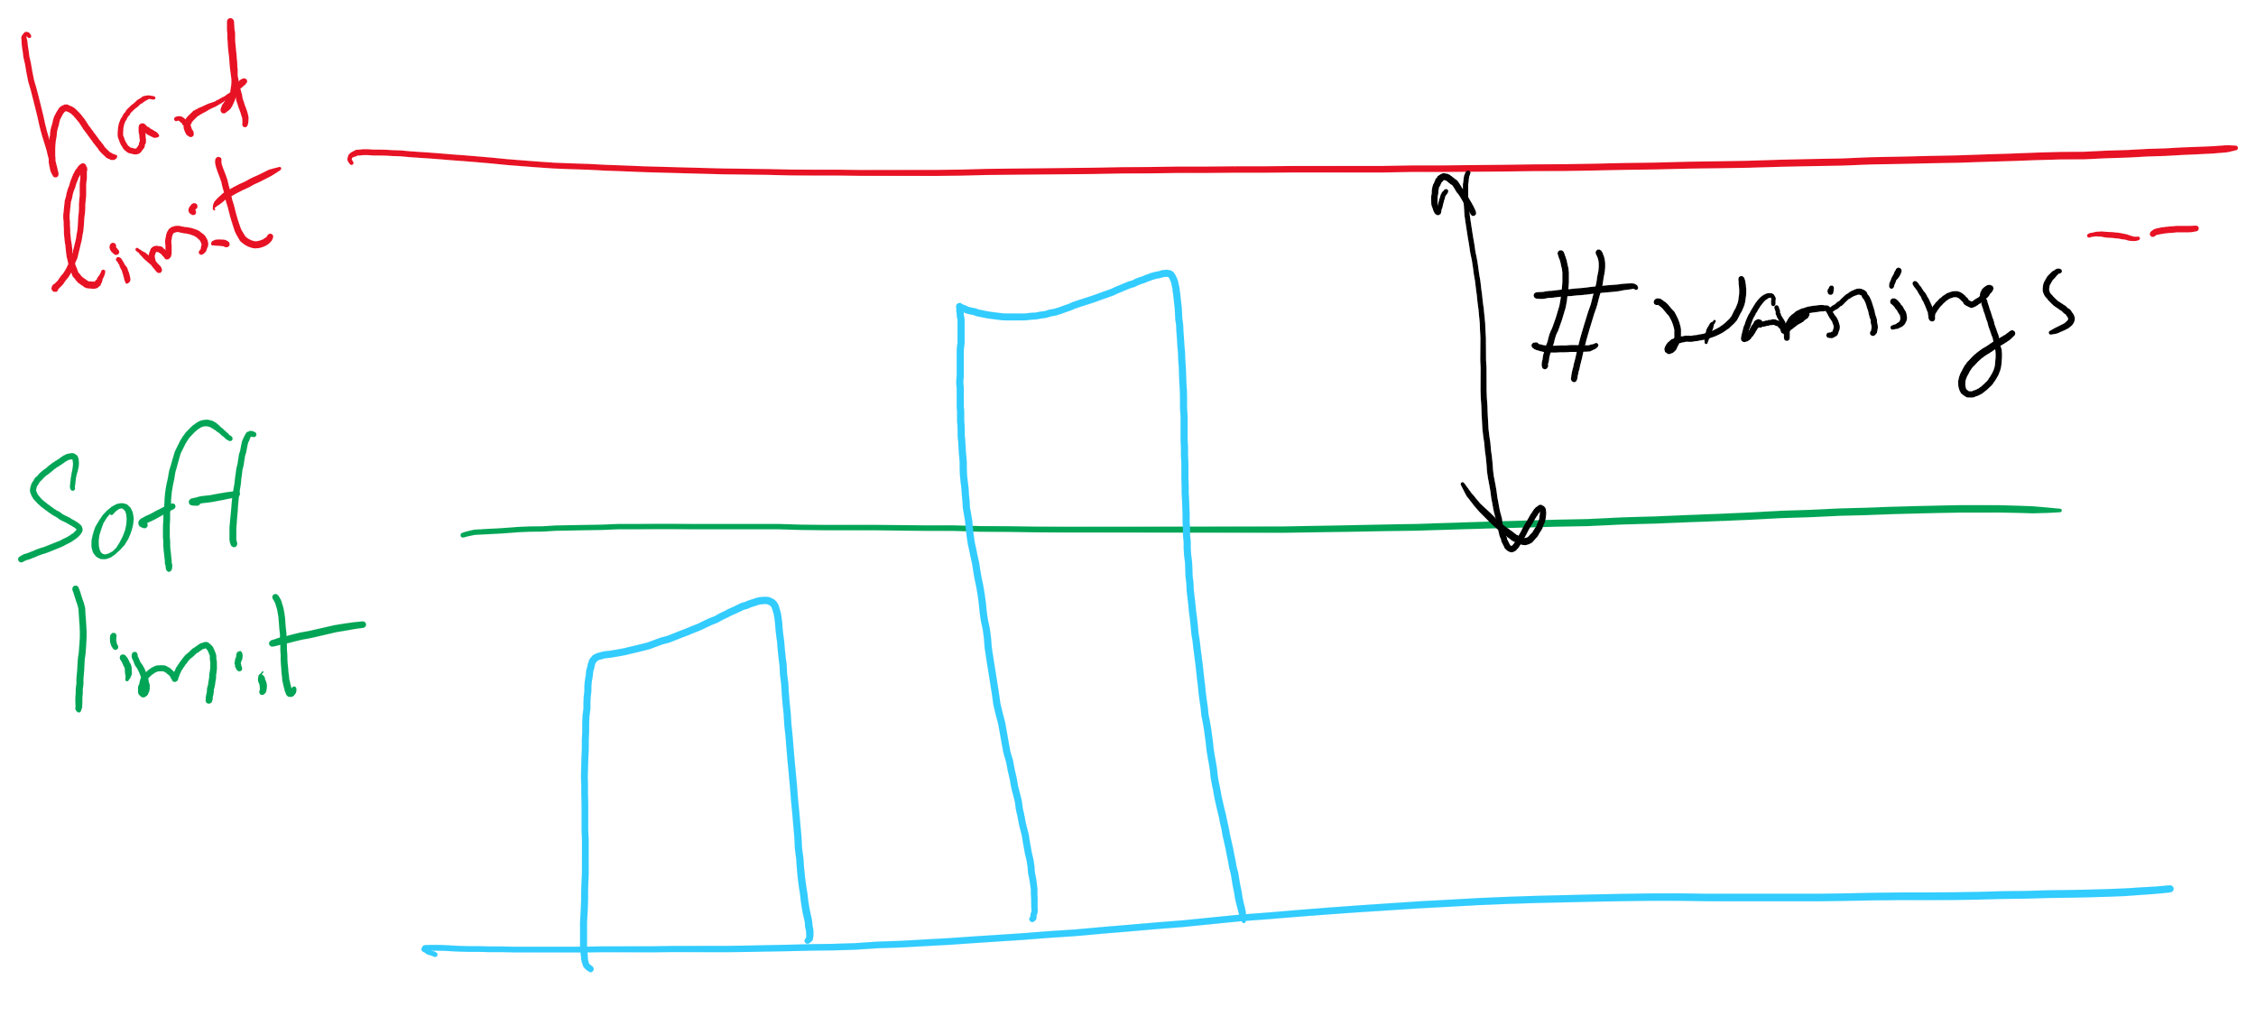
File-related kernel structures: quota table

Slide 10
Journaling File System
Problem: regular file system: changes to files and directories result in multiple separate writes to disk
e.g., deleting a file → three writes
power failures result in file system inconsistency
Solution: Write the changes twice
first to an on-disk journal
for efficiency, journal can be put on SSD or NVRAM
then commit changes to main part
atomic operations
modified data may or may not be written to the journal
implications?
Examples
Windows NTFS
Linux ext3, ext4

Slide 11
Journaling File System
Interaction with disk arm scheduling?
may cause a different write order than wanted
solution: flush write cache at certain points (barriers)
ext3 and ext4 file systems
Journaling vs. Log-structured file system
main file system itself is a journal
journaling is not needed in LFS

Slide 12
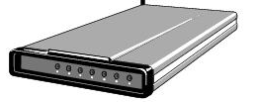
Buffering device input
User space
User space
User space
User space
Kernel space
Kernel space
Kernel space
Kernel space
2
2
1
1
3
Unbuffered input
Buffering in user space
Buffer in kernel Copy to user space
Double buffer in kernel

Slide 13
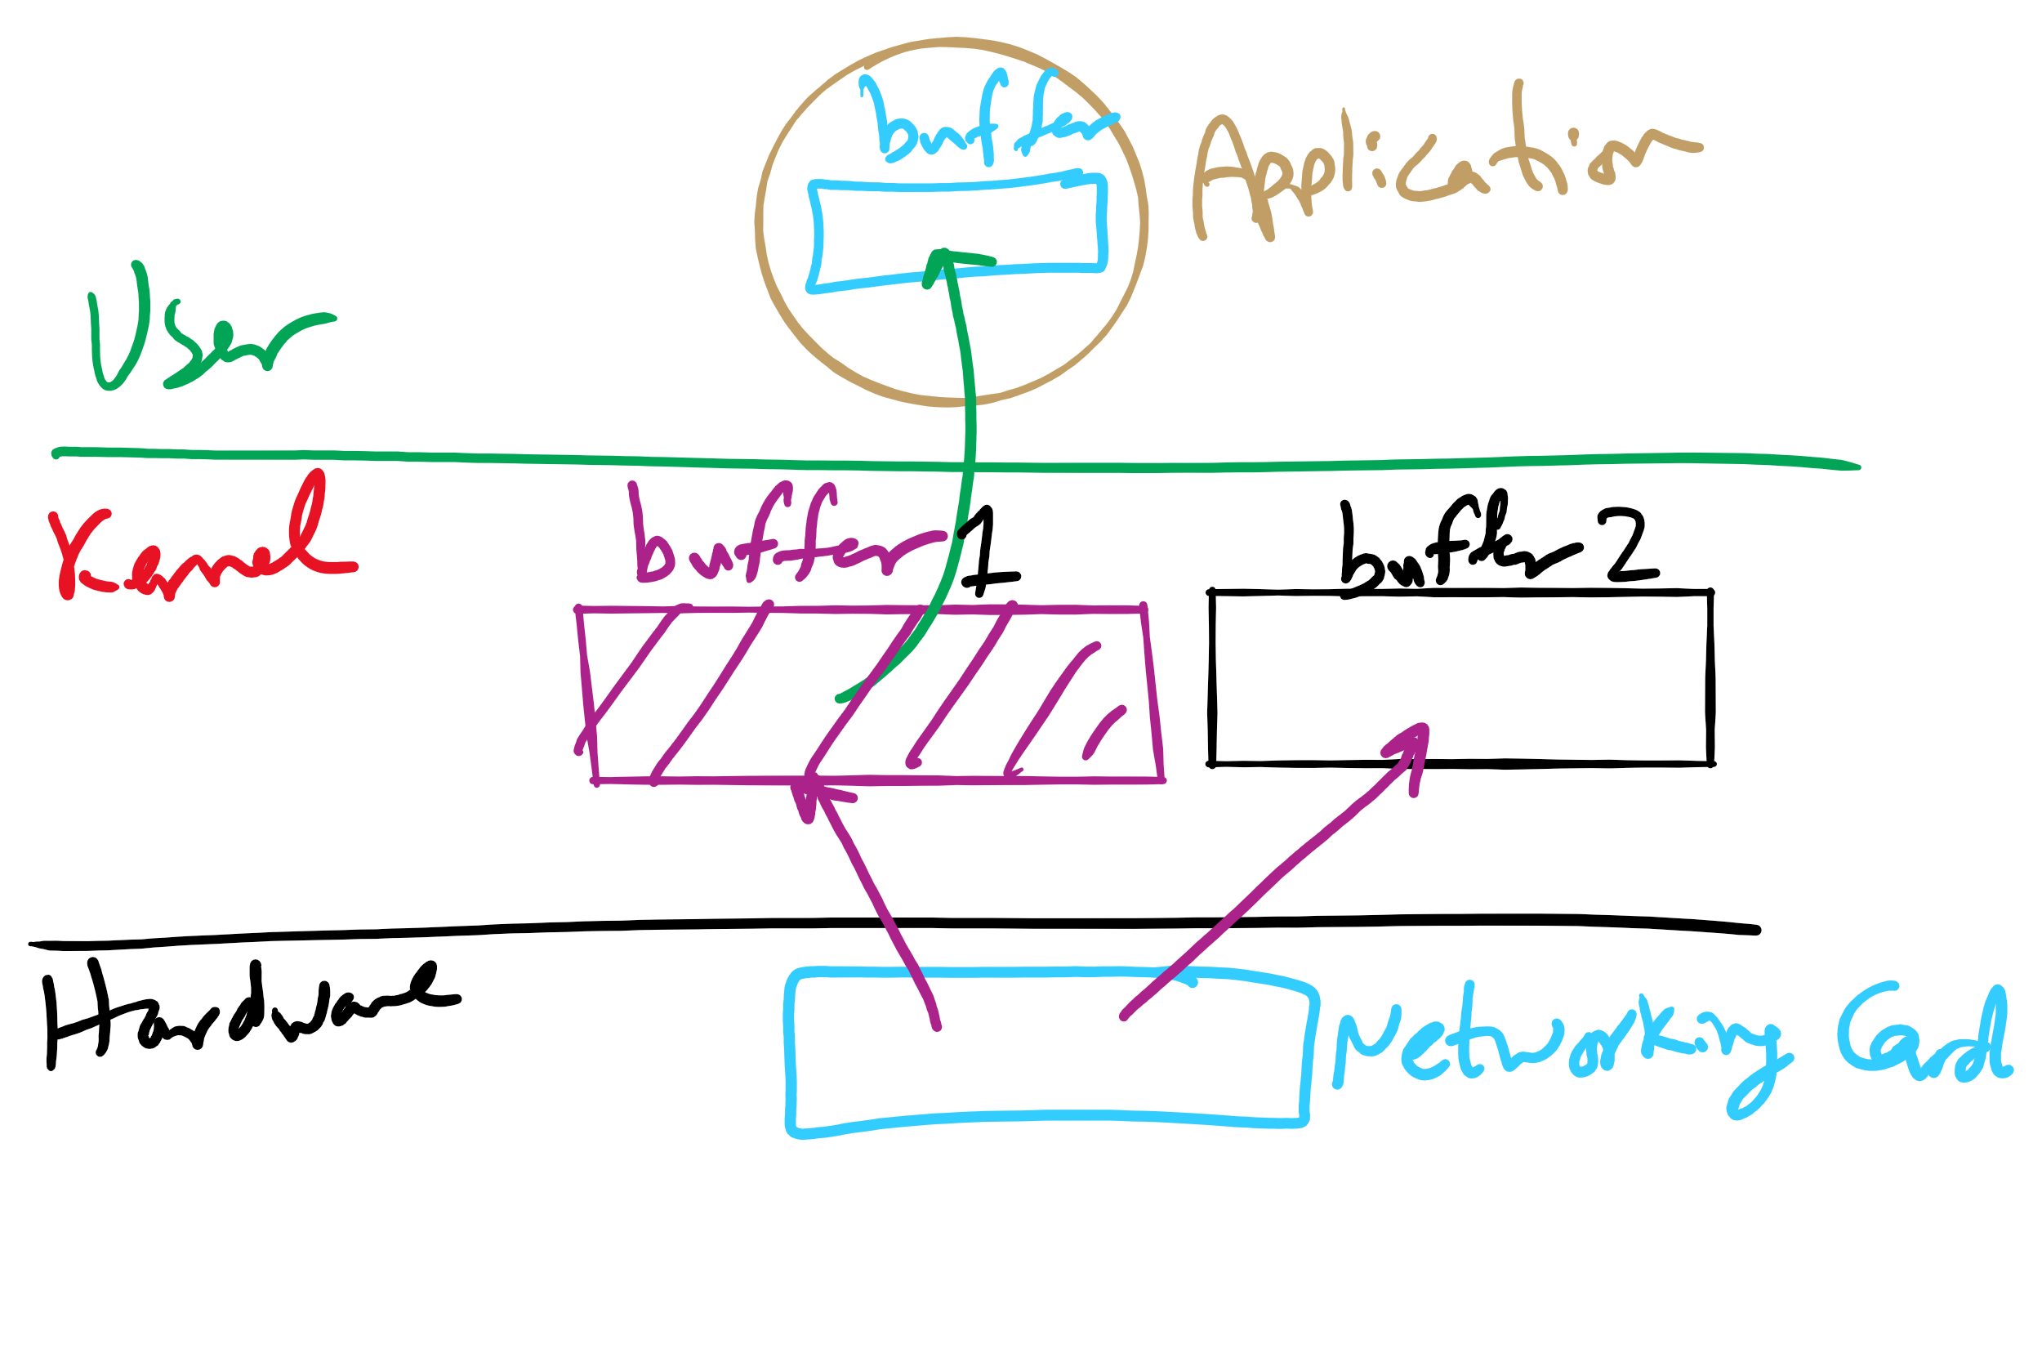
Double Buffering

Slide 14
Max Partition Size
Block size | FAT-12 | FAT-16 | FAT-32
0.5 KB | 2 MB
1 KB | 4 MB
2 KB | 8 MB | 128 MB
4 KB | 16 MB | 256 MB | 1 TB
8 KB |  | 512 MB | 2 TB
16 KB |  | 1024 MB | 2 TB
32 KB |  | 2048 MB | 2 TB

Slide 15
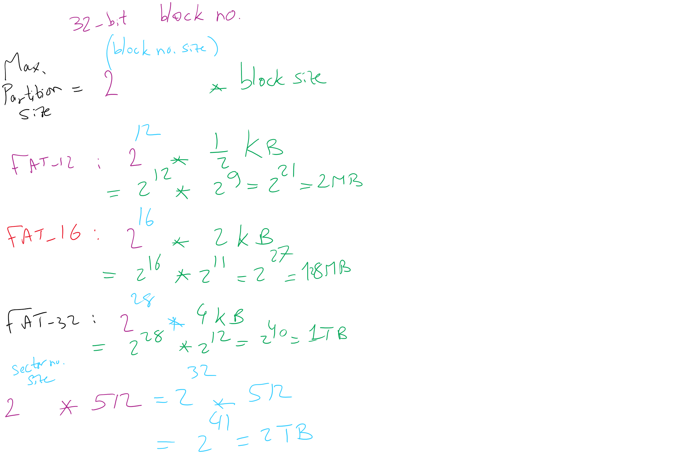
Max Partition Size
Block size | FAT-12 | FAT-16 | FAT-32
0.5 KB | 2 MB
1 KB | 4 MB
2 KB | 8 MB | 128 MB
4 KB | 16 MB | 256 MB | 1 TB
8 KB |  | 512 MB | 2 TB
16 KB |  | 1024 MB | 2 TB
32 KB |  | 2048 MB | 2 TB

Slide 16
Max Partition Size
Block size | FAT-12 | FAT-16 | FAT-32
0.5 KB | 2 MB
1 KB | 4 MB
2 KB | 8 MB | 128 MB
4 KB | 16 MB | 256 MB | 1 TB
8 KB |  | 512 MB | 2 TB
16 KB |  | 1024 MB | 2 TB
32 KB |  | 2048 MB | 2 TB

Slide 17
Max Partition Size
Block size | FAT-12 | FAT-16 | FAT-32
0.5 KB | 2 MB
1 KB | 4 MB
2 KB | 8 MB | 128 MB
4 KB | 16 MB | 256 MB | 1 TB
8 KB |  | 512 MB | 2 TB
16 KB |  | 1024 MB | 2 TB
32 KB |  | 2048 MB | 2 TB

Slide 18
Max Partition Size
Block size | FAT-12 | FAT-16 | FAT-32
0.5 KB | 2 MB
1 KB | 4 MB
2 KB | 8 MB | 128 MB
4 KB | 16 MB | 256 MB | 1 TB
8 KB |  | 512 MB | 2 TB
16 KB |  | 1024 MB | 2 TB
32 KB |  | 2048 MB | 2 TB

Slide 19
Max Partition Size
Block size | FAT-12 | FAT-16 | FAT-32
0.5 KB | 2 MB
1 KB | 4 MB
2 KB | 8 MB | 128 MB
4 KB | 16 MB | 256 MB | 1 TB
8 KB |  | 512 MB | 2 TB
16 KB |  | 1024 MB | 2 TB
32 KB |  | 2048 MB | 2 TB

Slide 20
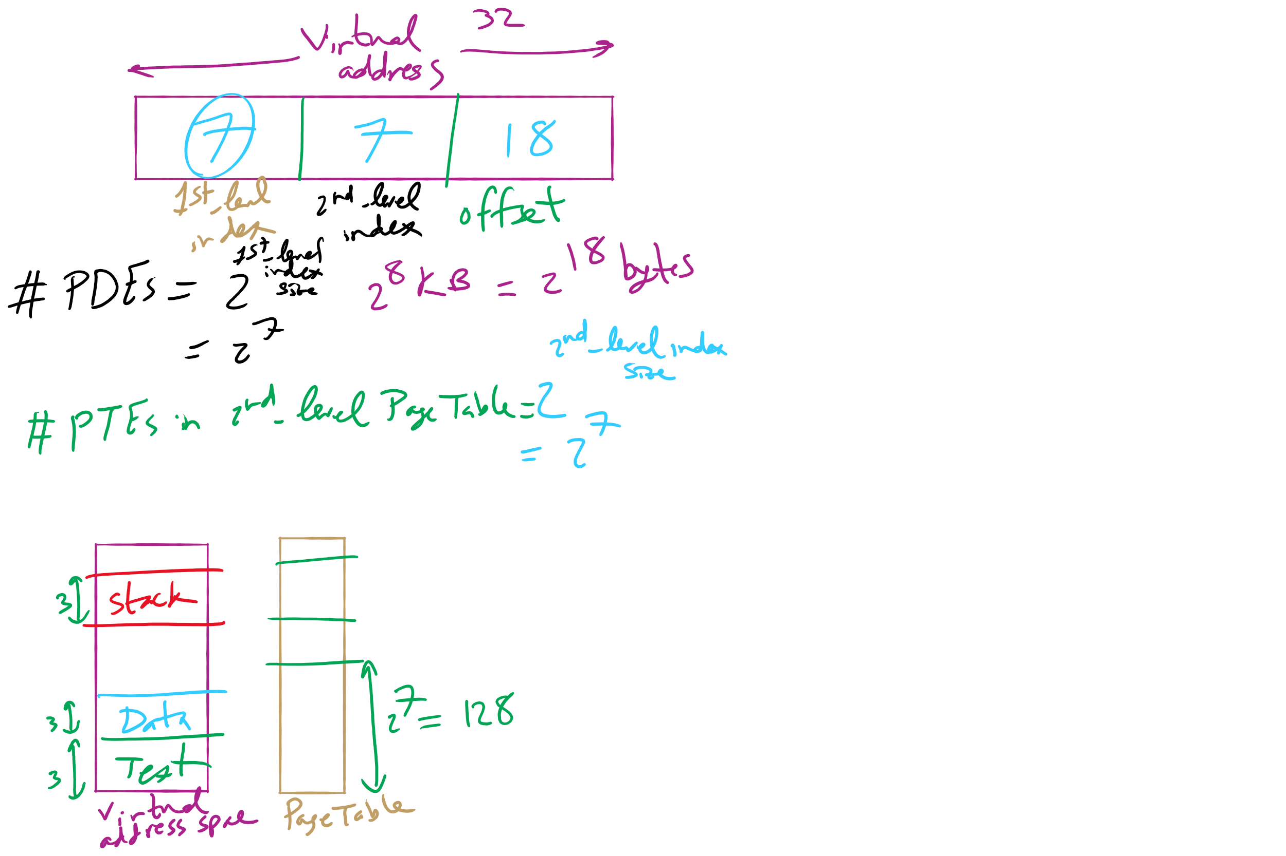
HW 10: Q 2-4

Slide 21
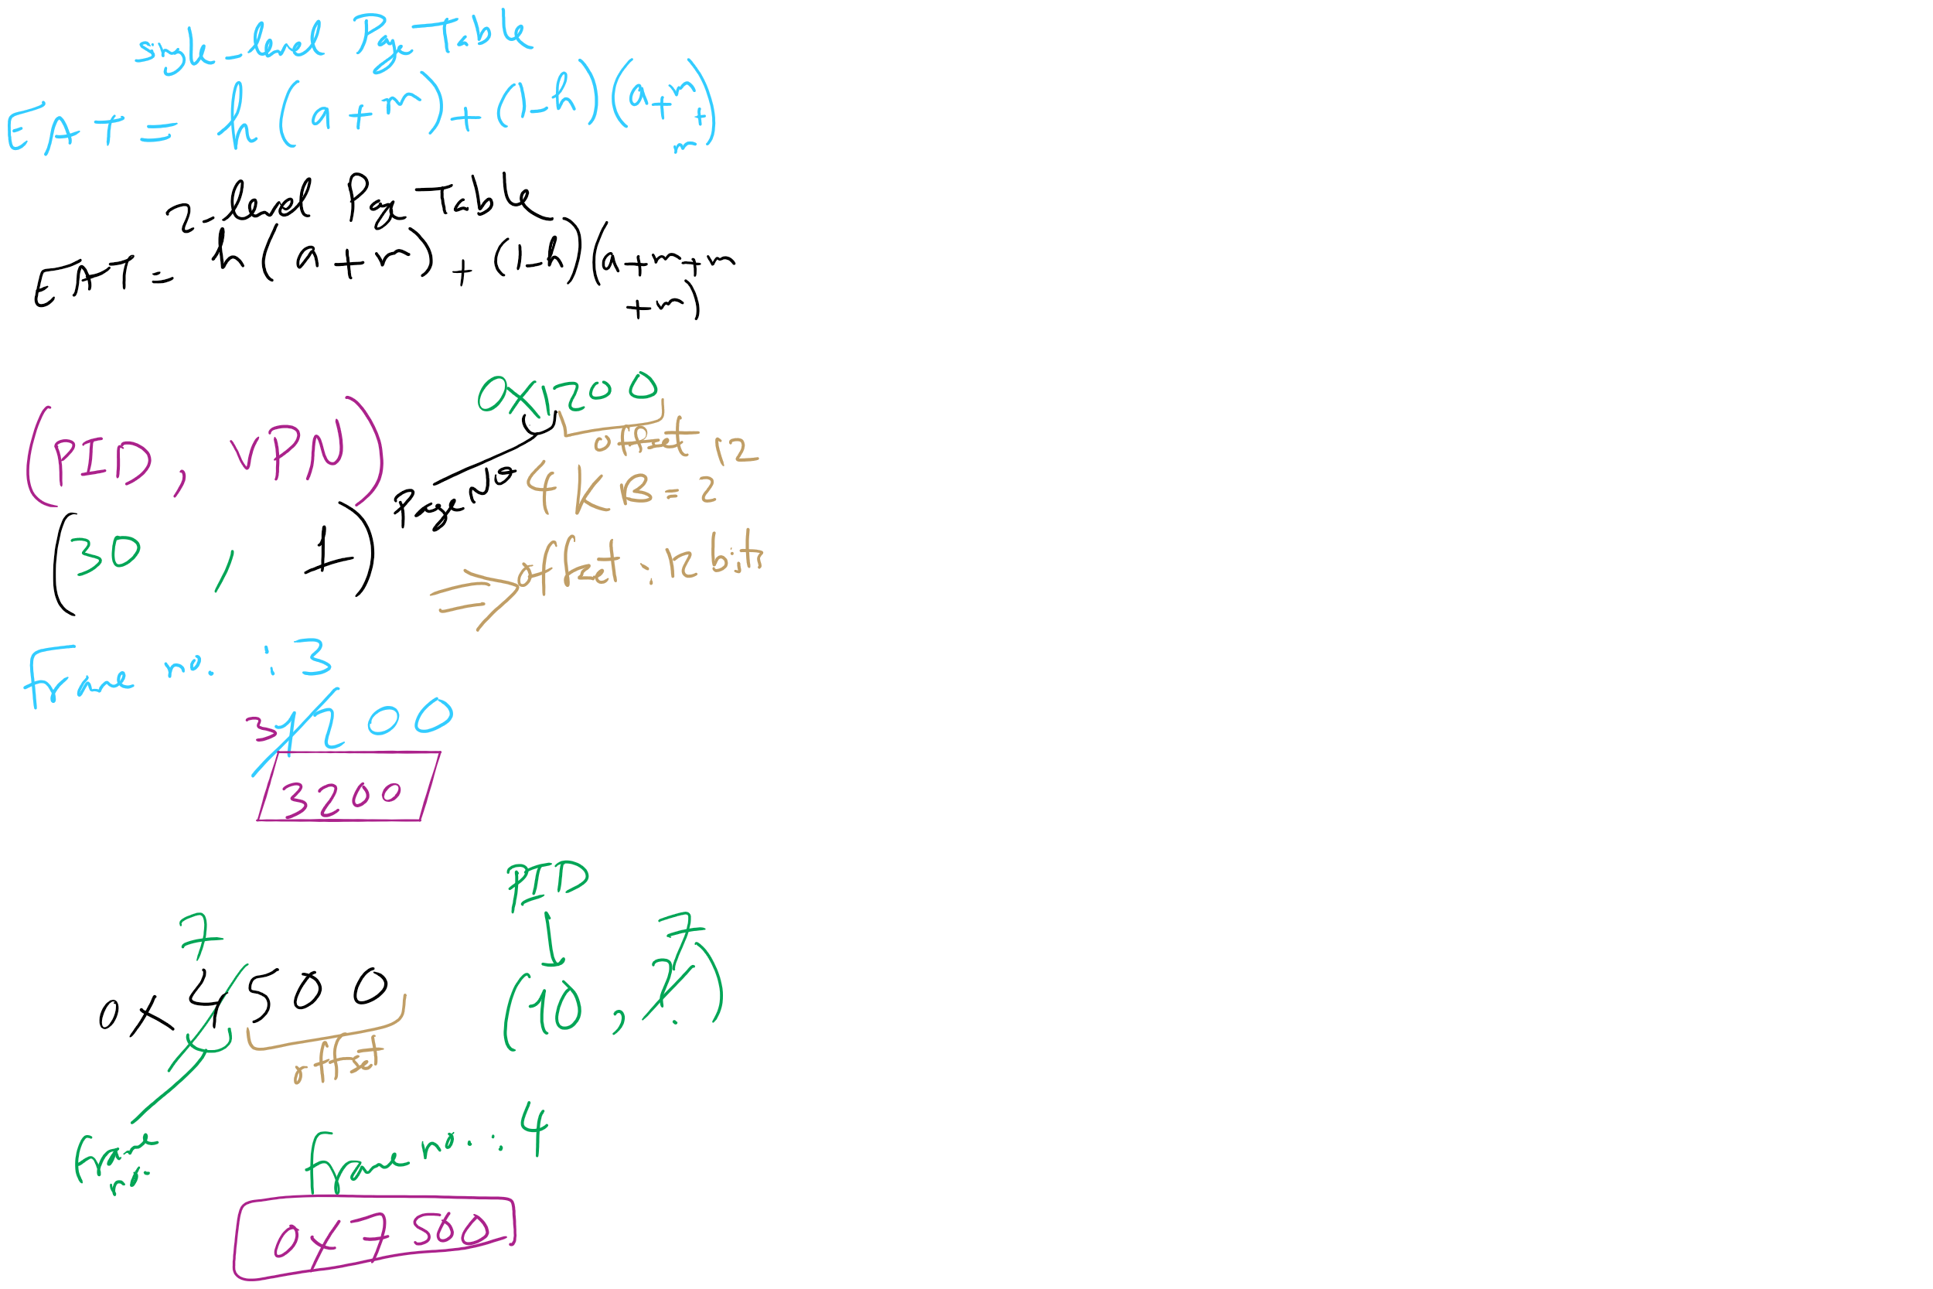
HW 10: Q 10-13

Slide 22
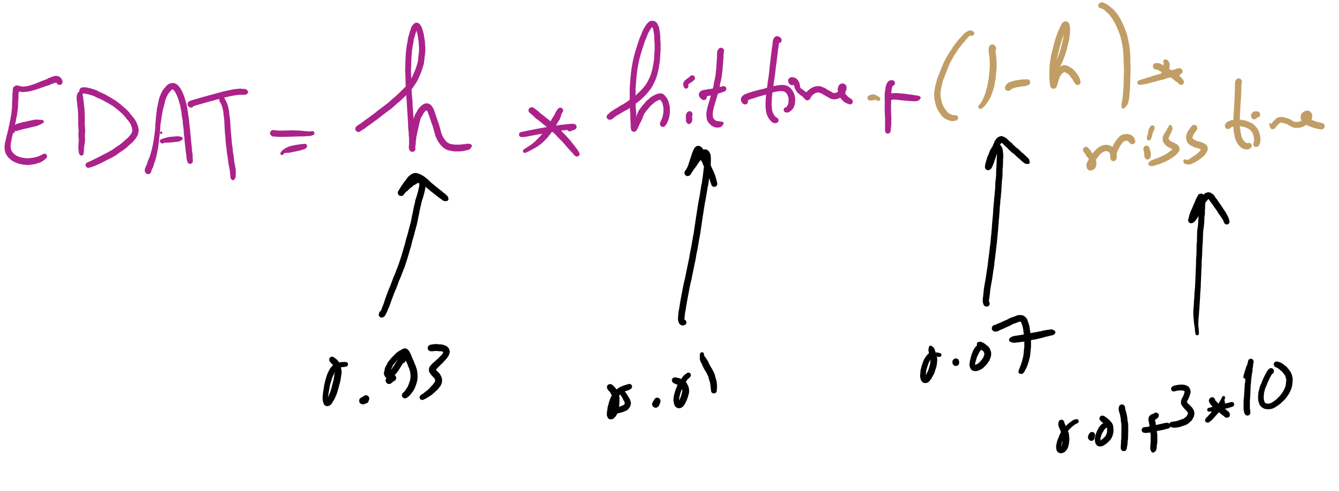
Effective Disk Access Time

Slide 23
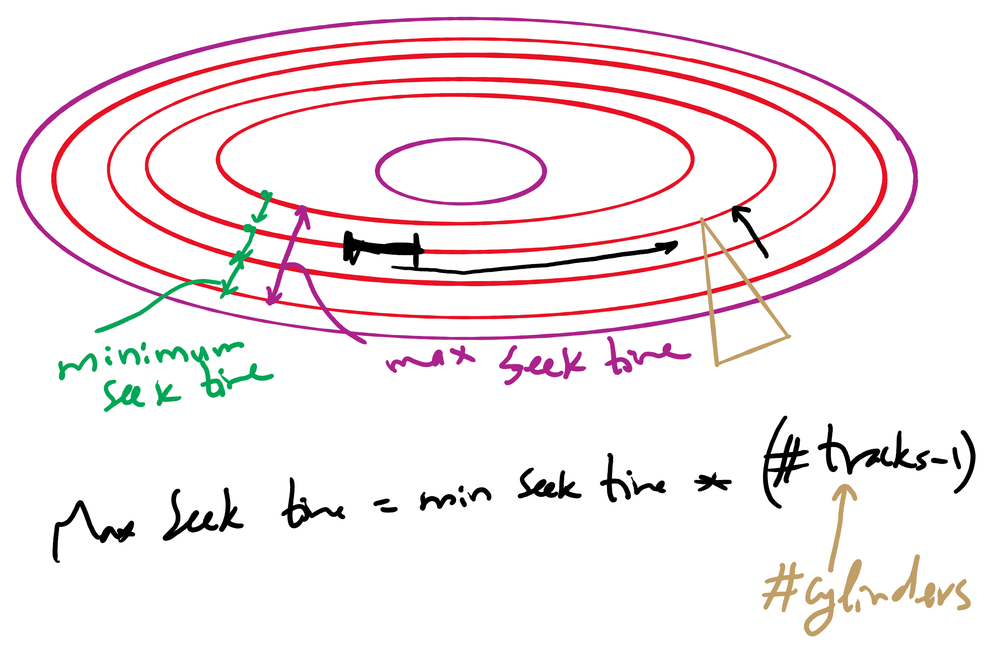
Minimum and Maximum Seek Time

Slide 24
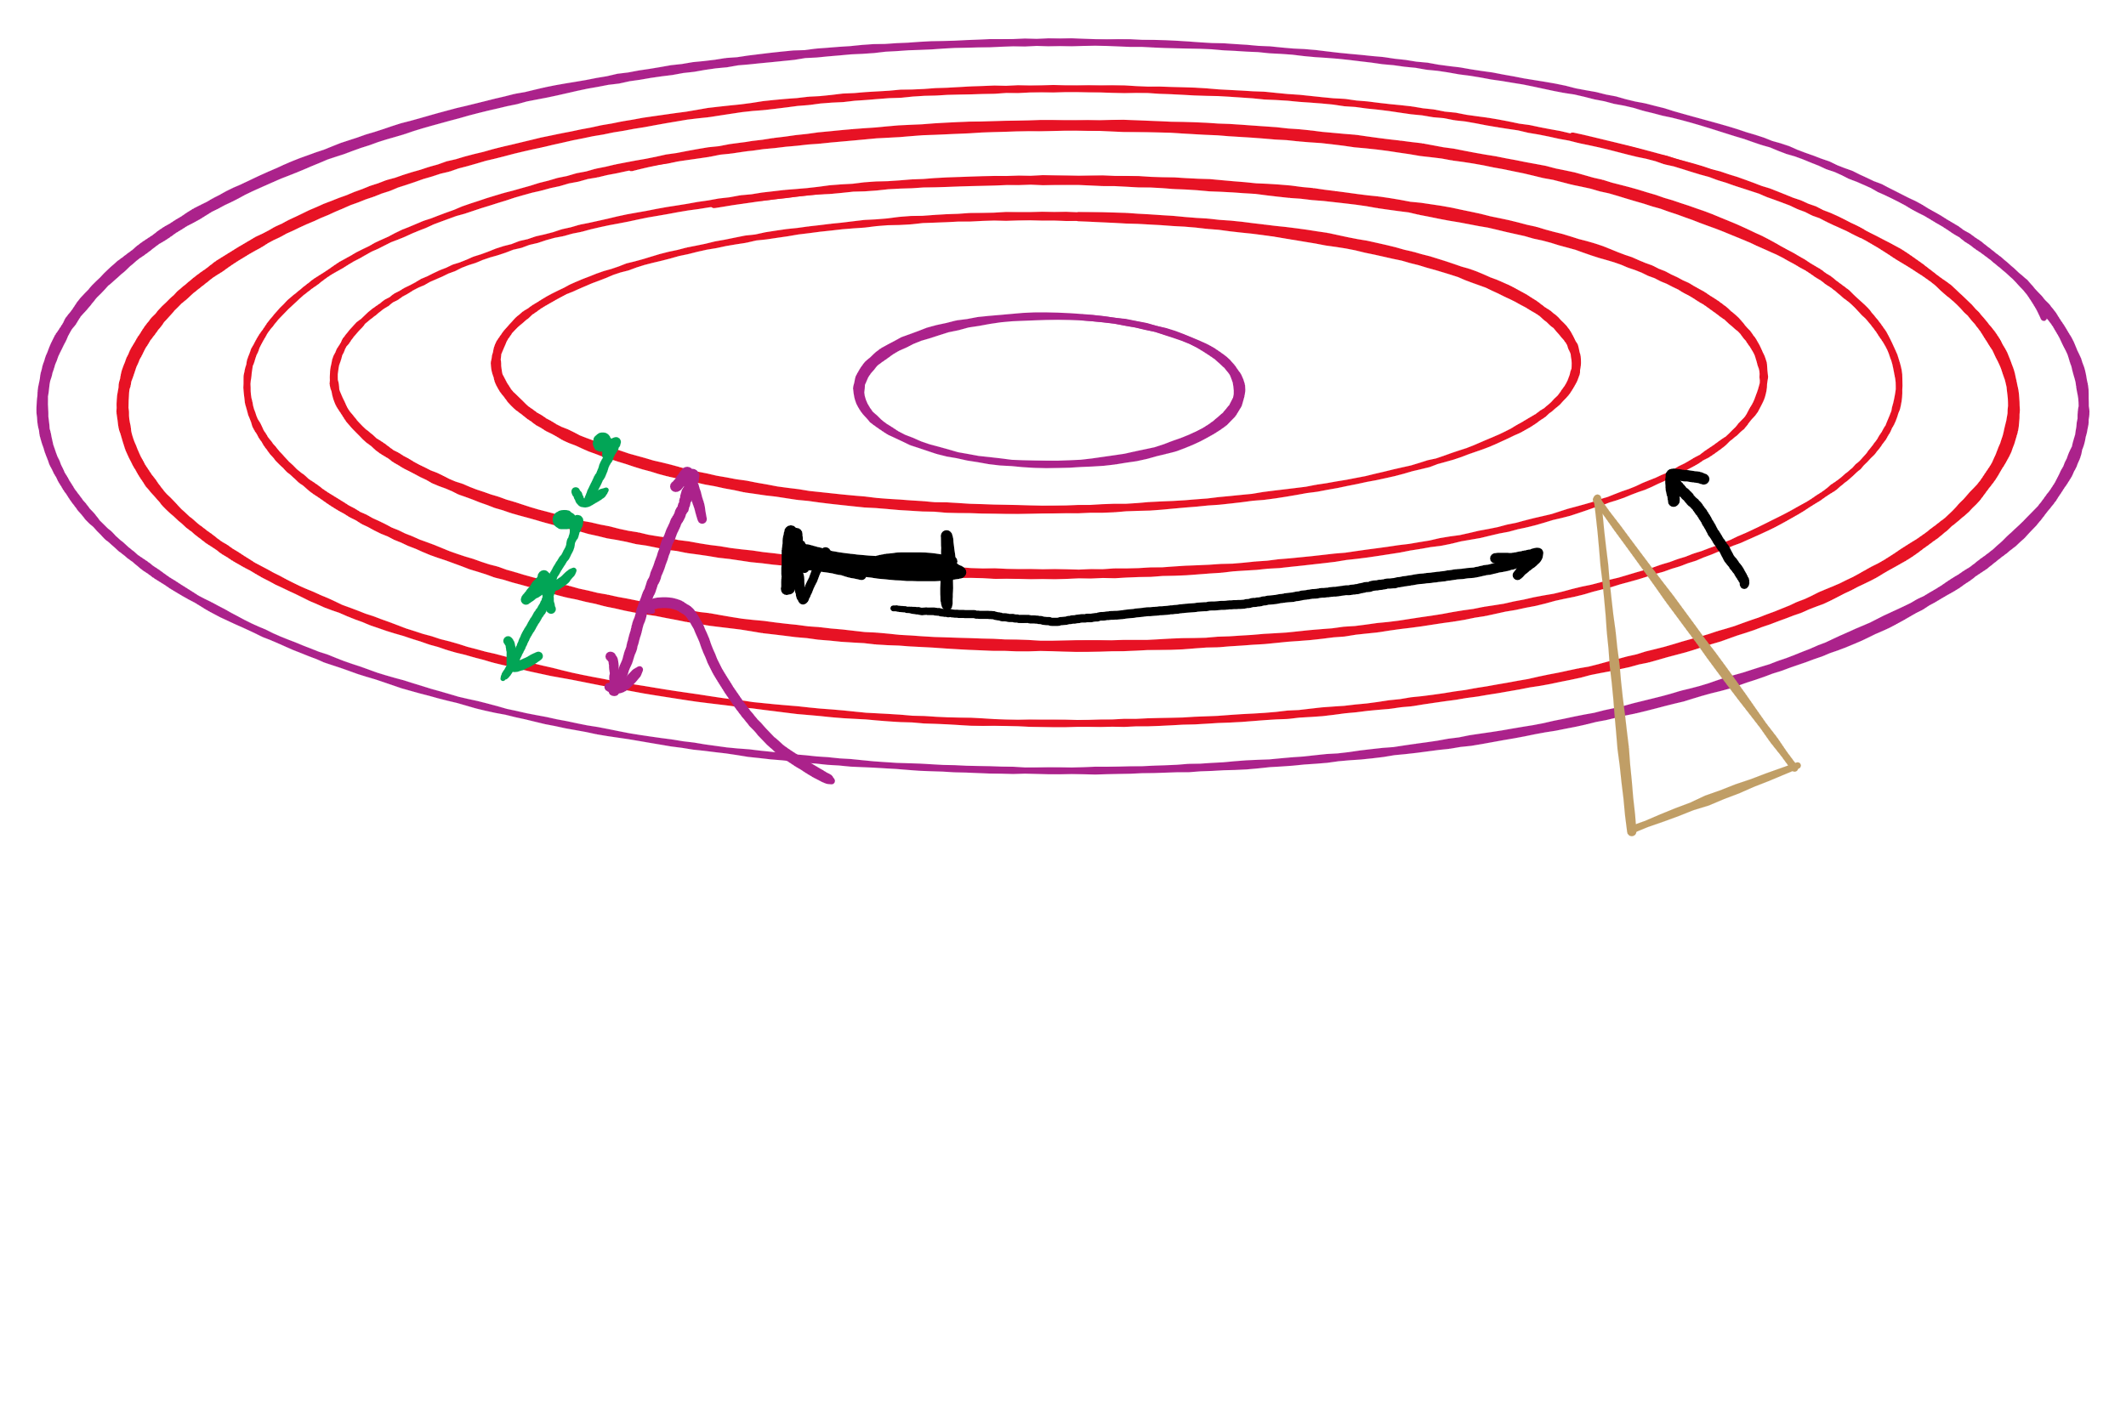
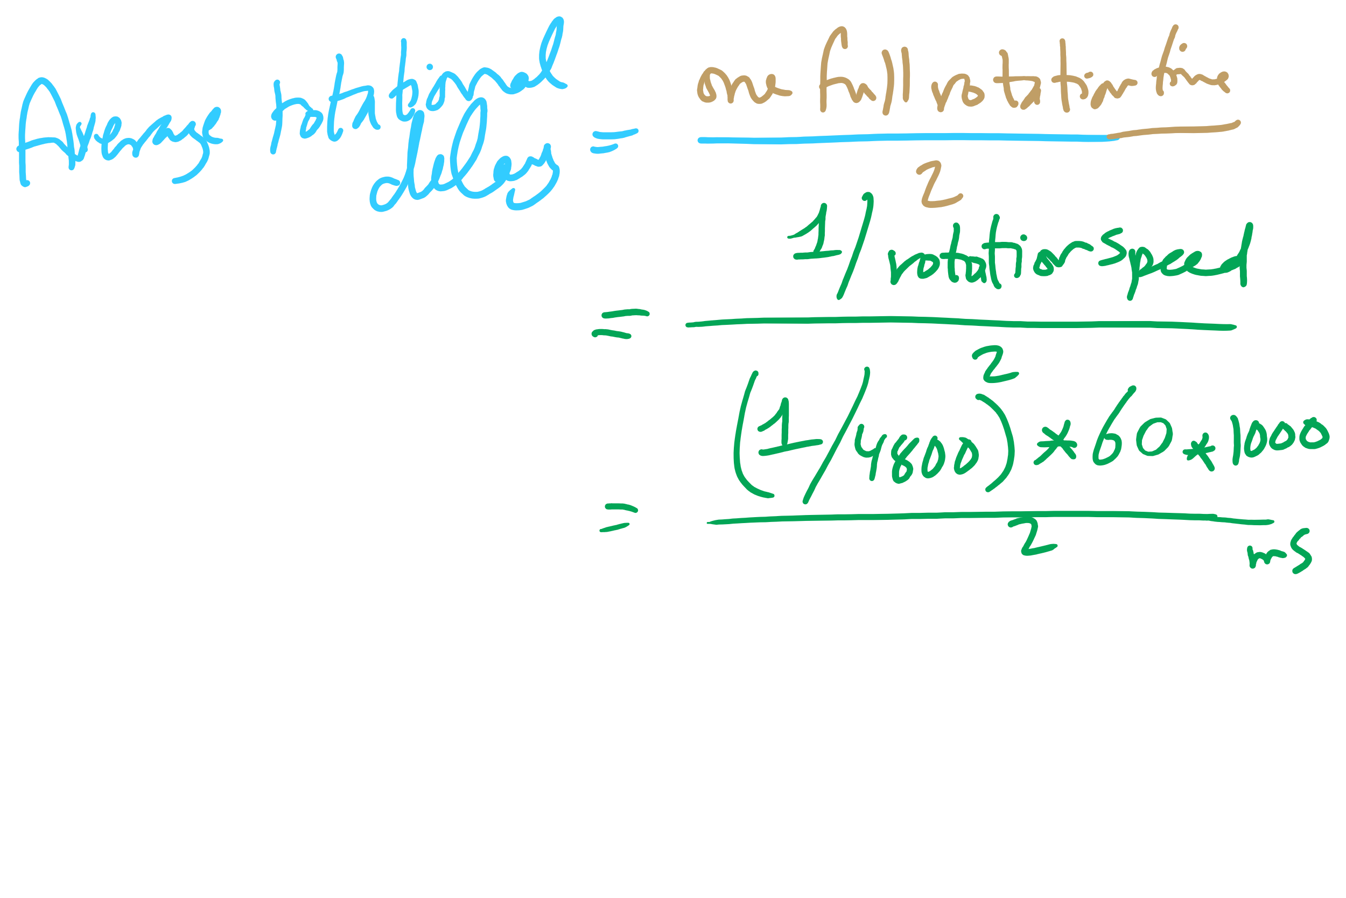
Average Rotational Delay

Slide 25
Problem of the Day: Protection
Protection is about controlling access of programs, processes, or users to the system resources (e.g., memory pages, files, devices, CPUs)
How to decide who can access what?
Specifications must be
Correct
Efficient
Easy to use (or nobody will use them!)

Slide 26
Protection domains
A process operates within a protection domain
resources accessible by the process
each domain lists objects with permitted operations
Domains can share objects & permissions
Objects can have different permissions in different domains
There need be no overlap between object permissions in different domains
How can this arrangement be specified more formally?
File1 [R] File2 [RW]
File3 [R]
File4 [RWX]
File5 [RW]
File3 [W]
Screen1 [W]
Mouse [R]
Printer [W]
Domain 1
Domain 2
Domain 3

Slide 27
Protection matrix
 | File1 | File2 | File3 | File4 | File5 | Printer1 | Camera
Domain1 | Read | Read Write
Domain2 |  |  | Read | Read Write Execute | Read Write | Write
Domain3 |  |  | Write |  |  | Write | Read
Each domain has a row in the matrix
Each object (resource) has a column in the matrix
Entry for <object, column> has the permissions
Who’s allowed to modify the protection matrix?
What changes can they make?
How is this implemented efficiently?

Slide 28
Domains as objects in the protection matrix
Domain | File1 | File2 | File3 | File4 | File5 | Printer1 | Camera | Dom1 | Dom2 | Dom3
1 | Read | Read Write |  |  |  |  |  | Modify
2 |  |  | Read | Read Write Execute | Read Write | Write |  | Modify
3 |  |  | Write |  |  | Write | Read |  | Enter
Specify permitted operations on domains in the matrix
Domains may (or may not) be able to modify themselves
Domains can modify other domains
Some domain transfers (switching) permitted, others not
Doing this allows flexibility in specifying domain permissions
Retains ability to restrict modification of domain policies

Slide 29
Representing the protection matrix
Need to find an efficient representation of the protection matrix (also called the access matrix)
Most entries in the matrix are empty!
Compress the matrix by:
Associating permissions with each object: access control list
Associating permissions with each domain: capabilities
How is this done, and what are the tradeoffs?

Slide 30
Access control lists (ACLs)
Each object has a list attached to it
List has
Protection domain (User name, Group of users, Other)
Access rights (Read, Write, Execute, Others)
No entry for domain => no rights for that domain
Operating system checks permissions when access is needed
File1
File2
elm: <R,W> znm: <R> root: <R,W,X>
elm: <R,X> uber: <R,W> root: <R,W> all: <R>

Slide 31
Access control lists in the real world
Unix file system
Access list for each file has exactly three domains on it
User (owner)
Group
Others
Rights include read, write, execute: interpreted differently for directories and files
AFS
Access lists only apply to directories: files inherit rights from the directory they’re in
Access list may have many entries on it with possible rights:
read, write, lock (for files in the directory)
lookup, insert, delete (for the directories themselves),
administer (ability to add or remove rights from the ACL)

Slide 32
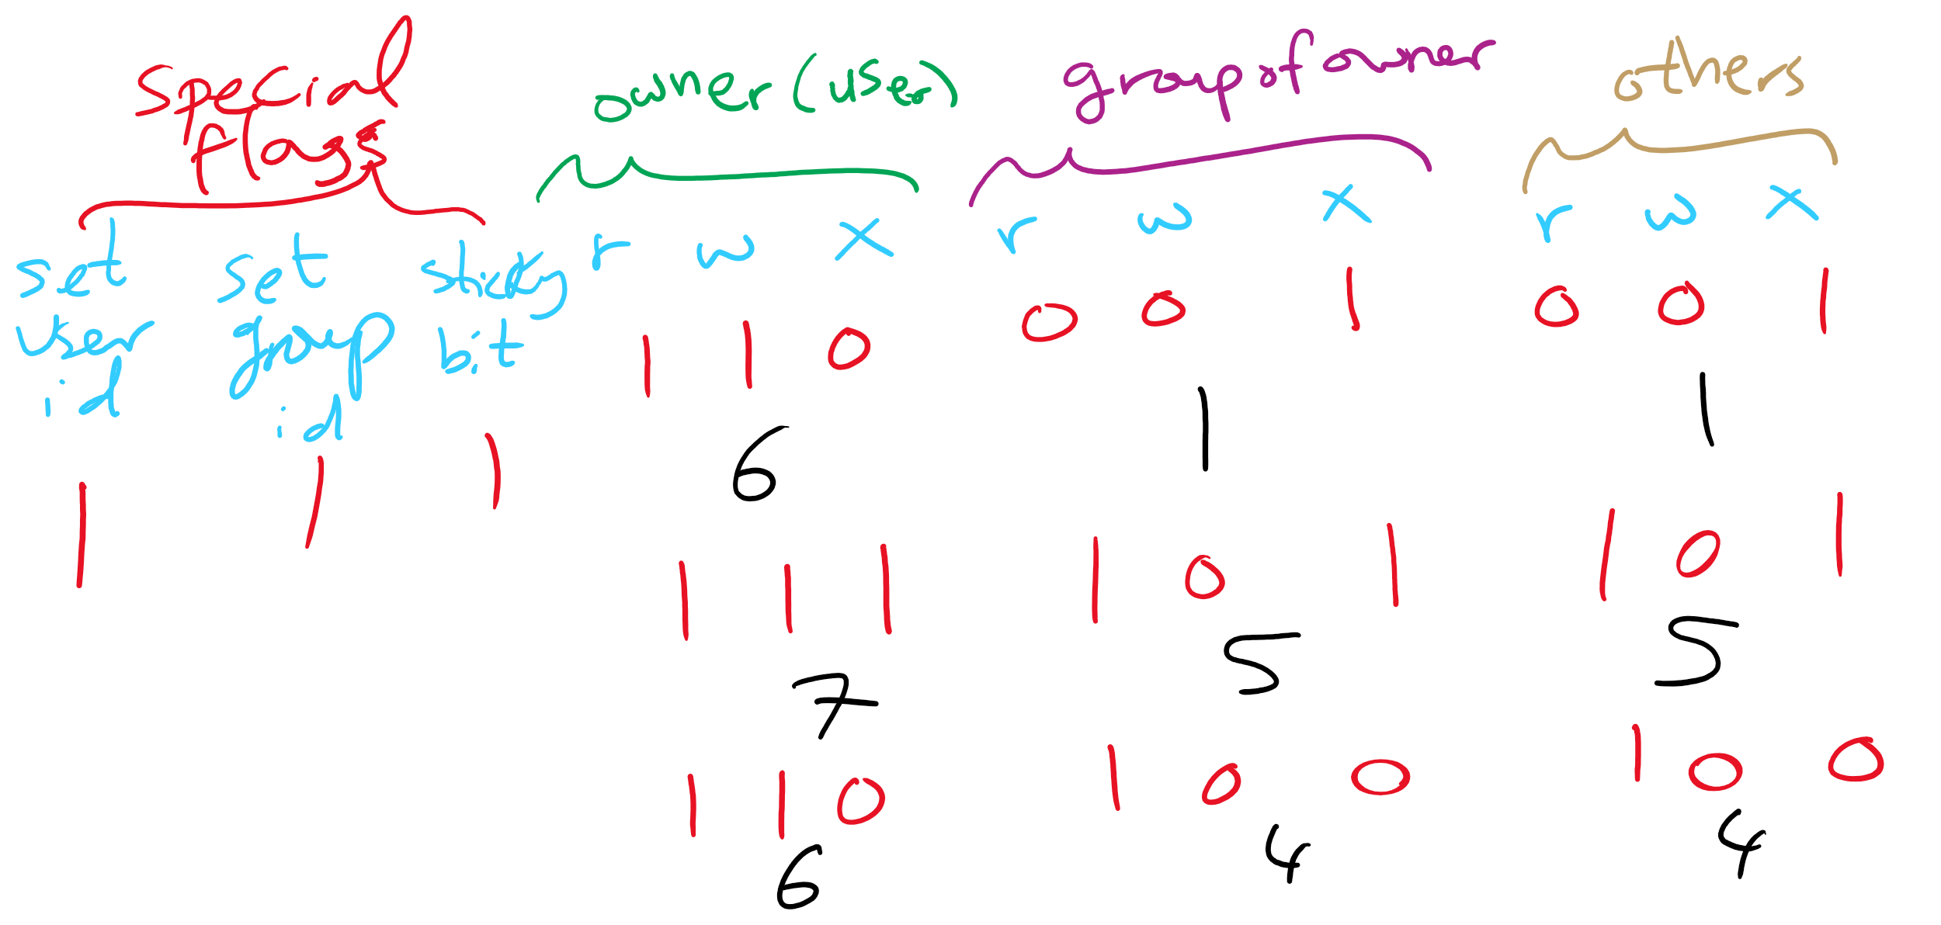
ACL in UNIX

Slide 33
Domains as objects in the protection matrix
Domain | File1 | File2 | File3 | File4 | File5 | Printer1 | Camera | Dom1 | Dom2 | Dom3
1 | Read | Read Write |  |  |  |  |  | Modify
2 |  |  | Read | Read Write Execute | Read Write | Write |  | Modify
3 |  |  | Write |  |  | Write | Read |  | Enter
Specify permitted operations on domains in the matrix
Domains may (or may not) be able to modify themselves
Domains can modify other domains
Some domain transfers (switching) permitted, others not
Doing this allows flexibility in specifying domain permissions
Retains ability to restrict modification of domain policies

Slide 34
Capabilities
Each process has a capability list
List has one entry per object the process can access
Object name
Object permissions
Objects not listed are not accessible
How are these secured?
Kept in kernel
Cryptographically secured
Process A
Process B
File1: <R,W> File2: <R> File3: <R,W,X>
File2: <R,W> File4: <R,W,X> File7: <W> File9: <R,W>

Slide 35
Cryptographically protected capability
Server
Object
Rights
H(Object,Rights,Check)
Rights include generic rights (read, write, execute) and
Copy capability
Copy object
Remove capability
Destroy object
Server has a secret (Check) and uses it to verify capabilities presented to it
Alternatively, use public-key signature techniques

Slide 36
Protecting the access matrix: summary
OS must ensure that the access matrix isn’t modified (or even accessed) in an unauthorized way
Access control lists
Reading or modifying the ACL is a system call
OS makes sure the desired operation is allowed
Capability lists
Can be handled the same way as ACLs: reading and modification done by OS
Can be handed to processes and verified cryptographically later on
May be better for widely distributed systems where capabilities can’t be centrally checked

