Slide 1


Introduction to Operating Systems CS 1550
Spring 2023
Sherif Khattab
ksm73@pitt.edu
(Some slides are from Silberschatz, Galvin and Gagne ©2013)

Slide 2
Announcements
Upcoming deadlines
Homework 5 is due this Friday
Project 1 is due on Friday 2/17 at 11:59 pm
Lab 2 is due on Tuesday 2/28 at 11:59 pm

Slide 3
Previous lecture …
Dining philosophers
Deadlock prevention
Banker’s Algorithm for deadlock detection and avoidance

Slide 4
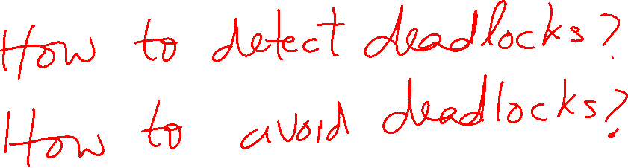
Banker’s Algorithm

Slide 5
Banker’s Algorithm
We can use the same algorithm for both detecting and avoiding deadlocks

Slide 6
Banker’s Algorithm
current=avail;
for (j = 0; j < N; j++) {
for (k=0; k<N; k++) {
if (finished[k])
continue;
if (want[k] <= current) {
finished[k] = 1;
current += hold[k];
break;
}
}
if (k==N) {
printf “Deadlock!\n”;
// finished[k]==0 means process is in
// the deadlock
break;
}
}
 | A | B | C | D
Avail | 2 | 3 | 0 | 1
Process | A | B | C | D
1 | 0 | 3 | 0 | 0
2 | 1 | 0 | 1 | 1
3 | 0 | 2 | 1 | 0
4 | 2 | 2 | 3 | 0
Hold
Process | A | B | C | D
1 | 3 | 2 | 1 | 0
2 | 2 | 2 | 0 | 0
3 | 3 | 5 | 3 | 1
4 | 0 | 4 | 1 | 1
Want
Note: want[j], hold[j], current, avail are arrays!

Slide 7
Banker’s Algorithm Insights
It is possible that some event sequences lead to a deadlock
What we are looking for is at least one event sequence that can make all processes finish
If such sequence exists, the state is safe
The Banker’s algorithm finds such sequence if it exists

Slide 8
Using the Banker’s Algorithm for Deadlock Avoidance
Call the algorithm on the following ``What-if” state instead of the current state

Slide 9
Problem of the Day: Sleepy Barbers
We have two sets of processes
Worker processes (e.g., barbers)
Customer processes
Customer processes may arrive at anytime
Worker processes check in when they are not serving any customers
Each worker process must wait until it gets matched with a customer process
Each customer process must wait until it gets matched with a worker process
The customer process cannot leave until the matched worker process finishes the work
The worker process cannot check in for the next customer until the matched customer process leaves
Many applications in the real-world

Slide 10
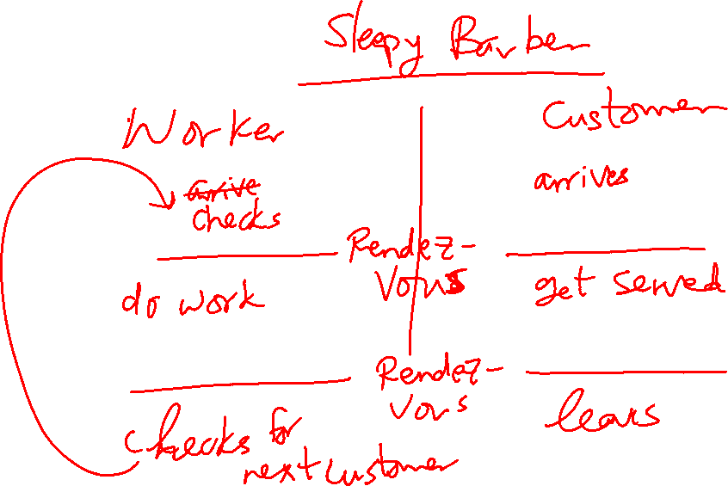
Rendezvous Pattern

Slide 11
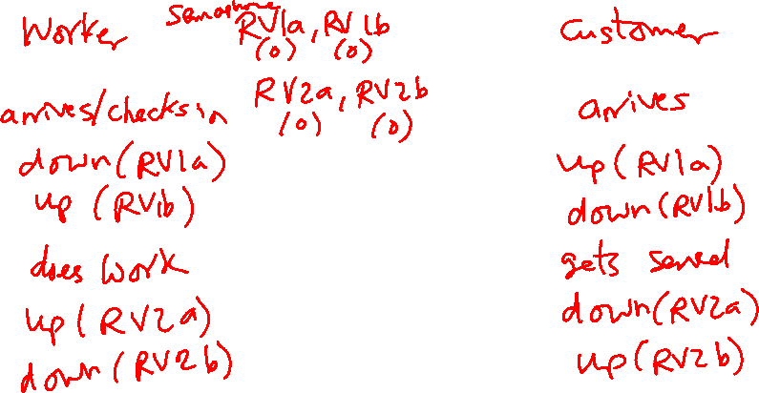
Solution Using Semaphores: Take 1
One pair of semaphores per rendezvous
RV1a and RV1b
RV2a and RV2b
Notice the flipped order of the down and up calls in the two processes

Slide 12
Solution Using Semaphores: Take 1
This solution doesn’t work for multiple workers and multiple customers
In that case, a customer can leave before its associated worker finishes

