Slide 1


Introduction to Operating Systems CS 1550
Spring 2023
Sherif Khattab
ksm73@pitt.edu
(Some slides are from Silberschatz, Galvin and Gagne ©2013)

Slide 2
Announcements
Upcoming deadlines:
Quiz 2: due on 3/25
Homework 9: due on 3/28
Lab 3: due on 4/1
Project 3: due on 4/11

Slide 3
Previous Lecture …
Tracing page replacement algorithms
FIFO and CLOCK
LRU and OPT

Slide 4
Muddiest Points
Do page evictions happen across processes?

Slide 5
Local vs. global allocation policies
What is the pool of pages eligible to be replaced?
Pages belonging to the process needing a new page
All pages in the system
Local allocation: replace a page from this process
May be more “fair”: penalize processes that replace many pages
Can lead to poor performance: some processes need more pages than others
Global allocation: replace a page from any process
Last access time
Page
A0
14
A1
12
Local allocation
A2
8
A3
A4
5
A4
B0
10
B1
9
Global allocation
B2
A4
3
C0
16
C1
12
C2
8
C3
5
C4
4

Slide 6
Muddiest Points
what measures do modern operating systems take in order to minimize thrashing?

Slide 7
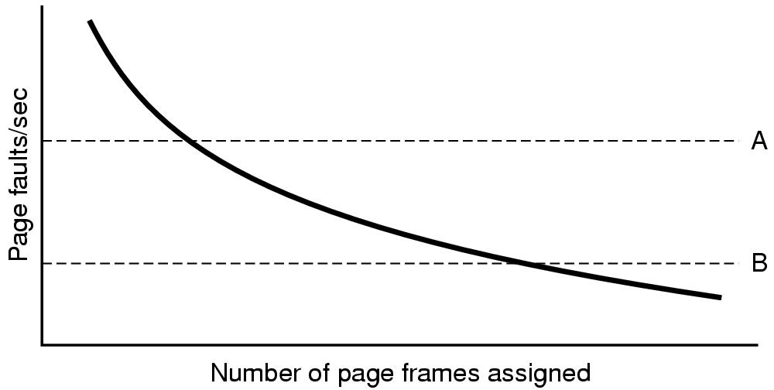
Page fault rate vs. allocated frames
Local allocation may be more “fair”
Don’t penalize other processes for high page fault rate
Global allocation is better for overall system performance
Take page frames from processes that don’t need them as much
Reduce the overall page fault rate (even though rate for a single process may go up)

Slide 8
Control overall page fault rate
Despite good designs, system may still thrash
Most (or all) processes have high page fault rate
Some processes need more memory, …
but no processes need less memory (and could give some up)
Problem: no way to reduce page fault rate
Solution : Reduce number of processes competing for memory
Swap one or more to disk, divide up pages they held
Reconsider degree of multiprogramming

Slide 9
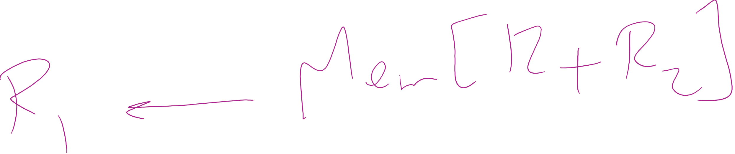
Backing up an instruction
Problem: page fault happens in the middle of instruction execution
Some changes may have already happened
Others may be waiting for VM to be fixed
Solution: undo all of the changes made by the instruction
Restart instruction from the beginning
This is easier on some architectures than others
Example: LW R1, 12(R2)
Page fault in fetching instruction: nothing to undo
Page fault in getting value at 12(R2): restart instruction

Slide 10
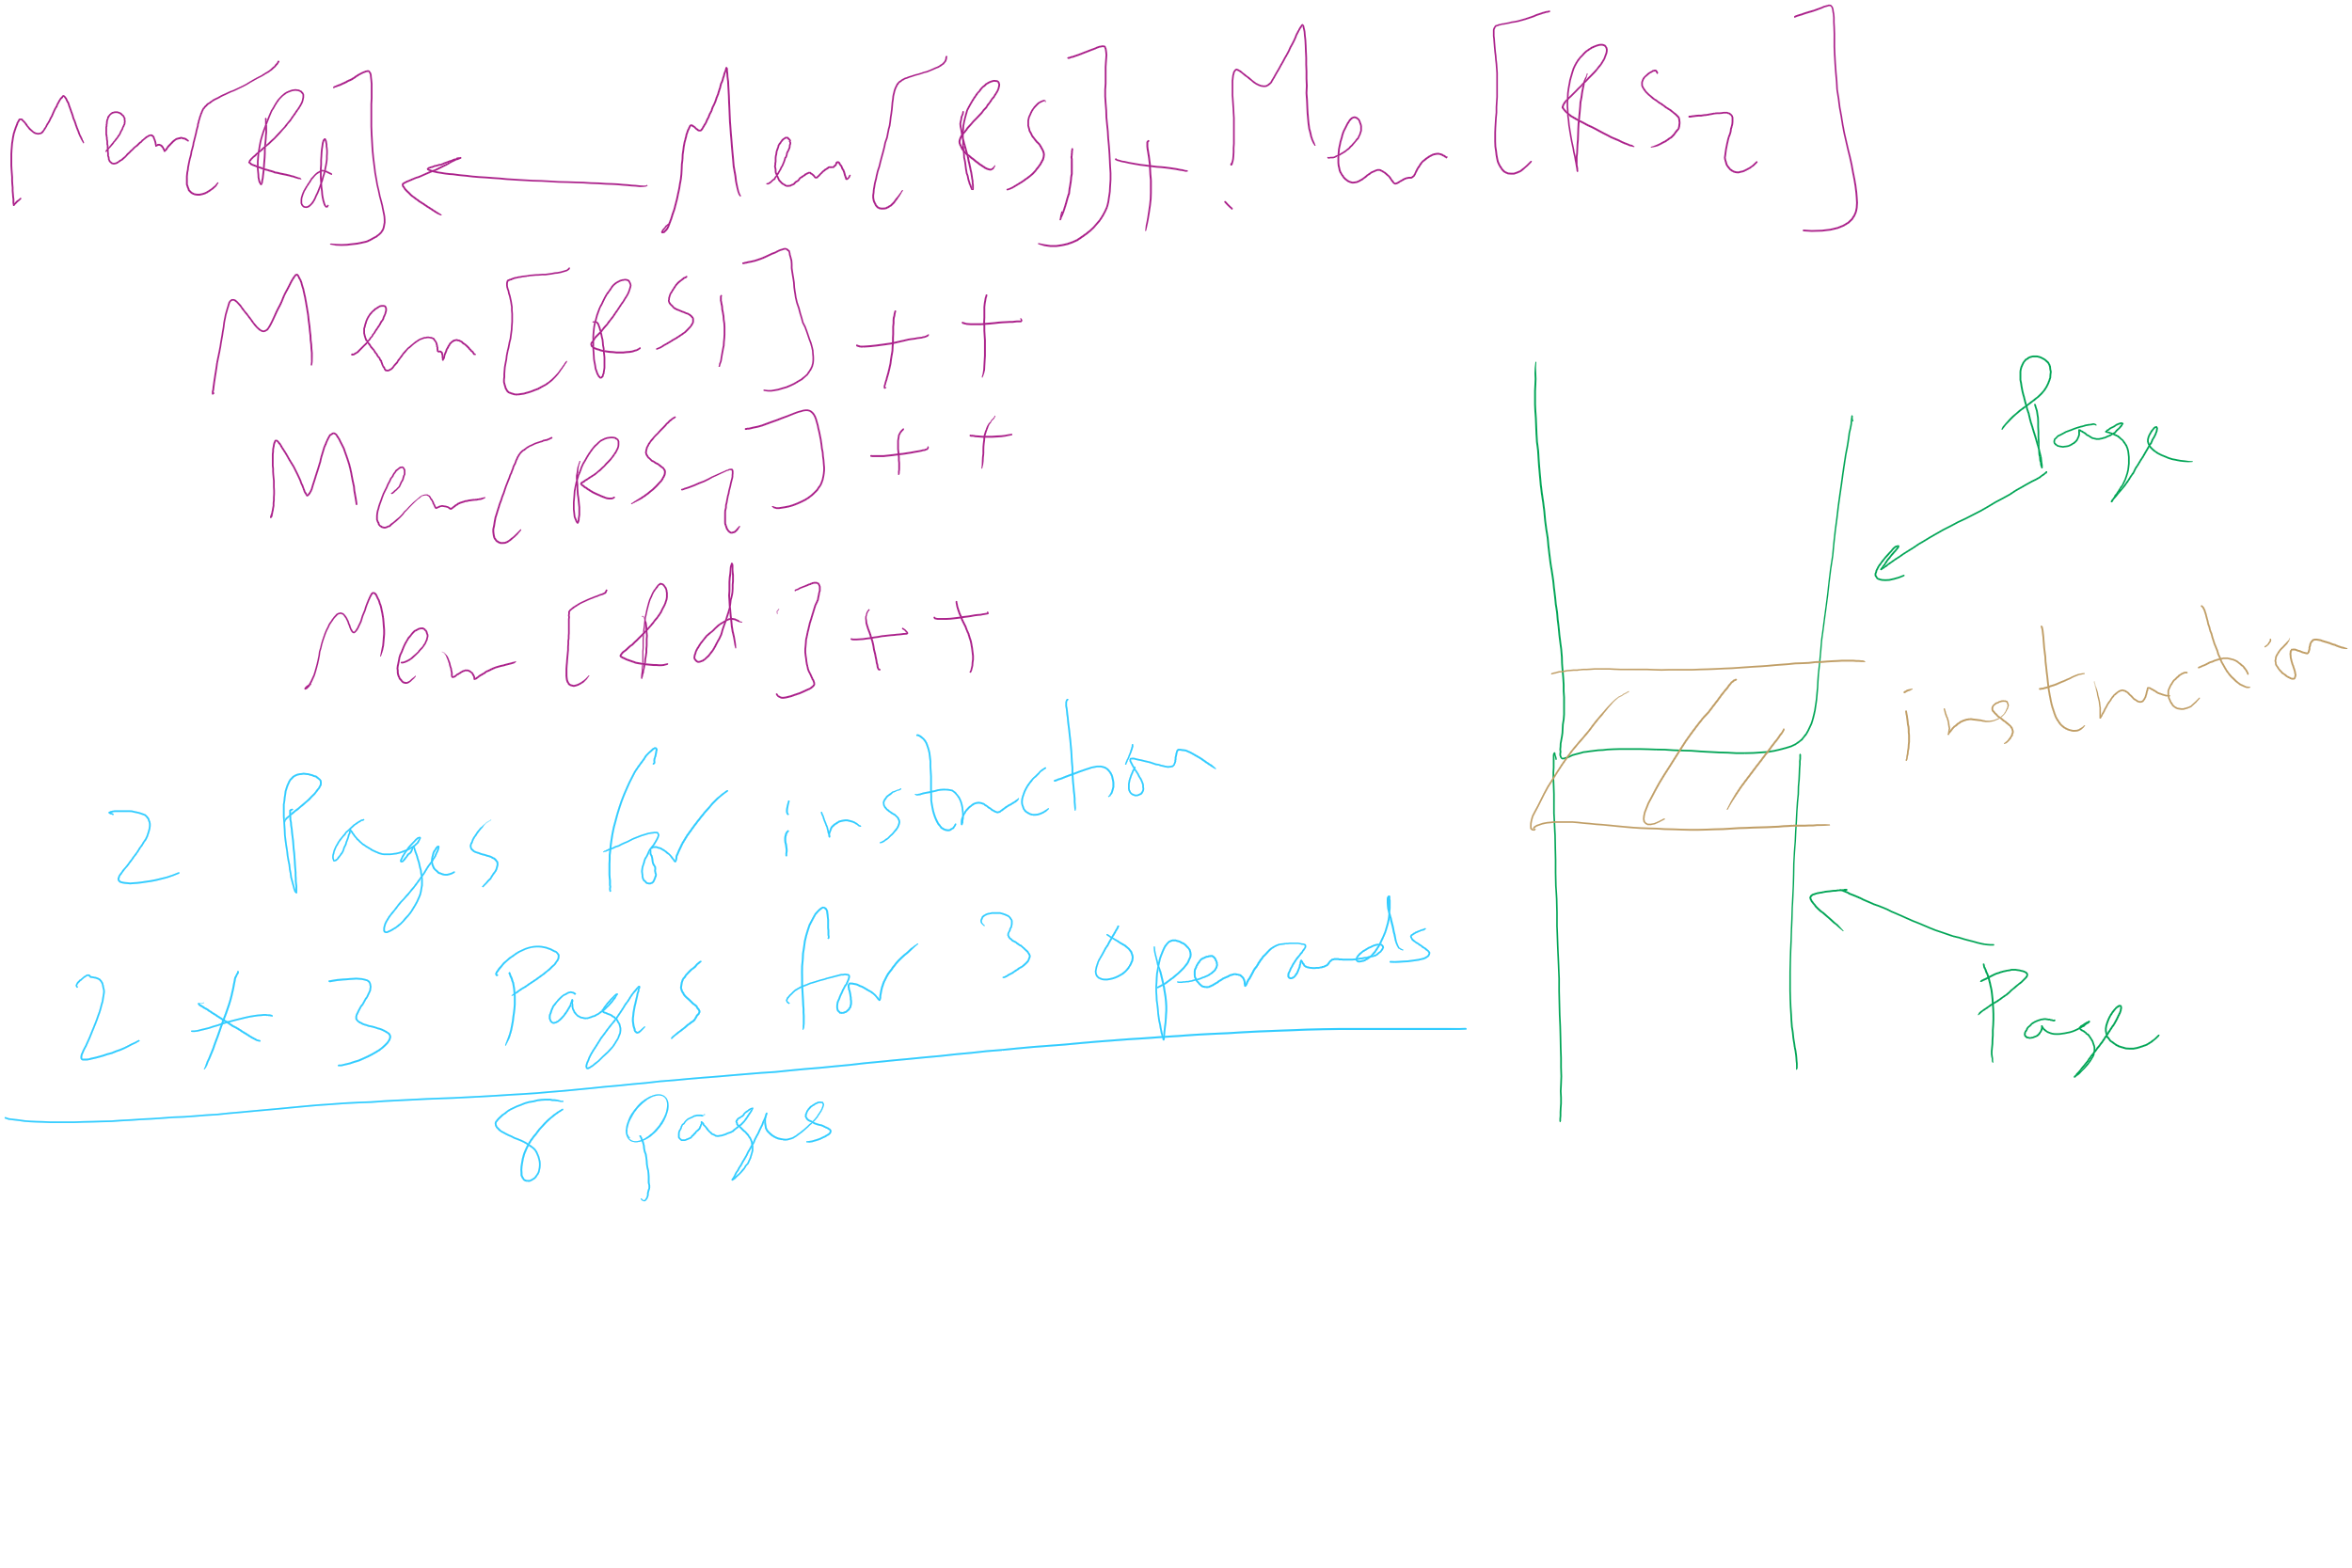
Minimum memory allocation to a process
Example: ADD (Rd)+,(Rs1)+,(Rs2)+
Page fault in writing to (Rd): may have to undo an awful lot…

Slide 11
Muddiest Points
What is disk write?
What does the * mean?
CLOCK
When does the orbit (or bit?) change in the clock simulation (FIFO/slide 14)
how does the clock iterate in the example from class?
LRU
Determining page faults in LRU modelling
How to calculate the distance
Is there a way to easily determine the disk writes using the LRU stack algorithm?
Would you please solve some example for LRU and OPT? Thank you so much

Slide 12
Muddiest Points
How the tracing changes between different types of scheduling
FIFO
why does FIFO have more page faults with more memory (small explanation?)?
How to implement stack algorithm in code

Slide 13
Muddiest Points
how to keep track of larger tables that can store more pages.
Problem of the Day!

Slide 14
Separating policy and mechanism
Mechanism for page replacement has to be in kernel
Modifying page tables
Reading and writing page table entries
Policy for deciding which pages to replace could be in user space
More flexibility
3. Request page
User process
External pager
4. Page arrives
User space
2. Page needed
5. Here is page!
Kernel space
Fault handler
MMU handler
1. Page fault
6. Map in page

Slide 15
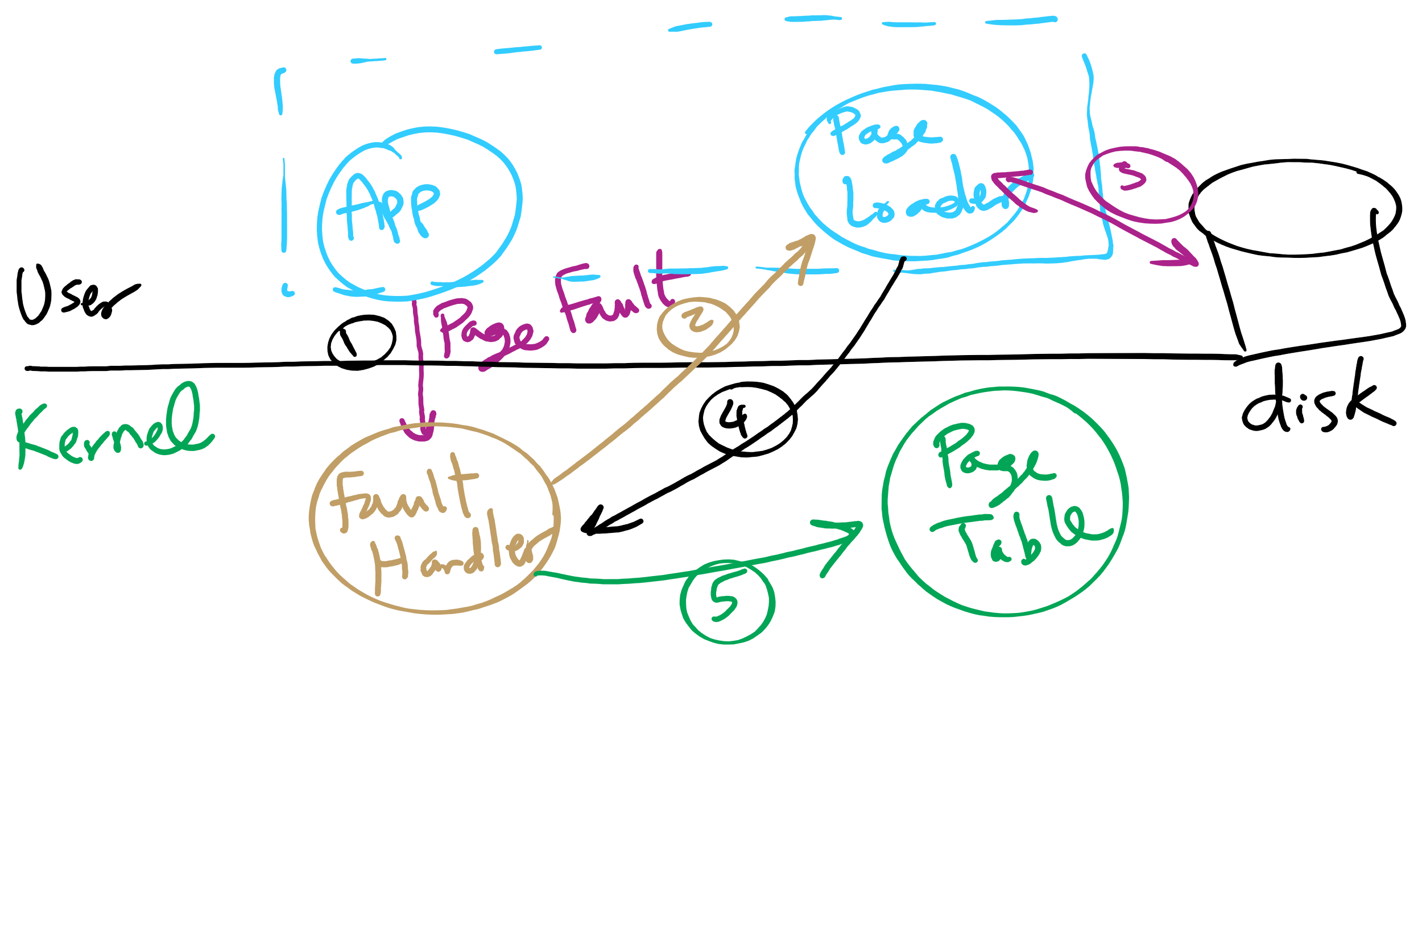
Separating Policy and Mechanism for Page Replacement

Slide 16
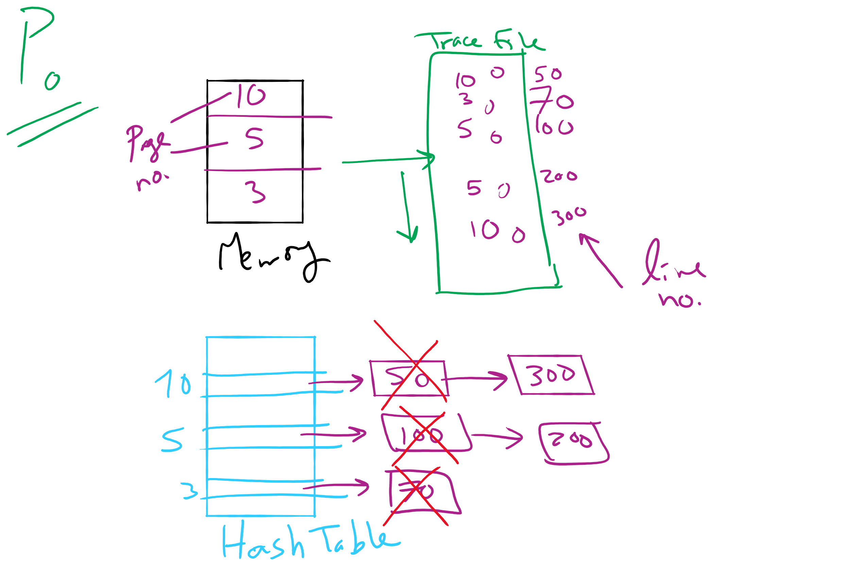
Project 3: OPT Simulation

Slide 17
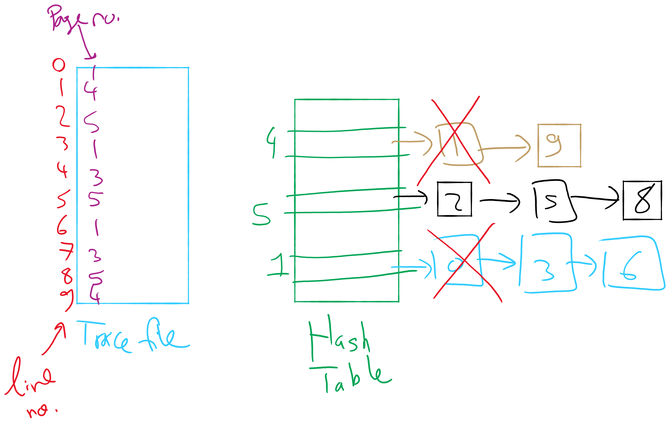
OPT Implementation Example

Slide 18

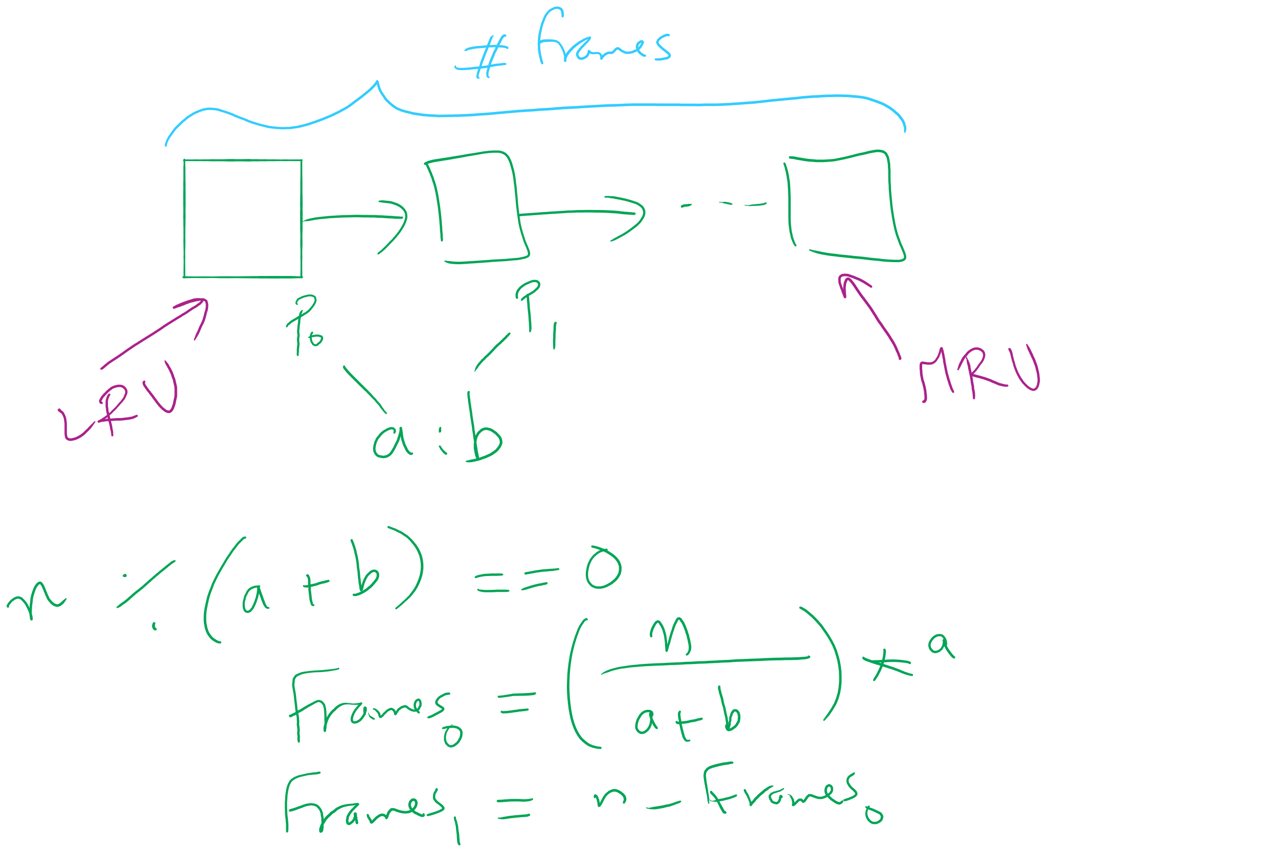
Project 3: LRU and miscellaneous hints

Slide 19
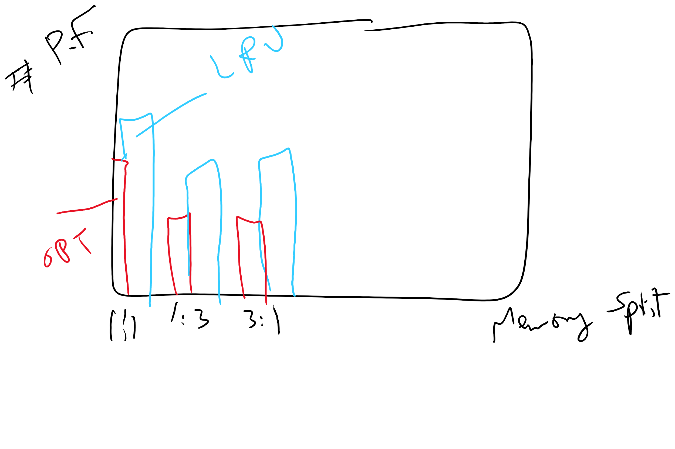
Project 3: Writeup hints

Slide 20
Problem of the Day
How to keep track of larger page tables that can store more pages
How big can a page table be?
64-bit machine
4 KB page size
How many pages?
How many PTE?
How big is a PTE?
How big is the page table of one process?

