Slide 1


Introduction to Operating Systems CS 1550
Spring 2023
Sherif Khattab
ksm73@pitt.edu
(Some slides are from Silberschatz, Galvin and Gagne ©2013)

Slide 2
Announcements
Upcoming deadlines
Homework 3 is due this Friday
Lab 1 is due on Tuesday 2/7 at 11:59 pm
Project 1 is due on Friday 2/17 at 11:59 pm
Discussed in this week’s recitations

Slide 3
Previous lecture …
Bounded buffer problem
semaphore-based solution

Slide 4
Problem of the Day
It is easy to make mistakes when using semaphores

Slide 5
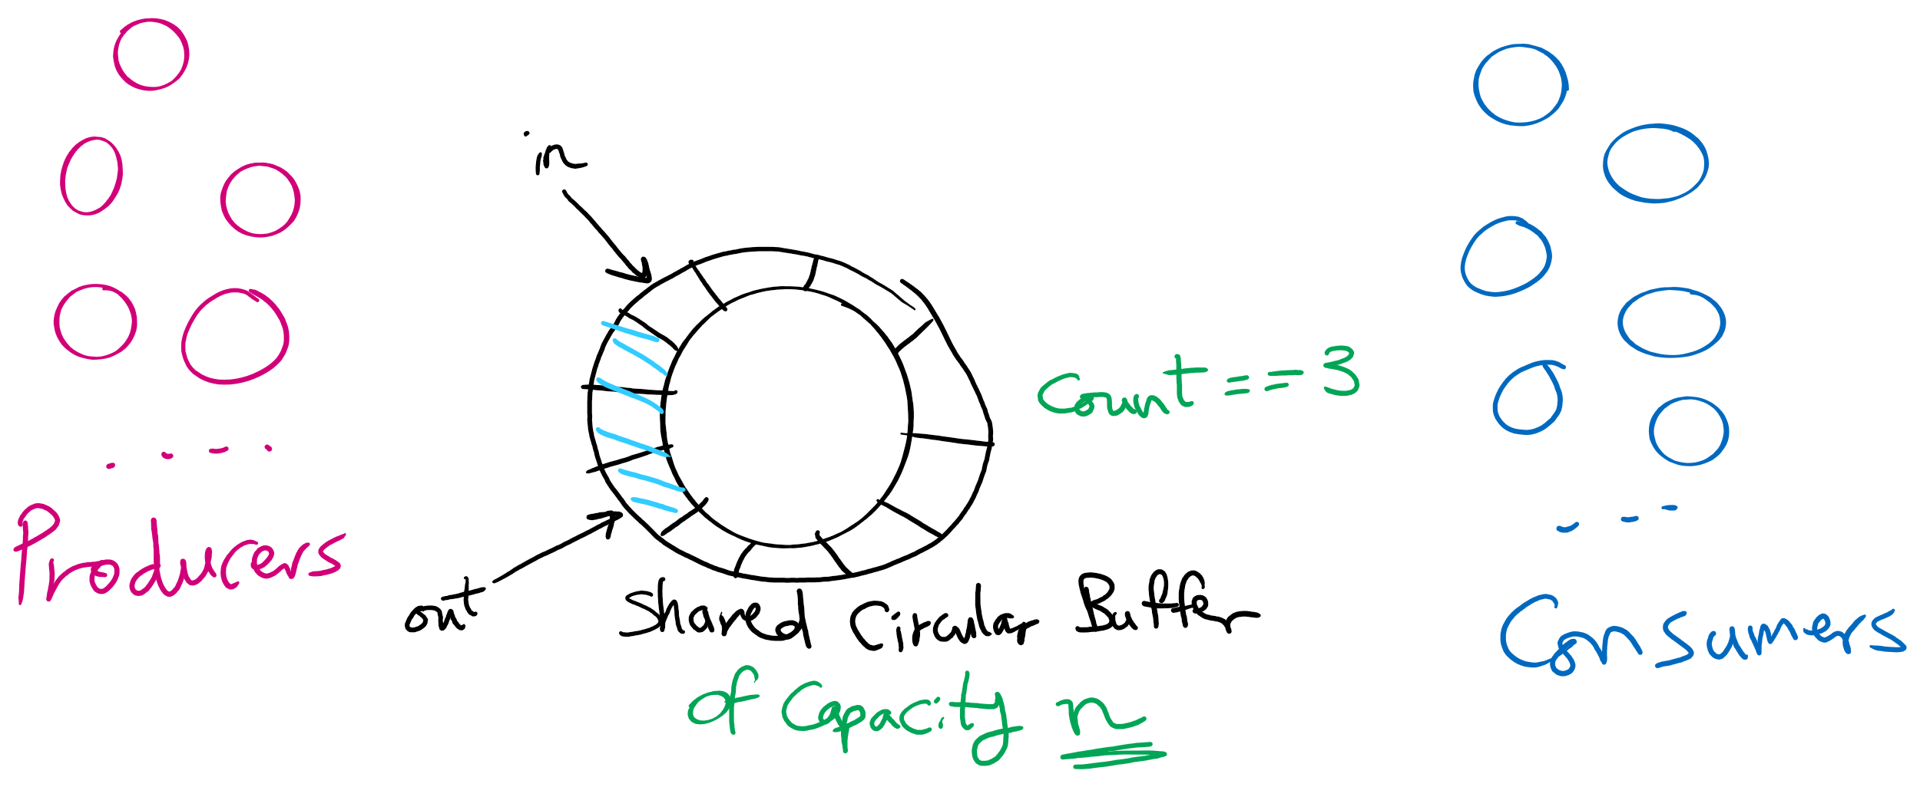
Produces Consumers Problem

Slide 6
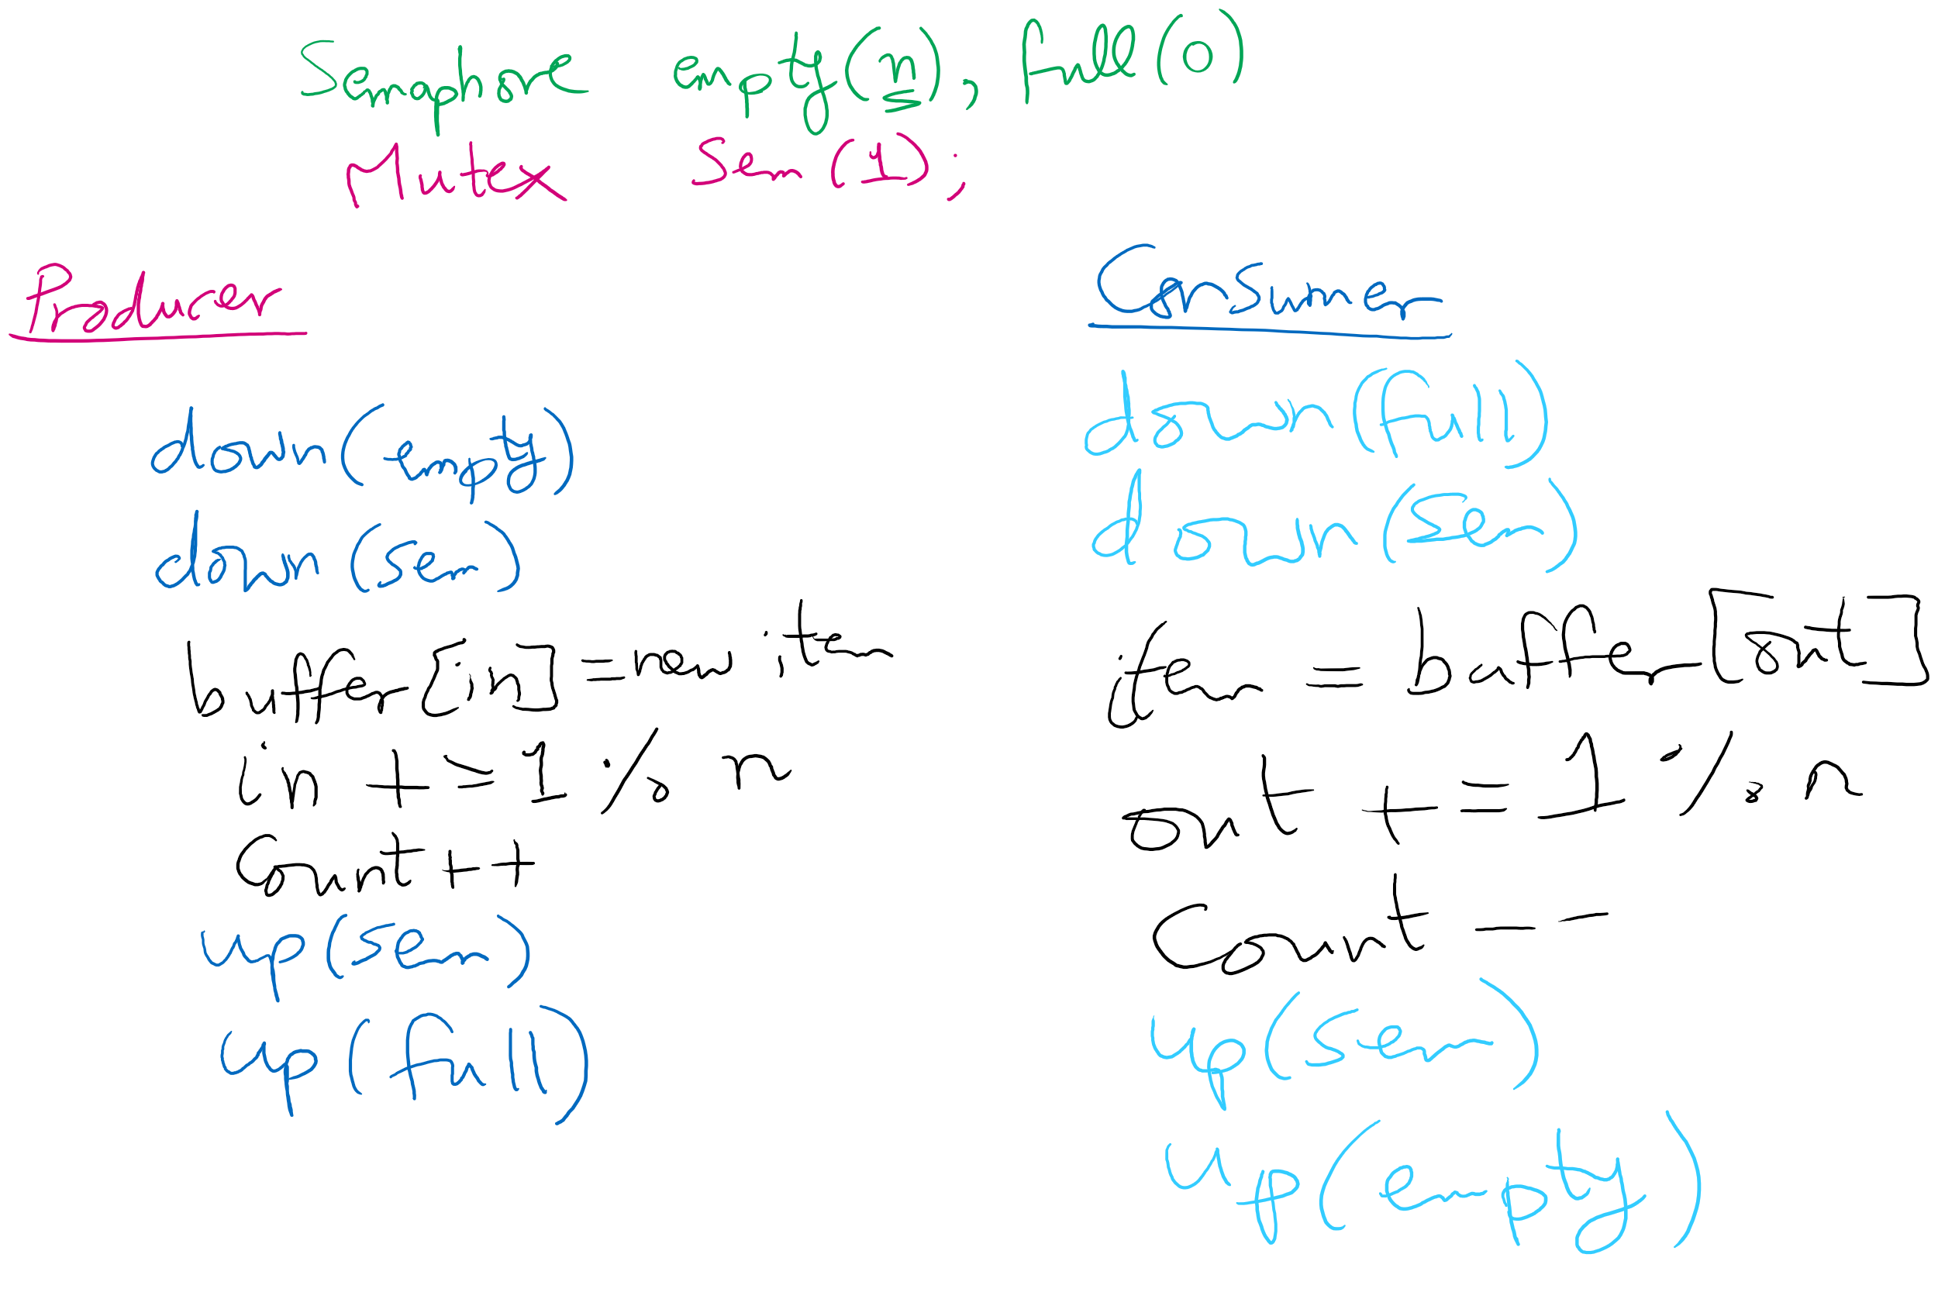
Solving Producers Consumers using Semaphores

Slide 7
Some thoughts
Do we need the count variable?
If we have one producer and one consumer
do we need the mutex?
For multiple producers and consumers
Why do we need the mutex?
what benefit would we get if we have one mutex for producers and one for consumers?

Slide 8
Condition Variables
Yet another construct for process/thread synchronization
(Add to Spinlock and Semaphore)
Has 3 operations
wait()
signal()
broadcast()
Not foreign to us at all
Every object variable in Java is a Condition Variable

Slide 9
Condition Variables Operations
These 3 operations must be called while holding a mutex lock
wait()
unlock mutex
block process
when awake, relock mutex
when successful, return
signal()
wakeup one waiting process in the condition variable’s queue if any
broadcast()
wakeup all waiting processes in the condition variable’s queue if any

Slide 10
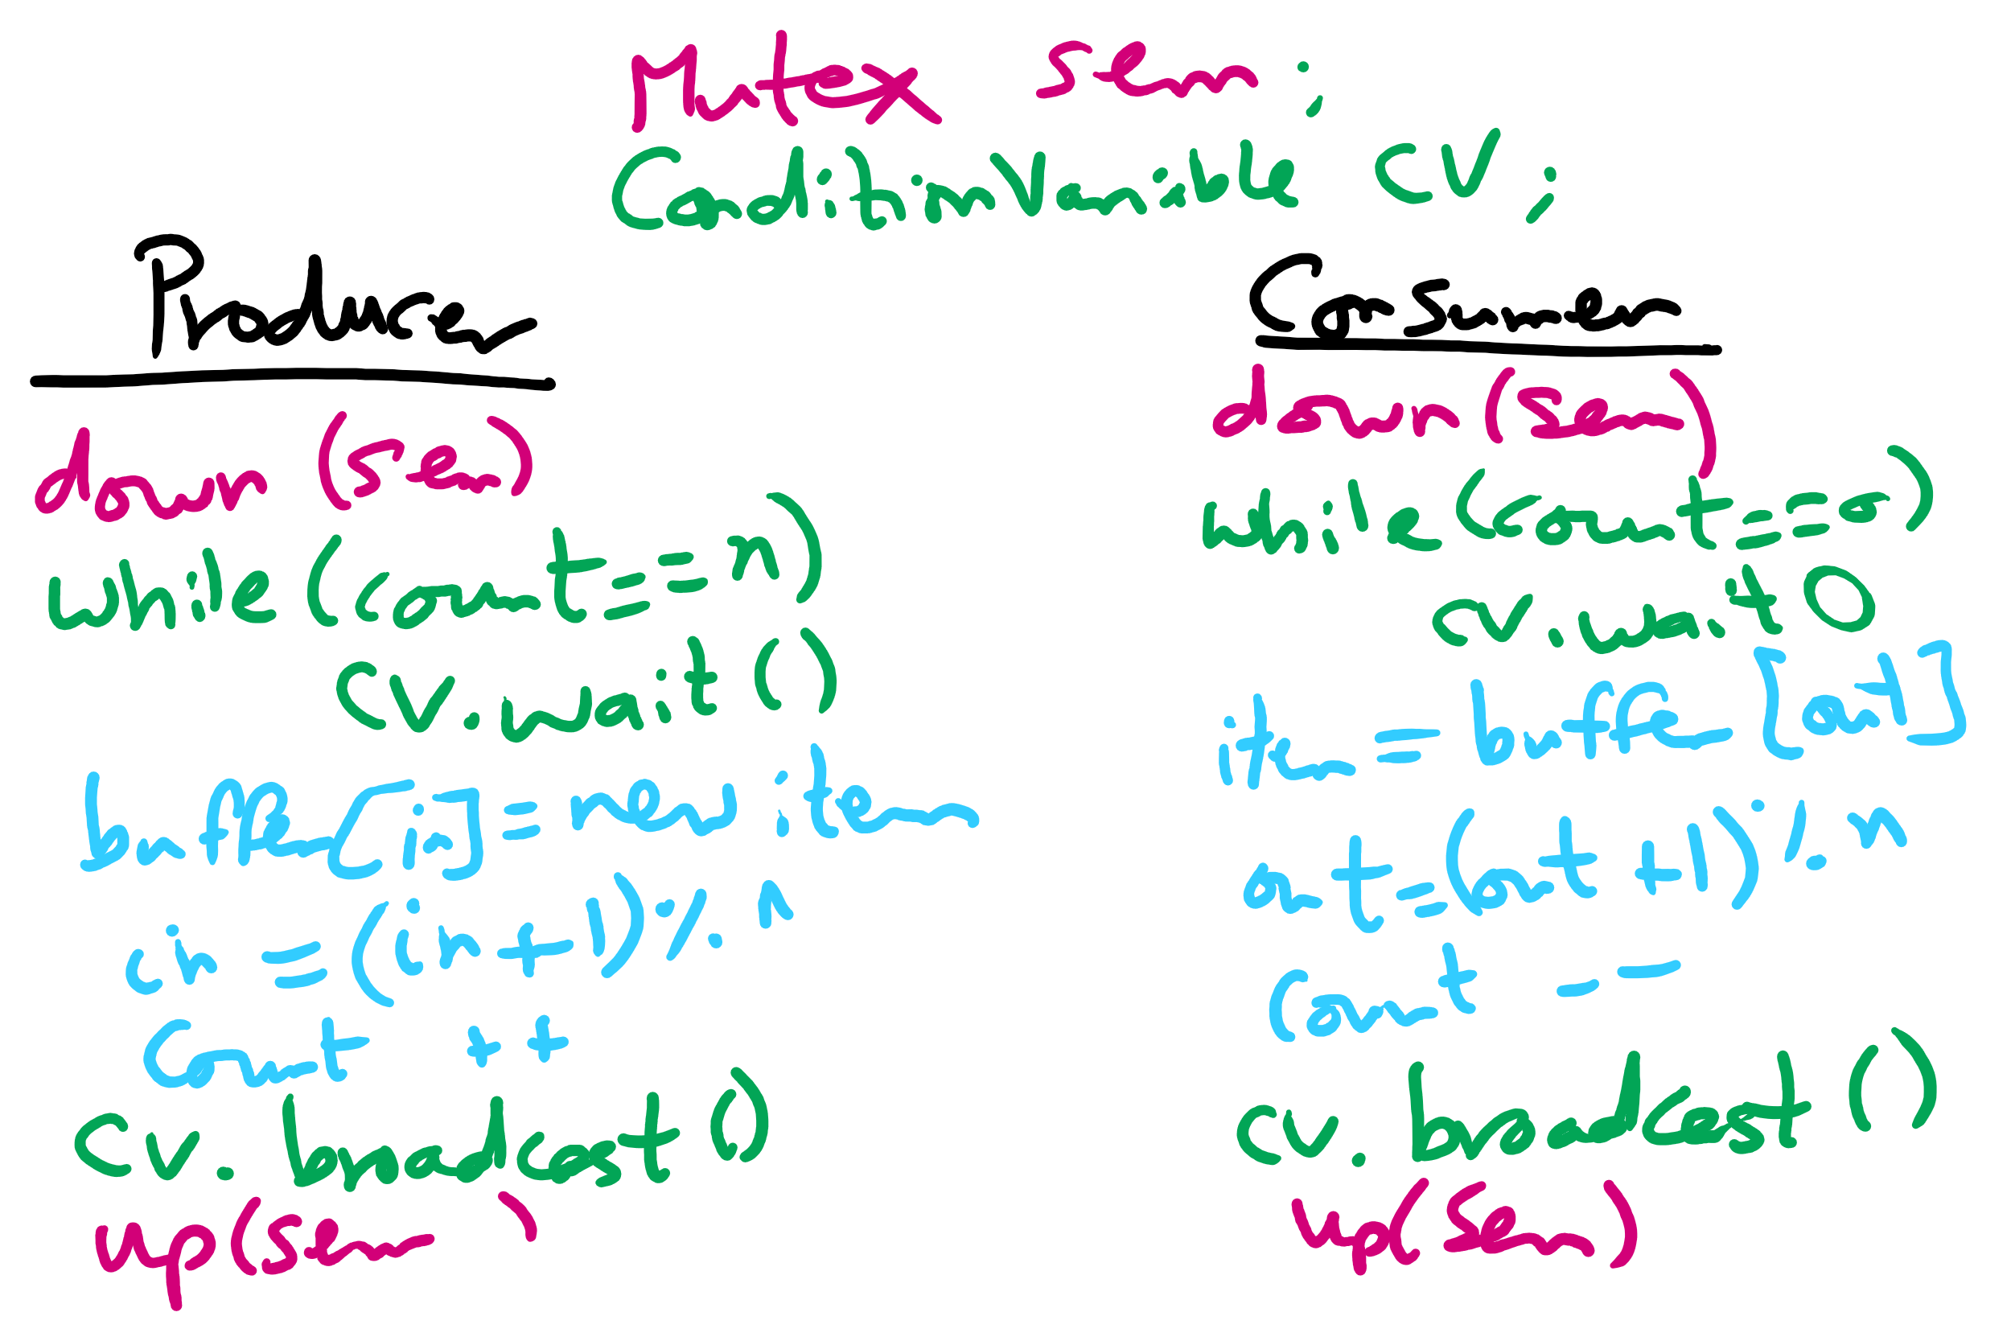
Solving Bounded Buffer Using Condition Variables

Slide 11
Readers & Writers Problem
Many processes that may read and/or write
Only one writer allowed at any time
Many readers allowed, but not while a process is writing
Real-world Applications
Database queries
We have this problem in Project 1

Slide 12
Semaphore-based Solution
Shared variables
int nreaders;
Semaphore mutex(1), writing(1);
Reader process
…
mutex.down();
nreaders += 1;
if (nreaders == 1) // wait if
writing.down(); // 1st reader
mutex.up();
// Read some stuff
mutex.down();
nreaders -= 1;
if (nreaders == 0) // signal if
writing.up(); // last reader
mutex.up();
…
Writer process
…
writing.down();
// Write some stuff
writing.up();
…

Slide 13
Solution Tracing
enterRead
Reader process
…
mutex.down();
nreaders += 1;
if (nreaders == 1) // wait if
writing.down(); // 1st reader
mutex.up();
// Read some stuff
mutex.down();
nreaders -= 1;
if (nreaders == 0) // signal if
writing.up(); // last reader
mutex.up();
…

Slide 14
Solution Tracing
read
Reader process
…
mutex.down();
nreaders += 1;
if (nreaders == 1) // wait if
writing.down(); // 1st reader
mutex.up();
// Read some stuff
mutex.down();
nreaders -= 1;
if (nreaders == 0) // signal if
writing.up(); // last reader
mutex.up();
…

Slide 15
Solution Tracing
doneRead
Reader process
…
mutex.down();
nreaders += 1;
if (nreaders == 1) // wait if
writing.down(); // 1st reader
mutex.up();
// Read some stuff
mutex.down();
nreaders -= 1;
if (nreaders == 0) // signal if
writing.up(); // last reader
mutex.up();
…

Slide 16
Writer Events
enterWrite
Writer process
…
writing.down();
// Write some stuff
writing.up();
…

Slide 17
Writer Events
write
Writer process
…
writing.down();
// Write some stuff
writing.up();
…

Slide 18
Writer Events
doneWrite
Writer process
…
writing.down();
// Write some stuff
writing.up();
…

Slide 19
Sequence 1
W0 enterWrite
W0 write
R0 enterRead
R1 enterRead
R2 enterRead
W0 doneWrite
R2 read
W1 enterWrite
R2 doneRead
W1 write
Reader process
…
mutex.down();
nreaders += 1;
if (nreaders == 1) // wait if
writing.down(); // 1st reader
mutex.up();
// Read some stuff
mutex.down();
nreaders -= 1;
if (nreaders == 0) // signal if
writing.up(); // last reader
mutex.up();
…
Writer process
…
writing.down();
// Write some stuff
writing.up();
…

Slide 20
Sequence 2
R0 enterRead
R0 read
R1 enterRead
R1 read
W0 enterWrite
R2 enterRead
R2 read
R2 doneRead
R1 doneRead
R0 doneRead
W0 write
W0 doneWrite
Reader process
…
mutex.down();
nreaders += 1;
if (nreaders == 1) // wait if
writing.down(); // 1st reader
mutex.up();
// Read some stuff
mutex.down();
nreaders -= 1;
if (nreaders == 0) // signal if
writing.up(); // last reader
mutex.up();
…
Writer process
…
writing.down();
// Write some stuff
writing.up();
…

Slide 21
Solution using Mutex and Condition Variables
https://cs1550-2214.github.io/cs1550-code-handouts/ProcessSynchronization/Slides/

