Slide 1


Introduction to Operating Systems CS 1550
Process Synchronization
Spring 2023
Sherif Khattab
ksm73@pitt.edu
(Some slides are from Silberschatz, Galvin and Gagne ©2013)

Slide 2
Announcements
Homework 1 is due this Friday at 11:59 pm
Recitations start this week
Steps of a Syscall posted on Canvas
TA Student Support Hours available on the syllabus page
Muddiest points are anonymous to all

Slide 3
Muddiest Points
How does the OS handle another interrupt coming in while it is in the middle of dealing with another?
Some interrupts can be interrupted!
The same interrupt process occurs, except that the the return-from-interrupt instruction does not necessarily return to user mode

Slide 4
Muddiest Points
the functionality of the functions in memory that aren’t f7(), and/or the process of how the IDT array (in memory) is used
Some of other functions are Interrupt Service Routines
pointed to from IDT table
end with return-from-interrupt instruction
Some other functions are System Call Implementations
pointed to from the syscall table
end with regular return instruction

Slide 5
Muddiest Points
memory-resident virus scenario
A boot-loader virus can change the IDT entries and make some or all of them point to the virus code

Slide 6
Muddiest Points
I was confused why we do not add an entry to the IDT when adding a syscall
The IDT size is limited by hardware
We can potentially have too many syscalls

Slide 7
Muddiest Points
Understanding the meaning of kernel.
The functions and data structures that include:
IDT and syscall tables
Interrupt Service Routines and Syscall Implementation functions
Kernel code runs in the privileged kernel mode
Compare that to the Shell
The command-line or GUI interface through which we can issue commands to the system
Shell includes support utilities, such as ls, file system check, etc.

Slide 8
Muddiest Points
A lot of new information and new words without simple terms to explain it.
Sorry about that. I hope things got more clear in the previous lecture.

Slide 9
Muddiest Points
if it an expensive operation what does that really mean?
Interrupt handling is an expensive process meaning that it takes much more time compared to the speed of the CPU
CPU does things in nano seconds
We now have a 6 GHz CPU?
Memory access occurs in microseconds
That’s ~1/1000 of CPU speed

Slide 10
Muddiest Points
Is that what we still use to this day?
Yes. The explained interrupt processing steps is essentially that happens in systems today
with some optimizations and variations between CPUs

Slide 11
Muddiest Points
Also back in the day when keyboards and all of this were new was there a limit on how fast you can type in concern to crashing the OS?
Possibly!
If interrupts happen too fast, the CPU will miss some of them.

Slide 12
Muddiest Points
Where is the data from the program counter register saved so we can return to what was occurring before the interrupt took place?
To the kernel stack in memory

Slide 13
Muddiest Points
how the interrupt vector comes in?
The bootup code fills in that table in memory
We will see that in the XV6 code walkthrough today

Slide 14
Xv6 Code Walkthrough
IDT table initialization
Syscall table
How a syscall is invoked
Syscall implementation
Parameter passing into a syscall
In Lab 1 you will add a system call to Xv6

Slide 15
Problem: race conditions
R is a CPU register
X is a variable stored in memory
P1
x++
P2
x++
x=3
R <= x
R = R+1
R => x
R <= x
R = R+1
R => x
x=5
R <= x
R <= x
R = R+1
R = R+1
R => x
R => x
x=6!

Slide 16
Race conditions
Cooperating processes share storage (memory)
Both may read and write the shared memory
Problem: can’t guarantee that read followed by write is atomic
Atomic means uninterruptible
Ordering matters!
This can result in erroneous results!
We need to eliminate race conditions…

Slide 17
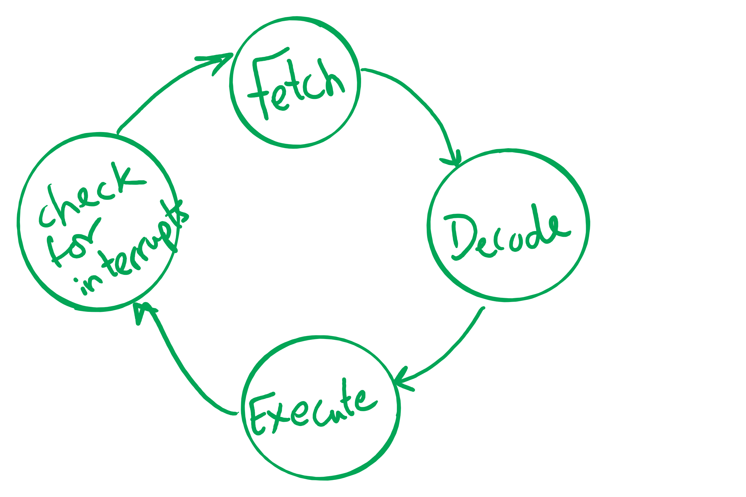
Atomic operations
If done in one instruction, then not interruptible

Slide 18
Context Switching
How did the CPU switch from P1 to P2 then to P1 then to P2 again …?

Slide 19
Process Control Block
``Active entities are data structures when viewed from a lower level.’’
Raphael Finkel, University of Kentucky

Slide 20
Process Control Block (PCB)
Information associated with each process
(also called task control block)
Process state – running, waiting, etc
Program counter – location of instruction to execute next
CPU registers – contents of all process-centric registers
CPU scheduling information- priorities, scheduling queue pointers
Memory-management information – memory allocated to the process
Accounting information – CPU used, clock time elapsed since start, time limits
I/O status information – I/O devices allocated to process, list of open files

Slide 21
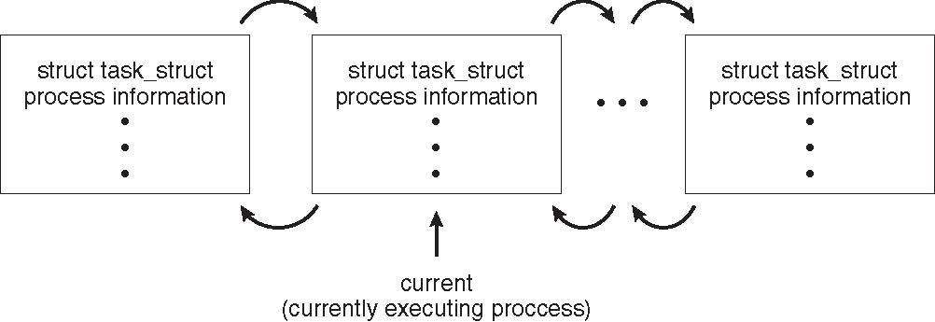
Process Representation in Linux
Represented by the C structure task_struct
pid_t pid; /* process identifier */ long state; /* state of the process */ unsigned int time_slice /* scheduling information */ struct task_struct *parent; /* this process’s parent */ struct list_head children; /* this process’s children */ struct files_struct *files; /* list of open files */ struct mm_struct *mm; /* address space of this process */

Slide 22
Context Switch
When CPU switches to another process, the system must save the state of the old process and load the saved state for the new process via a context switch
Context of a process represented in the PCB
Context-switch time is overhead; the system does no useful work while switching
The more complex the OS and the PCB ➔ the longer the context switch
Time dependent on hardware support
Some hardware provides multiple sets of registers per CPU ➔ multiple contexts loaded at once

Slide 23
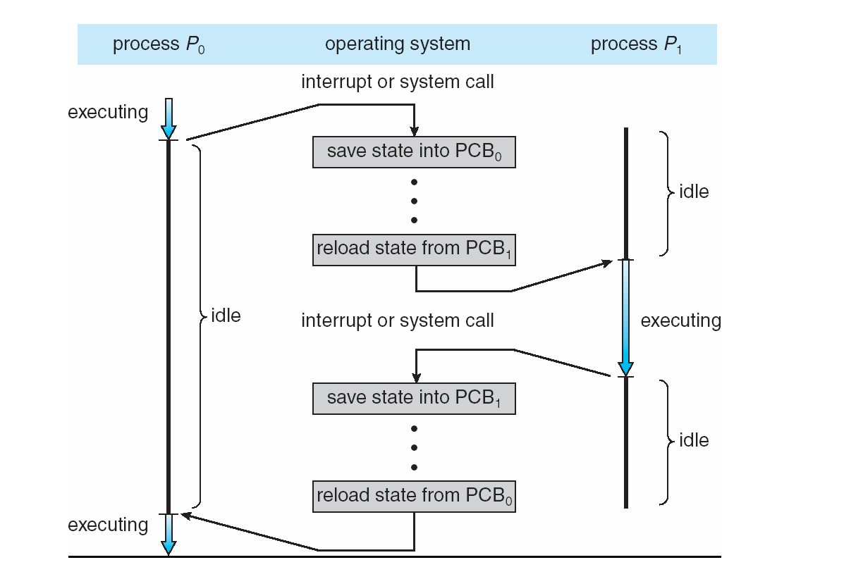
Context Switching

Slide 24
Xv6 Code Walkthrough
PCB and process table
Context switching
Calling of the swtch routine

Slide 25
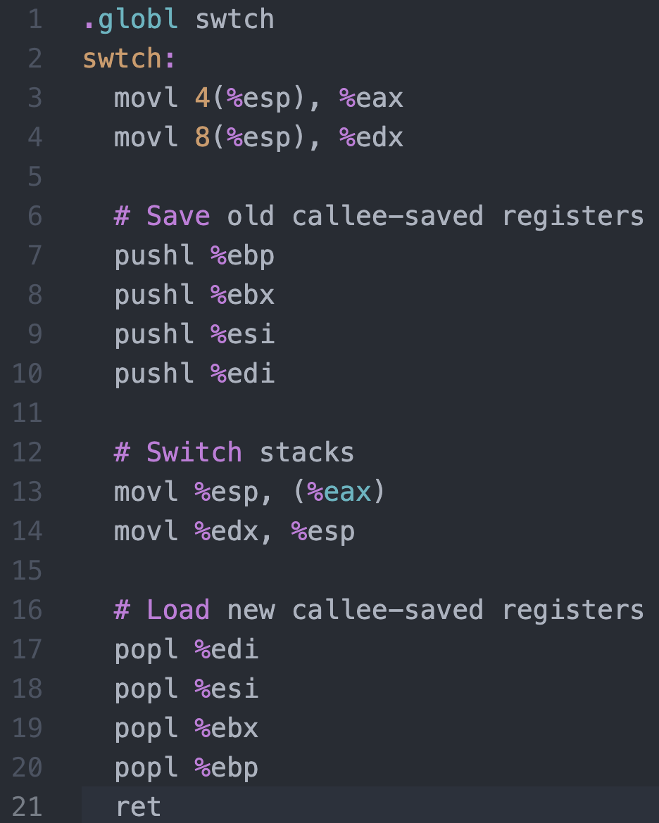




Context Switching in Xv6
%eax
%edx
context
PCB of Process${ P}_{0}$
Return address
%esp
%eip
Stack of Process${ P}_{0}$
Return address
Return address
CPU
context
PCB of Process${ P}_{1}$
Stack of Process${ P}_{1}$
Memory

Slide 26
Critical regions
Back to the race conditions problem
Use critical regions to provide mutual exclusion and help fix race conditions
Let’s put the statement x++ in a critical region
P1 enters critical region
P1 leaves critical region
Process P1
P2 enters critical region
P2 leaves critical region
P2 tries to enter critical region
Process P2
P2 blocked
Time

Slide 27
How to implement critical regions?
Turn-based solutions
Spinlocks
Semaphores
Monitors

Slide 28
Using Spinlocks
Spinlock lock;
Code for process P_{i}
While(1){
Lock(lock)
// critical section
Unlock(lock);
// remainder of code
}
}

Slide 29
Spinlock implementation (1/2)
Solution: use hardware
Several hardware methods
Test & set: test a variable and set it in one instruction
Atomic swap: switch register & memory in one instruction
Turn off interrupts: process won’t be switched out unless it asks to be suspended
The first two methods can be implemented in user land
Why can’t we implement the third method in user land?

