Slide 1


Introduction to Operating Systems CS 1550
Spring 2023
Sherif Khattab
ksm73@pitt.edu
(Some slides are from Silberschatz, Galvin and Gagne ©2013)

Slide 2
Announcements
Upcoming deadlines
Homework 6 is due this Friday
Quiz 1 and Lab 2 due on Tuesday 2/28 at 11:59 pm
Project 2 is due Friday 3/17 at 11:59 pm
Midterm exam on Thursday 3/2
In-person, on paper, closed book
Study guide, old exam, and practice Midterm on Canvas
Lost points because autograder or simple mistake?
please reach out to Grader TA over Piazza
Navigating the Panopto Videos
Video contents
Search in captions

Slide 3
Previous lecture …
Sleepy Barbers solution using Condition Variables

Slide 4
Today …
How to implement condition variables
Reflections on using semaphores and condition variables
CPU Scheduling

Slide 5
User-level implementation of Condition Variables
Why?
Some operating systems don’t have condition variables
Another exercise on solving synchronization problems with semaphores
What are the waiting situations?
waiting to acquire the lock
waiting on the condition variable
waiting after signaling on a condition variable
This is Hoare semantics
signaling process waits
Compare to Mesa semantics
signaled process waits

Slide 6
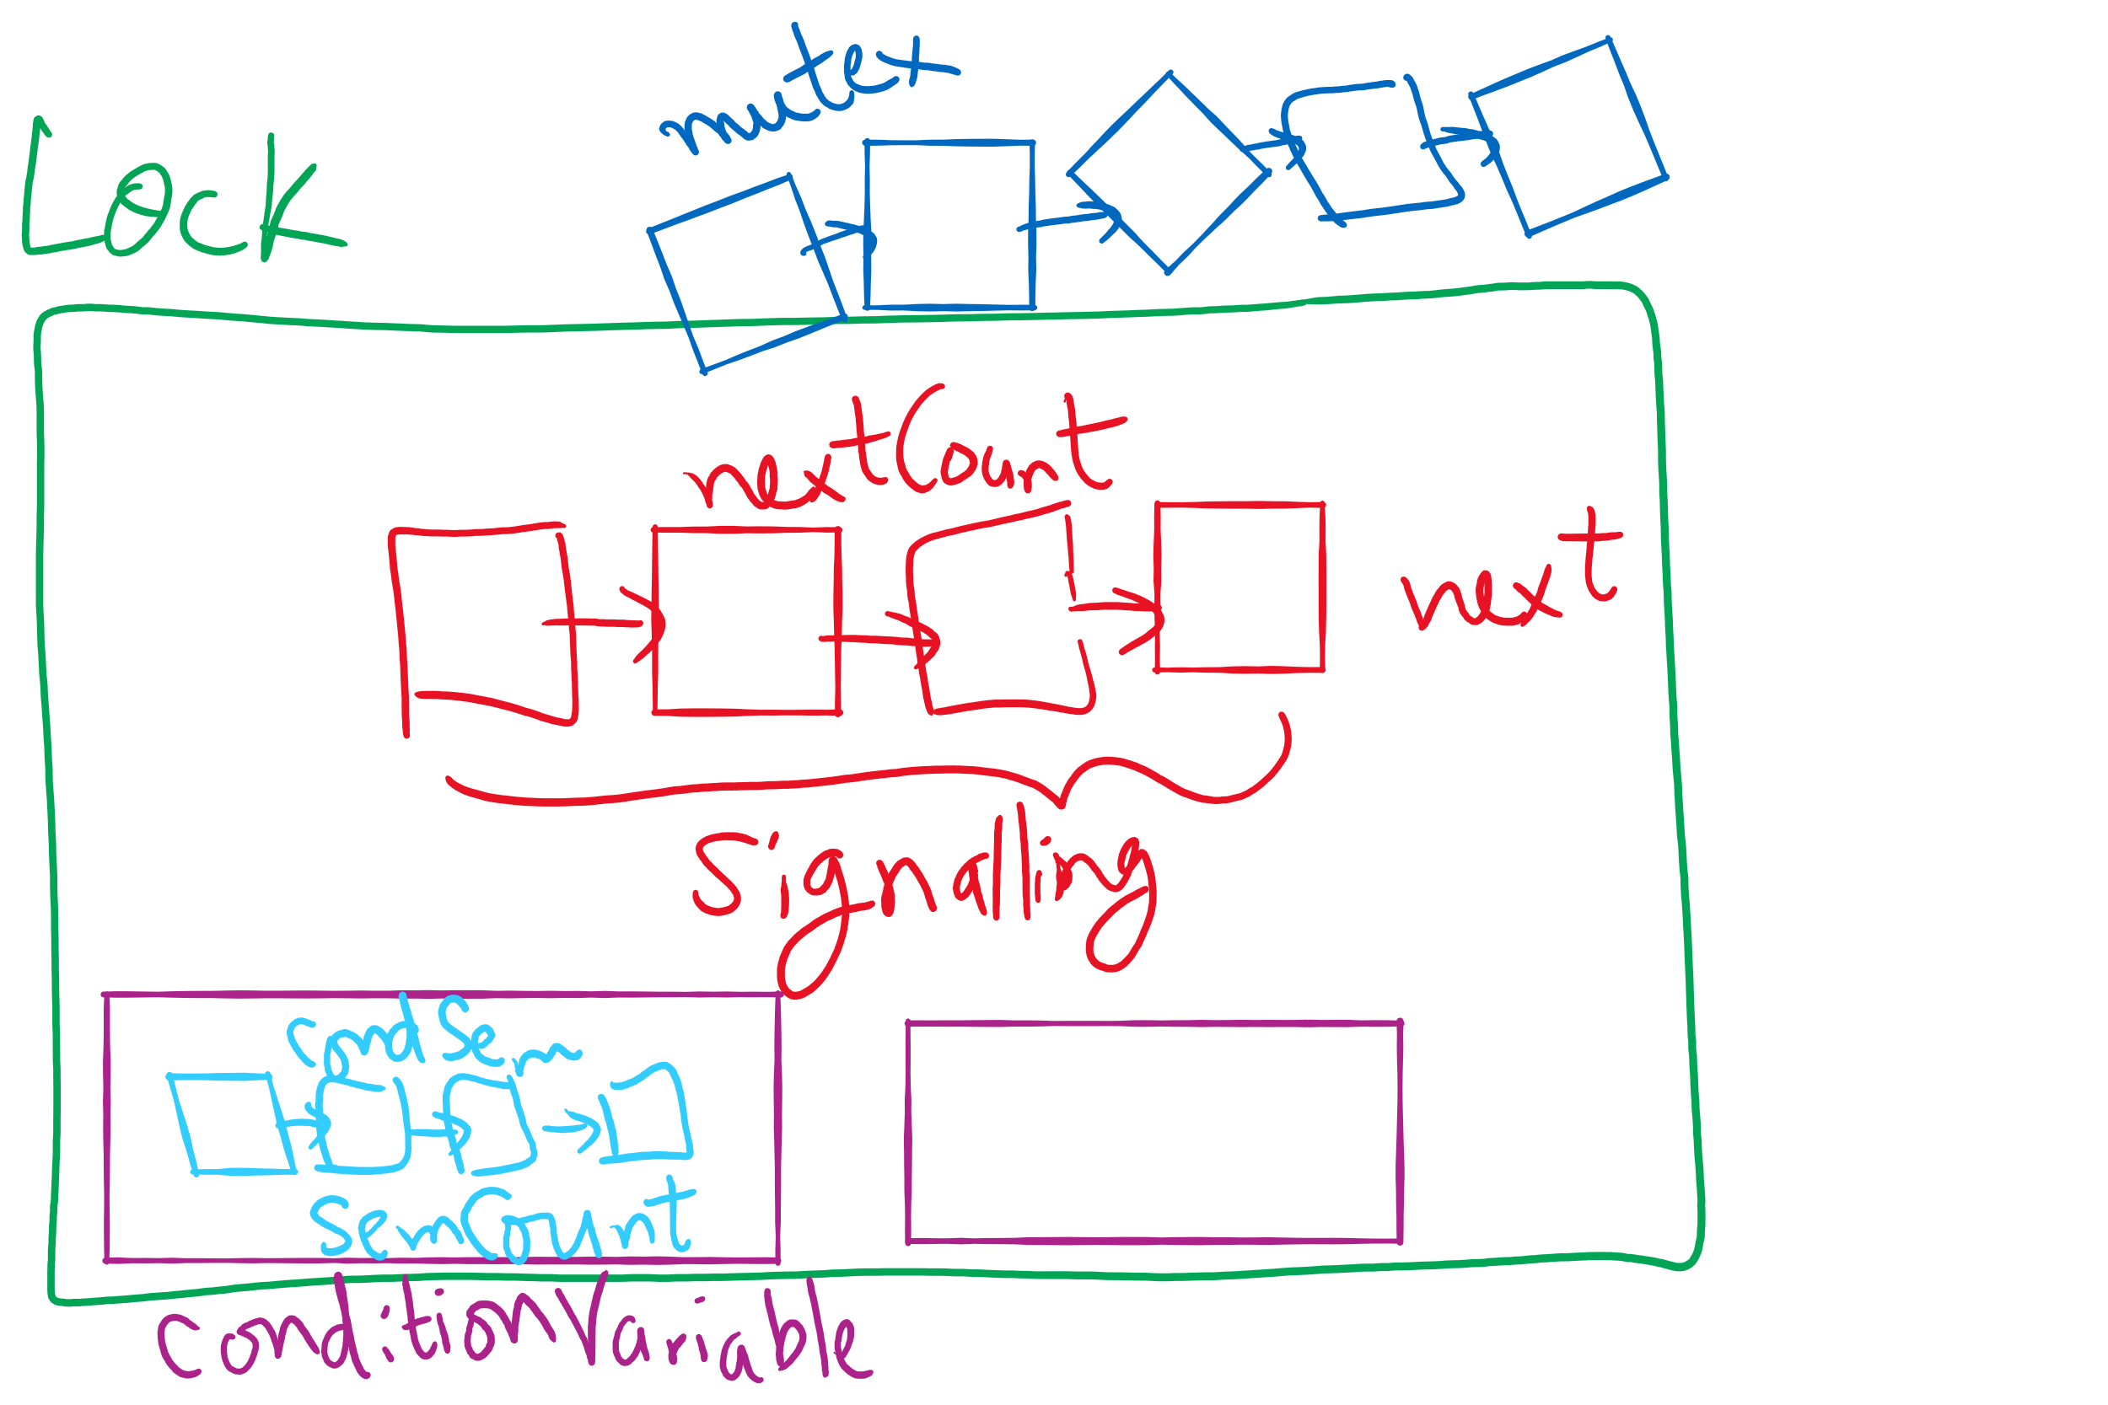
Lock and Condition Variable Implementation

Slide 7
Lock and Condition Variable Implementation
Let’s have a semaphore for each waiting situation

Slide 8
User-level implementation of Condition Variables
A Lock with two waiting queues
struct Lock {
Semaphore mutex(1);
Semaphore next(0);
int nextCount = 0;
}
Acquire(){
mutex.down();
}
Release(){
if(nextCount > 0){
next.up();
nextCount--;
} else mutex.up();
}

Slide 9
Condition Variable
struct ConditionVariable {
Semaphore condSem(0);
int semCount = 0;
Lock *lk;
}
Wait(){
if(lk->nextCount > 0)
lk->next.up();
lk->nextCount--;
else lk->mutex.up();
semCount++;
condSem.down();
semCount--;
}
Signal(){
if(semCount > 0){
condSem.up()
lk->nextCount++
lk->next.down();
lk->nextCount—
}
}

Slide 10
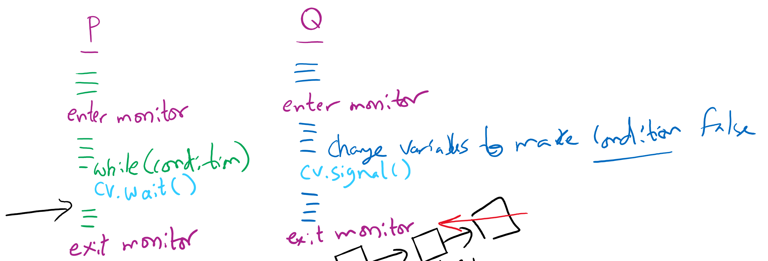
Let’s trace our solution!
Note: Monitor is another name for Lock

Slide 11
Reflections on semaphore usage
Semaphores can be used as
Resource counters
Waiting spaces
For mutual exclusion

Slide 12
Reflections on Condition Variables
Define a class and put all shared variables inside the class
Include a mutex and a condition variable in the class
For each public method of the class
Start by locking the mutex lock
If need to wait, use a while loop and wait on the condition variable
Before broadcasting on the condition variable, make sure to change the waiting condition

Slide 13
Final Remarks on Process Synchronization
Many other synchronization mechanisms
Message passing
Barriers
Futex
Re-entrant locks
AtomicInteger, AtomicX

Slide 14
Problem of the Day: CPU Scheduling
How does the short-term scheduler select the next process to run?

Slide 15
CPU Scheduling
Scheduling the processor among all ready processes
User-oriented criteria
Response Time: Elapsed time between the submission of a request and the receipt of a response
Turnaround Time: Elapsed time between the submission of a process to its completion
System-oriented criteria
Processor utilization
Throughput: number of process completed per unit time
Fairness

Slide 16
Short-Term Scheduler Dispatcher
The dispatcher is the module that gives control of the CPU to the process selected by the short-term scheduler
The functions of the dispatcher include:
Switching context
Switching to user mode
Jumping to the location in the user program to restart execution
The dispatch latency must be minimal

Slide 17





The CPU-I/O Cycle
Processes require alternate use of processor and I/O in a repetitive fashion
Each cycle consist of a CPU burst followed by an I/O burst
A process terminates on a CPU burst
CPU-bound processes have longer CPU bursts than I/O-bound processes

Slide 18
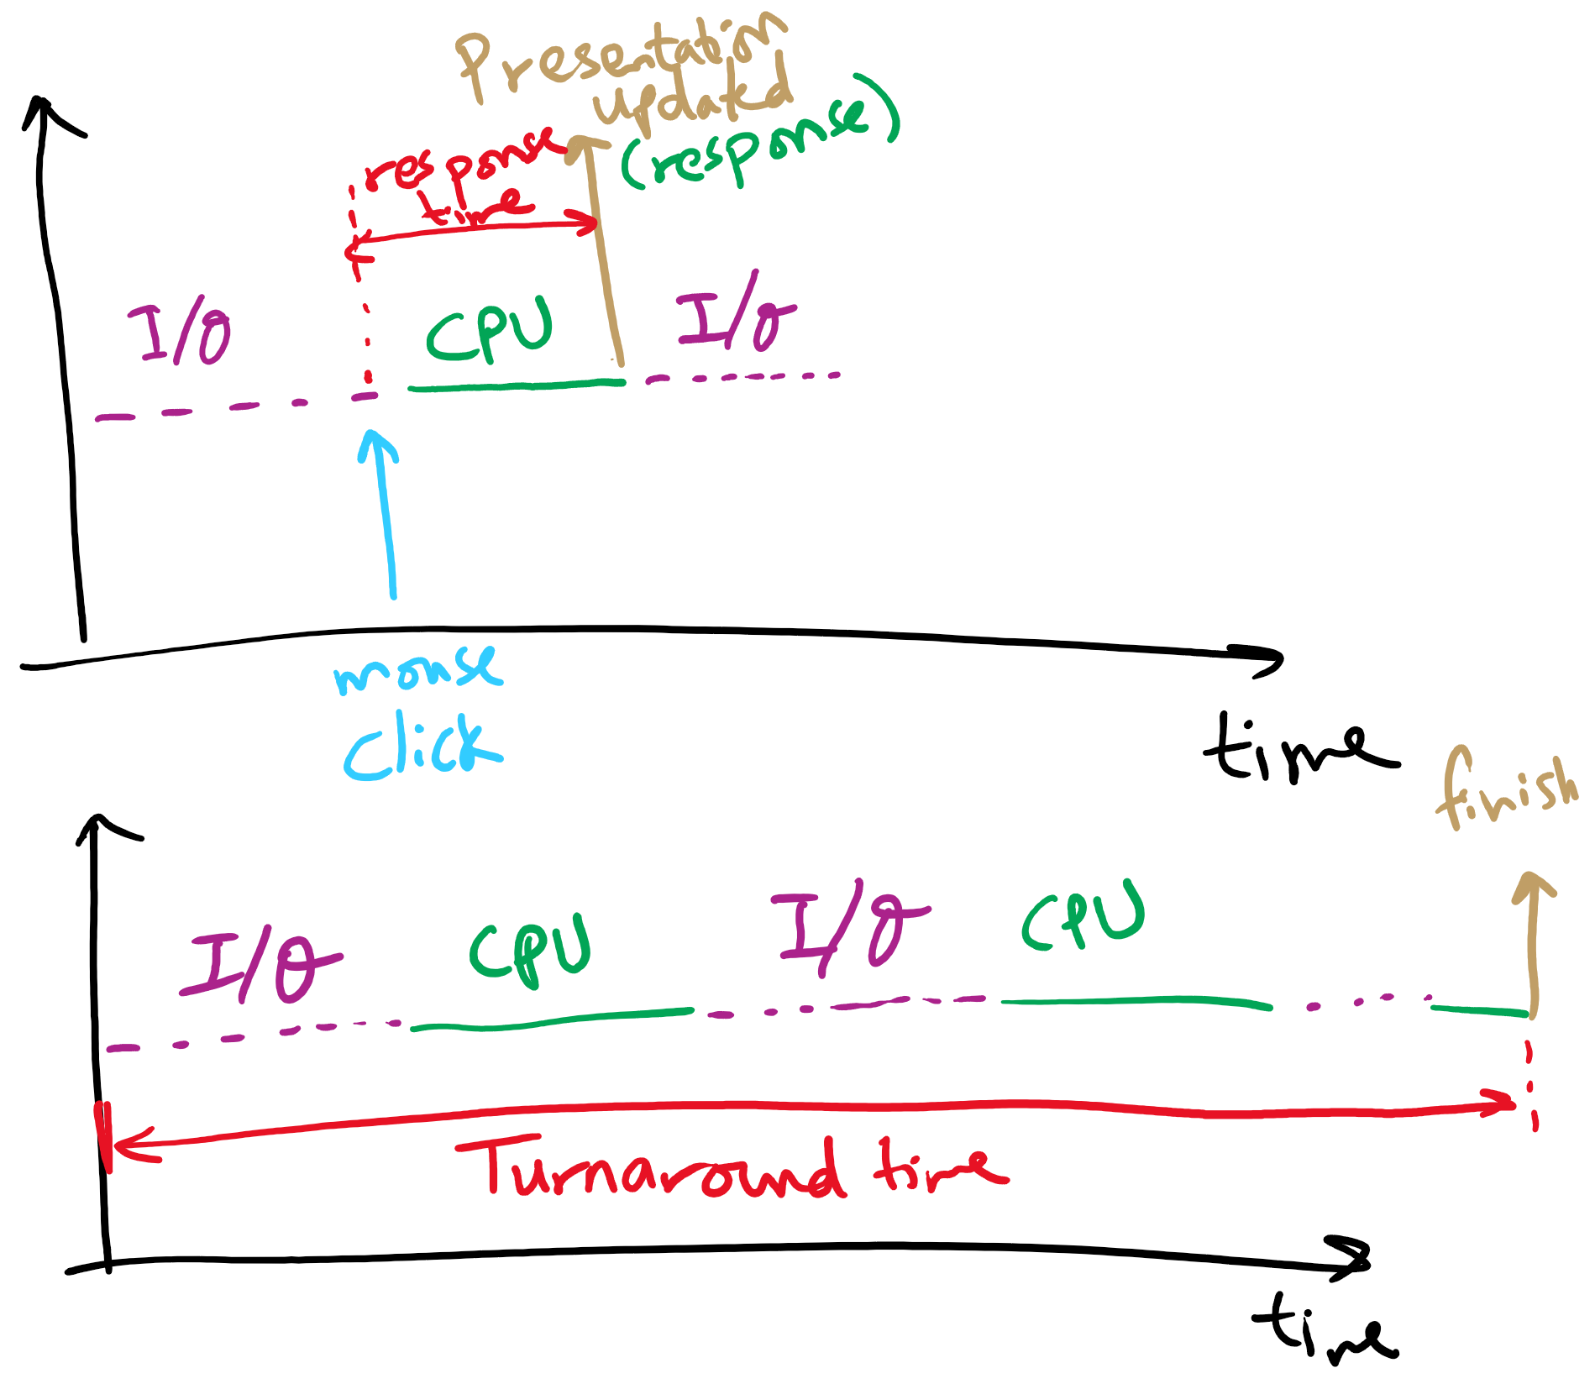
Response time vs. Turnaround time

Slide 19
Scheduling Algorithms
First-Come, First-Served Scheduling
Shortest-Job-First Scheduling
Also referred to as Shortest Process Next
Priority Scheduling
Round-Robin Scheduling
Multilevel Queue Scheduling
Multilevel Feedback Queue Scheduling

Slide 20
Characterization of Scheduling Policies
The selection function determines which ready process is selected next for execution
The decision mode specifies the instants in time the selection function is exercised
Nonpreemptive
Once a process is in the running state, it will continue until it terminates or blocks for an I/O
Preemptive
Currently running process may be interrupted and moved to the Ready state by the OS
Prevents one process from monopolizing the processor

Slide 21
Process Mix Example
Process
Arrival Time
Service Time
1
0
3
2
2
6
3
4
4
4
6
5
5
8
2
Service time = total processor time needed in one (CPU-I/O) cycle
Jobs with long service time are CPU-bound jobs and are referred
to as “long jobs”

Slide 22







First Come First Served (FCFS)
Selection function: the process that has been waiting the longest in the ready queue (hence, FCFS)
Decision mode: non-preemptive
a process runs until it blocks for an I/O
Process
Arrival Time
Service Time
1
0
3
2
2
6
3
4
4
4
6
5
5
8
2

Slide 23
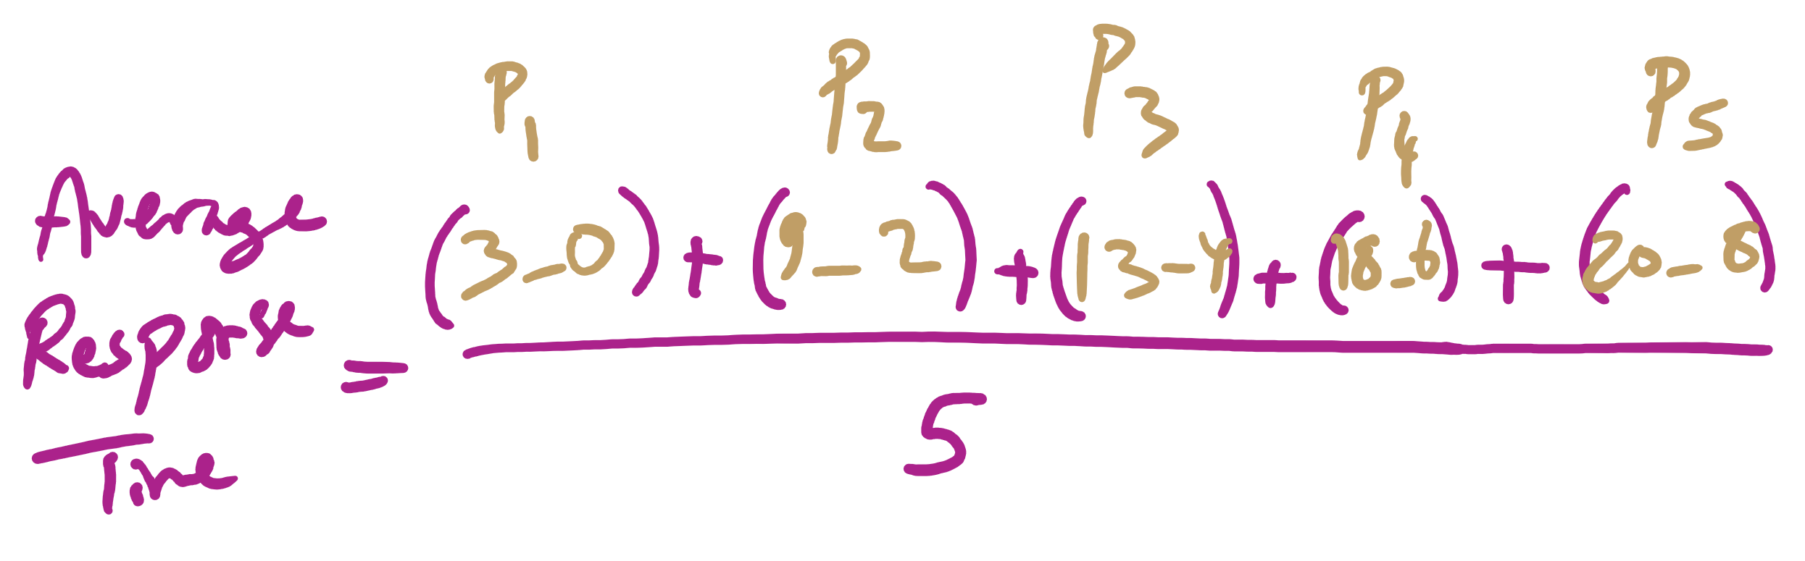
Average Response Time

Slide 24
FCFS drawbacks
Favours CPU-bound processes
CPU-bound processes monopolize the processor
I/O-bound processes have to wait until completion of CPU-bound process
I/O-bound processes may have to wait even after their I/Os are completed (poor device utilization)
Convoy effect
Better I/O device utilization could be achieved if I/O bound processes had higher priority

Slide 25
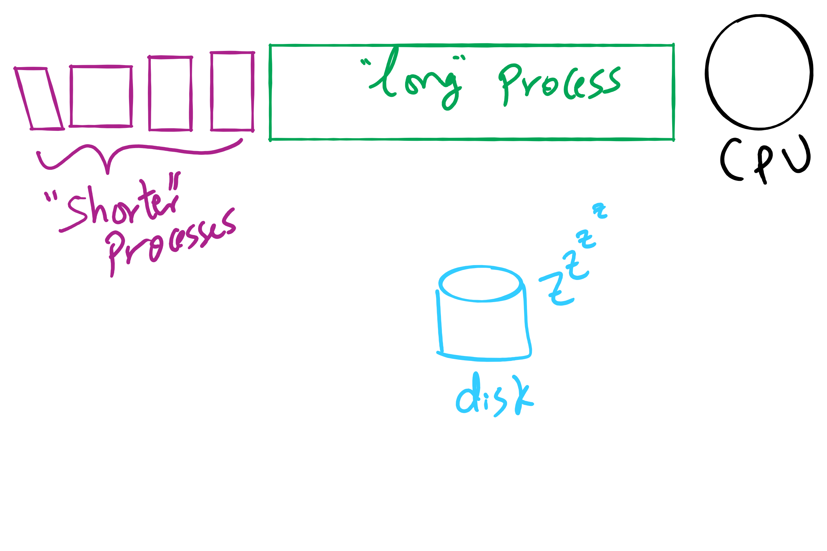
Convoy Effect

