Slide 1


Introduction to Operating Systems CS 1550
Spring 2023
Sherif Khattab
ksm73@pitt.edu
(Some slides are from Silberschatz, Galvin and Gagne ©2013)

Slide 2
Announcements
Upcoming deadlines
Homework 7 is due this Friday
Quiz 1 and Lab 2 due on Tuesday 2/28 at 11:59 pm
Project 2 is due Friday 3/17 at 11:59 pm
Midterm exam on Thursday 3/2
In-person, on paper, closed book
Study guide, old exam, and practice Midterm on Canvas
Midterm Review Session tomorrow 3/1 at 5:30 pm
Recorded
Same Zoom link as Student Support Hours

Slide 3
Previous lecture …
How to implement Condition Variables and Locks using semaphores
CPU scheduling
FCFS

Slide 4
Problem of the Day: CPU Scheduling
How does the short-term scheduler select the next process to run?

Slide 5











Shortest Job First (Shortest Process Next)
Selection function: the process with the shortest expected CPU burst time
I/O-bound processes will be selected first
Decision mode: non-preemptive
The required processing time, i.e., the CPU burst time, must be estimated for each process
Process
Arrival Time
Service Time
1
0
3
2
2
6
3
4
4
4
6
5
5
8
2

Slide 6
SJF / SPN Critique
Possibility of starvation for longer processes
Lack of preemption is not suitable in a time sharing environment
SJF/SPN implicitly incorporates priorities
Shortest jobs are given preference
CPU bound processes have lower priority, but a process doing no I/O could still monopolize the CPU if it is the first to enter the system

Slide 7
Priorities
Implemented by having multiple ready queues to represent each level of priority
Scheduler selects the process of a higher priority over one of lower priority
Lower-priority may suffer starvation
To alleviate starvation allow dynamic priorities
The priority of a process changes based on its age or execution history

Slide 8
Round-Robin
Selection function: same as FCFS
Decision mode: pre-emptive
a process is allowed to run until the time slice period (quantum, typically from 10 to 100 ms) has expired
a clock interrupt occurs and the running process is put on the ready queue
Process
Arrival Time
Service Time
1
0
3
2
2
6
3
4
4
4
6
5
5
8
2

Slide 9

Round-Robin
Selection function: same as FCFS
Decision mode: pre-emptive
a process is allowed to run until the time slice period (quantum, typically from 10 to 100 ms) has expired
a clock interrupt occurs and the running process is put on the ready queue
Process
Arrival Time
Service Time
1
0
3
2
2
6
3
4
4
4
6
5
5
8
2

Slide 10

Round-Robin
Selection function: same as FCFS
Decision mode: pre-emptive
a process is allowed to run until the time slice period (quantum, typically from 10 to 100 ms) has expired
a clock interrupt occurs and the running process is put on the ready queue
Process
Arrival Time
Service Time
1
0
3
2
2
6
3
4
4
4
6
5
5
8
2

Slide 11

Round-Robin
Selection function: same as FCFS
Decision mode: pre-emptive
a process is allowed to run until the time slice period (quantum, typically from 10 to 100 ms) has expired
a clock interrupt occurs and the running process is put on the ready queue
Process
Arrival Time
Service Time
1
0
3
2
2
6
3
4
4
4
6
5
5
8
2

Slide 12


Round-Robin
Selection function: same as FCFS
Decision mode: pre-emptive
a process is allowed to run until the time slice period (quantum, typically from 10 to 100 ms) has expired
a clock interrupt occurs and the running process is put on the ready queue
Process
Arrival Time
Service Time
1
0
3
2
2
6
3
4
4
4
6
5
5
8
2

Slide 13

Round-Robin
Selection function: same as FCFS
Decision mode: pre-emptive
a process is allowed to run until the time slice period (quantum, typically from 10 to 100 ms) has expired
a clock interrupt occurs and the running process is put on the ready queue
Process
Arrival Time
Service Time
1
0
3
2
2
6
3
4
4
4
6
5
5
8
2

Slide 14

Round-Robin
Selection function: same as FCFS
Decision mode: pre-emptive
a process is allowed to run until the time slice period (quantum, typically from 10 to 100 ms) has expired
a clock interrupt occurs and the running process is put on the ready queue
Process
Arrival Time
Service Time
1
0
3
2
2
6
3
4
4
4
6
5
5
8
2

Slide 15

Round-Robin
Selection function: same as FCFS
Decision mode: pre-emptive
a process is allowed to run until the time slice period (quantum, typically from 10 to 100 ms) has expired
a clock interrupt occurs and the running process is put on the ready queue
Process
Arrival Time
Service Time
1
0
3
2
2
6
3
4
4
4
6
5
5
8
2

Slide 16


Round-Robin
Selection function: same as FCFS
Decision mode: pre-emptive
a process is allowed to run until the time slice period (quantum, typically from 10 to 100 ms) has expired
a clock interrupt occurs and the running process is put on the ready queue
Process
Arrival Time
Service Time
1
0
3
2
2
6
3
4
4
4
6
5
5
8
2

Slide 17

Round-Robin
Selection function: same as FCFS
Decision mode: pre-emptive
a process is allowed to run until the time slice period (quantum, typically from 10 to 100 ms) has expired
a clock interrupt occurs and the running process is put on the ready queue
Process
Arrival Time
Service Time
1
0
3
2
2
6
3
4
4
4
6
5
5
8
2

Slide 18


Round-Robin
Selection function: same as FCFS
Decision mode: pre-emptive
a process is allowed to run until the time slice period (quantum, typically from 10 to 100 ms) has expired
a clock interrupt occurs and the running process is put on the ready queue
Process
Arrival Time
Service Time
1
0
3
2
2
6
3
4
4
4
6
5
5
8
2

Slide 19


Round-Robin
Selection function: same as FCFS
Decision mode: pre-emptive
a process is allowed to run until the time slice period (quantum, typically from 10 to 100 ms) has expired
a clock interrupt occurs and the running process is put on the ready queue
Process
Arrival Time
Service Time
1
0
3
2
2
6
3
4
4
4
6
5
5
8
2

Slide 20

Round-Robin
Selection function: same as FCFS
Decision mode: pre-emptive
a process is allowed to run until the time slice period (quantum, typically from 10 to 100 ms) has expired
a clock interrupt occurs and the running process is put on the ready queue
Process
Arrival Time
Service Time
1
0
3
2
2
6
3
4
4
4
6
5
5
8
2

Slide 21

Round-Robin
Selection function: same as FCFS
Decision mode: pre-emptive
a process is allowed to run until the time slice period (quantum, typically from 10 to 100 ms) has expired
a clock interrupt occurs and the running process is put on the ready queue
Process
Arrival Time
Service Time
1
0
3
2
2
6
3
4
4
4
6
5
5
8
2

Slide 22


Round-Robin
Selection function: same as FCFS
Decision mode: pre-emptive
a process is allowed to run until the time slice period (quantum, typically from 10 to 100 ms) has expired
a clock interrupt occurs and the running process is put on the ready queue
Process
Arrival Time
Service Time
1
0
3
2
2
6
3
4
4
4
6
5
5
8
2

Slide 23

Round-Robin
Selection function: same as FCFS
Decision mode: pre-emptive
a process is allowed to run until the time slice period (quantum, typically from 10 to 100 ms) has expired
a clock interrupt occurs and the running process is put on the ready queue
Process
Arrival Time
Service Time
1
0
3
2
2
6
3
4
4
4
6
5
5
8
2

Slide 24

Round-Robin
Selection function: same as FCFS
Decision mode: pre-emptive
a process is allowed to run until the time slice period (quantum, typically from 10 to 100 ms) has expired
a clock interrupt occurs and the running process is put on the ready queue
Process
Arrival Time
Service Time
1
0
3
2
2
6
3
4
4
4
6
5
5
8
2

Slide 25


Round-Robin
Selection function: same as FCFS
Decision mode: pre-emptive
a process is allowed to run until the time slice period (quantum, typically from 10 to 100 ms) has expired
a clock interrupt occurs and the running process is put on the ready queue
Process
Arrival Time
Service Time
1
0
3
2
2
6
3
4
4
4
6
5
5
8
2

Slide 26

Round-Robin
Selection function: same as FCFS
Decision mode: pre-emptive
a process is allowed to run until the time slice period (quantum, typically from 10 to 100 ms) has expired
a clock interrupt occurs and the running process is put on the ready queue
Process
Arrival Time
Service Time
1
0
3
2
2
6
3
4
4
4
6
5
5
8
2

Slide 27
RR Time Quantum
Quantum must be substantially larger than the time required to handle the clock interrupt and dispatching
Quantum should be larger then the typical interaction
but not much larger, to avoid penalizing I/O bound processes

Slide 28
RR Time Quantum

Slide 29
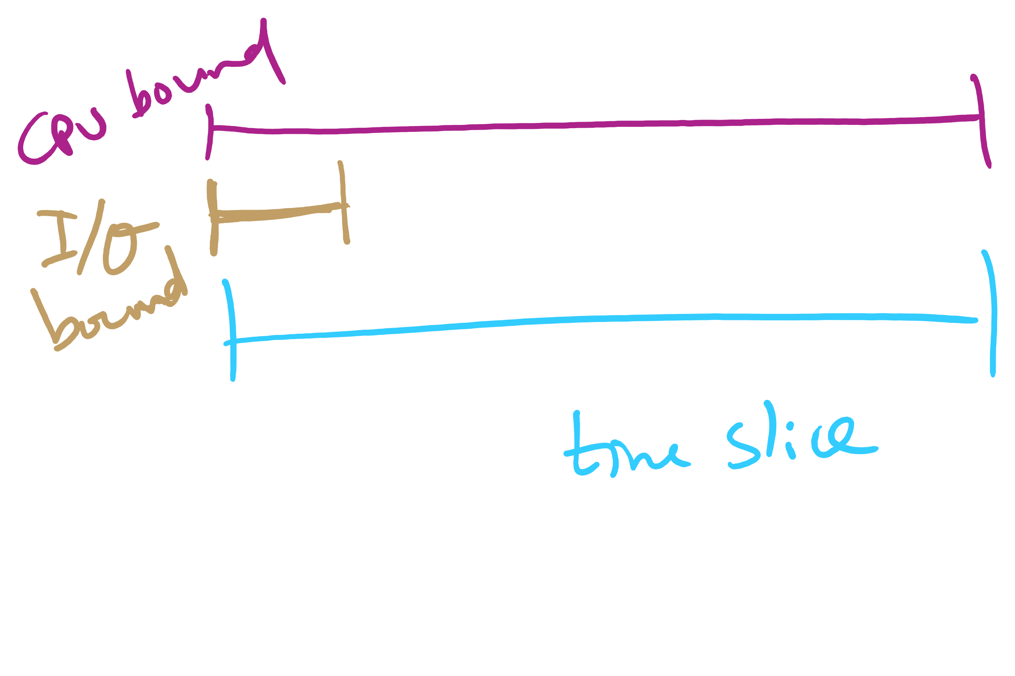
Quantum Length

Slide 30
Round Robin: critique
Still favors CPU-bound processes
An I/O bound process uses the CPU for a time less than the time quantum before it is blocked waiting for an I/O
A CPU-bound process runs for all its time slice and is put back into the ready queue
May unfairly get in front of blocked processes

