Slide 1


Introduction to Operating Systems CS 1550
Spring 2023
Sherif Khattab
ksm73@pitt.edu
(Some slides are from Silberschatz, Galvin and Gagne ©2013)

Slide 2
Announcements
Upcoming deadlines
Homework 5 is due this Friday
Project 1 is due on Friday 2/17 at 11:59 pm
Lab 2 is due on Tuesday 2/28 at 11:59 pm

Slide 3
Previous lecture …
Dining philosophers
Deadlock prevention
Banker’s Algorithm for deadlock detection and avoidance

Slide 4
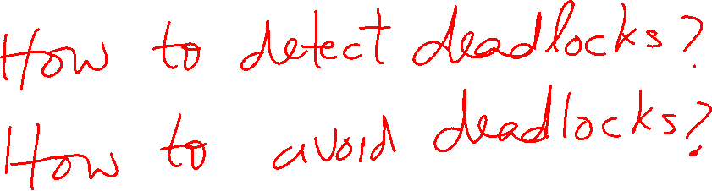
Banker’s Algorithm

Slide 5
Banker’s Algorithm
We can use the same algorithm for both detecting and avoiding deadlocks

Slide 6
Banker’s Algorithm
current=avail;
for (j = 0; j < N; j++) {
for (k=0; k<N; k++) {
if (finished[k])
continue;
if (want[k] <= current) {
finished[k] = 1;
current += hold[k];
break;
}
}
if (k==N) {
printf “Deadlock!\n”;
// finished[k]==0 means process is in
// the deadlock
break;
}
}
 | A | B | C | D
Avail | 2 | 3 | 0 | 1
Process | A | B | C | D
1 | 0 | 3 | 0 | 0
2 | 1 | 0 | 1 | 1
3 | 0 | 2 | 1 | 0
4 | 2 | 2 | 3 | 0
Hold
Process | A | B | C | D
1 | 3 | 2 | 1 | 0
2 | 2 | 2 | 0 | 0
3 | 3 | 5 | 3 | 1
4 | 0 | 4 | 1 | 1
Want
Note: want[j], hold[j], current, avail are arrays!

Slide 7
Banker’s Algorithm Insights
It is possible that some event sequences lead to a deadlock
What we are looking for is at least one event sequence that can make all processes finish
If such sequence exists, the state is safe
The Banker’s algorithm finds such sequence if it exists

Slide 8
Using the Banker’s Algorithm for Deadlock Avoidance
Call the algorithm on the following ``What-if” state instead of the current state

Slide 9
Problem of the Day: Sleepy Barbers
We have two sets of processes
Worker processes (e.g., barbers)
Customer processes
Customer processes may arrive at anytime
Worker processes check in when they are not serving any customers
Each worker process must wait until it gets matched with a customer process
Each customer process must wait until it gets matched with a worker process
The customer process cannot leave until the matched worker process finishes the work
The worker process cannot check in for the next customer until the matched customer process leaves
Many applications in the real-world

Slide 10
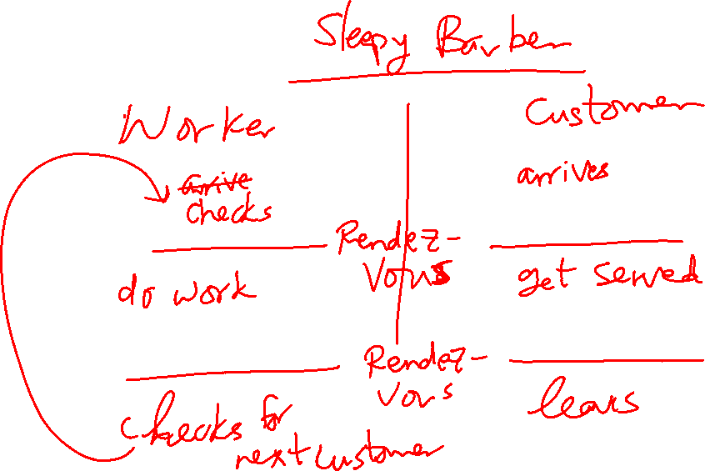
Rendezvous Pattern

Slide 11
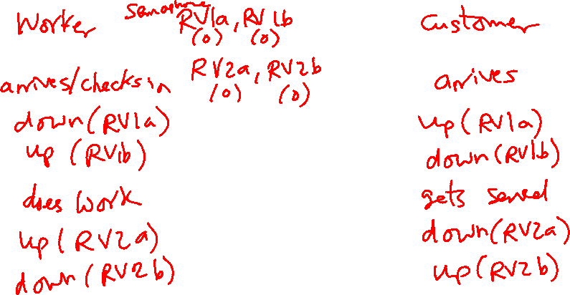
Solution Using Semaphores: Take 1
One pair of semaphores per rendezvous
RV1a and RV1b
RV2a and RV2b
Notice the flipped order of the down and up calls in the two processes

Slide 12
Solution Using Semaphores: Take 1
This solution doesn’t work for multiple workers and multiple customers
In that case, a customer can leave before its associated worker finishes

Slide 13
Sleepy Barbers Solution: Take 2
struct mysems {
Semaphore RV1a(0), RV1b(0), RV2a(0), RV2b(0);
};
SharedBuffer buff; //From producers-consumers problem
Worker Process
struct mysems sems = buff.consume();
up(sems.RV1a);
down(sems.RV1b);
//do work
down(sems.RV2a);
up(sems.RV2b);
//check-in for next customer
Customer Process
struct mysems sems = new struct mysems
buff.produce(sems);
down(sems.RV1a);
up(sems.RV1b);
//get work
up(sems.RV2a);
down(sems.RV2b);
//leave

Slide 14
Solution using Mutex and Condition Variables
https://cs1550-2214.github.io/cs1550-code-handouts/ProcessSynchronization/Slides/

Slide 15
How to implement Condition Variables?
How to implement condition variables?
Reflect more on all the solutions/problems that we have studied

Slide 16
User-level implementation of Condition Variables
A Lock with two waiting queues
struct Lock {
Semaphore mutex(1);
Semaphore next(0);
int nextCount = 0;
}
Acquire(){
mutex.down();
}
Release(){
if(nextCount > 0){
next.up();
nextCount--;
} else mutex.up();
}

Slide 17
Condition Variable
struct ConditionVariable {
Semaphore condSem(0);
int semCount = 0;
Lock *lk;
}
Wait(){
if(lk->nextCount > 0)
lk->next.up();
lk->nextCount--;
else {
lk->mutex.up();
}
semCount++;
condSem.down();
semCount--;
}
Signal(){
if(semCount > 0){
condSem.up()
lk->nextCount++
lk->next.down();
lk->nextCount—
}
}

Slide 18
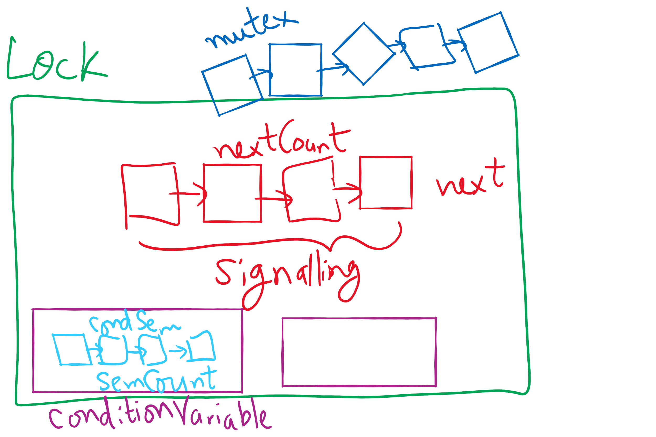
Lock and Condition Variable Implementation

Slide 19
Implementing locks with semaphores
Use mutex to ensure exclusion within the lock bounds
Use next to give lock to processes with a higher priority (why?)
nextCount indicates whether there are any higher priority waiters
class Lock {
Semaphore mutex(1);
Semaphore next(0);
int nextCount = 0;
};
Lock::Acquire()
{
mutex.down();
}
Lock::Release()
{
if (nextCount > 0)
next.up();
else
mutex.up();
}

Slide 20
Implementing condition variables
Are these Hoare or Mesa semantics?
Can there be multiple condition variables for a single Lock?
class Condition {
Lock *lock;
Semaphore condSem(0);
int semCount = 0;
};
Condition::Signal ()
{
if (semCount > 0) {
lock->nextCount += 1;
condSem.up ();
lock->next.down ();
lock->nextCount -= 1;
}
}
Condition::Wait ()
{
semCount += 1;
if (lock->nextCount > 0)
lock->next.up();
else
lock->mutex.up();
condSem.down ();
semCount -= 1;
}

Slide 21
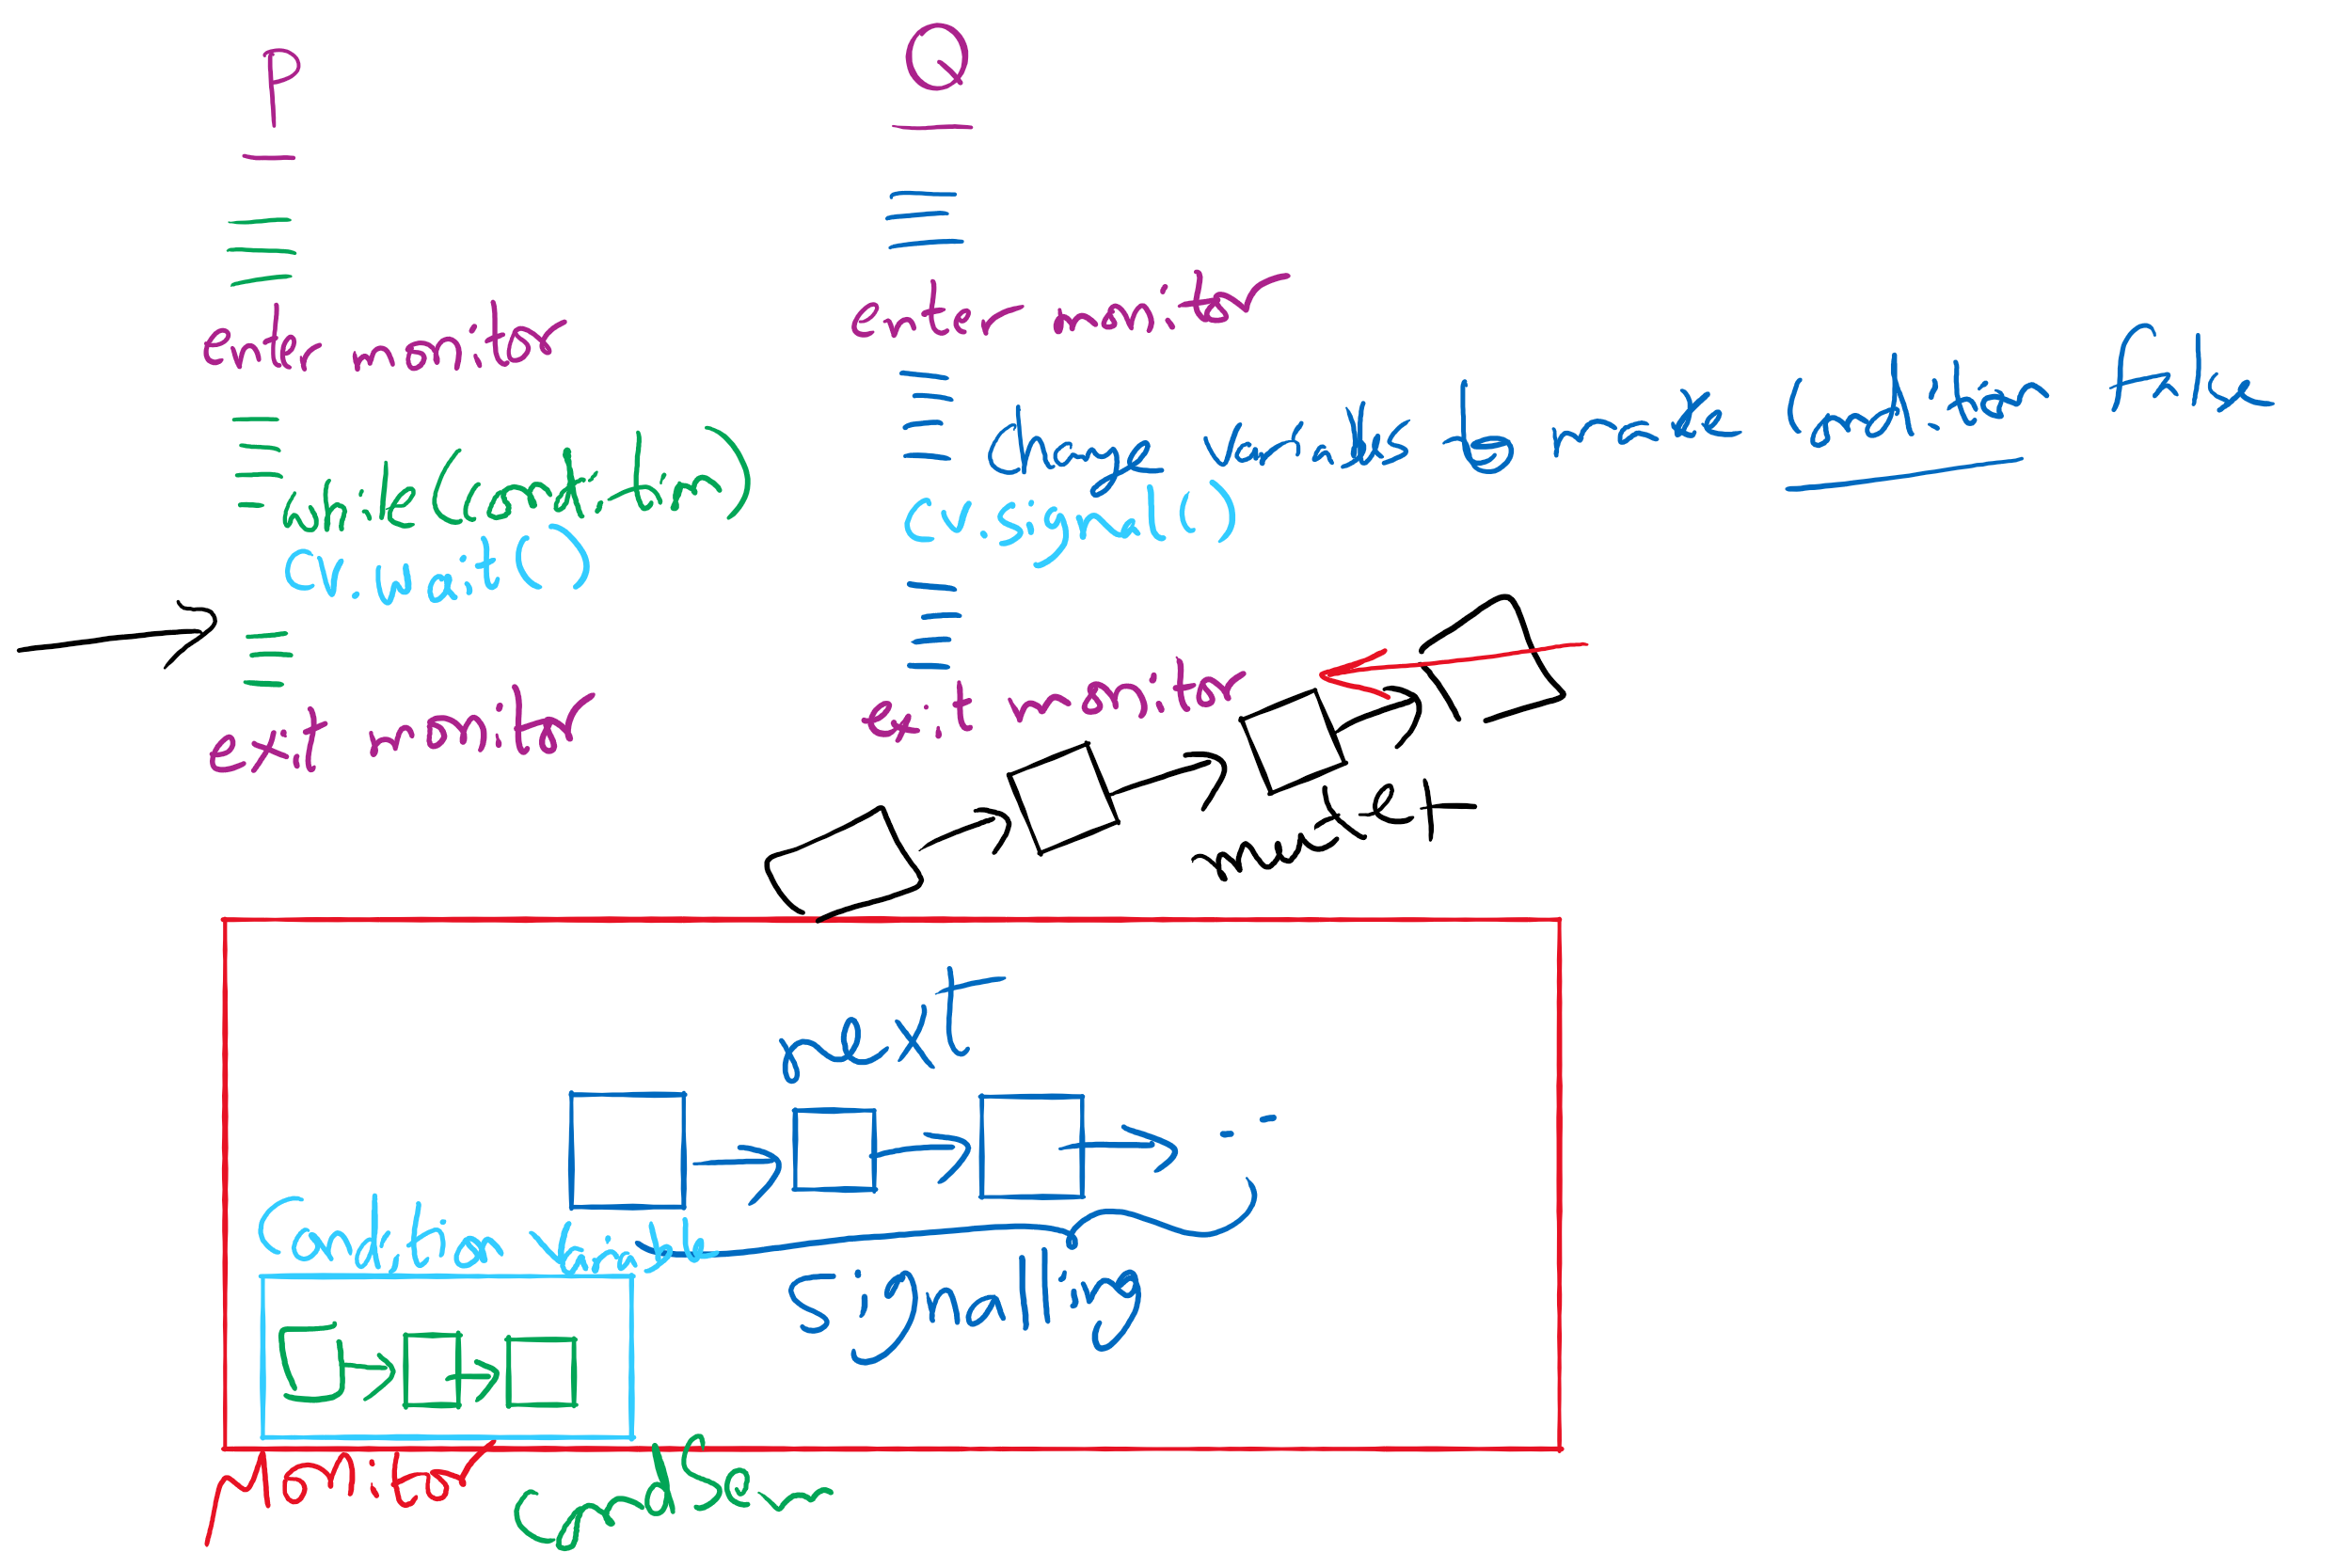
Process Synchronization inside Monitors

Slide 22
Condition Variable-based Solutions
Code Walkthrough at:
https://cs1550-2214.github.io/cs1550-code-handouts/ProcessSynchronization/Slides/

Slide 23
Reflections on semaphore usage
Semaphores can be used as
Resource counters
Waiting spaces
For mutual exclusion

Slide 24
Reflections on Condition Variables
Define a class and put all shared variables inside the class
Include a mutex and a condition variable in the class
For each public method of the class
Start by locking the mutex lock
If need to wait, use a while loop and wait on the condition variable
Before broadcasting on the condition variable, make sure to change the waiting condition

