Slide 1


Introduction to Operating Systems CS 1550
Spring 2023
Sherif Khattab
ksm73@pitt.edu
(Some slides are from Silberschatz, Galvin and Gagne ©2013)

Slide 2
Announcements
Upcoming deadlines
Homework 6 is due this Friday
Quiz 1 is due on Tuesday 2/28 at 11:59 pm
Lab 2 is due on Tuesday 2/28 at 11:59 pm
Project 2 is due Friday 3/17 at 11:59 pm
Midterm exam on Thursday 3/2
In-person, on paper, closed book
Study guide, old exam, and practice Midterm on Canvas
Lost points because autograder or simple mistake?
please reach out to Grader TA over Piazza
Navigating the Panopto Videos
Video contents
Search in captions

Slide 3
Previous Lecture
Review on Bounded Buffer and Readers-Writers
Sleepy Barbers solution using Semaphores

Slide 4
Today’s Agenda
Sleepy Barbers solution using Condition Variables
How to implement condition variables
Reflections on using semaphores and condition variables
CPU Scheduling

Slide 5
Solution using Mutex and Condition Variables
https://cs1550-2214.github.io/cs1550-code-handouts/ProcessSynchronization/Slides/

Slide 6
How to implement Condition Variables?
How to implement condition variables?
Reflect more on all the solutions/problems that we have studied

Slide 7
User-level implementation of Condition Variables
A Lock with two waiting queues
struct Lock {
Semaphore mutex(1);
Semaphore next(0);
int nextCount = 0;
}
Acquire(){
mutex.down();
}
Release(){
if(nextCount > 0){
next.up();
nextCount--;
} else mutex.up();
}

Slide 8
Condition Variable
struct ConditionVariable {
Semaphore condSem(0);
int semCount = 0;
Lock *lk;
}
Wait(){
if(lk->nextCount > 0)
lk->next.up();
lk->nextCount--;
else {
lk->mutex.up();
}
semCount++;
condSem.down();
semCount--;
}
Signal(){
if(semCount > 0){
condSem.up()
lk->nextCount++
lk->next.down();
lk->nextCount—
}
}

Slide 9
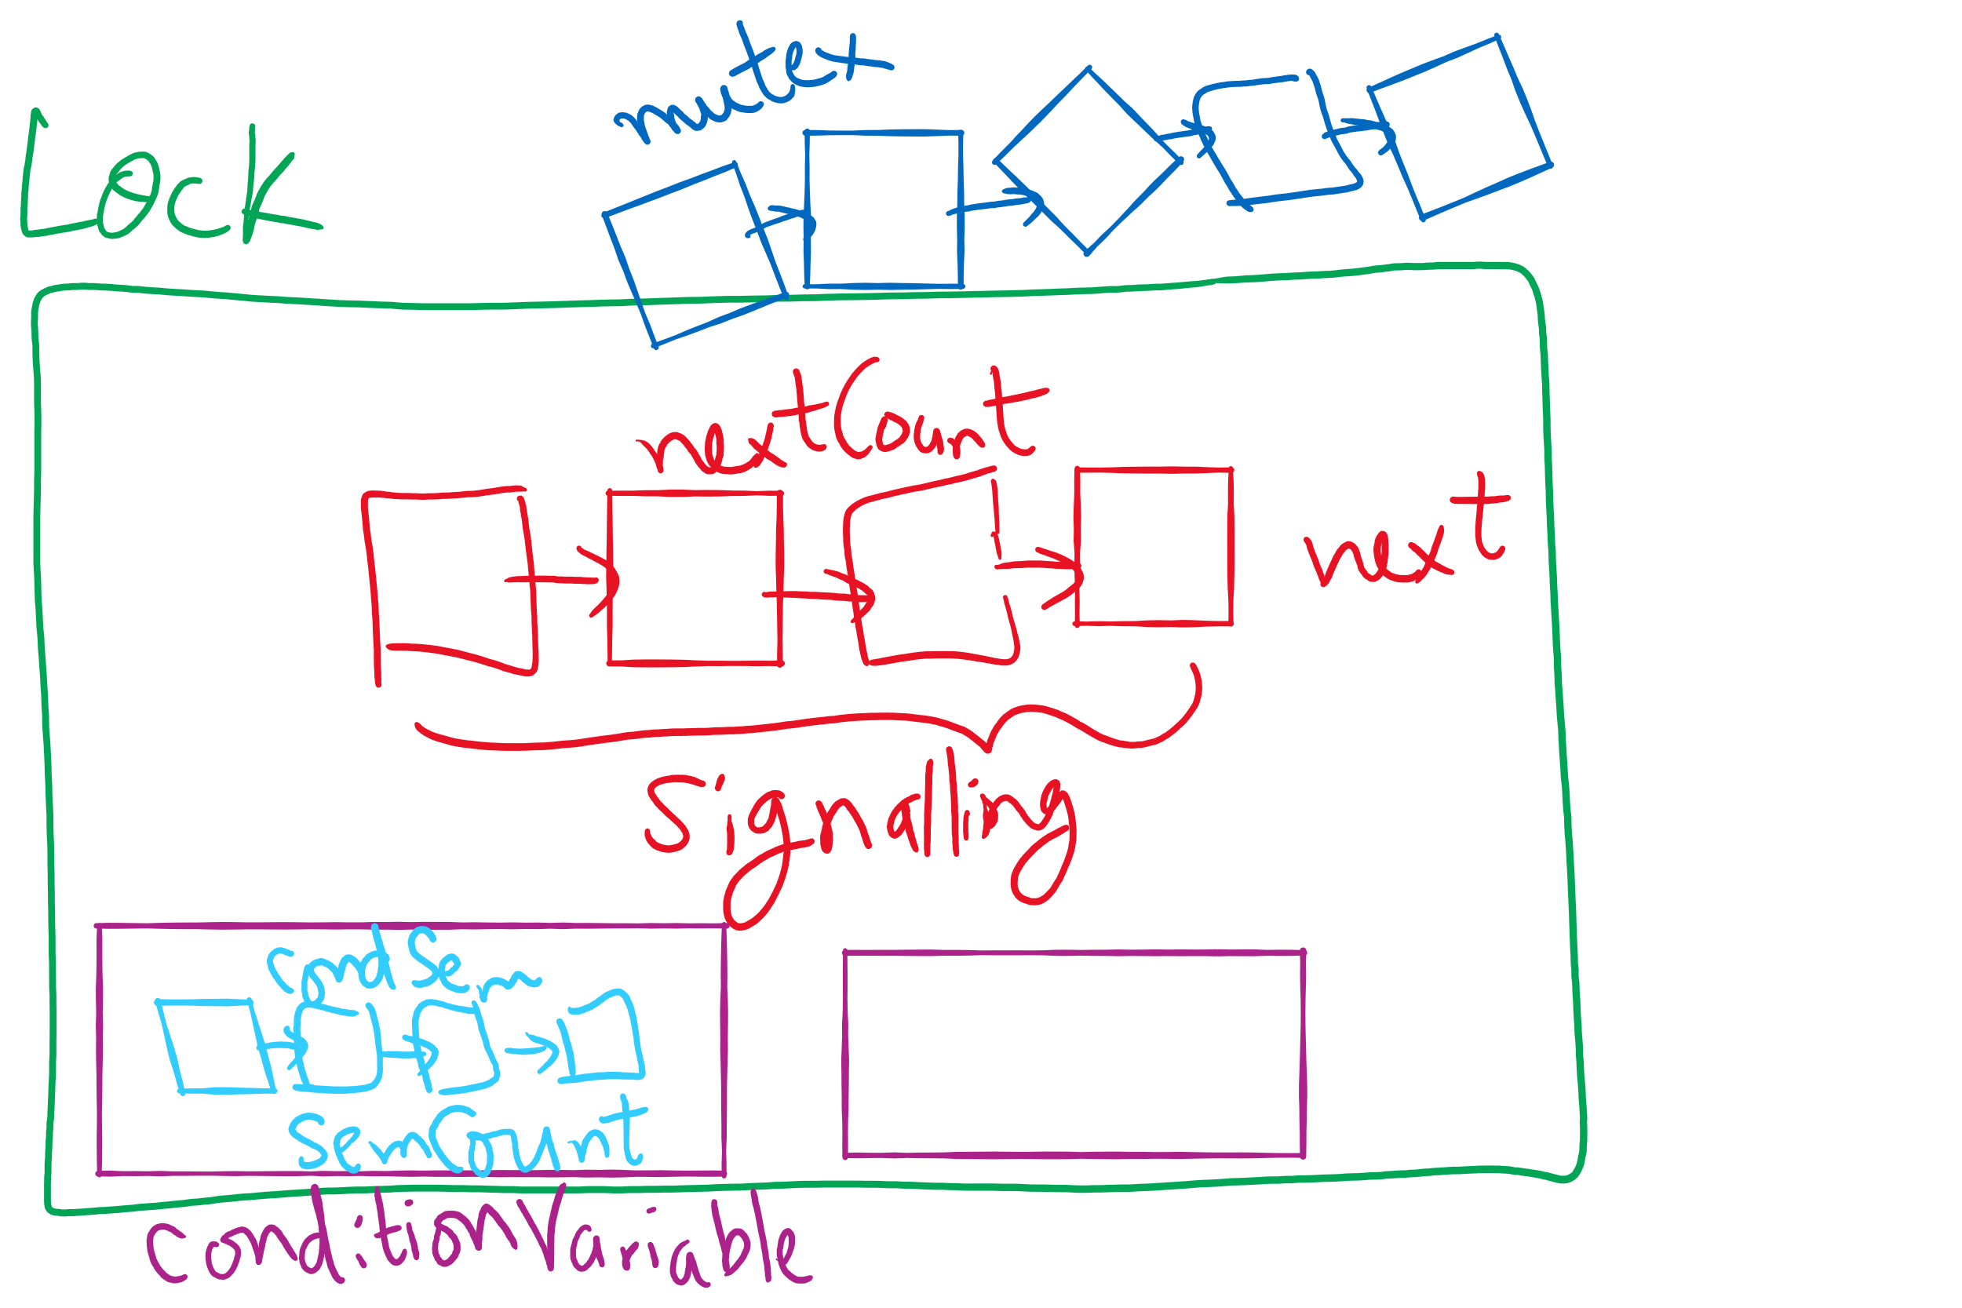
Lock and Condition Variable Implementation

Slide 10
Implementing locks with semaphores
Use mutex to ensure exclusion within the lock bounds
Use next to give lock to processes with a higher priority (why?)
nextCount indicates whether there are any higher priority waiters
class Lock {
Semaphore mutex(1);
Semaphore next(0);
int nextCount = 0;
};
Lock::Acquire()
{
mutex.down();
}
Lock::Release()
{
if (nextCount > 0)
next.up();
else
mutex.up();
}

Slide 11
Implementing condition variables
Are these Hoare or Mesa semantics?
Can there be multiple condition variables for a single Lock?
class Condition {
Lock *lock;
Semaphore condSem(0);
int semCount = 0;
};
Condition::Signal ()
{
if (semCount > 0) {
lock->nextCount += 1;
condSem.up ();
lock->next.down ();
lock->nextCount -= 1;
}
}
Condition::Wait ()
{
semCount += 1;
if (lock->nextCount > 0)
lock->next.up();
else
lock->mutex.up();
condSem.down ();
semCount -= 1;
}

Slide 12
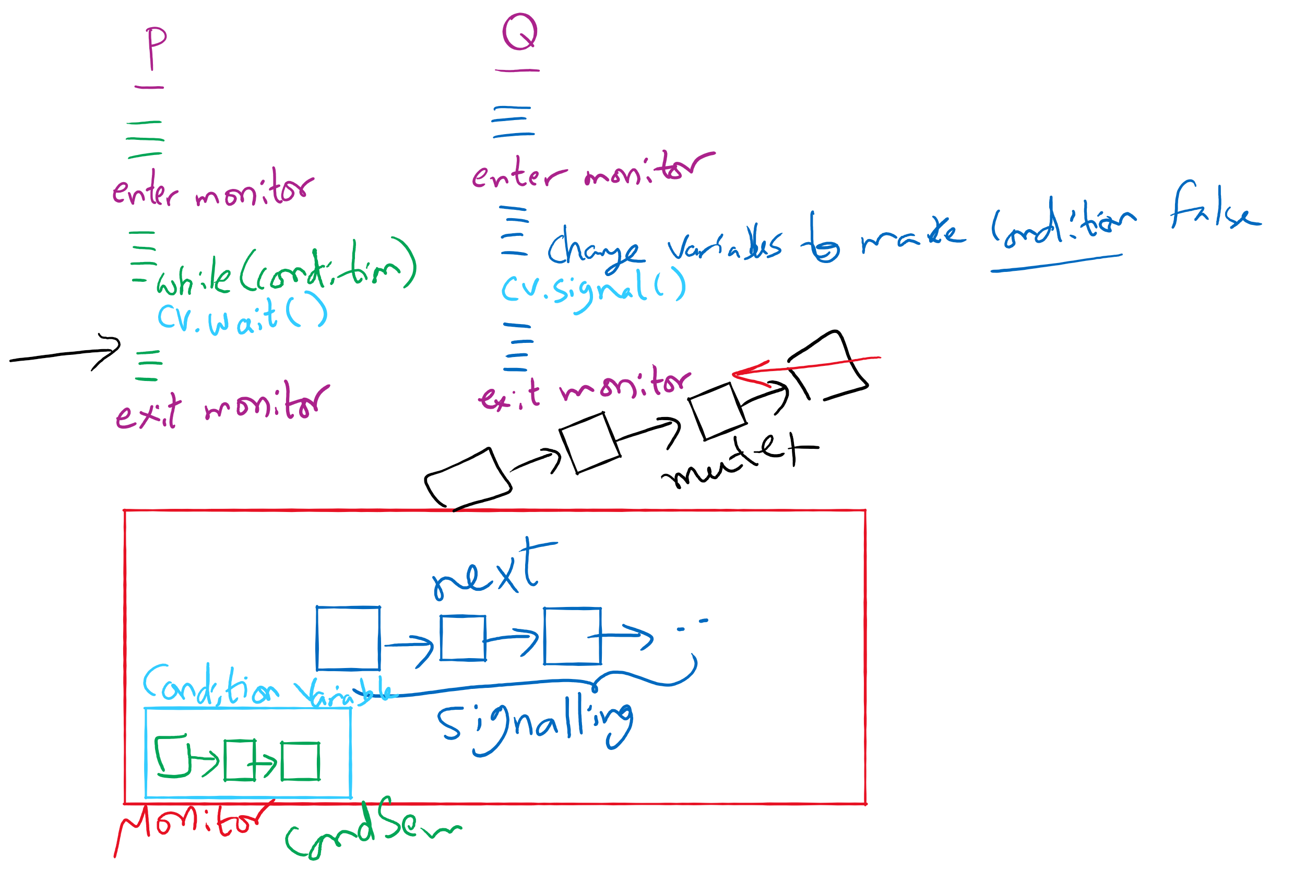
Process Synchronization inside Monitors

Slide 13
Reflections on semaphore usage
Semaphores can be used as
Resource counters
Waiting spaces
For mutual exclusion

Slide 14
Reflections on Condition Variables
Define a class and put all shared variables inside the class
Include a mutex and a condition variable in the class
For each public method of the class
Start by locking the mutex lock
If need to wait, use a while loop and wait on the condition variable
Before broadcasting on the condition variable, make sure to change the waiting condition

Slide 15
Final Remarks on Process Synchronization
Many other synchronization mechanisms
Message passing
Barriers
Futex
Re-entrant locks
Atomic*

Slide 16
Problem of the Day: CPU Scheduling
How does the short-term scheduler select the next process to run?

Slide 17
CPU Scheduling
Scheduling the processor among all ready processes
User-oriented criteria
Response Time: Elapsed time between the submission of a request and the receipt of a response
Turnaround Time: Elapsed time between the submission of a process to its completion
System-oriented criteria
Processor utilization
Throughput: number of process completed per unit time
Fairness

Slide 18
Short-Term Scheduler Dispatcher
The dispatcher is the module that gives control of the CPU to the process selected by the short-term scheduler
The functions of the dispatcher include:
Switching context
Switching to user mode
Jumping to the location in the user program to restart execution
The dispatch latency must be minimal

Slide 19





The CPU-I/O Cycle
Processes require alternate use of processor and I/O in a repetitive fashion
Each cycle consist of a CPU burst followed by an I/O burst
A process terminates on a CPU burst
CPU-bound processes have longer CPU bursts than I/O-bound processes

Slide 20
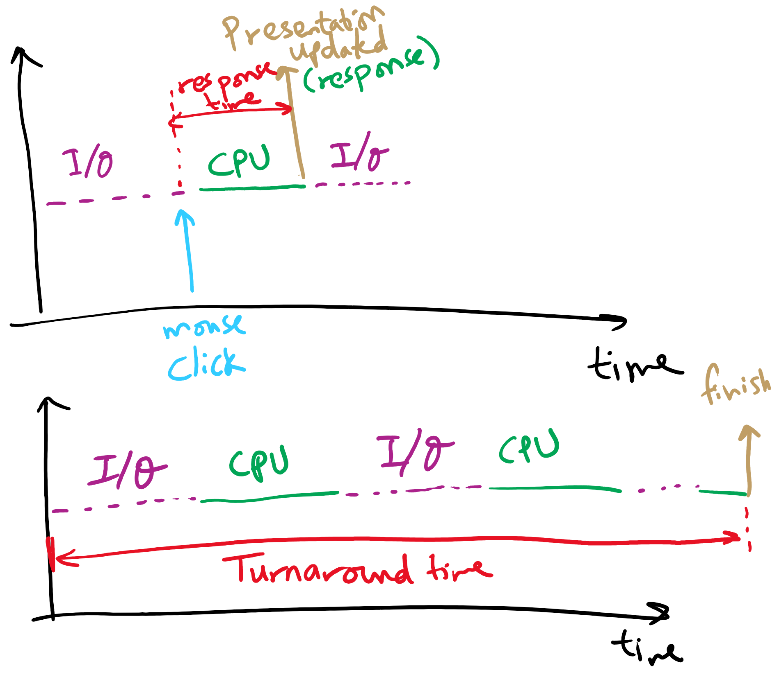
Response time vs. Turnaround time

Slide 21
Scheduling Algorithms
First-Come, First-Served Scheduling
Shortest-Job-First Scheduling
Also referred to as Shortest Process Next
Priority Scheduling
Round-Robin Scheduling
Multilevel Queue Scheduling
Multilevel Feedback Queue Scheduling

Slide 22
Characterization of Scheduling Policies
The selection function determines which ready process is selected next for execution
The decision mode specifies the instants in time the selection function is exercised
Nonpreemptive
Once a process is in the running state, it will continue until it terminates or blocks for an I/O
Preemptive
Currently running process may be interrupted and moved to the Ready state by the OS
Prevents one process from monopolizing the processor

Slide 23
Process Mix Example
Process
Arrival Time
Service Time
1
0
3
2
2
6
3
4
4
4
6
5
5
8
2
Service time = total processor time needed in one (CPU-I/O) cycle
Jobs with long service time are CPU-bound jobs and are referred
to as “long jobs”

Slide 24







First Come First Served (FCFS)
Selection function: the process that has been waiting the longest in the ready queue (hence, FCFS)
Decision mode: non-preemptive
a process runs until it blocks for an I/O
Process
Arrival Time
Service Time
1
0
3
2
2
6
3
4
4
4
6
5
5
8
2

Slide 25
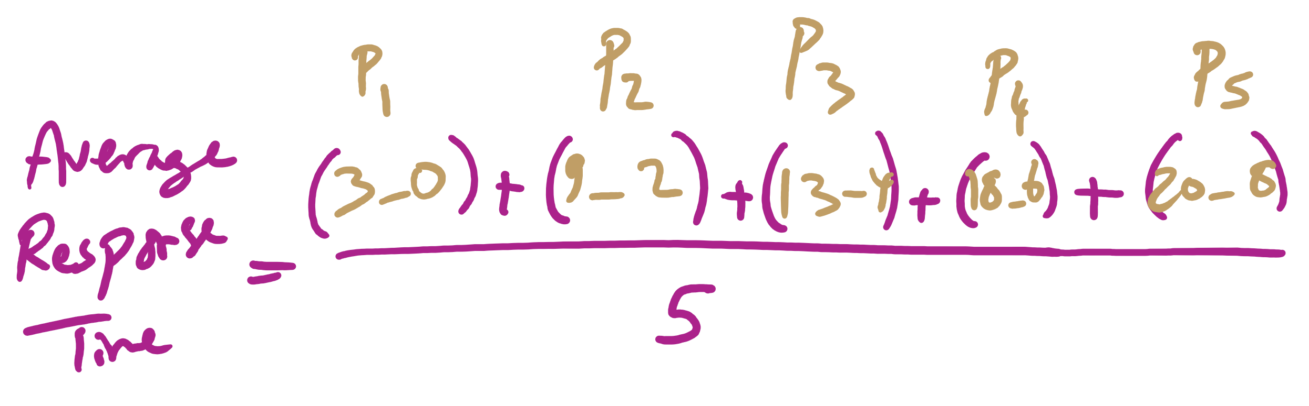
Average Response Time

Slide 26
FCFS drawbacks
Favours CPU-bound processes
CPU-bound processes monopolize the processor
I/O-bound processes have to wait until completion of CPU-bound process
I/O-bound processes may have to wait even after their I/Os are completed (poor device utilization)
Convoy effect
Better I/O device utilization could be achieved if I/O bound processes had higher priority

Slide 27
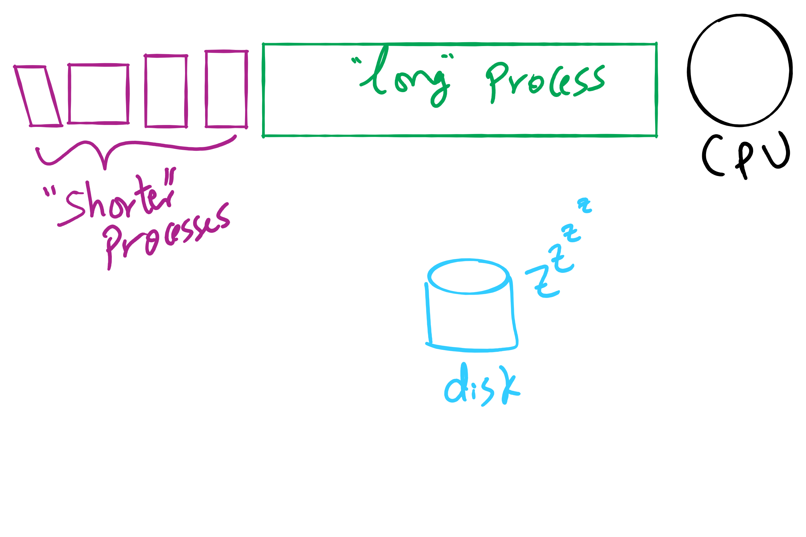
Convoy Effect

Slide 28











Shortest Job First (Shortest Process Next)
Selection function: the process with the shortest expected CPU burst time
I/O-bound processes will be selected first
Decision mode: non-preemptive
The required processing time, i.e., the CPU burst time, must be estimated for each process
Process
Arrival Time
Service Time
1
0
3
2
2
6
3
4
4
4
6
5
5
8
2

Slide 29
SJF / SPN Critique
Possibility of starvation for longer processes
Lack of preemption is not suitable in a time sharing environment
SJF/SPN implicitly incorporates priorities
Shortest jobs are given preference
CPU bound processes have lower priority, but a process doing no I/O could still monopolize the CPU if it is the first to enter the system

Slide 30
Priorities
Implemented by having multiple ready queues to represent each level of priority
Scheduler selects the process of a higher priority over one of lower priority
Lower-priority may suffer starvation
To alleviate starvation allow dynamic priorities
The priority of a process changes based on its age or execution history

Slide 31
Round-Robin
Selection function: same as FCFS
Decision mode: pre-emptive
a process is allowed to run until the time slice period (quantum, typically from 10 to 100 ms) has expired
a clock interrupt occurs and the running process is put on the ready queue
Process
Arrival Time
Service Time
1
0
3
2
2
6
3
4
4
4
6
5
5
8
2

Slide 32

Round-Robin
Selection function: same as FCFS
Decision mode: pre-emptive
a process is allowed to run until the time slice period (quantum, typically from 10 to 100 ms) has expired
a clock interrupt occurs and the running process is put on the ready queue
Process
Arrival Time
Service Time
1
0
3
2
2
6
3
4
4
4
6
5
5
8
2

Slide 33

Round-Robin
Selection function: same as FCFS
Decision mode: pre-emptive
a process is allowed to run until the time slice period (quantum, typically from 10 to 100 ms) has expired
a clock interrupt occurs and the running process is put on the ready queue
Process
Arrival Time
Service Time
1
0
3
2
2
6
3
4
4
4
6
5
5
8
2

Slide 34

Round-Robin
Selection function: same as FCFS
Decision mode: pre-emptive
a process is allowed to run until the time slice period (quantum, typically from 10 to 100 ms) has expired
a clock interrupt occurs and the running process is put on the ready queue
Process
Arrival Time
Service Time
1
0
3
2
2
6
3
4
4
4
6
5
5
8
2

Slide 35


Round-Robin
Selection function: same as FCFS
Decision mode: pre-emptive
a process is allowed to run until the time slice period (quantum, typically from 10 to 100 ms) has expired
a clock interrupt occurs and the running process is put on the ready queue
Process
Arrival Time
Service Time
1
0
3
2
2
6
3
4
4
4
6
5
5
8
2

Slide 36

Round-Robin
Selection function: same as FCFS
Decision mode: pre-emptive
a process is allowed to run until the time slice period (quantum, typically from 10 to 100 ms) has expired
a clock interrupt occurs and the running process is put on the ready queue
Process
Arrival Time
Service Time
1
0
3
2
2
6
3
4
4
4
6
5
5
8
2

Slide 37

Round-Robin
Selection function: same as FCFS
Decision mode: pre-emptive
a process is allowed to run until the time slice period (quantum, typically from 10 to 100 ms) has expired
a clock interrupt occurs and the running process is put on the ready queue
Process
Arrival Time
Service Time
1
0
3
2
2
6
3
4
4
4
6
5
5
8
2

Slide 38

Round-Robin
Selection function: same as FCFS
Decision mode: pre-emptive
a process is allowed to run until the time slice period (quantum, typically from 10 to 100 ms) has expired
a clock interrupt occurs and the running process is put on the ready queue
Process
Arrival Time
Service Time
1
0
3
2
2
6
3
4
4
4
6
5
5
8
2

Slide 39


Round-Robin
Selection function: same as FCFS
Decision mode: pre-emptive
a process is allowed to run until the time slice period (quantum, typically from 10 to 100 ms) has expired
a clock interrupt occurs and the running process is put on the ready queue
Process
Arrival Time
Service Time
1
0
3
2
2
6
3
4
4
4
6
5
5
8
2

Slide 40

Round-Robin
Selection function: same as FCFS
Decision mode: pre-emptive
a process is allowed to run until the time slice period (quantum, typically from 10 to 100 ms) has expired
a clock interrupt occurs and the running process is put on the ready queue
Process
Arrival Time
Service Time
1
0
3
2
2
6
3
4
4
4
6
5
5
8
2

Slide 41


Round-Robin
Selection function: same as FCFS
Decision mode: pre-emptive
a process is allowed to run until the time slice period (quantum, typically from 10 to 100 ms) has expired
a clock interrupt occurs and the running process is put on the ready queue
Process
Arrival Time
Service Time
1
0
3
2
2
6
3
4
4
4
6
5
5
8
2

Slide 42


Round-Robin
Selection function: same as FCFS
Decision mode: pre-emptive
a process is allowed to run until the time slice period (quantum, typically from 10 to 100 ms) has expired
a clock interrupt occurs and the running process is put on the ready queue
Process
Arrival Time
Service Time
1
0
3
2
2
6
3
4
4
4
6
5
5
8
2

Slide 43

Round-Robin
Selection function: same as FCFS
Decision mode: pre-emptive
a process is allowed to run until the time slice period (quantum, typically from 10 to 100 ms) has expired
a clock interrupt occurs and the running process is put on the ready queue
Process
Arrival Time
Service Time
1
0
3
2
2
6
3
4
4
4
6
5
5
8
2

Slide 44

Round-Robin
Selection function: same as FCFS
Decision mode: pre-emptive
a process is allowed to run until the time slice period (quantum, typically from 10 to 100 ms) has expired
a clock interrupt occurs and the running process is put on the ready queue
Process
Arrival Time
Service Time
1
0
3
2
2
6
3
4
4
4
6
5
5
8
2

Slide 45


Round-Robin
Selection function: same as FCFS
Decision mode: pre-emptive
a process is allowed to run until the time slice period (quantum, typically from 10 to 100 ms) has expired
a clock interrupt occurs and the running process is put on the ready queue
Process
Arrival Time
Service Time
1
0
3
2
2
6
3
4
4
4
6
5
5
8
2

Slide 46

Round-Robin
Selection function: same as FCFS
Decision mode: pre-emptive
a process is allowed to run until the time slice period (quantum, typically from 10 to 100 ms) has expired
a clock interrupt occurs and the running process is put on the ready queue
Process
Arrival Time
Service Time
1
0
3
2
2
6
3
4
4
4
6
5
5
8
2

Slide 47

Round-Robin
Selection function: same as FCFS
Decision mode: pre-emptive
a process is allowed to run until the time slice period (quantum, typically from 10 to 100 ms) has expired
a clock interrupt occurs and the running process is put on the ready queue
Process
Arrival Time
Service Time
1
0
3
2
2
6
3
4
4
4
6
5
5
8
2

Slide 48


Round-Robin
Selection function: same as FCFS
Decision mode: pre-emptive
a process is allowed to run until the time slice period (quantum, typically from 10 to 100 ms) has expired
a clock interrupt occurs and the running process is put on the ready queue
Process
Arrival Time
Service Time
1
0
3
2
2
6
3
4
4
4
6
5
5
8
2

Slide 49

Round-Robin
Selection function: same as FCFS
Decision mode: pre-emptive
a process is allowed to run until the time slice period (quantum, typically from 10 to 100 ms) has expired
a clock interrupt occurs and the running process is put on the ready queue
Process
Arrival Time
Service Time
1
0
3
2
2
6
3
4
4
4
6
5
5
8
2

Slide 50
RR Time Quantum
Quantum must be substantially larger than the time required to handle the clock interrupt and dispatching
Quantum should be larger then the typical interaction
but not much larger, to avoid penalizing I/O bound processes

Slide 51
RR Time Quantum

Slide 52
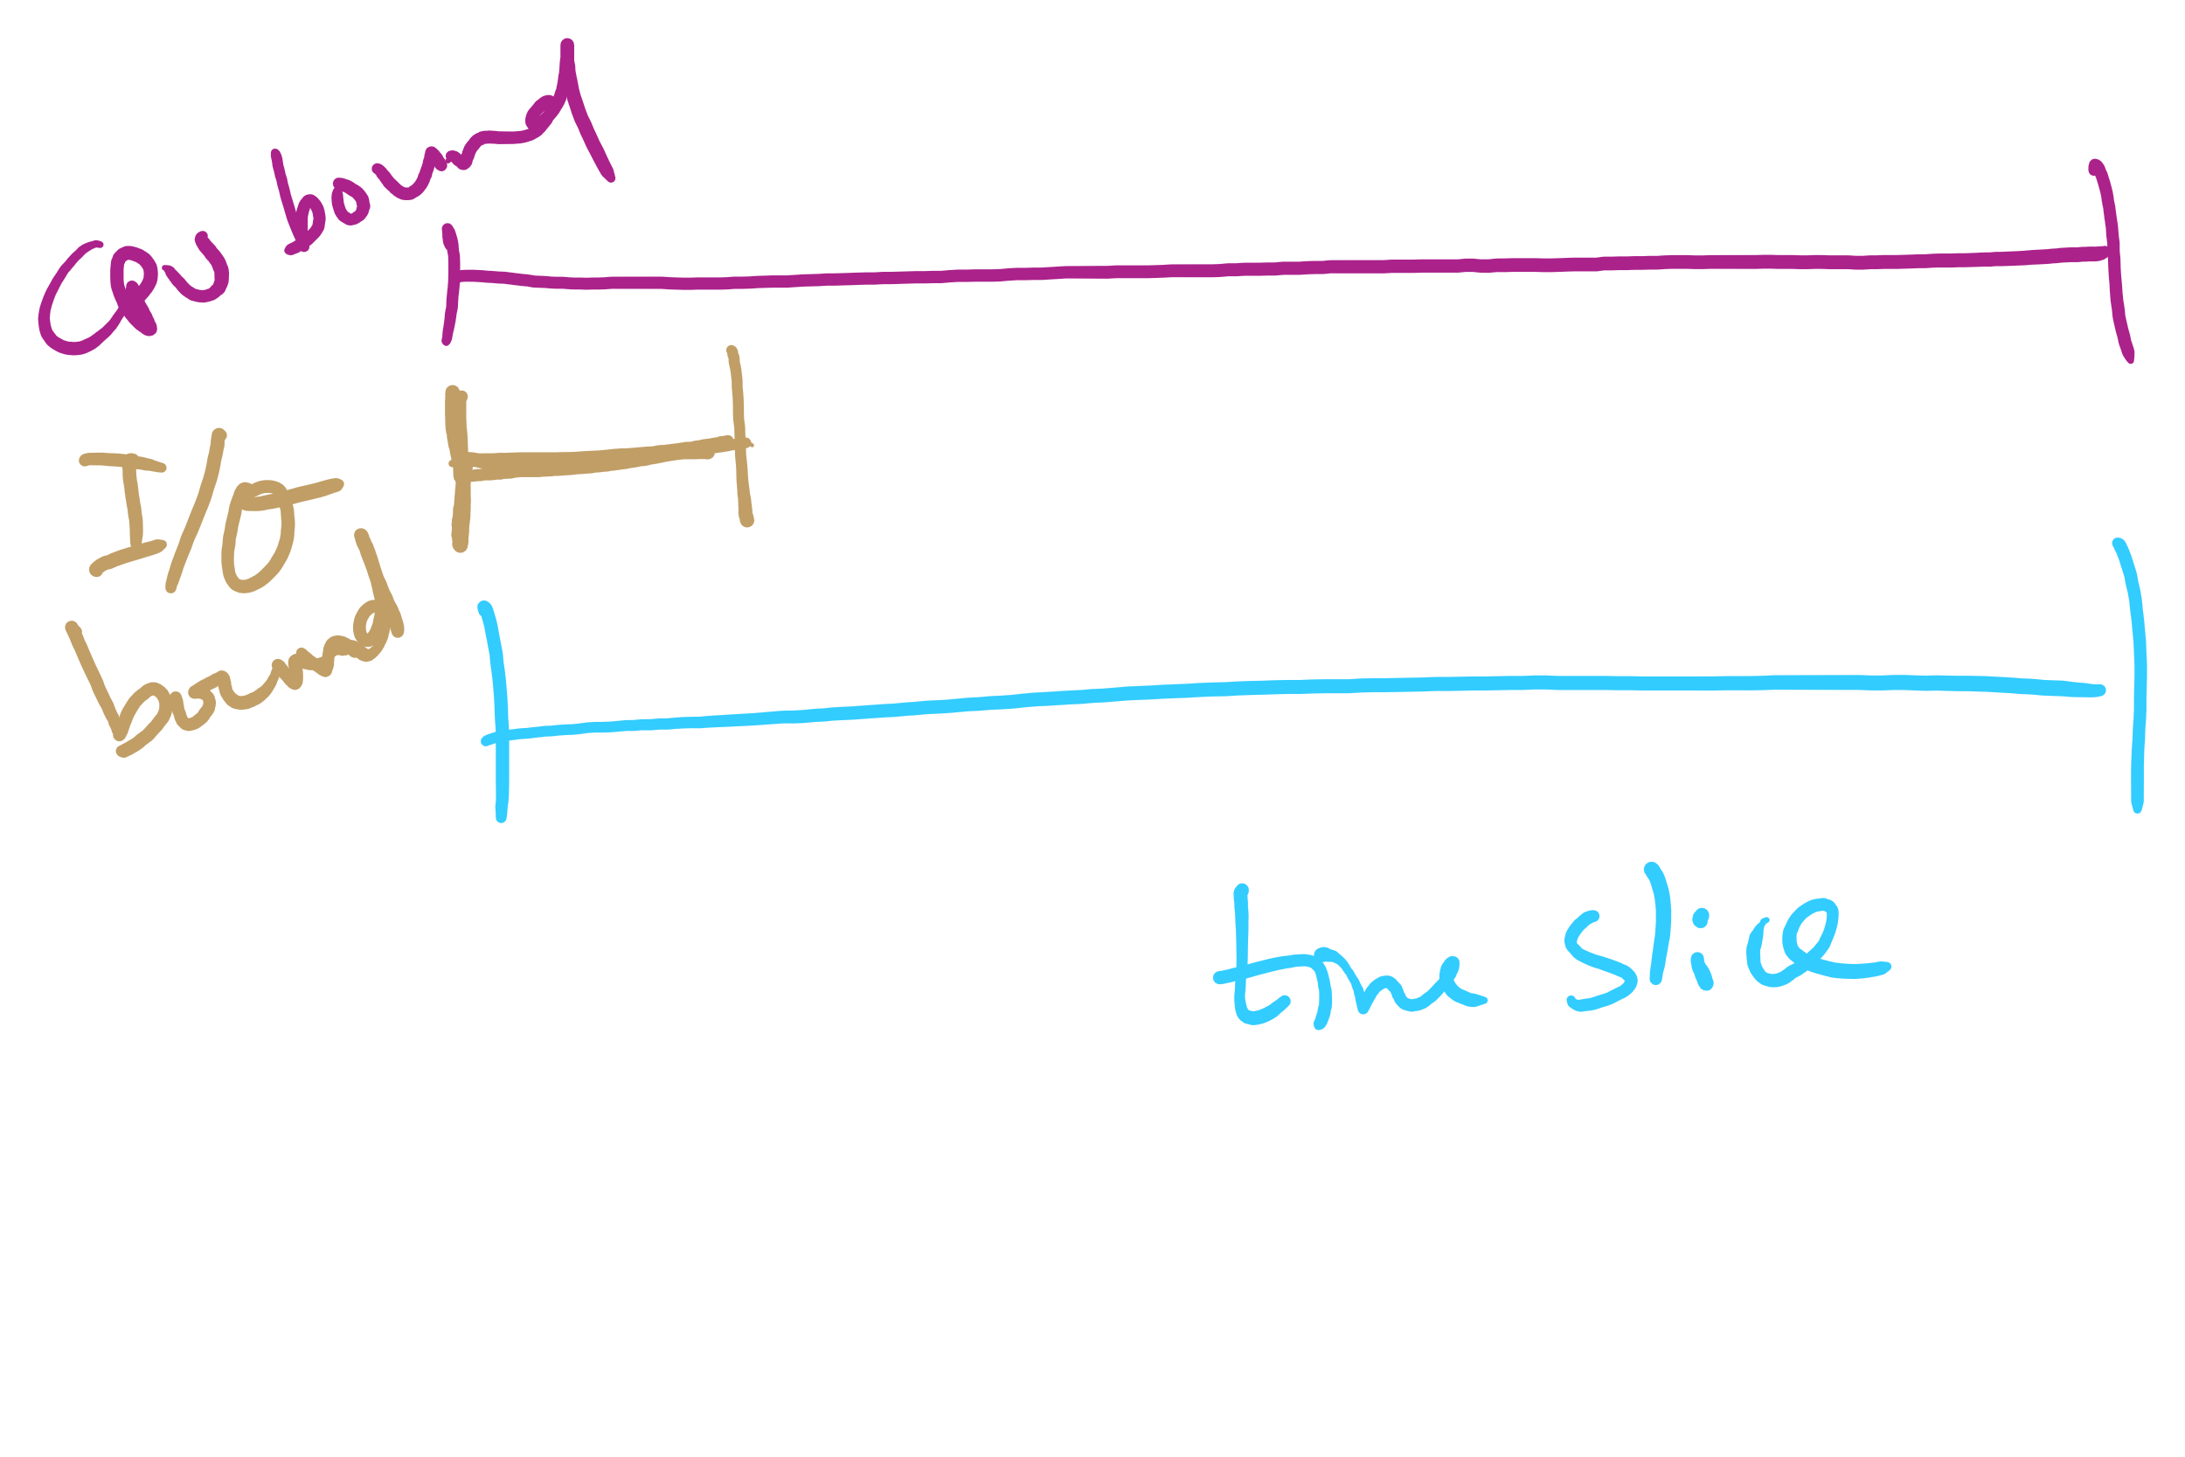
Quantum Length

Slide 53
Round Robin: critique
Still favors CPU-bound processes
An I/O bound process uses the CPU for a time less than the time quantum before it is blocked waiting for an I/O
A CPU-bound process runs for all its time slice and is put back into the ready queue
May unfairly get in front of blocked processes

