Slide 1


Introduction to Operating Systems CS 1550
Spring 2023
Sherif Khattab
ksm73@pitt.edu
(Some slides are from Silberschatz, Galvin and Gagne ©2013)

Slide 2
Announcements
Upcoming deadlines
All deadlines moved to Monday May 1st at 11:59 pm
But please don’t wait to last minute!
Homework 11, 12, Bonus Homework
Lab 4 and Lab 5
Quiz 3 and Quiz 4
Project 4 (no late deadline)

Slide 3
Final Exam
Wednesday 4/26 8:00-9:50
same classroom
coffee will be served!
Same format as midterm
Non-cumulative
Study guide and practice test on Canvas
Review Session during Finals’ Week
Date and time TBD
recorded

Slide 4
Bonus Opportunities
Bonus Homework
worth up to 1%
lowest two homework assignments still dropped
Post-Course Quiz on Canvas
worth 1%
bonus point for class when
OMETs response rate >= 80%
Currently at 28%
Deadline is Sunday 4/23

Slide 5
Previous Lecture …
How does a file system hide disk access delays?
How do device drivers program I/O devices?
Disk arm scheduling
FCFS, SSTF, SCAN, C-SCAN, LOOK, C-LOOK

Slide 6
Today …
Miscellaneous issues in File Systems
Protection in operating systems

Slide 7
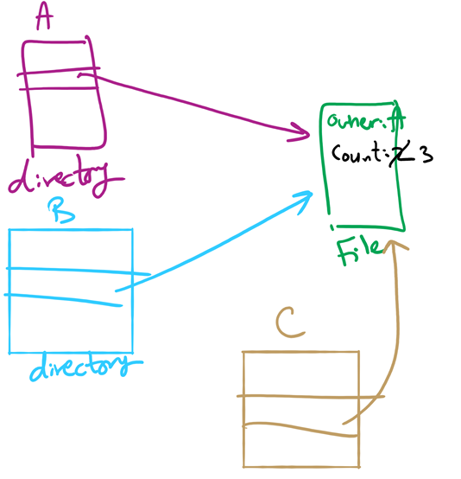
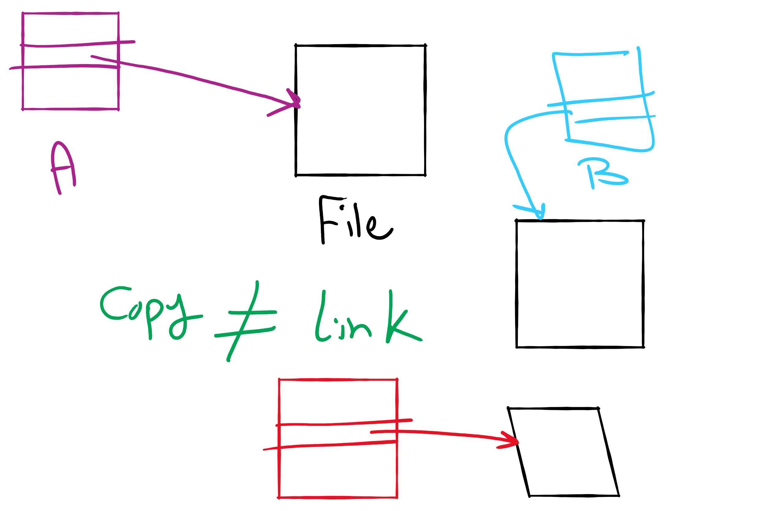
Hard Linking vs. Copying
hard linking
copying
doesn’t create a new i-node
increments the link count inside original i-node
e.g., ln command in Linux without -s
creates a new i-node
e.g., cp command in Linux
soft (symbolic linking)
creates a new i-node that contains path of original file
e.g., ln -s command in Linux

Slide 8
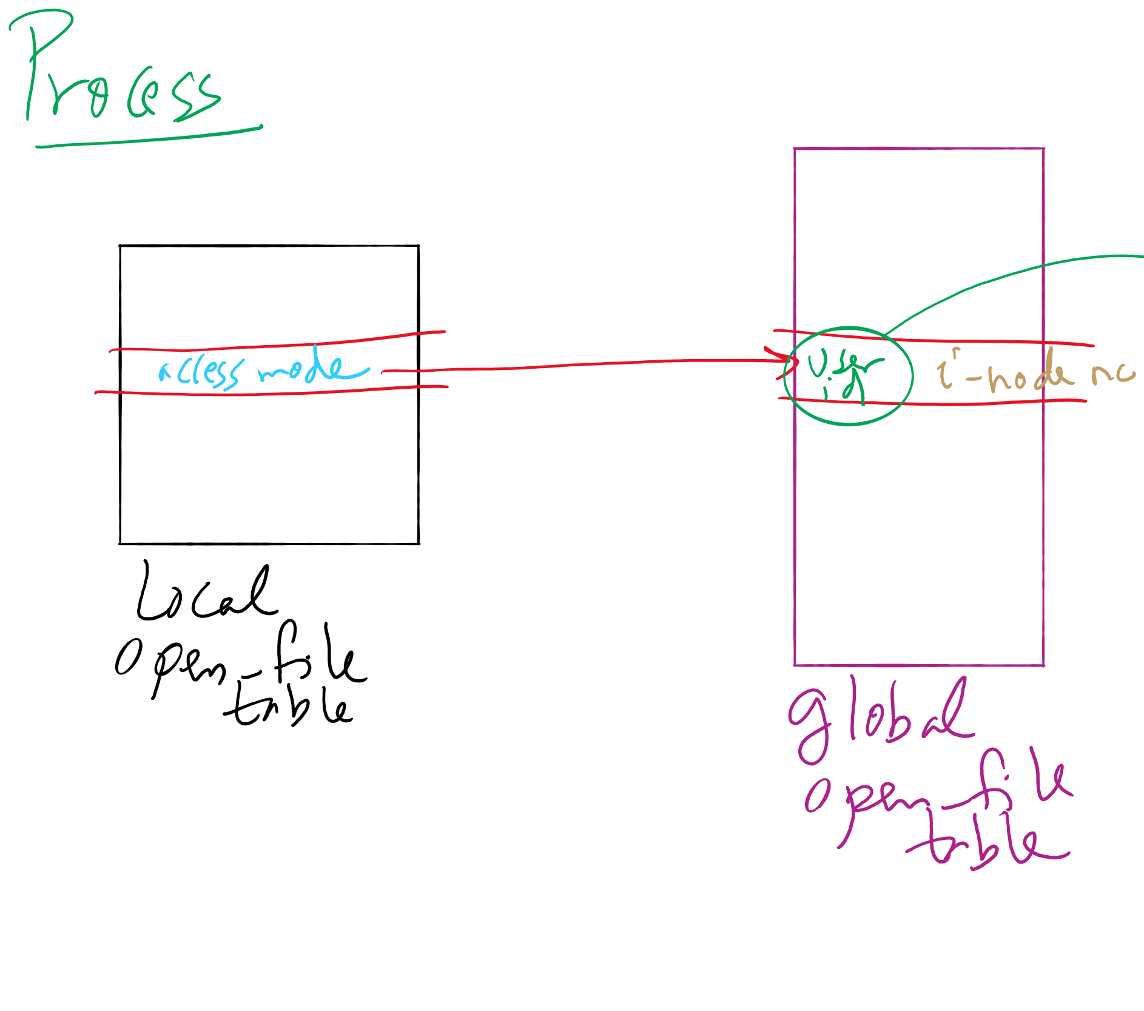
File-related kernel structures: open-file tables
per-process and global open-file tables

Slide 9
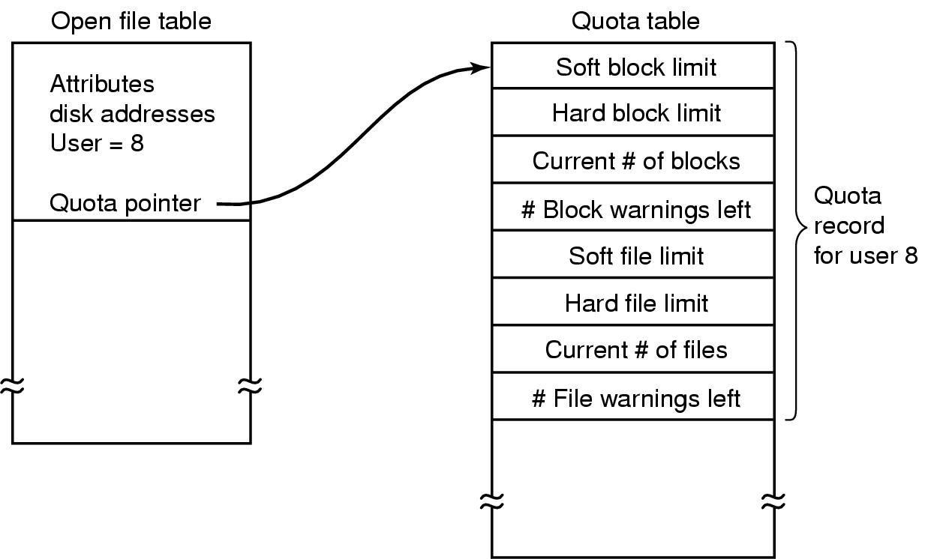
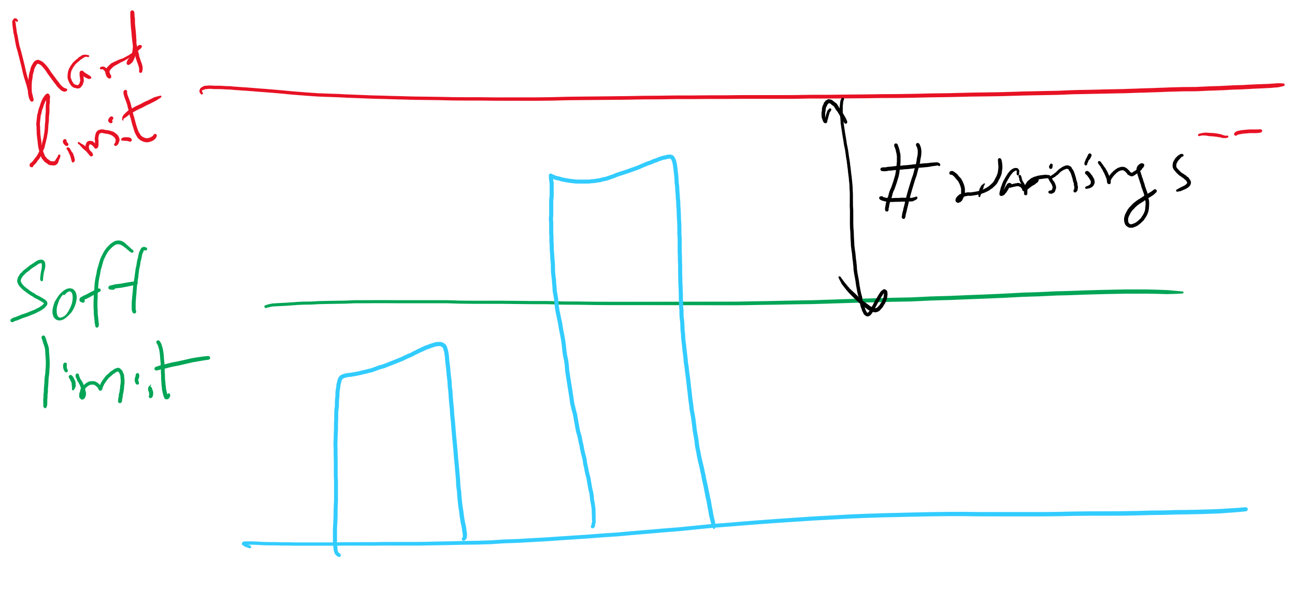
File-related kernel structures: quota table

Slide 10
Journaling File System
Problem: regular file system: changes to files and directories result in multiple separate writes to disk
e.g., deleting a file → three writes
power failures result in file system inconsistency
Solution: Write the changes twice
first to an on-disk journal
for efficiency, journal can be put on SSD or NVRAM
then commit changes to main part
atomic operations
modified data may or may not be written to the journal
implications?
Examples
Windows NTFS
Linux ext3, ext4

Slide 11
Journaling File System
Interaction with disk arm scheduling?
may cause a different write order than wanted
solution: flush write cache at certain points (barriers)
ext3 and ext4 file systems
Journaling vs. Log-structured file system
main file system itself is a journal
journaling is not needed in LFS

Slide 12
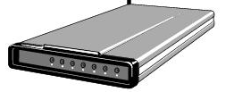
Buffering device input
User space
User space
User space
User space
Kernel space
Kernel space
Kernel space
Kernel space
2
2
1
1
3
Unbuffered input
Buffering in user space
Buffer in kernel Copy to user space
Double buffer in kernel

Slide 13
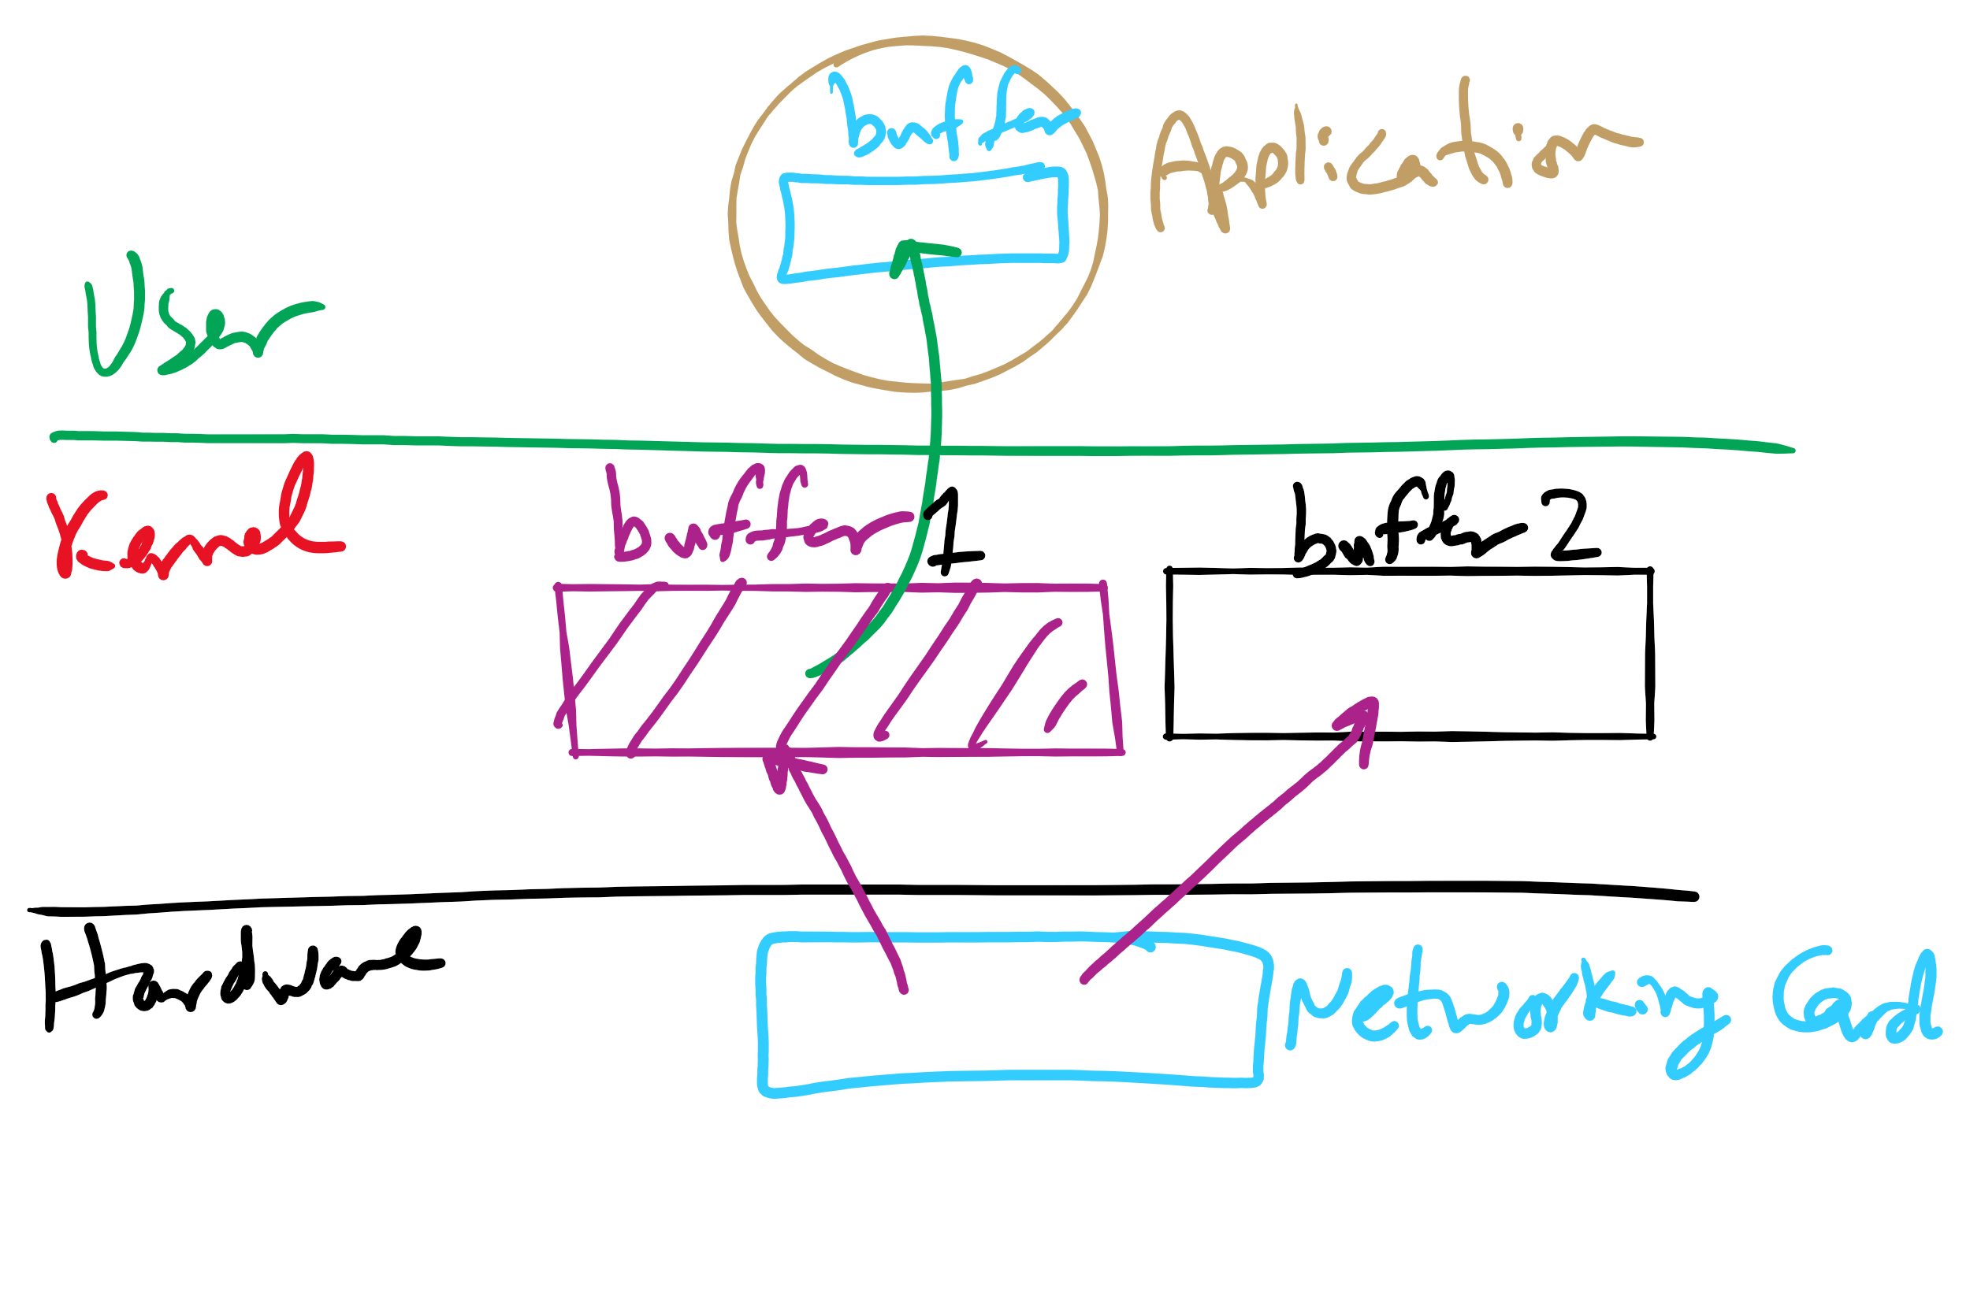
Double Buffering

Slide 14
Max Partition Size
Block size | FAT-12 | FAT-16 | FAT-32
0.5 KB | 2 MB
1 KB | 4 MB
2 KB | 8 MB | 128 MB
4 KB | 16 MB | 256 MB | 1 TB
8 KB |  | 512 MB | 2 TB
16 KB |  | 1024 MB | 2 TB
32 KB |  | 2048 MB | 2 TB

Slide 15
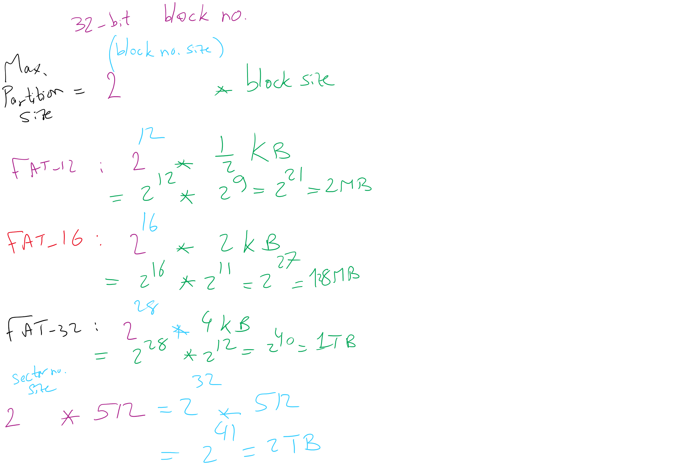
Max Partition Size
Block size | FAT-12 | FAT-16 | FAT-32
0.5 KB | 2 MB
1 KB | 4 MB
2 KB | 8 MB | 128 MB
4 KB | 16 MB | 256 MB | 1 TB
8 KB |  | 512 MB | 2 TB
16 KB |  | 1024 MB | 2 TB
32 KB |  | 2048 MB | 2 TB

Slide 16
Max Partition Size
Block size | FAT-12 | FAT-16 | FAT-32
0.5 KB | 2 MB
1 KB | 4 MB
2 KB | 8 MB | 128 MB
4 KB | 16 MB | 256 MB | 1 TB
8 KB |  | 512 MB | 2 TB
16 KB |  | 1024 MB | 2 TB
32 KB |  | 2048 MB | 2 TB

Slide 17
Max Partition Size
Block size | FAT-12 | FAT-16 | FAT-32
0.5 KB | 2 MB
1 KB | 4 MB
2 KB | 8 MB | 128 MB
4 KB | 16 MB | 256 MB | 1 TB
8 KB |  | 512 MB | 2 TB
16 KB |  | 1024 MB | 2 TB
32 KB |  | 2048 MB | 2 TB

Slide 18
Max Partition Size
Block size | FAT-12 | FAT-16 | FAT-32
0.5 KB | 2 MB
1 KB | 4 MB
2 KB | 8 MB | 128 MB
4 KB | 16 MB | 256 MB | 1 TB
8 KB |  | 512 MB | 2 TB
16 KB |  | 1024 MB | 2 TB
32 KB |  | 2048 MB | 2 TB

Slide 19
Max Partition Size
Block size | FAT-12 | FAT-16 | FAT-32
0.5 KB | 2 MB
1 KB | 4 MB
2 KB | 8 MB | 128 MB
4 KB | 16 MB | 256 MB | 1 TB
8 KB |  | 512 MB | 2 TB
16 KB |  | 1024 MB | 2 TB
32 KB |  | 2048 MB | 2 TB

Slide 20
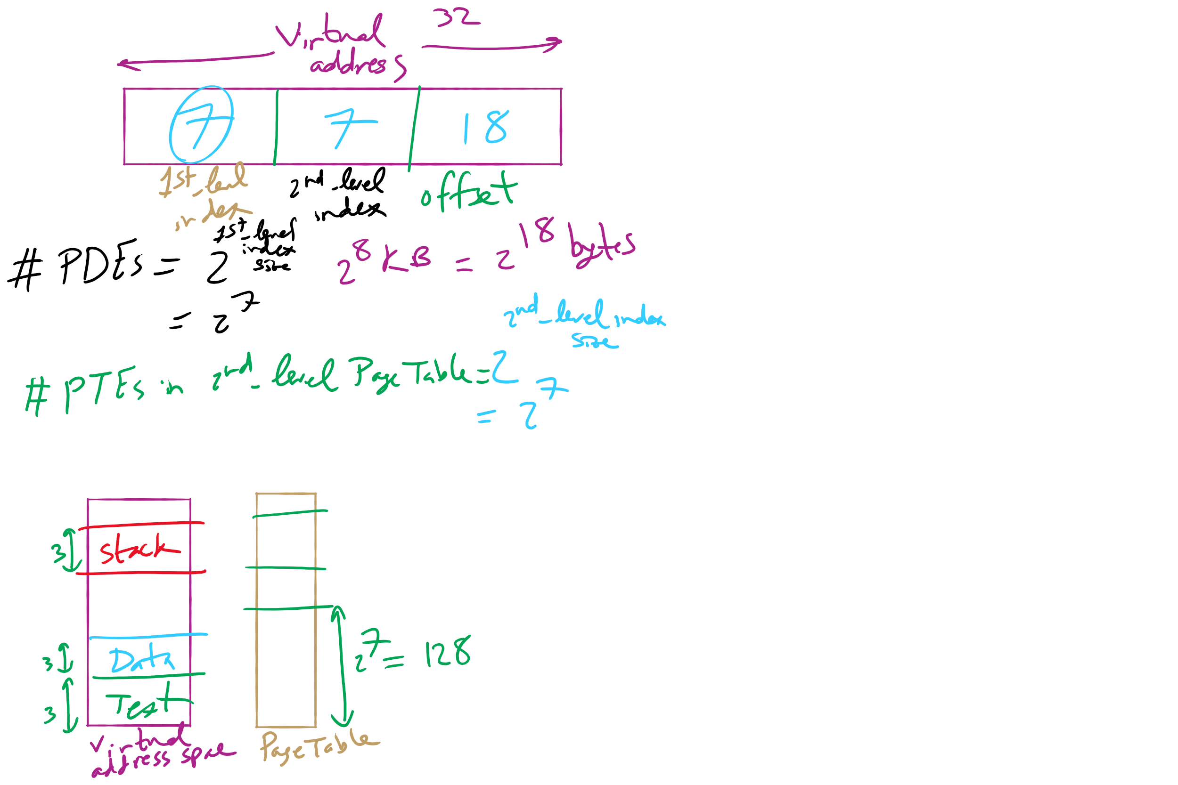
HW 10: Q 2-4

Slide 21
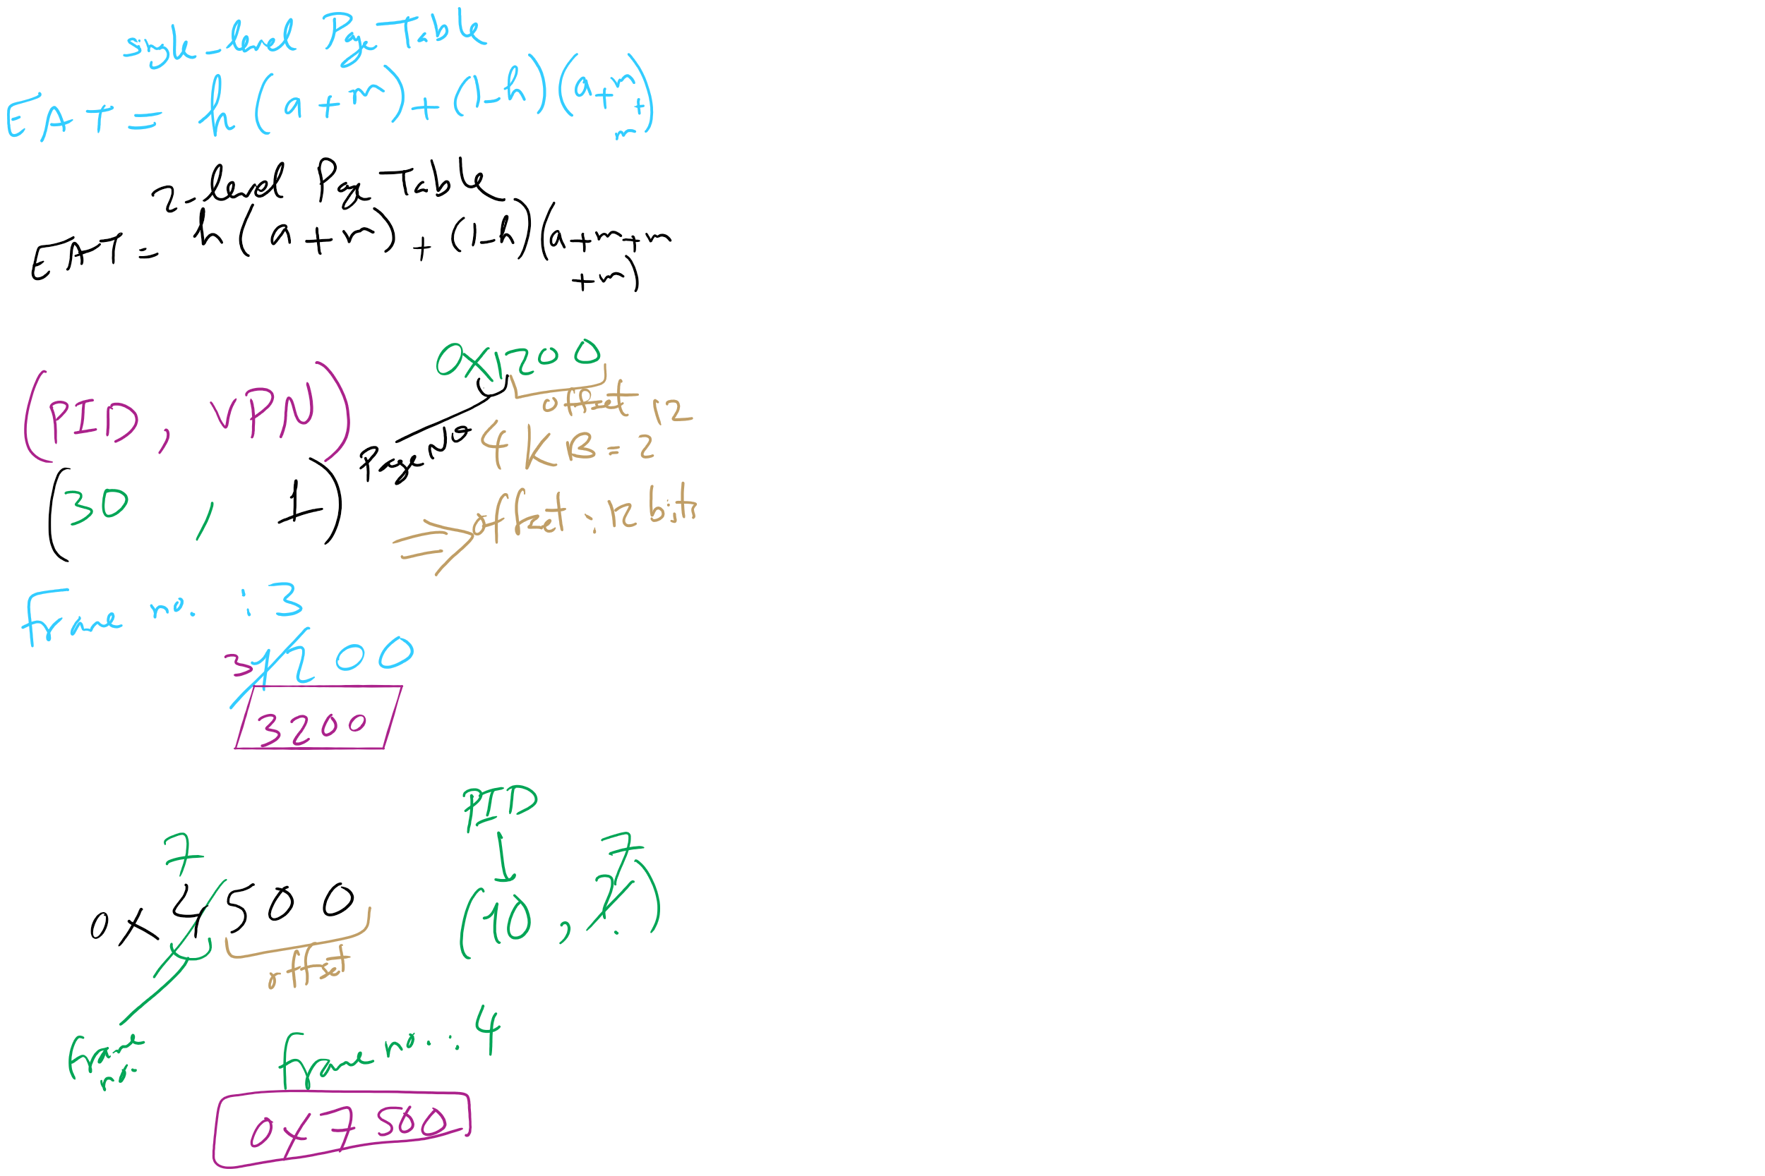
HW 10: Q 10-13

Slide 22
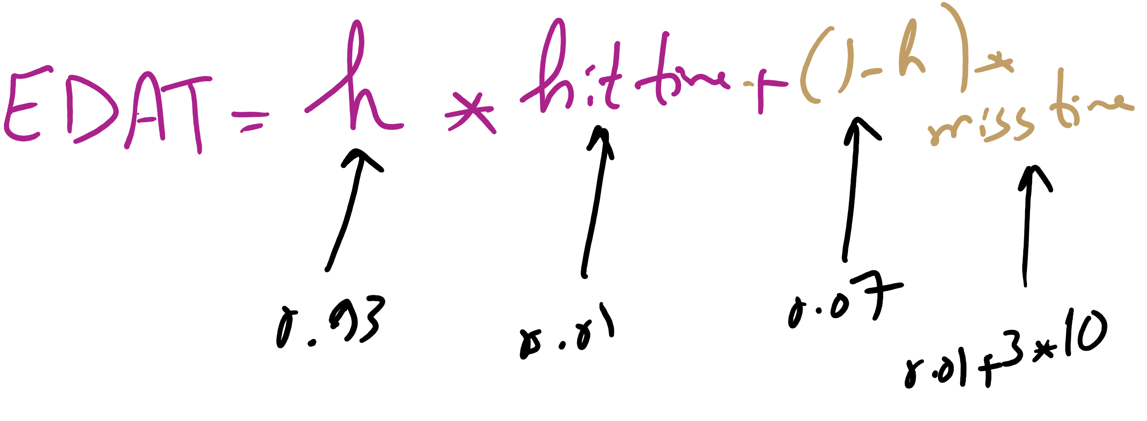
Effective Disk Access Time

Slide 23
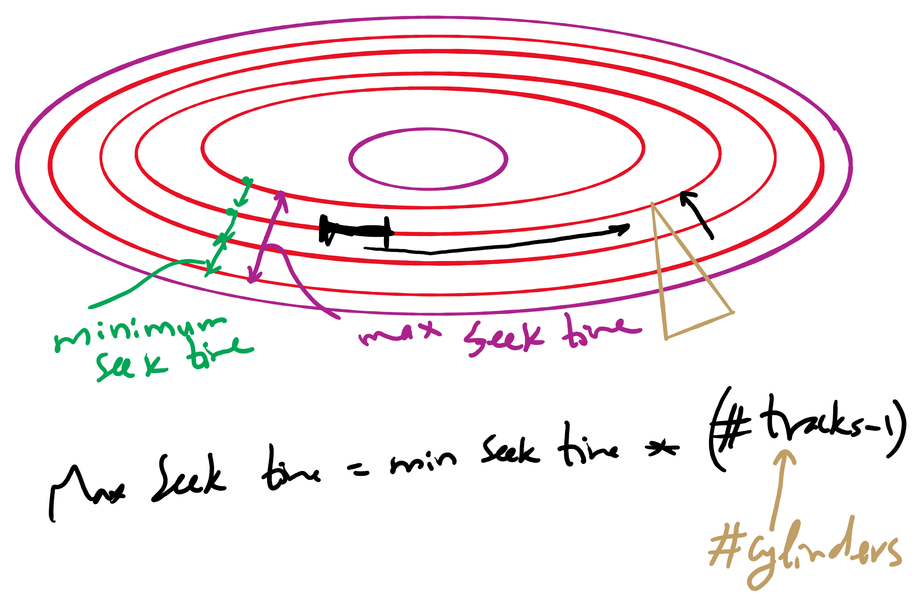
Minimum and Maximum Seek Time

Slide 24
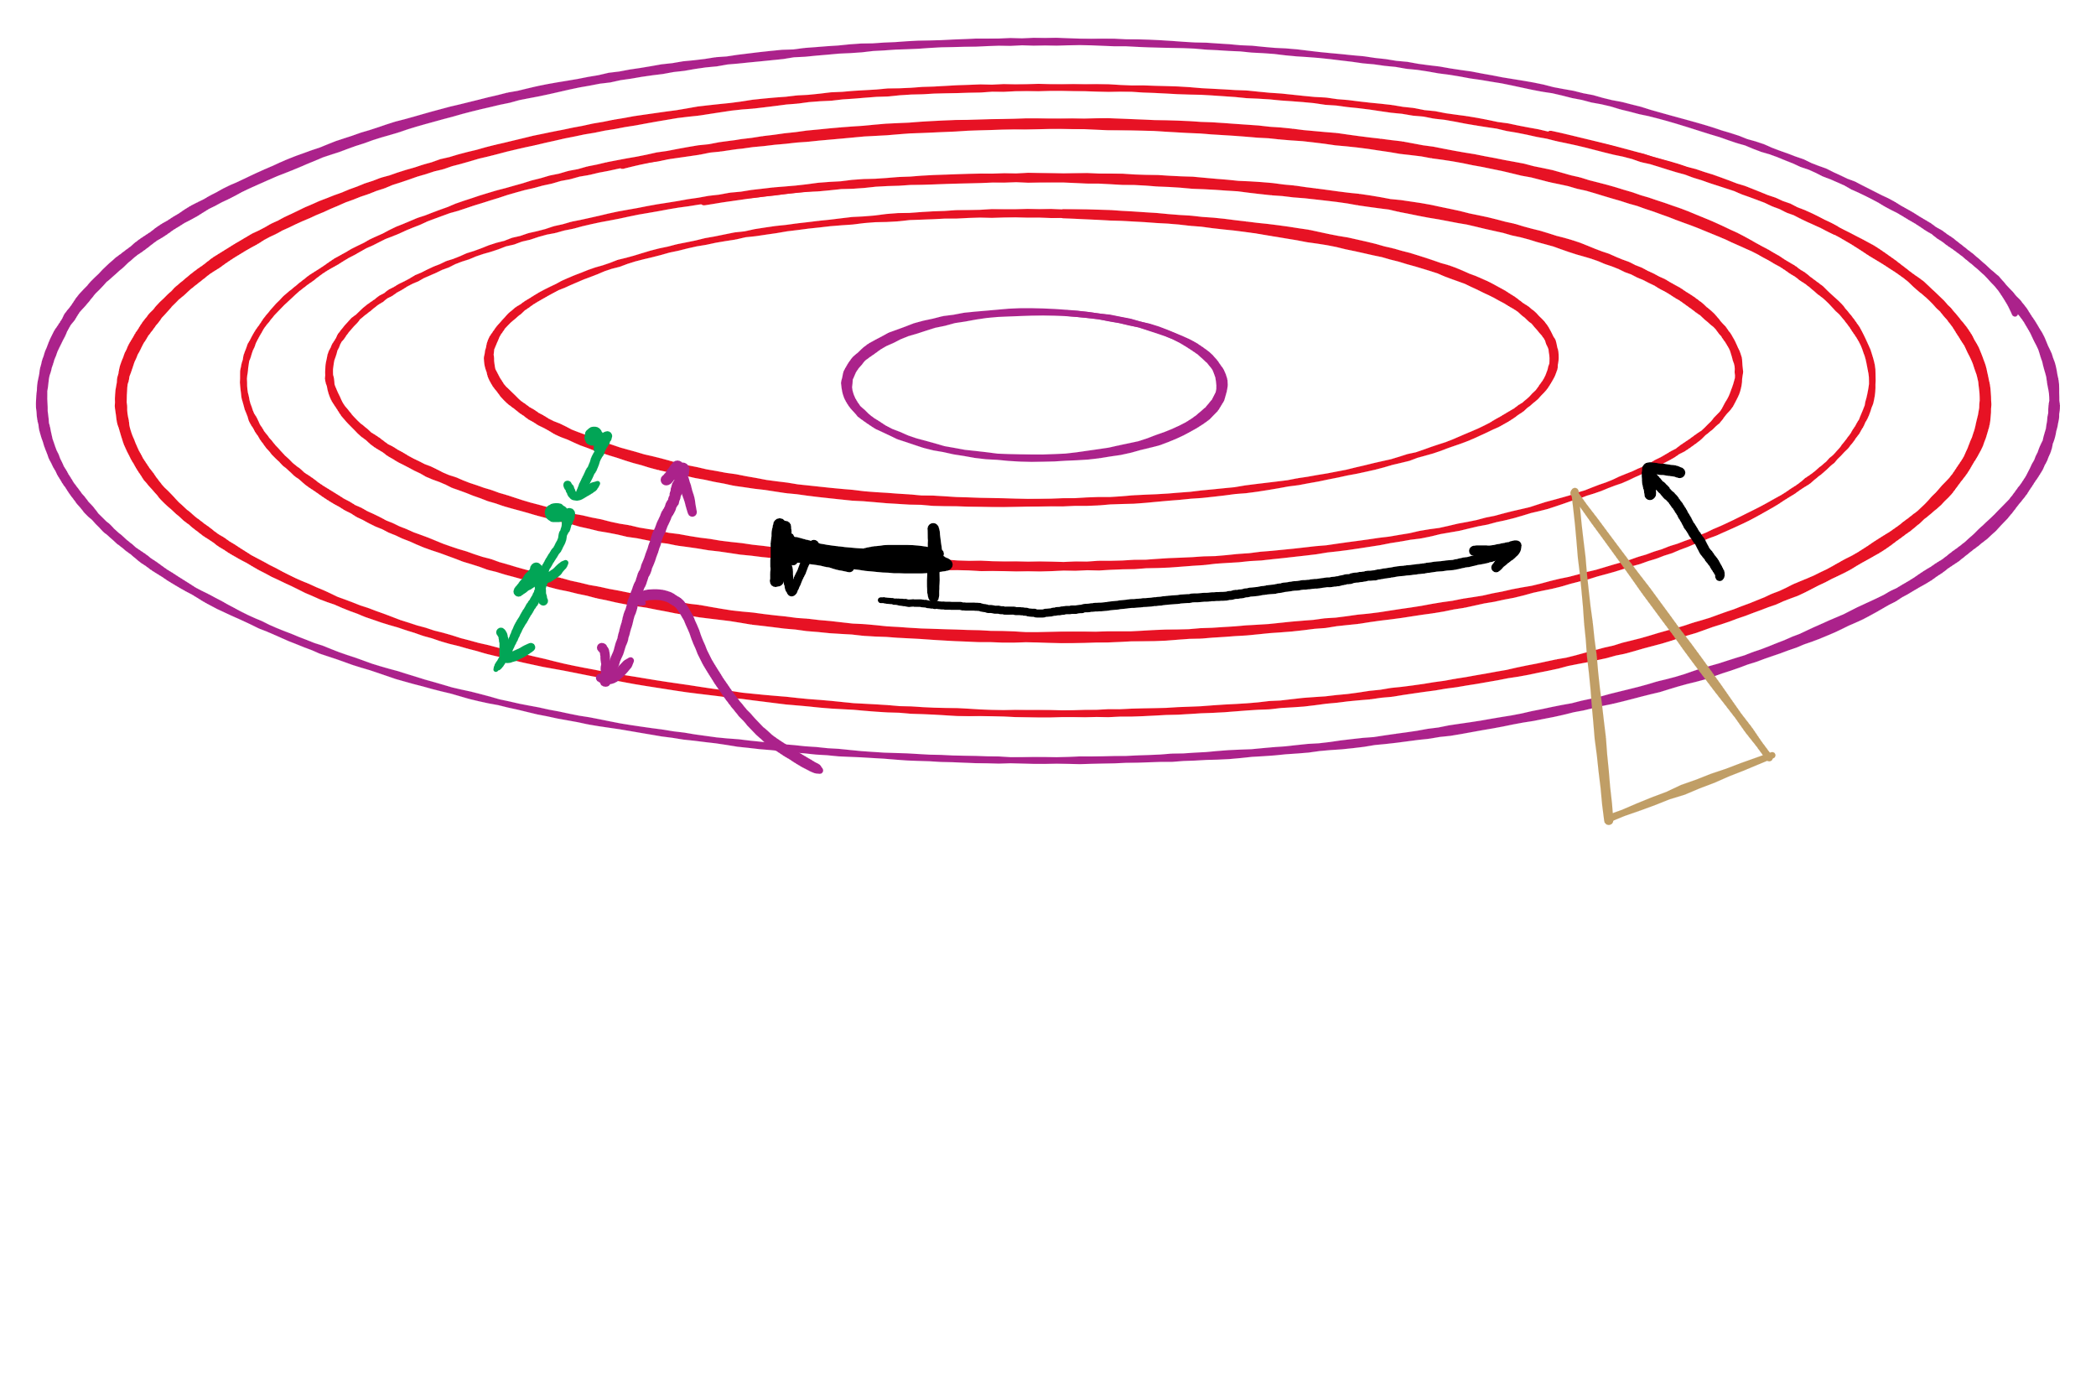
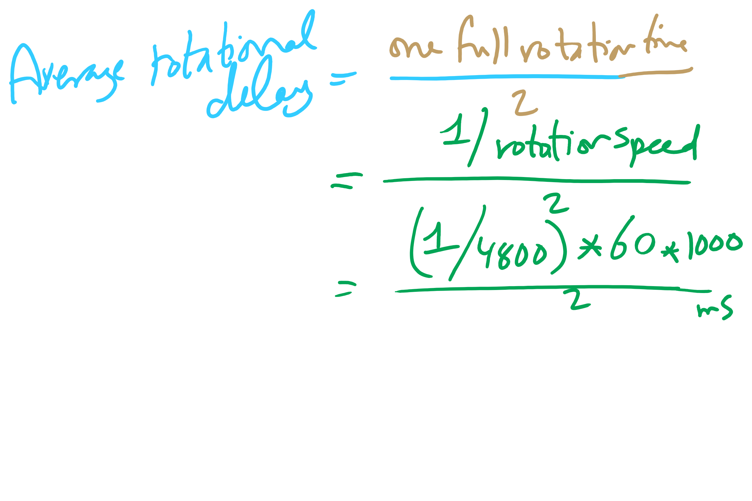
Average Rotational Delay

