Slide 1


Introduction to Operating Systems CS 1550
Spring 2023
Sherif Khattab
ksm73@pitt.edu
(Some slides are from Silberschatz, Galvin and Gagne ©2013)

Slide 2
Announcements
Upcoming deadlines
All deadlines moved to Monday May 1st at 11:59 pm
But please don’t wait to last minute!
Homework 11, 12, Bonus Homework
lowest two homework assignments dropped
Lab 4 and Lab 5
Quiz 3 and Quiz 4
lowest two of the labs and quizzes dropped
Project 4 (no late deadline)

Slide 3
Final Exam
Wednesday 4/26 8:00-9:50
same classroom
coffee will be served!
Same format as midterm
Non-cumulative
Study guide and practice test on Canvas
Review Session during Finals’ Week
Date and time TBD
recorded

Slide 4
Bonus Opportunities
Bonus Homework (1%)
Post-Course Quiz on Canvas (1%)
1% bonus for class when
OMETs response rate >= 80%
Currently at 46%
Deadline is Sunday 4/23

Slide 5
Previous Lecture …
Miscellaneous issues in File Systems
open-file tables
quota table
journaling file system
buffering
Max partition size
linking vs. copying
effective disk access time

Slide 6
This Lecture …
Protection and Security in operating systems

Slide 7
Problem of the Day: Protection
Protection is about controlling access of
programs, processes, or users to
system resources
(e.g., memory pages, files, devices, CPUs)
OS can enforce policies, but can’t decide what policies are appropriate
How to enforce who can access what?
Access Control Specification:
Correct
enable an implementation that is
efficient
easy to use (or nobody will use them!)

Slide 8
Protection domains
A process operates within a protection domain
defines what resources accessible by the process
Each domain lists objects with permitted operations
Objects can have different permissions in different domains
How can this arrangement be specified more formally?
File1 [R] File2 [RW]
File3 [R]
File4 [RWX]
File5 [RW]
File3 [W]
Screen1 [W]
Mouse [R]
Printer [W]
Domain 1
Domain 2
Domain 3

Slide 9
Protection matrix
 | File1 | File2 | File3 | File4 | File5 | Printer1 | Camera
Domain1 | Read | Read Write
Domain2 |  |  | Read | Read Write Execute | Read Write | Write
Domain3 |  |  | Write |  |  | Write | Read
Each domain has a row in the matrix
Each object (resource) has a column in the matrix
Entry i, j has the permissions of Domain i on Object j
Who’s allowed to modify the protection matrix?
What changes can they make?
How to efficiently enforce the matrix?

Slide 10
Domains as objects in the protection matrix
 | File1 | File2 | File3 | File4 | File5 | Printer1 | Camera | Dom1 | Dom2 | Dom3
Dom 1 | Read | Read Write |  |  |  |  |  | Modify
Dom 2 |  |  | Read | Read Write Execute | Read Write | Write |  | Modify
Dom 3 |  |  | Write |  |  | Write | Read |  | Enter
Specify permitted operations on domains in the matrix
Domains can modify other domains
Domains may (or may not) be able to modify themselves
Some domain transfers (switching) permitted, others not
Doing this allows flexibility in specifying domain permissions
Retains ability to restrict modification of domain policies

Slide 11
Representing the protection matrix
Need an efficient representation of the matrix
also called access control matrix
Most entries in the matrix are empty!
Two approaches:
Store permissions with each object
access control list
Store permissions with each domain
capabilities

Slide 12
Access control lists (ACLs)
Each object has a list attached to it
List has
Protection domain
e.g., User, Group of users, Other
Access rights
e.g., Read, Write, Execute
No entry for domain => no rights for that domain
Operating system checks permissions when access is needed
How are ACLs secured?
Kept in kernel
File1
File2
elm: <R,W> znm: <R> root: <R,W,X>
elm: <R,X> uber: <R,W> root: <R,W> all: <R>

Slide 13
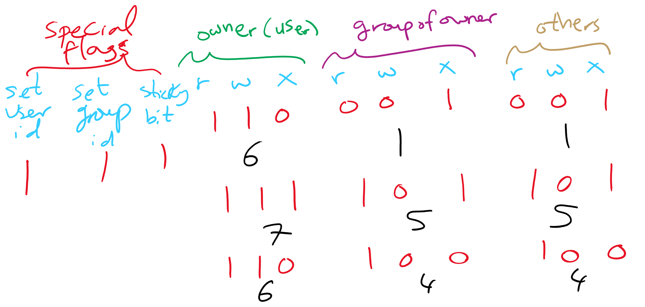
Access control lists in the real world
Unix file system
Access list for each file has exactly three domains on it
User (owner), Group, Others
Rights include read, write, execute: interpreted differently for directories and files

Slide 14
Access control lists in the real world
Andrew File System (AFS)
Access lists apply to directories
files inherit rights from the directory they’re in
what does that statement imply about AFS?
Possible rights:
read, write, lock (for files in the directory)
lookup, insert, delete (for the directories themselves)
administer (ability to add or remove rights from the ACL)

Slide 15
Capabilities
Each domain has a capability list
One entry per accessible object
Object name
Object permissions
not listed → no access
How are capabilities secured?
Kept in kernel
Cryptographically secured
Process A
Process B
File1: <R,W> File2: <R> File3: <R,W,X>
File2: <R,W> File4: <R,W,X> File7: <W> File9: <R,W>

Slide 16
Cryptographically protected capability
Server
Object
Rights
H(Object,Rights,Check)
Capability handed to processes and verified cryptographically
better for widely distributed systems where capabilities can’t be centrally checked
H() is a cryptographically secure one-way hash function
e.g., SHA-3, SHA-256
Rights include generic rights (read, write, execute) and
Copy capability, Copy object, Remove capability, Destroy object
Server has a secret (Check) and uses it to verify presented capabilities
how?
Alternatively, use public-key signature techniques

Slide 17
Reference monitor
Process A
All system calls go through the reference monitor for security checking
User space
Operating system kernel
Trusted computing base
Reference monitor
Kernel space

Slide 18
Formal models of protection
OS can enforce policies, but can’t decide what policies are authorized
Is it possible to go from an “authorized” matrix to an “unauthorized” one?
Limited set of primitive operations on access matrix
Create/delete object
Create/delete domain
Insert/remove right
Primitives can be combined into protection commands
In general, this question is undecidable
May be provable for limited cases

Slide 19
Bell-La Padula multilevel security model
Processes and objects have security levels (e.g., 1-4)
Goal: Prevent information from leaking from higher levels to lower levels
Simple security property
Process at level k can only read objects at levels k or lower
* property
Process at level k can only write objects at levels k or higher
Read down, write up
4
5
E
6
3
3
C
4
D
A writes 4
2
B
2
1
1
A

Slide 20
Biba multilevel integrity model
Goal: guarantee integrity of data
e.g., prevent planting fake information at a higher level
Simple integrity property
A process can write only objects at its security level or lower
The integrity * property
A process can read only objects at its security level or higher
Read up, write down

Slide 21
Covert channels
Circumvent security model by using more subtle ways of passing information
Send data using “side effects”
Allocating resources
Using the CPU
Locking a file
Making small changes in legal data exchange
Very difficult to plug leaks by covert channels!

Slide 22
Covert channel using file locking
Process A and Process B want to exchange information using file locking
Assume n+1 files accessible to both A and B
A sends information by
Locking files 0..n-1 according to an n-bit quantity to be conveyed to B
Locking file n to indicate that information is available
B gets information by
Reading the lock state of files 0..n+1
Unlocking file n to show that the information was received
May not even need access to the files (on some systems) to detect lock status!

Slide 23
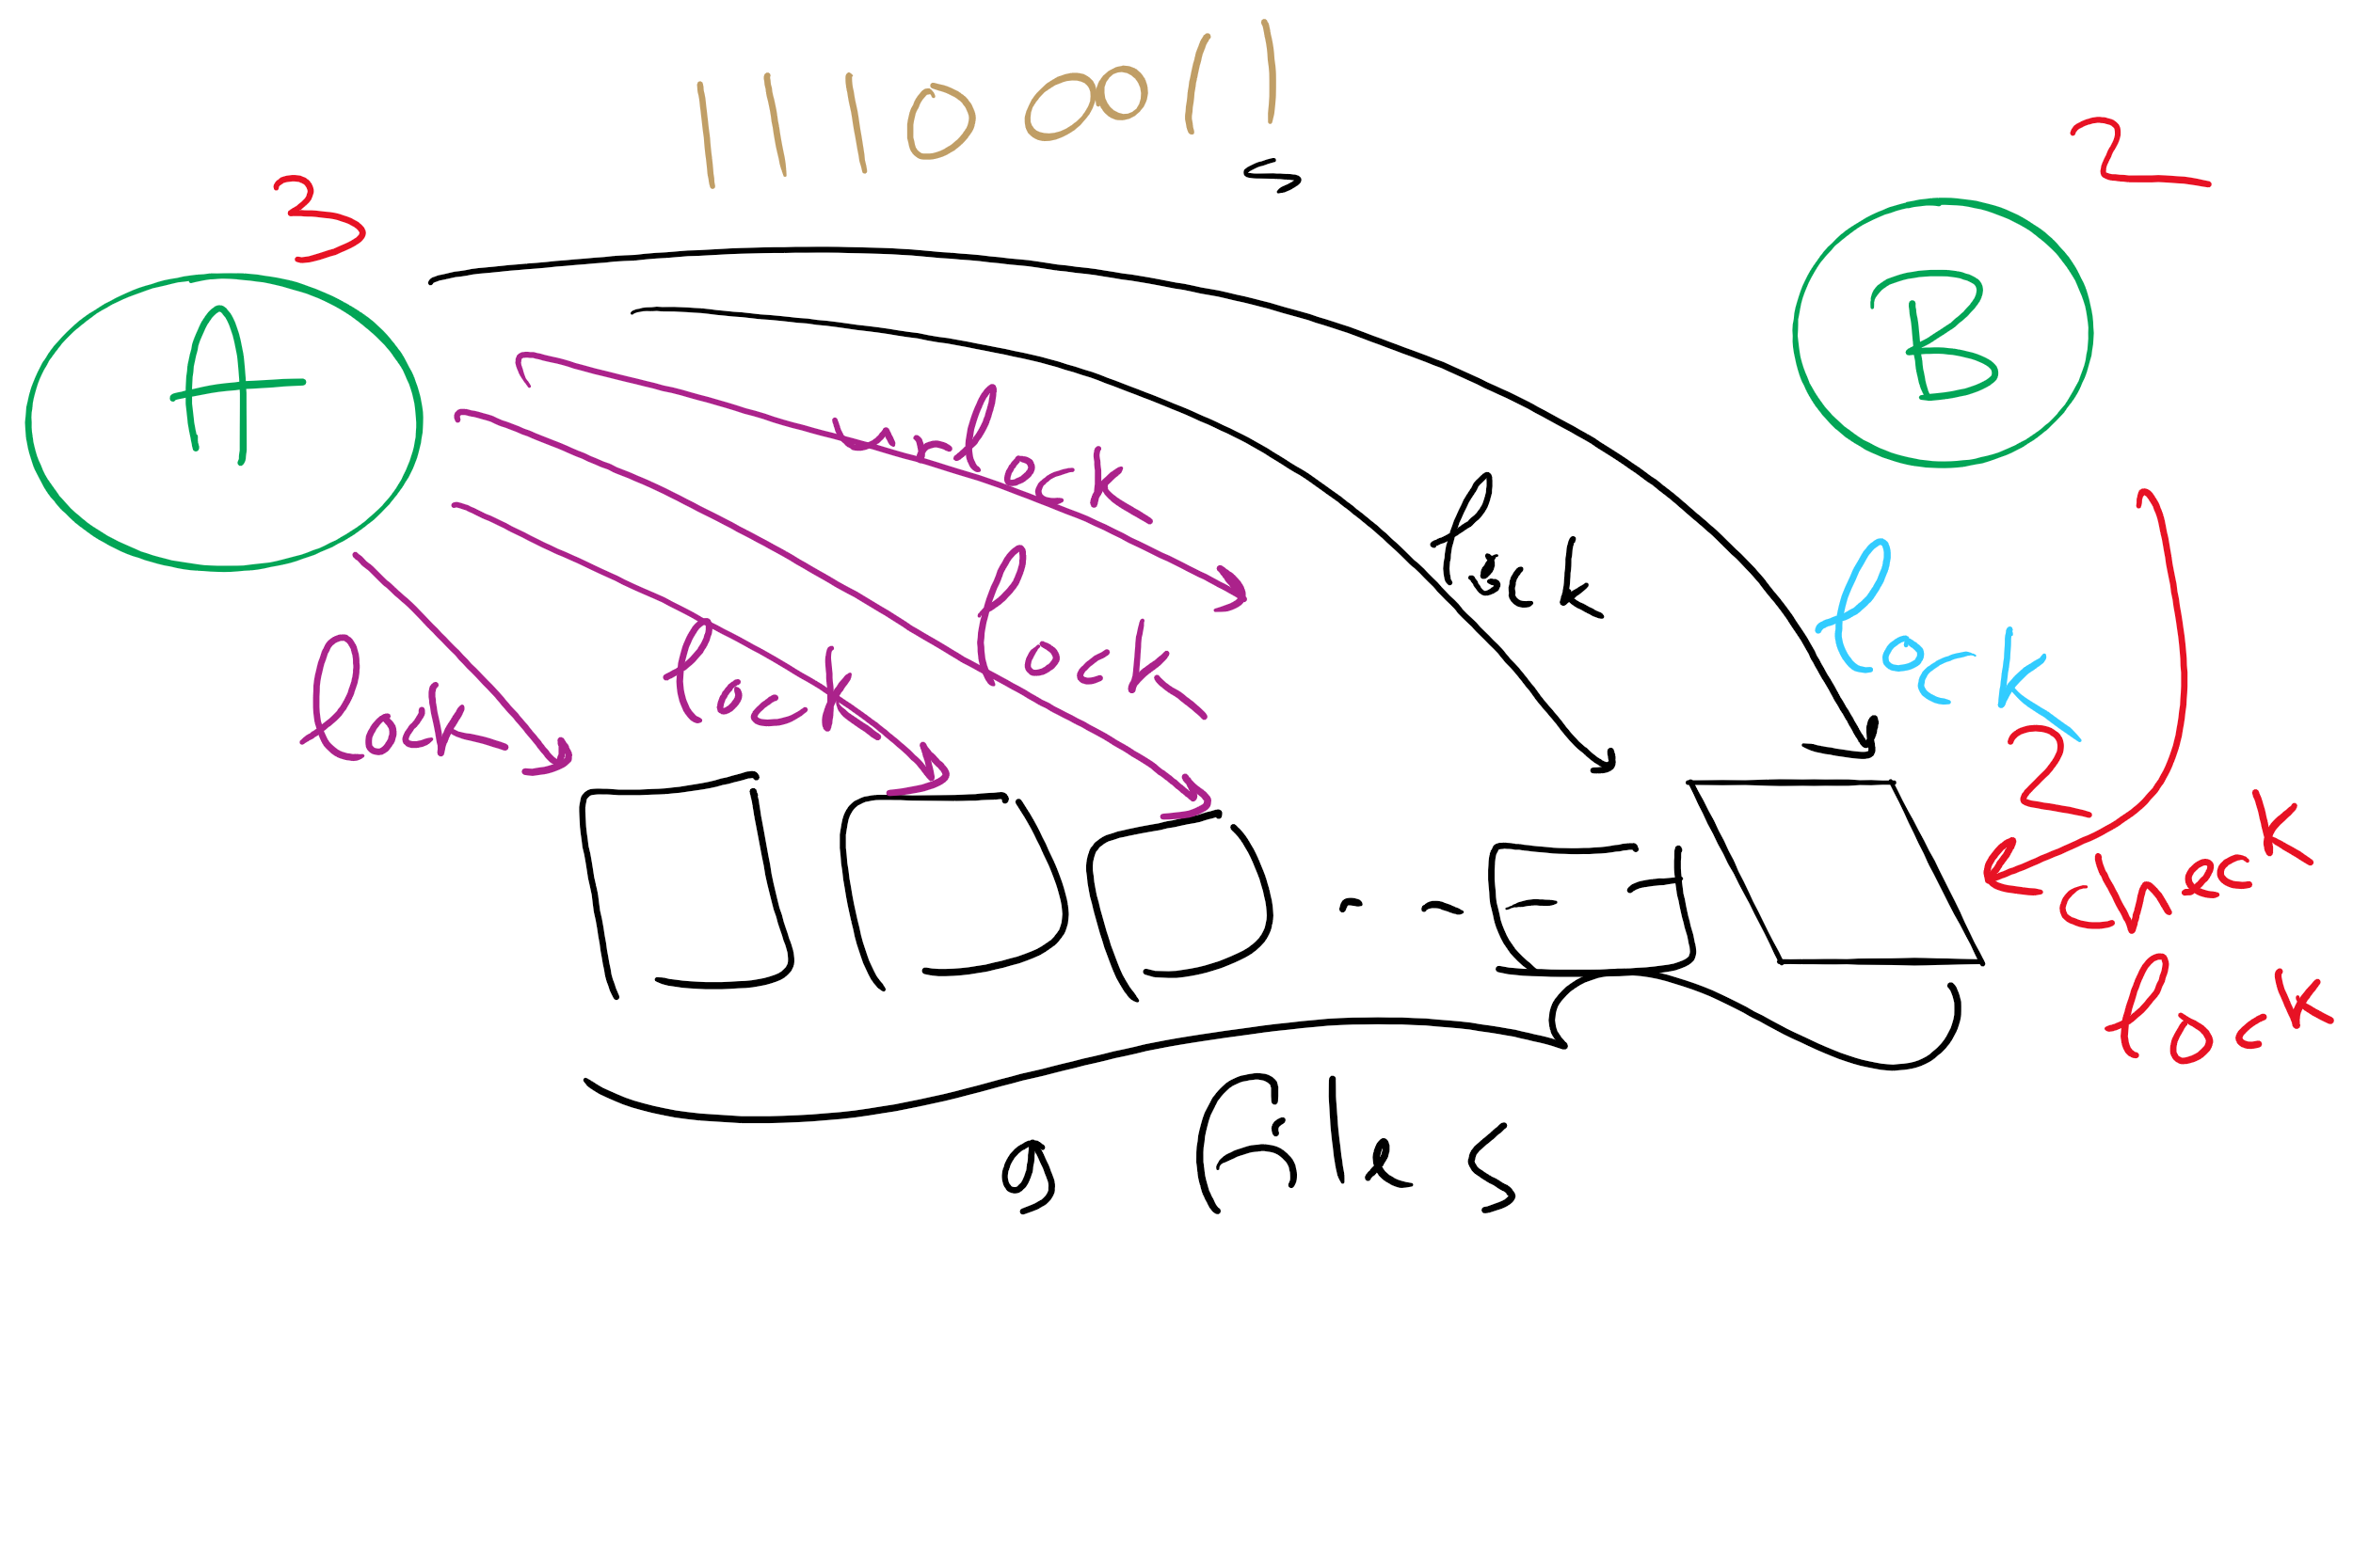
Covert Channel Using File Locking

Slide 24
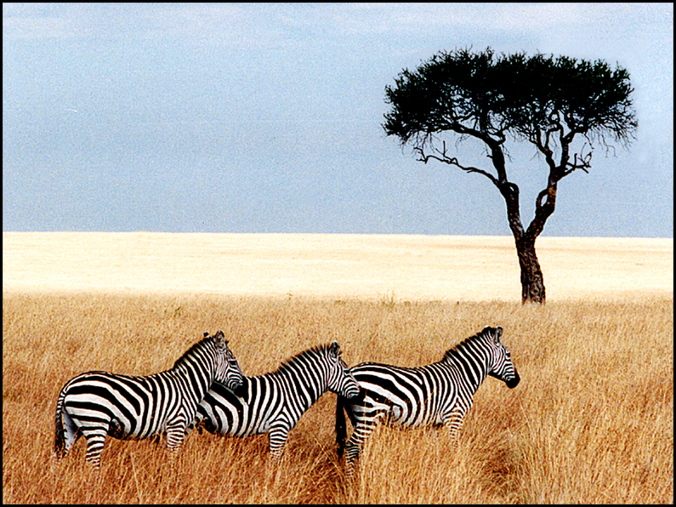
Steganography
Hide information in other data
Picture on right has text of 5 Shakespeare plays
Encrypted, inserted into low order bits of color values
Zebras
Hamlet, Macbeth, Julius Caesar
Merchant of Venice, King Lear

Slide 25
Protection vs Security
Protection is an internal problem
Assumes users are authenticated and programs are run only by authorized users
Security = Protection + defending attacks from external environment

Slide 26
Security environment: threats
Goal | Threat
Data confidentiality | Exposure of data
Data integrity | Tampering with data
System availability | Denial of service
Security goals:
Confidentiality
Integrity
Availability
Someone attempts to subvert the goals
Fun
Commercial gain

Slide 27
Security Problem 1: Password Attacks
Passwords can be
stolen,
guessed, or
cracked
How would you defend against these attacks?

Slide 28
User authentication
Problem: how does the computer know who you are?
Solution: use authentication to identify
Something the user knows
Something the user has
Something the user is
This must be done before user can use the system
Important: from the computer’s point of view…
Anyone who can duplicate your ID is you
Fooling a computer isn’t all that hard…

Slide 29
Password Stealing
Stealing the password file
Social Engineering
e.g., spoofing login screen
Key loggers
e.g., trojan horse programs

Slide 30
How should an OS store passwords?
Passwords should be memorable?
Passwords shouldn’t be stored “in the clear”
Password file is often readable by all system users!
Password must be checked against entry in this file
Solution: use hashing to hide “real” password
One-way function converting password to meaningless string of digits (Unix password hash, SHA-2)
Difficult to find another password that hashes to the same string
Knowing the hashed value and hash function gives no clue to the original password

Slide 31
Storing passwords
Some OSs use encryption algorithms to hash the passwords
Use the password as the key, not the plain text
But, what is encryption?

Slide 32
Cryptography
Goal: keep information from those who aren’t supposed to see it
Do this by “scrambling” the data
Use a well-known algorithm to scramble data
Algorithm has two inputs: data & key
Key is known only to “authorized” users
Relying upon the secrecy of the algorithm is a very bad idea (see WW2 Enigma for an example…)
Cracking codes is very difficult, Sneakers and other movies notwithstanding

Slide 33
Cryptography basics
Algorithms (E, D) are widely known
Keys (K_{E}, K_{D}) may be less widely distributed
For this to be effective, the ciphertext should be the only information that’s available to the world
Plaintext is known only to the people with the keys (in an ideal world…)
K_{E}
K_{D}
Encryption key
Decryption key
C=E(P,K_{E})
E
D
P
P
Plaintext
Ciphertext
Plaintext
Encryption
Decryption

Slide 34
Secret-key encryption
Also called symmetric-key encryption
Monoalphabetic substitution
Each letter replaced by different letter
Vigenere cipher
Use a multi-character key THEMESSAGE ELMELMELME XSQQPEWLSI
Both are easy to break!
Given the encryption key, easy to generate the decryption key
Alternatively, use different (but similar) algorithms for encryption and decryption

Slide 35
Modern encryption algorithms
Data Encryption Standard (DES)
Uses 56-bit keys
Same key is used to encrypt & decrypt
Keys used to be difficult to guess
Needed to try 2⁵⁵ different keys, on average
Modern computers can try millions of keys per second with special hardware
For $250K, EFF built a machine that broke DES quickly in 1998
Current algorithms (AES, Blowfish) use 128 bit keys
Adding one bit to the key makes it twice as hard to guess
Must try 2¹²⁷ keys, on average, to find the right one
At 10¹⁵ keys per second, this would require over 10²¹ seconds, or 1000 billion years!
Modern encryption isn’t usually broken by brute force…

Slide 36
Unbreakable codes
There is such a thing as an unbreakable code: one-time pad
Use a truly random key as long as the message to be encoded
XOR the message with the key a bit at a time
Code is unbreakable because
Key could be anything
Without knowing key, message could be anything with the correct number of bits in it
Difficulty: distributing key is as hard as distributing message
Difficulty: generating truly random bits
Can’t use computer random number generator!
May use physical processes
Radioactive decay
Leaky diode
Lava lamp (!) [https://www.atlasobscura.com/places/encryption-lava-lamps]

Slide 37
Public-key cryptography
Instead of using a single shared secret, keys come in pairs
One key of each pair distributed widely (public key), K_{p}
One key of each pair kept secret (private or secret key), K_{s}
Two keys are inverses of one another, but not identical
Encryption & decryption are the same algorithm, so E(K_{p},E(K_{s},M) = E(K_{s},E(K_{p},M) = M
Currently, most popular method involves primes and exponentiation
Difficult to crack unless large numbers can be factored
Very slow for large messages

Slide 38
Digital signatures
Original document
Original document
One-way hash function
Hash result encrypted with K_{s}
Hash
Digital signature
Digital signature
Receiver gets
Digital signature computed by
Applying one-way hash function to original document
Encrypting result with sender’s private key
Receiver can verify by
Applying one-way hash function to received document
Decrypting signature using sender’s public key
Comparing the two results: equality means document unmodified

Slide 39
Pretty Good Privacy (PGP)
Uses public key encryption
Facilitates key distribution
Allows messages to be sent encrypted to a person (encrypt with person’s public key)
Allows person to send message that must have come from her (encrypt with person’s private key)
Problem: public key encryption is very slow
Solution: use public key encryption to exchange a shared key
Shared key is relatively short (~128 bits)
Message encrypted using symmetric key encryption
PGP can also be used to authenticate sender
Use digital signature and send message as plaintext

Slide 40
Social Engineering
Convince a system programmer to add a trap door
Beg admin's secretary (or other people) to help a poor user who forgot password
Pretend you’re tech support and ask random users for their help in debugging a problem

Slide 41
Login spoofing
Login:
Login:
Real login screen
Phony login screen
No difference between real & phony login screens
Intruder sets up phony login, walks away
User logs into phony screen
Phony screen records user name, password
Phony screen prints “login incorrect” and starts real screen
User retypes password, thinking there was an error
Solution: don’t allow certain characters (ctrl+alt+delete) to be “caught”

Slide 42
Trojan horses
Free program made available to unsuspecting user
Actually contains code to do harm
May do something useful as well…
Altered version of utility program on victim's computer
Trick user into running that program
Example (getting superuser access?)
Place a file called ls in your home directory
File creates a shell in /tmp with privileges of whoever ran it
cp /bin/bash /tmp/.SecretShell && chmod 4755 /tmp/.SecretShell
File then actually runs the real ls
Complain to your sysadmin that you can’t see any files in your directory
Sysadmin runs ls in your directory
Hopefully, he runs your ls rather than the real one (depends on his search path)

Slide 43
Buffer overflow
Variables for main()
Variables for main()
Variables for main()
Stack pointer
Return addr
Return addr
A’s local variables
A’s local variables
SP
SP
Altered return address
Buffer B
Buffer B
Code
Code
Code
Buffer overflow is a big source of bugs in operating systems
Most common in user-level programs that help the OS do something
May appear in “trusted” daemons
Exploited by modifying the stack to
Return to a different address than that intended
Include code that does something malicious
Accomplished by writing past the end of a buffer on the stack

Slide 44
Password Guessing: Sample breakin (from LBL)
LBL> telnet elxsi
ELXSI AT LBL
LOGIN: root
PASSWORD: root
INCORRECT PASSWORD, TRY AGAIN
LOGIN: guest
PASSWORD: guest
INCORRECT PASSWORD, TRY AGAIN
LOGIN: uucp
PASSWORD: uucp
WELCOME TO THE ELXSI COMPUTER AT LBL
Moral: change all the default system passwords!

Slide 45
Password Cracking
Offline cracking
The attacker has the password files
password files contains password hashes
Online cracking
The attacker doesn’t have the password file

Slide 46
Offline Password Cracking
Passwords can be cracked
Hackers can get a copy of the password file
Run through dictionary words and names
Hash each name
Look for a match in the file
Hashes can be pre-computed offline!
Solution: use “salt”
Random characters added to the password before hashing
Salt characters stored “in the clear”
Increase the number of possible hash values for a given password
Actual password is “pass”
Salt = “aa” => hash “passaa”
Salt = “bb” => hash “passbb”
Result: cracker has to store many more combinations

Slide 47
Online Password Cracking
Login: elm Password: foobar Welcome to Linux!
Login: jimp User not found!
Login:
Login: elm Password: barfle Invalid password!
Login:
Successful login lets the user in
If things don’t go so well…
Login rejected after name entered
Login rejected after name and incorrect password entered
Don’t notify the user of incorrect user name until after the password is entered!
Early notification can make it easier to guess valid user names

Slide 48
Security flaws: TENEX OS password problem
Cracking passwords using side-channel attack
First page (in memory)
B
A
Page boundary
B
A
A
A
A
A
A
A
A
A
A
Second page (not in memory)
A
A
A
A
A
A
A
A
A
A
A

Slide 49
Bypassing Passwords
Request “free” memory, disk space, tapes and just read what was left there (not zero-filled on dealloc)
Try illegal system calls – if the system gets confused enough, you may be in
Start a login and hit DEL, RUBOUT, or BREAK to possibly kill password checking
Try to do specified DO NOTs

Slide 50
Countermeasures
Limiting times when someone can log in
Automatic callback at number prespecified
Can be hard to use unless there’s a modem involved
Limited number of login tries
Prevents attackers from trying lots of combinations quickly
A database of all logins
Simple login name/password as a trap
Security personnel notified when attacker bites
Variation: allow anyone to “log in,” but don’t let intruders do anything useful

Slide 51
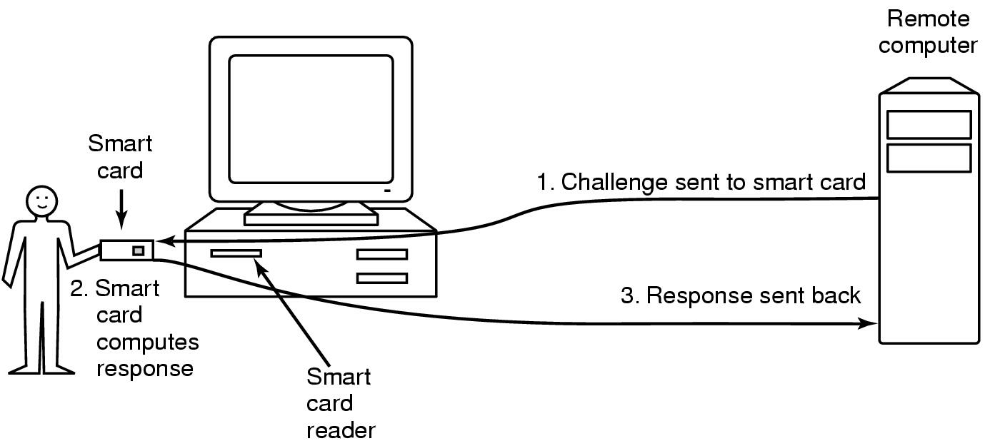
Authentication using a physical object
Magnetic card
Stores a password encoded in the magnetic strip
Allows for longer, harder to memorize passwords
Smart card
Card has secret encoded on it, but not externally readable
Remote computer issues challenge to the smart card
Smart card computes the response and proves it knows the secret

Slide 52
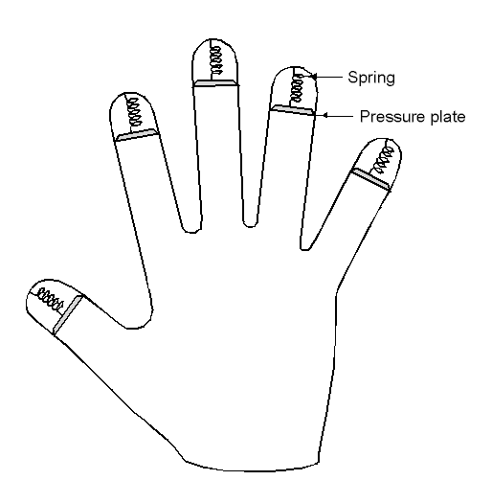
Authentication using biometrics
Use basic body properties to prove identity
Examples include
Fingerprints
Voice
Hand size
Retina patterns
Iris patterns
Facial features
Potential problems
Duplicating the measurement
Stealing it from its original owner?

Slide 53
Security Problem 2: Viruses and Worms
Virus: program that embeds itself into other (legitimate) code to reproduce and do its job
Attach its code to another program
Additionally, may do harm
Goals of virus writer
Quickly spreading virus
Difficult to detect
Hard to get rid of
Optional: does something malicious
e.g., Ransomware

Slide 54
How viruses work
Virus language
Assembly language: infects programs
“Macro” language: infects email and other documents
Runs when email reader / browser program opens message
Program “runs” virus (as message attachment) automatically
Inserted into another program
Use tool called a “dropper”
May also infect system code (boot block, etc.)
Virus dormant until program executed
Then infects other programs
Eventually executes its “payload”

Slide 55
Where viruses live in the program
Executable program
Virus
Executable program
Virus
Executable program
Executable program
Virus
Starting address
Virus
Virus
Header
Header
Header
Header
Uninfected program
Virus at start of program
Virus at end of program
Virus in program’s free spaces

Slide 56
Viruses infecting the operating system
Operating system
Operating system
Operating system
Virus
Virus
Virus
Syscall traps
Syscall traps
Syscall traps
Disk vector
Disk vector
Disk vector
Clock vector
Clock vector
Clock vector
Kbd vector
Kbd vector
Kbd vector
Virus has captured interrupt & trap vectors
OS retakes keyboard vector
Virus notices, recaptures keyboard

Slide 57
How do viruses spread?
Virus placed where likely to be copied
Popular download site
Photo site
When copied and run
Infects programs on hard drive, flash drive
May try to spread over LAN or WAN
Attach to innocent looking email
When it runs, use mailing list to replicate
May mutate slightly so recipients don’t get suspicious

Slide 58
Hiding a virus in a file
Start with an uninfected program
Add the virus to the end of the program
Problem: file size changes
Solution: compression
Compress infected program
Decompressor: for running executable
Compressor: for compressing newly infected binaries
Lots of free space (if needed)
Problem (for virus writer): virus easy to recognize
Virus
Executable program
Executable program
Unused
Virus
Compressor
Decompressor
Compressed executable program
Header
Header
Header

Slide 59
Using encryption to hide a virus
Hide virus by encrypting it
Vary the key in each file
Virus “code” varies in each infected file
Problem: lots of common code still in the clear
Compress / decompress
Encrypt / decrypt
Even better: leave only decryptor and key in the clear
Less constant per virus
Use polymorphic code (more in a bit) to hide even this
Unused
Unused
Unused
Virus
Virus
Compressor
Compressor
Virus
Decompressor
Decompressor
Encryptor
Encryptor
Compressor
Key
Key
Decompressor
Decryptor
Decryptor
Compressed executable program
Compressed executable program
Compressed executable program
Header
Header
Header

Slide 60
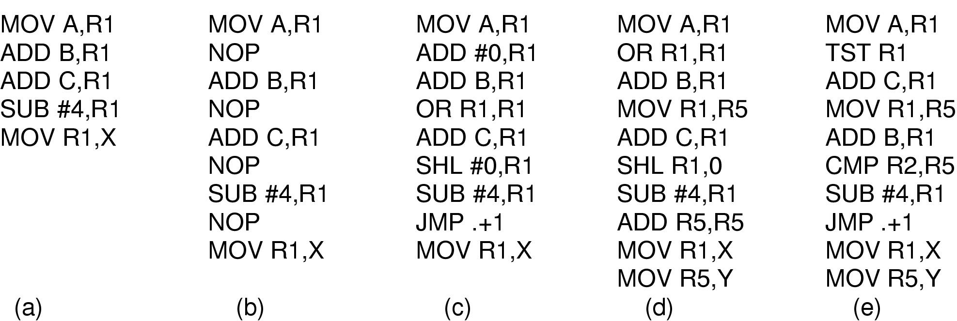
Polymorphic viruses
All of these code seqences do the same thing
All of them are very different in machine code
Use “snippets” combined in random ways to hide code

Slide 61
How can viruses be foiled?
Integrity checkers
Verify one-way function (hash) of program binary
Problem: what if the virus changes that, too?
Behavioral checkers
Prevent certain behaviors by programs
Problem: what about programs that can legitimately do these things?
Avoid viruses by
Having a good (secure) OS
Installing only shrink-wrapped software (just hope that the shrink-wrapped software isn’t infected!)
Using antivirus software
Not opening email attachments
Recovery from virus attack
Hope you made a recent backup!
Recover by halting computer, rebooting from safe disk (CD-ROM?), using an antivirus program

Slide 62
What if I have to run untrusted code?
Goal: run (untrusted) code on my machine
Problem: how can untrusted code be prevented from damaging my resources?
One solution: sandboxing
Memory divided into 1 MB sandboxes
Accesses may not cross sandbox boundaries
Sensitive system calls not in the sandbox
Another solution: interpreted code
Run the interpreter rather than the untrusted code
Interpreter doesn’t allow unsafe operations
Third solution: signed code
Use cryptographic techniques to sign code
Check to ensure that mobile code signed by reputable organization

Slide 63
Worms vs. viruses
Viruses require other programs to run
Worms are self-running (separate process)
The 1988 Internet Worm
Consisted of two programs
Bootstrap to upload worm
The worm itself
Exploited bugs in sendmail and finger
Worm first hid its existence
Next replicated itself on new machines
Brought the Internet (1988 version) to a screeching halt

