Slide 1


Introduction to Operating Systems CS 1550
Spring 2023
Sherif Khattab
ksm73@pitt.edu
(Some slides are from Silberschatz, Galvin and Gagne ©2013)

Slide 2
Announcements
Homework 1 is due tomorrow at 11:59 pm
Recitations start this week
Project 1 will be posted on Canvas this Friday
Docker images for labs and projects are available on Canvas
As an alternative to running the labs and projects on the Thoth server

Slide 3
Agenda
Context Switching
Critical Region as a solution to the Race Condition problem
Spinlocks to implement Critical Region
Busy Waiting Problem
Why does it happen?
What are its implications?
How to solve it?
Sempahores

Slide 4
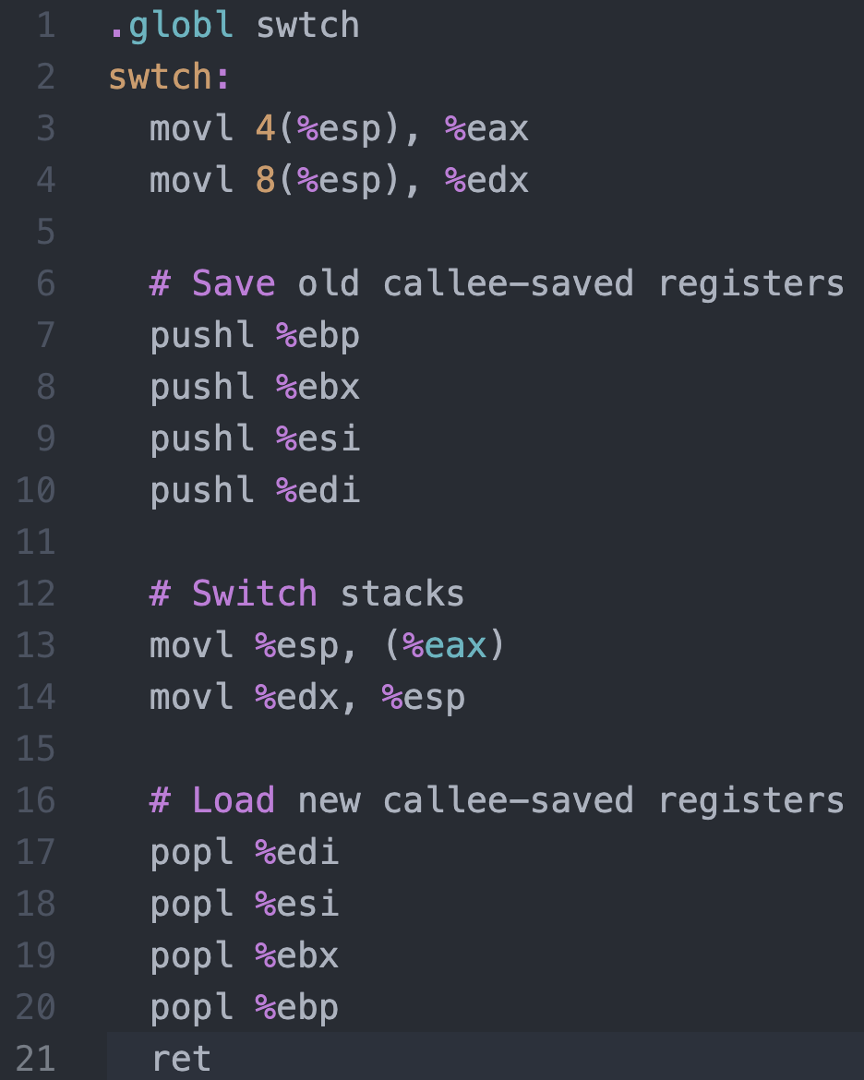
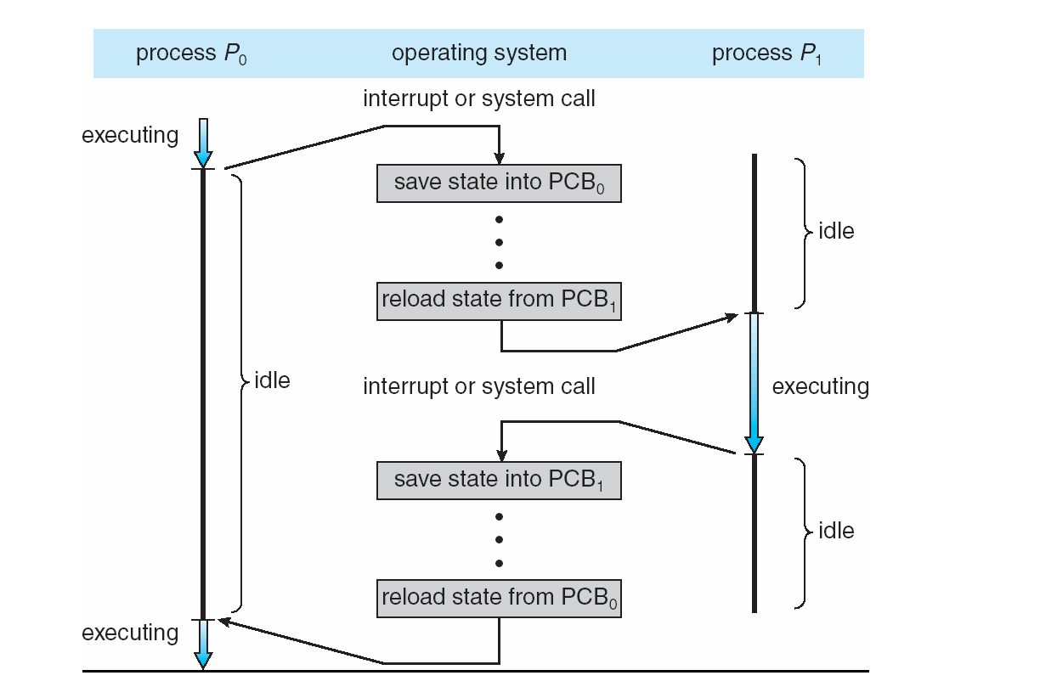




Context Switching in Xv6
%eax
%edx
context
PCB of Process${ P}_{0}$
Return address
%esp
%eip
Stack of Process${ P}_{0}$
Return address
Return address
CPU
context
PCB of Process${ P}_{1}$
Stack of Process${ P}_{1}$
Memory

Slide 5
Critical regions
Back to the race conditions problem
Use critical regions to provide mutual exclusion and help fix race conditions
Let’s put the statement x++ in a critical region
P1 enters critical region
P1 leaves critical region
Process P1
P2 enters critical region
P2 leaves critical region
P2 tries to enter critical region
Process P2
P2 blocked
Time

Slide 6
How to implement critical regions?
Turn-based solutions
Spinlocks
Semaphores
Monitors

Slide 7
Using Spinlocks
Spinlock lock;
Code for process P_{i}
While(1){
Lock(lock)
// critical section
Unlock(lock);
// remainder of code
}
}

Slide 8
Spinlock implementation (1/2)
Solution: use hardware
Several hardware methods
Test & set: test a variable and set it in one instruction
Atomic swap: switch register & memory in one instruction
Turn off interrupts: process won’t be switched out unless it asks to be suspended
The first two methods can be implemented in user land
Why can’t we implement the third method in user land?

Slide 9
Busy Waiting
A process that is trying to acquire a locked spinlock is running!
It continuously checks:
can I get the lock? No, lock is held by another process
can I get the lock? No, lock is held by another process
…
This continuous check is called spinning or busy waiting
But what is wrong with that?
Busy waiting wastes CPU cycles
on a single-core system it delays the process that is holding the lock from releasing it

Slide 10
Today’s problem: Busy Waiting
While P1 is in the critical region, P2 is busy waiting
Shared Data
Spinlock lk;
int x;
Process P1
lock(lk);
//critical region (e.g., x++)
unlock(lk);
Process P2
lock(lk);
//critical region (e.g., x++)
unlock(lk);

Slide 11
But why?
Why does busy waiting happen with spinlocks?

Slide 12
Atomic TestAndSet
TestAndSet is an atomic instruction
Works for single-core and multi-core Symmetric Multi-Processing (SMP)
int TestAndSet(int &x){
lock memory access to x
int temp = *x;
*x = 1;
unlock memory access to x
return temp;
}

Slide 13
Spinlock implementation using TestAndSet
Single shared variable: lock
Works for any number of processes
int lock = 0;
Lock(){
while (TestAndSet(&lock))
;
}
Unlock(){
lock = 0;
}

Slide 14
Atomic Swap
Swap is an atomic instruction
Works for single-core and multi-core Symmetric Multi-Processing (SMP)
int Swap(int &x, int y){
lock memory access to x
int temp = *x;
*x = y;
unlock memory access to x
return temp;
}

Slide 15
Spinlock implementation using Swap
Single shared variable: lock
Works for any number of processes
int lock = 0;
Lock(){
while (Swap(&lock, 1))
;
}
Unlock(){
lock = 0;
}

Slide 16
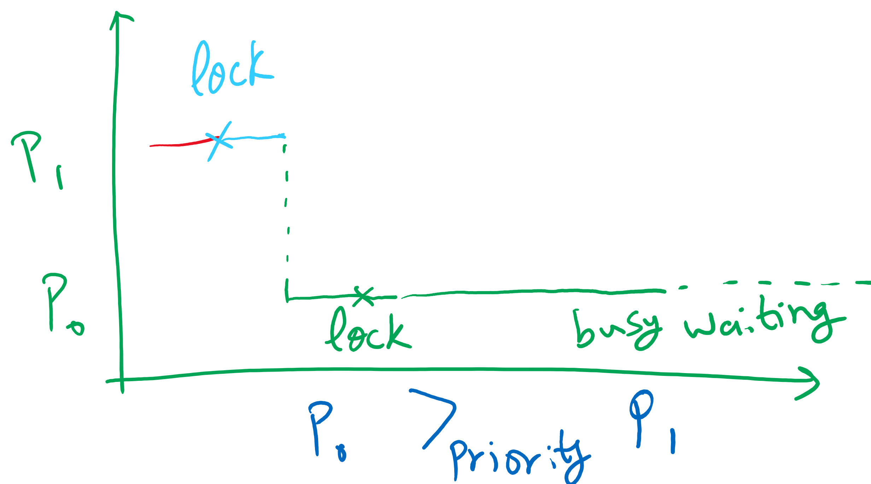
Implication of Busy Waiting
Subproblem: priority inversion (higher priority process busy waits for lower priority process)

Slide 17
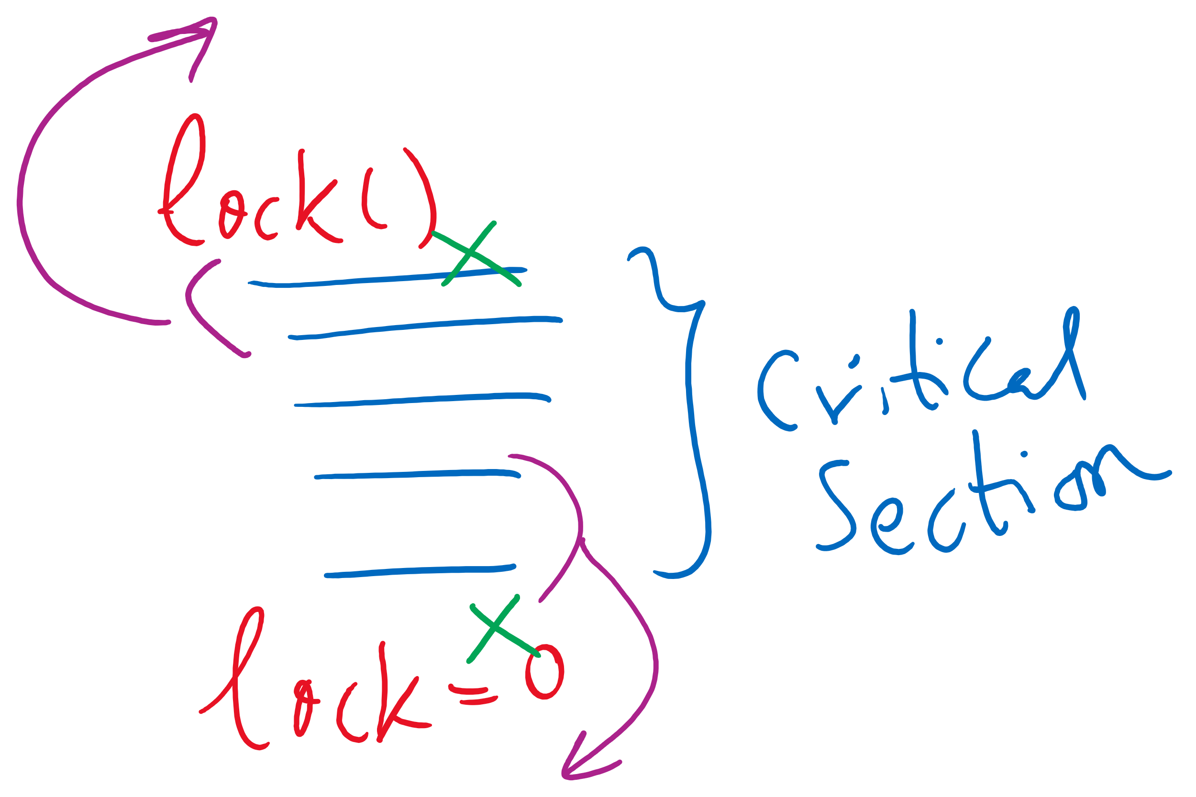
Implementation Detail
compiler and/or hardware may reorder instructions

Slide 18
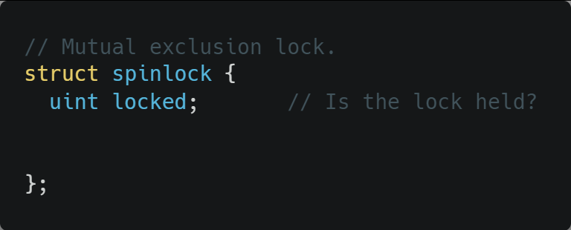
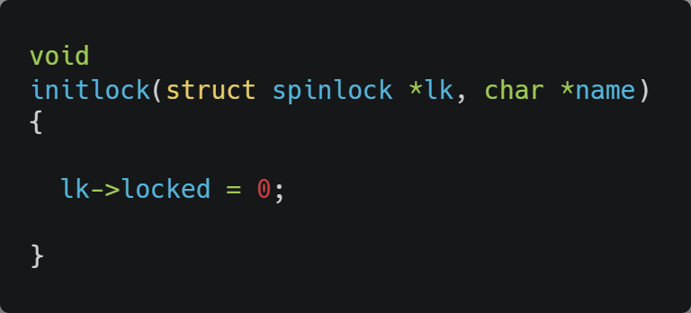
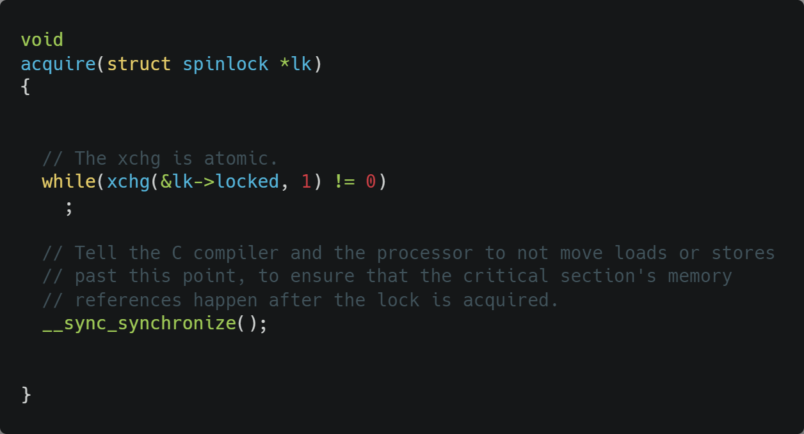
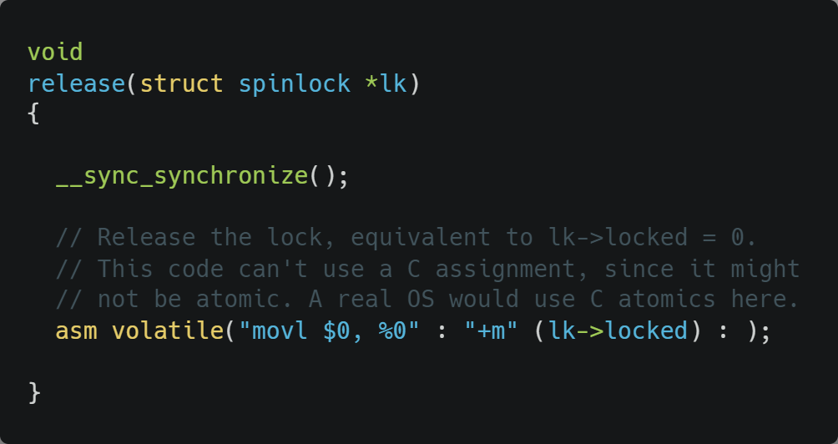
Xv6 Walkthrough
Spinlocks
__sync_synchronize() is a memory barrier instruction

Slide 19
Semaphores
Solution: use semaphores
Synchronization mechanism that doesn’t require busy waiting
Implementation
Semaphore S accessed by two atomic operations
Down(S): decrement the semaphore if > 0; block otherwise
Up(S): increment the semaphore and wakeup one blocked process if any
Down() is another name for P()
Up() is another name for V()

Slide 20
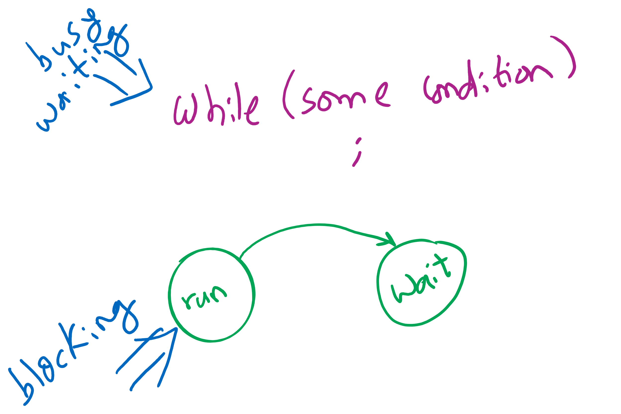
Busy waiting vs. Blocking
Blocking involves 2 context switches

Slide 21
Critical sections using semaphores
Shared variables
Semaphore sem(1);
Code for process P_{i}
while (1) {
// non-critical section
down(sem);
// critical section
up(sem);
// non-critical section
}

Slide 22
Types of semaphores
Two different types of semaphores
Counting semaphores
Binary semaphores
Counting semaphore
Value can range over an unrestricted range
Binary semaphore
Only two values possible
1 means the semaphore is available
0 means a process has acquired the semaphore
May be simpler to implement
Possible to implement one type using the other

Slide 23
Semaphore Implementation
But how do semaphores avoid busy waiting?

Slide 24
Implementing semaphores with blocking
Assume two operations:
Sleep(): suspends current process
Wakeup(P): allows process P to resume execution
Semaphore data structure
Tracks value of semaphore
Keeps a list of processes waiting for the semaphore
down ()
{
value -= 1;
if (value < 0) {
// add this process to pl
Sleep ();
}
}
up () {
Process P;
value += 1;
if (value <= 0) {
// remove a process P
// from pl
Wakeup (P);
}
}
struct Semaphore {
int value;
ProcessList pl;
};
How to protect these shared variables??

Slide 25
Spinlocks in Semaphores
down ()
{
value -= 1;
if (value < 0) {
// add this process to pl
Sleep ();
}
}
up () {
Process P;
value += 1;
if (value <= 0) {
// remove a process P
// from pl
Wakeup (P);
}
}
struct Semaphore {
int value;
ProcessList pl;
};

Slide 26
Spinlocks are sometimes better than Semaphores
Very (very) short waiting time to enter the critical section < the 2 context switches needed for blocking
Multi-core
so that the spinlock can be unlocked while the process is busy waiting
Few contending processes for the critical section
Short critical section code

