Slide 1
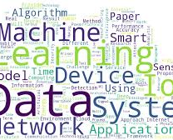
End-Semester Machine learning Project
Data science and sport are becoming more and more integrated and things have come a long way
By
Abdul Jalil Khan CS171090
Syed Muhammad Bilal CS171075
Notes:
NOTE: Want a different image on this slide? Select the picture and delete it. Now click the Pictures icon in the placeholder to insert your own image.

Slide 2


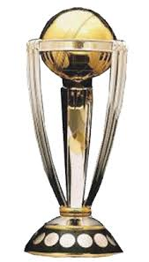
Cricket World Cup Prediction
Cricket is being played in many countries all around the world. There are a lot of domestic and international tournaments being held in many countries which play cricket. The Cricket game is one of the most exciting game played between two teams. Moreover people are more excited to see the matches. They are interested to see the results. Many people bet for the results.
Notes:
NOTE: Want a different image on this slide? Select the picture and delete it. Now click the Pictures icon in the placeholder to insert your own image.

Slide 3
Abstract
Cricket is a sport that contains a lot of statistical data.
There is data about batting records, bowling records, individual player records, scorecard of different matches played, etc.
This data can be put to proper use to predict the results of games and so this problem has become an interesting problem in today’s world.
Most of viewers nowadays try to do some sort of prediction at some stage of the tournaments to see which team will eventually win the upcoming matches and thereby the tournament.
This project is designed to fulfill their needs.

Slide 4

Tools Used In Project
Jupyter Notebook:
The Jupyter Notebook is an open-source web application that allows you to create and share documents that contain live code, equations, visualizations and narrative text.
Uses include: data cleaning and transformation, numerical simulation, statistical modeling, data visualization, machine learning, and much more.

Slide 5



Libraries Used In Project
Numpy
Pandas
Scikit-Learn

Slide 6
Purpose of this project :
To make a project to apply Machine Learning algorithms and to predict the winner of match.
This can help teams that if a model predict any team as a looser it will start practicing more and can perform well.
The team predicted as winner can give rest to some great players for further important matches.
Many people bet for the results of match and they can take help from this projects

Slide 7
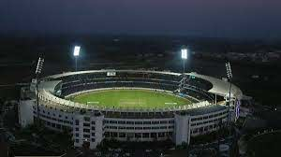
ICC T20 Cricket World Cup
South Africa India
Australia England
NewZeland Ireland
Pakistan Bangladesh
Srilanka Afghanistan
WestIndies Canada
United Arab Emarates

Slide 8
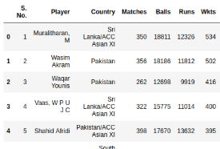
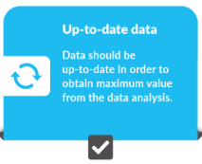
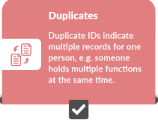
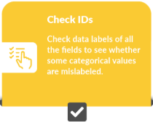
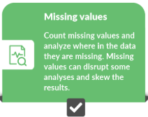
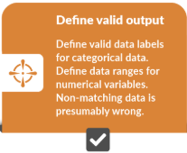
STEPS INVOLVED IN PROJECT
Dataset Generation
Data Cleaning
Data Mining
Analysis Of Result

Slide 9
Code And Its Explanation
By Abdul Jalil Khan

Slide 10
Code And Its Explanation
By Abdul Jalil Khan
By Syed Muhammad Bilal

Slide 11
Future work
There are some future works that can be done in order to improve this project.
We can improve accuracy by using some external factors like player injury, player fatigue, winning streak with a particular team, e.t.c.
The prediction can also be done taking into consideration the performance of the players in the team
Making a good UI Mobile and web app to take in the entire data set as input and display the prediction result for each of the instances to a pdf or text file.

Slide 12
Results
Algorithm | Accuracy
Logistic Regression | 22.34%
Naives Bayes | 44.48%
KN-Neighbour | 66.71%
SVM | 96.035%
Gradient Boost | 96.22%
Decision Tree | 96.422%
Random Forest | 96.422%

Slide 13









PREDICTION
After the schedule comes of World T20
Apply this code and you system will predict the winner of the event.

Slide 14
References
Data from cricket website
https://stats.espncricinfo.com/
Online sources for help
https://medium.com/
http://shivammitra.com/

Slide 15


