Slide 1
Key Principles for Agile Requirements
Active user involvement is imperative
Agile teams must be empowered to make decisions
Requirements emerge and evolve as software is developed
Agile requirements are ‘barely sufficient’
Requirements are developed in small pieces
Enough’s enough – apply the 80/20 rule
Cooperation, collaboration and communication
between all team members is essential

Slide 2
Requirements are a Communication Problem
Written requirements
  can be well thought through, reviewed and edited
  provide a permanent record
  are easily shared with groups of people
  time consuming to produce
  may be less relevant or superseded over time
  can be easily misinterpreted
Verbal requirements
  instantaneous feedback and clarification
  information-packed exchange
  easier to clarify and gain common understanding
  easily adapted to any new information known at the time
  can spark ideas about problems and opportunities

Slide 3
User Stories seek to combine the strengths of written and verbal communication, where possible supported by a picture.
* Kent Beck coined the term user stories in Extreme Programming Explained 1st Edition, 1999

Slide 4
What is a User Story?
A concise, written description of a piece of functionality that will be valuable to a user (or owner) of the software.
Stories are:
  User’s needs
  Product descriptions
  Planning items
  Tokens for a conversation
  Mechanisms for deferring conversation

Slide 5
User Story Cards have 3 parts
Description - A written description of the user story for planning purposes and as a reminder
Conversation - A section for capturing further information about the user story and details of any conversations
Confirmation - A section to convey what tests will be carried out to confirm the user story is complete and working as expected

Slide 6
User Story Template – 1
As a [user role] I want to [goal]
so I can [reason]
As a [type of user] I want to [perform some task] so that I can [reach some goal]
Example:
As a registered user I want to log in
so I can access subscriber-only content

Slide 7
User Story Template – 2
Who (user role)
  What (goal)
Why (reason)
    gives clarity as to why a feature is useful
    can influence how a feature should function
    can give you ideas for other useful features
    that support the user's goals

Slide 8
User Story Description
Steps:
Start with a title.
Add a concise description using the templates.
Add other relevant notes, specifications, or sketches
Before building software write acceptance criteria (how do we know when we’re done?)

Slide 9
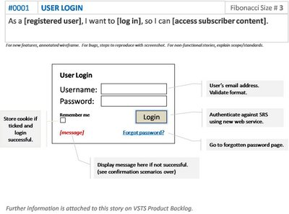
Example: Front of Card

Slide 10
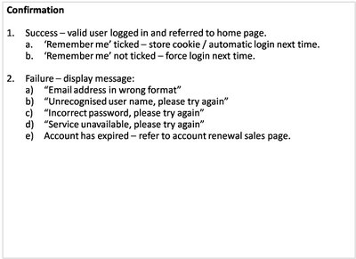
Example: Back of Card

Slide 11
How detailed should a User Story be?
Detailed enough
For the team to start working from
To establish further details and clarifications
at the time of development.

Slide 12
INVEST in Good User Stories
Independent – User Stories should be as independent as possible.
Negotiable – a User Story is not a contract. It is not a detailed specification. It is a reminder of features for the team to discuss and collaborate to clarify the details near the time of development.
Valuable – User Stories should be valuable to the user (or owner) of the solution. They should be written in user language. They should be features, not tasks.
Estimatable – User Stories need to be possible to estimate. They need to provide enough information to estimate, without being too detailed.
Small – User Stories should be small. Not too small and not too big.
Testable – User Stories need to be worded in a way that is testable, i.e. not too subjective and to provide clear details of how the User Story will be tested.

Slide 13
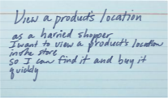
Prioritize stories in a backlog
Agile customers or product owner prioritize stories in a backlog
A collection of stories for a software product is referred to as the product backlog
The backlog is prioritized so that the most valuable items have the highest priorities

Slide 14
User Story Mapping – 1
User Story Mapping is an approach to Organize and Prioritize user stories
Unlike typical user story backlogs, Story Maps:
  make the workflow or value chain visible
  show the relationships of larger stories to their child stories
  help confirm the completeness of your backlog
  provide a useful context for prioritization
  plan releases in complete and valuable slices of functionality.

Slide 15

User Story Mapping – 2
Spatial arrangement:
  By arranging activity and task-centric story cards spatially, we can identify bigger stories
  Arrange activities left to right in the order you’d explain them to someone when asked the question: “What do people do with this system?”
time

Slide 16

User Story Mapping – 3
Overlap user tasks vertically if a user may do one of several tasks at approximately the same time
If in telling the story I say the systems’ user typically “does this or this or this, and then does that”. “or” signal a stacking vertically, and “then” signal stepping horizontally.
time

Slide 17
User Story Mapping – 4
The map shows decomposition and typical flow across the
entire system.
time
Below each activity, or large story are the child stories that make it up
Reading the activities across the top of the system helps
us understand end-to-end use of the system.

Slide 18
User Story Mapping - prioritizing
Prioritizing based on product goal
  Product goals describe what outcome or benefit is received by the organization after the product is put into use
  Use product goals to identify candidate incremental releases, where each release delivers some benefit

Slide 19


User Story Mapping - prioritizing
  Create horizontal swim-lanes to group features into releases
  Arrange features vertically by necessity from the user’s perspective
  Split tasks into parts that can be deferred till later releases
  Use the product goals to identify slices that incrementally realize product goals.
necessary
less
optional
optionality
more
optional

Slide 20
From user story to test case
We can also use templates to write test cases for the use stories. One tool that employs such templates is CUCUMBER. The template is as follows:
Scenario: a short description of the test scenario
Given: test preconditions
When: test action – input
Then: test result – output
And: can be used to include more than one precondition, input or output.

Slide 21
CUCUMBER example
Scenario: memory BIT
When: we have inserted a memory fault
And: run a memory BIT
Then: the memory fault flag should be set
And: the system should move to the error state

Slide 22
Agile – Challenges
    Active user involvement can be demanding on the user representative's time and require a big commitment for the duration of the project.
    Iterations can be a substantial overhead if the deployment cost are large
    Agile requirements are barely sufficient:
      This can mean less information available to new starters in the team about features and how they should work.
    Usually not suitable for projects with high developer turnover with long-term maintenance contract
    Arguably not suitable for safety critical systems.

Slide 23
User Stories Summary
User Stories combine written and verbal communications, supported with a picture where possible.
User Stories should describe features that are of value to the user, written in the user’s language.
User Stories detail just enough information and no more.
Details are deferred and captured through collaboration
just in time for development.
Test cases should be written before development, when the User Story is written.
User Stories should be Independent, Negotiable, Valuable, Estimatable, Small and Testable.

