Slide 1
Educo
Facebook EdMod Labs Team

Slide 2


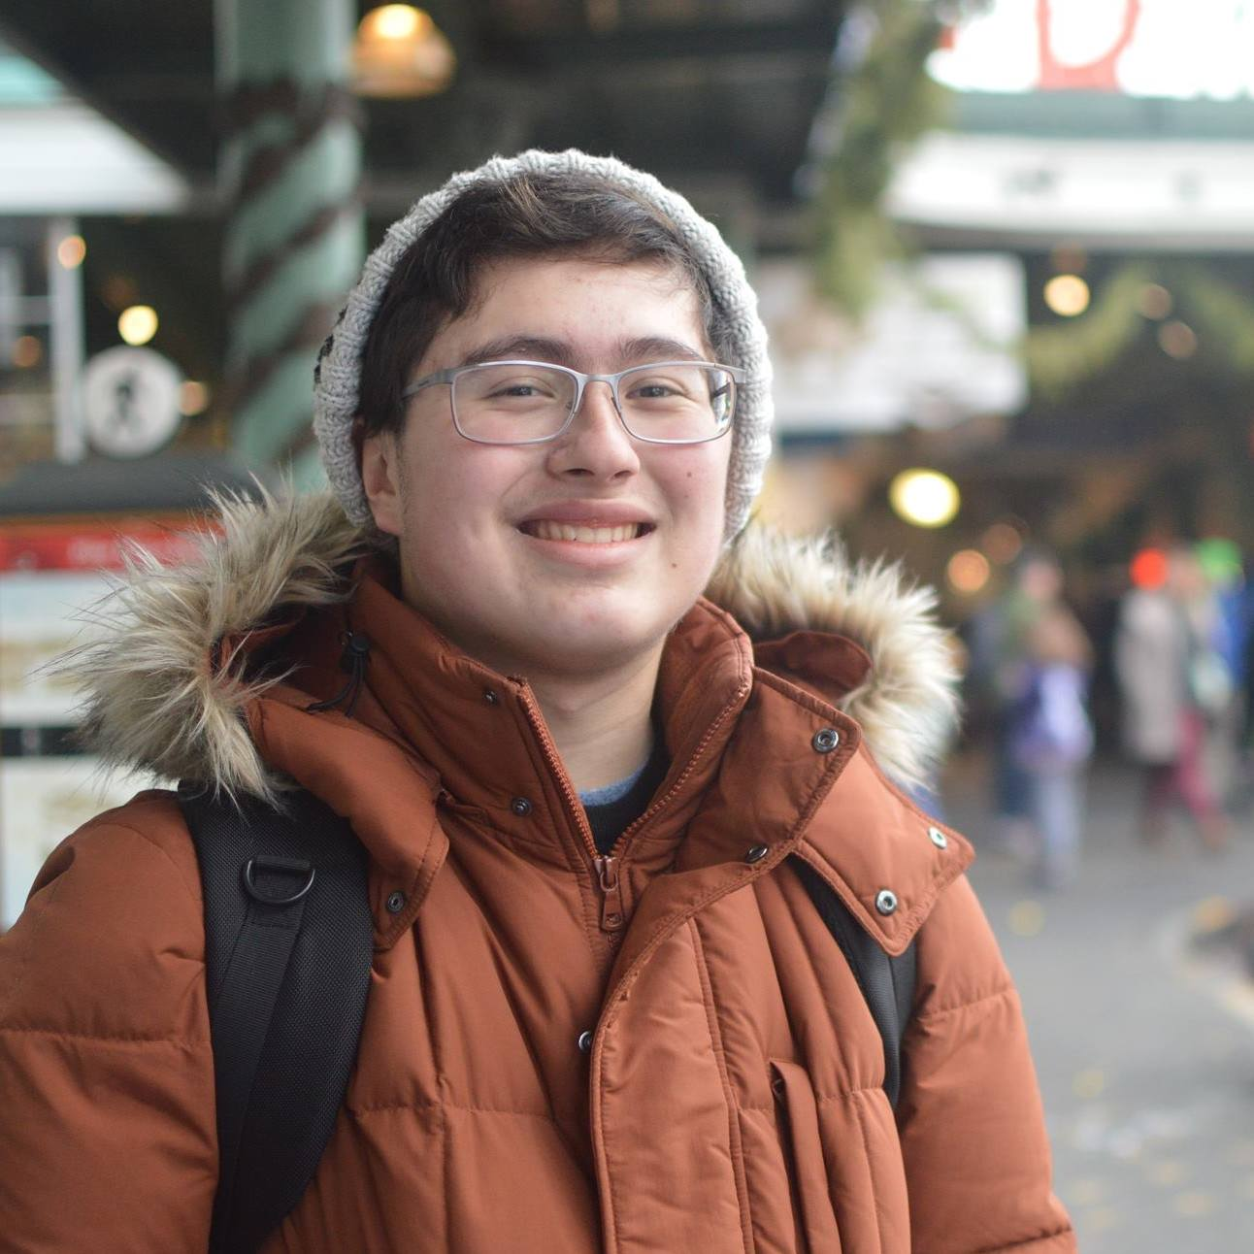



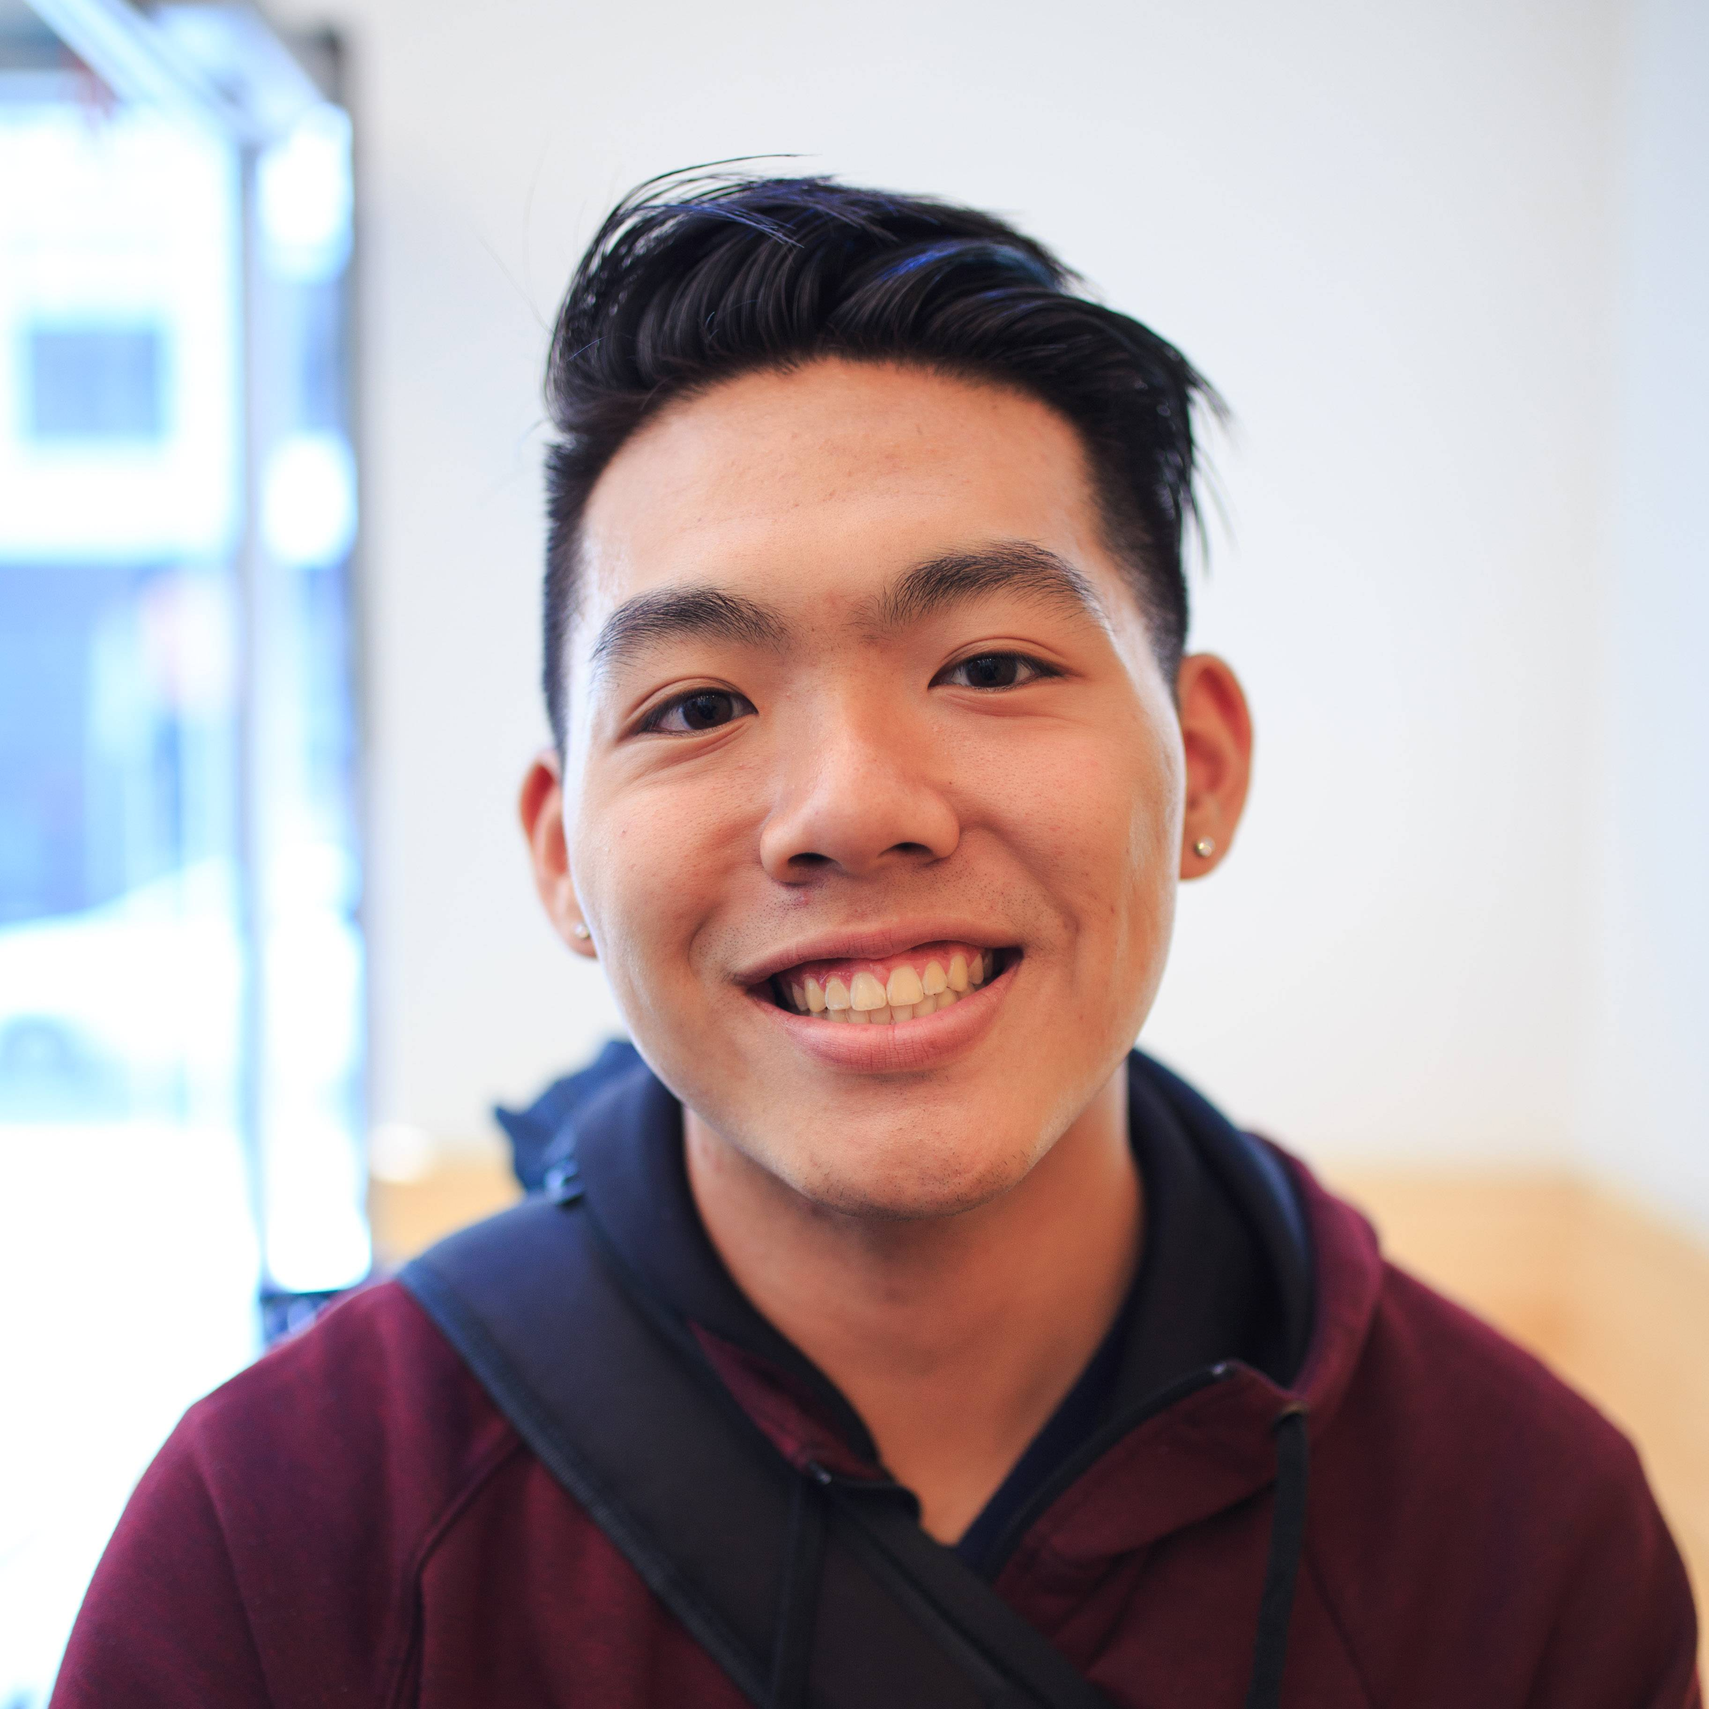
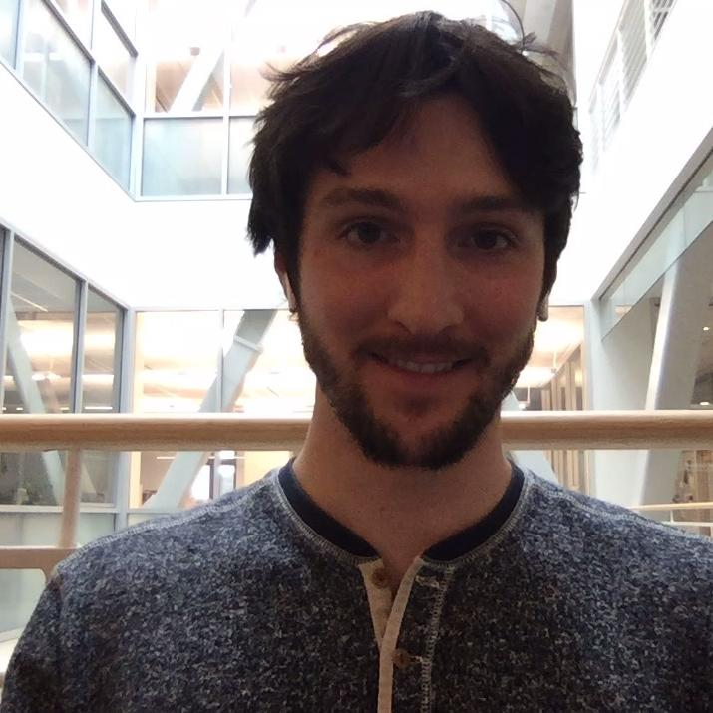
Our Team
Susan Benavidez
AI/NLP, Python, Backend, ReactJS
Stephanie Brito
Systems/Backend, Python, AI/ML
Isaiah
Bush
AI/ML, Python, Backend
Austin
Chow
Python, Java, Javascript, React, Flask
John
Chuter
AI/ML, Android+iOS+xPlatform
Notes:
Stephanie

Slide 3
Agenda
1
2
3
4
Corporate Partner and Problem Statement
Users
Our Solution
Next Steps
Notes:
Solution: Community
Means: Platform
Functions: QA threads, Groups, Calendar (OH, events), Feed
Interfaces: Site, SMS
Closing Slide
Next Steps

Slide 4
Facebook EdMod
1
Context; program
Notes:
JOHN

Slide 5
Problem Statement
1
Notes:
Isaiah

Slide 6
Our Users: Facilitators
2
Notes:
Austin

Slide 7
Our Users: Learners
2
Notes:
Austin

Slide 8
Our Approach
SMS Integration Point into Web Platform

Slide 9
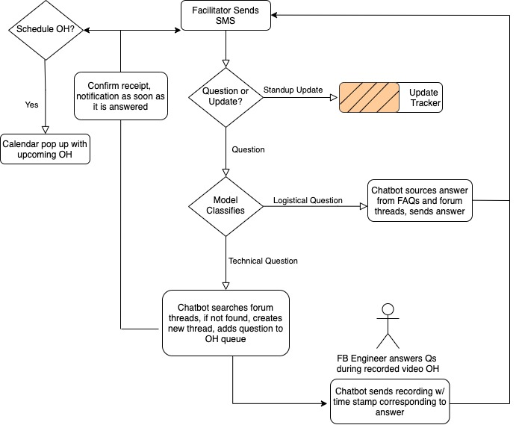
Our Approach: SMS Prototype
3
School firewall
Limited resources
Central Q&A repository
Reliance on human customer service
Low engagement
High drop off
Notes:
Facebook currently offers community and a space to ask questions via a private FB group but most schools have a firewall that blocks access to Facebook. In addition, most centers have limited access to computers as every laptop is meant to be used by the student learners. Facilitators can leverage their mobile to submit their daily updates (doing away with the current paper written reports), as well as submit their questions. Our chatbot will be an integration point to a central repository of Q&As and can distinguish between logistical and technical questions. The bot will update the facilitator immediately, confirming receipt of the question as well as providing timely updates of pending answer. OH are currently poorly attended and/or have low engagement as they are a video recording and facilitators feel embarrassed to speak up and ask. FB engineers will now have a queue of submitted questions to answer to start off OH. Our chatbot will send a link to the video recording with a timestamp of when their question was answered. This removes a heavy reliance on human follow through and logistical overhead.

Slide 10
Our Approach: Visually Web
3
Notes:
Stephanie

Slide 11
Our Approach: Visually Web
3
Notes:
Stephanie

Slide 12
Next Steps

Slide 13
Next Steps
4
Notes:
Stephanie

Slide 14
Thank you!
Susana Benavidez
sbenavid@stanford.edu
Stephanie Brito
sbrito@stanford.edu
Isaiah Bush
tbush@stanford.edu
Austin Chow archow@stanford.edu
John Chuter
jchuter@stanford.edu

Slide 15





Notes:
JOHN
recap

Slide 16





Notes:
Next steps
-user/facilitator interviews
-prototyping w/ feedback
- funding

