Slide 1
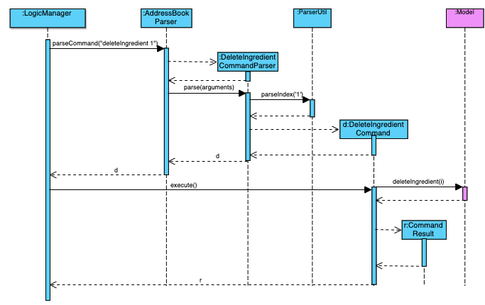
Logic
execute(“deleteIngredient 1”)
r

