Slide 1
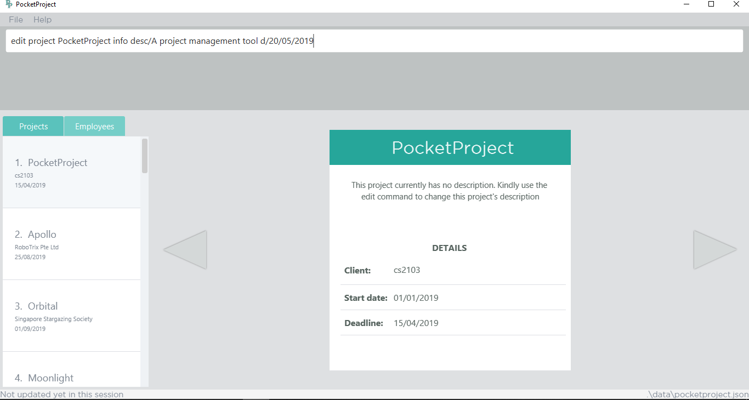
1. Type the command to edit PocketProject’s description and deadline

Slide 2
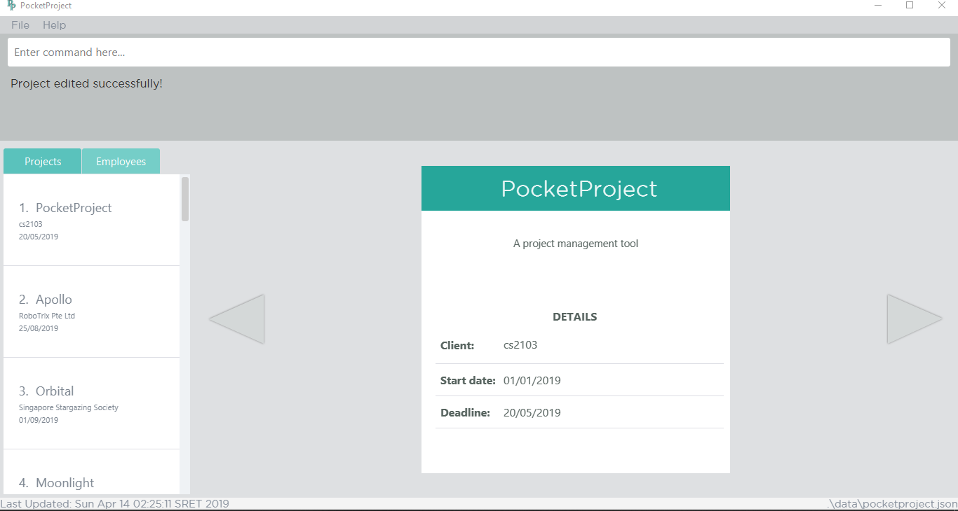
2. The success message will be shown
4. The deadline has been updated
3. The changes made to the description is reflected here
4. The changes made to the description is reflected here

Slide 3
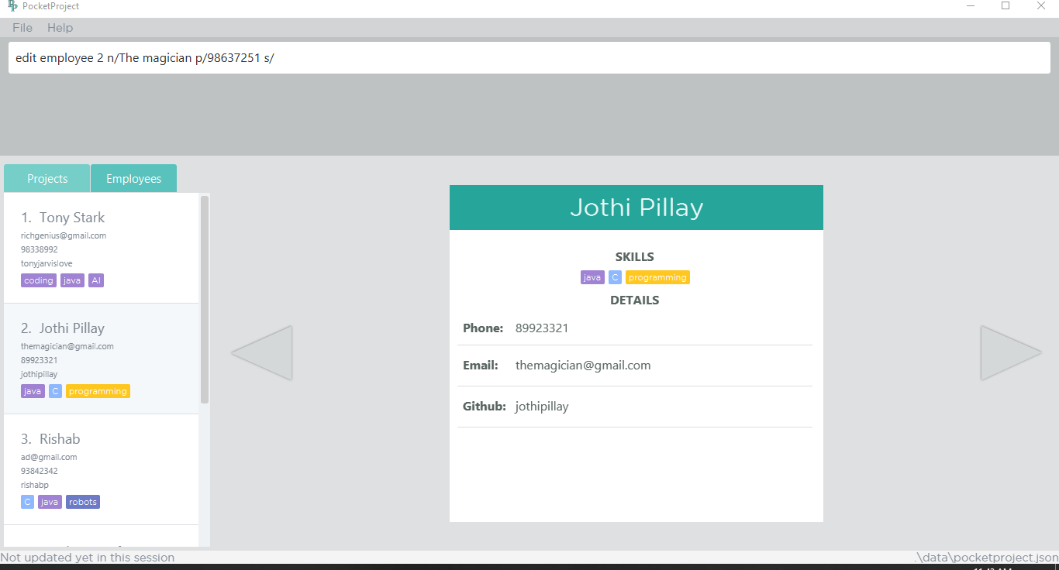
1. Type the command to edit PocketProject’s description and deadline
2. target employee from the list to be edited. For eg, target employee is at index 2 of the displayed list.

Slide 4
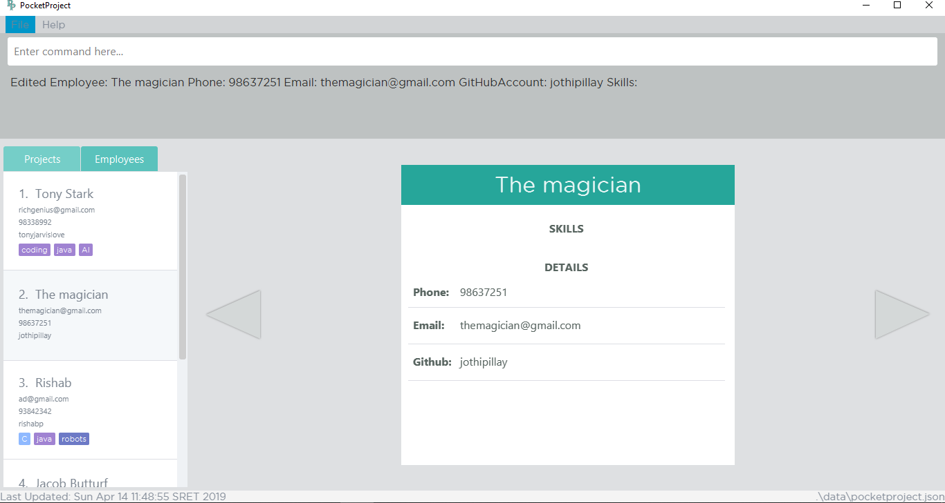
3. The success message will be shown
5. The changes are reflected on the detail panel as well.
4. The target employee’s information has been changed. Name changed from ‘Jothi Pillay’ to ‘The magician’ and the skills are removed.

Slide 5
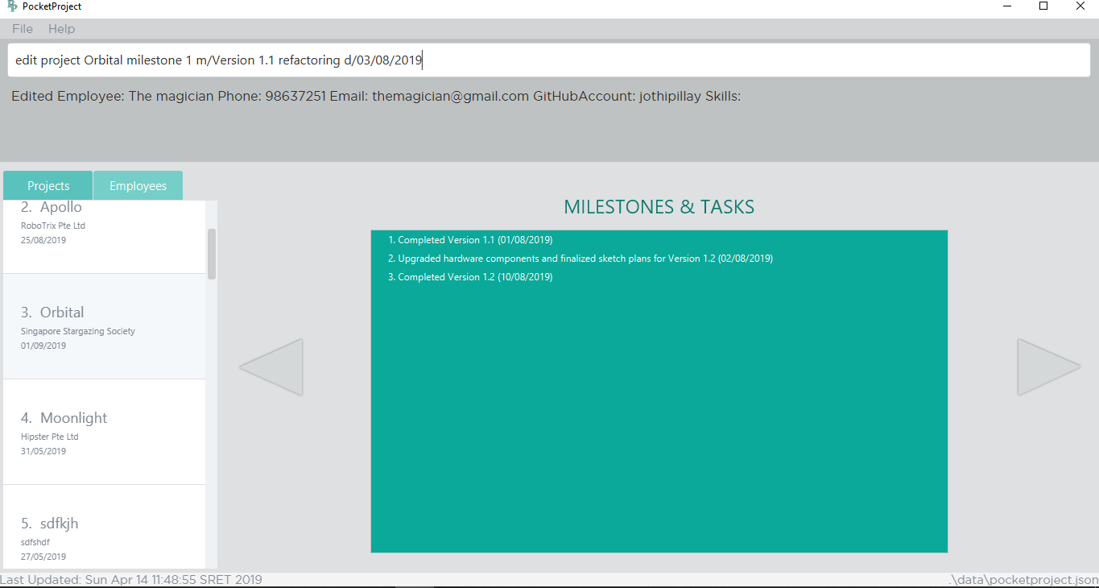
1. Type the command to edit the first milestone of Orbital
3. Target milestone to be edited
2. Target project to be edited

Slide 6

4. The success message will be shown
5. The edited milestone. Since the milestones are sorted by date, changing the date to 03/08/2019 shifted the milestone to be second in the list

Slide 7
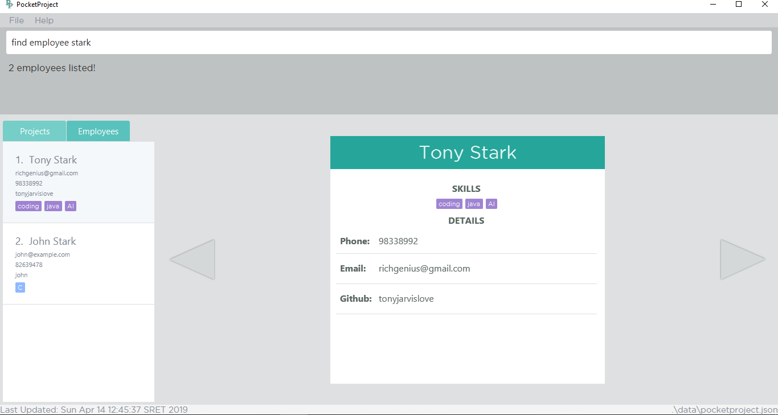
1. Type the command to find employees with ‘stark’ in their name
2. The success message with number of employees found is shown
3. The employees with ‘stark’ in their name that are found

Slide 8
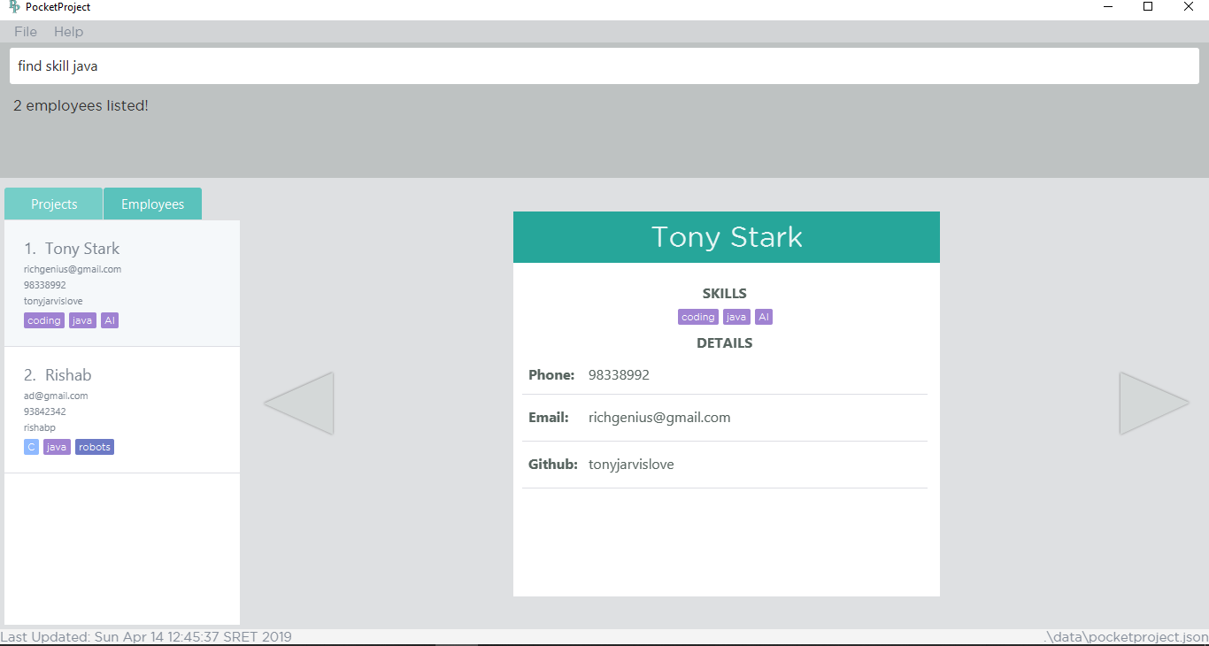
1. Type the command to find employees with skill java
2. The success message with number of employees found is shown
3. The employees with ‘stark’ in their name that are found

Slide 9
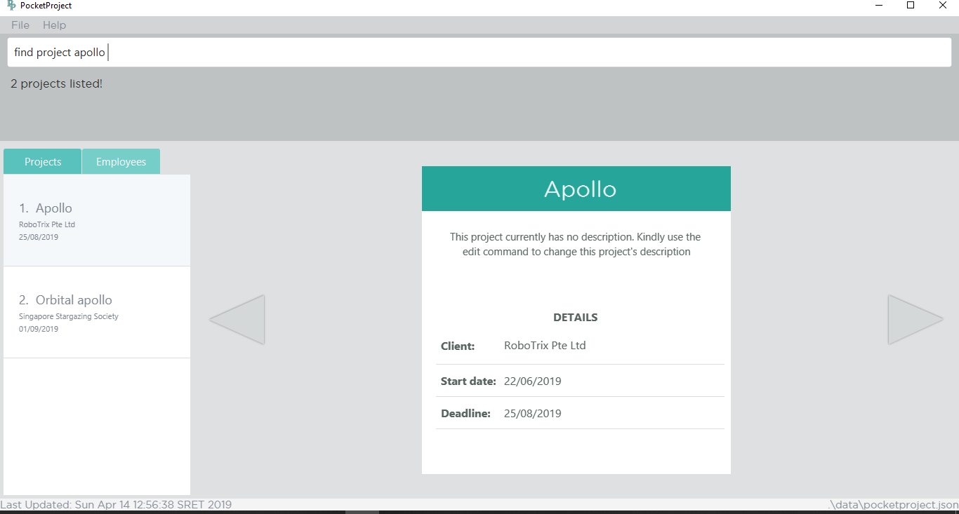
1. Type the command to find project with name apollo
2. The success message with number of projects found is shown
3. The employees with ‘stark’ in their name that are found

Slide 10

1. Type the command to find project which contain the word management in the name or the description
2. The success message with number of projects found is shown
3. The projects that contain the word management are found

Slide 11

1. Type the command to find project with deadline before 31/05/2019 (current date is 14/04/2019)
2. The success message with number of projects found is shown
3. The projects with deadline before 31/05/2019

