Slide 1
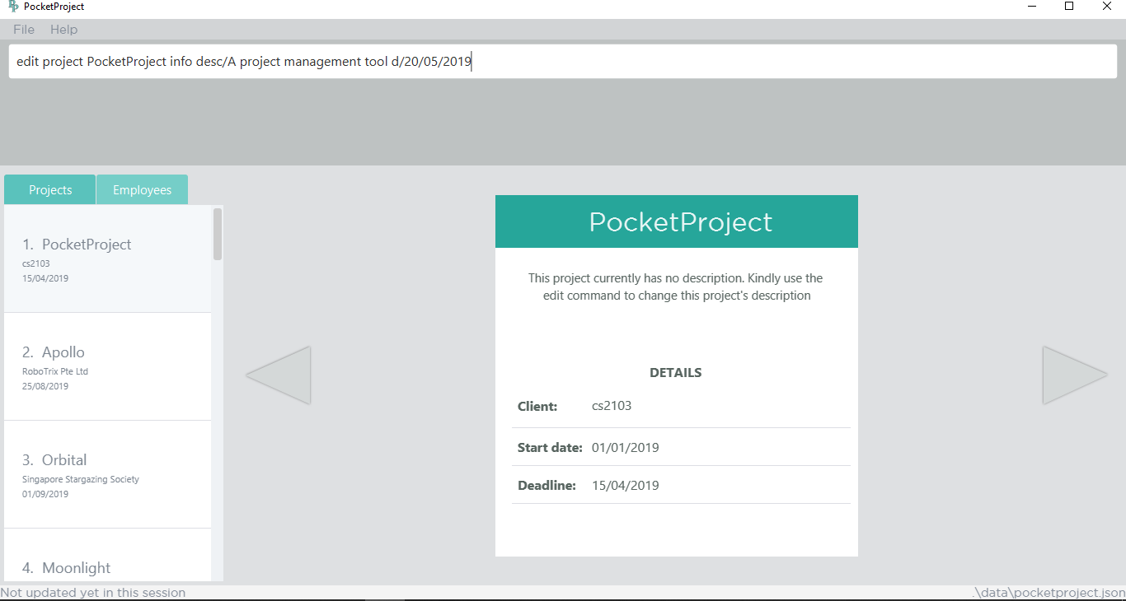
1. Type the command to edit PocketProject’s description and deadline
2. The target project to be edited is here

Slide 2
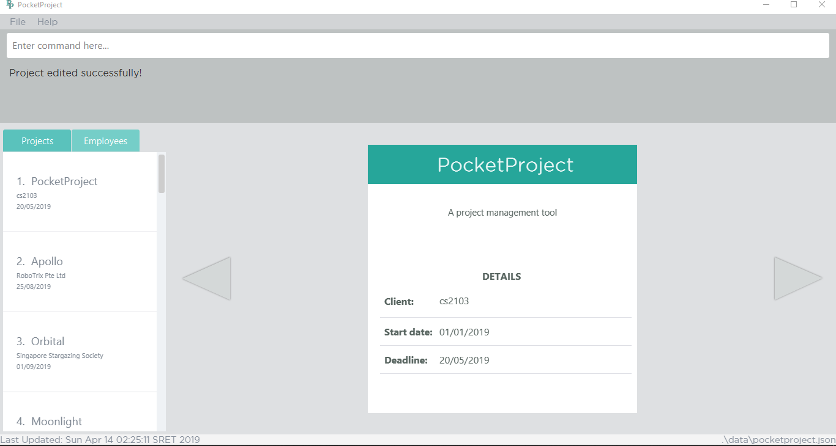
2. The success message will be shown
4. The deadline has been updated
3. The changes made to the description is reflected here
4. The changes made to the deadline is reflected here

Slide 3
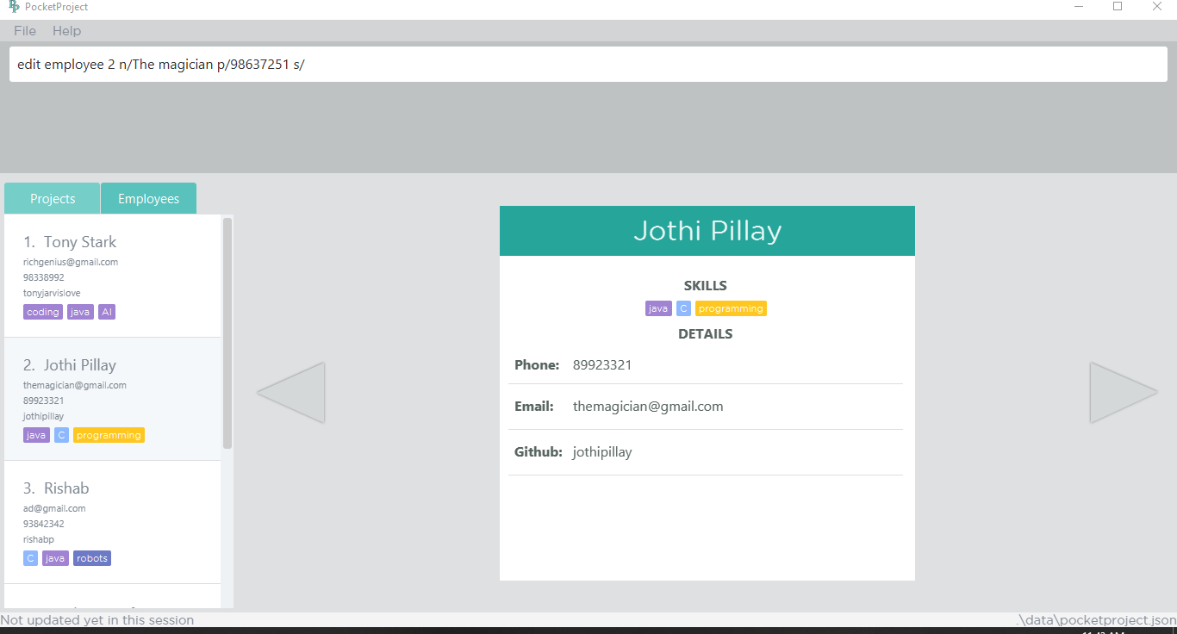
1. Type the command to edit name, phone and skill of the employee at index 2
2. The target employee at index 2 which will be edited when the command is entered.

Slide 4
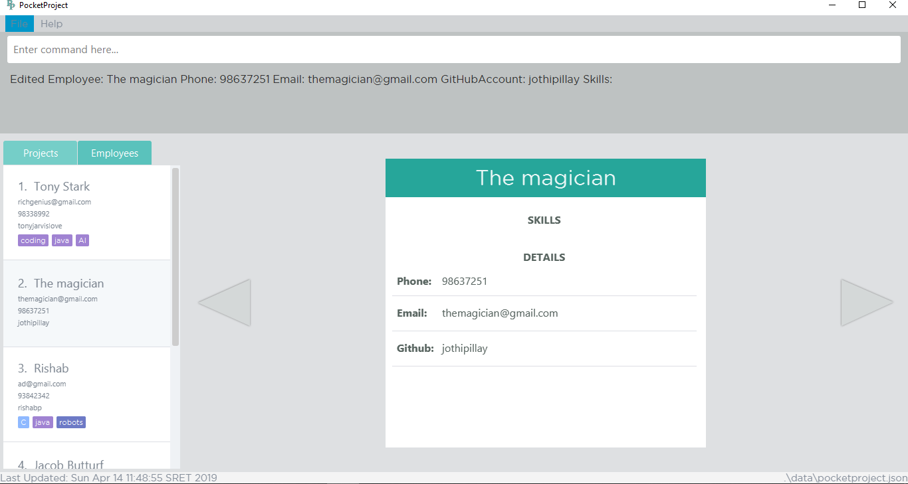
3. The success message will be shown
5. The changes are reflected on the detail panel as well.
4. The target employee’s information has been changed. Name changed from ‘Jothi Pillay’ to ‘The magician’ and the skills are removed.

Slide 5
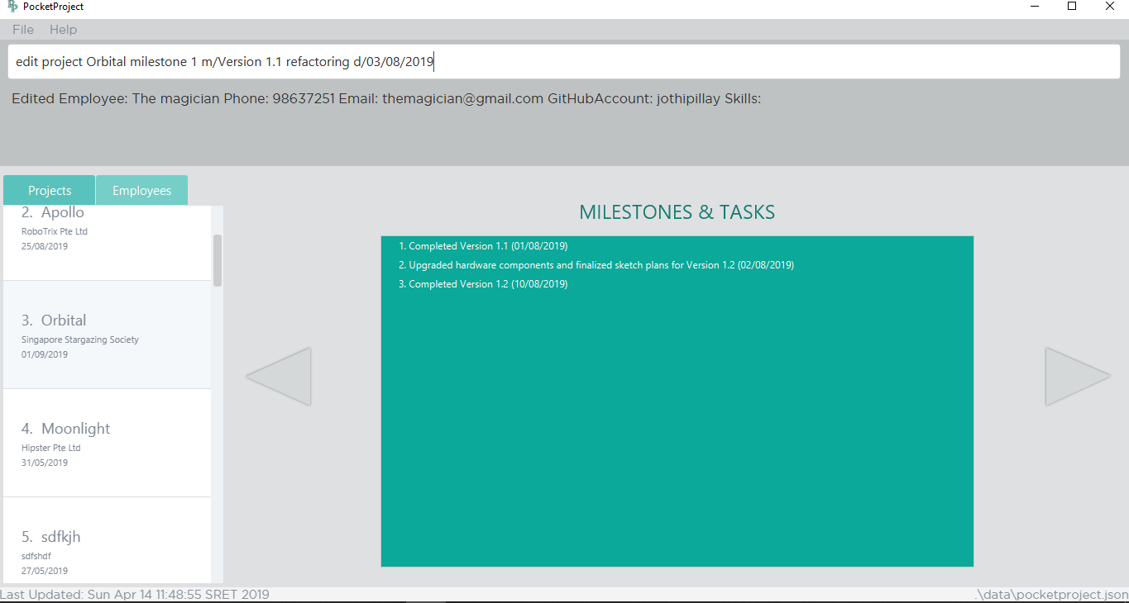
1. Type the command to edit the first milestone of Orbital
3. Target milestone to be edited
2. Target project to be edited

Slide 6

4. The success message will be shown
5. The edited milestone is shown at index 2. Since the milestones are sorted by date, changing the date to 03/08/2019 shifted the milestone to be second in the list.

Slide 7
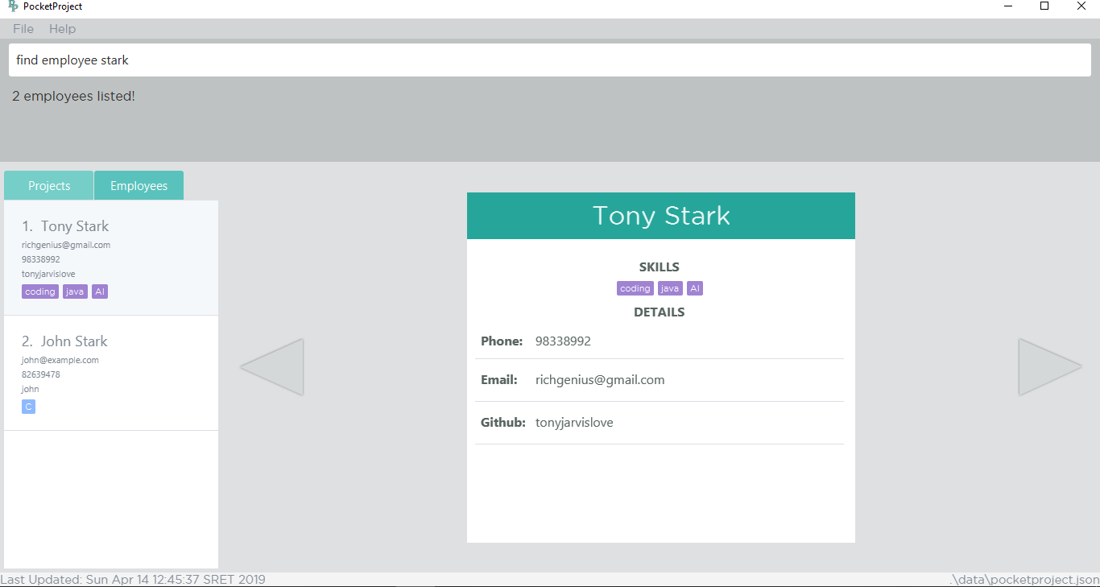
1. Type the command to find employees with ‘stark’ in their name
2. The success message with number of employees found is shown
3. The employees with ‘stark’ in their name that are found

Slide 8
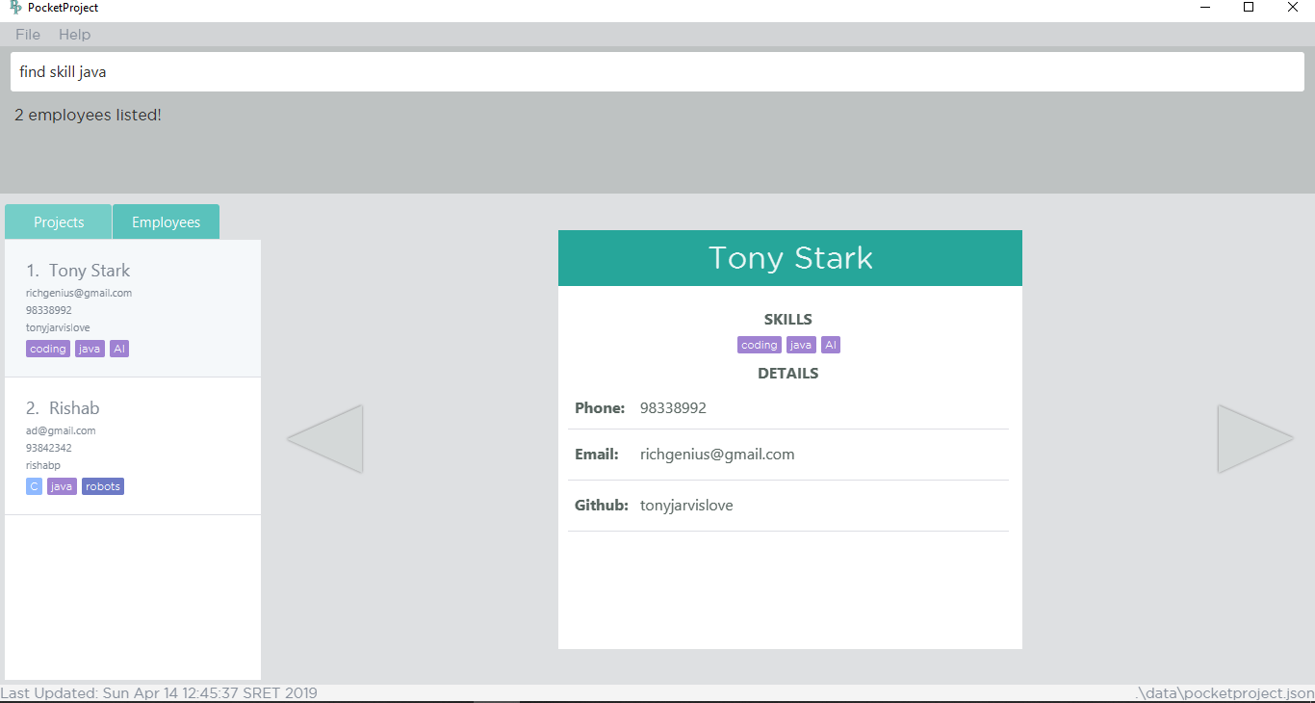
1. Type the command to find employees with skill java
2. The success message with number of employees found is shown
3. All the employees with ‘java’ skill are listed here

Slide 9
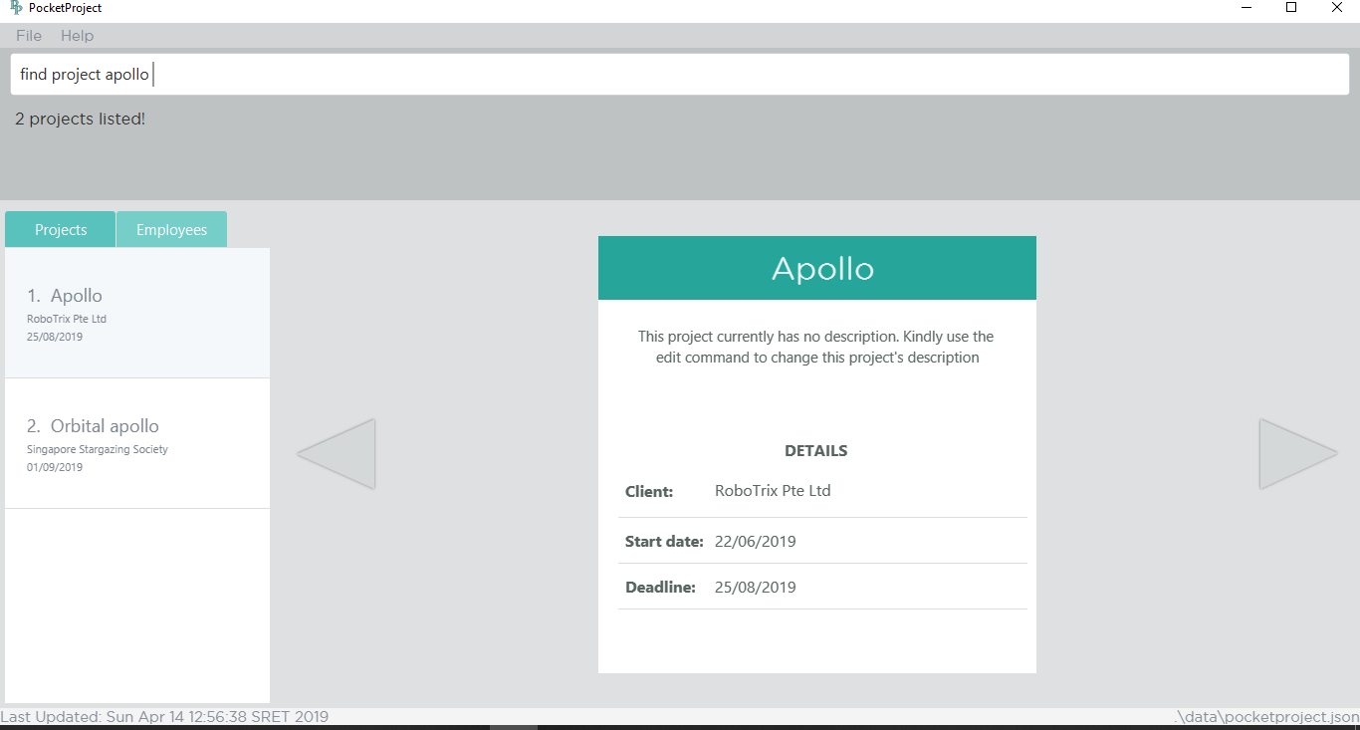
1. Type the command to find project with name apollo
2. The success message with number of projects found is shown
3. The projects with the word ‘Apollo’ in their project’s name are listed

Slide 10

1. Type the command to find project which contain the word management in the name or the description
2. The success message with number of projects found is shown
3. The projects that contain the word management are found

Slide 11

1. Type the command to find project with deadline before 31/05/2019 (current date is 14/04/2019)
2. The success message with number of projects found is shown
3. The projects with deadline before 31/05/2019

