Slide 1
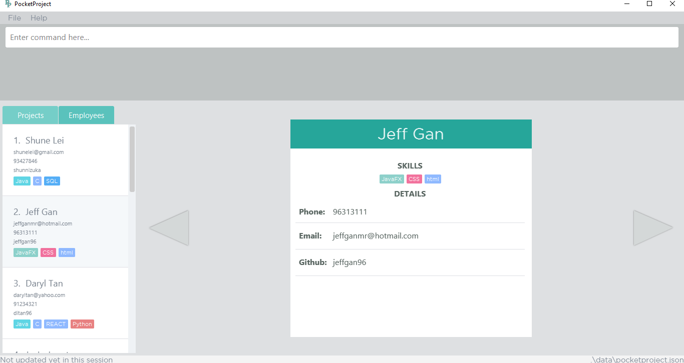
1
2
3
5
4
4

Slide 2
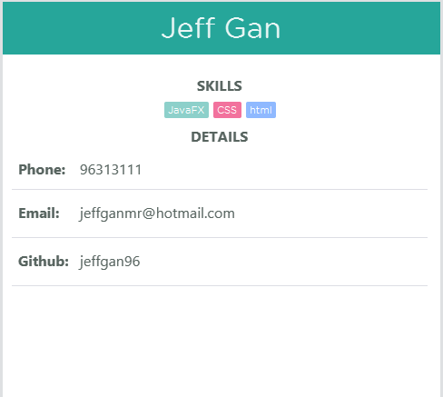
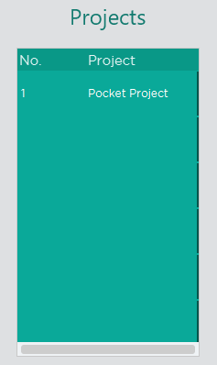
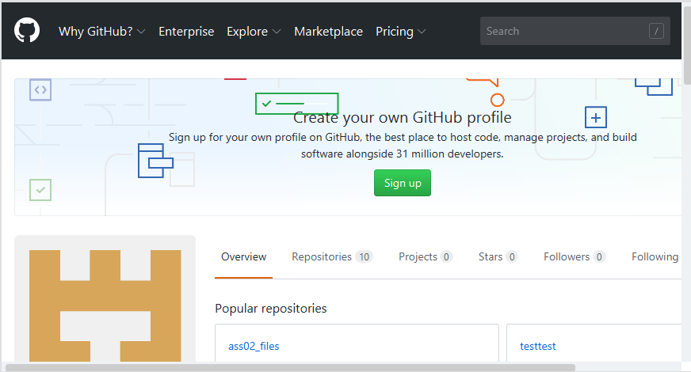
1
2
3

Slide 3
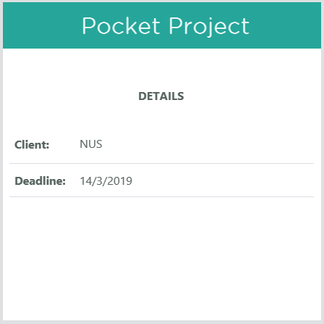
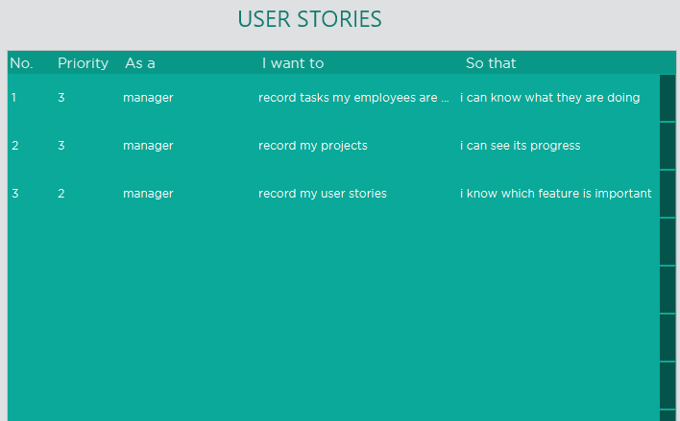
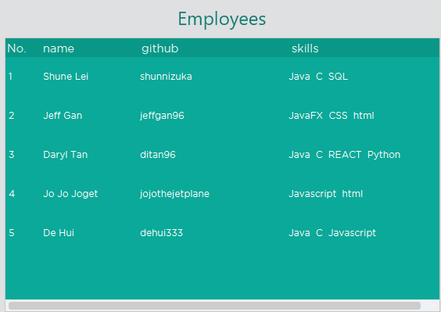
1
2
3

Slide 4
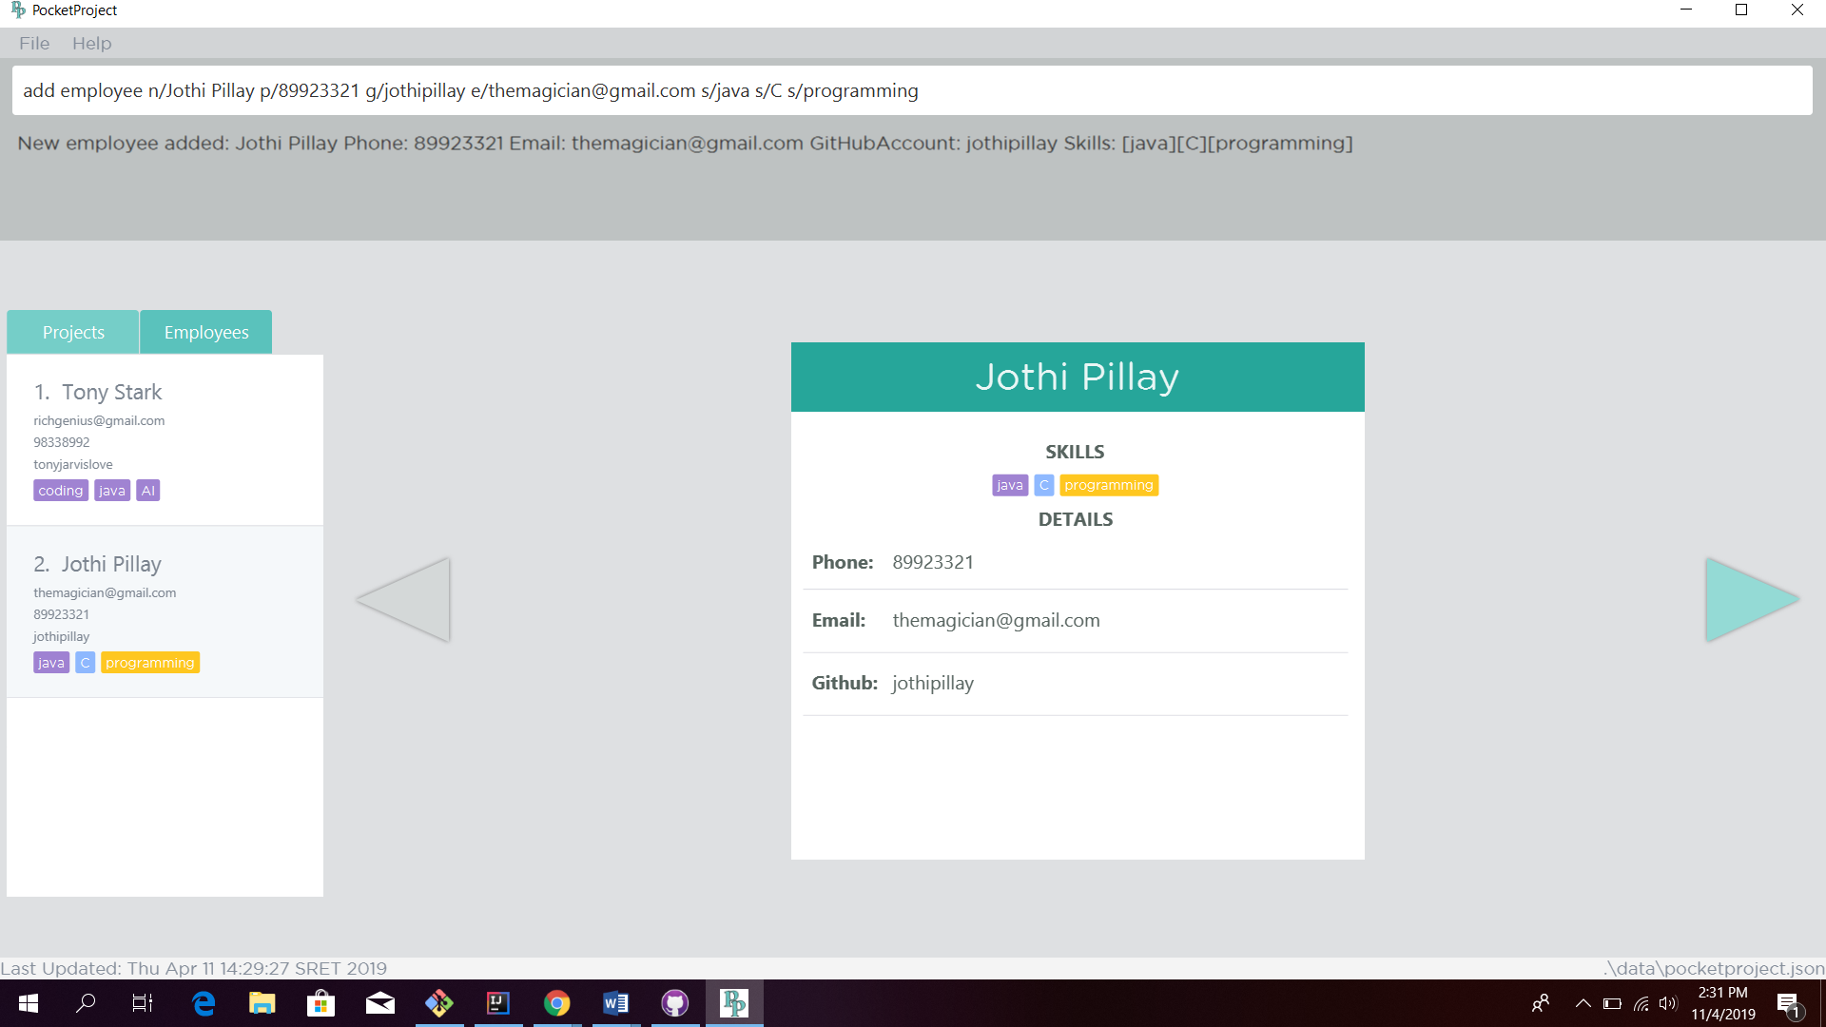
1. Type the command to add an employee
2. The details of the added employee will be indicated as a success message
3. Panel will display the newly added employee. Clicking on it will display the employee card.
5. Toggling the arrow leads to a loaded GitHub page of the employee based on his GitHub account username.
4. The employee card which contains key details of the employee.

Slide 5
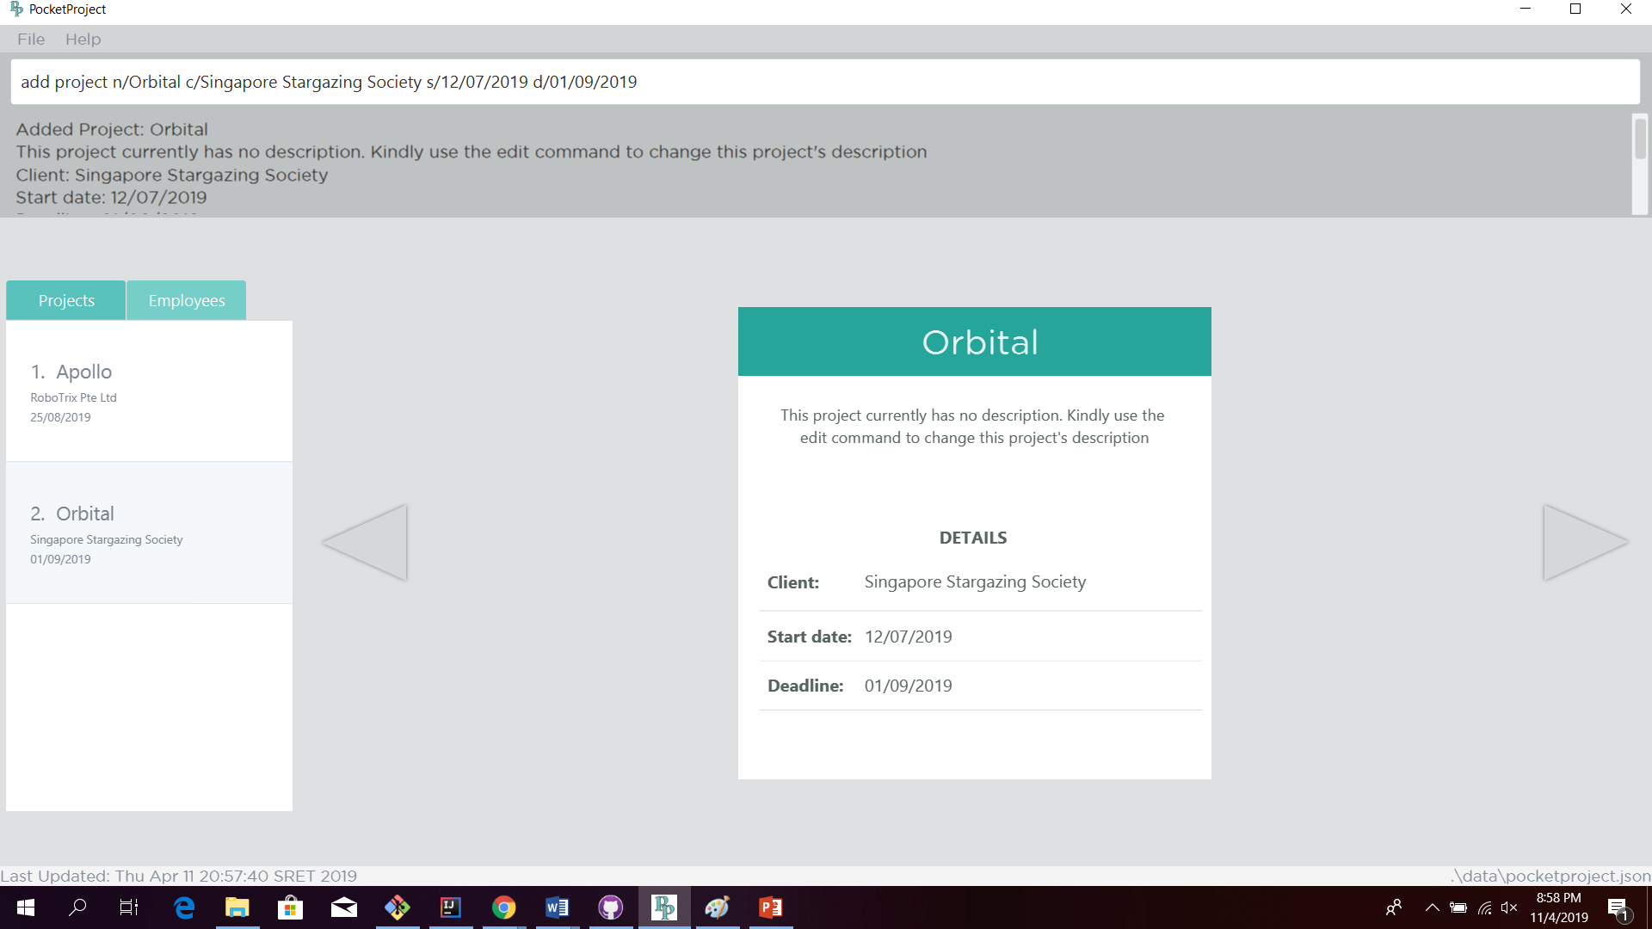
1. Type the command to add a project
2. The details of the added project will be indicated as a success message.
5. The project is created with a default description. The description has to be edited using the edit project command
3. Panel will display the newly added project. Clicking on it will display the project card.
4. The project card which contains key initial details of the project.

Slide 6
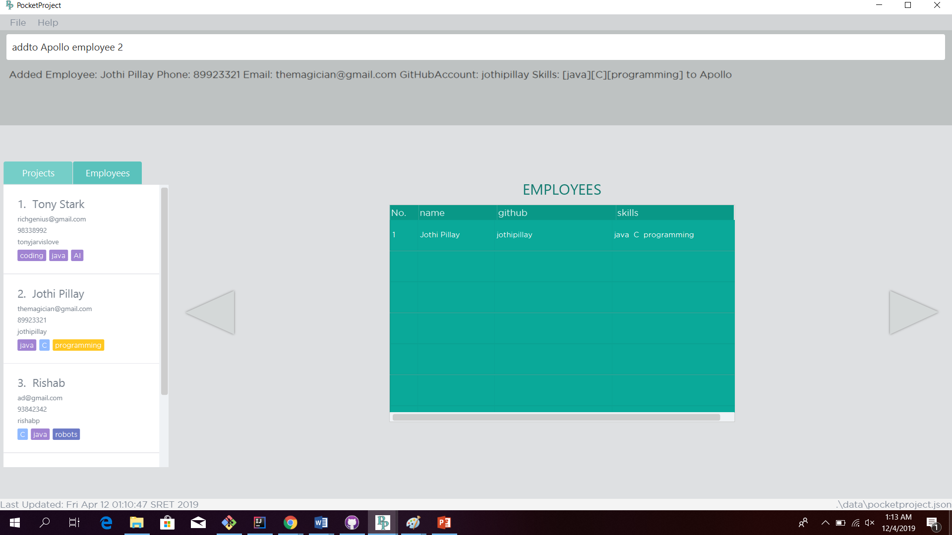
3. Type the command to add an employee to a project
4. The details of the added employee and the target project, Apollo, will be indicated as a success message
1. Either call the find command to get a filtered list of employees or call the list command to get a full list of employees. Alternatively, can click on the Employees tab to get the full list of employees.
2. Identify target employee from the list. For eg, target employee is at index 2 of the displayed list.
5. By selecting project “Apollo” and using the arrows to toggle to the list of employees assigned to project “Apollo”, you will be able to see the target employee already added to the list.

Slide 7
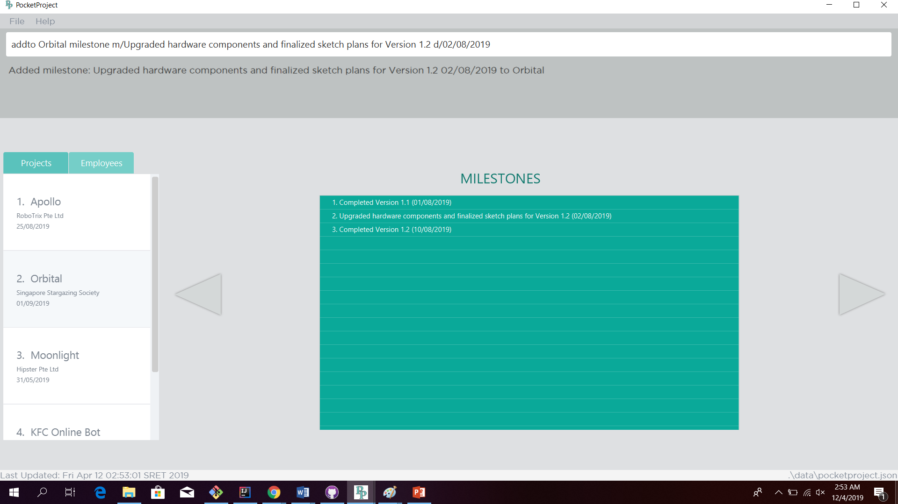
2. Type the command to add a milestone to a project
3. The details of the added milestone and the target project, Orbital, will be indicated as a success message
4. By selecting project “Orbital” and using the arrows to toggle to the list of milestones under project “Orbital”, you will be able to see the new milestone already added to the list.
5. As the date of the new milestone falls between the 2 milestones already in the list , the new milestone entry will be placed in between
1. Identify target project from the list of projects. For eg, name of target project is “Orbital”

Slide 8
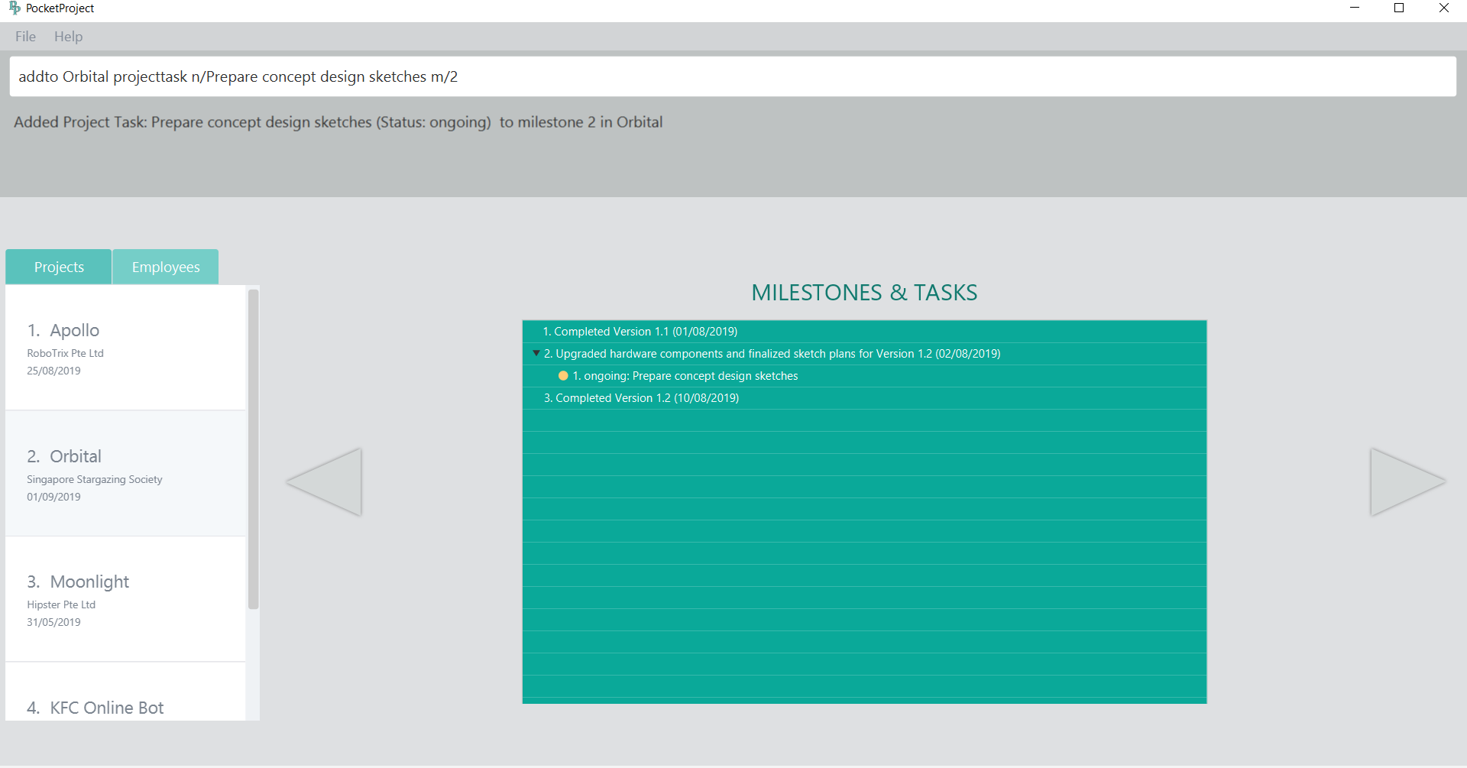
3. Type the command to add a task to a project’s milestone
4. The details of the added project task, the target milestone index, 2, and the target project, Orbital, will be indicated in the success message
5. By selecting project “Orbital” and using the arrows to toggle to the list of milestones and tasks under project “Orbital”, you will be able to see the new project task already added to the list.
2. Arrow for collapsing the list of tasks under a milestone.
6. The new project task is added under the milestone at index 2. Project tasks are set to ongoing status by default on addition to the milestone.
1. Identify target project from the list of projects. For eg, name of target project is “Orbital”

Slide 9
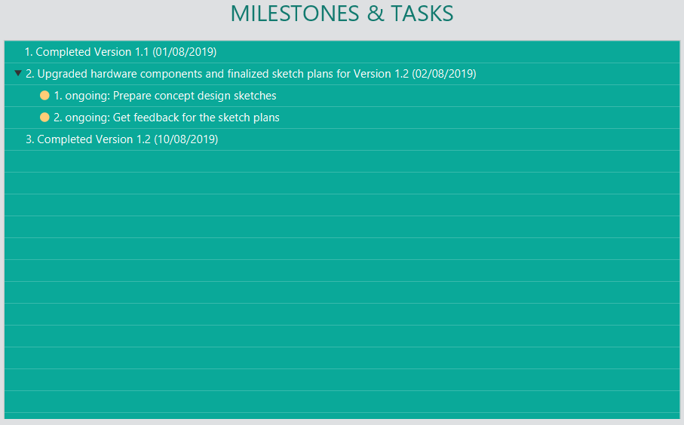
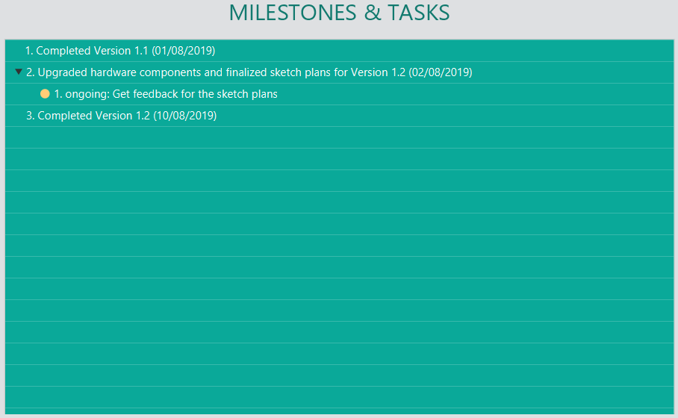
BEFORE
AFTER
The 1st project task is removed from the milestone at index 2. The index of the remaining project task is updated from 1 to 2.

Slide 10
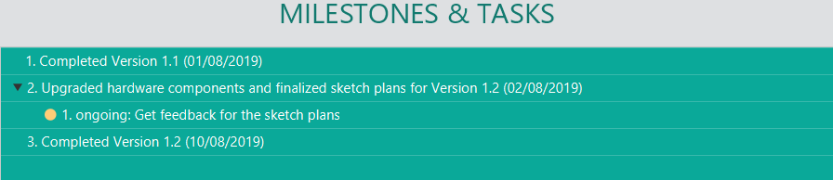
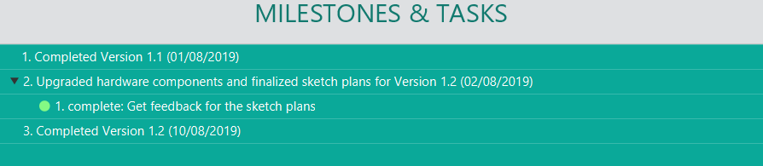
BEFORE
The status of the project task is updated from ongoing to complete
AFTER

Slide 11
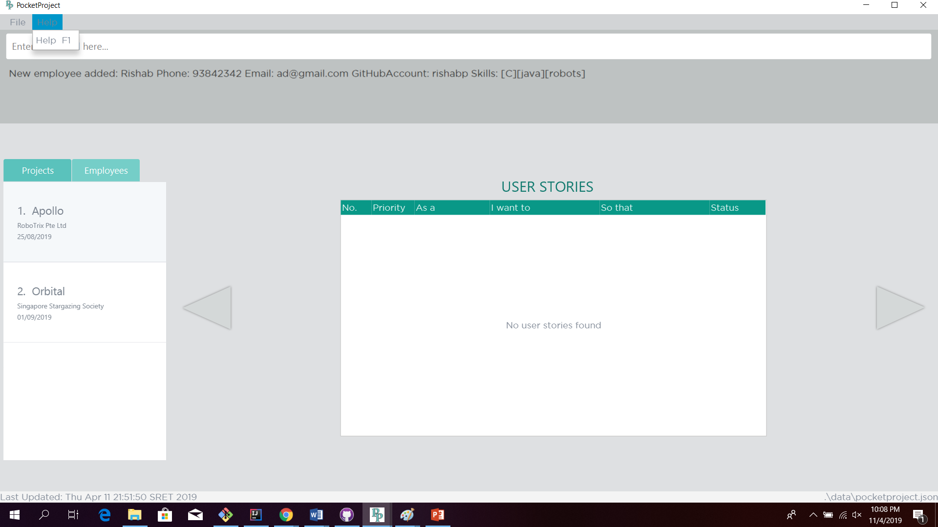

Slide 12
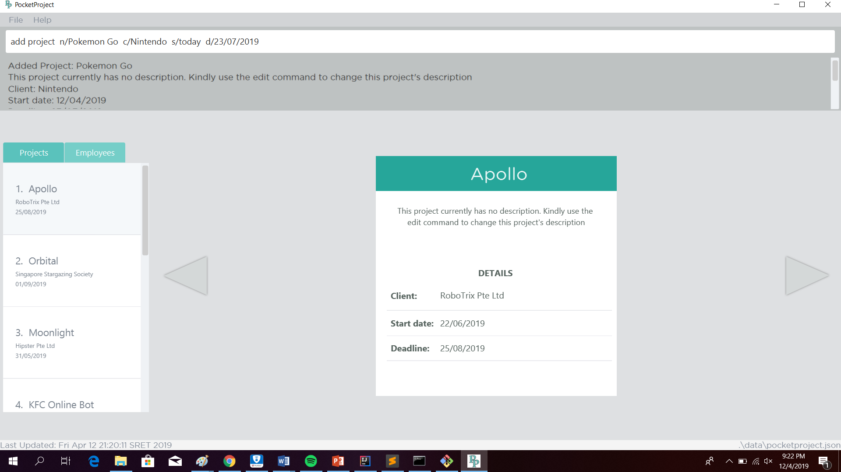

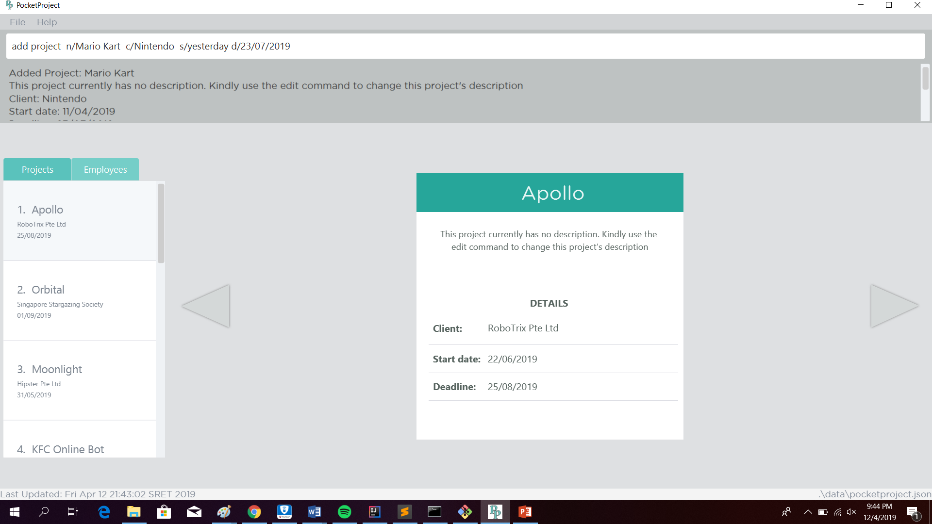
Assuming current date is 12 April 2019 (12/04/2019), Friday
1. User has typed in today as the start date of the project.
Example 1: Today
2. The input gets automatically translated to today’s date in DD/MM/YYYY format.
1. User has typed in “tomorrow” as the start date of the project.
Example 2: Tomorrow
2. The input gets automatically translated to tomorrow’s date in DD/MM/YYYY format.
1. User has typed in “yesterday” as the start date of the project.
Example 3: Yesterday
2. The input gets automatically translated to yesterday’s date in DD/MM/YYYY format.

Slide 13
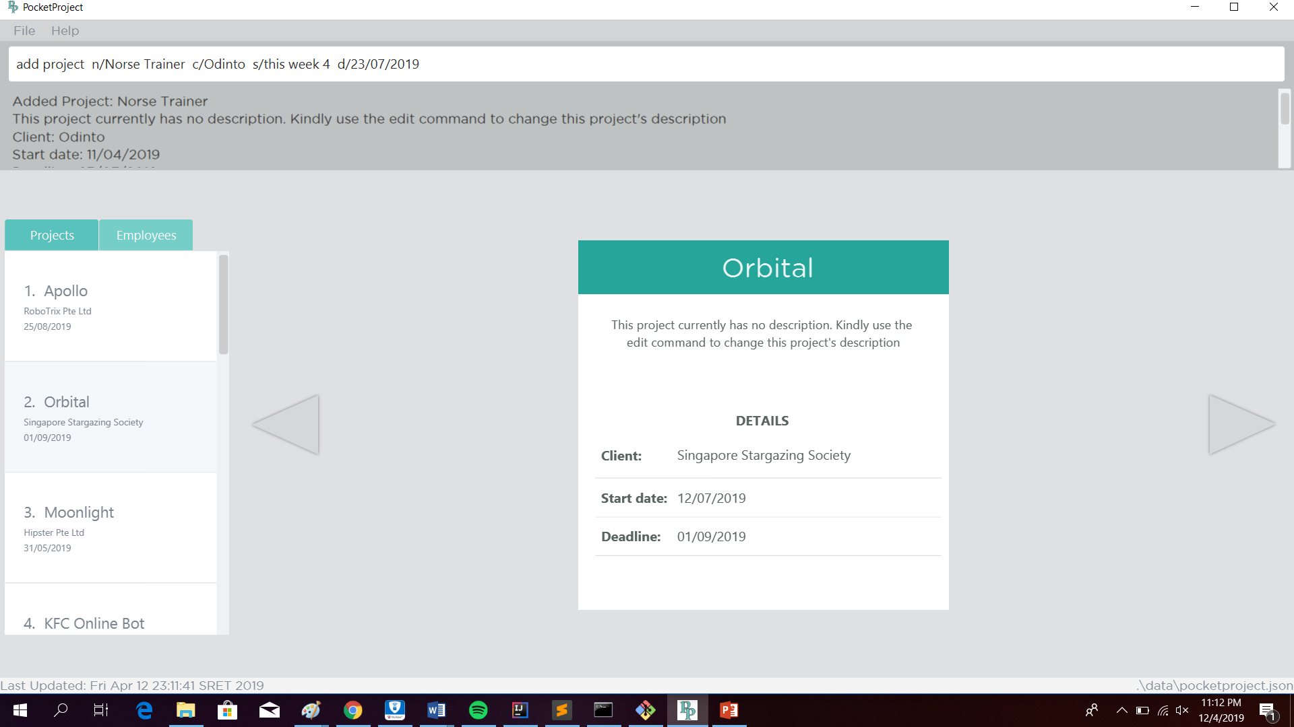


Assuming current date is 12 April 2019 (12/04/2019), Friday
1. User has targeted the current week’s Thursday as the start date of the project.
Example 1:
this week DAY_OF_WEEK
2. The input gets automatically translated to the target date in DD/MM/YYYY format.
1. User has targeted next week’s Sunday as the start date of the project.
Example 2:
next week DAY_OF_WEEK
2. The input gets automatically translated to the target date in DD/MM/YYYY format.
1. User has targeted last week’s Tuesday as the start date of the project.
Example 3:
last week DAY_OF_WEEK
2. The input gets automatically translated to the target date in DD/MM/YYYY format.

Slide 14
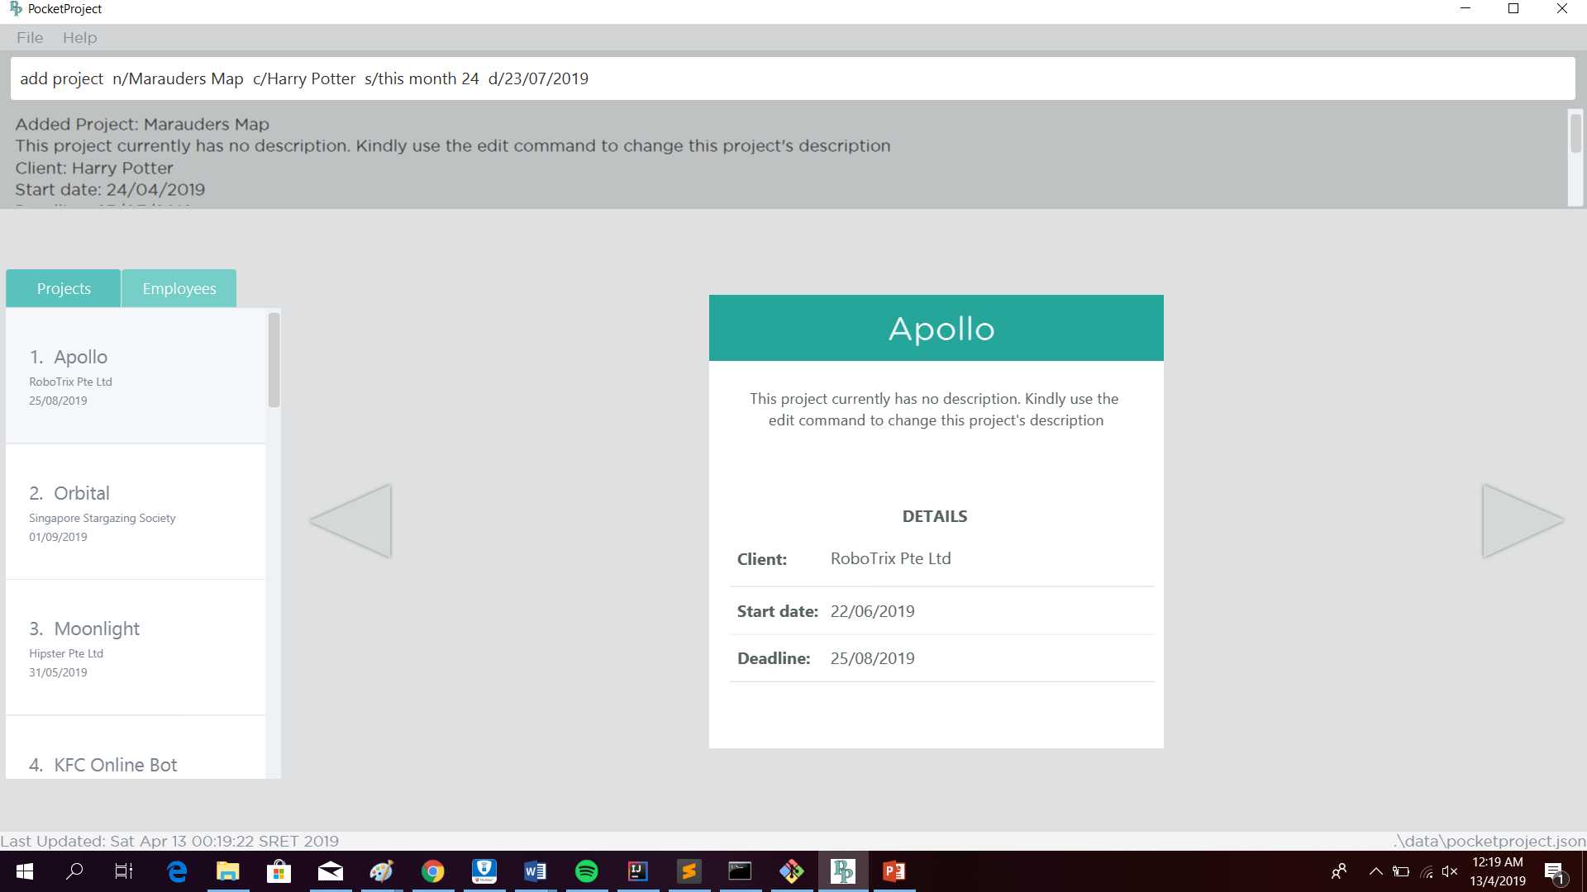


Assuming current date is 12 April 2019 (12/04/2019), Friday
1. User has targeted the current month’s 24th day as the start date of the project.
Example 1:
this month DAY_OF_MONTH
2. The input gets automatically translated to the target date in DD/MM/YYYY format.
1. User has targeted next month’s 17th day as the start date of the project.
Example 2:
next month DAY_OF_MONTH
2. The input gets automatically translated to the target date in DD/MM/YYYY format.
1. User has targeted last month’s 6th day as the start date of the project.
Example 3:
last month DAY_OF_MONTH
2. The input gets automatically translated to the target date in DD/MM/YYYY format.

