Slide 1
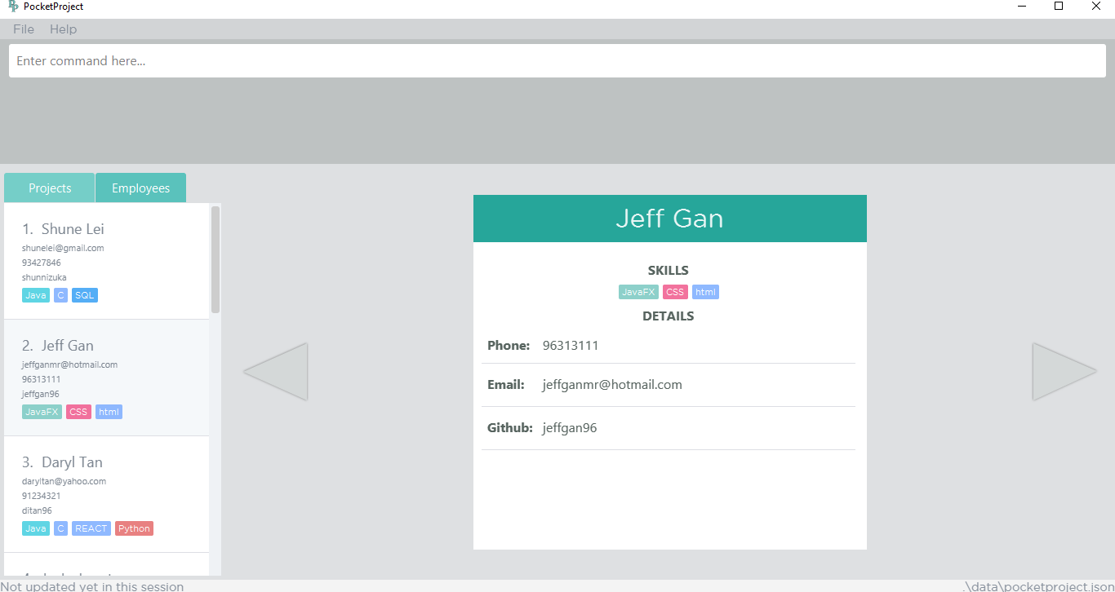
1
2
3
5
4
4

Slide 2
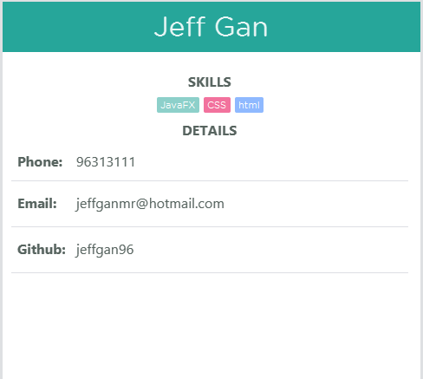
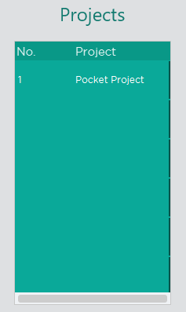
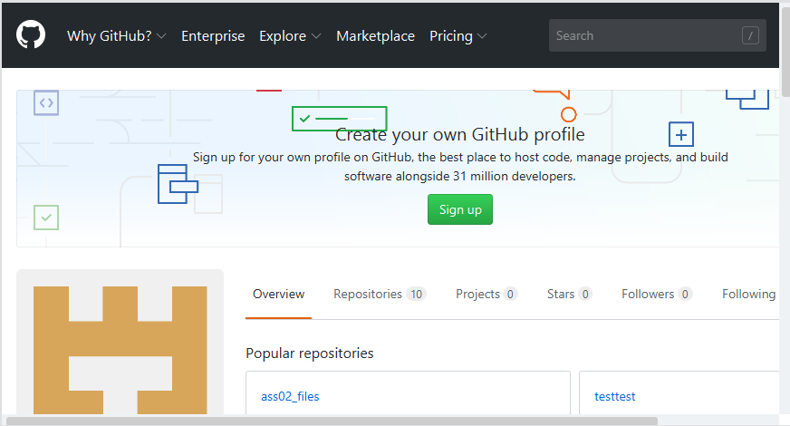
1
2
3

Slide 3
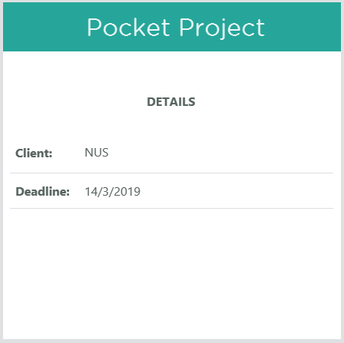
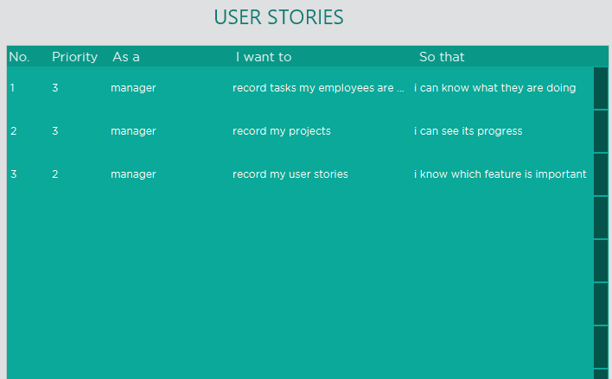
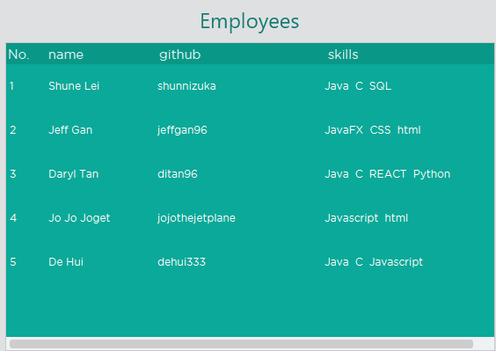
1
2
3

Slide 4
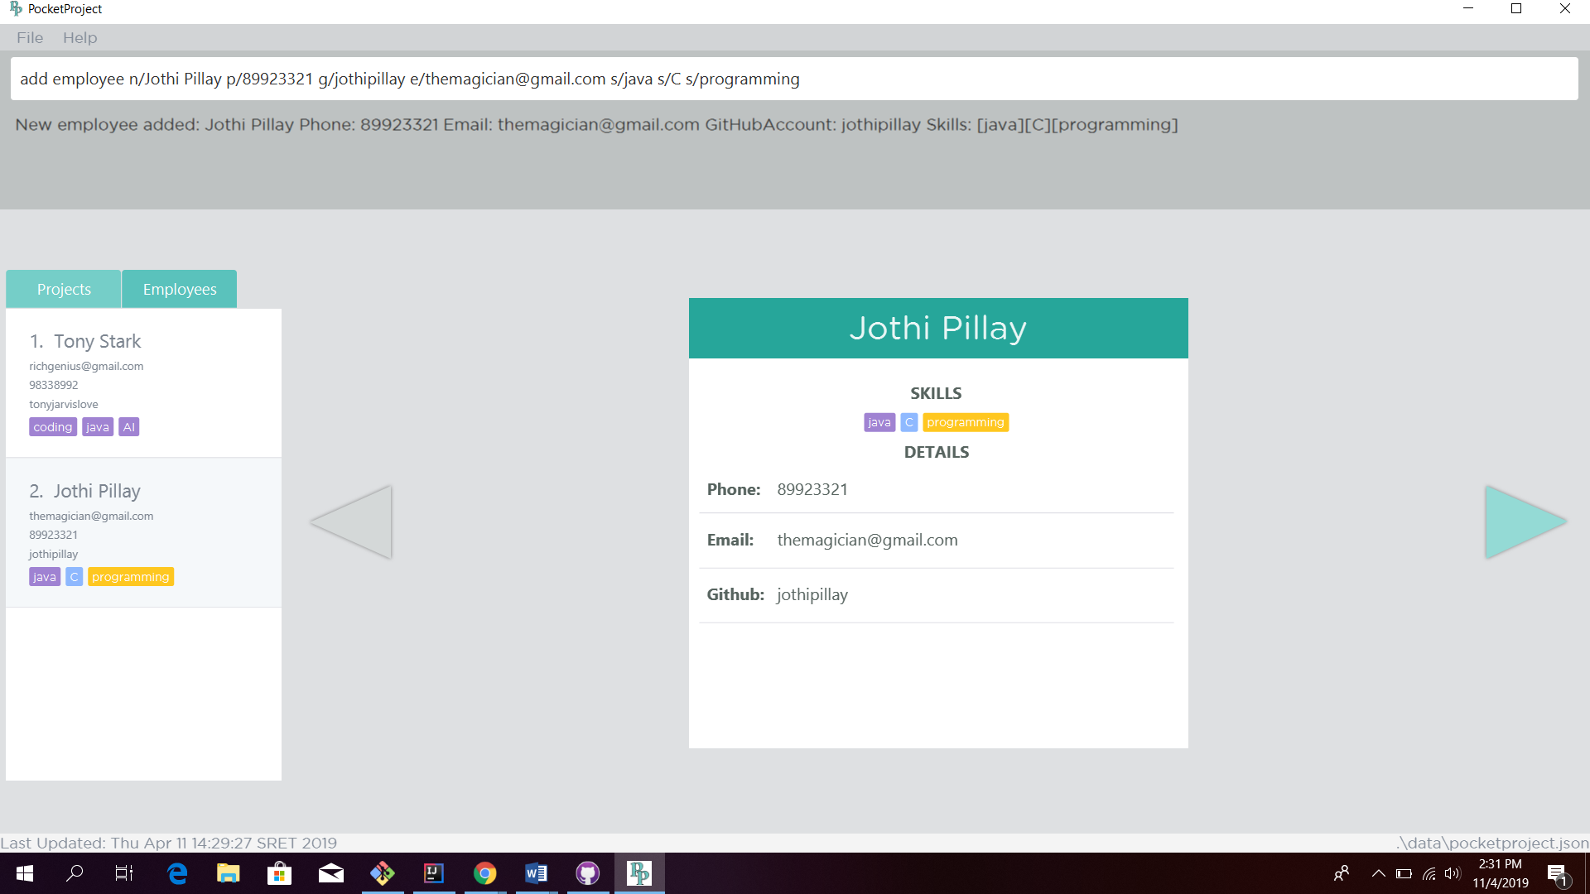
1. Type the command to add an employee
2. The details of the added employee will be indicated as a success message
3. Panel will display the newly added employee. Clicking on it will display the employee card.
5. Toggling the arrow leads to a loaded GitHub page of the employee based on his GitHub account username.
4. The employee card which contains key details of the employee.

Slide 5
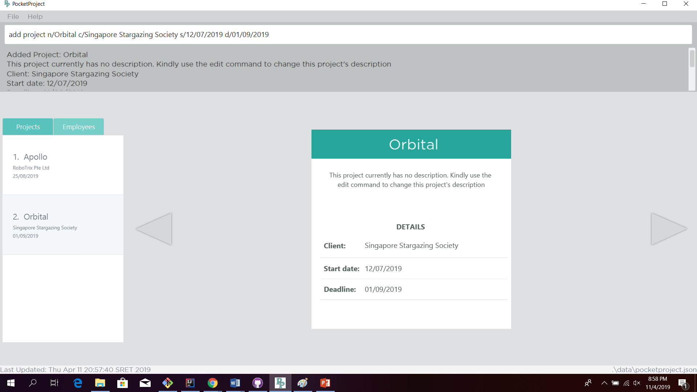
1. Type the command to add a project
2. The details of the added project will be indicated as a success message.
5. The project is created with a default description. The description has to be edited using the edit project command
3. Panel will display the newly added project. Clicking on it will display the project card.
4. The project card which contains key initial details of the project.

