Slide 1
Preparing for the interview
Notes:
Before you prepare for the interview, it’s useful to understand how most
organizations decide what they are looking for in a candidate, and how they
use this to choose the questions they ask at the interview. It can also be
helpful to know how the selection procedure works, why employers
conduct interviews and what’s likely to happen at the average interview.

Slide 2
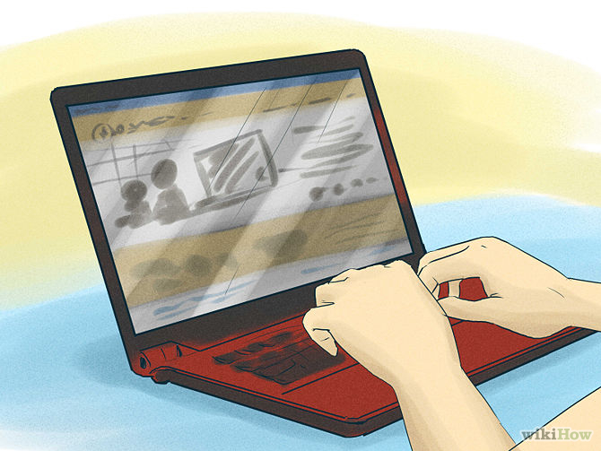
Research
Notes:
Research the company's profile and background.
Before you go on a job interview, it's important to find out as much as you can about the company. Company research is a critical part of interview preparation.
Start by looking into their future goals and plans, you can visit the company's website, their annual report, and newspaper/business magazine articles to gather as much information as possible. All these information will be useful when handling questions and you may ask questions regarding some of the recent news to show that you have done research on their company.
Imagine going on a date with someone who says they’ve always longed to meet you, are absolutely fascinated by you and are really enthusiastic about future dates. Yet, when you question them, they know absolutely nothing about you and don’t seem particularly interested in finding out, either. Would you think them genuine, or a total sham? Well, companies can be just as sensitive.
The more senior the position, the more they’ll expect you to know, but at any level industry knowledge wins you gold stars at interview. A good grounding in company background also helps your confidence and enhances your performance.

Slide 3


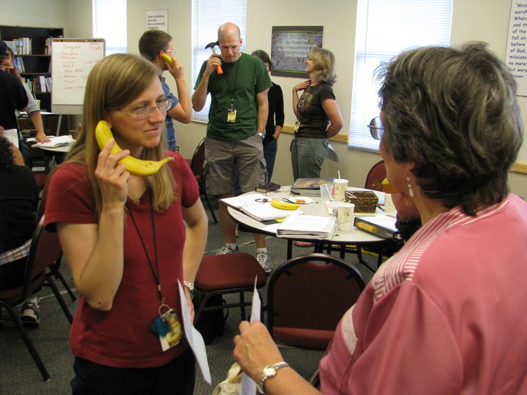
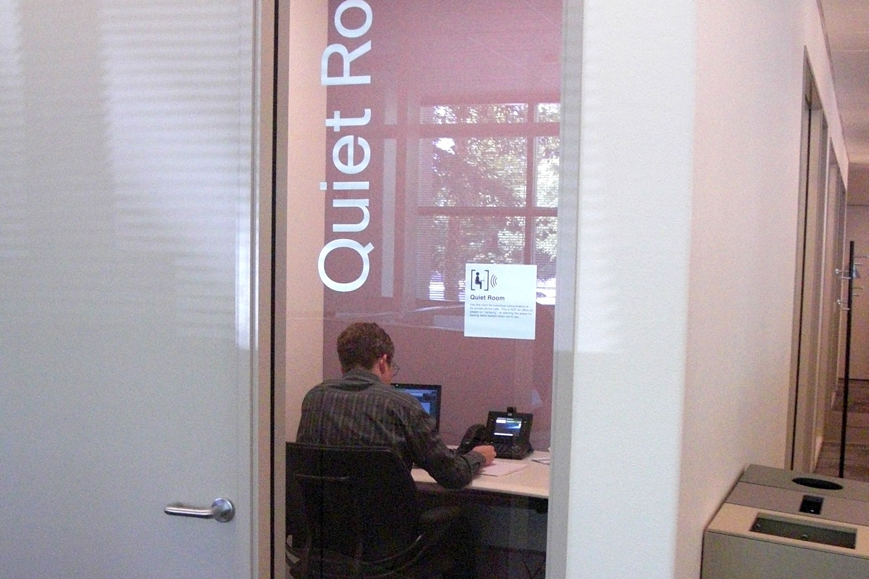
Phone interview
Confirm the Interview
Choose an Interview Space
Phone Interview Etiquette
Practice Interviewing
Battery life
Notes:
Confirm the Interview
Before the call, confirm all the details including the date, time and who you will be talking to. Be sure you know whether the interviewer is calling you or if you need to make the call.
Choose an Interview Space
Use a quiet, comfortable, and private space. If you're at home, kick out kids, spouses, significant others, parents, pets and anyone else who is in the house and close the door.
Use Proper Phone Interview Etiquette
Use the interviewer's title during the conversation (Mr. or Ms. and their last name.). Only use a first name if they ask you to. Otherwise, use the formal title.
Listen to the interviewer and don't interrupt. If you have something you want to say, jot it down on your note pad and mention it when it's your turn to talk.
If you need a few seconds to gather your thoughts, don't worry, but don't leave too much dead air. If you need the interviewer to repeat the question, ask.
Practice Interviewing
Talking on the phone isn't as easy as it seems. I've always found it's helpful to practice. Have a friend or family member conduct a mock interview and tape record it so you can see how you sound over the phone. Any cassette recorder will work. You'll be able to hear your "ums" and "uhs" and "okays" and you can practice reducing them from your conversational speech. Also rehearse answers to those typical questions you'll be asked.

Slide 4

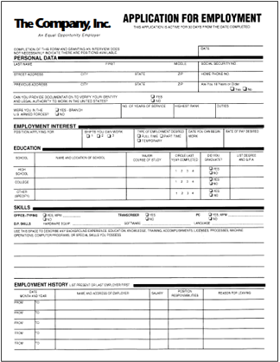
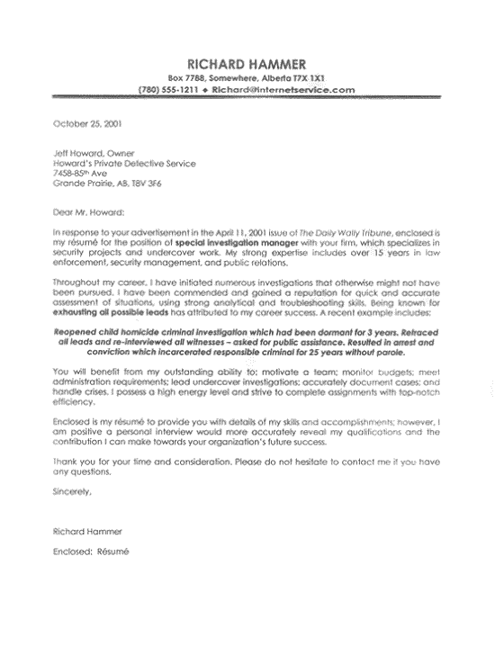


What to take with you
Curriculum Vitae/ Resume
Application form
Cover letter
Portfolio
Certificates
Testimonials

Slide 5
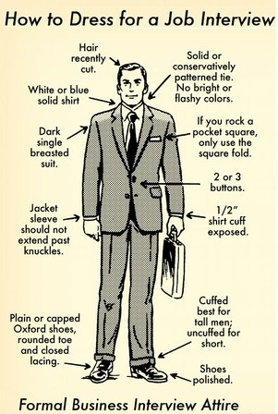

Dress code
Sparse makeup
Clean and professional
hair style
Mild or no fragrance
Suit
Knee length skirt
Knee length skirt

Slide 6








Dress code
DEPENDS!

