Slide 1
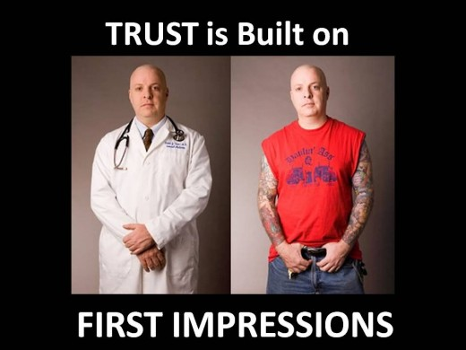
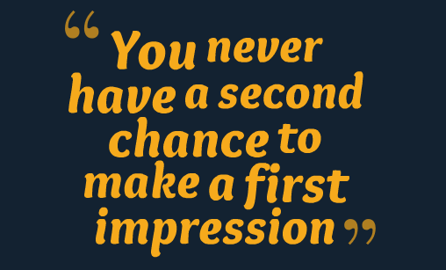
Why making a good impression is important?
Notes:
Unless you can travel back in time like x-men but it’s nearly impossible right now.

Slide 2


Phone interview
Personal interview

Slide 3

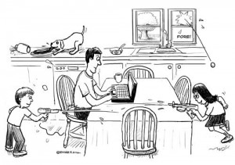
During phone interview
Eliminate distractions

Slide 4

During phone interview
Take notes

Slide 5


During phone interview
Focus, listen and enunciate

Slide 6

During phone interview
Be all smiles

Slide 7


During phone interview
Maintain a professional attitude

Slide 8
Effective communication
use of words
Use of body language
Use of tone of voice
Notes:
Ask audience about % of those
7% - use of words
38% use of tone of voice
55%- use of body language
As per Albert Mehrabian (born 1939 in an Armenian family in Iran), currently Professor Emeritus of Psychology

Slide 9




Before personal interview
Show up on time
Bring only the essentials, have everything neat, organized and accessible
Be nice to a receptionist
Do a Pre-Interview Body check, put phone away

Slide 10

During personal interview

Slide 11

Dress appropriately
Check with human resources of the company

Slide 12
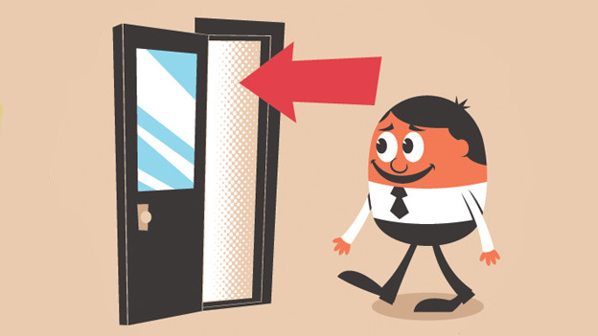
Entering confidently

Slide 13

Handshake and eye contact

Slide 14
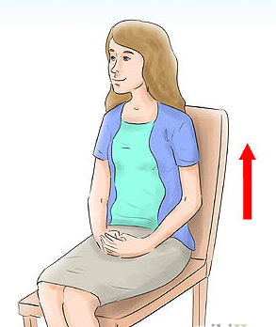

Posture and gesture

Slide 15
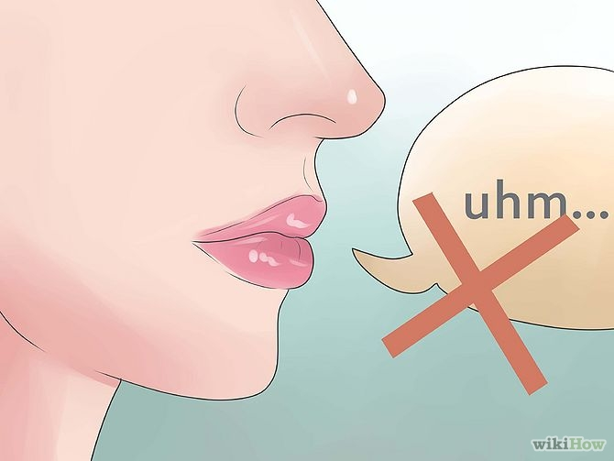

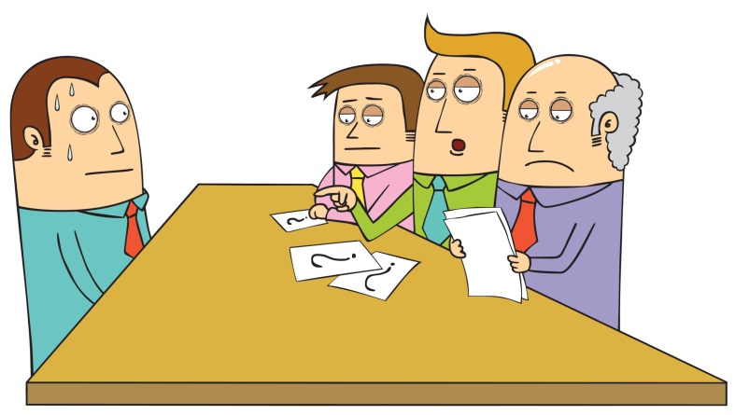
Speak clearly and confidently
Match the frequency

Slide 16
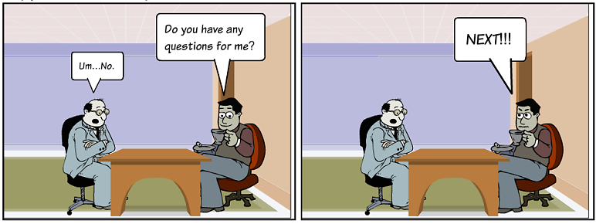

Ask questions and thanks to interviewer

