Slide 1

Task catalyst
Oral Presentation 2 – Software Demo
Notes:
NOTE: Want a different image on this slide? Select the picture and delete it. Now click the Pictures icon in the placeholder to insert your own image.

Slide 2
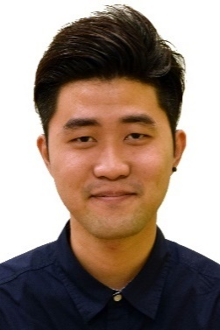
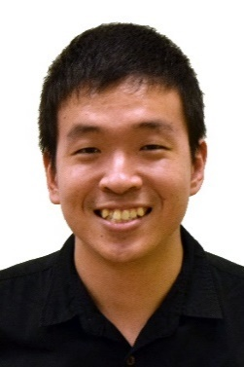
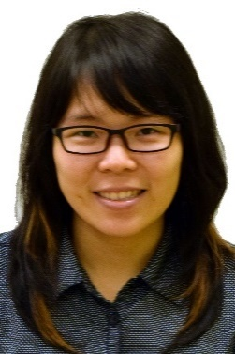
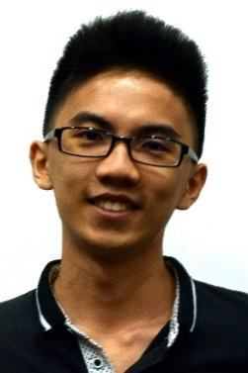
Introduction
Zhen Yu
Kelvin
Thida
Wei Jie
Introduction
Functionalities of the system
Software Demonstration
Software Demonstration

Slide 3
Target Audience

Slide 4
SOFTWARE DEMONSTRATION

