Slide 1
Schedule – 9 weeks
Do
Check
Release
Plan

Slide 2
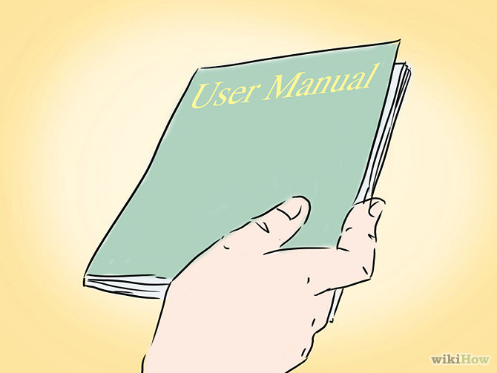
Week 5
Project manual

Slide 3
Week 6
Week 7
Code skeleton, GUI
Welcome to Task Catalyst
Buy coffee for meeting
Create
Write Reports
Remove
Meeting at 9am
Read
Help colleague’s work
Update
Printing reports
Text Here|

Slide 4

Week 8
Major improvement for the product
Add some more new features
Notes:
.

Slide 5


Week 9
Update project manual
Improve code stability
Notes:
On week 9, we shall make some necessary updates on the project manual and that’ll be our final project manual. Here, we shall also add more security to our codes.

Slide 6

Week 10
Week 11
Do systematic Testing

Slide 7

Week 12
Beta version of the product

Slide 8

Week 13
Release final product

Slide 9

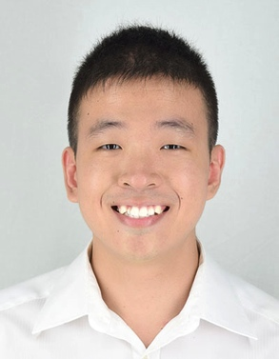


Team Members
Kelvin
Wei Jie
Thida

Slide 10
Thank You

