Slide 1
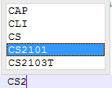
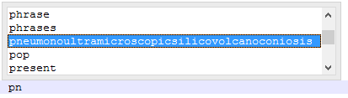
Extra Functionalities(Advanced)
Autocomplete & autocorrect

Slide 2
Extra Functionalities(Advanced)
Encryption
password for locker 323324
password for locker ******

Slide 3


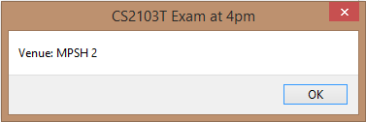
Extra Functionalities(Advanced)
Notification / Alarm

Slide 4

Extra Functionalities(Advanced)
Regular Expression search
IS\d
IS, followed by a digit

