Slide 1
Algorithms – I (CS29003/203)
Autumn 2022, IIT Kharagpur
Graphs

Slide 2
Resources
Apart from the book
UC Riverside, CS 141 course, Fall 2021 by Prof. Yan Gu and Prof. Yihan Sun
Stanford University, CS 161 course, Winter 2022 by Prof. Moses Charikar and Prof. Nima Anari

Slide 3
Minimum Spanning Tree
For today we will focus on connected graphs. Say we have an undirected weighted graph
A spanning tree is a tree that connects all of the vertices
8
7
B
C
D
4
9
2
11
4
A
I
14
E
7
6
8
10
1
2
H
G
F
Source: Stanford, CS 161 course, Winter 2022

Slide 4
Minimum Spanning Tree
For today we will focus on connected graphs. Say we have an undirected weighted graph
A spanning tree is a tree that connects all of the vertices
The cost of a spanning tree is the sum of the weights on the edges
8
7
This is a spanning tree.
B
C
D
It has cost 67
4
9
2
11
4
A
I
14
E
7
6
8
10
1
2
H
G
F
Source: Stanford, CS 161 course, Winter 2022

Slide 5
Minimum Spanning Tree
For today we will focus on connected graphs. Say we have an undirected weighted graph
A spanning tree is a tree that connects all of the vertices
8
7
This is also a spanning tree.
B
C
D
It has cost 37
4
9
2
11
4
A
I
14
E
7
6
8
10
1
2
H
G
F
Source: Stanford, CS 161 course, Winter 2022

Slide 6
Minimum Spanning Tree
For today we will focus on connected graphs. Say we have an undirected weighted graph
A spanning tree is a tree that connects all of the vertices
8
7
B
C
D
4
9
2
11
4
A
I
14
E
7
6
8
10
1
2
H
G
F
minimum
of minimum cost
Source: Stanford, CS 161 course, Winter 2022

Slide 7
Minimum Spanning Tree
For today we will focus on connected graphs. Say we have an undirected weighted graph
A spanning tree is a tree that connects all of the vertices
This is a minimum spanning tree
8
7
It has cost 37
B
C
D
4
9
2
11
4
A
I
14
E
7
6
8
10
1
2
H
G
F
minimum
of minimum cost
Source: Stanford, CS 161 course, Winter 2022

Slide 8
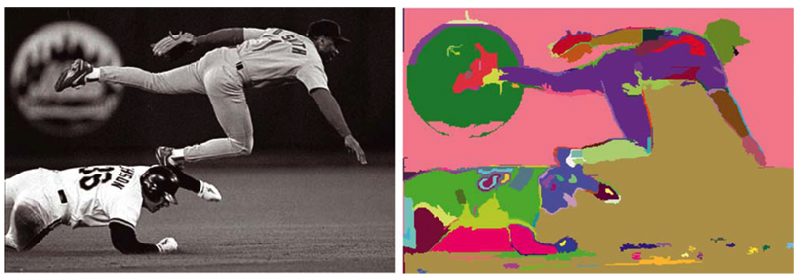
Why Minimum Spanning Trees
Network Design
Connecting cities with roads/electricity/telephone/…
Cluster analysis
e.g., genetic distance
Image processing
e.g., image segmentation
Useful primitive
for other graph algorithms
Ref: Felzenswalb et. Al., Efficient graph-based image segmentation, IJCV 2004

Slide 9
How to find Minimum Spanning Trees
We will see two greedy algorithms
Start growing a tree, greedily add the shortest edge we can to grow the tree
8
7
B
C
D
4
9
2
11
4
A
I
14
E
7
6
8
10
1
2
H
G
F
Source: Stanford, CS 161 course, Winter 2022

Slide 10
How to find Minimum Spanning Trees
We will see two greedy algorithms
Start growing a tree, greedily add the shortest edge we can to grow the tree
8
7
B
C
D
4
9
2
11
4
A
I
14
E
7
6
8
10
1
2
H
G
F
Source: Stanford, CS 161 course, Winter 2022

Slide 11
How to find Minimum Spanning Trees
We will see two greedy algorithms
Start growing a tree, greedily add the shortest edge we can to grow the tree
8
7
B
C
D
4
9
2
11
4
A
I
14
E
7
6
8
10
1
2
H
G
F
Source: Stanford, CS 161 course, Winter 2022

Slide 12
How to find Minimum Spanning Trees
We will see two greedy algorithms
Start growing a tree, greedily add the shortest edge we can to grow the tree
8
7
B
C
D
4
9
2
11
4
A
I
14
E
7
6
8
10
1
2
H
G
F
Source: Stanford, CS 161 course, Winter 2022

Slide 13
How to find Minimum Spanning Trees
We will see two greedy algorithms
Start growing a tree, greedily add the shortest edge we can to grow the tree
8
7
B
C
D
4
9
2
11
4
A
I
14
E
7
6
8
10
1
2
H
G
F
Source: Stanford, CS 161 course, Winter 2022

Slide 14
How to find Minimum Spanning Trees
We will see two greedy algorithms
Start growing a tree, greedily add the shortest edge we can to grow the tree
8
7
B
C
D
4
9
2
11
4
A
I
14
E
7
6
8
10
1
2
H
G
F
Source: Stanford, CS 161 course, Winter 2022

Slide 15
How to find Minimum Spanning Trees
We will see two greedy algorithms
Start growing a tree, greedily add the shortest edge we can to grow the tree
8
7
B
C
D
4
9
2
11
4
A
I
14
E
7
6
8
10
1
2
H
G
F
Source: Stanford, CS 161 course, Winter 2022

Slide 16
How to find Minimum Spanning Trees
We will see two greedy algorithms
Start growing a tree, greedily add the shortest edge we can to grow the tree
8
7
B
C
D
4
9
2
11
4
A
I
14
E
7
6
8
10
1
2
H
G
F

Slide 17
How to find Minimum Spanning Trees
We will see two greedy algorithms
Start growing a tree, greedily add the shortest edge we can to grow the tree
8
7
B
C
D
4
9
2
11
4
A
I
14
E
7
6
8
10
1
2
H
G
F
Source: Stanford, CS 161 course, Winter 2022

Slide 18
How to find Minimum Spanning Trees
We will see two greedy algorithms
Start growing a tree, greedily add the shortest edge we can to grow the tree
8
7
B
C
D
4
9
2
11
4
A
I
14
E
❌
7
6
8
❌
10
1
2
H
G
F

Slide 19
How to find Minimum Spanning Trees
We will see two greedy algorithms
Start growing a tree, greedily add the shortest edge we can to grow the tree
8
7
B
C
D
4
9
2
11
4
A
I
14
E
7
6
8
10
1
2
H
G
F
Source: Stanford, CS 161 course, Winter 2022

Slide 20
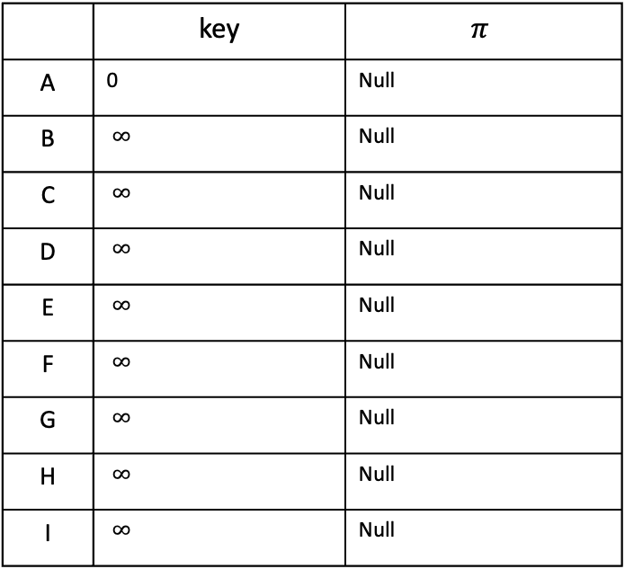
How to find Minimum Spanning Trees
B
8
C
7
D
 | key | $$π$$
A | 0 | Null
B | $∞$ | Null
C | $∞$ | Null
D | $∞$ | Null
E | $∞$ | Null
F | $∞$ | Null
G | $∞$ | Null
H | $∞$ | Null
I | $∞$ | Null
4
9
2
11
4
A
I
14
E
8
7
6
10
H
1
G
2
F

Slide 21
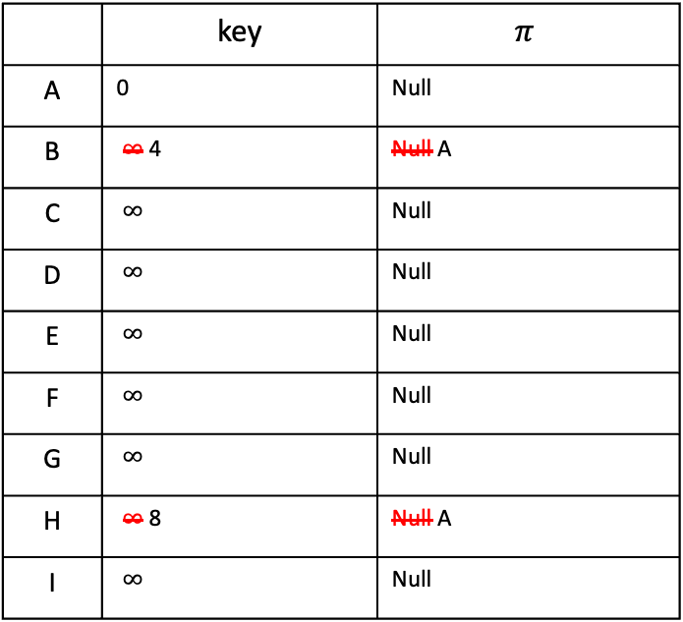
How to find Minimum Spanning Trees
B
8
C
7
D
 | key | $$π$$
A | 0 | Null
B | $∞$ 4 | Null A
C | $∞$ | Null
D | $∞$ | Null
E | $∞$ | Null
F | $∞$ | Null
G | $∞$ | Null
H | $∞$ 8 | Null A
I | $∞$ | Null
4
9
✅
2
11
4
A
I
14
E
8
7
6
10
H
1
G
2
F
Now $A$ is out
Also, $AB$ is the greedy choice. So, I shall first update the neighbors of $B$ and I shall not consider $B$ again
Note that $A$’s neighbors are already in updated state in the priority queue

Slide 22
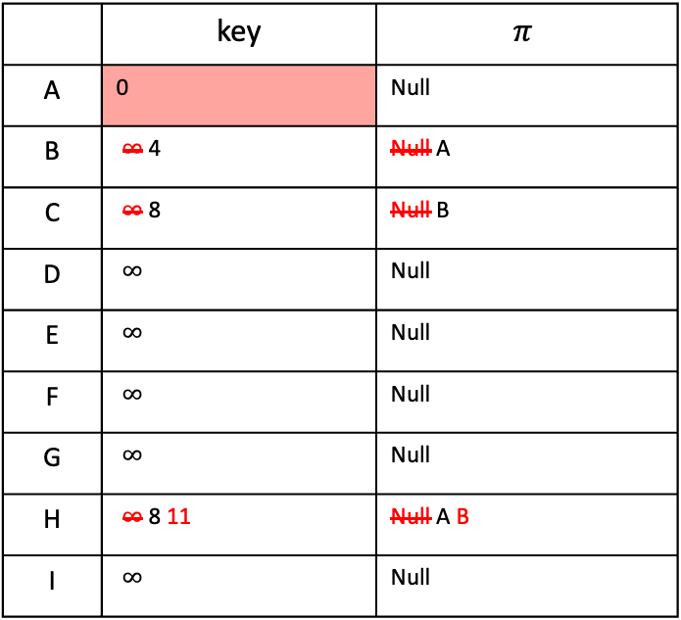
How to find Minimum Spanning Trees
B
8
C
7
D
 | key | $$π$$
A | 0 | Null
B | $∞$ 4 | Null A
C | $∞$ 8 | Null B
D | $∞$ | Null
E | $∞$ | Null
F | $∞$ | Null
G | $∞$ | Null
H | $∞$ 8 11 | Null A B
I | $∞$ | Null
4
9
✅
2
11
4
✅
A
I
14
E
8
7
6
10
H
1
G
2
F
Now $A$ is out
Also, $AB$ is the greedy choice. So, I shall first update the neighbors of $B$ and I shall not consider $B$ again
Note that $A$’s neighbors are already in updated state in the priority queue

Slide 23
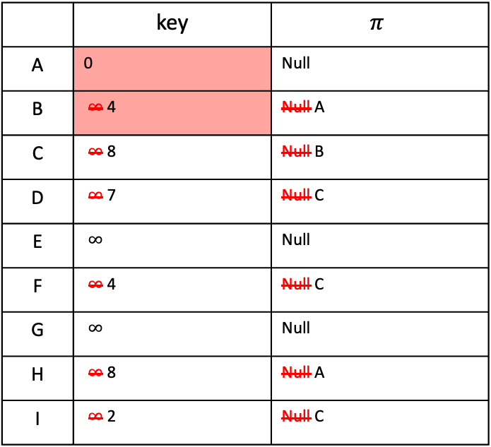
How to find Minimum Spanning Trees
B
8
C
7
D
 | key | $$π$$
A | 0 | Null
B | $∞$ 4 | Null A
C | $∞$ 8 | Null B
D | $∞$ 7 | Null C
E | $∞$ | Null
F | $∞$ 4 | Null C
G | $∞$ | Null
H | $∞$ 8 | Null A
I | $∞$ 2 | Null C
4
9
✅
2
11
4
✅
A
I
14
E
✅
8
7
6
10
H
1
G
2
F
Now $B$ is out
Also, $BC$ is the greedy choice. So, I shall first update the neighbors of $C$ and I shall not consider $C$ again

Slide 24
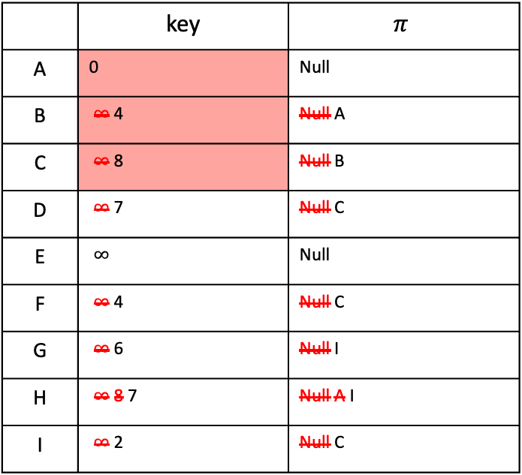
How to find Minimum Spanning Trees
B
8
C
7
D
 | key | $$π$$
A | 0 | Null
B | $∞$ 4 | Null A
C | $∞$ 8 | Null B
D | $∞$ 7 | Null C
E | $∞$ | Null
F | $∞$ 4 | Null C
G | $∞$ 6 | Null I
H | $∞$ 8 7 | Null A I
I | $∞$ 2 | Null C
4
9
✅
2
11
4
✅
A
I
14
E
✅
8
7
6
10
H
1
G
2
F
✅
Now $C$ is out
Also, $CI$ is the greedy choice. So, I shall first update the neighbors of $I$ and I shall not consider $I$ again

Slide 25
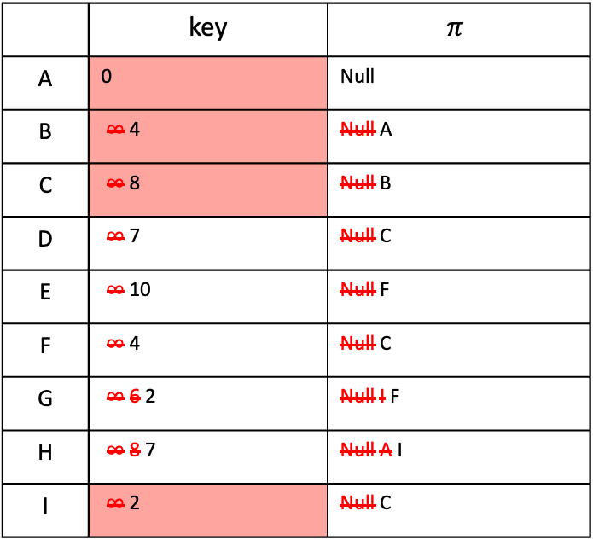
How to find Minimum Spanning Trees
B
8
C
7
D
 | key | $$π$$
A | 0 | Null
B | $∞$ 4 | Null A
C | $∞$ 8 | Null B
D | $∞$ 7 | Null C
E | $∞$ 10 | Null F
F | $∞$ 4 | Null C
G | $∞$ 6 2 | Null I F
H | $∞$ 8 7 | Null A I
I | $∞$ 2 | Null C
4
9
✅
2
11
4
✅
A
I
14
E
✅
8
7
6
10
H
1
G
2
F
✅
✅
Now $I$ is out
Also, $CF$ is the greedy choice. So, I shall first update the neighbors of $F$ and I shall not consider $F$ again

Slide 26

How to find Minimum Spanning Trees
B
8
C
7
D
 | key | $$π$$
A | 0 | Null
B | $∞$ 4 | Null A
C | $∞$ 8 | Null B
D | $∞$ 7 | Null C
E | $∞$ 10 | Null F
F | $∞$ 4 | Null C
G | $∞$ 6 2 | Null I F
H | $∞$ 8 7 1 | Null A I G
I | $∞$ 2 | Null C
4
9
✅
2
11
4
✅
A
I
14
E
✅
8
7
6
10
H
1
G
2
F
✅
✅
✅
Now $F$ is out
Also, $FG$ is the greedy choice. So, I shall first update the neighbors of $G$ and I shall not consider $G$ again

Slide 27
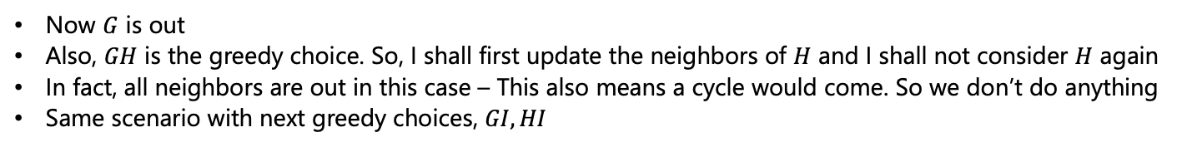
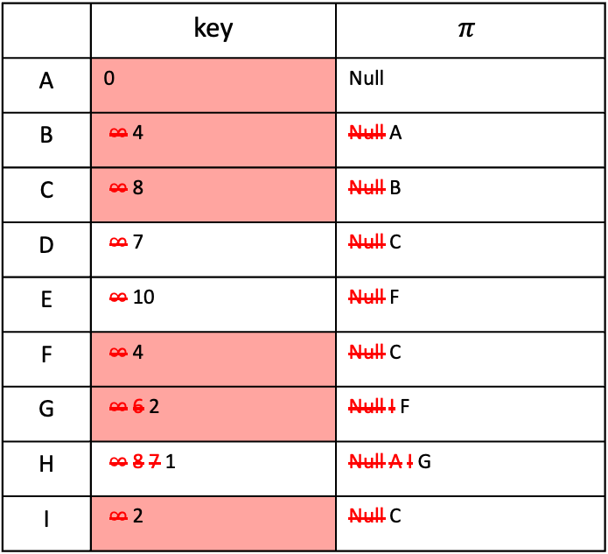
How to find Minimum Spanning Trees
B
8
C
7
D
 | key | $$π$$
A | 0 | Null
B | $∞$ 4 | Null A
C | $∞$ 8 | Null B
D | $∞$ 7 | Null C
E | $∞$ 10 | Null F
F | $∞$ 4 | Null C
G | $∞$ 6 2 | Null I F
H | $∞$ 8 7 1 | Null A I G
I | $∞$ 2 | Null C
4
9
✅
2
11
4
✅
A
I
14
E
✅
8
7
6
10
H
1
G
2
F
✅
✅
✅
✅
Now $G$ is out
Also, $GH$ is the greedy choice. So, I shall first update the neighbors of $H$ and I shall not consider $H$ again
In fact, all neighbors are out in this case – This also means a cycle would come. So we don’t do anything
Same scenario with next greedy choices, $GI, HI$

Slide 28
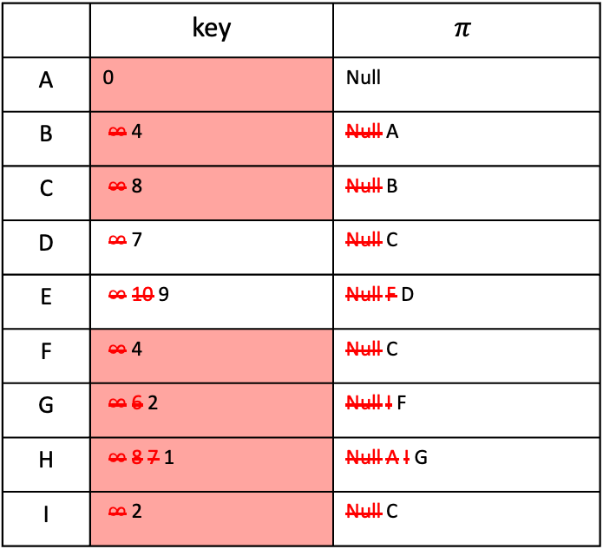
How to find Minimum Spanning Trees
B
8
C
7
D
 | key | $$π$$
A | 0 | Null
B | $∞$ 4 | Null A
C | $∞$ 8 | Null B
D | $∞$ 7 | Null C
E | $∞$ 10 9 | Null F D
F | $∞$ 4 | Null C
G | $∞$ 6 2 | Null I F
H | $∞$ 8 7 1 | Null A I G
I | $∞$ 2 | Null C
4
9
✅
2
11
4
✅
A
I
14
E
✅
8
7
6
10
✅
H
1
G
2
F
✅
✅
✅
✅
Our next greedy choice is $CD$. So, I shall first update the neighbors of $D$ and I shall not consider $D$ again

Slide 29
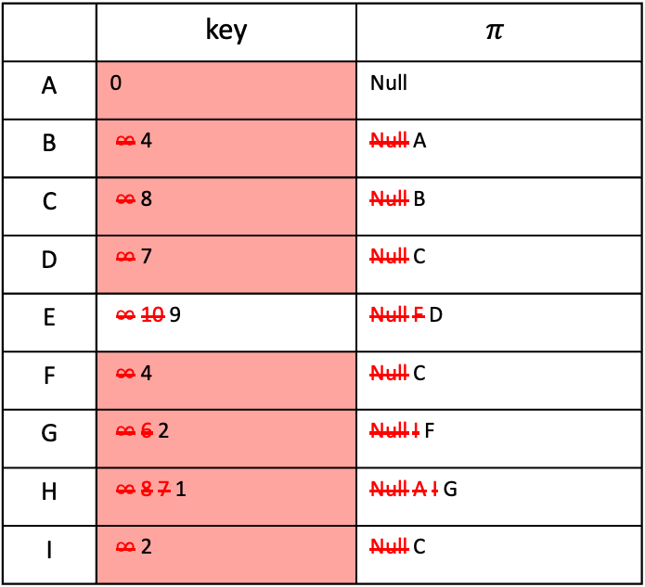
How to find Minimum Spanning Trees
B
8
C
7
D
 | key | $$π$$
A | 0 | Null
B | $∞$ 4 | Null A
C | $∞$ 8 | Null B
D | $∞$ 7 | Null C
E | $∞$ 10 9 | Null F D
F | $∞$ 4 | Null C
G | $∞$ 6 2 | Null I F
H | $∞$ 8 7 1 | Null A I G
I | $∞$ 2 | Null C
4
9
✅
2
11
4
✅
A
I
14
E
✅
8
7
6
10
✅
H
1
G
2
F
✅
✅
✅
✅
✅
Our next greedy choice is $DE$. However, $E$’s neighbors are already updated
Note choosing DE is not completing any cycle, but exploring its neighbors can
Now the priority queue is empty, so we stop

Slide 30
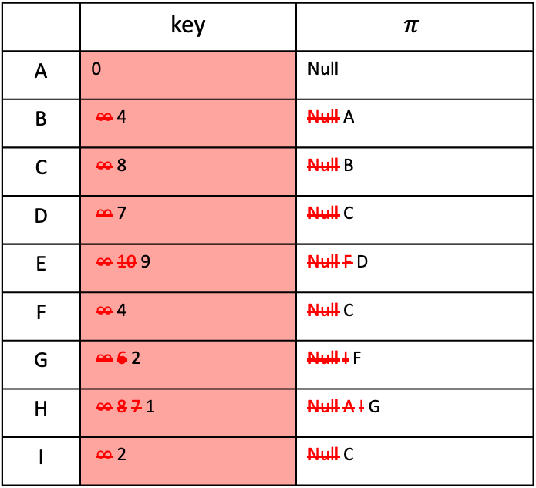
How to find Minimum Spanning Trees
B
8
C
7
D
 | key | $$π$$
A | 0 | Null
B | $∞$ 4 | Null A
C | $∞$ 8 | Null B
D | $∞$ 7 | Null C
E | $∞$ 10 9 | Null F D
F | $∞$ 4 | Null C
G | $∞$ 6 2 | Null I F
H | $∞$ 8 7 1 | Null A I G
I | $∞$ 2 | Null C
4
9
✅
2
11
4
✅
A
I
14
E
✅
8
7
6
10
✅
H
1
G
2
F
✅
✅
✅
✅
✅
Our next greedy choice is $DE$. However, $E$’s neighbors are already updated
Note choosing DE is not completing any cycle, but exploring its neighbors can
Now the priority queue is empty, so we stop

Slide 31
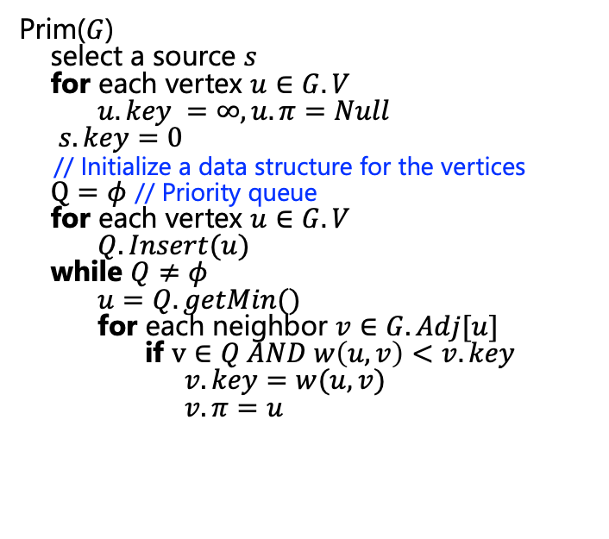
How to find Minimum Spanning Trees
8
7
Prim($G$)
select a source $s$
for each vertex $u∈G.V$
$u.key =∞, u.π=Null$
$s.key=0$
// Initialize a data structure for the vertices
$Q=φ$ // Priority queue
for each vertex $u∈G.V$
$Q.Insert(u)$
while $Q≠φ$
$u=Q.getMin()$
for each neighbor $v∈G.Adj[u]$
if $v∈Q AND w\left(u,v\right)<v.key$
$v.key=w(u,v)$
$v.π=u$
B
C
D
4
9
2
11
4
A
I
14
E
8
7
6
10
H
1
G
2
F

Slide 32
Brief Aside
A cut is a partition of the vertices into two parts
8
7
B
C
D
4
9
2
11
4
A
I
14
E
7
6
8
10
1
2
H
G
F
This is the cut “{A,B,D,E} and {C,I,H,G,F}”
Source: Stanford, CS 161 course, Winter 2022

Slide 33
Cuts in Graphs
This is not a cut. Cuts are partitions of vertices
8
7
B
C
D
4
9
2
11
4
A
I
14
E
7
6
8
10
1
2
H
G
F
Source: Stanford, CS 161 course, Winter 2022

Slide 34
Let S be a set of edges in G
We say a cut respects S if no edges in S cross the cut
An edge crossing a cut is called light if it has the smallest weight of any edge crossing the cut
8
B
C
D
7
4
9
2
11
4
A
I
14
E
7
6
8
10
1
2
H
G
F
S is the set of thick orange edges
Source: Stanford, CS 161 course, Winter 2022

Slide 35
Let S be a set of edges in G
We say a cut respects S if no edges in S cross the cut
An edge crossing a cut is called light if it has the smallest weight of any edge crossing the cut
This edge is light
8
B
C
D
7
4
9
2
11
4
A
I
14
E
7
6
8
10
1
2
H
G
F
S is the set of thick orange edges
Source: Stanford, CS 161 course, Winter 2022

Slide 36
Lemma
Let S be a set of edges, and consider a cut that respects S
Suppose there is an MST containing S
Let {u,v} be a light edge
Then there is an MST containing S ∪ {{u,v}}
This edge is light
B
8
C
D
7
4
9
2
11
4
A
I
14
E
8
7
6
10
H
1
G
2
F
S is the set of thick orange edges
Source: Stanford, CS 161 course, Winter 2022

Slide 37
Lemma
Let S be a set of edges, and consider a cut that respects S
Suppose there is an MST containing S
Let {u,v} be a light edge
Then there is an MST containing S ∪ {{u,v}}
It’s ”safe” to add this edge!
If we haven’t ruled out the possibility of success so far, then adding a light edge still won’t rule it out.
B
8
C
D
7
4
9
2
11
4
A
I
14
E
8
7
6
10
H
1
G
2
F
S is the set of thick orange edges
Source: Stanford, CS 161 course, Winter 2022

Slide 38
Proof of Lemma
Assume that we have:
a cut that respects S
Source: Stanford, CS 161 course, Winter 2022

Slide 39
Proof of Lemma
Assume that we have:
a cut that respects S
S is part of some MST T
Say that {u,v} is light
lowest cost crossing the cut
Source: Stanford, CS 161 course, Winter 2022

Slide 40
Proof of Lemma
Assume that we have:
a cut that respects S
S is part of some MST T
Say that {u,v} is light
lowest cost crossing the cut
If {u,v} is in T, we are done.
T is an MST containing both {u,v} and S.
u
v
Source: Stanford, CS 161 course, Winter 2022

Slide 41
Proof of Lemma
Claim: Adding any additional edge to a spanning tree will create a cycle
Proof: Both endpoints are already in the tree and connected to each other.
Assume that we have:
a cut that respects S
S is part of some MST T
Say that {u,v} is light.
lowest cost crossing the cut
Say {u,v} is not in T
Note that adding {u,v} to T will make a cycle
u
v
Source: Stanford, CS 161 course, Winter 2022

Slide 42
Proof of Lemma
Claim: Adding any additional edge to a spanning tree will create a cycle
Proof: Both endpoints are already in the tree and connected to each other.
Assume that we have:
a cut that respects S
S is part of some MST T
Say that {u,v} is light.
lowest cost crossing the cut
Say {u,v} is not in T
Note that adding {u,v} to T will make a cycle
There is at least one other edge, {x,y}, in this cycle crossing the cut
x
y
u
v
Source: Stanford, CS 161 course, Winter 2022

Slide 43
Proof of Lemma
Consider swapping {u,v} for {x,y} in T
Call the resulting tree T’
x
y
u
v
Source: Stanford, CS 161 course, Winter 2022

Slide 44
Proof of Lemma
Consider swapping {u,v} for {x,y} in T
Call the resulting tree T’
Claim: T’ is still an MST
It is still a spanning tree (why?)
It has cost at most that of T
Because {u,v} was light
T had minimal cost
So T’ does too
So T’ is an MST containing S and {u,v}
This is what we wanted
x
y
u
v
Source: Stanford, CS 161 course, Winter 2022

Slide 45
Lemma
Let S be a set of edges, and consider a cut that respects S
Suppose there is an MST containing S
Let {u,v} be a light edge
Then there is an MST containing S ∪ {{u,v}}
This edge is light
B
8
C
D
7
4
9
2
11
4
A
I
14
E
8
7
6
10
H
1
G
2
F
S is the set of thick orange edges
Source: Stanford, CS 161 course, Winter 2022

Slide 46
Partway through Prim
Assume that our choices S so far don’t rule out success
There is an MST consistent with those choices
How can we use our lemma to show that our next choice also does not rule out success?
S is the set of
edges selected so far.
8
7
B
C
D
4
9
11
2
4
A
I
14
E
8
7
6
2
10
H
G
F
1
Source: Stanford, CS 161 course, Winter 2022

Slide 47
Partway through Prim
Assume that our choices S so far don’t rule out success
There is an MST consistent with those choices
Consider the cut {visited, unvisited}
This cut respects S
S is the set of
edges selected so far.
8
7
B
C
D
4
9
11
2
4
A
I
14
E
8
7
6
2
10
H
G
F
1
Source: Stanford, CS 161 course, Winter 2022

Slide 48
Partway through Prim
Assume that our choices S so far don’t rule out success
There is an MST consistent with those choices
Consider the cut {visited, unvisited}
This cut respects S
The edge we add next is a light edge
Least weight of any edge crossing the cut
By the Lemma, that edge is safe to add
There is still an MST consistent with the new set of edges
S is the set of
edges selected so far.
8
7
B
C
D
4
9
11
2
4
A
I
14
E
8
7
6
2
10
add this one next
H
G
F
1
Source: Stanford, CS 161 course, Winter 2022

Slide 49
Partway through Prim
Our greedy choices don’t rule out success.
This is enough (along with an argument by induction) to guarantee correctness of Prim’s algorithm.
Source: Stanford, CS 161 course, Winter 2022

Slide 50
That’s not the only greedy algorithm for MST!
what if we just always take the cheapest edge?
whether or not it’s connected to what we have so far?
8
7
B
C
D
4
9
2
11
4
A
I
14
E
7
6
8
10
1
2
H
G
F
Source: Stanford, CS 161 course, Winter 2022

Slide 51
That’s not the only greedy algorithm for MST!
what if we just always take the cheapest edge?
whether or not it’s connected to what we have so far?
8
7
B
C
D
4
9
2
11
4
A
I
14
E
7
6
8
10
1
2
H
G
F
Source: Stanford, CS 161 course, Winter 2022

Slide 52
That’s not the only greedy algorithm for MST!
what if we just always take the cheapest edge?
whether or not it’s connected to what we have so far?
8
7
B
C
D
4
9
2
11
4
A
I
14
E
7
6
8
10
1
2
H
G
F
Source: Stanford, CS 161 course, Winter 2022

Slide 53
That’s not the only greedy algorithm for MST!
what if we just always take the cheapest edge?
whether or not it’s connected to what we have so far?
8
7
B
C
D
4
9
2
11
4
A
I
14
E
7
6
8
10
1
2
H
G
F
Source: Stanford, CS 161 course, Winter 2022

Slide 54
That’s not the only greedy algorithm for MST!
what if we just always take the cheapest edge?
whether or not it’s connected to what we have so far?
8
7
B
C
D
4
9
2
11
4
A
I
14
E
7
6
8
10
1
2
H
G
F
Source: Stanford, CS 161 course, Winter 2022

Slide 55
That’s not the only greedy algorithm for MST!
what if we just always take the cheapest edge?
whether or not it’s connected to what we have so far?
8
7
B
C
D
4
9
2
11
4
A
I
14
E
7
6
8
10
1
2
H
G
F
Source: Stanford, CS 161 course, Winter 2022

Slide 56
That’s not the only greedy algorithm for MST!
what if we just always take the cheapest edge?
whether or not it’s connected to what we have so far?
8
7
That won’t cause a cycle
B
C
D
4
9
2
11
4
A
I
14
E
!!!!!
7
6
8
10
1
2
H
G
F
Source: Stanford, CS 161 course, Winter 2022

Slide 57
That’s not the only greedy algorithm for MST!
what if we just always take the cheapest edge?
whether or not it’s connected to what we have so far?
8
7
That won’t cause a cycle
B
C
D
4
9
2
11
4
A
I
14
E
7
6
8
10
1
2
H
G
F
Source: Stanford, CS 161 course, Winter 2022

Slide 58
That’s not the only greedy algorithm for MST!
what if we just always take the cheapest edge?
whether or not it’s connected to what we have so far?
8
7
That won’t cause a cycle
B
C
D
4
9
2
11
4
A
I
14
E
7
6
8
10
1
2
H
G
F
Source: Stanford, CS 161 course, Winter 2022

Slide 59
That’s not the only greedy algorithm for MST!
what if we just always take the cheapest edge?
whether or not it’s connected to what we have so far?
8
7
That won’t cause a cycle
B
C
D
4
9
2
11
4
A
I
14
E
7
6
8
10
1
2
H
G
F
Source: Stanford, CS 161 course, Winter 2022

Slide 60
That’s not the only greedy algorithm for MST!
what if we just always take the cheapest edge?
whether or not it’s connected to what we have so far?
8
7
That won’t cause a cycle
B
C
D
4
9
2
11
4
A
I
14
E
7
6
8
10
1
2
H
G
F
Source: Stanford, CS 161 course, Winter 2022

Slide 61

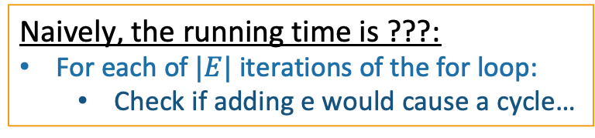
We’ve Reached Kruskal’s Algorithm
slowKruskal(G = (V,E)):
Sort the edges in E by non-decreasing weight.
MST = {}
for e in E (in sorted order):
if adding e to MST won’t cause a cycle:
add e to MST.
return MST
$|E|$ iterations through this loop
How do we check this?
How would you figure out if added e would make a cycle in this algorithm?
Naively, the running time is ???:
For each of $|E|$ iterations of the for loop:
Check if adding e would cause a cycle…
Source: Stanford, CS 161 course, Winter 2022

Slide 62
Two questions
Does it work?
That is, does it actually return a MST?
How do we actually implement this?
The pseudocode above says “slowKruskal” …
Let’s do this one first
Source: Stanford, CS 161 course, Winter 2022

Slide 63
At each step of Kruskal’s
A forest is a collection of disjoint trees
We are maintaining a forest
8
7
B
C
D
4
9
2
11
4
A
I
14
E
7
6
8
10
1
2
H
G
F
Source: Stanford, CS 161 course, Winter 2022

Slide 64
At each step of Kruskal’s
A forest is a collection of disjoint trees
We are maintaining a forest
When we add an edge, we merge two trees
8
7
B
C
D
4
9
2
11
4
A
I
14
E
7
6
8
10
1
2
H
G
F
Source: Stanford, CS 161 course, Winter 2022

Slide 65
At each step of Kruskal’s
A forest is a collection of disjoint trees
We are maintaining a forest
When we add an edge, we merge two trees
8
7
B
C
D
4
9
2
11
4
A
I
14
E
7
6
8
10
1
2
H
G
F
Source: Stanford, CS 161 course, Winter 2022

Slide 66
At each step of Kruskal’s
A forest is a collection of disjoint trees
We are maintaining a forest
When we add an edge, we merge two trees
We never add an edge within a tree since that would create a cycle
8
7
B
C
D
4
9
2
11
4
A
I
14
E
7
6
8
10
1
2
H
G
F
Source: Stanford, CS 161 course, Winter 2022

Slide 67
Keep the Trees in a Special Data Structure
“treehouse”?
Source: Stanford, CS 161 course, Winter 2022

Slide 68
Union-find Data Structure
Also called disjoint-set data structure
Used for storing collections of sets
Supports
makeSet(u): create a set {u}
find(u): return the set that u is in
union(u,v): merge the set that u is in with the set that v is in
makeSet(x)
makeSet(y)
makeSet(z)
union(x,y)
x
y
z
Source: Stanford, CS 161 course, Winter 2022

Slide 69
Union-find Data Structure
Also called disjoint-set data structure
Used for storing collections of sets
Supports
makeSet(u): create a set {u}
find(u): return the set that u is in
union(u,v): merge the set that u is in with the set that v is in
makeSet(x)
makeSet(y)
makeSet(z)
union(x,y)
x
y
z
Source: Stanford, CS 161 course, Winter 2022

Slide 70
Union-find Data Structure
Also called disjoint-set data structure
Used for storing collections of sets
Supports
makeSet(u): create a set {u}
find(u): return the set that u is in
union(u,v): merge the set that u is in with the set that v is in
makeSet(x)
makeSet(y)
makeSet(z)
union(x,y)
find(x)
x
y
z
Source: Stanford, CS 161 course, Winter 2022

Slide 71
Kruskal Pseudocode
Kruskal(G = (V,E)):
Sort the edges in E by non-decreasing weight.
MST = {} // initialize an empty tree
for v in V:
makeSet(v) // put each vertex in its own tree in the forest
for (u,v) in E: // go through the edges in sorted order
if find(u) != find(v): // if u and v are not in the same tree
add (u,v) to MST
union(u,v) // merge u’s tree with v’s tree
return MST
Source: Stanford, CS 161 course, Winter 2022

Slide 72
Once More …
To start, every vertex is in its own tree
8
7
B
C
D
4
9
2
11
4
A
I
14
E
7
6
8
10
1
2
H
G
F
Source: Stanford, CS 161 course, Winter 2022

Slide 73
Once More …
Then start merging
8
7
B
C
D
4
9
2
11
4
A
I
14
E
7
6
8
10
1
2
H
G
F
Source: Stanford, CS 161 course, Winter 2022

Slide 74
Once More …
Then start merging
8
7
B
C
D
4
9
2
11
4
A
I
14
E
7
6
8
10
1
2
H
G
F
Source: Stanford, CS 161 course, Winter 2022

Slide 75
Once More …
Then start merging
8
7
B
C
D
4
9
2
11
4
A
I
14
E
7
6
8
10
1
2
H
G
F
Source: Stanford, CS 161 course, Winter 2022

Slide 76
Once More …
Then start merging
8
7
B
C
D
4
9
2
11
4
A
I
14
E
7
6
8
10
1
2
H
G
F
Source: Stanford, CS 161 course, Winter 2022

Slide 77
Once More …
Then start merging
8
7
B
C
D
4
9
2
11
4
A
I
14
E
7
6
8
10
1
2
H
G
F
Source: Stanford, CS 161 course, Winter 2022

Slide 78
Once More …
Then start merging
8
7
B
C
D
4
9
2
11
4
A
I
14
E
7
6
8
10
1
2
H
G
F
Source: Stanford, CS 161 course, Winter 2022

Slide 79
Once More …
Then start merging
8
7
B
C
D
4
9
2
11
4
A
I
14
E
7
6
8
10
1
2
H
G
F
Source: Stanford, CS 161 course, Winter 2022

Slide 80
Once More …
Then start merging
Stop when we have one big tree!
8
7
B
C
D
4
9
2
11
4
A
I
14
E
7
6
8
10
1
2
H
G
F
Source: Stanford, CS 161 course, Winter 2022

Slide 81
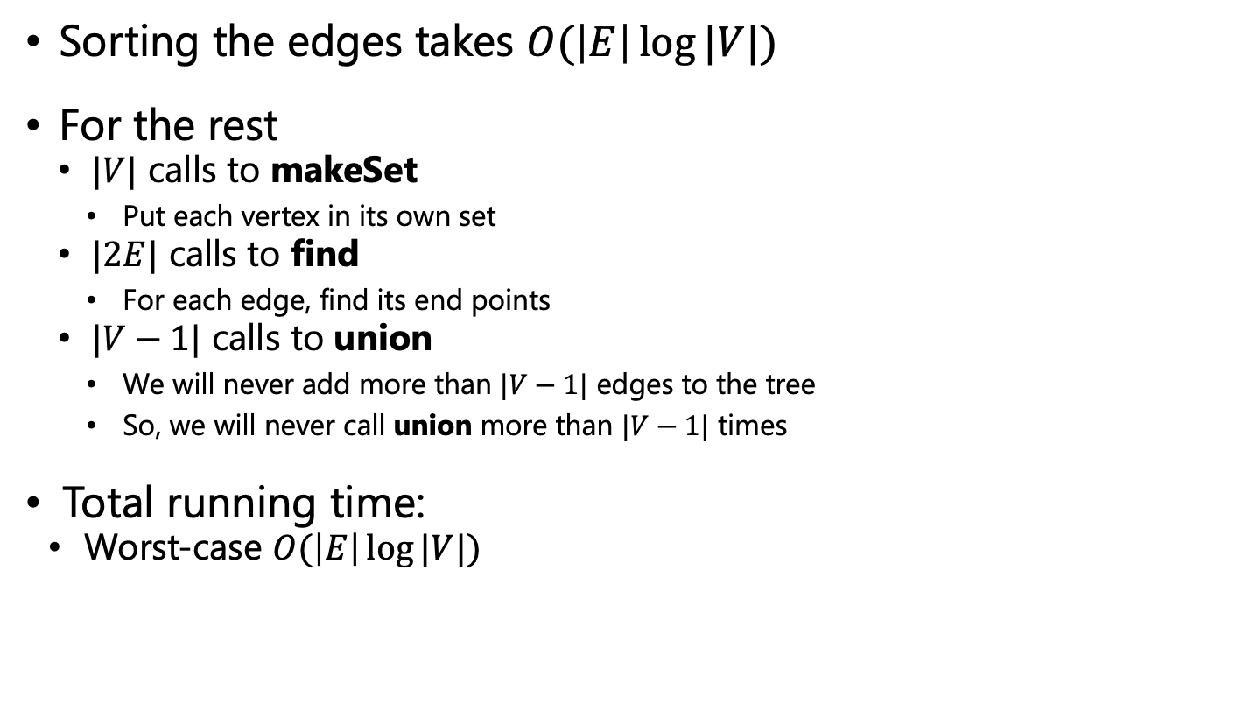
Running Time
Sorting the edges takes $O(\left|E\right|\log{|V|})$
For the rest
$|V|$ calls to makeSet
Put each vertex in its own set
$|2E|$ calls to find
For each edge, find its end points
$|V−1|$ calls to union
We will never add more than $|V−1|$ edges to the tree
So, we will never call union more than $|V−1|$ times
Total running time:
Worst-case $O(\left|E\right|\log{|V|})$
In practice, each of makeSet, find, and union run in constant time*
Notes:
O(|E|log|E|) and E=O(V^2) – So, O(2|E|log|V|) = O(|E|log|V|)

Slide 82
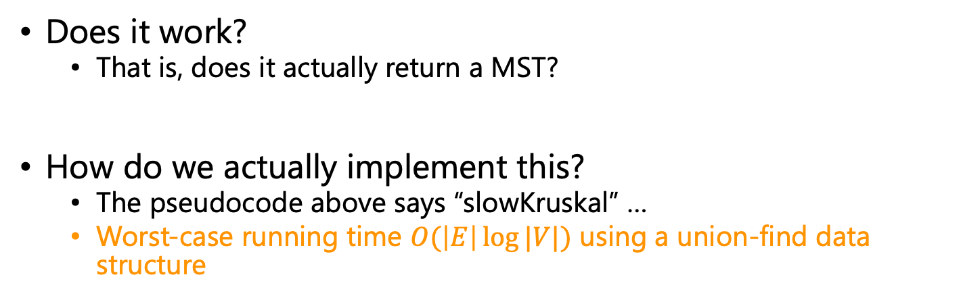
Two questions
Does it work?
That is, does it actually return a MST?
How do we actually implement this?
The pseudocode above says “slowKruskal” …
Worst-case running time $O(\left|E\right|\log{|V|})$ using a union-find data structure
Now that we understand this “tree-merging” view, let’s do this one
Source: Stanford, CS 161 course, Winter 2022

Slide 83
Does it Work?
We need to show that our greedy choices don’t rule out success
That is, at every step:
There exists an MST that contains all of the edges we have added so far
Now it is time to use our lemma!
again!
Source: Stanford, CS 161 course, Winter 2022

Slide 84
Lemma
Let S be a set of edges, and consider a cut that respects S
Suppose there is an MST containing S
Let {u,v} be a light edge
Then there is an MST containing S ∪ {{u,v}}
This edge is light
B
8
C
D
7
4
9
2
11
4
A
I
14
E
8
7
6
10
H
1
G
2
F
S is the set of thick orange edges
Source: Stanford, CS 161 course, Winter 2022

Slide 85
Partway through Kruskal
Assume that our choices S so far don’t rule out success
There is an MST extending them
S is the set of
edges selected so far.
8
7
B
C
D
4
9
2
11
4
A
I
14
E
8
7
6
10
H
1
G
2
F
Source: Stanford, CS 161 course, Winter 2022

Slide 86
Partway through Kruskal
Assume that our choices S so far don’t rule out success
There is an MST extending them
The next edge we add will merge two trees, T1, T2
Consider the cut {T1, V – T1}.
This cut respects S
Our new edge is light for the cut
By the Lemma, that edge is safe to add
There is still an MST extending the new set
This is the next edge
S is the set of
edges selected so far.
8
7
B
C
D
4
9
2
11
4
A
I
14
E
8
7
6
10
H
1
G
2
F
Source: Stanford, CS 161 course, Winter 2022

Slide 87
Partway through Kruskal
Our greedy choices don’t rule out success.
This is enough (along with an argument by induction) to guarantee correctness of Kruskal’s algorithm.
Source: Stanford, CS 161 course, Winter 2022

Slide 88
Two questions
Does it work?
That is, does it actually return a MST?
Yes
How do we actually implement this?
The pseudocode above says “slowKruskal” …
Using a union-find data structure!
Source: Stanford, CS 161 course, Winter 2022

Slide 89
Recap
Two algorithms for Minimum Spanning Tree
Prim’s algorithm
Kruskal’s algorithm
Both are greedy algorithms
Make a series of choices
Show that at each step, your choice does not rule out success
At the end of the day, you haven’t ruled out success, so you must be successful
Source: Stanford, CS 161 course, Winter 2022

Slide 90
SSSP Again
We have seen Dijkstra’s method
One drawback is that it needs non-negative edge weights
Bellman-Ford algorithm
It is a dynamic programming algorithm
It has a higher cost than Dijkstra, but can handle graphs with negative edge weights

Slide 91
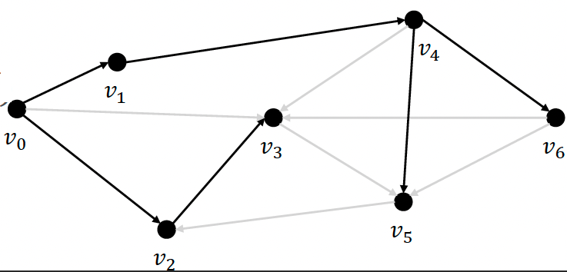
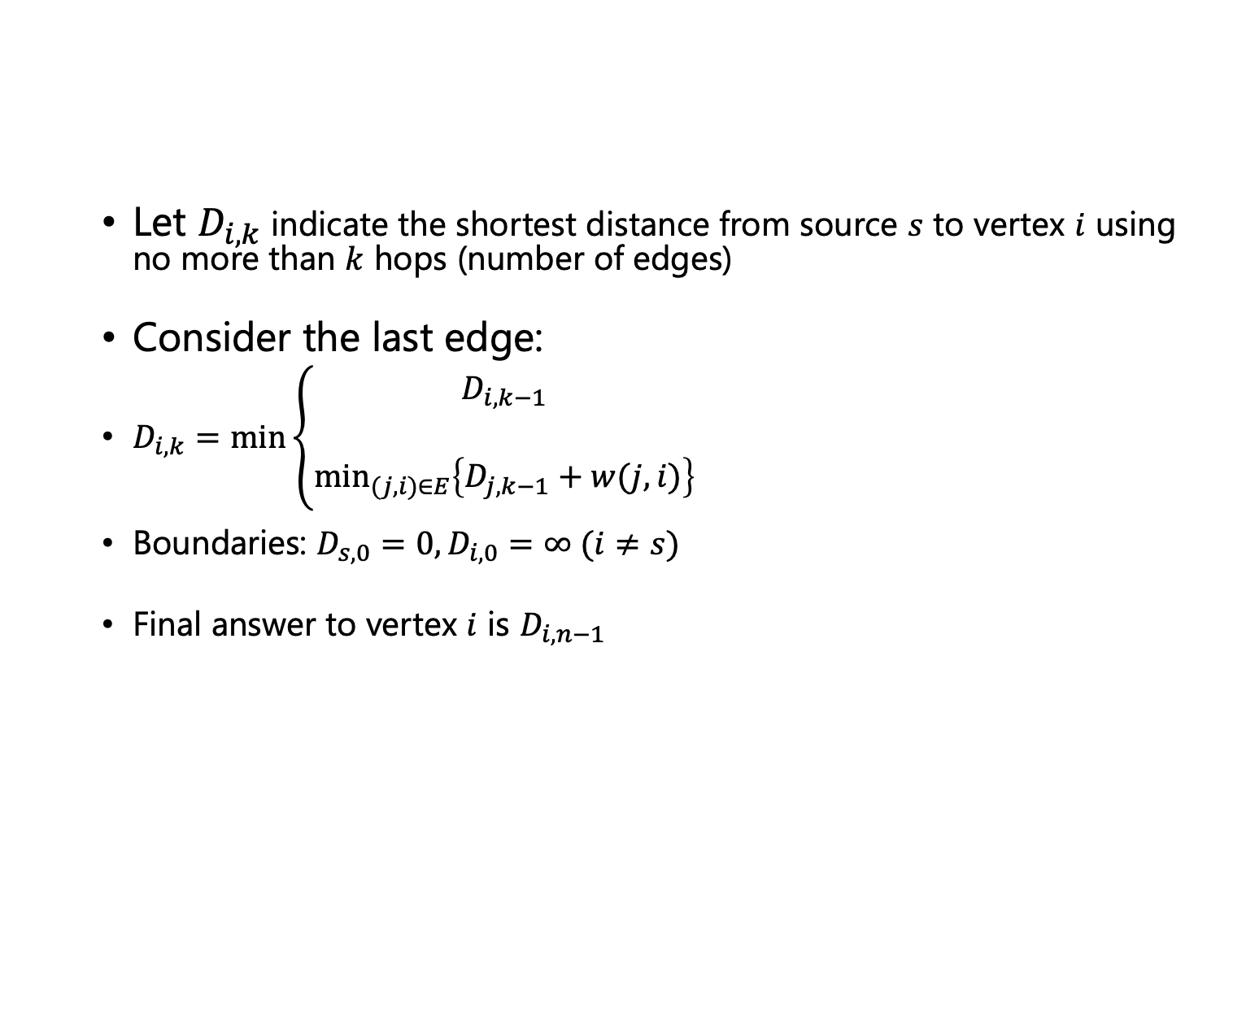
Bellman-Ford as DP
Let $D_{i,k}$ indicate the shortest distance from source $s$ to vertex $i$ using no more than $k$ hops (number of edges)
Consider the last edge:
$D_{i,k}=\min\left\{\begin{aligned}D_{i,k−1} \\ \\ \min_{(j,i)∈E}\left\{D_{j,k−1}+w(j,i)\right\}\end{aligned}\right.$
Boundaries: $D_{s,0}=0, D_{i,0}=∞ (i≠s)$
Final answer to vertex $i$ is $D_{i,n−1}$
Source: UCR, CS 141 course, Fall 2021

Slide 92
SSSP Again
5
1
2
6
-2
0
2
8
-4
-3
7
7
4
3
9

Slide 93
Thank You

