Slide 1
Algorithms – I (CS29003/203)
Autumn 2022, IIT Kharagpur
Hashing

Slide 2
Resources
Apart from the book
UC Davis ECS 36C Course by Prof. Joël Porquet-Lupine

Slide 3
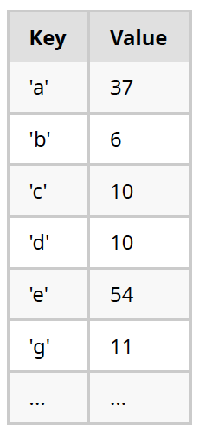
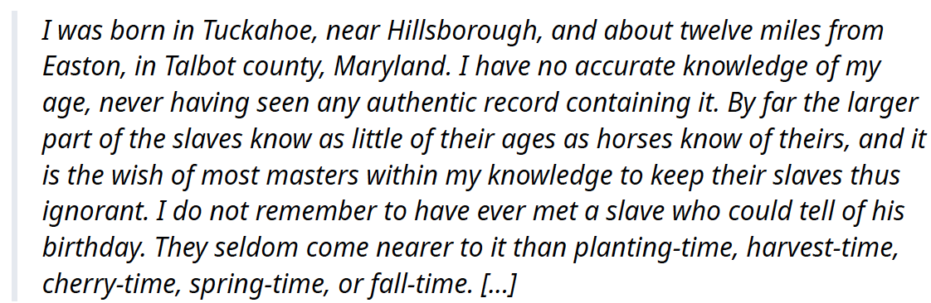
Introduction
Symbol table
Association of a value with a key
table[key] = value
Typical operations
Insert(), Remove(), Contains()/Get()
Other possible operations
Min(), Max(), Rank(), SortedList(), etc.
Example #1: frequency of letters
Compute the frequency of all the (alphabetical) characters in a text
Source: UC Davis, ECS 36C course, Spring 2020

Slide 4
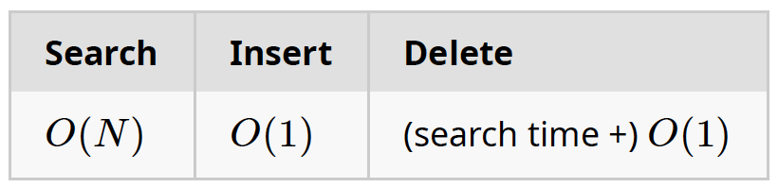
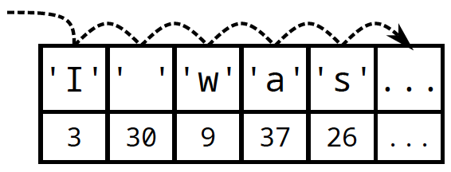
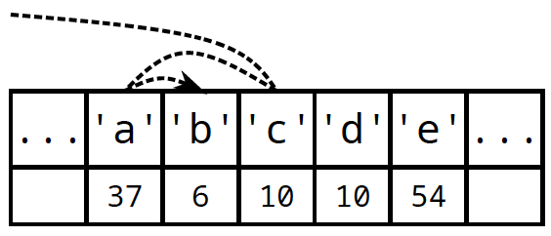
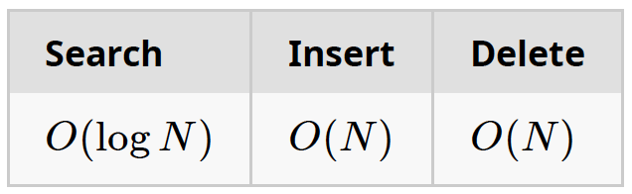
Naïve Implementations
Unordered array
Linear search: Sequentially check each item until match is found
Ordered/sorted array
Binary search: Can perform binary search to find item
Source: UC Davis, ECS 36C course, Spring 2020

Slide 5
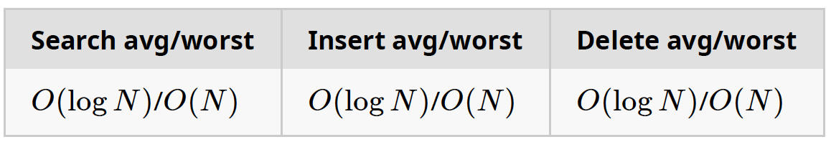
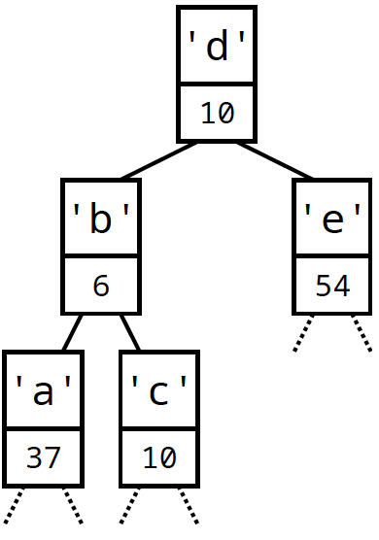
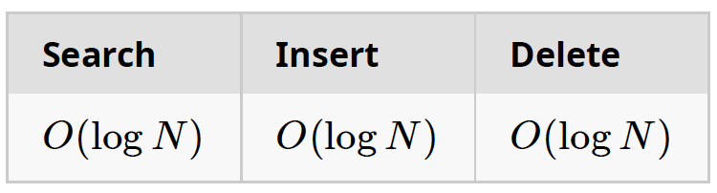
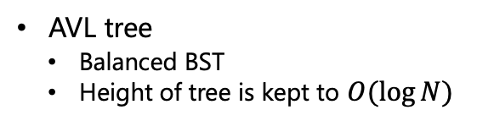
Advanced Implementations
Binary search tree: Organization of data items in BST, following certain order
Any node's key is greater than all keys in its left subtree
Any node's key is smaller than all keys in its right subtree
At most, explore height of tree
AVL tree
Balanced BST
Height of tree is kept to $O(\log{N})$
Source: UC Davis, ECS 36C course, Spring 2020

Slide 6
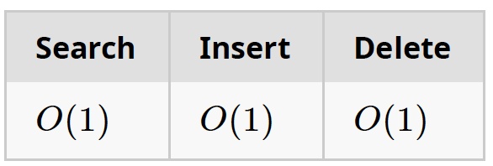
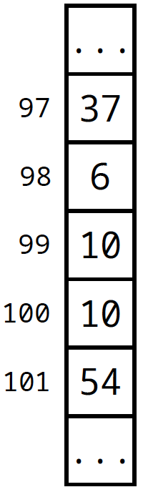
Ideal Data Structure
Can we achieve constant time on all three main operations?
Using data as index
Keys are small integers
ASCII is 128 characters
Can directly be used as index
table[key] = value
Limitations
Doesn't (efficiently) support other operations – min(),max() etc.
Wasted memory for unused keys – e.g., ASCII defines about 30 control characters
What if the key is not a small integer?
Source: UC Davis, ECS 36C course, Spring 2020

Slide 7
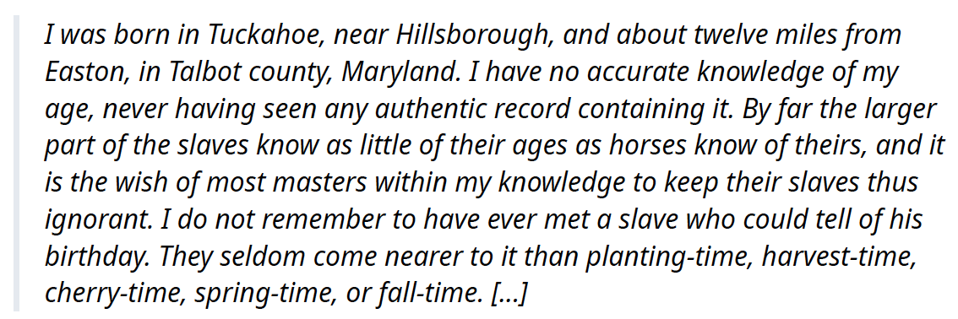
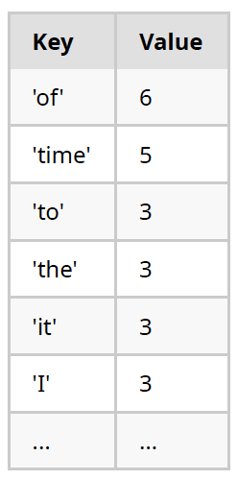
Example #2: frequency of words
Compute the frequency of all the words in a text
Issues
Very large number of words in English
Would need a huge table to index by word
int table[171476];
Cannot index an array with a string
table["time"] is not a proper C construct
Can only index arrays with an integer
Source: UC Davis, ECS 36C course, Spring 2020

Slide 8
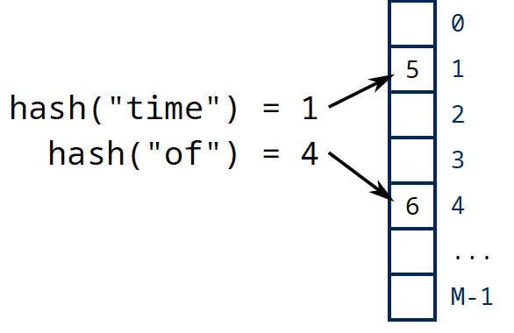
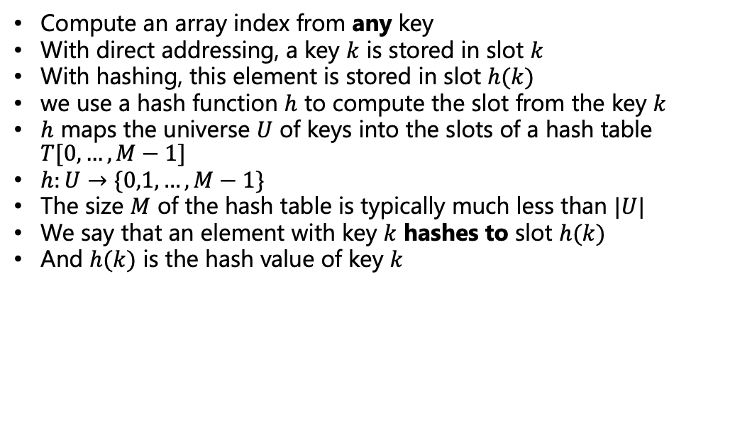
Hashing
Compute an array index from any key
With direct addressing, a key $k$ is stored in slot $k$
With hashing, this element is stored in slot $h(k)$
we use a hash function $h$ to compute the slot from the key $k$
$h$ maps the universe $U$ of keys into the slots of a hash table $T[0,…,M−1]$
$h:U→\{0,1,…,M−1\}$
The size $M$ of the hash table is typically much less than $|U|$
We say that an element with key $k$ hashes to slot $h(k)$
And $h(k)$ is the hash value of key $k$

Slide 9
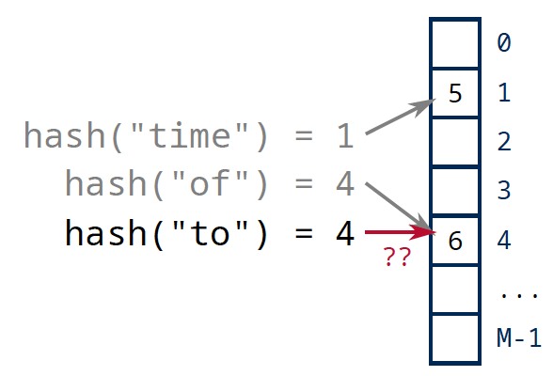
Hashing
We will see how to provide hashing for any type of key, e.g., Boolean, integers, floating-point numbers, strings, user-defined objects, etc.
Two keys may hash to the same slot. Such a situation is called a collision
How to resolve potential collisions properly?
Source: UC Davis, ECS 36C course, Spring 2020

Slide 10
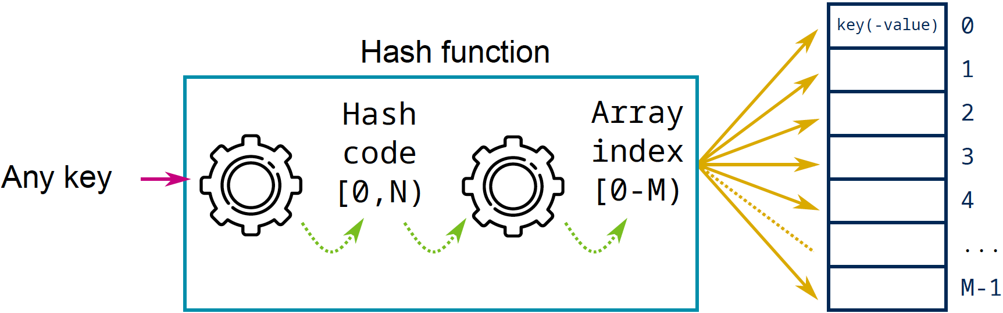
Hashing
Before going to collisions, lets discuss some hashing techniques
Required properties:
Simple to compute and fast
Hash of a key has to be deterministic
Equal keys must produce the same hash value
assert(a == b && hash(a) == hash(b));
Uniform distribution of the keys across the index range
Two implicit steps:
Transform any potentially non-integer key into an integer hash code
Reduce this hash code to an index range
Source: UC Davis, ECS 36C course, Spring 2020
Notes:
Note [0, N) has comma while [0-M) has hyphen

Slide 11

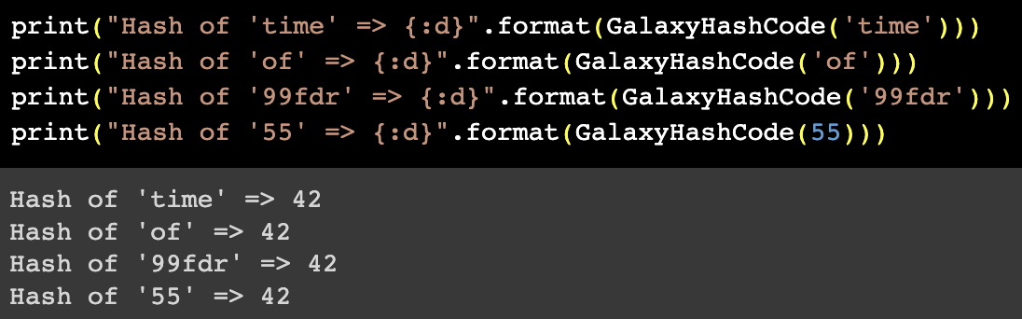
Some Pitfalls
Worse (yet functional) hash function
Problem
Can only insert one key
All the following keys will collide, regardless of their value
Solution
Need to distinguish keys by value
Source: UC Davis, ECS 36C course, Spring 2020

Slide 12
Key Subset Selection
Possible scenario
Keys are phone numbers: e.g., (530) 752-1011
Hash table is of size 1000
Idea: use first three digits as a direct index?
hash("(530) 752-1011") = 530
Problem
Phone numbers with same area code will collide
Solution
Select another set of 3 digits that shows better "random" properties (e.g., the last three)
Or consider the entire phone number instead
Source: UC Davis, ECS 36C course, Spring 2020

Slide 13
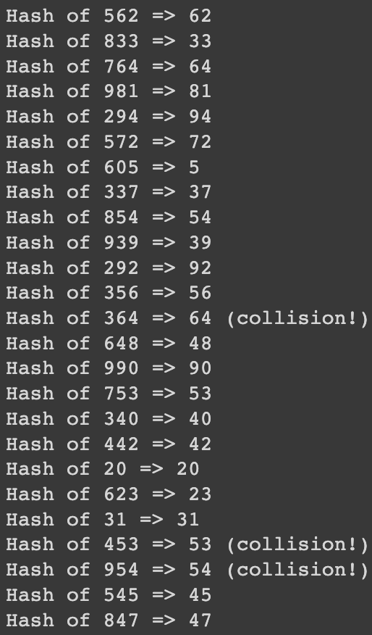

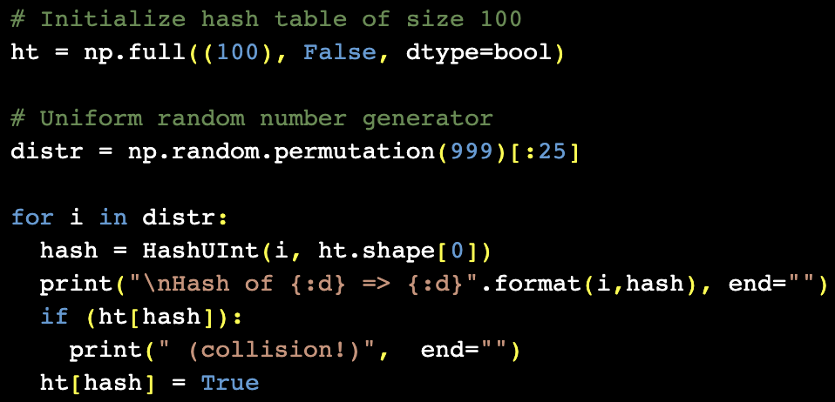
Hashing Positive Integers
Key is a simple unsigned integer in the range 0..K-1
Array index is always an unsigned integer in the range 0..M-1
Hashing is done via modulo operation
Source: UC Davis, ECS 36C course, Spring 2020

Slide 14
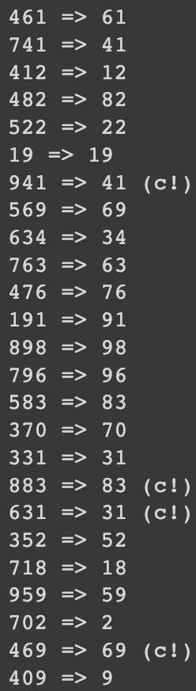
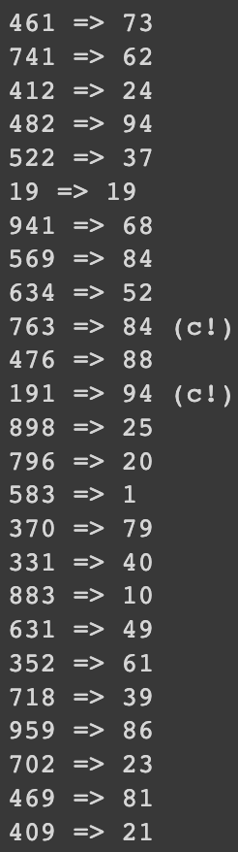
Consideration about table size (1/2)
Does the size of the hash table matter?
Same scenario as previous slide
Keys are random numbers between 0 and 999
Distribution of keys is uniform
Hashing of 25 keys
But hash table can either be of size 100 or size 97
Conclusion
Table size is not critical
If distribution of keys is uniform
100
97
Source: UC Davis, ECS 36C course, Spring 2020

Slide 15
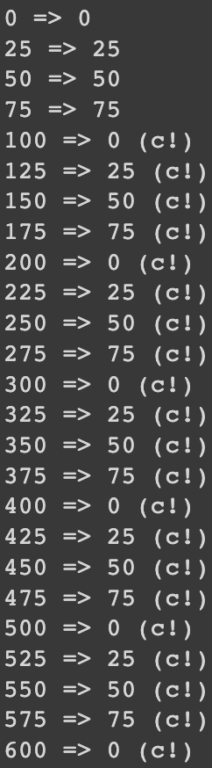
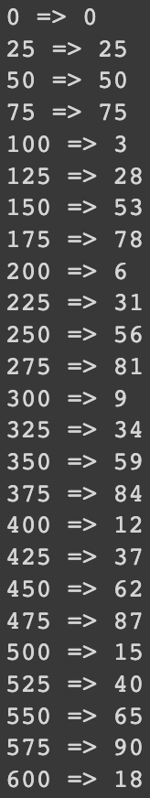
Consideration about table size (2/2)
Does the size of the hash table matter?
Same scenario as previous slide
Keys are random numbers between 0 and 999
Distribution of keys is non-uniform
Hashing of 25 keys
But hash table can either be of size 100 or size 97
Conclusion
Table size becomes critical
If distribution of keys is non-uniform
Prime numbers exhibit good properties
100
97
Source: UC Davis, ECS 36C course, Spring 2020
Notes:
100 is a multiple of 25, but 97 is not a multiple of anything

Slide 16
Thank You

