Slide 1
Algorithms – I (CS29003/203)
Autumn 2022, IIT Kharagpur
Greedy Algorithms

Slide 2
Greedy Algorithms
Greedy algorithm repeatedly makes locally best choice/decision ignoring what its effect will be in future
They are often intuitive, easy to understand and easy to implement
However the problem is that in many situations we can not solve a problem using a greedy approach
Greedy solution is not necessarily best
Sometimes greedy may also be good enough
When you can prove it

Slide 3
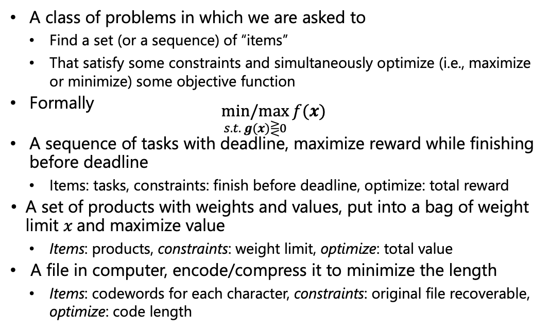
Optimization Problems
A class of problems in which we are asked to
Find a set (or a sequence) of “items”
That satisfy some constraints and simultaneously optimize (i.e., maximize or minimize) some objective function
Formally $\underset{s.t. g(x)⋛0}{min/max}{f(x)}$
A sequence of tasks with deadline, maximize reward while finishing before deadline
Items: tasks, constraints: finish before deadline, optimize: total reward
A set of products with weights and values, put into a bag of weight limit $x$and maximize value
Items: products, constraints: weight limit, optimize: total value
A file in computer, encode/compress it to minimize the length
Items: codewords for each character, constraints: original file recoverable, optimize: code length

Slide 4
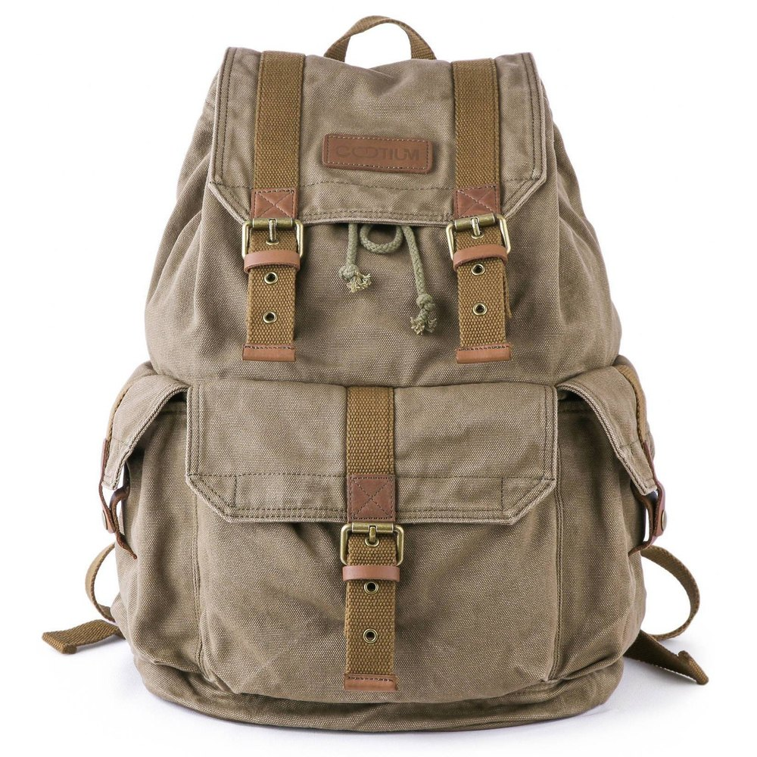
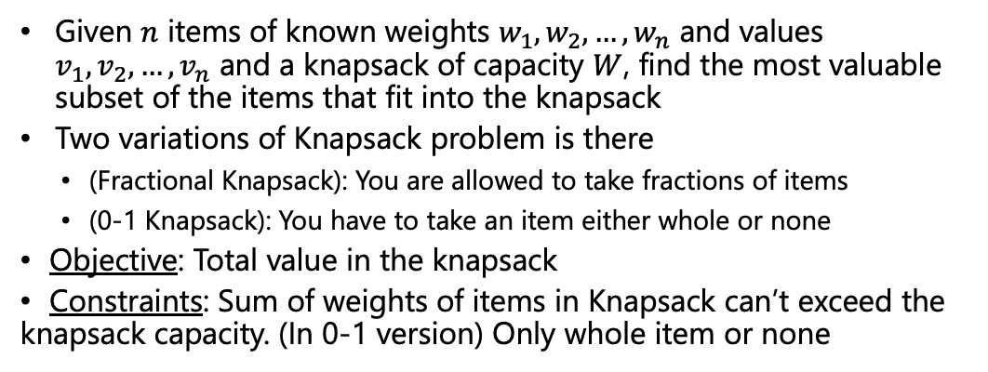
Knapsack Problem
Given $n$ items of known weights $w_{1},w_{2},…, w_{n}$ and values $v_{1},v_{2},…, v_{n}$ and a knapsack of capacity $W$, find the most valuable subset of the items that fit into the knapsack
Two variations of Knapsack problem is there
(Fractional Knapsack): You are allowed to take fractions of items
(0-1 Knapsack): You have to take an item either whole or none
Objective: Total value in the knapsack
Constraints: Sum of weights of items in Knapsack can’t exceed the knapsack capacity. (In 0-1 version) Only whole item or none
Item 3
Item 2
Item 1
30 Kg
50 Kg
20 Kg
10 Kg
Rs. 60
Rs. 100
Rs. 120
image source: www.indiamart.com

Slide 5
Knapsack Problem
Which variation of the Knapsack problem should be easy to solve?
Any simple approach to solve the fractional Knapsack problem?
Get the per unit value of the items and fill out the knapsack starting with the item highest per unit value and go on in a descending order
The total value is coming to be Rs. 240
The strategy here is literally “greedy”
It is also optimal in this case
Total value =
60+100+4*20 =
Rs. 240
4 Rs/kg
Item 3
5 Rs/kg
Item 2
6 Rs/kg
20 kg
Item 1
30 kg
50 Kg
20 kg
20 kg
10 kg
Rs. 60
Rs. 100
Rs. 120
10 kg
image source: www.indiamart.com

Slide 6
Knapsack Problem
What may come challenging sometimes is proving a greedy technique indeed gives optimal solution
For fractional knapsack its relatively easy
Intuitively: For the first 10 kg space of the knapsack we are putting the best possible option (item 1).
For the next 20 kg space we going for the best possible option available and so on
Formal proof will come later
Total value =
60+100+4*20 =
Rs. 240
4 Rs/kg
Item 3
5 Rs/kg
Item 2
6 Rs/kg
20 kg
Item 1
30 kg
50 Kg
20 kg
20 kg
10 kg
Rs. 60
Rs. 100
Rs. 120
10 kg
image source: www.indiamart.com

Slide 7
Knapsack Problem
Lets see how this strategy works for 0-1 Knapsack problem
But this is not the optimal solution. We can do better
What is the optimal solution?
Total value =
60+100 =
Rs. 160
4 Rs/kg
Item 3
5 Rs/kg
Item 2
6 Rs/kg
0 kg
Item 1
30 kg
50 Kg
20 kg
20 kg
10 kg
Rs. 60
Rs. 100
Rs. 120
10 kg
image source: www.indiamart.com

Slide 8
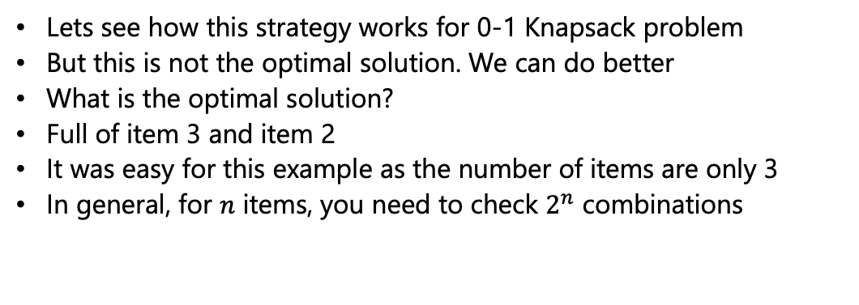
Knapsack Problem
Lets see how this strategy works for 0-1 Knapsack problem
But this is not the optimal solution. We can do better
What is the optimal solution?
Full of item 3 and item 2
It was easy for this example as the number of items are only 3
In general, for $n$ items, you need to check $2^{n}$ combinations
Total value =
120+100 =
Rs. 220
4 Rs/kg
Item 3
5 Rs/kg
Item 2
6 Rs/kg
20 kg
Item 1
30 kg
50 Kg
20 kg
10 kg
30 kg
Rs. 60
Rs. 100
Rs. 120
image source: www.indiamart.com

Slide 9
Knapsack Problem
The greedy strategy that worked for the fractional Knapsack problem, did not work for the 0-1 Knapsack problem
Lets try another greedy strategy
Starting with the item highest total value and go on in a descending order
For this instance, it gives the optimal solution
Any instance/example where this strategy fails?
Total value =
120+100 =
Rs. 220
4 Rs/kg
Item 3
5 Rs/kg
Item 2
6 Rs/kg
20 kg
Item 1
30 kg
50 Kg
20 kg
10 kg
30 kg
Rs. 60
Rs. 100
Rs. 120
image source: www.indiamart.com

Slide 10
Knapsack Problem
Add a 4th item with more weight but with slightly high value
Say a 4th item weighs 40 kg with value Rs. 130
The greedy strategy gives the solution as 40 kg of item 4 and 10 kg of item 1. The total value is Rs. 190
However, the optimal solution is 30 kg of item 1 and 20 kg of item 2. The total value is Rs. 220
Item 4
Item 3
Item 2
40 kg
Item 1
30 kg
50 Kg
20 kg
10 kg
Rs. 60
Rs. 100
Rs. 120
Rs. 130
image source: www.indiamart.com

Slide 11
Knapsack Problem
We have tried two different greedy strategies to solve 0-1 Knapsack problem. But none of them worked
Do we have any greedy strategy that works for 0-1 Knapsack problem?
To the best of our knowledge there is no known greedy strategy that works for 0-1 Knapsack problem
Later we will see other approaches to solve a 0-1 Knapsack problem
Item 4
Item 3
Item 2
40 kg
Item 1
30 kg
50 Kg
20 kg
10 kg
Rs. 60
Rs. 100
Rs. 120
Rs. 130
image source: www.indiamart.com

Slide 12
Fractional Knapsack Problem - Pseudocode
FractionalKnapsack(w, V, C, n)
Find V[i]/w[i] for all item i
Sort the items in both V[i] and w[i] by V[i]/w[i] in descending order
load = 0
for i=1 to n
if w[i] < C – load
Take whole of item i
load += w[i]
else
Take (C-load) amount of item i
Load = C
break

Slide 13
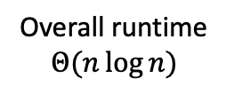
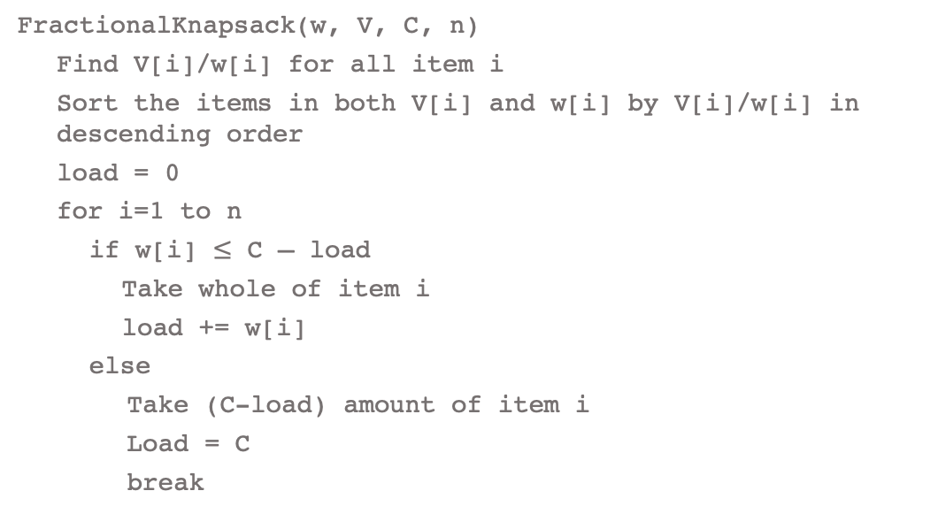




Fractional Knapsack Problem - Analysis
FractionalKnapsack(w, V, C, n)
Find V[i]/w[i] for all item i
Sort the items in both V[i] and w[i] by V[i]/w[i] in descending order
load = 0
for i=1 to n
if w[i] $≤$ C – load
Take whole of item i
load += w[i]
else
Take (C-load) amount of item i
Load = C
break
$$Θ(n)$$
$$Θ(n\log{n})$$
$$Θ(1)$$
Overall runtime
$$Θ(n\log{n})$$
$$Θ(n)$$

Slide 14
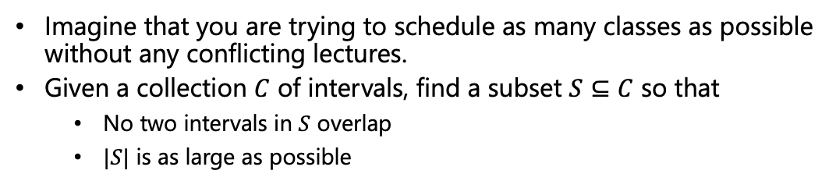
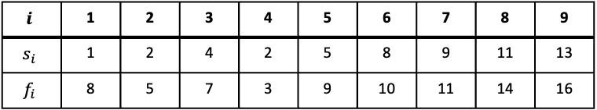
Activity Selection/Interval Scheduling Problem
Imagine that you are trying to schedule as many classes as possible without any conflicting lectures.
Given a collection $C$ of intervals, find a subset $S⊆C$ so that
No two intervals in $S$ overlap
$|S|$ is as large as possible
$$i$$ | 1 | 2 | 3 | 4 | 5 | 6 | 7 | 8 | 9
$$s_{i}$$ | 1 | 2 | 4 | 2 | 5 | 8 | 9 | 11 | 13
$$f_{i}$$ | 8 | 5 | 7 | 3 | 9 | 10 | 11 | 14 | 16
1
2
3
4
5
6
7
8
9

Slide 15
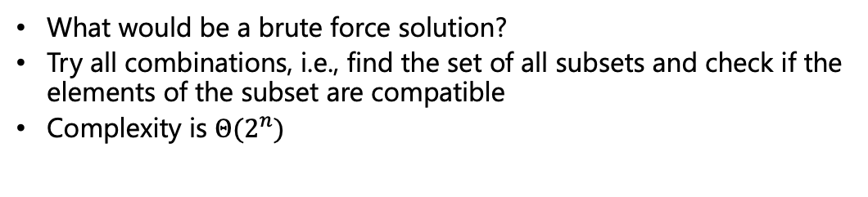
Activity Selection/Interval Scheduling Problem
What would be a brute force solution?
Try all combinations, i.e., find the set of all subsets and check if the elements of the subset are compatible
Complexity is $Θ(2^{n})$
$$i$$ | 1 | 2 | 3 | 4 | 5 | 6 | 7 | 8 | 9
$$s_{i}$$ | 1 | 2 | 4 | 2 | 5 | 8 | 9 | 11 | 13
$$f_{i}$$ | 8 | 5 | 7 | 3 | 9 | 10 | 11 | 14 | 16
1
2
3
4
5
6
7
8
9

Slide 16
Activity Selection/Interval Scheduling Problem
What can be a greedy strategy?
Remember greedy implies choosing a criterion and according to the criterion, take a decision that seems best at the moment and repeat this
What about picking the shortest duration first, then the next shortest duration and so on?
$$i$$ | 1 | 2 | 3 | 4 | 5 | 6 | 7 | 8 | 9
$$s_{i}$$ | 1 | 2 | 4 | 2 | 5 | 8 | 9 | 11 | 13
$$f_{i}$$ | 8 | 5 | 7 | 3 | 9 | 10 | 11 | 14 | 16
1
2
3
4
5
6
7
8
9

Slide 17
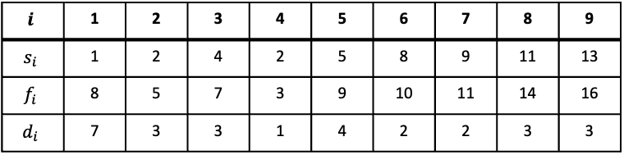
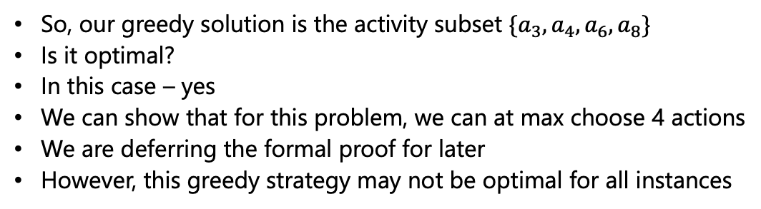
Shortest Duration
$$i$$ | 1 | 2 | 3 | 4 | 5 | 6 | 7 | 8 | 9
$$s_{i}$$ | 1 | 2 | 4 | 2 | 5 | 8 | 9 | 11 | 13
$$f_{i}$$ | 8 | 5 | 7 | 3 | 9 | 10 | 11 | 14 | 16
$$d_{i}$$ | 7 | 3 | 3 | 1 | 4 | 2 | 2 | 3 | 3
❌
❌
✅
✅
❌
✅
❌
✅
❌
So, our greedy solution is the activity subset $\{a_{3},a_{4},a_{6},a_{8}\}$
Is it optimal?
In this case – yes
We can show that for this problem, we can at max choose 4 actions
We are deferring the formal proof for later
However, this greedy strategy may not be optimal for all instances

Slide 18
Earliest Start
What about choosing by early start?
Is it optimal?
No – in general

Slide 19
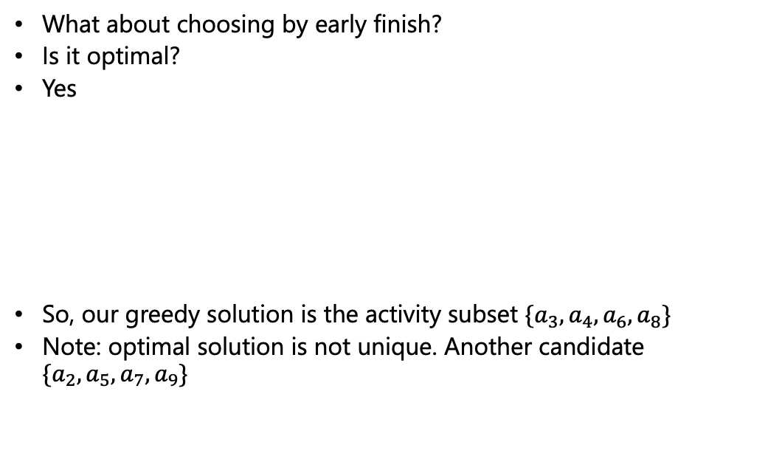
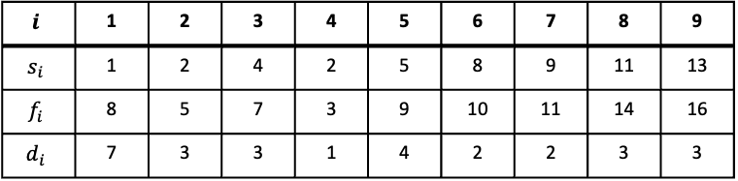
Earliest Finish
What about choosing by early finish?
Is it optimal?
Yes
So, our greedy solution is the activity subset $\{a_{3},a_{4},a_{6},a_{8}\}$
Note: optimal solution is not unique. Another candidate $\{a_{2},a_{5},a_{7},a_{9}\}$
$$i$$ | 1 | 2 | 3 | 4 | 5 | 6 | 7 | 8 | 9
$$s_{i}$$ | 1 | 2 | 4 | 2 | 5 | 8 | 9 | 11 | 13
$$f_{i}$$ | 8 | 5 | 7 | 3 | 9 | 10 | 11 | 14 | 16
$$d_{i}$$ | 7 | 3 | 3 | 1 | 4 | 2 | 2 | 3 | 3
❌
❌
✅
✅
❌
✅
❌
✅
❌

Slide 20
Alternate Strategy
Given that ‘earliest finish’ strategy works, using symmetry what can be an alternate strategy that will also work?
Hint: Think why ‘earliest finish’ strategy works
Choosing earliest finish leaves maximum room for other activities to fill in
So, by symmetry, ‘latest start’ [looking from the other end] will also give optimal solution

Slide 21

Tutorial Problems
Given an infinite array in which the first $n$ elements are integers in sorted order and the rest of the cells are filled with some special symbol (say $). Assume we do not know the $n$ value. Give an algorithm that takes an integer $k$ as input and finds a position in the array containing $k$, if the integer $k$ exists in the array in $O(\log{n})$ time

Slide 22

Tutorial Problems
Given a sorted array of non-repeated integers A[1..n], check whether there is an index $i$ for which $A\left[i\right]=i$. Give a divide-and-conquer algorithm that runs in time $O(\log{n})$

Slide 23

Tutorial Problems
We are given two sorted arrays of size n. Give an algorithm for finding the median element in the union of the two lists so that the complexity is $Θ(n)$

Slide 24
To be continued

