Slide 1
Algorithms – I (CS29003/203)
Autumn 2022, IIT Kharagpur
Divide and Conquer, Recursion

Slide 2
Divide and Conquer
General techniques
Merge sort
Recursion Tree Method
Master Theorem
CS21003/CS21203 / Algorithms - I | Divide and COnquer

Slide 3
Divide and Conquer
Divide and conquer involves three steps
Divide a problem into pieces (smaller instances of same problem)
E.g., divide into halves
Conquer the subproblems by solving them recursively
Can just call the same algorithm on the subproblems (recursively solving)
Base case: when n=1 (or is small)
Combine solutions to pieces to get answer to original problem
Combining results from recursive calls.
Usually the hardest part in the algorithm design
CS21003/CS21203 / Algorithms - I | Divide and Conquer

Slide 4
Merge Sort
8
3
2
9
5
1
7
4
8
3
2
9
5
1
7
4
8
3
2
9
5
1
7
4
8
3
2
9
5
1
7
4
3
8
2
9
1
5
4
7
2
3
8
9
1
4
5
7
1
2
3
4
5
7
8
9
CS21003/CS21203 / Algorithms - I | Divide and Conquer

Slide 5
Merge Sort
Dividing is easy. The key operation, though, is merge.
How to do merging of two sorted arrays to produce a merged sorted array?
2
5
9
3
4
8
CS21003/CS21203 / Algorithms - I | Divide and Conquer

Slide 6
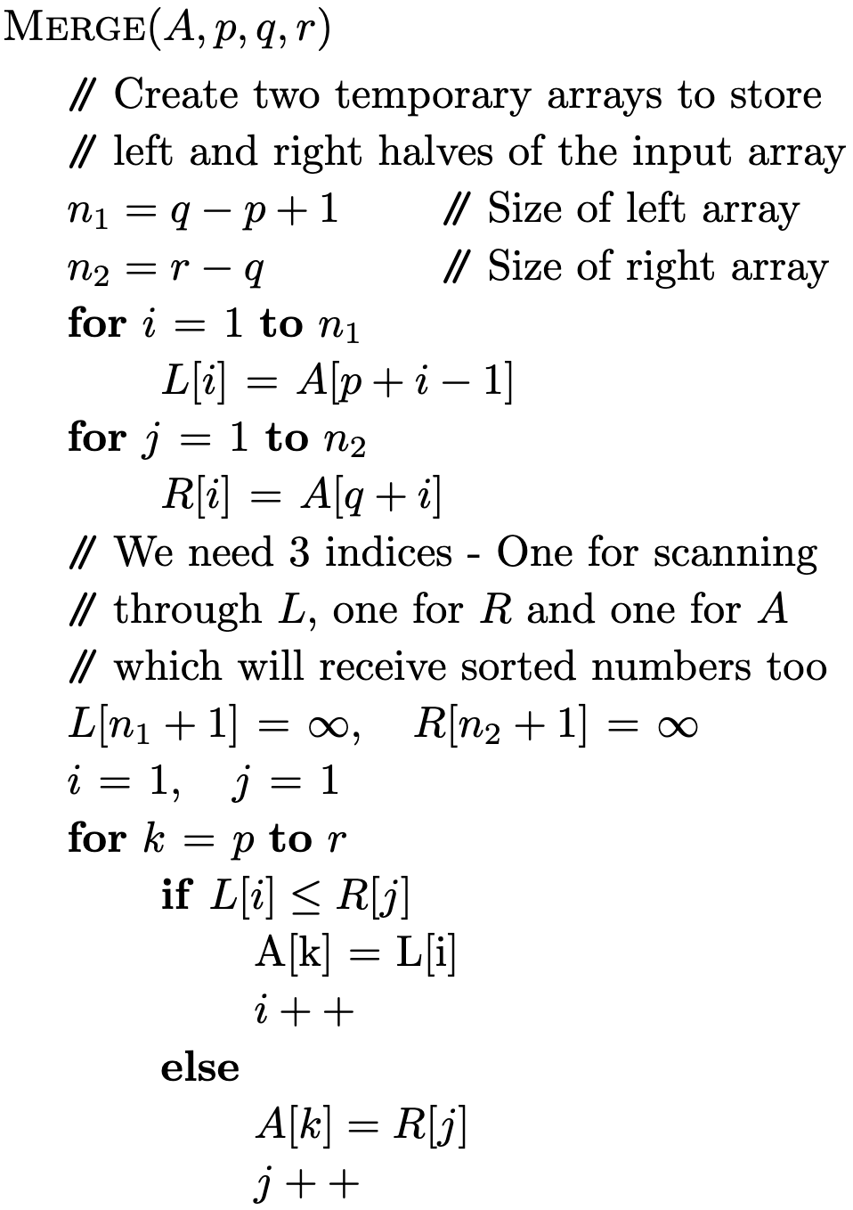
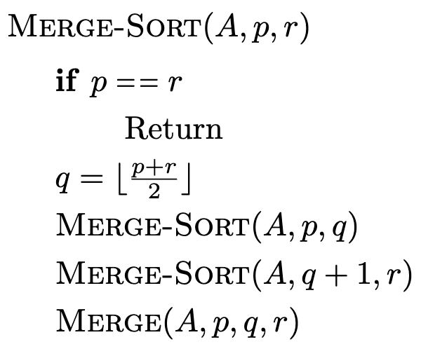
Merge Sort Pseudocode
CS21003/CS21203 / Algorithms - I | Divide and Conquer

Slide 7
Merge Sort – In What Order?
8
3
2
9
5
1
7
4
8
3
2
9
5
1
7
4
8
3
2
9
5
1
7
4
8
3
2
9
5
1
7
4
3
8
2
9
1
5
4
7
2
3
8
9
1
4
5
7
1
2
3
4
5
7
8
9
CS21003/CS21203 / Algorithms - I | Divide and Conquer

Slide 8




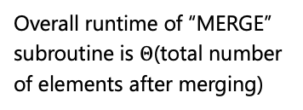


Merge Sort – Runtime Analysis
Total number of elements in two arrays is $n_{1}+n_{2}$
$Θ\left(1\right)$ [Constant time]
$$Θ\left(n_{1}\right)$$
$$Θ\left(n_{2}\right)$$
Overall runtime of “MERGE” subroutine is $Θ$(total number of elements after merging)
$$Θ\left(1\right)$$
$$Θ\left(n_{1}+n_{2}\right)$$
CS21003/CS21203 / Algorithms - I | Divide and Conquer

Slide 9
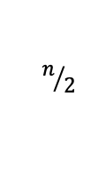





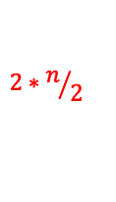

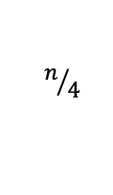















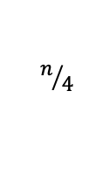

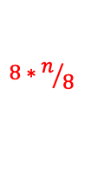



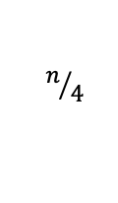



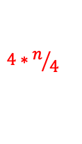



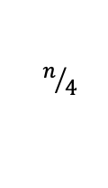


Merge Sort – Runtime Analysis
$$p$$
$$n$$
$$r$$
$$p$$
$$n/2$$
$$r$$
$$p$$
$$n/2$$
$$r$$
$$Θ\left(1\right)$$
$$2∗n/2$$
$$Θ\left(1\right)$$
$$p$$
$$r$$
$$p$$
$$r$$
$$p$$
$$r$$
$$n/4$$
$$p$$
$$r$$
$$n/4$$
$$n/4$$
$$n/4$$
$$4∗n/4$$
$$Θ\left(n\right)$$
$$p=r$$
$$p=r$$
$$p=r$$
$$p=r$$
$$p=r$$
$$p=r$$
$$p=r$$
$$p=r$$
$$8∗n/8$$
$$n/4$$
$$n/4$$
$$n/4$$
$$n/4$$
$$n/4$$
$$n/4$$
$$n/4$$
$$n/4$$
How do we count the recursive calls?
Recursive calls belong to the next level
CS21003/CS21203 / Algorithms - I | Divide and Conquer
Notes:
If two subroutines each are \Theta(n/2), then why not the overall runtime \Theta(n/2). Because – these are separate ‘n/2’ numbers (inputs). – not the same inputs.
We are trying to count the number of levels and number of operations at each level. When we are at a certain level, we count const, const and \Theta(n), the two mergesort recursions will be counted in the next level.

Slide 10
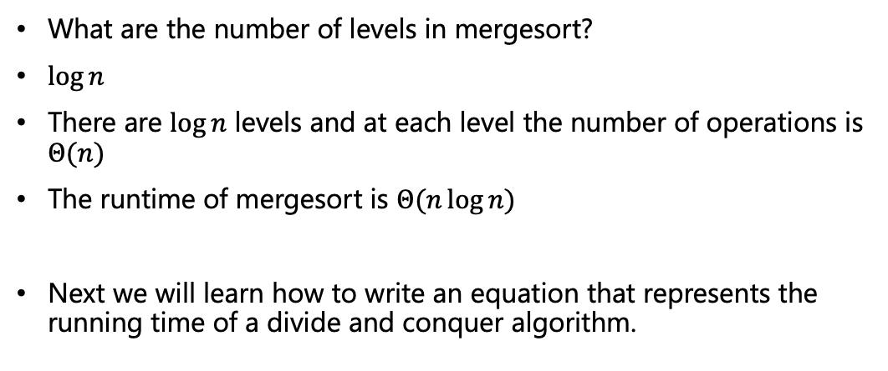
Merge Sort – Runtime Analysis
What are the number of levels in mergesort?
$\log{n}$
There are $\log{n}$ levels and at each level the number of operations is $Θ(n)$
The runtime of mergesort is $Θ(n\log{n})$
Next we will learn how to write an equation that represents the running time of a divide and conquer algorithm.
CS21003/CS21203 / Algorithms - I | Divide and Conquer
Notes:
Actually logn + 1, but we don’t care for the +1.

Slide 11


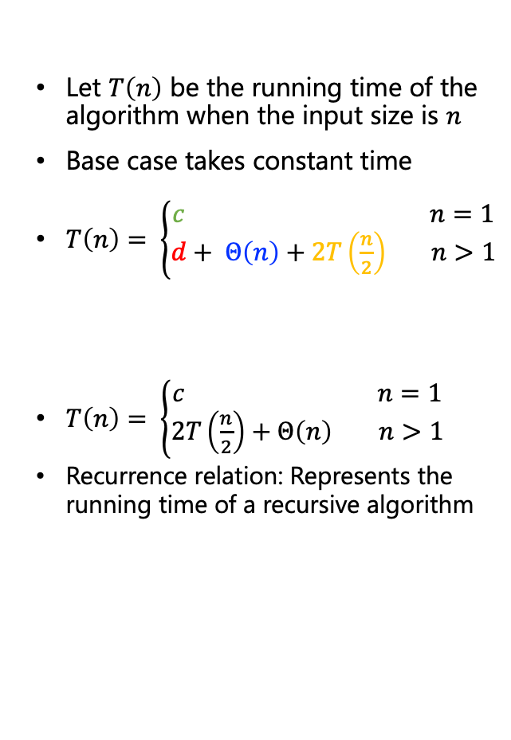
Recurrence Relation
Let $T\left(n\right)$ be the running time of the algorithm when the input size is $n$
Base case takes constant time
$T\left(n\right)= \left\{\begin{aligned}c n=1 \\ d+ Θ\left(n\right)+2T\left(\frac{n}{2}\right) n>1\end{aligned}\right.$
$T\left(n\right)= \left\{\begin{aligned}c n=1 \\ 2T\left(\frac{n}{2}\right)+Θ\left(n\right) n>1\end{aligned}\right.$
Recurrence relation: Represents the running time of a recursive algorithm
Base case
Divide time = const
Conquer time = $T(\frac{n}{2})$ each
Combine time = $Θ(n)$
CS21003/CS21203 / Algorithms - I | Divide and Conquer

Slide 12
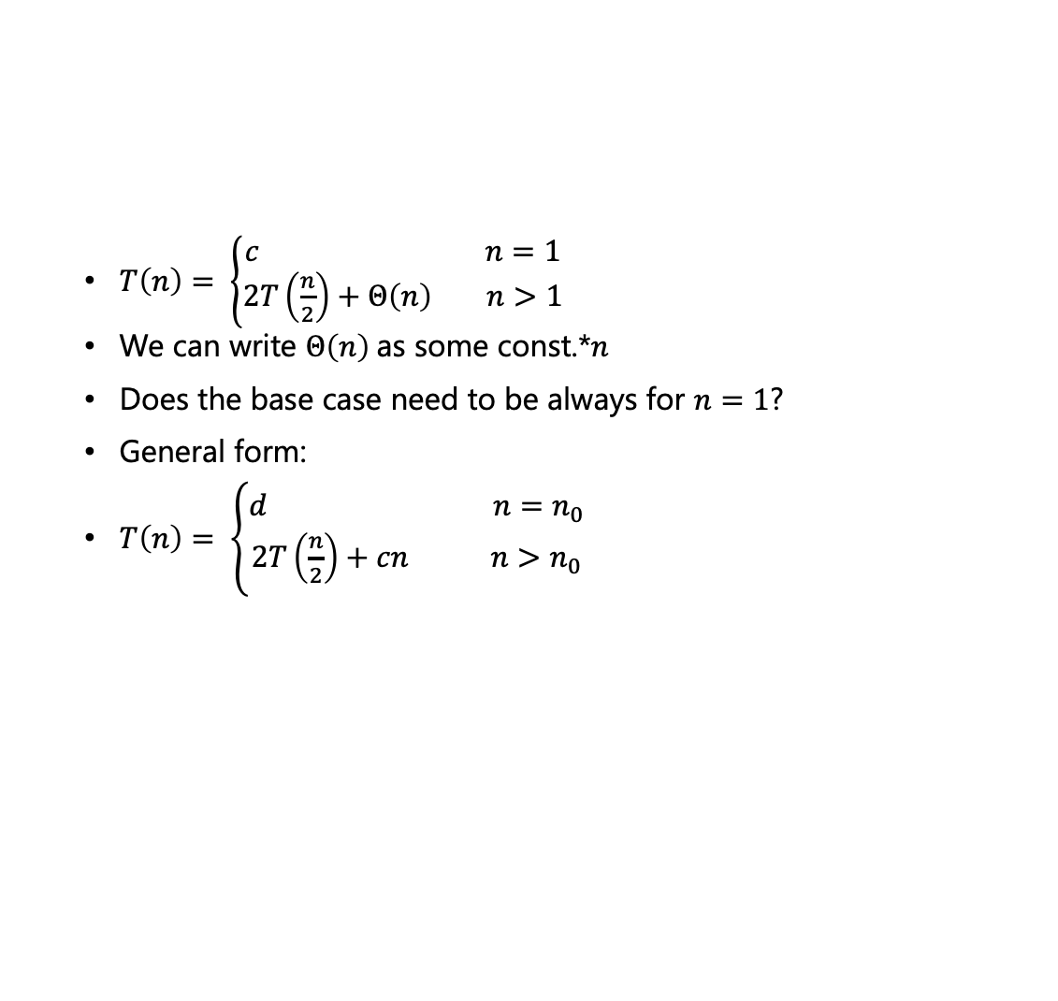
Solving Recurrences – Recursion Tree
$T\left(n\right)= \left\{\begin{aligned}c n=1 \\ 2T\left(\frac{n}{2}\right)+Θ\left(n\right) n>1\end{aligned}\right.$
We can write $Θ\left(n\right)$as some const.*$n$
Does the base case need to be always for $n=1$?
General form:
$T\left(n\right)= \left\{\begin{aligned}d n=n_{0} \\ 2T\left(\frac{n}{2}\right)+cn n>n_{0}\end{aligned}\right.$
CS21003/CS21203 / Algorithms - I | Divide and Conquer

Slide 13
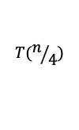




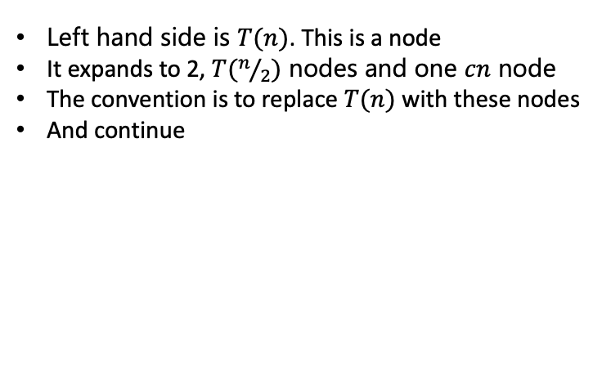
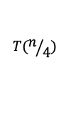
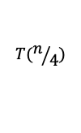
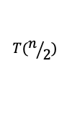


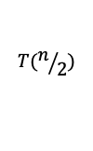

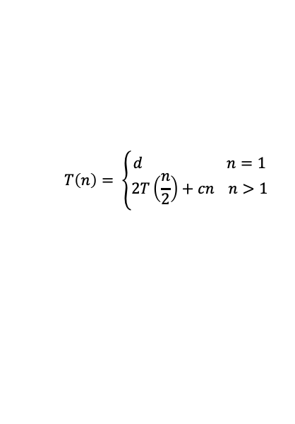
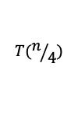

Solving Recurrences – Recursion Tree
$$T\left(n\right)= \left\{\begin{aligned}d n=1 \\ 2T\left(\frac{n}{2}\right)+cn n>1\end{aligned}\right.$$
Left hand side is $T(n)$. This is a node
It expands to 2, $T(n/2)$ nodes and one $cn$ node
The convention is to replace $T(n)$ with these nodes
And continue
$$cn$$
$$T(n)$$
$$T(n)$$
$$T(n/2)$$
$$T(n/2)$$
$$cn$$
$$T(n/2)$$
$$T(n/2)$$
$$T(n/4)$$
$$T(n/4)$$
$${cn}/2$$
$$T(n/4)$$
$$T(n/4)$$
$${cn}/2$$
CS21003/CS21203 / Algorithms - I | Divide and Conquer

Slide 14


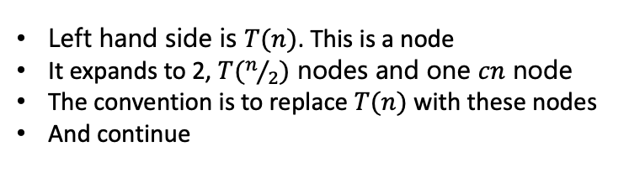
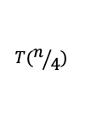


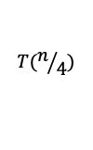



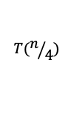

Solving Recurrences – Recursion Tree
$$T\left(n\right)= \left\{\begin{aligned}d n=1 \\ 2T\left(\frac{n}{2}\right)+cn n>1\end{aligned}\right.$$
Left hand side is $T(n)$. This is a node
It expands to 2, $T(n/2)$ nodes and one $cn$ node
The convention is to replace $T(n)$ with these nodes
And continue
$$cn$$
The tree ends when the base case is reached
$$T(n)$$
$${cn}/2$$
$${cn}/2$$
How many $d$ ?
$$T(n/4)$$
$$T(n/4)$$
$$T(n/4)$$
$$T(n/4)$$
Base
$$d$$
$$d$$
$$d$$
$$d$$
CS21003/CS21203 / Algorithms - I | Divide and Conquer

Slide 15
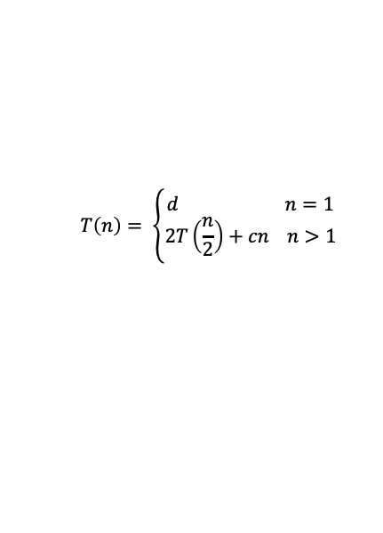




Solving Recurrences – Recursion Tree
$$cn$$
$${cn}/2$$
$${cn}/2$$
$$T\left(n\right)= \left\{\begin{aligned}d n=1 \\ 2T\left(\frac{n}{2}\right)+cn n>1\end{aligned}\right.$$
$${cn}/4$$
$${cn}/4$$
$${cn}/4$$
$${cn}/4$$
Base
$$d$$
$$d$$
$$d$$
$$d$$
Total runtime comes from counting number of operations from the internal nodes and counting them from base nodes
Lets get introduced to trees and some related terminologies as we need
More will come later
CS21003/CS21203 / Algorithms - I | Divide and Conquer

Slide 16
Solving Recurrences – Recursion Tree
Graphs are sets of nodes and edges
Trees are a form of a graph with some specialties
Trees have direction (parent/child relationships) and don't contain cycles
Some terminologies
In a Binary Tree, a node can have at most two children
Root
A
B
C
Internal
D
E
F
G
Leaf
CS21003/CS21203 / Algorithms - I | Divide and Conquer

Slide 17
Some Terminologies
A
Parent
Left child
Right child
B
Siblings
C
D
E
F
G
A
Root
Left subtree
Right subtree
B
C
D
E
F
G
CS21003/CS21203 / Algorithms - I | Divide and Conquer

Slide 18

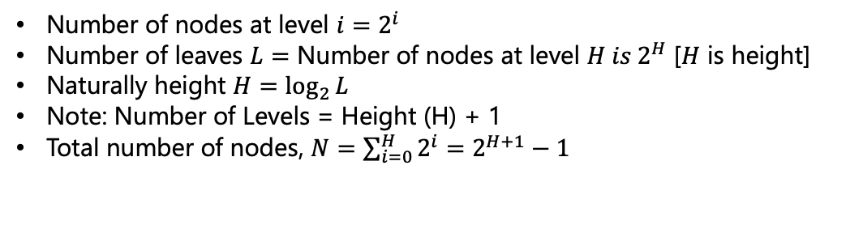



Some Terminologies
Max # of
Nodes
A
Level 0
$$1=2^{0}$$
B
C
Level 1
$$2=2^{1}$$
D
E
F
G
Level 2
$$4=2^{2}$$
D
E
D
E
D
E
D
E
Level 3
$$8=2^{3}$$
Number of nodes at level $i=2^{i}$
Number of leaves $L=$ Number of nodes at level $H is 2^{H}$ [$H$ is height]
Naturally height $H=\log_{2}{L}$
Note: Number of Levels = Height (H) + 1
Total number of nodes, $N=\sum_{i=0}^{H}{2^{i}=2^{H+1}−1}$
CS21003/CS21203 / Algorithms - I | Divide and Conquer

Slide 19
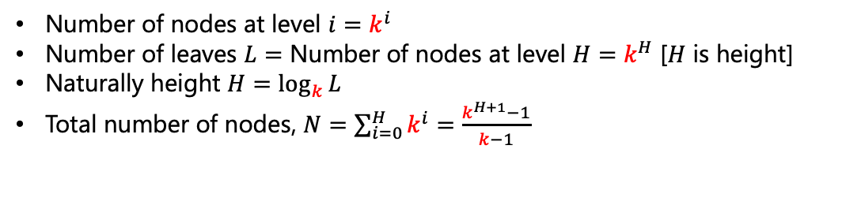
Some Terminologies
A
B
C
D
E
F
G
For general `k’-array Tree
D
E
D
E
D
E
D
E
Number of nodes at level $i=k^{i}$
Number of leaves $L=$ Number of nodes at level $H=k^{H}$ [$H$ is height]
Naturally height $H=\log_{k}{L}$
Total number of nodes, $N=\sum_{i=0}^{H}{k^{i}=\frac{k^{H+1}−1}{k−1}}$
CS21003/CS21203 / Algorithms - I | Divide and Conquer

Slide 20


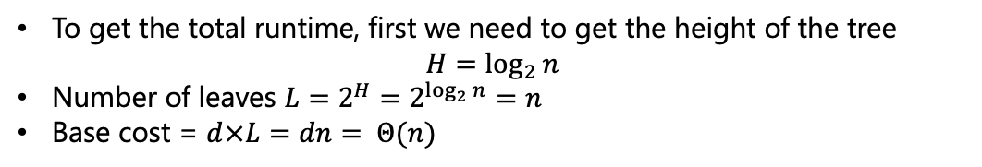
Solving Recurrences – Recursion Tree
Level 0
$$cn$$
$${cn}/2$$
$${cn}/2$$
Level 1
$$T\left(n\right)= \left\{\begin{aligned}d n=1 \\ 2T\left(\frac{n}{2}\right)+cn n>1\end{aligned}\right.$$
$${cn}/4$$
$${cn}/4$$
$${cn}/4$$
$${cn}/4$$
Level $H−1$
Base
$$d$$
$$d$$
$$d$$
$$d$$
Level $H$
To get the total runtime, first we need to get the height of the tree $H=\log_{2}{n}$
Number of leaves $L=2^{H}=2^{\log_{2}{n}}=n$
Base cost = $d×L=dn= Θ(n)$
CS21003/CS21203 / Algorithms - I | Divide and Conquer

Slide 21
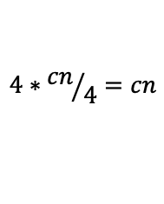
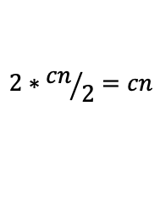

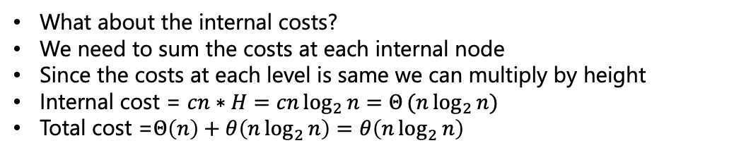
Solving Recurrences – Recursion Tree
Level 0
$$cn$$
$$cn$$
$$2∗{cn}/2=cn$$
$${cn}/2$$
$${cn}/2$$
Level 1
$$4∗{cn}/4=cn$$
$${cn}/4$$
$${cn}/4$$
$${cn}/4$$
$${cn}/4$$
Level $H−1$
Base
$$d$$
$$d$$
$$d$$
$$d$$
Level $H$
What about the internal costs?
We need to sum the costs at each internal node
Since the costs at each level is same we can multiply by height
Internal cost = $cn∗H=cn\log_{2}{n=Θ}(n\log_{2}{n})$
Total cost =$Θ\left(n\right)+θ\left(n\log_{2}{n}\right)=θ\left(n\log_{2}{n}\right)$
CS21003/CS21203 / Algorithms - I | Divide and Conquer

Slide 22
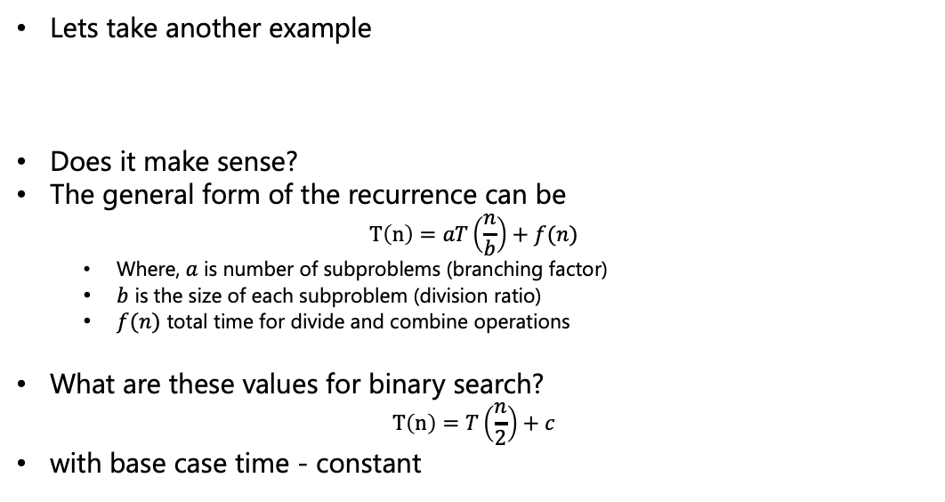
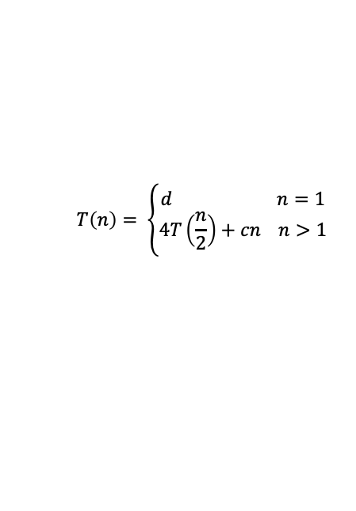
Solving Recurrences – Recursion Tree
Lets take another example
Does it make sense?
The general form of the recurrence can be $T\left(n\right)=aT\left(\frac{n}{b}\right)+f(n)$
Where, $a$ is number of subproblems (branching factor)
$b$ is the size of each subproblem (division ratio)
$f(n)$ total time for divide and combine operations
What are these values for binary search?
$$T\left(n\right)=T\left(\frac{n}{2}\right)+c$$
with base case time - constant
$$T\left(n\right)= \left\{\begin{aligned}d n=1 \\ 4T\left(\frac{n}{2}\right)+cn n>1\end{aligned}\right.$$
CS21003/CS21203 / Algorithms - I | Divide and Conquer

Slide 23
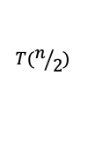

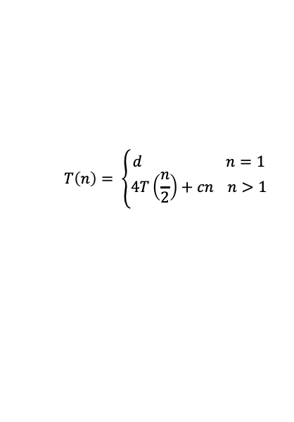
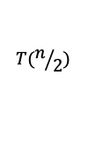



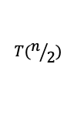

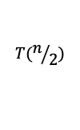





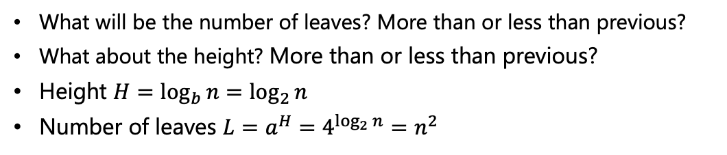
Solving Recurrences – Recursion Tree
$$T\left(n\right)= \left\{\begin{aligned}d n=1 \\ 4T\left(\frac{n}{2}\right)+cn n>1\end{aligned}\right.$$
c$n$
c$n$
$$T(n/2)$$
$$T(n/2)$$
$$T(n/2)$$
$$T(n/2)$$
$${cn}/2$$
$${cn}/2$$
$${cn}/2$$
$${cn}/2$$
$${cn}/4$$
$${cn}/4$$
$${cn}/4$$
$${cn}/4$$
Base
$$d$$
$$d$$
$$d$$
$$d$$
What will be the number of leaves? More than or less than previous?
What about the height? More than or less than previous?
Height $H=\log_{b}{n}=\log_{2}{n}$
Number of leaves $L=a^{H}=4^{\log_{2}{n}}=n^{2}$
CS21003/CS21203 / Algorithms - I | Divide and Conquer

Slide 24




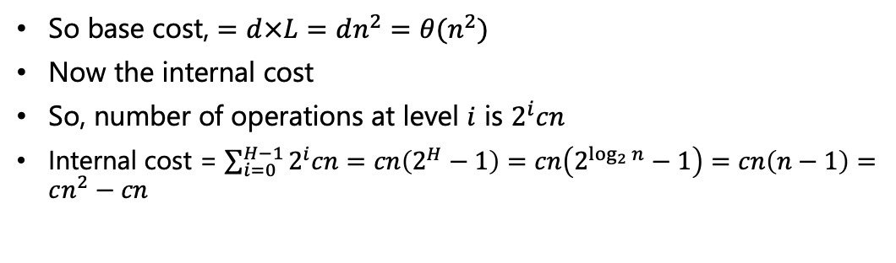

Solving Recurrences – Recursion Tree
$$T\left(n\right)= \left\{\begin{aligned}d n=1 \\ 4T\left(\frac{n}{2}\right)+cn n>1\end{aligned}\right.$$
c$n$
Level 0
$$cn$$
$${cn}/2$$
$${cn}/2$$
$${cn}/2$$
$${cn}/2$$
Level 1
$$4\frac{cn}{2}=2cn$$
$${cn}/4$$
$${cn}/4$$
$${cn}/4$$
$${cn}/4$$
Level 2
$$16\frac{cn}{4}=4cn$$
Level $H−1$
Base
$$d$$
$$d$$
$$d$$
$$d$$
Level $H$
So base cost, $=d×L=dn^{2}=θ(n^{2})$
Now the internal cost
So, number of operations at level $i$ is $2^{i}cn$
Internal cost = $\sum_{i=0}^{H−1}{2^{i}cn}=cn\left(2^{H}−1\right)=cn\left(2^{\log_{2}{n}}−1\right)=cn\left(n−1\right)=cn^{2}−cn$
CS21003/CS21203 / Algorithms - I | Divide and Conquer

Slide 25
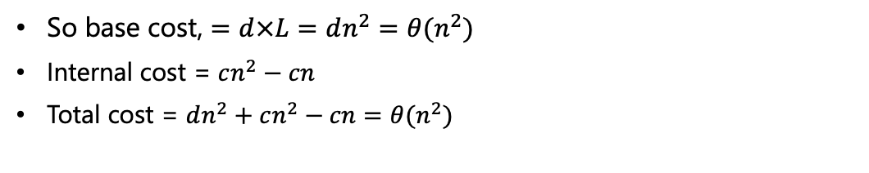
Solving Recurrences – Recursion Tree
$$T\left(n\right)= \left\{\begin{aligned}d n=1 \\ 4T\left(\frac{n}{2}\right)+cn n>1\end{aligned}\right.$$
c$n$
Level 0
$$cn$$
$${cn}/2$$
$${cn}/2$$
$${cn}/2$$
$${cn}/2$$
Level 1
$$4\frac{cn}{2}=2cn$$
$${cn}/4$$
$${cn}/4$$
$${cn}/4$$
$${cn}/4$$
Level 2
$$16\frac{cn}{4}=4cn$$
Level $H−1$
Base
$$d$$
$$d$$
$$d$$
$$d$$
Level $H$
So base cost, $=d×L=dn^{2}=θ(n^{2})$
Internal cost = $cn^{2}−cn$
Total cost = $dn^{2}+cn^{2}−cn=θ(n^{2})$
CS21003/CS21203 / Algorithms - I | Divide and Conquer

Slide 26

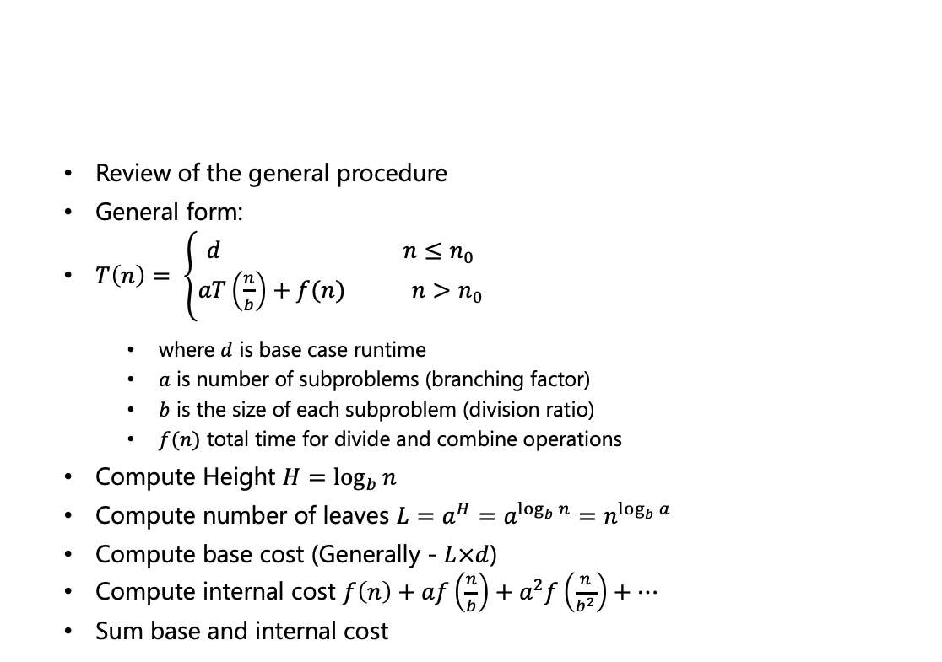







Solving Recurrences – Master Theorem
Review of the general procedure
General form:
$T\left(n\right)= \left\{\begin{aligned}d n≤n_{0} \\ aT\left(\frac{n}{b}\right)+f(n) n>n_{0}\end{aligned}\right.$
where $d$ is base case runtime
$a$ is number of subproblems (branching factor)
$b$ is the size of each subproblem (division ratio)
$f(n)$ total time for divide and combine operations
Compute Height $H=\log_{b}{n}$
Compute number of leaves $L=a^{H}=a^{\log_{b}{n}}=n^{\log_{b}{a}}$
Compute base cost (Generally - $L×d$)
Compute internal cost $f\left(n\right)+af\left(\frac{n}{b}\right)+a^{2}f\left(\frac{n}{b^{2}}\right)+…$
Sum base and internal cost
$$a$$
$$f(n)$$
$$f(\frac{n}{b})$$
$$f(\frac{n}{b})$$
$$f(\frac{n}{b})$$
$$f(\frac{n}{b})$$
Base
$$d$$
$$d$$
$$d$$
CS21003/CS21203 / Algorithms - I | Divide and Conquer

Slide 27
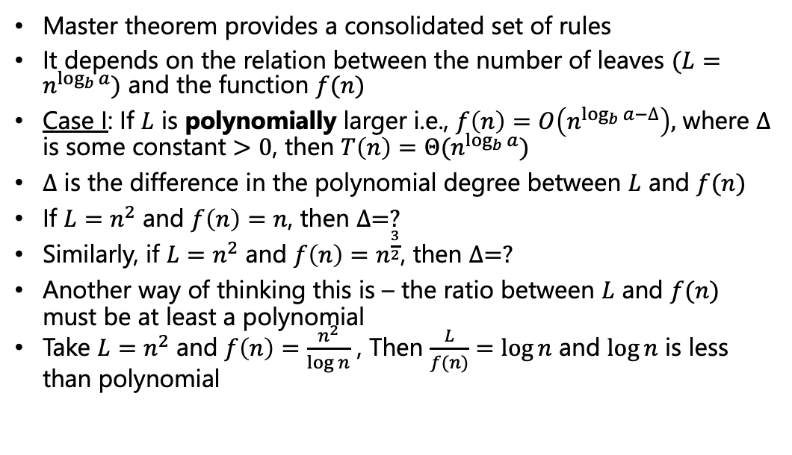
Solving Recurrences – Master Theorem
Master theorem provides a consolidated set of rules
It depends on the relation between the number of leaves $(L=n^{\log_{b}{a}})$ and the function $f(n)$
Case I: If $L$ is polynomially larger i.e., $f\left(n\right)=O\left(n^{\log_{b}{a}−∆}\right),$ where $∆$ is some constant $>0$, then $T\left(n\right)=Θ(n^{\log_{b}{a}})$
$∆$ is the difference in the polynomial degree between $L$ and $f(n)$
If $L=n^{2}$ and $f\left(n\right)=n$, then $∆=?$
Similarly, if $L=n^{2}$ and $f\left(n\right)=n^{\frac{3}{2}}$, then $∆=?$
Another way of thinking this is – the ratio between $L$ and $f(n)$ must be at least a polynomial
Take $L=n^{2}$ and $f\left(n\right)=\frac{n^{2}}{\log{n}}$ , Then $\frac{L}{f(n)}=\log{n}$ and $\log{n}$ is less than polynomial
→ 1
→ 0.5
CS21003/CS21203 / Algorithms - I | Divide and Conquer

Slide 28
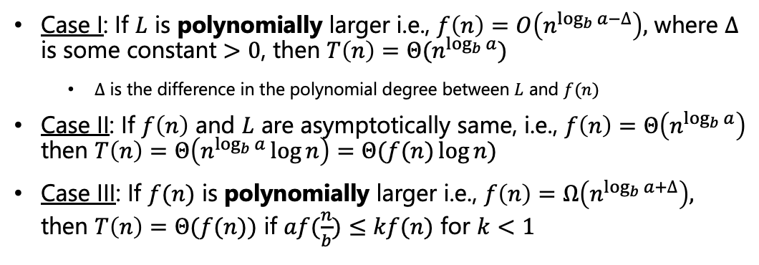
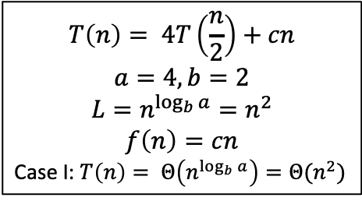
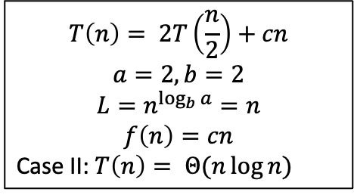
Solving Recurrences – Master Theorem
Case I: If $L$ is polynomially larger i.e., $f\left(n\right)=O\left(n^{\log_{b}{a}−∆}\right),$ where $∆$ is some constant $>0$, then $T\left(n\right)=Θ(n^{\log_{b}{a}})$
$∆$ is the difference in the polynomial degree between $L$ and $f(n)$
Case II: If $f\left(n\right)$ and $L$ are asymptotically same, i.e., $f\left(n\right)=Θ\left(n^{\log_{b}{a}}\right)$ then $T\left(n\right)=Θ\left(n^{\log_{b}{a}}\log{n}\right)=Θ(f(n)\log{n})$
Case III: If $f(n)$ is polynomially larger i.e., $f\left(n\right)=Ω\left(n^{\log_{b}{a}+∆}\right),$ then $T\left(n\right)=Θ(f(n))$ if $af(\frac{n}{b})≤kf(n)$ for $k<1$
Regularity Condition
$$T\left(n\right)= 2T\left(\frac{n}{2}\right)+cn$$
$$a=2,b=2$$
$$L=n^{\log_{b}{a}}=n$$
$$f\left(n\right)=cn$$
Case II: $T\left(n\right)= Θ(n\log{n})$
$$T\left(n\right)= 4T\left(\frac{n}{2}\right)+cn$$
$$a=4,b=2$$
$$L=n^{\log_{b}{a}}=n^{2}$$
$$f\left(n\right)=cn$$
Case I: $T\left(n\right)= Θ\left(n^{\log_{b}{a}}\right)=Θ(n^{2})$
CS21003/CS21203 / Algorithms - I | Divide and Conquer

Slide 29
Quicksort
Quicksort is a sorting algorithm which puts elements in the right places one by one
What is a “right place”?
Is there any element which is at the right place?
3
7
9
5
15
11
4
4
7
9
5
15
11
17
4
7
5
9
15
11
12
CS21003/CS21203 / Algorithms - I | Divide and Conquer
Notes:
3 – everything to its right are greater.
17 - everything to its left are smaller.
9 - everything to its left are smaller and everything to its right are greater.
These are not necessarily sorted though

Slide 30
Quicksort
Lets walkthrough an example to understand how quicksort works
The crucial step in quicksort is partioning (divide into two parts such that left of pivot is less and right of pivot id more)
7
6
10
5
9
2
1
15
7
CS21003/CS21203 / Algorithms - I | Divide and Conquer

Slide 31
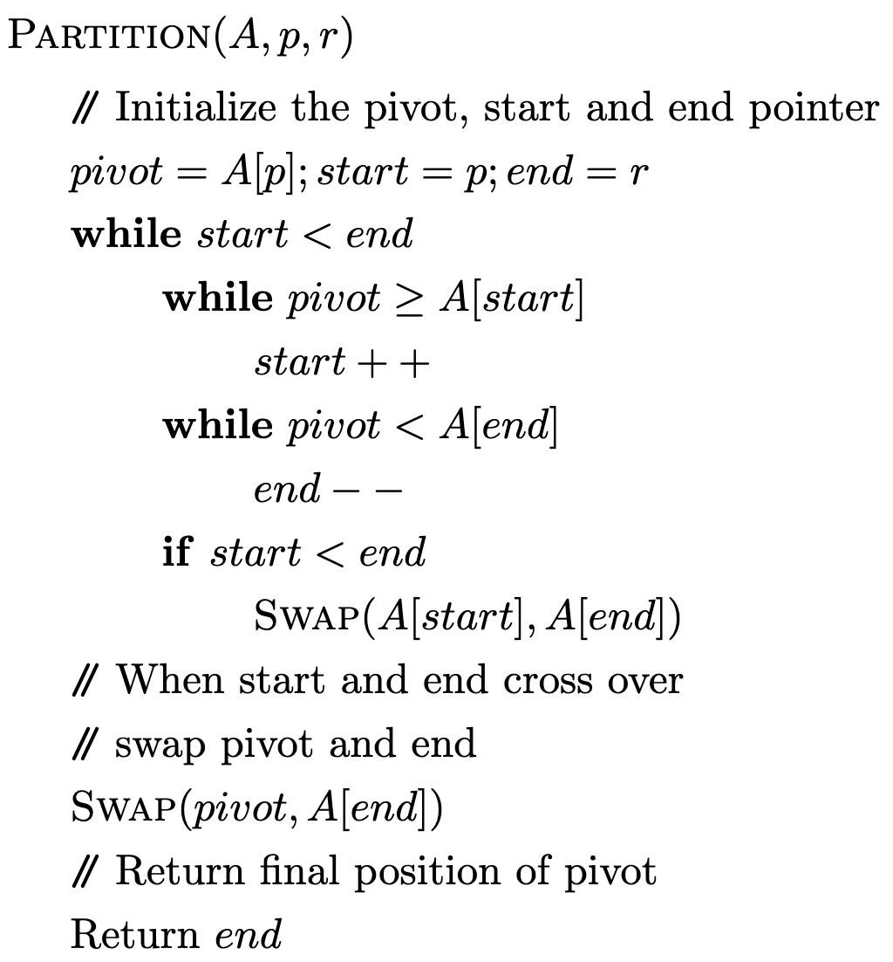
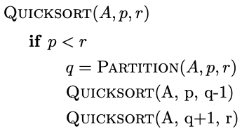
Quicksort
CS21003/CS21203 / Algorithms - I | Divide and Conquer

Slide 32




Quicksort – Runtime Analysis
$$Θ\left(1\right)$$
$$Θ\left(n\right)$$
Overall runtime of “PARTITION” subroutine is $Θ(n)$
$$Θ\left(1\right)$$
CS21003/CS21203 / Algorithms - I | Divide and Conquer
Notes:
The while loop is \Theta(n) as it comes out of the loop when start and end crosses over and that happens after a total scan of the whole array.

Slide 33


Quicksort – Runtime Analysis
$$Θ\left(n\right)$$
Hard to tell about these.
Lets take two extreme cases
Partitions are perfectly balanced everytime
Number of levels = $\log_{2}{n}$
Recurrence relation $T\left(n\right)= 2T\left(\frac{n}{2}\right)+cn$
Same as mergesort – $Θ(n\log{n})$
However, this is the best case scenario
CS21003/CS21203 / Algorithms - I | Divide and Conquer

Slide 34


Quicksort – Runtime Analysis
$$Θ\left(n\right)$$
Hard to tell about these.
Lets take two extreme cases
Partitions are most unbalanced everytime
Number of levels = $Θ(n)$
Recurrence relation $T\left(n\right)= T\left(n−1\right)+T(0)+cn$
Lets try to solve this recusrsive eqn.
$$Const.$$
CS21003/CS21203 / Algorithms - I | Divide and Conquer

Slide 35





Quicksort – Runtime Analysis
c$n$
Base case = $const.$
Internal cost at level $i$ is $c(n−i)$
Total internal cost $c\left(2+3+…n\right)$ $=c\left[\frac{n(n+1)}{2}−1\right]$ $=Θ(n^{2})$
C$(n−1)$
C$(n−2)$
2c
Number of levels = $Θ(n)$
Recurrence relation $T\left(n\right)= T\left(n−1\right)+T\left(0\right)+cn$
Same as insertion sort – $Θ\left(n^{2}\right)$
This is the worst case scenario
Base case
$$Const.$$
CS21003/CS21203 / Algorithms - I | Divide and Conquer

Slide 36

Quicksort – Runtime Analysis
What should the input look like for the best case?
The medians are chosen as pivots always
What should the input look like for the worst case?
The input array is already sorted
Probability of getting an already sorted array is $\frac{1}{n!}$
However, the problem can be tackled if instead of always taking the first element as pivot, we take any element as pivot in random
The average-case time complexity of the randomized version of quicksort is $Θ(n\log{n})$
The proof of this involves a more complicated recurrence than we have seen so far.
CS21003/CS21203 / Algorithms - I | Divide and Conquer
Notes:
Probability justification – Probability that lowest element is first is 1/n. Given the lowest element is in first position the probability that the second element is in the second position is 1/(n-1), and so on.

Slide 37




Quicksort – Runtime Analysis
We will follow “Introduction to Algorithms and Data Structures” by M. J. Dinneen, G. Gimelfarb, M. C. Wilson for the proof
Let $T(n)$ denote the average-case running time for size $n$ list
In the first step, the time taken to compare all the elements with the pivot is $cn$
Let $0≤i≤n−1$ is the final position of the pivot. So, the two sublists are of size $i$ and $n−i−1$ respectively
The recurrence relation for this $i$ is $T\left(n\right)=T\left(i\right)+T\left(n−1−i\right)+cn$
Small detail: Last term should be $Θ\left(n\right),$ as it depends on the exact implementaiton (e.g., whether comparison starts from pivot or one element after, etc.)
$$i$$
$$i$$
$$n−i−1$$
CS21003/CS21203 / Algorithms - I | Divide and Conquer
Notes:
We are going by the convention by the book [0 index start]

Slide 38




Quicksort – Runtime Analysis
The recurrence relation for this $i$ is $T\left(n\right)=T\left(i\right)+T\left(n−1−i\right)+cn$
The final pivot position $i$ can be any of the $n$ positions with equal probability
So, the value of $T(n)$ to be $T\left(0\right)+T\left(n−1\right)+cn$ (i.e., $i=0$) has probability $\frac{1}{n}$
Similarly, the value of $T(n)$ to be $T\left(1\right)+T\left(n−2\right)+cn$ (i.e., $i=1$) has probability $\frac{1}{n}$ and so on
So the expected value of $T(n)$ is given by,
$$T\left(n\right)= \frac{1}{n}\sum_{i=0}^{n−1}{\left(T\left(i\right)+T\left(n−1−i\right)+cn\right)=}\frac{1}{n}\sum_{i=0}^{n−1}{\left(T\left(i\right)+T\left(n−1−i\right)\right)+cn}$$
$$i$$
$$i$$
$$n−i−1$$
CS21003/CS21203 / Algorithms - I | Divide and Conquer

Slide 39







Quicksort – Runtime Analysis
$T\left(n\right)= \frac{1}{n}\sum_{i=0}^{n−1}{(T\left(i\right)+T\left(n−1−i\right))+cn}$
$T\left(0\right)+T\left(n−1\right)=T\left(n−1\right)+T\left(0\right) for i=0 and i=n−1$
$T\left(1\right)+T\left(n−2\right)=T\left(n−2\right)+T\left(1\right) for i=1 and i=n−2$ and so on
$T\left(n\right)= \frac{1}{n}\sum_{i=0}^{n−1}{(T\left(i\right)+T\left(n−1−i\right))+cn}=\frac{2}{n}\sum_{i=0}^{n−1}{T\left(i\right)+cn}$
Let us rewrite this as $nT\left(n\right)=2\sum_{i=0}^{n−1}{T\left(i\right)+cn^{2}}$
$$i$$
$$i$$
$$i$$
$$n−i−1$$
$$n−i−1$$
$$i$$
CS21003/CS21203 / Algorithms - I | Divide and Conquer

Slide 40

Quicksort – Runtime Analysis
$nT\left(n\right)=2\sum_{i=0}^{n−1}{T\left(i\right)+cn^{2}}$
Replace $n$ by $n−1$ and subtract from the above
$nT\left(n\right)=2\left(T\left(0\right)+T\left(1\right)+…T\left(n−2\right)+T\left(n−1\right)\right)+cn^{2}$ $\left(n−1\right)T\left(n−1\right)=2\left(T\left(0\right)+T\left(1\right)+…+T\left(n−3\right)+T(n−2)\right)+c{\left(n−1\right)}^{2}$
$nT\left(n\right)−\left(n−1\right)T\left(n−1\right)=2T\left(n−1\right)+c\left(n^{2}−{\left(n−1\right)}^{2}\right)$
$nT\left(n\right)=\left(n+1\right)T\left(n−1\right)+c(2n−1)$
Divide everything by $n(n+1)$
$\frac{T(n)}{n+1}=\frac{T(n−1)}{n}+c\frac{2n−1}{n(n+1)}=\frac{T(n−1)}{n}+c\left(\frac{3}{n+1}−\frac{1}{n}\right)$
Last term uses partial fraction decomposition
CS21003/CS21203 / Algorithms - I | Divide and Conquer

Slide 41

Quicksort – Runtime Analysis
$\frac{T(n)}{n+1}=\frac{T(n−1)}{n}+c\frac{2n−1}{n(n+1)}=\frac{T(n−1)}{n}+c\left(\frac{3}{n+1}−\frac{1}{n}\right)$
Lets put $n=1, 2,3,…n$
$\frac{T(1)}{2}=\frac{T(0)}{1}+\frac{3c}{2}− \frac{c}{1}$
$\frac{T(2)}{3}=\frac{T(1)}{2}+\frac{3c}{3}− \frac{c}{2}$
$\frac{T(3)}{4}=\frac{T(2)}{3}+\frac{3c}{4}− \frac{c}{3}$
$\frac{T(n)}{n+1}=\frac{T(n−1)}{n}+\frac{3c}{n+1}− \frac{c}{n}$
$\frac{T(n)}{n+1}=\frac{T(0)}{1}+3c\left(\frac{1}{2}+ \frac{1}{3}+\frac{1}{4}+…+\frac{1}{n+1}\right)−c\left(\frac{1}{1}+\frac{1}{2}+\frac{1}{3}+…+\frac{1}{n}\right)$
CS21003/CS21203 / Algorithms - I | Divide and Conquer

Slide 42

Quicksort – Runtime Analysis
$\frac{T(n)}{n+1}=\frac{T(0)}{1}+3c\left(\frac{1}{2}+ \frac{1}{3}+\frac{1}{4}+…+\frac{1}{n+1}\right)−c\left(\frac{1}{1}+\frac{1}{2}+\frac{1}{3}+…+\frac{1}{n}\right)$
$\frac{T(n)}{n+1}=\frac{T(0)}{1}−c+\frac{3c}{n+1}+2c\left(\frac{1}{2}+ \frac{1}{3}+\frac{1}{4}+…+\frac{1}{n}\right)=d−c+\frac{3c}{n+1}+2c(H_{n}−1)$
$H_{n}=1+\frac{1}{2}+\frac{1}{3}+…+\frac{1}{n}$ $;d=T(0)$
$T\left(n\right)=\left(d−c\right)\left(n+1\right)+3c+2c\left(n+1\right)\left(H_{n}−1\right)$
$=d+\left(d−3c\right)n+2cH_{n}+2cnH_{n}$
Using a result $H_{n}=Θ(\log{n})$, we can write
$T\left(n\right)=d+\left(d−3c\right)n+2cΘ\left(\log{n}\right)+2cΘ\left(n\log{n}\right)=Θ(n\log{n})$
$H_{n}=Θ\left(\log{n}\right)$ -> This will shown to be true for a special case, next
CS21003/CS21203 / Algorithms - I | Divide and Conquer
Notes:
d is T(0) – a constant time operation

Slide 43




Quicksort – Runtime Analysis
In case, the number of terms in the Harmonic series is a perfect power of 2,i.e., $n=2^{k}$ or $k=\log_{2}{n}$,
$H_{n}=1+\frac{1}{2}+\frac{1}{3}+…+\frac{1}{2^{k}}≤1+\left(\frac{1}{2}+\frac{1}{2}\right)+\left(\frac{1}{4}+\frac{1}{4}+\frac{1}{4}+\frac{1}{4}\right)+(\frac{1}{8}+…$
All the bracketed sums are 1
So, $H_{n}≤k+\frac{1}{n}=\log_{2}{n}+\frac{1}{n}≤\log_{2}{n}+1$ as $1> \frac{1}{n}$
$$k=1$$
$$k=2$$
$$k=3$$
CS21003/CS21203 / Algorithms - I | Divide and Conquer

Slide 44

Quicksort – Runtime Analysis
So, $H_{n}≤\log_{2}{n}+1$ … (1)
Again, for $n=2^{k}$ or $k=\log_{2}{n}$,
$H_{n}=1+\frac{1}{2}+\frac{1}{3}+\frac{1}{4}+\frac{1}{5}…+\frac{1}{2^{k}}$
$≥1+\frac{1}{2}+\left(\frac{1}{4}+\frac{1}{4}\right)+\left(\frac{1}{8}+\frac{1}{8}+\frac{1}{8}+\frac{1}{8}\right)+\left(\frac{1}{2^{k}}+…+\frac{1}{2^{k}}\right)$
$=1+\left(\frac{1}{2}+\frac{1}{2}+k times\right)=1+\frac{1}{2}k≥\frac{1}{2}k= \frac{1}{2}\log_{2}{n}$
$H_{n}≥\frac{1}{2}\log_{2}{n}$ … (2)
Combining (1) and (2), $\frac{1}{2}\log_{2}{n}≤H_{n}≤\log_{2}{n}+$1
$H_{n}=Θ(\log_{2}{n})$
CS21003/CS21203 / Algorithms - I | Divide and Conquer

Slide 45

Quicksort
Quicksort was proposed by Sir Charles Antony Richard (Tony) Hoare in 1959/60 at age 26
He was trying to sort words for a machine translation project from Russian to English
In his own words – “I have been very lucky. What a wonderful way to start a career in Computing, by discovering a new sorting algorithm!”
Emeritus Professor, Oxford University
Turing award winner, 1980.
source: http://curation.cs.manchester.ac.uk/Turing100/www.turing100.manchester.ac.uk/speakers/invited-list/11-speakers/39-hoare.html
CS21003/CS21203 / Algorithms - I | Divide and Conquer

Slide 46

A Quick Animation
Click to play https://tinyurl.com/3k8pt3a3
CS21003/CS21203 / Algorithms - I | Divide and Conquer

Slide 47

Median Finding
Given a set of numbers, a median is the “halfway point” of the set
More formally, given a set of $n$ numbers, medians occur at $i=⌊\frac{n+1}{2}⌋$ (lower median) and at $i=⌈\frac{n+1}{2}⌉$ (upper median)
Following the book, by “median”, we will mean the lower median
We would like to find the median.
If a list is sorted, the median can be easily found out. But that means at least $Θ(n\log{n})$ operation
We would like to do it faster than that
We would like to find $i^{th}$ rank element in a sorted list
CS21003/CS21203 / Algorithms - I | Divide and Conquer

Slide 48

Median Finding
The problem is called the selection problem
Input: Set $A$ of $n$ (distinct) numbers and an integer $i$, with $1≤i≤n$
Output: The element $x∈A$ that is larger than exactly $i−1$ other elements of $A$
The idea we will be using is that after the partition operation we know the “right” position of the pivot element. We will use it to discard some “obvious” elements
6
2
9
1
12
5
10
3
CS21003/CS21203 / Algorithms - I | Divide and Conquer

Slide 49
Median Finding - PseudoCode
CS21003/CS21203 / Algorithms - I | Divide and Conquer

Slide 50

Median Finding – Running Time Analysis
Best case is that the first pivot is $i$
What is the running time?
$Θ(n)$ [At least once you have to scan the array to get the partition]
What is the worst case?
(Similar to quicksort) To get the pivot always at one of the ends
The running time is $Θ(n^{2})$ – Same as quicksort
Another best case scenario is – perfectly balanced partitioning at all levels
Recurrence relation for such case is
$T\left(n\right)= T\left(\frac{n}{2}\right)+cn$
CS21003/CS21203 / Algorithms - I | Divide and Conquer

Slide 51


Median Finding – Running Time Analysis
$$T\left(n\right)= T\left(\frac{n}{2}\right)+cn$$
$$a=1,b=2$$
$$L=n^{\log_{b}{a}}=n^{0}=1$$
$$f\left(n\right)=cn$$
Case III: We need to check the regularity condition
$af\left(\frac{n}{b}\right)≤kf\left(n\right)⇒c\frac{n}{2}≤kcn$ – This is true for $\frac{1}{2}≤k<1$
$$T\left(n\right)= Θ(n)$$
Just like quicksort, it can be proven that the average case complexity is also of the same order as the best case complexity i.e., $Θ(n)$
CS21003/CS21203 / Algorithms - I | Divide and Conquer

Slide 52

Maximum Sum Subarray
Given an array, we need to find a subarray whose sum of elements among all possible subarray sums is the maximum
The problem will be trivial if the numbers are all positive
By inspection the solution is the subarray from 3 to 9
What can be a brute-force strategy to find this?
As we are looking for start and end positions of the subarray, we can try for all possible start indices and all possible end indices
This means n-choose-2 i.e., $Θ(n^{2})$ algorithm
Can we use divide-and-conquer paradigm to improve the runtime?
-1
3
4
-5
9
-2
CS21003/CS21203 / Algorithms - I | Divide and Conquer

Slide 53

Maximum Sum Subarray
The natural first step is to divide the array into half
Then recursively solve the same problem on the divided subarrays
Next we need to combine. While combining, the maximum sum can come from the two subarrays as well from an array that spans across the two subarrays
We need to find the maximum sum corresponding to the subarray crossing the centerline. And we need to find it efficiently.
If we can find the maximum crossing subarray in $Θ(n)$ time, then we have a chance to get $T\left(n\right)=2T\left(\frac{n}{2}\right)+Θ(n)$ recursion leading to $Θ\left(n\log{n}\right)$ overall runtime
-1
3
4
-5
9
-2
CS21003/CS21203 / Algorithms - I | Divide and Conquer

Slide 54
Maximum Sum Subarray
6
7
4
-5
4
2
-1
3
4
-5
9
-2
To do so, we will cleverly use the fact that we are trying to find a subarray whose one end lies on the right of the centerline and the other end lies on the left
The maximum subarray crossing the centerline will be a concatenation of 1) a subarray whose one end is the centerline and goes to the left 2) a subarray whose one end is the centerline and goes to the right
So, start at the centerline, keep going to the left, keep doing the sum and keep track of the maximum of the sum. Similarly, for the subarray going to the right from the centerline
CS21003/CS21203 / Algorithms - I | Divide and Conquer

Slide 55
To be continued

