Slide 1
Algorithms – I (CS29003/203)
Autumn 2022, IIT Kharagpur
Trees

Slide 2
Resources
Apart from the book
UC Davis ECS 36C Course by Prof. Joël Porquet-Lupine

Slide 3
Tree as a Data Structure
Since Data is an integral part on which algorithms operate, particular ways of organizing data play a critical role in design and analysis of algorithms
A data structure can be defined as a particular scheme of organizing related data items
Two most important elementary data structures are arrays and linked lists
Quick review:
Array: A sequence of items of same data type stored contiguously in memory and accessible by specifying an index
Linked list: A sequence of elements (nodes) containing some data as well as links to other nodes. Accessible by starting with the first node and going through the links until the node in question is reached

Slide 4
Searching Data
Searching data is one of the ubiquitous operations in programing
Similar related operations are finding maximum or minimum etc.
Now, the question is how to make searching as efficient as possible
A related question: What are the best search data structures?

Slide 5
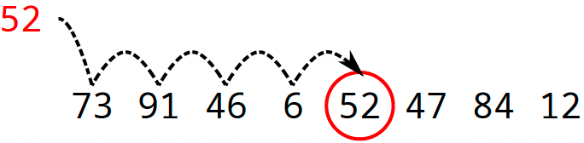
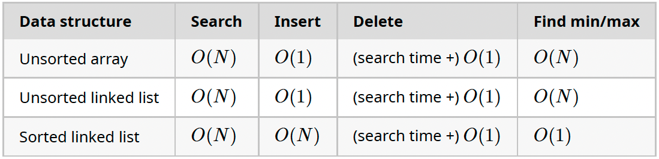
Searching Data
Linear search: Definition
Sequentially check each item of list until match is found
Also called sequential search
Characteristics
Very simple to implement
Only practical when list is short or for single-search scenario
Related data structures and complexity
Source: UC Davis, ECS 36C course, Spring 2020

Slide 6
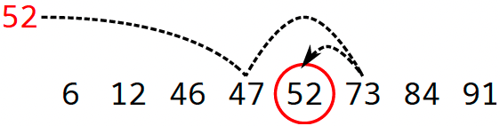
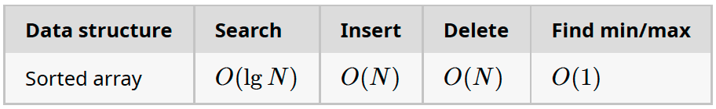
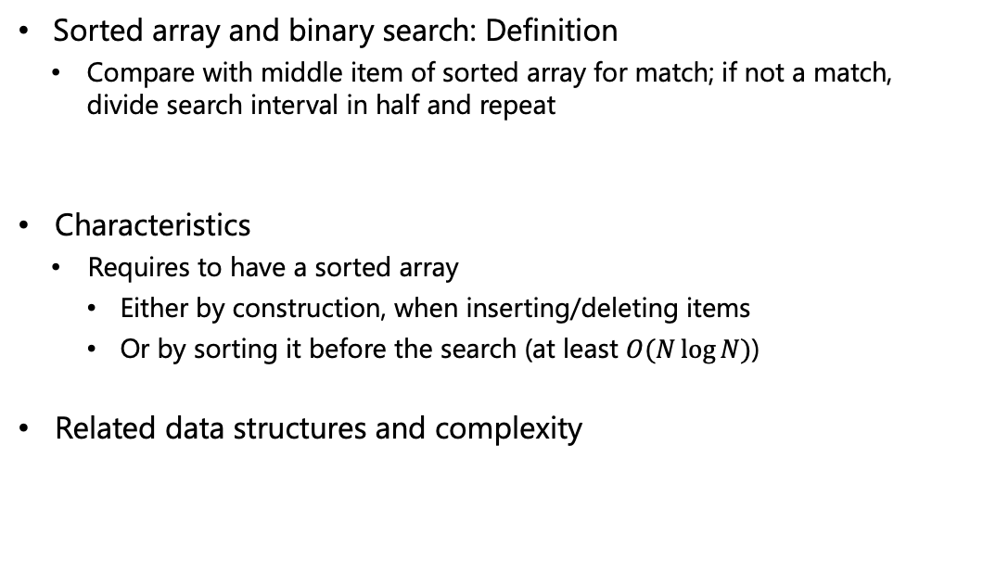
Searching Data
Sorted array and binary search: Definition
Compare with middle item of sorted array for match; if not a match, divide search interval in half and repeat
Characteristics
Requires to have a sorted array
Either by construction, when inserting/deleting items
Or by sorting it before the search (at least $O(N\log{N})$)
Related data structures and complexity
Source: UC Davis, ECS 36C course, Spring 2020

Slide 7
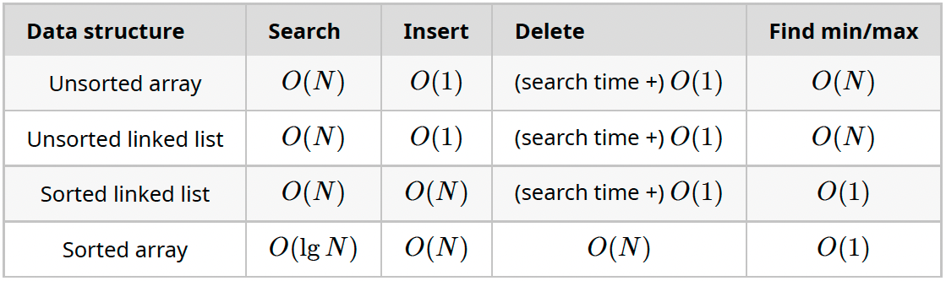
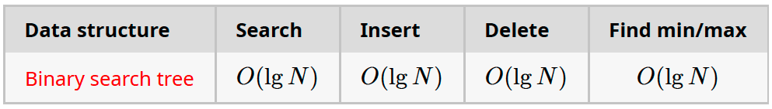

Searching Data
Summary
Problem
For large sets of items, the linear complexity of linked lists and arrays for some operations is prohibitive
Need for a new search data structure for which the average time of most operations is $O(\log{n})$
Source: UC Davis, ECS 36C course, Spring 2020

Slide 8
Trees
Recursive Definition
A tree can be defined recursively as:
A collection of nodes starting at a root node
Where each node is connected to zero or more child nodes via edges
With the constraints that no reference is duplicated, and no node points back to the root
A
B
C
D
E
F
G
H
I
J
K
Source: UC Davis, ECS 36C course, Spring 2020

Slide 9
Trees
Some Terminologies
Root: The root node is the tree's top node
There can be only one!
A
B
C
D
E
F
G
H
I
J
K
Source: UC Davis, ECS 36C course, Spring 2020

Slide 10
Trees
Some Terminologies
Edge: An edge is a connecting link between two nodes
A tree composed of N nodes has N - 1 edges
A
B
C
D
E
F
G
H
I
J
K
Source: UC Davis, ECS 36C course, Spring 2020

Slide 11
Trees
Some Terminologies
Parent: A parent node is the direct predecessor of another node
A
B
C
D
E
F
G
H
I
J
K
Source: UC Davis, ECS 36C course, Spring 2020

Slide 12
Trees
Some Terminologies
Child: A child is a node which is the direct descendant of another node
In a tree, all the nodes except the root are child nodes
A
B
C
D
E
F
G
H
I
J
K
Source: UC Davis, ECS 36C course, Spring 2020

Slide 13
Trees
Some Terminologies
Descendent/Ancestor: Nodes connected by more than one edge
A descendant node is also known as subchild
A
B
C
D
E
F
G
H
I
J
K
Source: UC Davis, ECS 36C course, Spring 2020

Slide 14
Trees
Some Terminologies
Sibling: Siblings are all the nodes descending from the same parent
A
B
C
D
E
F
G
H
I
J
K
Source: UC Davis, ECS 36C course, Spring 2020

Slide 15
Trees
Some Terminologies
Leaf: A leaf node is a node which has no child
Also called external, outer or terminal node
A
B
C
D
E
F
G
H
I
J
K
Source: UC Davis, ECS 36C course, Spring 2020

Slide 16
Trees
Some Terminologies
Internal Node: An internal node is a node which has at least one child
Opposite of leaf node and also called inner or branch node
A
B
C
D
E
F
G
H
I
J
K
Source: UC Davis, ECS 36C course, Spring 2020

Slide 17
Trees
Some Terminologies
Degree: The degree of a node is the number of its children
A leaf node has always degree 0
The degree of a tree is the maximum degree of any of its nodes
A
B
C
D
E
F
G
H
I
J
K
Source: UC Davis, ECS 36C course, Spring 2020

Slide 18
Trees
Some Terminologies
Level: The level of a node is one greater than the level of its parent with level of the root node being 0
A
Level 0
B
C
Level 1
D
E
F
G
H
Level 2
I
J
K
Level 3

Slide 19
Trees
Some Terminologies
Path: A path is a sequence of nodes and edges connecting a node with a descendant
The length of the path is the number of edges composing it
A
B
C
D
E
F
G
H
I
J
K
Source: UC Davis, ECS 36C course, Spring 2020

Slide 20
Trees
Some Terminologies
Depth: The depth of a node is the path length from the root to this node
The depth of root is 0
The depth of a tree is equal to the depth of the deepest leaf
A
B
C
D
E
F
G
H
I
J
K
Source: UC Davis, ECS 36C course, Spring 2020

Slide 21
Trees
Some Terminologies
Height: The height of a node is the length of the longest path from a leaf to this node
All leaves are at height 0
The height of a tree is equal to the height of the root from the deepest leaf (which is always equal to the depth of the tree)
A
B
C
D
E
F
G
H
I
J
K
Source: UC Davis, ECS 36C course, Spring 2020

Slide 22
Trees
Some Terminologies
Subtree: A subtree consists of a child node and all of its descendants
A
B
C
D
E
F
G
H
I
J
K
Source: UC Davis, ECS 36C course, Spring 2020

Slide 23
Typical Implementations
Each node is a struct containing data and ‘n’ pointers to ‘n’ children
However, node degrees are not necessarily known in advance for the construction
A
B
C
D
E
F
G
H
I
J
K

Slide 24
Typical Implementations
Each node is a linked list with data and two pointers
First pointer links to the first child and second pointer to the next sibling
A
B
C
D
E
F
G
H
I
J
K

Slide 25
Binary Trees
A binary tree is a tree in which each node has at most two children
Usually referred to as left child and right child
Source: UC Davis, ECS 36C course, Spring 2020

Slide 26
Full Binary Tree
In a full binary tree, every node has either 0 or 2 children
The number of leaves in a non-empty full binary tree is one more than the number of internal nodes. Easy to see. Books have proof by induction. (Skipping it here)
Source: UC Davis, ECS 36C course, Spring 2020

Slide 27
Complete Binary Tree
In a complete binary tree, every level, except possibly the last one, is completely filled and all nodes in the last level are as far left as possible
Source: UC Davis, ECS 36C course, Spring 2020

Slide 28

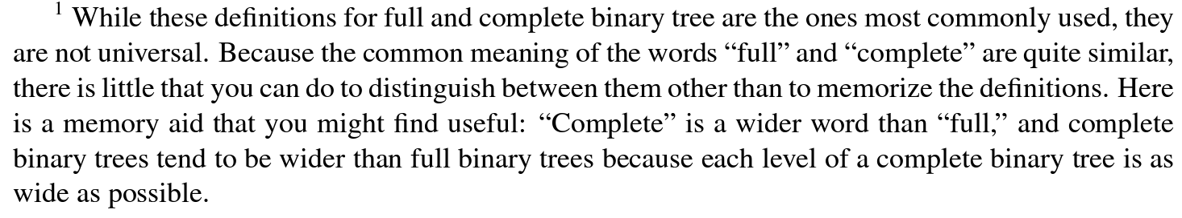
Complete vs Full Binary Tree: Memory Aid
Image Source: amazon.com

Slide 29
Perfect Binary Tree
In a perfect binary tree, all internal nodes have two children and all leaf nodes have the same depth
Source: UC Davis, ECS 36C course, Spring 2020

Slide 30

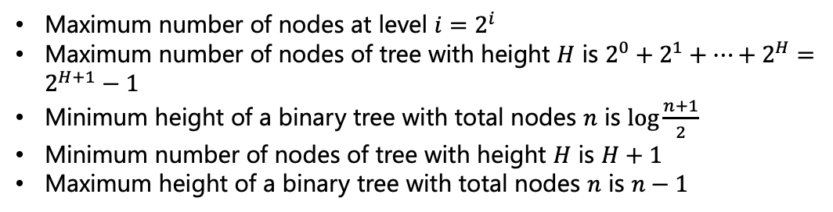



Binary Trees
Max # of
Nodes
A
Level 0
$$1=2^{0}$$
B
C
Level 1
$$2=2^{1}$$
D
E
F
G
Level 2
$$4=2^{2}$$
I
J
K
L
M
N
O
P
Level 3
$$8=2^{3}$$
Maximum number of nodes at level $i=2^{i}$
Maximum number of nodes of tree with height $H$ is ${2^{0}+2^{1}+…+2}^{H}=2^{H+1}−1$
Minimum height of a binary tree with total nodes $n$ is $\log{\frac{n+1}{2}}$
Minimum number of nodes of tree with height $H$ is $H+1$
Maximum height of a binary tree with total nodes $n$ is $n−1$

Slide 31
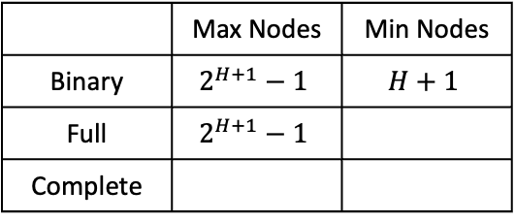
Binary Trees
A
B
C
D
E
F
G
H
I
 | Max Nodes | Min Nodes
Binary | $$2^{H+1}−1$$ | $$H+1$$
Full | $$2^{H+1}−1$$
Complete

Slide 32


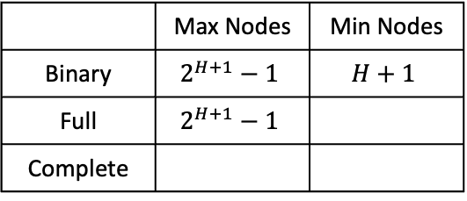








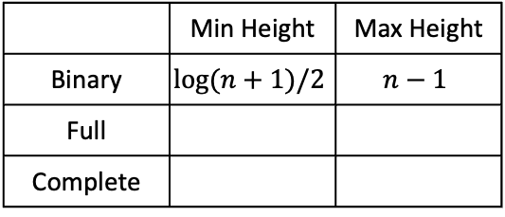

Binary Trees
A
For $H=0$, Min nodes = 1
For $H=1$, Min nodes = 3
C
For $H=2$, Min nodes = 5
B
For $H=3$, Min nodes = 7
D
E
F
G
 | Max Nodes | Min Nodes
Binary | $$2^{H+1}−1$$ | $$H+1$$
Full | $$2^{H+1}−1$$
Complete
 | Min Height | Max Height
Binary | $$\log{(n+1)/2}$$ | $$n−1$$
Full
Complete
$$2H+1$$
$$\log{(n+1)/2}$$
$$(n−1)/2$$
$$2^{H+1}−1$$
$$2^{H}$$
$$\log{(n+1)/2}$$
$$\log{n}$$

Slide 33
Implementing Binary Tree
struct node
{
int data;
struct node* left;
struct node* right;
};
Create a node with data and two NULL pointers in left and right
struct node* newNode(int data)
{
// Allocate memory for new node
struct node* node = (struct node*)malloc(sizeof(struct node));
node->data = data;
node->left = NULL;
node->right = NULL;
return node;
}

Slide 34
Implementing Binary Tree
Create a simple binary tree
int main()
{
// create root with data=1
struct node* root = newNode(1)
// left and right child of the root
root->left = newNode(2);
root->right = newNode(3);
// left-left child of the root
root->left->left = newNode(4);
return 0;
}
1
2
3
4

Slide 35
Binary Tree Traversal
Often we wish to process a binary tree by “visiting” each of its nodes, each time performing a specific action (such as printing, updating, searching the contents of the node)
Any process for visiting all of the nodes in some order is called a traversal
Unlike linear data structures (e.g. arrays, linked lists, etc), trees do not inherently have a linear order in which they can be traversed
There is no “natural” end or start so to say of a tree.
General recursive pattern:
Different order of three basic operations from a node N
(N) Process N itself
(L) Recurse on N’s left subtree
(R) Recurse on N’s right subtree

Slide 36
Binary Tree Traversal
From a node N
(N) Process N itself
(L) Recurse on N’s left subtree
(R) Recurse on N’s right subtree
Pre-order (NLR)
A-B-D-H-I-E-C-F-J-G
In-order (LNR)
Post-order (LRN)
H-D-I-B-E-A-J-F-C-G
H-I-D-E-B-J-F-G-C-A

Slide 37
Implementing Binary Tree Traversals
Pre-order (NLR)
void printPreorder(struct node* node)
{
if (node==NULL)
return;
// Print (N)
printf(“%d ”, node->data);
// Recurse on left subtree (L)
printPreorder(node->left);
// Recurse on right subtree (R)
printPreorder(node->right);
};

Slide 38
Implementing Binary Tree Traversals
In-order (LNR)
void printInorder(struct node* node)
{
if (node==NULL)
return;
// Recurse on left subtree (L)
printInorder(node->left);
// Print (N)
printf(“%d ”, node->data);
// Recurse on right subtree (R)
printInorder(node->right);
};

Slide 39
Implementing Binary Tree Traversals
Post-order (LRN)
void printPostorder(struct node* node)
{
if (node==NULL)
return;
// Recurse on left subtree (L)
printPostorder(node->left);
// Recurse on right subtree (R)
printPostorder(node->right);
// Print (N)
printf(“%d ”, node->data);
};

Slide 40
Binary Search Tree
Definition: A binary search tree is a special kind of binary tree in which
Each node contains one comparable key
(and optionally some associated data/value)
Each node’s key is greater than any key stored in its left subtree
Each node’s key is less than any key stored in its right subtree
51
43
43
93
18
54
18
54
99
2
42
51
93
2
42
74
74
99

Slide 41
Searching in Binary Search Tree
Start at the root
If query is equal to the root, return the position
If query is less than the root, go to the left subtree and continue the search
If query is more than the root, go to the right subtree and continue the search
51
43
93
18
54
99
2
42
74

Slide 42
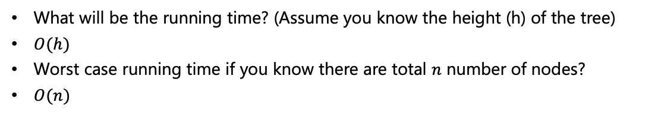
Implementing Search in Binary Search Tree
struct node* search(struct node* root, int query)
{
// Base case: root is null or key is present at root
if (root == NULL || root->key == query)
return root;
// If query is less than root’s key, recurse on left subtree, else recurse on right subtree (R)
if (query < root->key)
return search(root->left, query);
else
return search(root->right, query);
}
What will be the running time? (Assume you know the height (h) of the tree)
$O(h)$
Worst case running time if you know there are total $n$ number of nodes?
$O(n)$

Slide 43
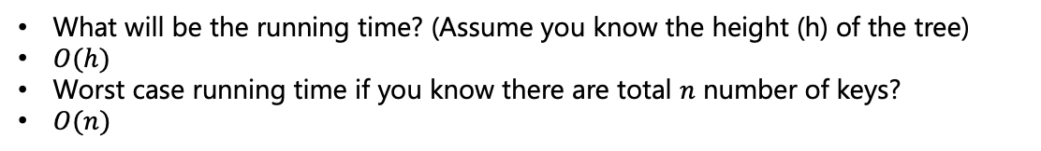
Inserting in Binary Search Tree
// function to insert a new node with given key in BST
struct node* insert(struct node* node, int key){
// If we reach a NULL pointer, this is the place to insert
if (node == NULL)
return newNode(key);
// Recur down the tree
if (key < node->key)
node->left = insert(node->left, key);
else if (key > node->key)
node->right = insert(node->right, key);
else
printf("Key %d is already present!\n", key);
// Return the (unchanged) node pointer
return node;
}
What will be the running time? (Assume you know the height (h) of the tree)
$O(h)$
Worst case running time if you know there are total $n$ number of keys?
$O(n)$

Slide 44
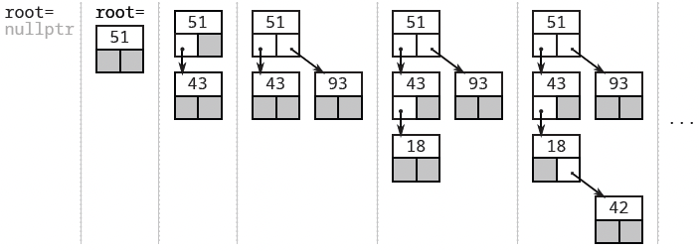
Inserting in Binary Search Tree
Source: UC Davis, ECS 36C course, Spring 2020

Slide 45
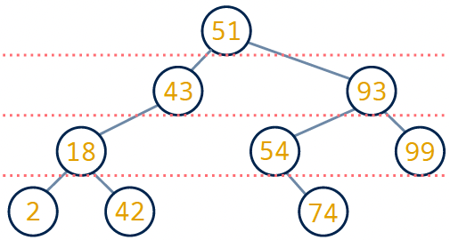
Printing Binary Search Tree
Basically inorder traversal – printing level of the node also
void printTree (struct node* node, int level)
{
if (node==NULL)
return;
printTree(node->left, level+1);
// Print node key and level
printf(“%d [%d] ”, node->key, level);
printTree(node->right, level+1);
}
0
1
2
3
2 [3] 18 [2] 42 [3] 43 [1] 51 [0] 54 [2] 74 [3] 93 [1] 99 [2]

Slide 46


Finding Max/Min Element of Binary Search Tree
Go as far right as possible
Go as far left as possible
int getMax(struct node* node)
{
while(node->right != NULL)
node = node->right;
return node->key;
}
struct node* getMin(struct node* node)
{
if(node->left != NULL)
return getMin(node->left);
else
return node;
}
99
Finding max is $O(h)$
2
Finding max is $O(h)$

Slide 47
Removing Node from Binary Search Tree
Lazy node deletion: Don’t actually delete the node
Keep the key and mark the node as “disabled”
Upon later insertion of the same key, node can easily be re-enabled
Somewhat viable approach only if number of deletions is very small (e.g., log files)
51
Example after removing 93
43
93
18
54
99
2
42
74
Source: UC Davis, ECS 36C course, Spring 2020

Slide 48
Removing Node from Binary Search Tree
Actual node deletion:
3 Scenarios
Leaf node i.e., node with no child
51
43
93
18
54
99
2
42
74
Internal node with one child
Internal node with two children
51
51
43
93
43
93
18
54
99
42
54
99
42
74
74
Source: UC Davis, ECS 36C course, Spring 2020

Slide 49
Removing Node from Binary Search Tree
Leaf node i.e., node with no child
Before
51
43
93
18
54
99
2
42
74
Algorithm
Simply remove node to be deleted from the tree
After
51
51
43
93
43
93
18
54
99
18
54
99
2
42
74
42
74
Source: UC Davis, ECS 36C course, Spring 2020

Slide 50
Removing Node from Binary Search Tree
Internal node with one child
Before
51
43
93
18
54
99
Algorithm
42
74
Replace node with its child
After
51
51
43
93
43
93
42
54
99
18
54
99
74
42
74
Source: UC Davis, ECS 36C course, Spring 2020

Slide 51
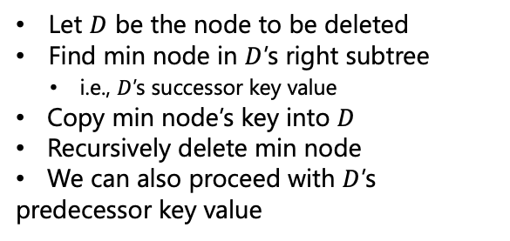
Removing Node from Binary Search Tree
Internal node with two children
Before
51
Algorithm
Let $D$ be the node to be deleted
Find min node in $D$’s right subtree
i.e., $D$’s successor key value
Copy min node’s key into $D$
Recursively delete min node
We can also proceed with $D$’s predecessor key value
43
93
42
54
99
74
51
54
43
93
42
54
99
74
Source: UC Davis, ECS 36C course, Spring 2020

Slide 52
Removing Node from Binary Search Tree
Internal node with two children
Before
51
Algorithm
Let $D$ be the node to be deleted
Find min node in $D$’s right subtree
i.e., $D$’s successor key value
Copy min node’s key into $D$
Recursively delete min node
We can also proceed with $D$’s predecessor key value
43
93
42
54
99
74
After
51
54
43
93
43
93
42
54
99
42
74
99
74
Source: UC Davis, ECS 36C course, Spring 2020

Slide 53
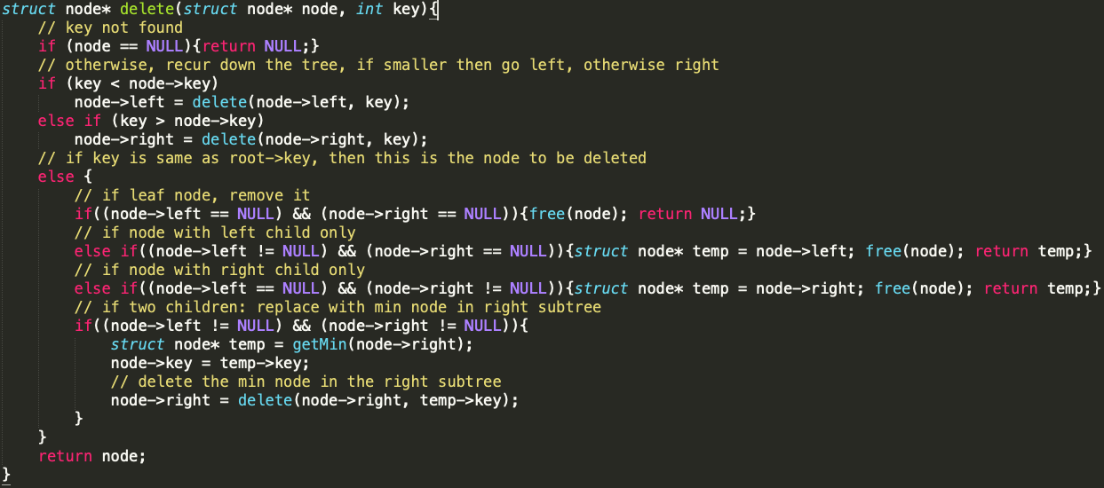
Removing Node from Binary Search Tree

Slide 54
To be continued

