Slide 1
Algorithms – I (CS29003/203)
Autumn 2022, IIT Kharagpur
Dynamic Programing

Slide 2
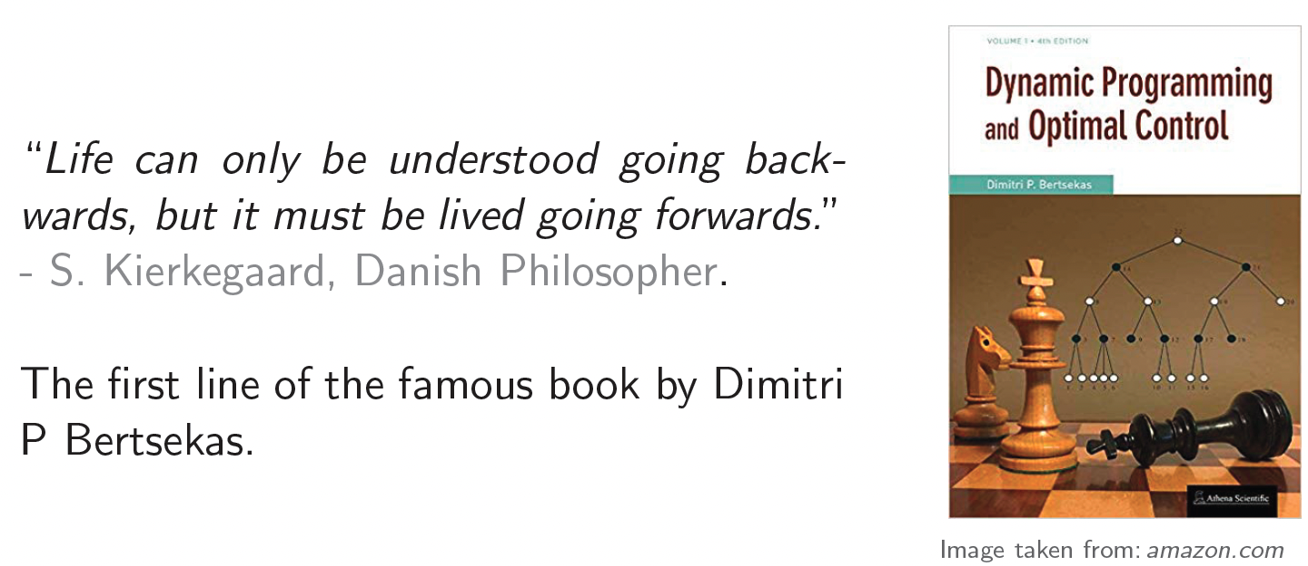
Dynamic Programing

Slide 3
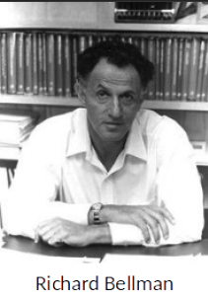
Dynamic Programing
Dynamic Programing (DP), like Divide-and-conquer, solves problems by combining solutions to subproblems
It was invented as a general method for optimizing multistage decision processes in the 1950s by prominent US Mathematician Richard Bellman
Why is it named programing?
‘Programing’ here refers to a tabular method for solving an optimization problem as opposed to writing computer code
Much like linear programing or quadratic programing

Slide 4
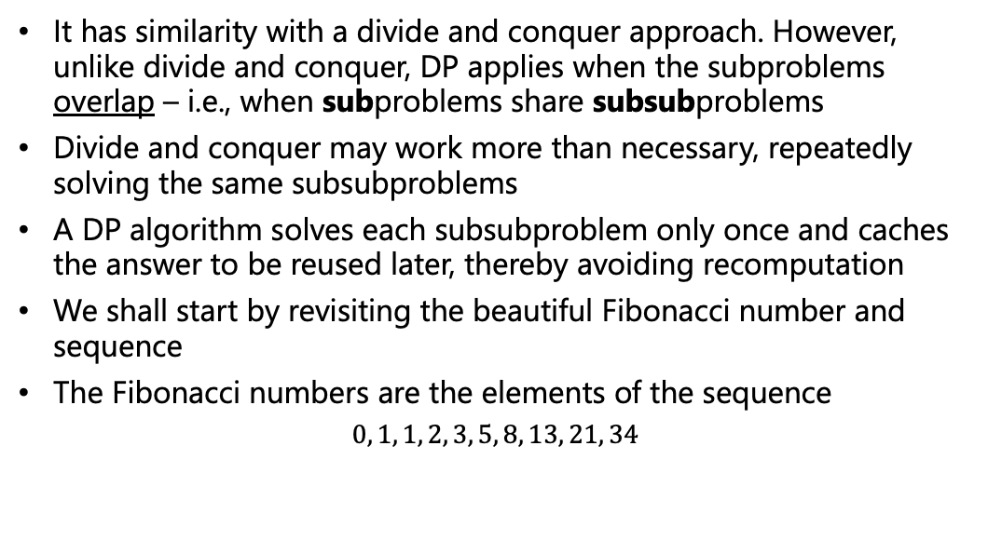
Dynamic Programing
It has similarity with a divide and conquer approach. However, unlike divide and conquer, DP applies when the subproblems overlap – i.e., when subproblems share subsubproblems
Divide and conquer may work more than necessary, repeatedly solving the same subsubproblems
A DP algorithm solves each subsubproblem only once and caches the answer to be reused later, thereby avoiding recomputation
We shall start by revisiting the beautiful Fibonacci number and sequence
The Fibonacci numbers are the elements of the sequence
$$0, 1, 1, 2, 3, 5, 8, 13, 21, 34$$

Slide 5
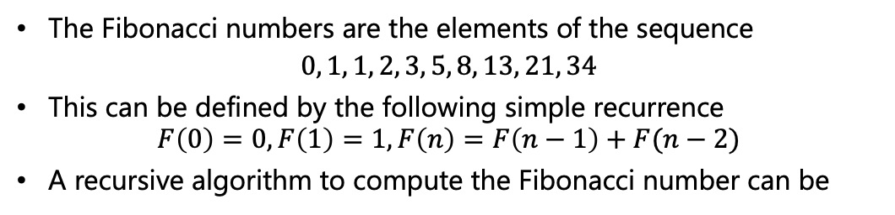
Fibonacci Number Recursive Algorithm
The Fibonacci numbers are the elements of the sequence
$$0, 1, 1, 2, 3, 5, 8, 13, 21, 34$$
This can be defined by the following simple recurrence $F\left(0\right)=0, F\left(1\right)=1, F\left(n\right)=F\left(n−1\right)+F(n−2)$
A recursive algorithm to compute the Fibonacci number can be
//Input (n): A nonnegative integer
//Output: The n^{th} Fibonacci number
Fib(n)
if ((n==0) or (n==1))
return n
return Fib(n-1) + Fib(n-2)

Slide 6
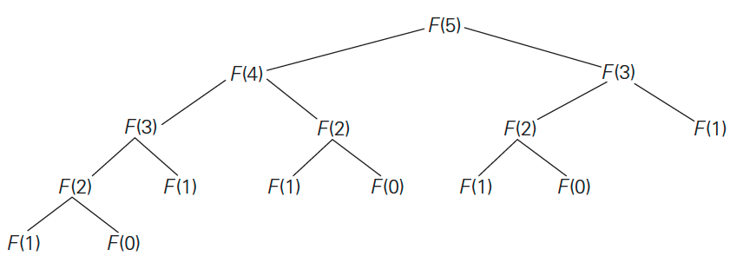
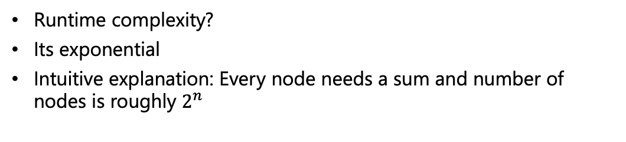
Fibonacci Number Recursive Algorithm
Runtime complexity?
Its exponential
Intuitive explanation: Every node needs a sum and number of nodes is roughly $2^{n}$

Slide 7
Fibonacci Number – Efficient Computation
It does a lot of duplicate computations
How can we avoid that?
We compute each subproblem only once and reuse them
Lets take a bottom-up approach rather than a top-down approach
That is – instead of starting from top of the tree why don’t we start small (the base cases, n=0 or 1) and use the solutions of the smaller problems to get the solution to the bigger problems
Fib(n)
Create an array A of size n+1 // 0-based index
A[0] = 0
A[1] = 1
for i=2 to n:
A[i] = A[i-1] + A[i-2]
return A[n]

Slide 8
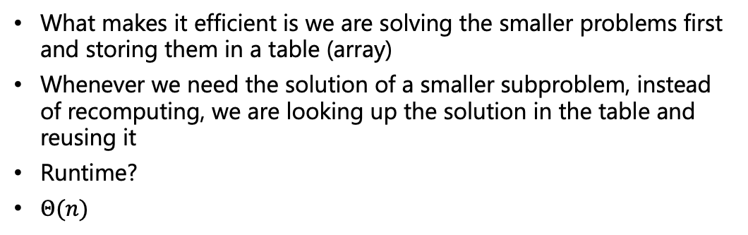
Fibonacci Number – Efficient Computation
What makes it efficient is we are solving the smaller problems first and storing them in a table (array)
Whenever we need the solution of a smaller subproblem, instead of recomputing, we are looking up the solution in the table and reusing it
Runtime?
$Θ(n)$
Fib(n)
Create an array A of size n+1 // 0-based index
A[0] = 0
A[1] = 1
for i=2 to n:
A[i] = A[i-1] + A[i-2]
return A[n]

Slide 9
Unlimited Number Knapsack
Overall weight limit: 8 lb, we can take an unlimited number of each item
Item a: 5 lb, $150
Item b: 4 lb, $100
Item c: 2 lb, $10
Expensive first: Item a + Item c, value: $160
Lightest first: Item c, 4 times, value: $40
Optimal: Item b, 2 times, value: $200
Greedy strategy does not provide the optimal solution
A naive solution? Try all possibilities!
Source: UC Riverside, CS141 course, Fall 2021

Slide 10
A Naïve Algorithm
Item a: 5 lb, $150
Item b: 4 lb, $100
Item c: 2 lb, $10
suitcase(8)
suitcase(3)+150 //a fits
suitcase(1)+10 //Only c fits
0 //Nothing fits
max(0,0+10)=10
max(0,10+150)=160
suitcase(leftWeight)
curBest = 0
foreach item of (weight, val)
if (leftWeight >= weight)
curBest = max(curBest, suitcase(leftWeight-weight)+val)
return curBest
// Calling the function
answer = suitcase(8)
Recursive call
Source: UC Riverside, CS141 course, Fall 2021

Slide 11

Execution Recurrence Tree
$200
Item $a$: 5lb, $150
Item $b$: 4lb, $100
Item $c$: 2lb, $10
S₈
+$150
+$10
+$100
$10
$100
$150
S₃
S₄
S₆
+$10
+$10
+$100
+$150
+$100
+$10
$0
$10
$0
$0
$10
$100
S₁
S₂
S₀
S₁
S₂
S₄
+$10
+$10
+$10
+$100
$0
$0
$10
$0
S₀
S₀
S₂
S₀
+$10
$0
S₀
Source: UC Riverside, CS141 course, Fall 2021

Slide 12
Execution Recurrence Tree
$200
Item $a$: 5lb, $150
Item $b$: 4lb, $100
Item $c$: 2lb, $10
S₈
+$150
+$10
+$100
$10
$100
$150
S₃
S₄
S₆
+$10
+$10
+$100
+$150
+$100
+$10
$0
$10
$0
$0
$10
$100
S₁
S₂
S₀
S₁
S₂
S₄
+$10
+$10
+$10
+$100
$0
$0
$10
$0
S₀
S₀
S₂
S₀
+$10
$0
S₀
Source: UC Riverside, CS141 course, Fall 2021

Slide 13
Execution Recurrence Tree
$200
Item $a$: 5lb, $150
Item $b$: 4lb, $100
Item $c$: 2lb, $10
S₈
+$150
+$10
+$100
$10
$100
$150
S₃
S₄
S₆
+$10
+$10
+$100
+$150
+$100
+$10
$0
$10
$0
$0
$10
$100
S₁
S₂
S₀
S₁
S₂
S₄
+$10
+$10
+$10
+$100
$0
$0
$10
$0
S₀
S₀
S₂
S₀
+$10
There are at most 9 different subproblems that need to be computed for this enormous recursion tree
$0
S₀
Source: UC Riverside, CS141 course, Fall 2021

Slide 14
An Efficient Algorithm
Item a: 5 lb, $150, Item b: 4 lb, $100, Item c: 2 lb, $10
suitcase(leftWeight)
curBest = 0
foreach item of (weight, val)
if (leftWeight >= weight)
curBest = max(curBest, suitcase(leftWeight-weight)+val)
return curBest
// Calling the function
answer = suitcase(8)
Previous naïve version
Source: UC Riverside, CS141 course, Fall 2021

Slide 15
An Efficient Algorithm
Item a: 5 lb, $150, Item b: 4 lb, $100, Item c: 2 lb, $10
suitcase(leftWeight)
if (ans[leftWeight] != -1)
return ans[leftWeight]
curBest = 0
foreach item of (weight, val)
if (leftWeight >= weight)
curBest = max(curBest, suitcase(leftWeight-weight)+val)
ans[leftWeight] = curBest
return curBest
// Calling the function
ans[0,..,8] = {-1,..,-1}
answer = suitcase(8)
Source: UC Riverside, CS141 course, Fall 2021

Slide 16
An Efficient Algorithm
Item a: 5 lb, $150, Item b: 4 lb, $100, Item c: 2 lb, $10
suitcase(leftWeight)
if (ans[leftWeight] != -1)
return ans[leftWeight]
curBest = 0
foreach item of (weight, val)
if (leftWeight >= weight)
curBest = max(curBest, suitcase(leftWeight-weight)+val)
ans[leftWeight] = curBest
return curBest
// Calling the function
ans[0,..,8] = {-1,..,-1}
answer = suitcase(8)
COMPLEXITY??
Source: UC Riverside, CS141 course, Fall 2021
Notes:
Time complexity: Θ((W+1)*N). As we can take all items multiple number of times, we check all of them(1 to N) for all weights from 0 to W. Hence, time complexity = (W+1) * N.

Slide 17
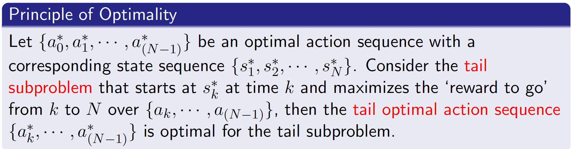





Overlapping Subproblems and Optimal Substructure
Dynamic Programing addresses a bigger problem by breaking it down as subproblems and then
Solving the subproblems
Combining solutions to subproblems
Dynamic Programing is based on the principle of optimality
$$s_{k}^{∗}$$
Tail subproblem
$$0$$
$$k$$
$$N$$
Time
$$a_{0}^{∗},⋯,a_{k}^{∗},⋯,a_{N−1}^{∗}$$
Optimal action sequence

Slide 18
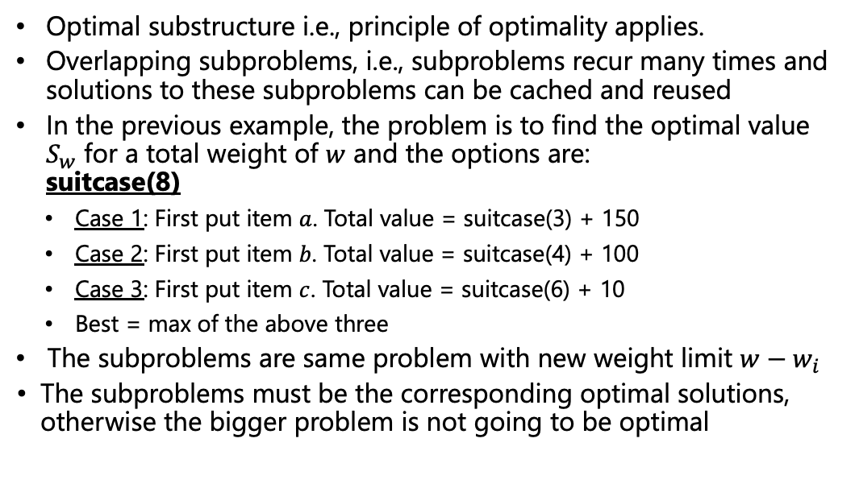
Requirements of Dynamic Programing
Optimal substructure i.e., principle of optimality applies.
Overlapping subproblems, i.e., subproblems recur many times and solutions to these subproblems can be cached and reused
In the previous example, the problem is to find the optimal value $S_{w}$ for a total weight of $w$ and the options are: suitcase(8)
Case 1: First put item $a$. Total value = suitcase(3) + 150
Case 2: First put item $b$. Total value = suitcase(4) + 100
Case 3: First put item $c$. Total value = suitcase(6) + 10
Best = max of the above three
The subproblems are same problem with new weight limit $w−w_{i}$
The subproblems must be the corresponding optimal solutions, otherwise the bigger problem is not going to be optimal
Notes:
In greedy we fix a criterion and choose one action. In DP, we try all actions and choose the best

Slide 19
0/1 Knapsack Problem
Item a: 5 lb, $150, Item b: 4 lb, $100, Item c: 2 lb, $10
suitcase(leftWeight)
if (ans[leftWeight] != -1)
return ans[leftWeight]
curBest = 0
foreach item of (weight, val)
if (leftWeight >= weight)
curBest = max(curBest, suitcase(leftWeight-weight)+val)
ans[leftWeight] = curBest
return curBest
// Calling the function
ans[0,..,8] = {-1,..,-1}
answer = suitcase(8)
Will the solution work if we only allow to use an item once?
Source: UC Riverside, CS141 course, Fall 2021

Slide 20
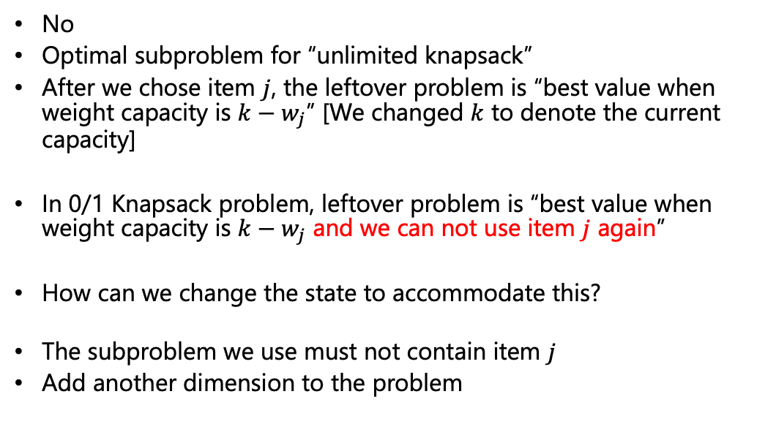
0/1 Knapsack Problem
No
Optimal subproblem for “unlimited knapsack”
After we chose item $j$, the leftover problem is “best value when weight capacity is $k−w_{j}$” [We changed $k$ to denote the current capacity]
In 0/1 Knapsack problem, leftover problem is “best value when weight capacity is $k−w_{j}$ and we can not use item $j$ again”
How can we change the state to accommodate this?
The subproblem we use must not contain item $j$
Add another dimension to the problem
Source: UC Riverside, CS141 course, Fall 2021
Notes:
In greedy we fix a criterion and choose one action. In DP, we try all actions and choose the best

Slide 21
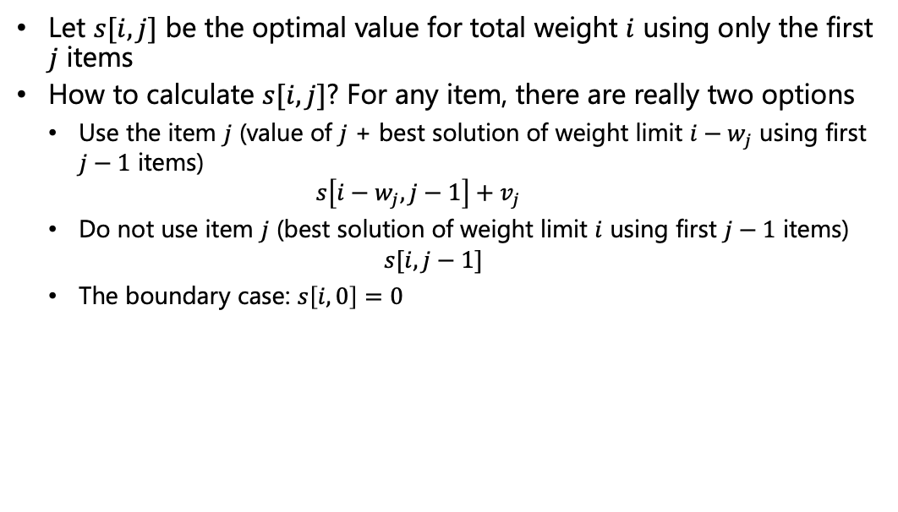
0/1 Knapsack Problem
Let $s[i,j]$ be the optimal value for total weight $i$ using only the first $j$ items
How to calculate $s[i,j]$? For any item, there are really two options
Use the item $j$ (value of $j$ + best solution of weight limit $i−w_{j}$ using first $j−1$ items) $s\left[i−w_{j},j−1\right]+v_{j}$
Do not use item $j$ (best solution of weight limit $i$ using first $j−1$ items) $s[i,j−1]$
The boundary case: $s\left[i,0\right]=0$
Source: UC Riverside, CS141 course, Fall 2021

Slide 22
0/1 Knapsack Problem Example
Item $1$
8 lb
$$j$$
5 lb
Item $2$
 | No item | Item 1 | Item 1 & 2 | Item 1, 2 & 3
0
1
2
3
4
5
6
7
8
$$i$$
4 lb
Item $3$
2 lb
Cost:
$$150$
$$100$
$$10$
Knapsack
$s$[$i]$[$j$] : optimal solution for a knapsack of capacity $i$ using item $1, 2, …, j$

Slide 23
0/1 Knapsack Problem Example
Item $1$
8 lb
$$j$$
5 lb
Item $2$
 | No item | Item 1 | Item 1 & 2 | Item 1, 2 & 3
0 | 0
1 | 0
2 | 0
3 | 0
4 | 0
5 | 0
6 | 0
7 | 0
8 | 0
$$i$$
4 lb
Item $3$
2 lb
Cost:
$$150$
$$100$
$$10$
Knapsack
$s$[$i]$[$j$] : optimal solution for a knapsack of capacity $i$ using item $1, 2, …, j$

Slide 24
0/1 Knapsack Problem Example
Item $1$
8 lb
$$j$$
5 lb
Item $2$
 | No item | Item 1 | Item 1 & 2 | Item 1, 2 & 3
0 | 0
1 | 0
2 | 0
3 | 0
4 | 0
5 | 0
6 | 0
7 | 0
8 | 0
$$i$$
4 lb
Item $3$
2 lb
Cost:
$$150$
$$100$
$$10$
Knapsack
$s$[$i]$[$j$] : optimal solution for a knapsack of capacity $i$ using item $1, 2, …, j$

Slide 25
0/1 Knapsack Problem Example
Item $1$
8 lb
$$j$$
5 lb
Item $2$
 | No item | Item 1 | Item 1 & 2 | Item 1, 2 & 3
0 | 0 | 0
1 | 0 | 0
2 | 0 | 0
3 | 0 | 0
4 | 0 | 0
5 | 0
6 | 0
7 | 0
8 | 0
$$i$$
4 lb
Item $3$
2 lb
Cost:
$$150$
$$100$
$$10$
Knapsack
$s$[$i]$[$j$] : optimal solution for a knapsack of capacity $i$ using item $1, 2, …, j$

Slide 26
0/1 Knapsack Problem Example
Item $1$
8 lb
$$j$$
5 lb
 | No item | Item 1 | Item 1 & 2 | Item 1, 2 & 3
0 | 0 | 0
1 | 0 | 0
2 | 0 | 0
3 | 0 | 0
4 | 0 | 0
5 | 0
6 | 0
7 | 0
8 | 0
Item $2$
$$i$$
4 lb
Item $3$
2 lb
Cost:
$$150$
$$100$
$$10$
Knapsack
$s$[$i]$[$j$] : optimal solution for a knapsack of capacity $i$ using item $1, 2, …, j$
Opt$1+V_{j}=$
Opt$2=$

Slide 27
0/1 Knapsack Problem Example
Item $1$
8 lb
$$j$$
5 lb
Item $2$
 | No item | Item 1 | Item 1 & 2 | Item 1, 2 & 3
0 | 0 | 0
1 | 0 | 0
2 | 0 | 0
3 | 0 | 0
4 | 0 | 0
5 | 0
6 | 0
7 | 0
8 | 0
$$i$$
4 lb
Item $3$
2 lb
Cost:
$$150$
$$100$
$$10$
Knapsack
$s$[$i]$[$j$] : optimal solution for a knapsack of capacity $i$ using item $1, 2, …, j$
Opt$1+V_{j}=0+\$150$
Opt$2=0$

Slide 28
0/1 Knapsack Problem Example
Item $1$
8 lb
$$j$$
5 lb
Item $2$
 | No item | Item 1 | Item 1 & 2 | Item 1, 2 & 3
0 | 0 | 0
1 | 0 | 0
2 | 0 | 0
3 | 0 | 0
4 | 0 | 0
5 | 0 | $$150$$
6 | 0
7 | 0
8 | 0
$$i$$
4 lb
Item $3$
2 lb
Cost:
$$150$
$$100$
$$10$
Knapsack
$s$[$i]$[$j$] : optimal solution for a knapsack of capacity $i$ using item $1, 2, …, j$
Opt$1+V_{j}=0+\$150$
Opt$2=0$

Slide 29
0/1 Knapsack Problem Example
Item $1$
8 lb
$$j$$
5 lb
Item $2$
 | No item | Item 1 | Item 1 & 2 | Item 1, 2 & 3
0 | 0 | 0
1 | 0 | 0
2 | 0 | 0
3 | 0 | 0
4 | 0 | 0
5 | 0 | $$150$$
6 | 0 | $$150$$
7 | 0
8 | 0
$$i$$
4 lb
Item $3$
2 lb
Cost:
$$150$
$$100$
$$10$
Knapsack
$s$[$i]$[$j$] : optimal solution for a knapsack of capacity $i$ using item $1, 2, …, j$
Opt$1+V_{j}=0+\$150$
Opt$2=0$

Slide 30
0/1 Knapsack Problem Example
Item $1$
8 lb
$$j$$
5 lb
Item $2$
 | No item | Item 1 | Item 1 & 2 | Item 1, 2 & 3
0 | 0 | 0
1 | 0 | 0
2 | 0 | 0
3 | 0 | 0
4 | 0 | 0
5 | 0 | $$150$$
6 | 0 | $$150$$
7 | 0 | $$150$$
8 | 0 | $$150$$
$$i$$
4 lb
Item $3$
2 lb
Cost:
$$150$
$$100$
$$10$
Knapsack
$s$[$i]$[$j$] : optimal solution for a knapsack of capacity $i$ using item $1, 2, …, j$
Opt$1+V_{j}=0+\$150$
Opt$2=0$

Slide 31
0/1 Knapsack Problem Example
Item $1$
8 lb
$$j$$
5 lb
Item $2$
 | No item | Item 1 | Item 1 & 2 | Item 1, 2 & 3
0 | 0 | 0 | 0
1 | 0 | 0 | 0
2 | 0 | 0 | 0
3 | 0 | 0 | 0
4 | 0 | 0
5 | 0 | $$150$$
6 | 0 | $$150$$
7 | 0 | $$150$$
8 | 0 | $$150$$
$$i$$
4 lb
Item $3$
2 lb
Cost:
$$150$
$$100$
$$10$
Knapsack
$s$[$i]$[$j$] : optimal solution for a knapsack of capacity $i$ using item $1, 2, …, j$
Opt$1+V_{j}=0+\$100$
Opt$2=0$

Slide 32
0/1 Knapsack Problem Example
Item $1$
8 lb
$$j$$
5 lb
Item $2$
 | No item | Item 1 | Item 1 & 2 | Item 1, 2 & 3
0 | 0 | 0 | 0
1 | 0 | 0 | 0
2 | 0 | 0 | 0
3 | 0 | 0 | 0
4 | 0 | 0 | $$100$$
5 | 0 | $$150$$
6 | 0 | $$150$$
7 | 0 | $$150$$
8 | 0 | $$150$$
$$i$$
4 lb
Item $3$
2 lb
Cost:
$$150$
$$100$
$$10$
Knapsack
$s$[$i]$[$j$] : optimal solution for a knapsack of capacity $i$ using item $1, 2, …, j$
Opt$1+V_{j}=0+\$100$
Opt$2=0$

Slide 33
0/1 Knapsack Problem Example
Item $1$
8 lb
$$j$$
5 lb
Item $2$
 | No item | Item 1 | Item 1 & 2 | Item 1, 2 & 3
0 | 0 | 0 | 0
1 | 0 | 0 | 0
2 | 0 | 0 | 0
3 | 0 | 0 | 0
4 | 0 | 0 | $$100$$
5 | 0 | $$150$$ | $$150$$
6 | 0 | $$150$$
7 | 0 | $$150$$
8 | 0 | $$150$$
$$i$$
4 lb
Item $3$
2 lb
Cost:
$$150$
$$100$
$$10$
Knapsack
$s$[$i]$[$j$] : optimal solution for a knapsack of capacity $i$ using item $1, 2, …, j$
Opt$1+V_{j}=0+\$100$
Opt$2=150$

Slide 34
0/1 Knapsack Problem Example
Item $1$
8 lb
$$j$$
5 lb
Item $2$
 | No item | Item 1 | Item 1 & 2 | Item 1, 2 & 3
0 | 0 | 0 | 0
1 | 0 | 0 | 0
2 | 0 | 0 | 0
3 | 0 | 0 | 0
4 | 0 | 0 | $$100$$
5 | 0 | $$150$$ | $$150$$
6 | 0 | $$150$$ | $$150$$
7 | 0 | $$150$$ | $$150$$
8 | 0 | $$150$$ | $$150$$
$$i$$
4 lb
Item $3$
2 lb
Cost:
$$150$
$$100$
$$10$
Knapsack
$s$[$i]$[$j$] : optimal solution for a knapsack of capacity $i$ using item $1, 2, …, j$
Opt$1+V_{j}=0+\$100$
Opt$2=0$

Slide 35
0/1 Knapsack Problem Example
Item $1$
8 lb
$$j$$
5 lb
Item $2$
 | No item | Item 1 | Item 1 & 2 | Item 1, 2 & 3
0 | 0 | 0 | 0 | 0
1 | 0 | 0 | 0 | 0
2 | 0 | 0 | 0
3 | 0 | 0 | 0
4 | 0 | 0 | $$100$$
5 | 0 | $$150$$ | $$150$$
6 | 0 | $$150$$ | $$150$$
7 | 0 | $$150$$ | $$150$$
8 | 0 | $$150$$ | $$150$$
$$i$$
4 lb
Item $3$
2 lb
Cost:
$$150$
$$100$
$$10$
Knapsack
$s$[$i]$[$j$] : optimal solution for a knapsack of capacity $i$ using item $1, 2, …, j$
Opt$1+V_{j}=0+\$10$
Opt$2=0$

Slide 36
0/1 Knapsack Problem Example
Item $1$
8 lb
$$j$$
5 lb
Item $2$
 | No item | Item 1 | Item 1 & 2 | Item 1, 2 & 3
0 | 0 | 0 | 0 | 0
1 | 0 | 0 | 0 | 0
2 | 0 | 0 | 0 | $$10$$
3 | 0 | 0 | 0
4 | 0 | 0 | $$100$$
5 | 0 | $$150$$ | $$150$$
6 | 0 | $$150$$ | $$150$$
7 | 0 | $$150$$ | $$150$$
8 | 0 | $$150$$ | $$150$$
$$i$$
4 lb
Item $3$
2 lb
Cost:
$$150$
$$100$
$$10$
Knapsack
$s$[$i]$[$j$] : optimal solution for a knapsack of capacity $i$ using item $1, 2, …, j$
Opt$1+V_{j}=0+\$10$
Opt$2=0$

Slide 37
0/1 Knapsack Problem Example
Item $1$
8 lb
$$j$$
5 lb
Item $2$
 | No item | Item 1 | Item 1 & 2 | Item 1, 2 & 3
0 | 0 | 0 | 0 | 0
1 | 0 | 0 | 0 | 0
2 | 0 | 0 | 0 | $$10$$
3 | 0 | 0 | 0 | $$10$$
4 | 0 | 0 | $$100$$
5 | 0 | $$150$$ | $$150$$
6 | 0 | $$150$$ | $$150$$
7 | 0 | $$150$$ | $$150$$
8 | 0 | $$150$$ | $$150$$
$$i$$
4 lb
Item $3$
2 lb
Cost:
$$150$
$$100$
$$10$
Knapsack
$s$[$i]$[$j$] : optimal solution for a knapsack of capacity $i$ using item $1, 2, …, j$
Opt$1+V_{j}=0+\$10$
Opt$2=100$

Slide 38
0/1 Knapsack Problem Example
Item $1$
8 lb
$$j$$
5 lb
Item $2$
 | No item | Item 1 | Item 1 & 2 | Item 1, 2 & 3
0 | 0 | 0 | 0 | 0
1 | 0 | 0 | 0 | 0
2 | 0 | 0 | 0 | $$10$$
3 | 0 | 0 | 0 | $$10$$
4 | 0 | 0 | $$100$$ | $$100$$
5 | 0 | $$150$$ | $$150$$
6 | 0 | $$150$$ | $$150$$
7 | 0 | $$150$$ | $$150$$
8 | 0 | $$150$$ | $$150$$
$$i$$
4 lb
Item $3$
2 lb
Cost:
$$150$
$$100$
$$10$
Knapsack
$s$[$i]$[$j$] : optimal solution for a knapsack of capacity $i$ using item $1, 2, …, j$
Opt$1+V_{j}=0+\$10$
Opt$2=100$

Slide 39
0/1 Knapsack Problem Example
Item $1$
8 lb
$$j$$
5 lb
Item $2$
 | No item | Item 1 | Item 1 & 2 | Item 1, 2 & 3
0 | 0 | 0 | 0 | 0
1 | 0 | 0 | 0 | 0
2 | 0 | 0 | 0 | $$10$$
3 | 0 | 0 | 0 | $$10$$
4 | 0 | 0 | $$100$$ | $$100$$
5 | 0 | $$150$$ | $$150$$ | $$150$$
6 | 0 | $$150$$ | $$150$$ | $$150$$
7 | 0 | $$150$$ | $$150$$ | $$160$$
8 | 0 | $$150$$ | $$150$$
$$i$$
4 lb
Item $3$
2 lb
Cost:
$$150$
$$100$
$$10$
Knapsack
$s$[$i]$[$j$] : optimal solution for a knapsack of capacity $i$ using item $1, 2, …, j$
Opt$1+V_{j}=150+\$10$
Opt$2=150$

Slide 40
0/1 Knapsack Problem Example
Item $1$
8 lb
$$j$$
5 lb
Item $2$
 | No item | Item 1 | Item 1 & 2 | Item 1, 2 & 3
0 | 0 | 0 | 0 | 0
1 | 0 | 0 | 0 | 0
2 | 0 | 0 | 0 | $$10$$
3 | 0 | 0 | 0 | $$10$$
4 | 0 | 0 | $$100$$ | $$100$$
5 | 0 | $$150$$ | $$150$$ | $$150$$
6 | 0 | $$150$$ | $$150$$ | $$150$$
7 | 0 | $$150$$ | $$150$$ | $$160$$
8 | 0 | $$150$$ | $$150$$ | $$160$$
$$i$$
4 lb
Item $3$
2 lb
Cost:
$$150$
$$100$
$$10$
Knapsack
$s$[$i]$[$j$] : optimal solution for a knapsack of capacity $i$ using item $1, 2, …, j$
Opt$1+V_{j}=150+\$10$
Opt$2=150$

Slide 41
0/1 Knapsack Problem Pseudocode
suitcase(i,j) //i is the capacity, j is the item
if (ans[i][j] != -1)
return ans[i][j] //If soln to subproblem already exists
if (j==0) //Base case
ans[i][j] = 0
return ans[i][j]
best = suitcase(i,j-1) //If j is not taken
if (i >= weight[j]) //If item j is taken
best = max(best, suitcase(i-weight[j],j-1)+val[j])
ans[i][j] = best
return ans[i][j]
// Calling the function
ans[k][n] = {-1,..,-1}
answer = suitcase(8,3)
Source: UC Riverside, CS141 course, Fall 2021

Slide 42
0/1 Knapsack Problem Pseudocode
getitems()
i = k
for j=n downto 1
if ans[i][j] > ans[i][j-1]
Take item j
i = i – weight[j] //Move to the right row

Slide 43
Longest Common Subsequence
A strand of DNA can be viewed as a string of bases {A, C, G, T}
S₁=ACCGGTCGAGT
S₂=GTCGTTCGGAATGC
Biological applications often need to compare the DNA of two or more organisms to determine how “similar” they are as some measure of how closely related the two organisms are
Two strands are similar if
One is a substring of another
Number of changes needed to turn one into the other is small
A third string is long enough and has bases appearing in each of the original two in the same order, but not necessarily consecutively
Longest Common Subsequence (LCS) deals with the third way

Slide 44
Longest Common Subsequence
Sequence
A
C
C
G
G
T
C
G
A
G
Subsequence
A
G
T
G
A
Subsequence
G
C
T
A
A
A
Sequence
G
T
C
G
T
C
G
G
A
A
T
G
C
Source: UC Riverside, CS141 course, Fall 2021

Slide 45
Longest Common Subsequence
Sequence
A
C
C
G
G
T
C
G
A
G
Common subsequence
G
G
T
C
Sequence
G
T
C
G
T
C
G
G
A
A
T
G
C
Source: UC Riverside, CS141 course, Fall 2021

Slide 46
Longest Common Subsequence
Sequence
A
C
C
G
G
T
C
G
A
G
Common subsequence
G
G
T
C
Longer common subsequence
G
G
T
C
A
G
Sequence
G
T
C
G
T
C
G
G
A
A
T
G
C
Source: UC Riverside, CS141 course, Fall 2021

Slide 47
Longest Common Subsequence
Sequence
A
C
C
G
G
T
C
G
A
G
Common subsequence
G
G
T
C
Longer common subsequence
G
G
T
C
A
G
Longest common subsequence
G
G
T
C
G
A
G
Sequence
G
T
C
G
T
C
G
G
A
A
T
G
C
Source: UC Riverside, CS141 course, Fall 2021

Slide 48
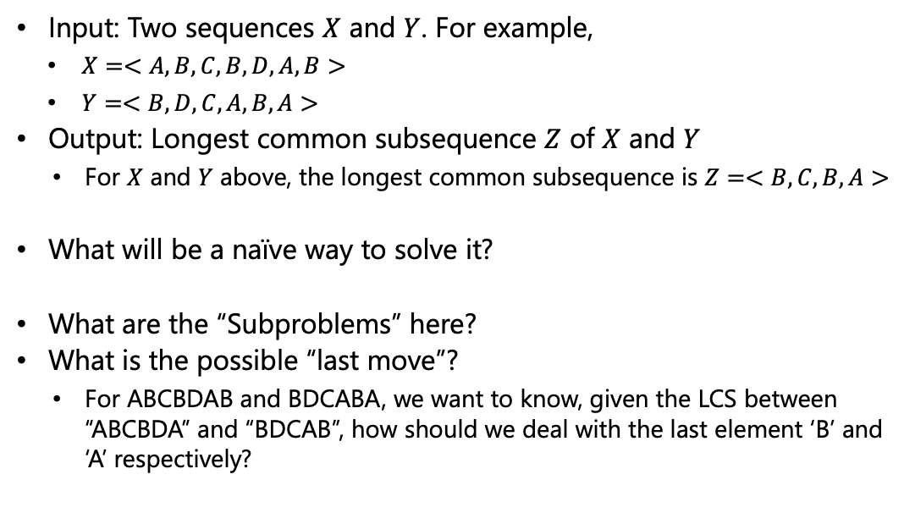
Problem Definition
Input: Two sequences $X$ and $Y$. For example,
$X=<A, B,C,B,D,A,B>$
$Y=<B,D,C,A,B,A>$
Output: Longest common subsequence $Z$ of $X$ and $Y$
For $X$ and $Y$ above, the longest common subsequence is $Z=<B,C,B,A>$
What will be a naïve way to solve it?
What are the “Subproblems” here?
What is the possible “last move”?
For ABCBDAB and BDCABA, we want to know, given the LCS between “ABCBDA” and “BDCAB”, how should we deal with the last element ‘B’ and ‘A’ respectively?

Slide 49

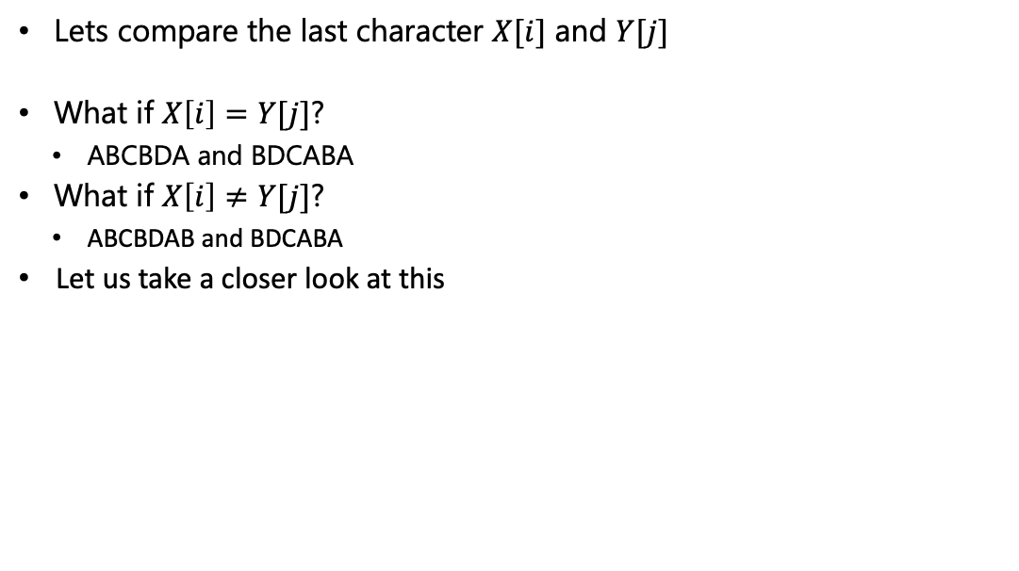



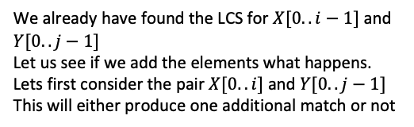


Lets Focus on the Last Characters
Lets compare the last character $X[i]$ and $Y[j]$
What if $X\left[i\right]=Y[j]$?
ABCBDA and BDCABA
What if $X\left[i\right]≠Y[j]$?
ABCBDAB and BDCABA
Let us take a closer look at this
Good news. Whatever was the LCS between the two prefixes, considering the last elements of the two, increases it by 1
We already have found the LCS for $X[0..i−1]$ and $Y[0..j−1]$
Let us see if we add the elements what happens.
Lets first consider the pair $X[0..i]$ and $Y[0..j−1]$
This will either produce one additional match or not
0
$$i$$
$$i−1$$
$$X$$
$$Y$$
0
$$j−1$$
$$j$$

Slide 50

Lets Focus on the Last Characters
Lets compare the last character $X[i]$ and $Y[j]$
What if $X\left[i\right]=Y[j]$?
ABCBDA and BDCABA
What if $X\left[i\right]≠Y[j]$?
ABCBDAB and BDCABA
Let us take a closer look at this
Good news. Whatever was the LCS between the two prefixes, considering the last elements of the two, increases it by 1
We already have found the LCS for $X[0..i−1]$ and $Y[0..j−1]$
Let us see if we add the elements what happens.
Lets first consider the pair $X[0..i]$ and $Y[0..j−1]$
This will either produce one additional match or not
Lets now consider the pair $X[0..i−1]$ and $Y[0..j]$
This will either produce one additional match or not
0
$$i−1$$
$$X$$
$$Y$$
0
$$j−1$$
$$j$$

Slide 51

Lets Focus on the Last Characters
Lets compare the last character $X[i]$ and $Y[j]$
What if $X\left[i\right]=Y[j]$?
ABCBDA and BDCABA
What if $X\left[i\right]≠Y[j]$?
ABCBDAB and BDCABA
Let us take a closer look at this
Good news. Whatever was the LCS between the two prefixes, considering the last elements of the two, increases it by 1
We already have found the LCS for $X[0..i−1]$ and $Y[0..j−1]$
Let us see if we add the elements what happens.
Lets first consider the pair $X[0..i]$ and $Y[0..j−1]$
This will either produce one additional match or not
Lets now consider the pair $X[0..i−1]$ and $Y[0..j]$
This will either produce one additional match or not
Do we now compare $X[0..i]$ and $Y[0..j]$?
No. As, given we have compared the other two cases, this will only make any difference only if $X[i]$ and $Y[j]$ are equal – which we assume are not
0
$$i$$
$$i−1$$
$$X$$
$$Y$$
0
$$j−1$$
$$j$$

Slide 52

Lets Focus on the Last Characters
Lets compare the last character $X[i]$ and $Y[j]$
What if $X\left[i\right]=Y[j]$?
ABCBDA and BDCABA
What if $X\left[i\right]≠Y[j]$?
ABCBDAB and BDCABA
Let us take a closer look at this
So, in summary, we have to compare $X[0..i−1]$ and $Y[0..j]$ and also $X[0..i]$ and $Y[0..j−1]$ to get the LCS between $X[0..i]$ and $Y[0..j]$
Now, do we need to scan and check every element of the other sequence to know if any match is being added?
No – as both the comparisons ($X[0..i−1]$ with $Y[0..j]$ and $X[0..i]$ with $Y[0..j−1]$ ) have been made already and stored.
We can reuse them. We have to take the maximum out of the two cases
0
$$i−1$$
$$X$$
$$Y$$
0
$$j−1$$
$$j$$

Slide 53

Solution to LCS – An Example
Lets use $s\left[i,j\right]$ to denote the LCS of the first $i$ characters in $X$ and first $j$ characters in $Y$
If $X\left[i\right]=Y[j]$
$s\left[i,j\right]=s\left[i−1,j−1\right]+1$
$s\left[4,5\right]=s\left[3,4\right]+1$
Index
1
2
3
4
5
6
7
X=
A
B
C
B
D
A
B
LCS of “ABCB” and “BDCAB” must be:
(the LCS of “ABC” and “BDCA”) + “B”
Y=
B
D
C
A
B
A

Slide 54
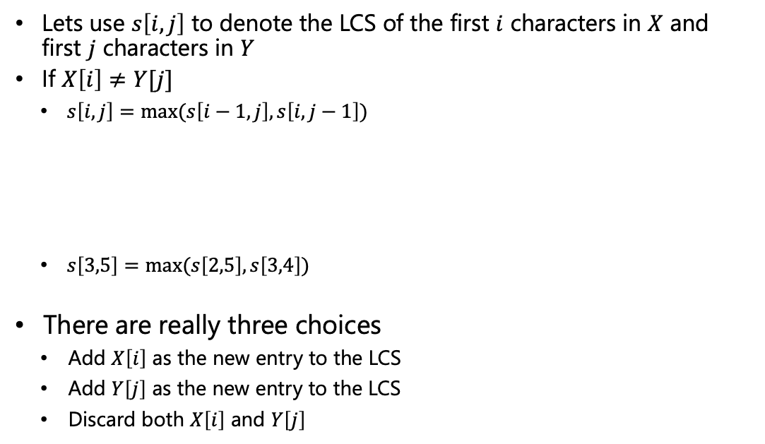
Solution to LCS – An Example
Lets use $s\left[i,j\right]$ to denote the LCS of the first $i$ characters in $X$ and first $j$ characters in $Y$
If $X\left[i\right]≠Y[j]$
$s\left[i,j\right]=max⁡(s\left[i−1,j\right], s\left[i,j−1\right])$
$s\left[3,5\right]=max⁡(s\left[2,5\right],s\left[3,4\right])$
There are really three choices
Add $X\left[i\right]$ as the new entry to the LCS
Add $Y\left[j\right]$ as the new entry to the LCS
Discard both $X\left[i\right]$ and $Y\left[j\right]$
Index
1
2
3
4
5
6
7
X=
A
B
C
B
D
A
B
Y=
B
D
C
A
B
A
LCS of “ABC” and “BDCAB” can be:
the LCS of “AB” and “BDCAB”
the LCS of “ABC” and “BDCA”
the LCS of “AB” and “BDCA”
(included above)

Slide 55
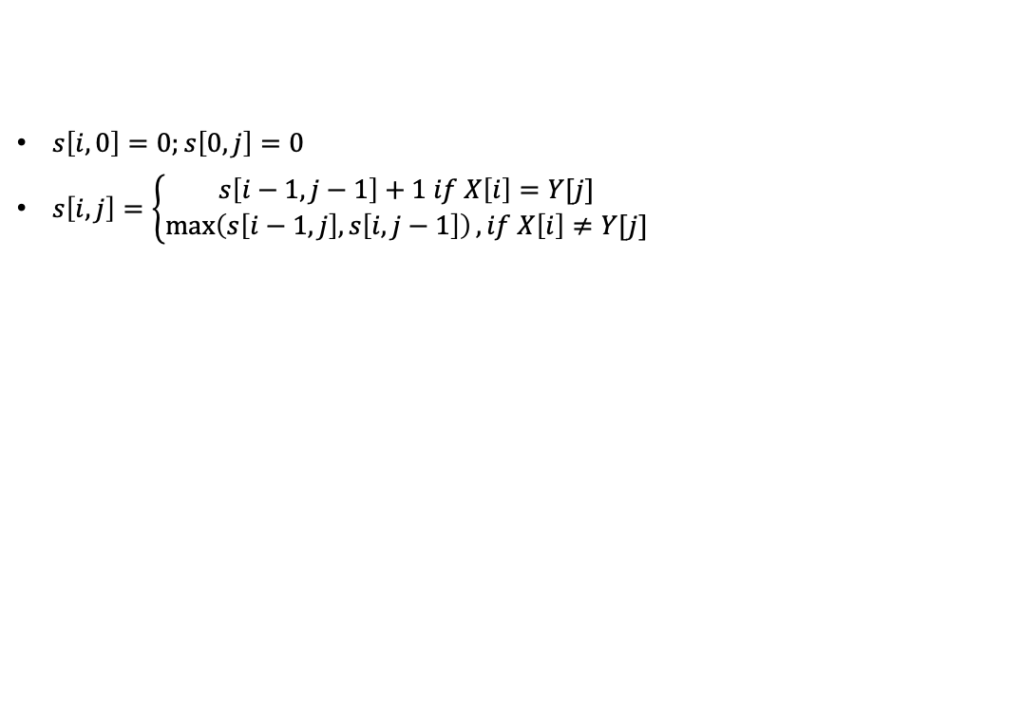

Solution to LCS – An Example
$s\left[i,0\right]=0;s\left[0,j\right]=0$
$s\left[i,j\right]=\left\{\begin{aligned}s\left[i−1,j−1\right]+1 if X\left[i\right]=Y[j] \\ \max\left(s\left[i−1,j\right],s\left[i,j−1\right]\right), if X\left[i\right]≠Y[j]\end{aligned}\right.$
$$j$$
0
1
2
3
4
5
6
$$i$$
 | None | B | D | C | A | B | A
None
A
B
C
B
D
A
B
0
1
2
3
4
5
6
7

Slide 56
Solution to LCS – An Example
$s\left[i,0\right]=0;s\left[0,j\right]=0$
$s\left[i,j\right]=\left\{\begin{aligned}s\left[i−1,j−1\right]+1 if X\left[i\right]=Y[j] \\ \max\left(s\left[i−1,j\right],s\left[i,j−1\right]\right), if X\left[i\right]≠Y[j]\end{aligned}\right.$
$$j$$
0
1
2
3
4
5
6
$$i$$
 | None | B | D | C | A | B | A
None | 0 | 0 | 0 | 0 | 0 | 0 | 0
A | 0
B | 0
C | 0
B | 0
D | 0
A | 0
B | 0
0
1
2
3
4
5
6
7

Slide 57
Solution to LCS – An Example
$s\left[i,0\right]=0;s\left[0,j\right]=0$
$s\left[i,j\right]=\left\{\begin{aligned}s\left[i−1,j−1\right]+1 if X\left[i\right]=Y[j] \\ \max\left(s\left[i−1,j\right],s\left[i,j−1\right]\right), if X\left[i\right]≠Y[j]\end{aligned}\right.$
$$j$$
0
1
2
3
4
5
6
$$i$$
 | None | B | D | C | A | B | A
None | 0 | 0 | 0 | 0 | 0 | 0 | 0
A | 0 | 0
B | 0
C | 0
B | 0
D | 0
A | 0
B | 0
0
1
2
3
4
5
6
7

Slide 58
Solution to LCS – An Example
$s\left[i,0\right]=0;s\left[0,j\right]=0$
$s\left[i,j\right]=\left\{\begin{aligned}s\left[i−1,j−1\right]+1 if X\left[i\right]=Y[j] \\ \max\left(s\left[i−1,j\right],s\left[i,j−1\right]\right), if X\left[i\right]≠Y[j]\end{aligned}\right.$
$$j$$
0
1
2
3
4
5
6
$$i$$
 | None | B | D | C | A | B | A
None | 0 | 0 | 0 | 0 | 0 | 0 | 0
A | 0 | 0 | 0 | 0
B | 0
C | 0
B | 0
D | 0
A | 0
B | 0
0
1
2
3
4
5
6
7

Slide 59
Solution to LCS – An Example
$s\left[i,0\right]=0;s\left[0,j\right]=0$
$s\left[i,j\right]=\left\{\begin{aligned}s\left[i−1,j−1\right]+1 if X\left[i\right]=Y[j] \\ \max\left(s\left[i−1,j\right],s\left[i,j−1\right]\right), if X\left[i\right]≠Y[j]\end{aligned}\right.$
$$j$$
0
1
2
3
4
5
6
$$i$$
 | None | B | D | C | A | B | A
None | 0 | 0 | 0 | 0 | 0 | 0 | 0
A | 0 | 0 | 0 | 0 | 1
B | 0
C | 0
B | 0
D | 0
A | 0
B | 0
0
1
2
3
4
5
6
7

Slide 60
Solution to LCS – An Example
$s\left[i,0\right]=0;s\left[0,j\right]=0$
$s\left[i,j\right]=\left\{\begin{aligned}s\left[i−1,j−1\right]+1 if X\left[i\right]=Y[j] \\ \max\left(s\left[i−1,j\right],s\left[i,j−1\right]\right), if X\left[i\right]≠Y[j]\end{aligned}\right.$
$$j$$
0
1
2
3
4
5
6
$$i$$
 | None | B | D | C | A | B | A
None | 0 | 0 | 0 | 0 | 0 | 0 | 0
A | 0 | 0 | 0 | 0 | 1 | 1
B | 0
C | 0
B | 0
D | 0
A | 0
B | 0
0
1
2
3
4
5
6
7

Slide 61
Solution to LCS – An Example
$s\left[i,0\right]=0;s\left[0,j\right]=0$
$s\left[i,j\right]=\left\{\begin{aligned}s\left[i−1,j−1\right]+1 if X\left[i\right]=Y[j] \\ \max\left(s\left[i−1,j\right],s\left[i,j−1\right]\right), if X\left[i\right]≠Y[j]\end{aligned}\right.$
$$j$$
0
1
2
3
4
5
6
$$i$$
 | None | B | D | C | A | B | A
None | 0 | 0 | 0 | 0 | 0 | 0 | 0
A | 0 | 0 | 0 | 0 | 1 | 1 | 1
B | 0
C | 0
B | 0
D | 0
A | 0
B | 0
0
1
2
3
4
5
6
7

Slide 62
Solution to LCS – An Example
$s\left[i,0\right]=0;s\left[0,j\right]=0$
$s\left[i,j\right]=\left\{\begin{aligned}s\left[i−1,j−1\right]+1 if X\left[i\right]=Y[j] \\ \max\left(s\left[i−1,j\right],s\left[i,j−1\right]\right), if X\left[i\right]≠Y[j]\end{aligned}\right.$
$$j$$
0
1
2
3
4
5
6
$$i$$
 | None | B | D | C | A | B | A
None | 0 | 0 | 0 | 0 | 0 | 0 | 0
A | 0 | 0 | 0 | 0 | 1 | 1 | 1
B | 0 | 1
C | 0
B | 0
D | 0
A | 0
B | 0
0
1
2
3
4
5
6
7

Slide 63
Solution to LCS – An Example
$s\left[i,0\right]=0;s\left[0,j\right]=0$
$s\left[i,j\right]=\left\{\begin{aligned}s\left[i−1,j−1\right]+1 if X\left[i\right]=Y[j] \\ \max\left(s\left[i−1,j\right],s\left[i,j−1\right]\right), if X\left[i\right]≠Y[j]\end{aligned}\right.$
$$j$$
0
1
2
3
4
5
6
$$i$$
 | None | B | D | C | A | B | A
None | 0 | 0 | 0 | 0 | 0 | 0 | 0
A | 0 | 0 | 0 | 0 | 1 | 1 | 1
B | 0 | 1 | 1 | 1 | 1
C | 0
B | 0
D | 0
A | 0
B | 0
0
1
2
3
4
5
6
7

Slide 64
Solution to LCS – An Example
$s\left[i,0\right]=0;s\left[0,j\right]=0$
$s\left[i,j\right]=\left\{\begin{aligned}s\left[i−1,j−1\right]+1 if X\left[i\right]=Y[j] \\ \max\left(s\left[i−1,j\right],s\left[i,j−1\right]\right), if X\left[i\right]≠Y[j]\end{aligned}\right.$
$$j$$
0
1
2
3
4
5
6
$$i$$
 | None | B | D | C | A | B | A
None | 0 | 0 | 0 | 0 | 0 | 0 | 0
A | 0 | 0 | 0 | 0 | 1 | 1 | 1
B | 0 | 1 | 1 | 1 | 1 | 2 | 2
C | 0
B | 0
D | 0
A | 0
B | 0
0
1
2
3
4
5
6
7

Slide 65
Solution to LCS – An Example
$s\left[i,0\right]=0;s\left[0,j\right]=0$
$s\left[i,j\right]=\left\{\begin{aligned}s\left[i−1,j−1\right]+1 if X\left[i\right]=Y[j] \\ \max\left(s\left[i−1,j\right],s\left[i,j−1\right]\right), if X\left[i\right]≠Y[j]\end{aligned}\right.$
$$j$$
0
1
2
3
4
5
6
$$i$$
 | None | B | D | C | A | B | A
None | 0 | 0 | 0 | 0 | 0 | 0 | 0
A | 0 | 0 | 0 | 0 | 1 | 1 | 1
B | 0 | 1 | 1 | 1 | 1 | 2 | 2
C | 0 | 1 | 1 | 2 | 2 | 2 | 2
B | 0 | 1 | 1 | 2 | 2 | 3 | 3
D | 0 | 1 | 2 | 2 | 2 | 3 | 3
A | 0 | 1 | 2 | 2 | 3 | 3 | 4
B | 0 | 1 | 2 | 2 | 3 | 4 | 4
0
1
2
3
4
5
6
7
LCS(X,Y)=4

Slide 66
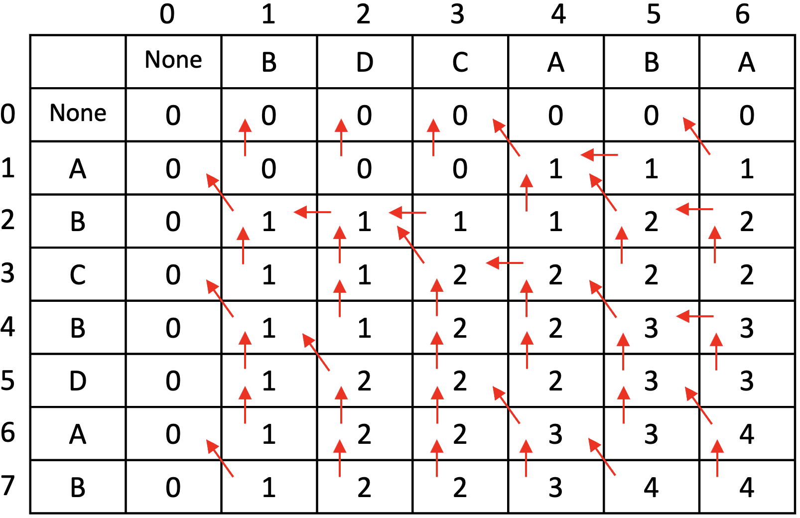
Solution to LCS – An Example
How do we know which characters are in the LCS?
The ones with diagonal arrow are taken
Even without storing arrow directions separately, how can we know whether a cell has diagonal arrow?
Compare the characters
The LCS is BCBA

Slide 67

Solution to LCS – Pseudocode
LCS(X,Y)
m = X.length, n = Y.length
Create 2-D array s with m+1 rows and n+1 columns
for i=1 to m //Fill up the first column with 0’s
s[i,0] = 0
for j=1 to n //Fill up the first row with 0’s
s[0,j] = 0
for i=1 to m
for j=1 to n
if X[i]==Y[j]
s[i,j] = s[i-1,j-1] + 1
else
if s[i-1,j] >= s[i,j-1]
s[i,j] = s[i-1,j]
else
s[i,j] = s[i,j-1]
What is the time complexity?
$$Θ(mn)$$

Slide 68

Solution to LCS – Pseudocode
ConstructLCS(X,Y,s)
m = X.length, n = Y.length
i = m, j = n //Start at the last cell of s
while (i>0 || j>0)
if X[i] == Y[j]
Add X[i] to LCS string
i--; j--
else
if s[i-1,j] >= s[i,j-1]
i--
else
j--
What is the time complexity?
$$O(m+n)$$

Slide 69
To be continued

