Slide 1
Algorithms – I (CS29003/203)
Autumn 2022, IIT Kharagpur
Greedy Algorithms

Slide 2
Greedy Algorithms
Greedy algorithm repeatedly makes locally best choice/decision ignoring what its effect will be in future
They are often intuitive, easy to understand and easy to implement
However the problem is that in many situations we can not solve a problem using a greedy approach
Greedy solution is not necessarily best
Sometimes greedy may also be good enough
When you can prove it

Slide 3
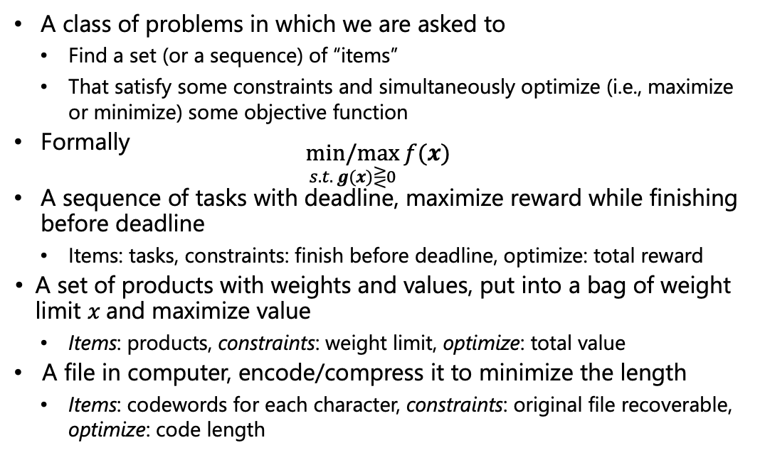
Optimization Problems
A class of problems in which we are asked to
Find a set (or a sequence) of “items”
That satisfy some constraints and simultaneously optimize (i.e., maximize or minimize) some objective function
Formally $\underset{s.t. g(x)⋛0}{min/max}{f(x)}$
A sequence of tasks with deadline, maximize reward while finishing before deadline
Items: tasks, constraints: finish before deadline, optimize: total reward
A set of products with weights and values, put into a bag of weight limit $x$and maximize value
Items: products, constraints: weight limit, optimize: total value
A file in computer, encode/compress it to minimize the length
Items: codewords for each character, constraints: original file recoverable, optimize: code length

Slide 4
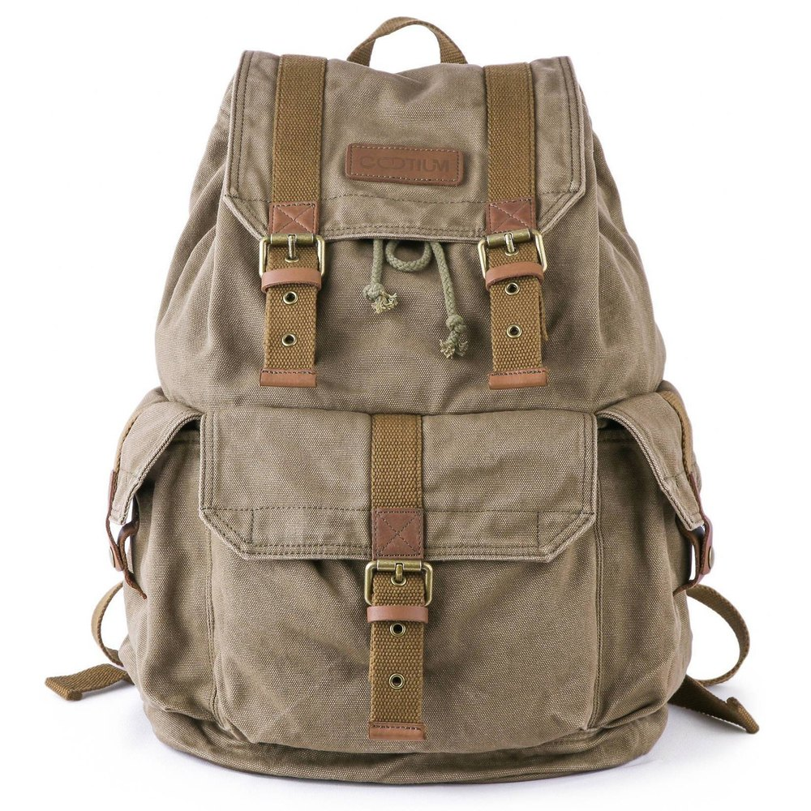
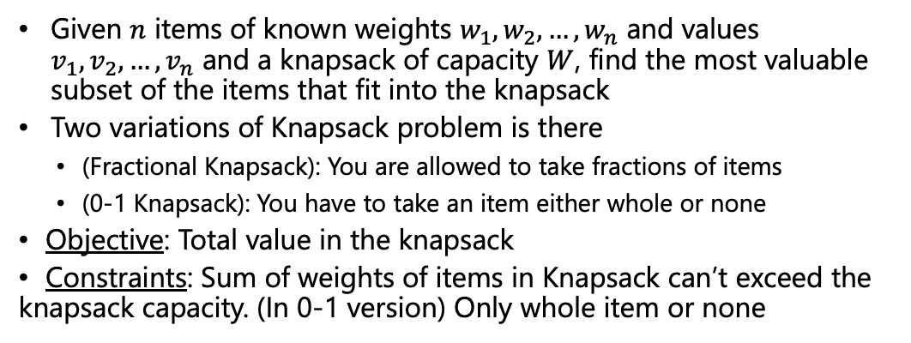
Knapsack Problem
Given $n$ items of known weights $w_{1},w_{2},…, w_{n}$ and values $v_{1},v_{2},…, v_{n}$ and a knapsack of capacity $W$, find the most valuable subset of the items that fit into the knapsack
Two variations of Knapsack problem is there
(Fractional Knapsack): You are allowed to take fractions of items
(0-1 Knapsack): You have to take an item either whole or none
Objective: Total value in the knapsack
Constraints: Sum of weights of items in Knapsack can’t exceed the knapsack capacity. (In 0-1 version) Only whole item or none
Item 3
Item 2
Item 1
30 Kg
50 Kg
20 Kg
10 Kg
Rs. 60
Rs. 100
Rs. 120
image source: www.indiamart.com

Slide 5
Knapsack Problem
Which variation of the Knapsack problem should be easy to solve?
Any simple approach to solve the fractional Knapsack problem?
Get the per unit value of the items and fill out the knapsack starting with the item highest per unit value and go on in a descending order
The total value is coming to be Rs. 240
The strategy here is literally “greedy”
It is also optimal in this case
Total value =
60+100+4*20 =
Rs. 240
4 Rs/kg
Item 3
5 Rs/kg
Item 2
6 Rs/kg
20 kg
Item 1
30 kg
50 Kg
20 kg
20 kg
10 kg
Rs. 60
Rs. 100
Rs. 120
10 kg
image source: www.indiamart.com

Slide 6
Knapsack Problem
What may come challenging sometimes is proving a greedy technique indeed gives optimal solution
For fractional knapsack its relatively easy
Intuitively: For the first 10 kg space of the knapsack we are putting the best possible option (item 1).
For the next 20 kg space we going for the best possible option available and so on
Formal proof will come later
Total value =
60+100+4*20 =
Rs. 240
4 Rs/kg
Item 3
5 Rs/kg
Item 2
6 Rs/kg
20 kg
Item 1
30 kg
50 Kg
20 kg
20 kg
10 kg
Rs. 60
Rs. 100
Rs. 120
10 kg
image source: www.indiamart.com

Slide 7
Knapsack Problem
Lets see how this strategy works for 0-1 Knapsack problem
But this is not the optimal solution. We can do better
What is the optimal solution?
Total value =
60+100 =
Rs. 160
4 Rs/kg
Item 3
5 Rs/kg
Item 2
6 Rs/kg
0 kg
Item 1
30 kg
50 Kg
20 kg
20 kg
10 kg
Rs. 60
Rs. 100
Rs. 120
10 kg
image source: www.indiamart.com

Slide 8
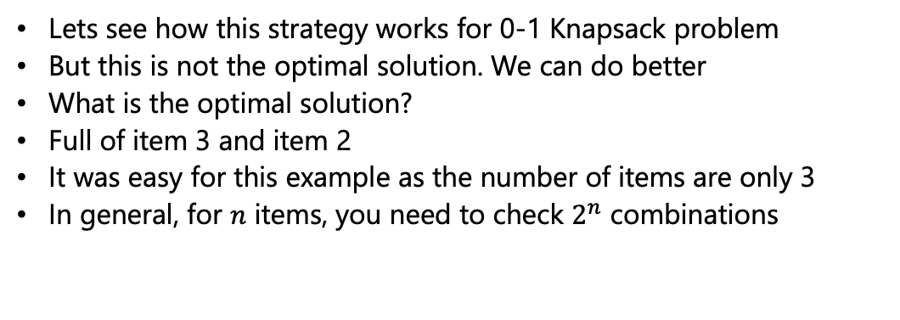
Knapsack Problem
Lets see how this strategy works for 0-1 Knapsack problem
But this is not the optimal solution. We can do better
What is the optimal solution?
Full of item 3 and item 2
It was easy for this example as the number of items are only 3
In general, for $n$ items, you need to check $2^{n}$ combinations
Total value =
120+100 =
Rs. 220
4 Rs/kg
Item 3
5 Rs/kg
Item 2
6 Rs/kg
20 kg
Item 1
30 kg
50 Kg
20 kg
10 kg
30 kg
Rs. 60
Rs. 100
Rs. 120
image source: www.indiamart.com

Slide 9
Knapsack Problem
The greedy strategy that worked for the fractional Knapsack problem, did not work for the 0-1 Knapsack problem
Lets try another greedy strategy
Starting with the item highest total value and go on in a descending order
For this instance, it gives the optimal solution
Any instance/example where this strategy fails?
Total value =
120+100 =
Rs. 220
4 Rs/kg
Item 3
5 Rs/kg
Item 2
6 Rs/kg
20 kg
Item 1
30 kg
50 Kg
20 kg
10 kg
30 kg
Rs. 60
Rs. 100
Rs. 120
image source: www.indiamart.com

Slide 10
Knapsack Problem
Add a 4th item with more weight but with slightly high value
Say a 4th item weighs 40 kg with value Rs. 130
The greedy strategy gives the solution as 40 kg of item 4 and 10 kg of item 1. The total value is Rs. 190
However, the optimal solution is 30 kg of item 1 and 20 kg of item 2. The total value is Rs. 220
Item 4
Item 3
Item 2
40 kg
Item 1
30 kg
50 Kg
20 kg
10 kg
Rs. 60
Rs. 100
Rs. 120
Rs. 130
image source: www.indiamart.com

Slide 11
Knapsack Problem
We have tried two different greedy strategies to solve 0-1 Knapsack problem. But none of them worked
Do we have any greedy strategy that works for 0-1 Knapsack problem?
To the best of our knowledge there is no known greedy strategy that works for 0-1 Knapsack problem
Later we will see other approaches to solve a 0-1 Knapsack problem
Item 4
Item 3
Item 2
40 kg
Item 1
30 kg
50 Kg
20 kg
10 kg
Rs. 60
Rs. 100
Rs. 120
Rs. 130
image source: www.indiamart.com

Slide 12
Fractional Knapsack Problem - Pseudocode
FractionalKnapsack(w, V, C, n)
Find V[i]/w[i] for all item i
Sort the items in both V[i] and w[i] by V[i]/w[i] in descending order
load = 0
for i=1 to n
if w[i] < C – load
Take whole of item i
load += w[i]
else
Take (C-load) amount of item i
Load = C
break

Slide 13
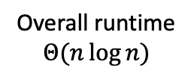
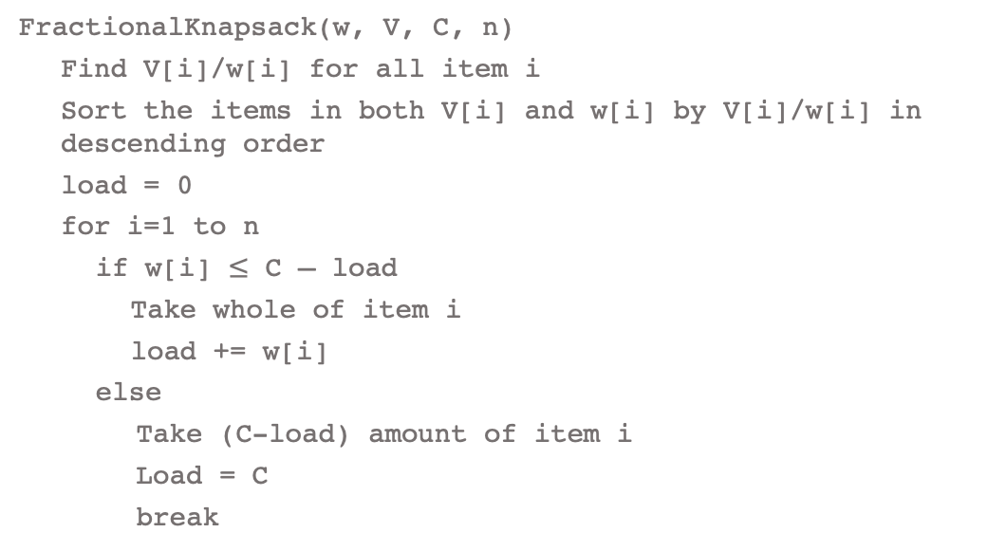




Fractional Knapsack Problem - Analysis
FractionalKnapsack(w, V, C, n)
Find V[i]/w[i] for all item i
Sort the items in both V[i] and w[i] by V[i]/w[i] in descending order
load = 0
for i=1 to n
if w[i] $≤$ C – load
Take whole of item i
load += w[i]
else
Take (C-load) amount of item i
Load = C
break
$$Θ(n)$$
$$Θ(n\log{n})$$
$$Θ(1)$$
Overall runtime
$$Θ(n\log{n})$$
$$Θ(n)$$

Slide 14
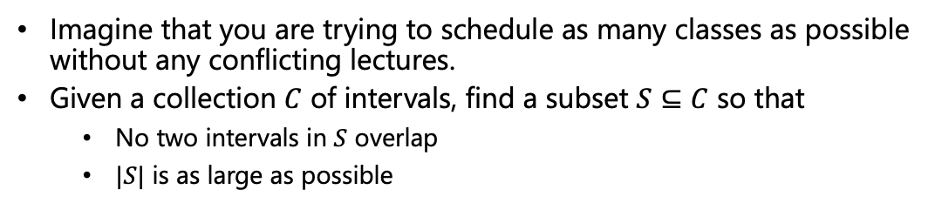
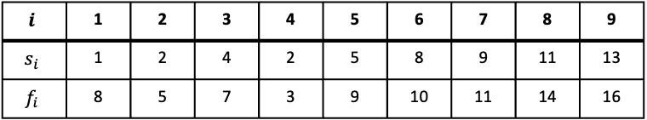
Activity Selection/Interval Scheduling Problem
Imagine that you are trying to schedule as many classes as possible without any conflicting lectures.
Given a collection $C$ of intervals, find a subset $S⊆C$ so that
No two intervals in $S$ overlap
$|S|$ is as large as possible
$$i$$ | 1 | 2 | 3 | 4 | 5 | 6 | 7 | 8 | 9
$$s_{i}$$ | 1 | 2 | 4 | 2 | 5 | 8 | 9 | 11 | 13
$$f_{i}$$ | 8 | 5 | 7 | 3 | 9 | 10 | 11 | 14 | 16
1
2
3
4
5
6
7
8
9

Slide 15
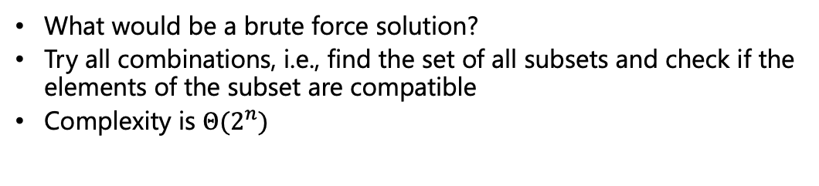
Activity Selection/Interval Scheduling Problem
What would be a brute force solution?
Try all combinations, i.e., find the set of all subsets and check if the elements of the subset are compatible
Complexity is $Θ(2^{n})$
$$i$$ | 1 | 2 | 3 | 4 | 5 | 6 | 7 | 8 | 9
$$s_{i}$$ | 1 | 2 | 4 | 2 | 5 | 8 | 9 | 11 | 13
$$f_{i}$$ | 8 | 5 | 7 | 3 | 9 | 10 | 11 | 14 | 16
1
2
3
4
5
6
7
8
9

Slide 16
Activity Selection/Interval Scheduling Problem
What can be a greedy strategy?
Remember greedy implies choosing a criterion and according to the criterion, take a decision that seems best at the moment and repeat this
What about picking the shortest duration first, then the next shortest duration and so on?
$$i$$ | 1 | 2 | 3 | 4 | 5 | 6 | 7 | 8 | 9
$$s_{i}$$ | 1 | 2 | 4 | 2 | 5 | 8 | 9 | 11 | 13
$$f_{i}$$ | 8 | 5 | 7 | 3 | 9 | 10 | 11 | 14 | 16
1
2
3
4
5
6
7
8
9

Slide 17
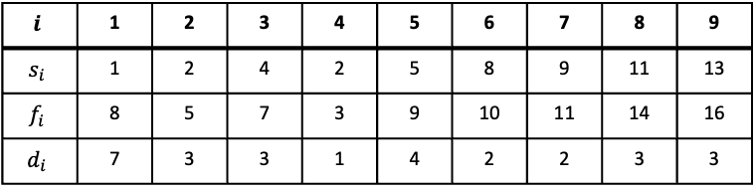
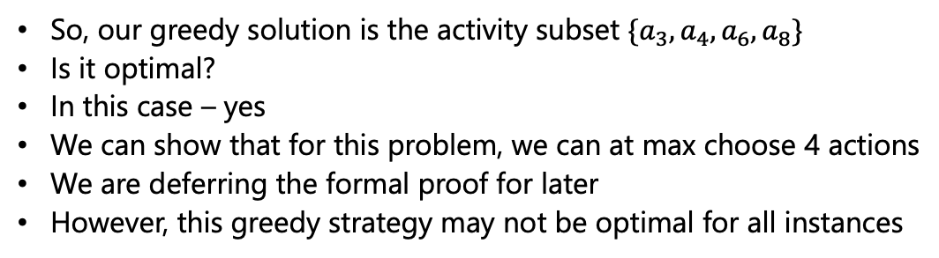
Shortest Duration
$$i$$ | 1 | 2 | 3 | 4 | 5 | 6 | 7 | 8 | 9
$$s_{i}$$ | 1 | 2 | 4 | 2 | 5 | 8 | 9 | 11 | 13
$$f_{i}$$ | 8 | 5 | 7 | 3 | 9 | 10 | 11 | 14 | 16
$$d_{i}$$ | 7 | 3 | 3 | 1 | 4 | 2 | 2 | 3 | 3
❌
❌
✅
✅
❌
✅
❌
✅
❌
So, our greedy solution is the activity subset $\{a_{3},a_{4},a_{6},a_{8}\}$
Is it optimal?
In this case – yes
We can show that for this problem, we can at max choose 4 actions
We are deferring the formal proof for later
However, this greedy strategy may not be optimal for all instances

Slide 18
Earliest Start
What about choosing by early start?
Is it optimal?
No – in general

Slide 19
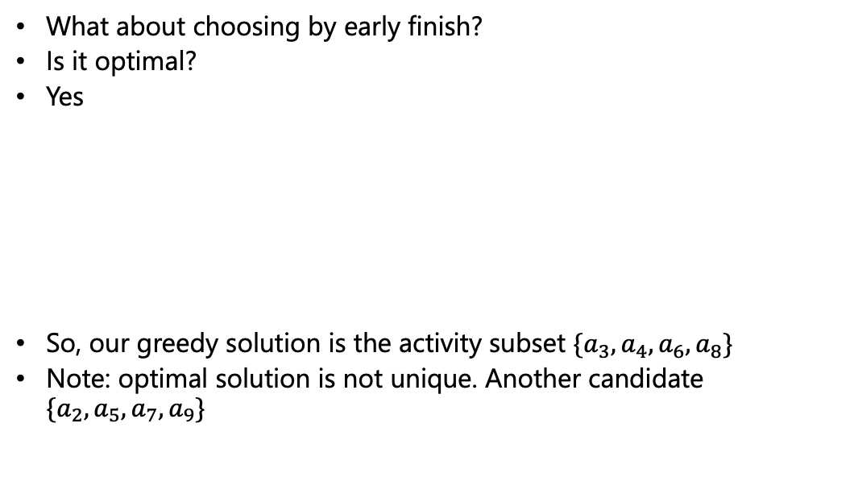
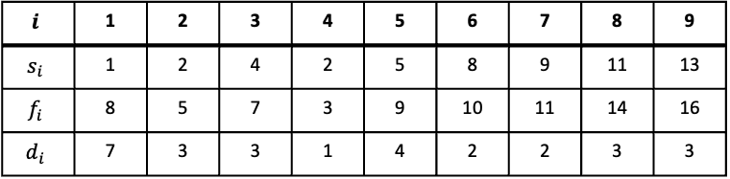
Earliest Finish
What about choosing by early finish?
Is it optimal?
Yes
So, our greedy solution is the activity subset $\{a_{3},a_{4},a_{6},a_{8}\}$
Note: optimal solution is not unique. Another candidate $\{a_{2},a_{5},a_{7},a_{9}\}$
$$i$$ | 1 | 2 | 3 | 4 | 5 | 6 | 7 | 8 | 9
$$s_{i}$$ | 1 | 2 | 4 | 2 | 5 | 8 | 9 | 11 | 13
$$f_{i}$$ | 8 | 5 | 7 | 3 | 9 | 10 | 11 | 14 | 16
$$d_{i}$$ | 7 | 3 | 3 | 1 | 4 | 2 | 2 | 3 | 3
❌
❌
✅
✅
❌
✅
❌
✅
❌

Slide 20
Alternate Strategy
Given that ‘earliest finish’ strategy works, using symmetry what can be an alternate strategy that will also work?
Hint: Think why ‘earliest finish’ strategy works
Choosing earliest finish leaves maximum room for other activities to fill in
So, by symmetry, ‘latest start’ [looking from the other end] will also give optimal solution

Slide 21

Tutorial Problems
Given an infinite array in which the first $n$ elements are integers in sorted order and the rest of the cells are filled with some special symbol (say $). Assume we do not know the $n$ value. Give an algorithm that takes an integer $k$ as input and finds a position in the array containing $k$, if the integer $k$ exists in the array in $O(\log{n})$ time

Slide 22

Tutorial Problems
Given a sorted array of non-repeated integers A[1..n], check whether there is an index $i$ for which $A\left[i\right]=i$. Give a divide-and-conquer algorithm that runs in time $O(\log{n})$

Slide 23

Tutorial Problems
We are given two sorted arrays of size n. Give an algorithm for finding the median element in the union of the two lists so that the complexity is $Θ(n)$

Slide 24
Activity Selection Problem - Pseudocode
s: Array of start times, f: Array of finish times
R: Set of all requests, A: Set of accepted requests
n: Number of activities, k: Index of last accepted activity
ActivitySel(s, f, A, n)
Sort the items in s, f and A by f[i] in ascending order
Remove R[1] from R and add to A
k = 1; i = 2
while R is not empty:
if s[i] > f[k]:
Remove R[i] from R and add to A
k = i
else:
Remove R[i] from R
i++
The runtime is $Θ(n\log{n})$ [Sorting dominates]

Slide 25
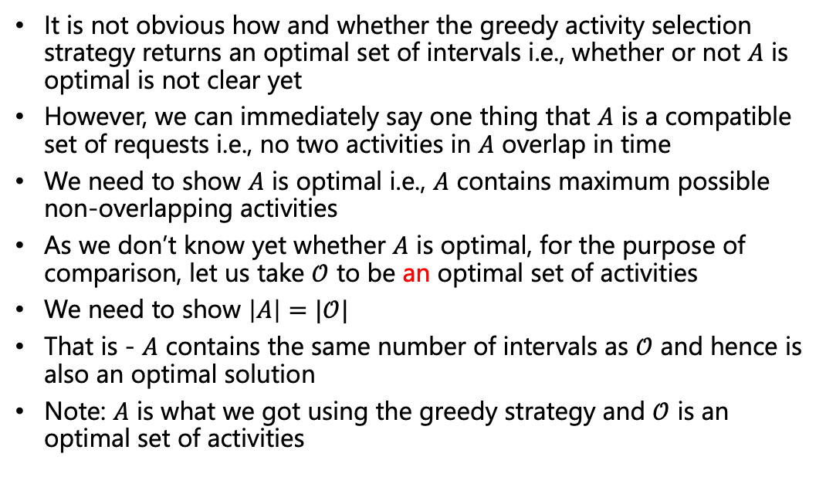
Optimality of Greedy Activity Selection
It is not obvious how and whether the greedy activity selection strategy returns an optimal set of intervals i.e., whether or not $A$ is optimal is not clear yet
However, we can immediately say one thing that $A$ is a compatible set of requests i.e., no two activities in $A$ overlap in time
We need to show $A$ is optimal i.e., $A$ contains maximum possible non-overlapping activities
As we don’t know yet whether $A$ is optimal, for the purpose of comparison, let us take $𝒪$ to be an optimal set of activities
We need to show $\left|A\right|=|𝒪|$
That is - $A$ contains the same number of intervals as $𝒪$ and hence is also an optimal solution
Note: $A$ is what we got using the greedy strategy and $𝒪$ is an optimal set of activities

Slide 26
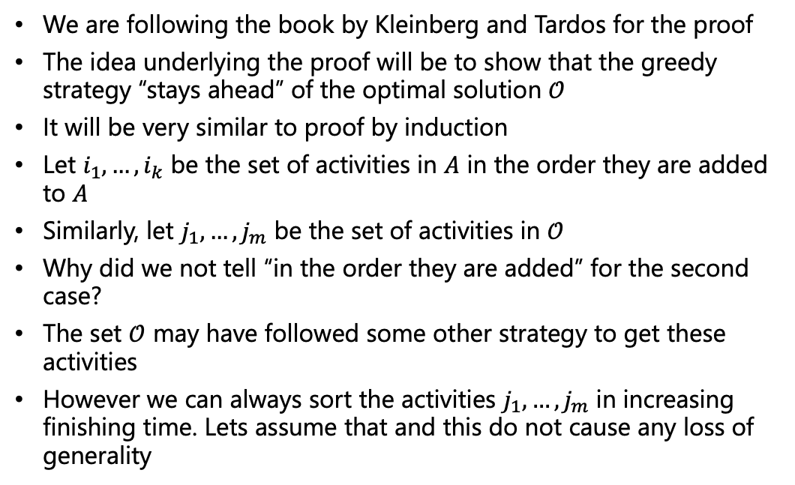
Optimality of Greedy Activity Selection
We are following the book by Kleinberg and Tardos for the proof
The idea underlying the proof will be to show that the greedy strategy “stays ahead” of the optimal solution $𝒪$
It will be very similar to proof by induction
Let $i_{1},…,i_{k}$ be the set of activities in $A$ in the order they are added to $A$
Similarly, let $j_{1},…,j_{m}$ be the set of activities in $𝒪$
Why did we not tell “in the order they are added” for the second case?
The set $𝒪$ may have followed some other strategy to get these activities
However we can always sort the activities $j_{1},…,j_{m}$ in increasing finishing time. Lets assume that and this do not cause any loss of generality
Notes:
Answer to the question: Well this set is described to be optimal i.e., this set contains maximum number of non-overlapping activities, but it is not necessary that they have been obtained by some order. Its just one set with maximum number of compatible activities

Slide 27
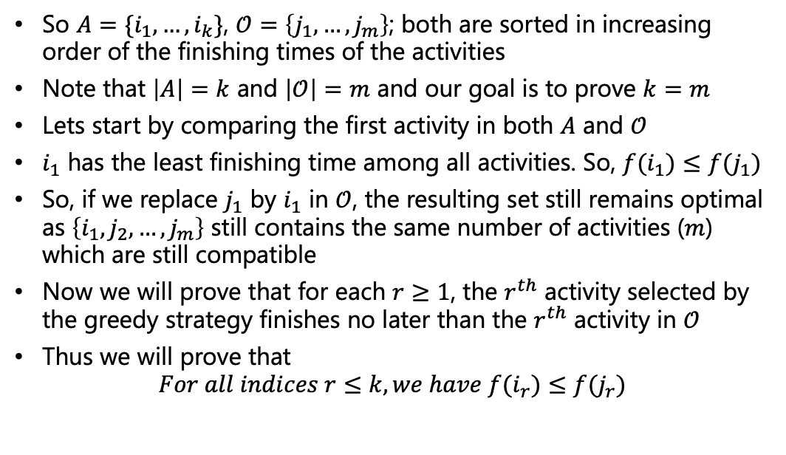
Optimality of Greedy Activity Selection
So $A=\{i_{1},…,i_{k}\}$, $𝒪=\left\{j_{1},…,j_{m}\right\}$; both are sorted in increasing order of the finishing times of the activities
Note that $\left|A\right|=k$ and $\left|𝒪\right|=m$ and our goal is to prove $k=m$
Lets start by comparing the first activity in both $A$ and $𝒪$
$i_{1}$ has the least finishing time among all activities. So, $f(i_{1})≤f(j_{1})$
So, if we replace $j_{1}$ by $i_{1}$ in $𝒪$, the resulting set still remains optimal as $\left\{i_{1},j_{2},…,j_{m}\right\}$ still contains the same number of activities ($m$) which are still compatible
Now we will prove that for each $r≥1$, the $r^{th}$ activity selected by the greedy strategy finishes no later than the $r^{th}$ activity in $𝒪$
Thus we will prove that $For all indices r≤k, we have f(i_{r})≤f(j_{r})$

Slide 28
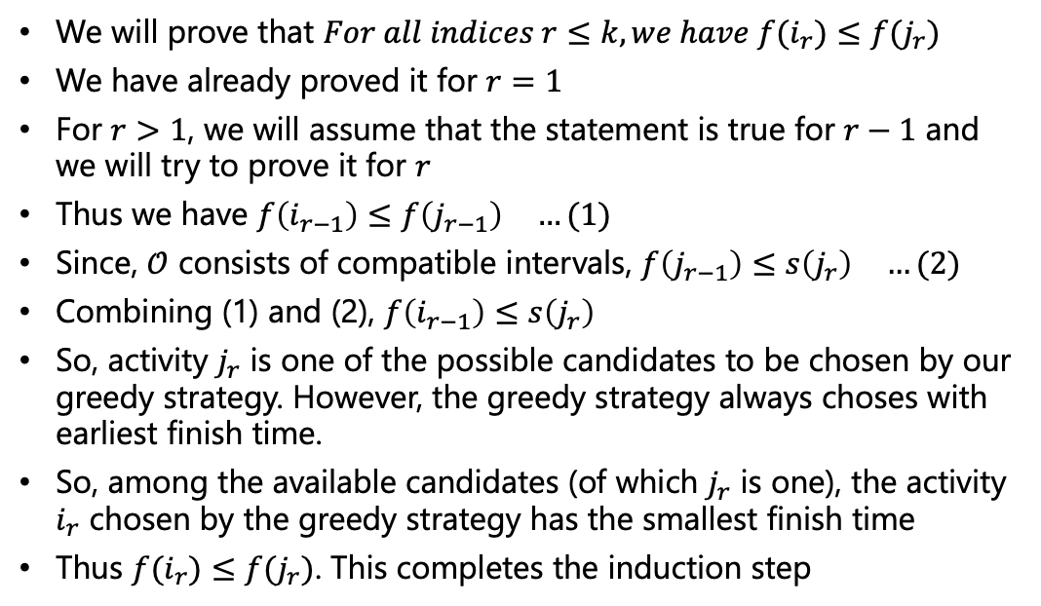
Optimality of Greedy Activity Selection
We will prove that $For all indices r≤k, we have f(i_{r})≤f(j_{r})$
We have already proved it for $r=1$
For $r>1$, we will assume that the statement is true for $r−1$ and we will try to prove it for $r$
Thus we have $f\left(i_{r−1}\right)≤f\left(j_{r−1}\right) …(1)$
Since, $𝒪$ consists of compatible intervals, $f\left(j_{r−1}\right)≤s\left(j_{r}\right) …(2)$
Combining (1) and (2), $f\left(i_{r−1}\right)≤s\left(j_{r}\right)$
So, activity $j_{r}$ is one of the possible candidates to be chosen by our greedy strategy. However, the greedy strategy always choses with earliest finish time.
So, among the available candidates (of which $j_{r}$ is one), the activity $i_{r}$ chosen by the greedy strategy has the smallest finish time
Thus $f(i_{r})≤f(j_{r})$. This completes the induction step

Slide 29
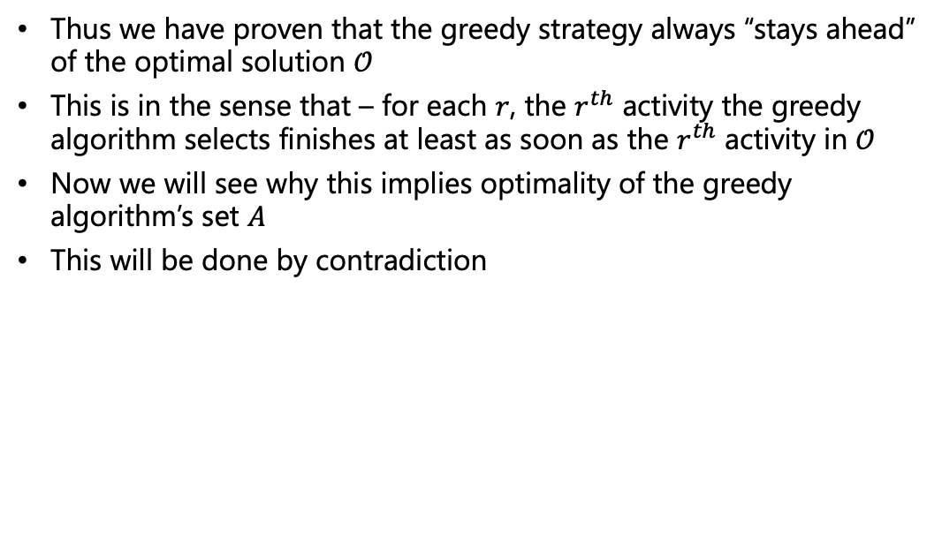
Optimality of Greedy Activity Selection
Thus we have proven that the greedy strategy always “stays ahead” of the optimal solution $𝒪$
This is in the sense that – for each $r$, the $r^{th}$ activity the greedy algorithm selects finishes at least as soon as the $r^{th}$ activity in $𝒪$
Now we will see why this implies optimality of the greedy algorithm’s set $A$
This will be done by contradiction

Slide 30
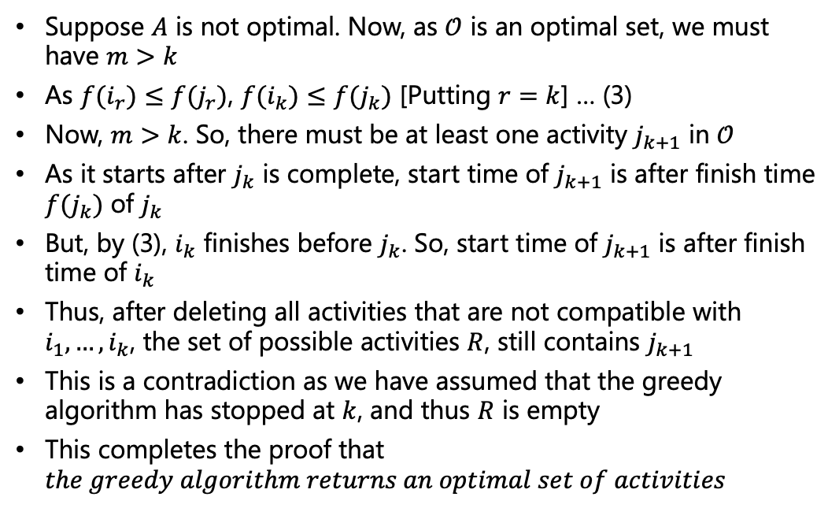
Optimality of Greedy Activity Selection
Suppose $A$ is not optimal. Now, as $𝒪$ is an optimal set, we must have $m>k$
As $f(i_{r})≤f(j_{r})$, $f(i_{k})≤f(j_{k})$ [Putting $r=k$] … (3)
Now, $m>k$. So, there must be at least one activity $j_{k+1}$ in $𝒪$
As it starts after $j_{k}$ is complete, start time of $j_{k+1}$ is after finish time $f(j_{k})$ of $j_{k}$
But, by (3), $i_{k}$ finishes before $j_{k}$. So, start time of $j_{k+1}$ is after finish time of $i_{k}$
Thus, after deleting all activities that are not compatible with $i_{1},…, i_{k}$, the set of possible activities $R$, still contains $j_{k+1}$
This is a contradiction as we have assumed that the greedy algorithm has stopped at $k$, and thus $R$ is empty
This completes the proof that $the greedy algorithm returns an optimal set of activities$

Slide 31
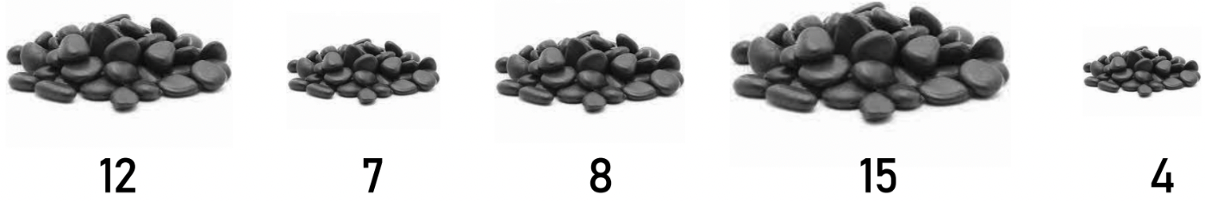
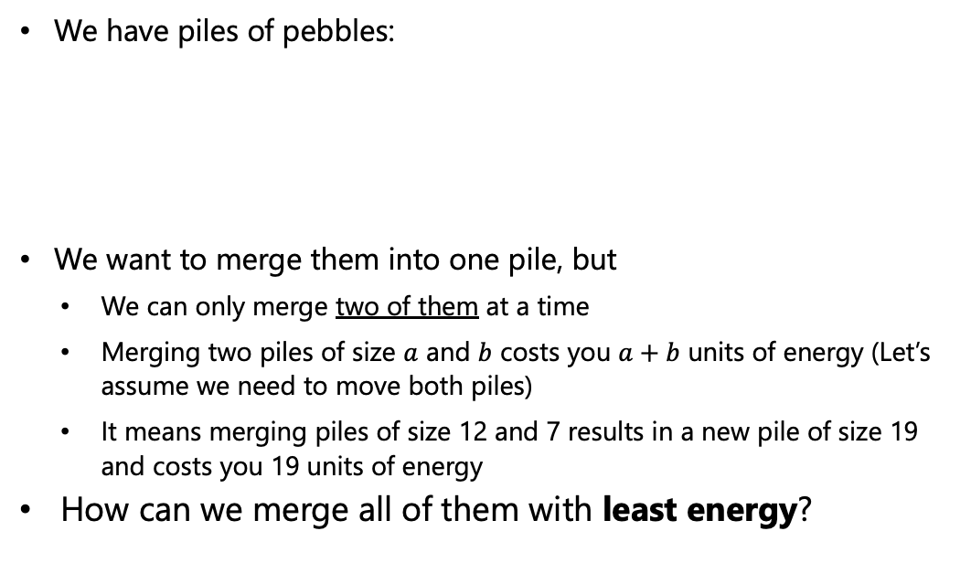
Merge Pebbles
We have piles of pebbles:
We want to merge them into one pile, but
We can only merge two of them at a time
Merging two piles of size $a$ and $b$ costs you $a+b$ units of energy (Let’s assume we need to move both piles)
It means merging piles of size 12 and 7 results in a new pile of size 19 and costs you 19 units of energy
How can we merge all of them with least energy?
Source: UC Riverside, CS141 course, Fall 2021

Slide 32
Merge Pebbles
Lets try to merge the piles in the order they are given
We will use a tree to represent the trace of merging
12
7
8
15
4
46
42
4
27
15
19
8
Energy cost: 19
+ 27
+ 42
+ 46 = 134
12
7
Source: UC Riverside, CS141 course, Fall 2021

Slide 33
Merge Pebbles – Another Solution
Lets try to merge the piles two at a time from original piles
We will use a tree to represent the trace of merging
12
7
8
15
4
46
42
4
19
23
Energy cost: 19
+ 23
+ 42
+ 46 = 130
12
7
8
15
Source: UC Riverside, CS141 course, Fall 2021

Slide 34
Merge Pebbles – Any Greedy Idea?
Always merge two smallest piles
We will use a tree to represent the trace of merging
12
7
8
15
4
46
One thing to notice: The total cost sums all the internal nodes
19
27
11
8
12
15
Energy cost: 11
+ 19
+ 27
+ 46 = 103
4
7
Source: UC Riverside, CS141 course, Fall 2021

Slide 35
Merge Pebbles – Why Greedy is Good
You may need to move a pile multiple times (Cost for moving the same pile is incurred multiple times)
The pile will be charged at all of its ancestors!
Lets consider moving the pile of size 8
Paying thrice
46
Paying twice
Paying twice
46
42
4
Paying once
Paying once
27
15
19
27
19
8
11
8
12
15
12
7
Cost: 134
4
7
Cost: 103
Source: UC Riverside, CS141 course, Fall 2021

Slide 36
Merge Pebbles – Why Greedy is Good
You may need to move a pile multiple times (Cost for moving the same pile is incurred multiple times)
The pile will be charged at all of its ancestors!
How many times do we move the pile of size 8?
The height of it (number of ancestors)
46
Total cost: 12x4 + 7x4 + 8x3 + 15x2 + 4x1 = 134
Total cost: 4x3 + 7x3 + 8x2 + 12x2 + 15x2 = 103
46
42
4
27
15
19
27
19
8
11
8
12
15
12
7
Cost: 134
4
7
Cost: 103
Source: UC Riverside, CS141 course, Fall 2021
Notes:
Bigger piles if moved closed to the root then saving is done. Note that if we have n piles, n-1 merging needs to be done always

Slide 37
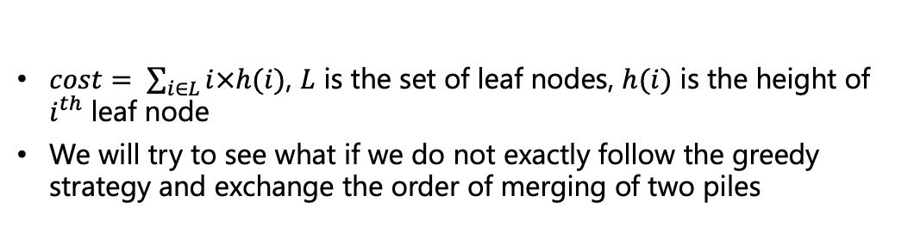
Merge Pebbles – Why Greedy is Good
$cost= \sum_{i∈L}{i×h(i)}$, $L$ is the set of leaf nodes, $h(i)$ is the height of $i^{th}$ leaf node
We will try to see what if we do not exactly follow the greedy strategy and exchange the order of merging of two piles
46
+12 -7
46
19
27
24
22
11
8
12
15
16
8
7
15
4
7
4
12
Total cost: 4x3 + 7x2 + 8x2 + 12x3 + 15x2 = 108
Total cost: 4x3 + 7x3 + 8x2 + 12x2 + 15x2 = 103
Source: UC Riverside, CS141 course, Fall 2021
Notes:
Exchanging piles at the same level does not matter

Slide 38
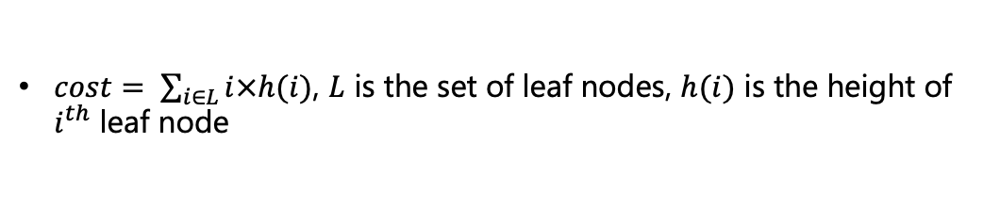
Merge Pebbles – Some Observations
$cost= \sum_{i∈L}{i×h(i)}$, $L$ is the set of leaf nodes, $h(i)$ is the height of $i^{th}$ leaf node
46
It makes sense to put the smallest piles the deepest
Since everytime we merge two piles, there are always two leaves in the deepest level
Once we merge two smallest piles we have the same problem decreased in size by 1 (optimal substructure)
Why do we care about moving pebble piles?
19
27
11
8
12
15
4
7
Total cost: 4x3 + 7x3 + 8x2 + 12x2 + 15x2 = 103
Source: UC Riverside, CS141 course, Fall 2021

Slide 39
To be continued

