Slide 1
Algorithms – I (CS29003/203)
Autumn 2022, IIT Kharagpur
Priority Queues and Heaps

Slide 2

Breakthrough during the Vacation

Slide 3
Resources
Apart from the book
UC Davis ECS 36C Course by Prof. Joël Porquet-Lupine

Slide 4
Introduction
Let us think about a scenario where you are performing the following tasks simultaneously
Start a long code compilation
Refresh moodle page
Send Gmail chat message
Receive email notification
Objective: Execute multiple processes until completion, but keep the system responsive
Are processes executed until completion?
Will the system feel responsive?
1
2
3
4

Slide 5
Process Scheduling
Round-robin scheduling
Add processes to a (typically FIFO) queue
Execute them for equal chunks of time
Will the system feel more responsive? Can we do better?
Priority scheduling
Associate priority with each process, e.g., short processes get higher priority
Execute the processes with the highest priority first
1
2
3
4
1
2
3
4
A very good resource on process scheduling:
Prof. Krzyzanowski’s lecture notes
Source: UC Davis, ECS 36C course, Spring 2020

Slide 6
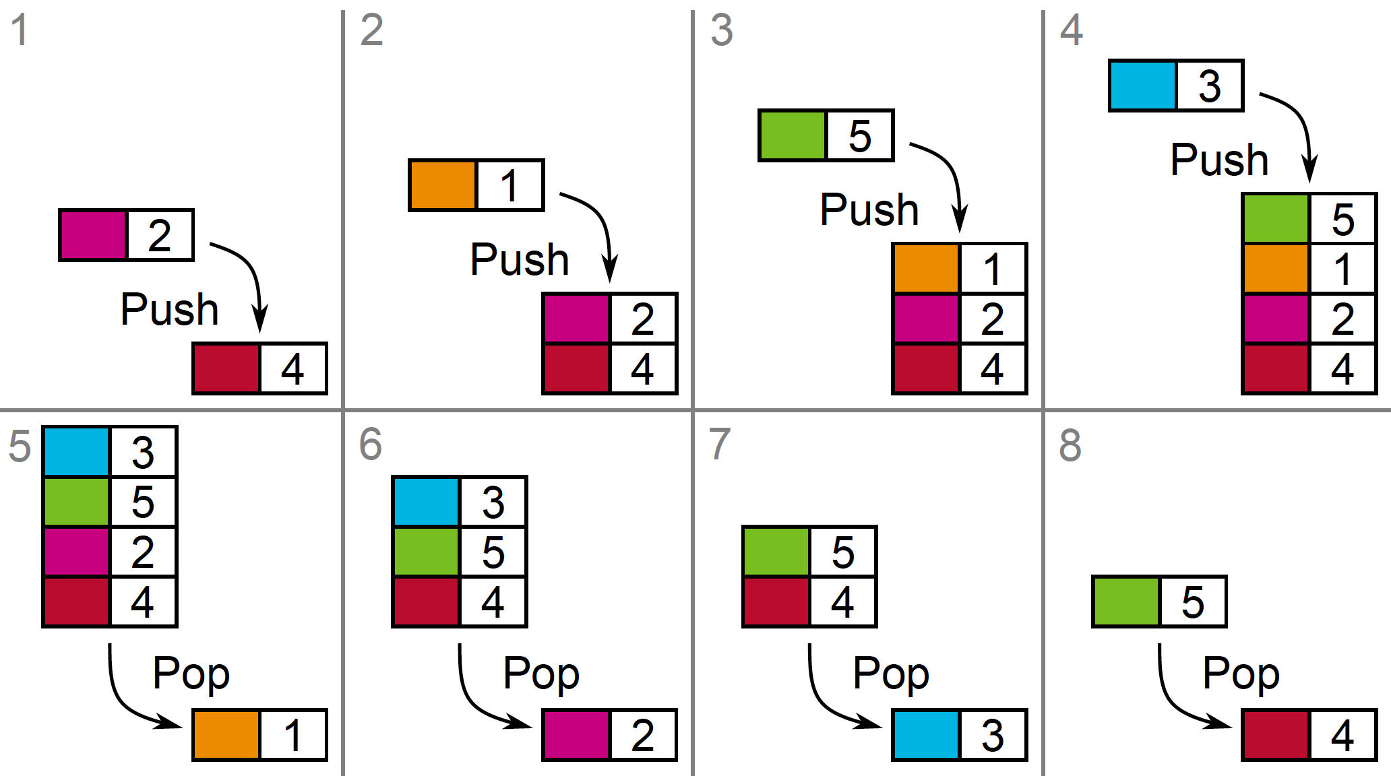
Priority Queue
Definition: Queue where each item is associated to a priority (i.e., a comparable key)
Push/Insert: add item and associated priority
Pop/Pull: remove item with highest priority
Source: UC Davis, ECS 36C course, Spring 2020

Slide 7
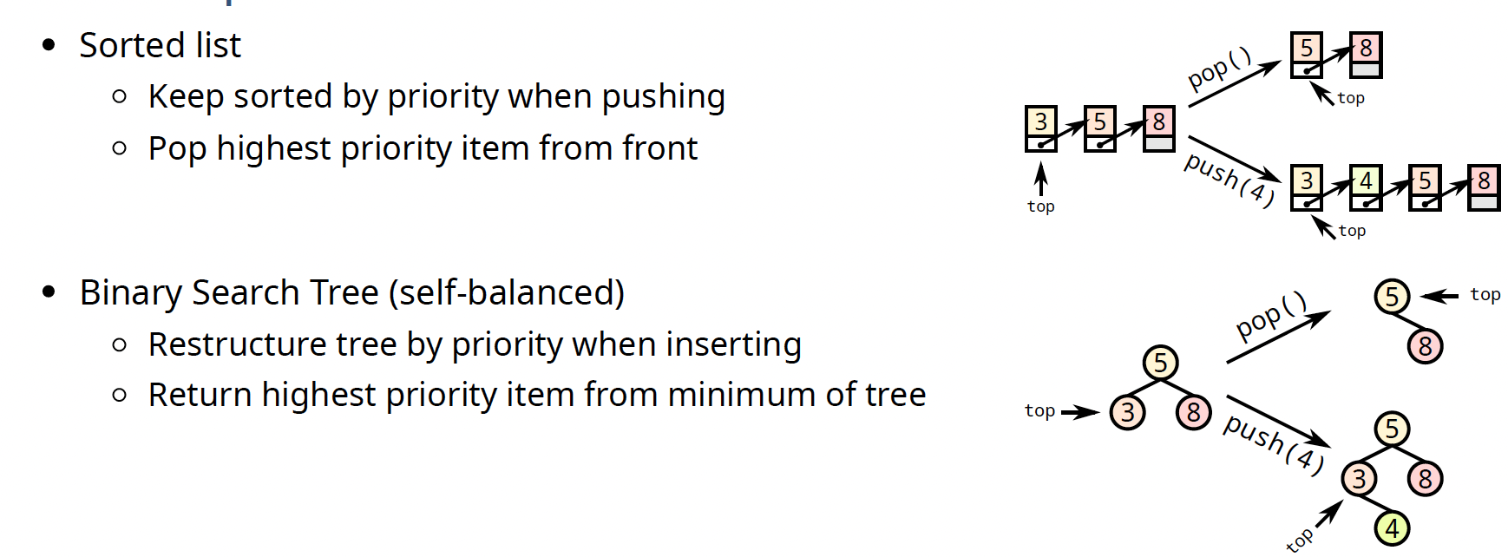
Naïve Implementations
Source: UC Davis, ECS 36C course, Spring 2020

Slide 8
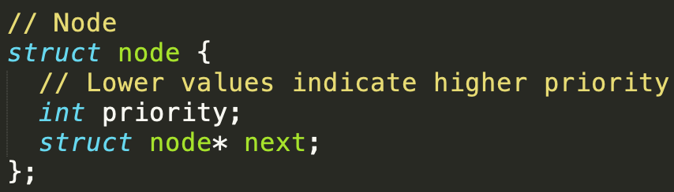
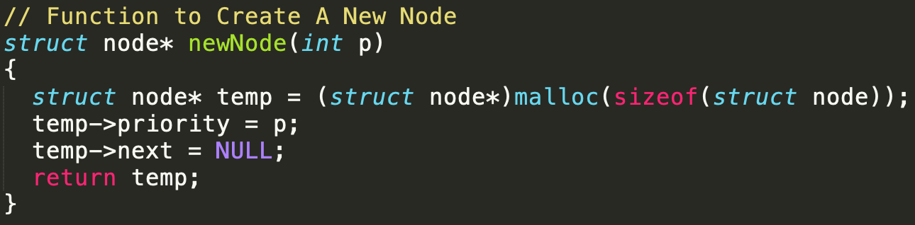
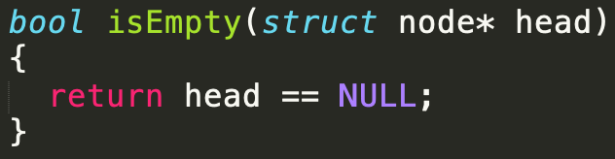
List Implementations
Struct node
Function to create a new node
Function to check if queue is empty

Slide 9
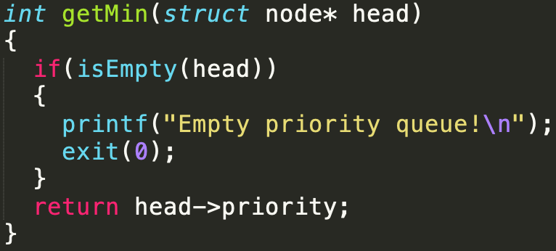
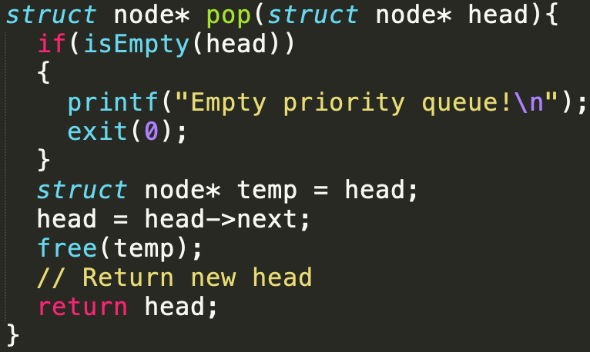
List Implementations
Get value of the maximum priority (minimum element)
Extract the element with maximum priority (minimum element)

Slide 10
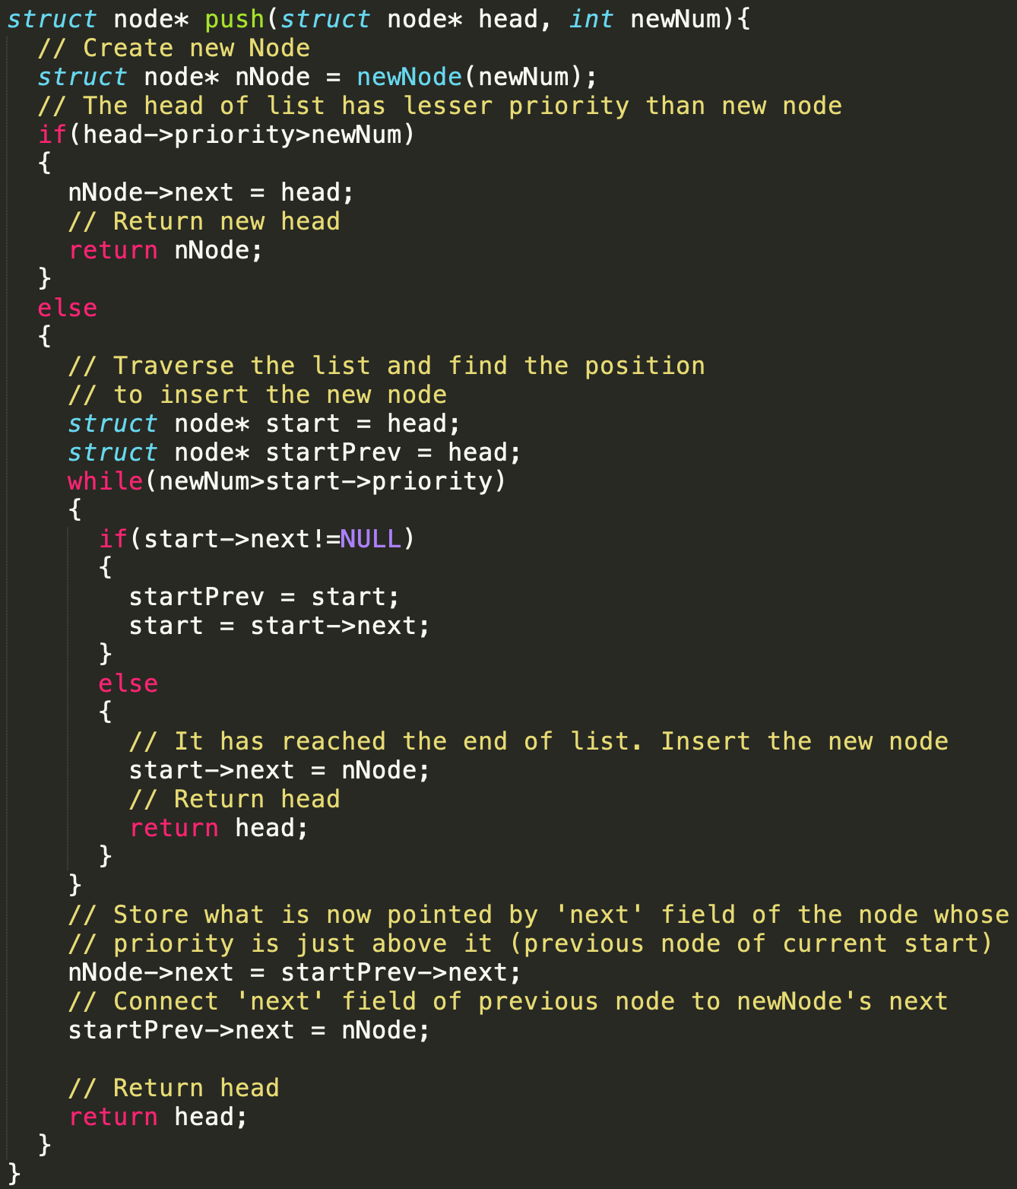
List Implementations
Push new element at the right place

Slide 11

List Implementations
Complexities?
getMin() - $O\left(1\right)$
pop() - $O(1)$
push() - $O(n)$

Slide 12
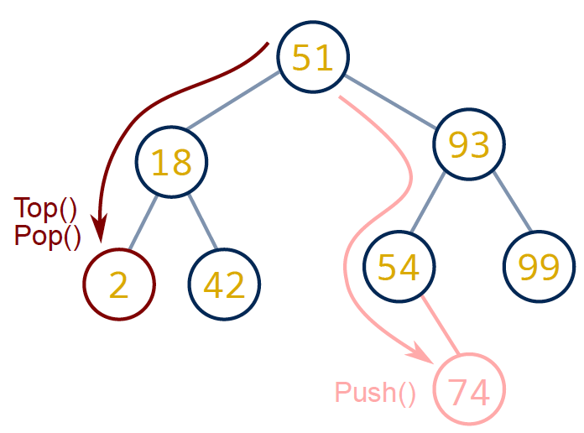
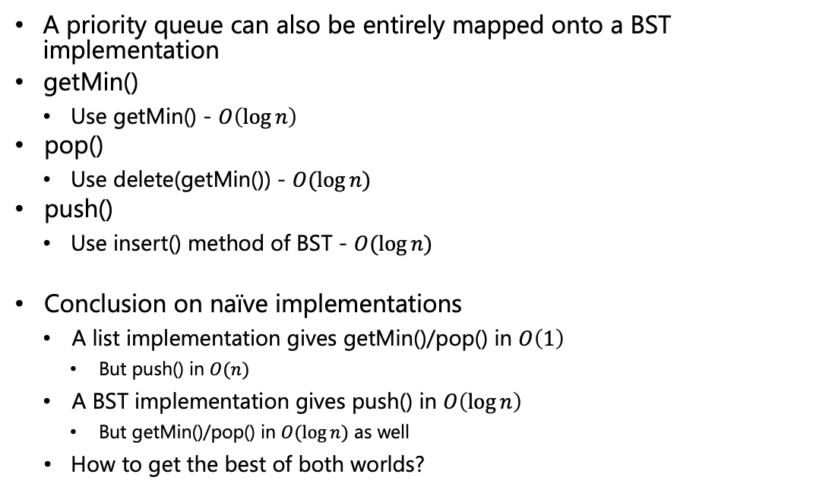
Binary Search Tree Implementations
A priority queue can also be entirely mapped onto a BST implementation
getMin()
Use getMin() - $O\left(\log{n}\right)$
pop()
Use delete(getMin()) - $O(\log{n})$
push()
Use insert() method of BST - $O(\log{n})$
Conclusion on naïve implementations
A list implementation gives getMin()/pop() in $O\left(1\right)$
But push() in $O(n)$
A BST implementation gives push() in $O\left(\log{n}\right)$
But getMin()/pop() in $O(\log{n})$ as well
How to get the best of both worlds?
Source: UC Davis, ECS 36C course, Spring 2020

Slide 13
Binary Heap
Most common data structure for implementing a priority queue
So ubiquitous in implementing priority queues that the word ‘heap’ is used without any qualifier in this context
A heap is a binary tree with two properties
Heap-order property
Structure property
Operations on heaps can destroy one or more of these properties
So a heap operation must not terminate until all heap properties are in order
2
18
42
51
99
93
Source: UC Davis, ECS 36C course, Spring 2020

Slide 14
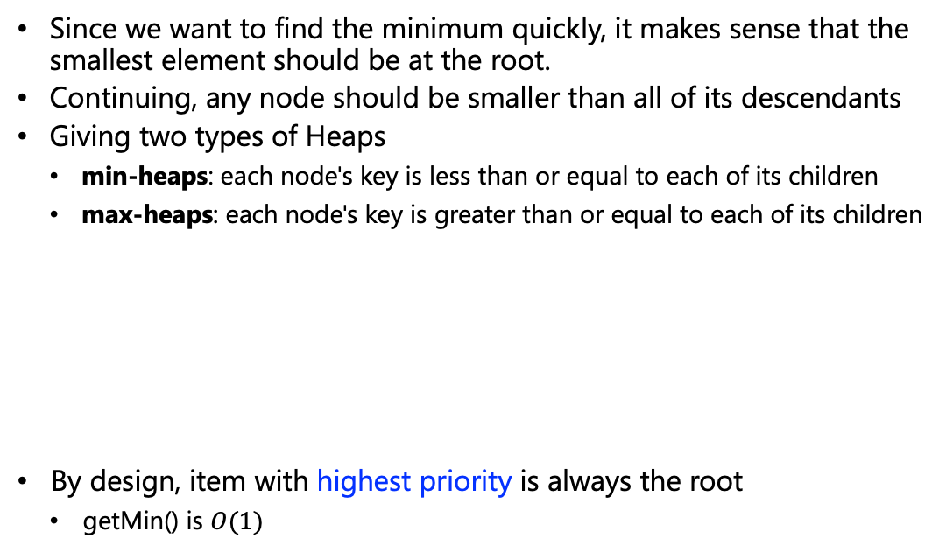
Heap-Order Property
Since we want to find the minimum quickly, it makes sense that the smallest element should be at the root.
Continuing, any node should be smaller than all of its descendants
Giving two types of Heaps
min-heaps: each node's key is less than or equal to each of its children
max-heaps: each node's key is greater than or equal to each of its children
By design, item with highest priority is always the root
getMin() is $O(1)$
2
2
18
42
51
42
Example of min heap
Example of broken heap
51
99
93
18
99
93
Source: UC Davis, ECS 36C course, Spring 2020

Slide 15
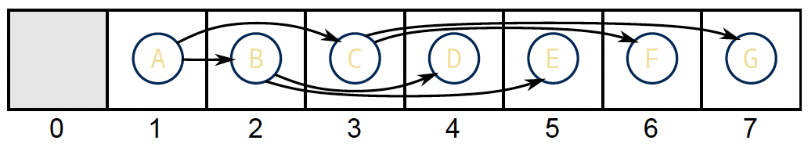
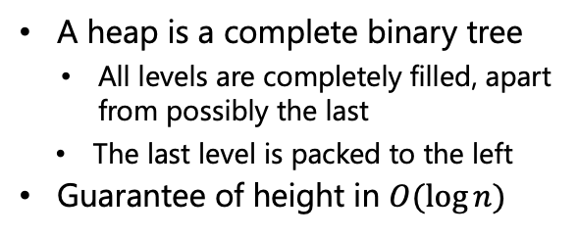

Structure Property
A
A heap is a complete binary tree
All levels are completely filled, apart from possibly the last
The last level is packed to the left
Guarantee of height in $O(\log{n})$
B
C
D
E
F
G
H
I
J
Easy representation
Complete binary tree is so regular, it can be represented in an array
No need for complicated link management, and fast traversal
Root is always at index 1
For node at index $i$*:
Left child at index $2i$
Right child at index $2i+1$
Parent (if not root) at index $⌊\frac{i}{2}⌋$
*Heap could start at array index 0, but node indexing would become a little more complex
Source: UC Davis, ECS 36C course, Spring 2020

Slide 16
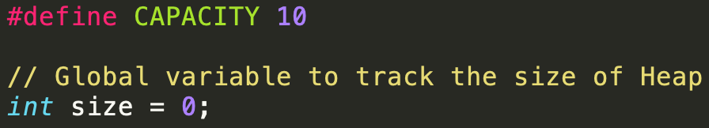

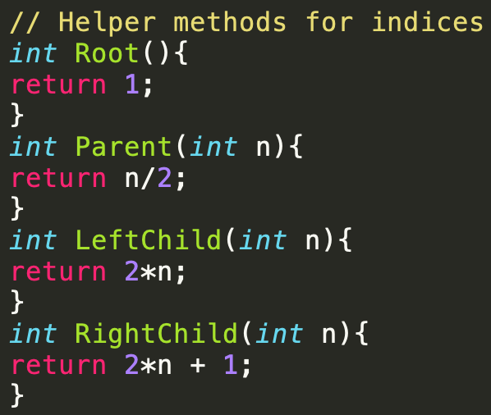
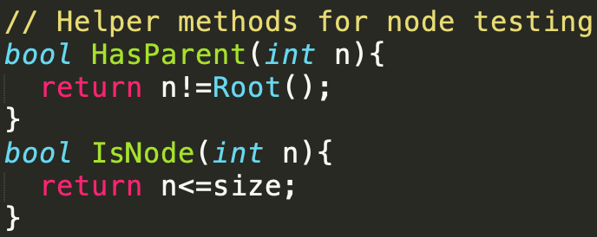
Implementation
Min-heap version
Simple array (capacity incremented by 1 for the unused first element)
Source: UC Davis, ECS 36C course, Spring 2020

Slide 17
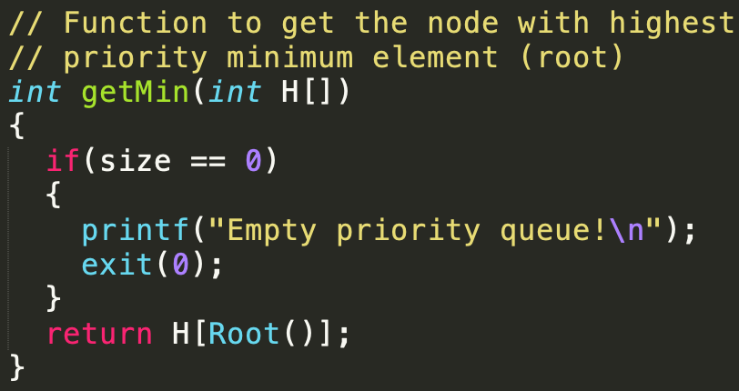
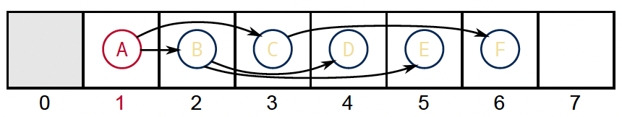
Implementation
getMin() – Returns the node with highest priority (minimum value in min-heap)
It is as simple as returning the root only
A
B
C
D
E
F
Next, we will insert or push() an element into the heap
What is the most natural position for the new element? (Don’t worry about the heap order property, just keep the structure property intact)
Source: UC Davis, ECS 36C course, Spring 2020

Slide 18
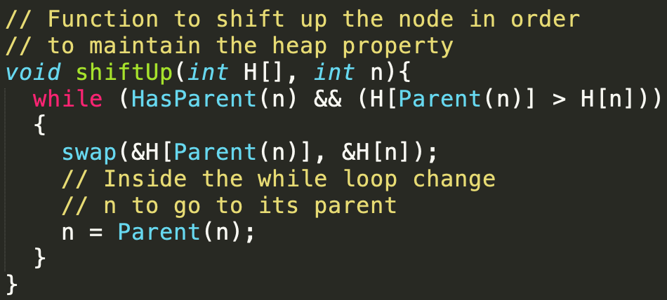
Implementation
push() – Insert only at locations that keeps the tree complete
If heap-order not broken, stop!
Otherwise, swap with parent
2
2
18
54
18
54
42
43
99
93
15
43
99
93
52
15
52
42
Continue going up tree until heap-order is respected
Strategy known as shift up
Also called bubble up, heapify-up
2
15
54
18
43
99
93
52
42
Source: UC Davis, ECS 36C course, Spring 2020

Slide 19
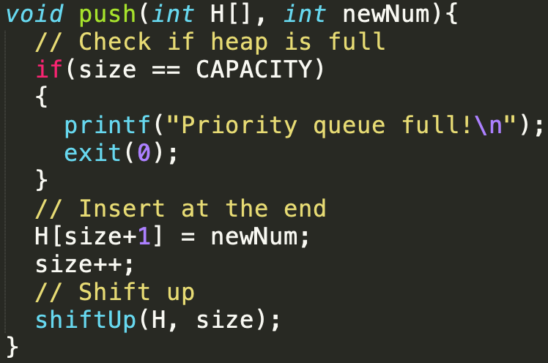
Implementation
Continue going up tree until heap-order is respected
Strategy known as shift up
Also called bubble up, heapify-up
2
15
54
18
43
99
93
52
42
Insertion of new item
Source: UC Davis, ECS 36C course, Spring 2020

Slide 20
Implementation
pop() – Removing min item leaves hole at root. Move last item to root to keep the tree complete
If heap-order not broken, stop!
Otherwise, swap with smallest child
2
93
18
18
54
93
54
42
43
99
93
42
43
99
Continue going down tree until heap-order is respected again
Strategy known as shift down
Also called bubble down, heapify-down
18
42
54
93
43
99
Source: UC Davis, ECS 36C course, Spring 2020

Slide 21
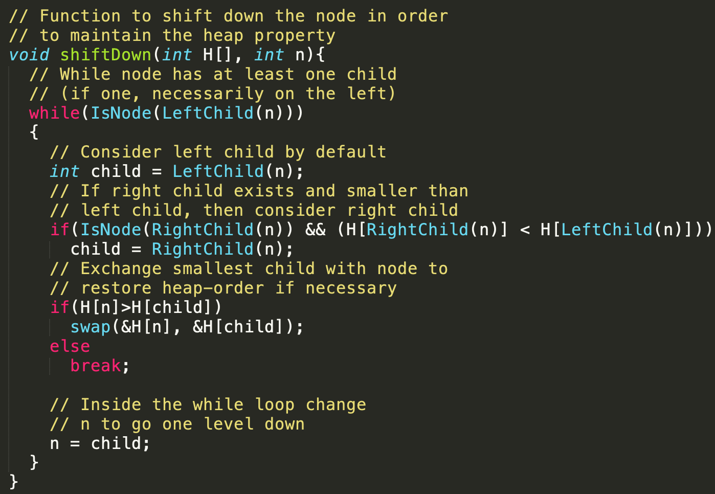
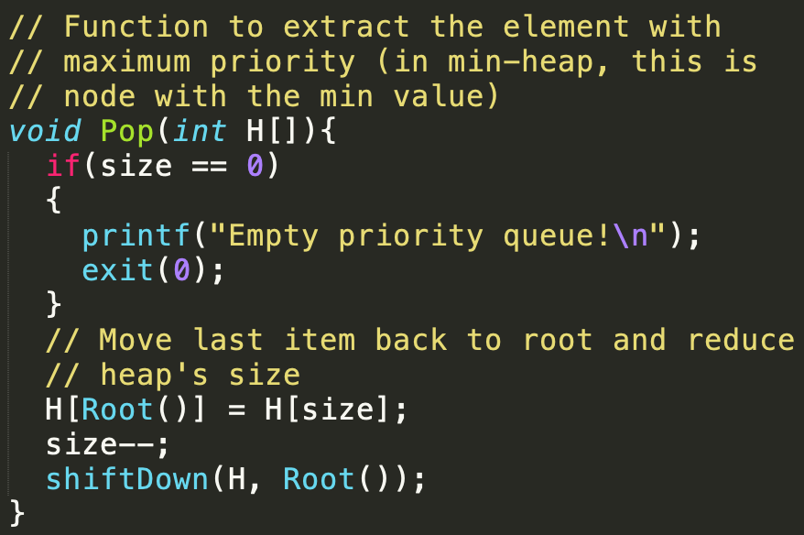
Implementation
Strategy known as shift down
Also called bubble down, heapify-down

Slide 22
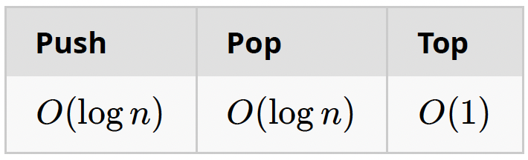
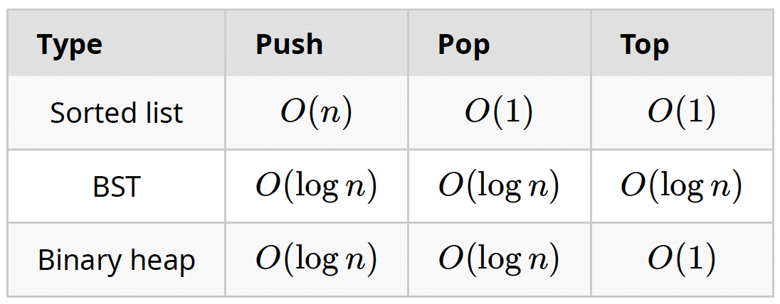
Conclusion
Running time complexities
Other operations:
In-place item modification, e.g., when heap/priority queue is used for process scheduling, change priority of a process
DecreaseItem(Item, DeltaPriority)
IncreaseItem(Item, DeltaPriority)
Heap variants:
2-3 heap, Binomial heaps, d-ary heaps, Fibonacci heaps, Leftist heaps, Skew heaps etc.
Source: UC Davis, ECS 36C course, Spring 2020

Slide 23
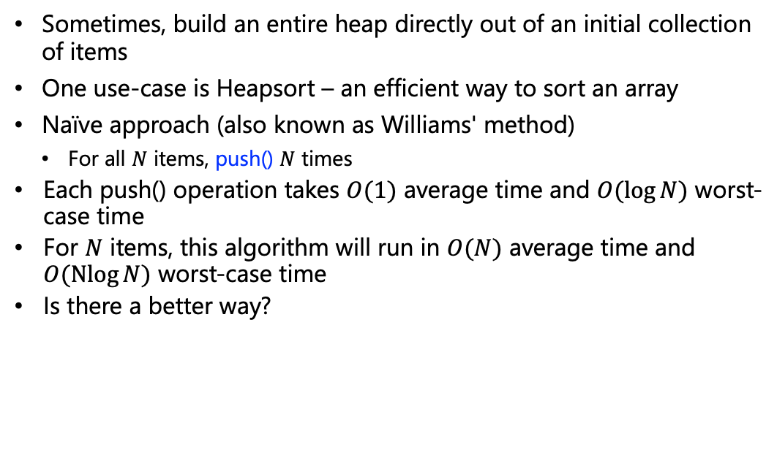
Heapify/BuildHeap
Sometimes, build an entire heap directly out of an initial collection of items
One use-case is Heapsort – an efficient way to sort an array
Naïve approach (also known as Williams' method)
For all $N$ items, push() $N$ times
Each push() operation takes $O(1)$ average time and $O(\log{N})$ worst-case time
For $N$ items, this algorithm will run in $O(N)$ average time and $O(\operatorname{Nlog}{N})$ worst-case time
Is there a better way?
Notes:
Push(), average complexity is O(1) because, its an array implementation

Slide 24
Heapify/BuildHeap
Linear approach (Floyd's method)
Put all the elements on binary tree, only respecting structure property
Shift down all the elements starting from the first node who has at least one child, and up to the root
51
51
43
93
43
93
18
42
99
54
2
42
99
54
2
74
18
74

Slide 25
Heapify/BuildHeap
51
51
43
54
2
54
2
42
99
93
18
42
99
93
18
74
43
74
2
18
54
43
42
99
93
51
74

Slide 26
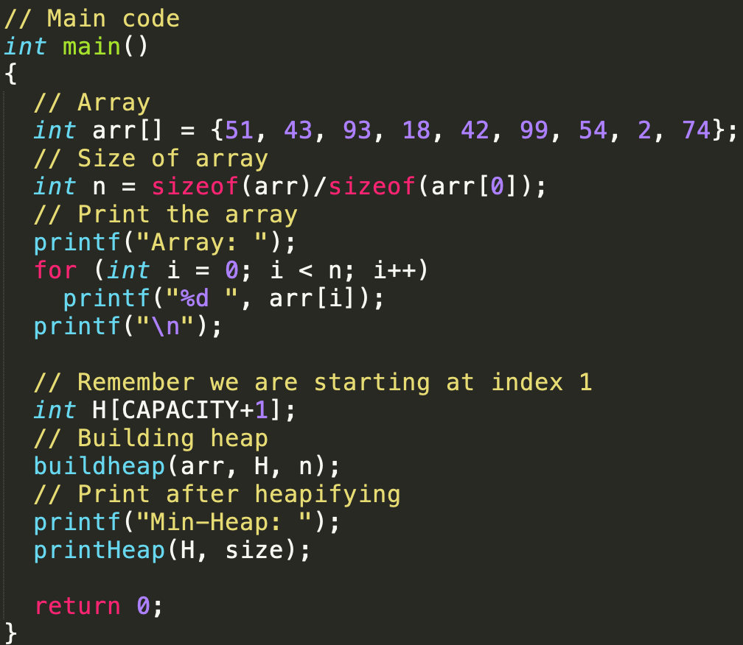
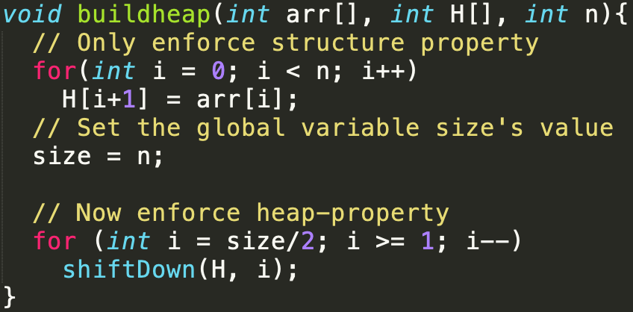
Heapify/BuildHeap Implementations

Slide 27
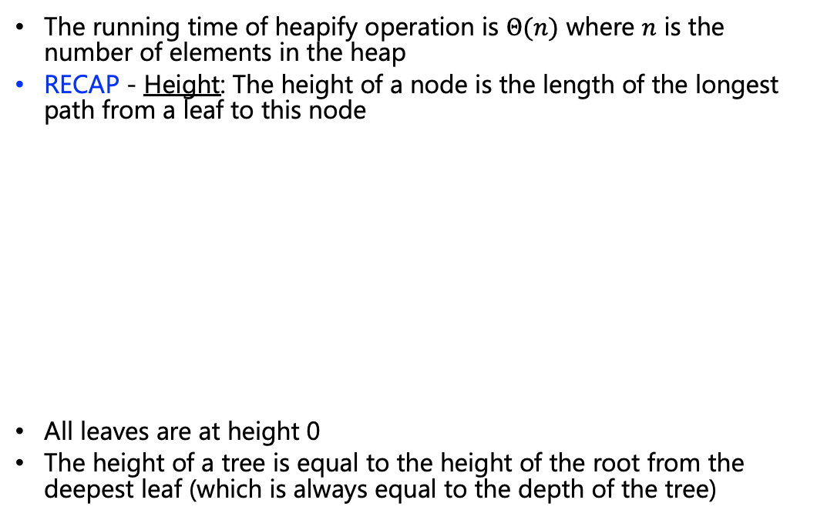
Heapify/BuildHeap Complexity Analysis
The running time of heapify operation is $Θ(n)$ where $n$ is the number of elements in the heap
RECAP - Height: The height of a node is the length of the longest path from a leaf to this node
All leaves are at height 0
The height of a tree is equal to the height of the root from the deepest leaf (which is always equal to the depth of the tree)
A
B
C
D
E
F
G
H
I
J
K

Slide 28
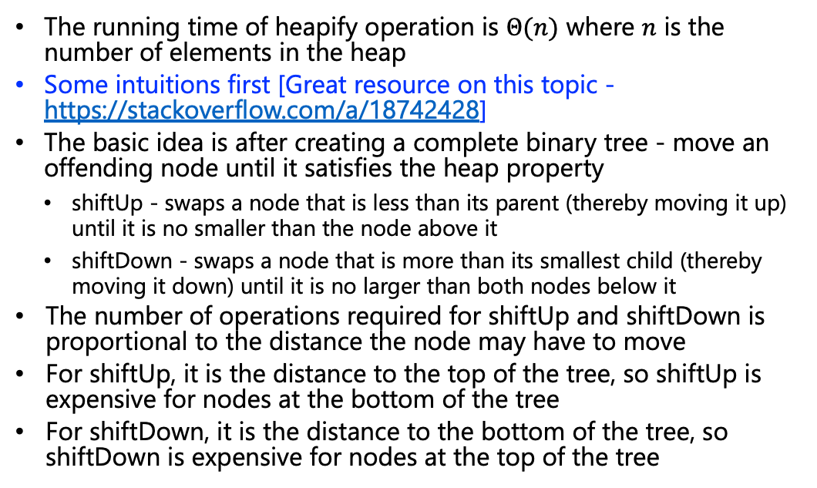
Heapify/BuildHeap Complexity Analysis
The running time of heapify operation is $Θ(n)$ where $n$ is the number of elements in the heap
Some intuitions first [Great resource on this topic - https://stackoverflow.com/a/18742428]
The basic idea is after creating a complete binary tree - move an offending node until it satisfies the heap property
shiftUp - swaps a node that is less than its parent (thereby moving it up) until it is no smaller than the node above it
shiftDown - swaps a node that is more than its smallest child (thereby moving it down) until it is no larger than both nodes below it
The number of operations required for shiftUp and shiftDown is proportional to the distance the node may have to move
For shiftUp, it is the distance to the top of the tree, so shiftUp is expensive for nodes at the bottom of the tree
For shiftDown, it is the distance to the bottom of the tree, so shiftDown is expensive for nodes at the top of the tree

Slide 29








Heapify/BuildHeap Complexity Analysis
Although both operations are O(log n) in the worst case, only one node is at the top whereas half the nodes lie in the bottom layer
So it shouldn't be too surprising that if we have to apply an operation to every node, we would prefer shiftDown over shiftUp
Max # of
swaps
Max # of
nodes
A
height $h$
$$1=2^{0}$$
B
C
height $h−1$
$$2=2^{1}$$
D
E
F
G
height $h−2$
$$4=2^{2}$$
I
J
K
L
M
N
O
P
height $h−3$ $$=0$$
$$8=2^{3}$$

Slide 30
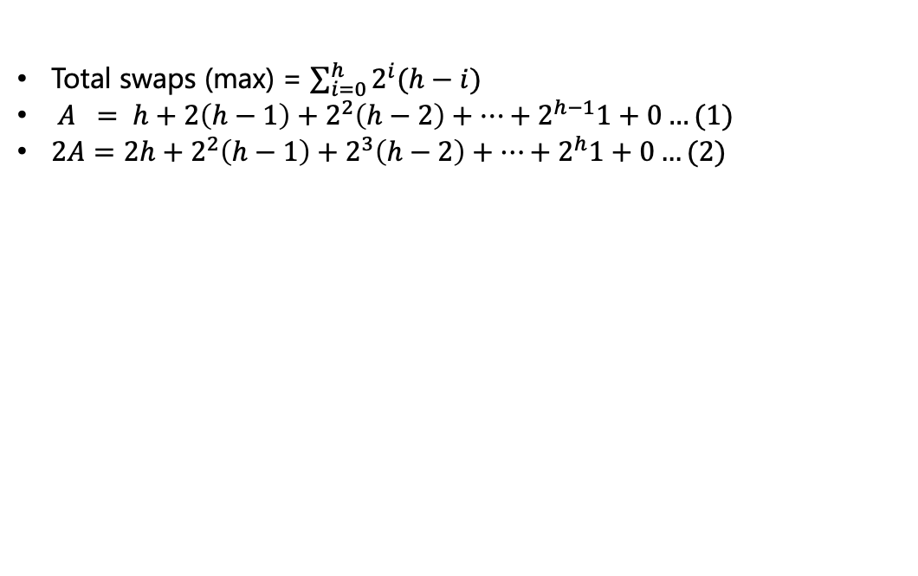
Heapify/BuildHeap Complexity Analysis
Total swaps (max) = $\sum_{i=0}^{h}{2^{i}(h−i)}$
$A = h+2\left(h−1\right)+2^{2}\left(h−2\right)+…+2^{h−1}1+0…(1)$
$2A=2h+2^{2}\left(h−1\right)+2^{3}\left(h−2\right)+…+2^{h}1+0…(2)$
Max # of
swaps
Max # of
nodes
A
height $h$
$$1=2^{0}$$
B
C
height $h−1$
$$2=2^{1}$$
D
E
F
G
height $h−2$
$$4=2^{2}$$
I
J
K
L
M
N
O
P
height $h−3$ $$=0$$
$$8=2^{3}$$

Slide 31
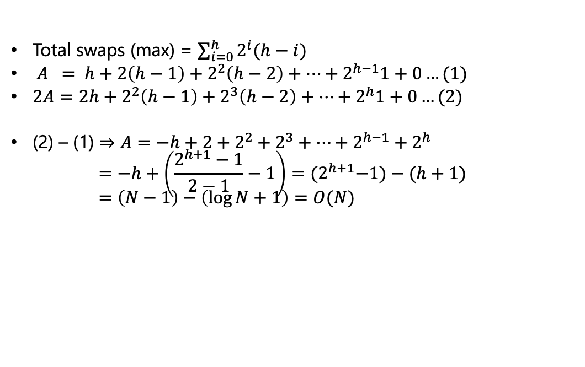
Heapify/BuildHeap Complexity Analysis
Total swaps (max) = $\sum_{i=0}^{h}{2^{i}(h−i)}$
$A = h+2\left(h−1\right)+2^{2}\left(h−2\right)+…+2^{h−1}1+0…(1)$
$2A=2h+2^{2}\left(h−1\right)+2^{3}\left(h−2\right)+…+2^{h}1+0…(2)$
(2) – (1) $⇒A=−h+2+2^{2}+2^{3}+…+2^{h−1}+2^{h}$ $=−h+\left(\frac{2^{h+1}−1}{2−1}−1\right)={(2}^{h+1}−1)−(h+1)$ $=\left(N−1\right)−\left(\log{N}+1\right)=O(N)$

Slide 32
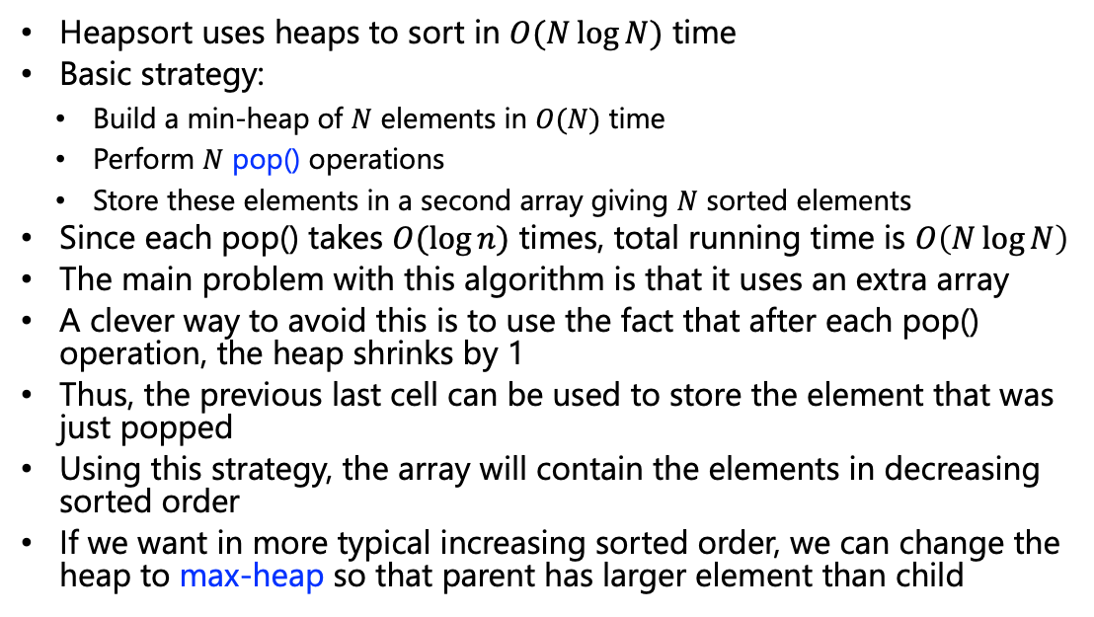
Heapsort
Heapsort uses heaps to sort in $O(N\log{N})$ time
Basic strategy:
Build a min-heap of $N$ elements in $O(N)$ time
Perform $N$ pop() operations
Store these elements in a second array giving $N$ sorted elements
Since each pop() takes $O(\log{n})$ times, total running time is $O\left(N\log{N}\right)$
The main problem with this algorithm is that it uses an extra array
A clever way to avoid this is to use the fact that after each pop() operation, the heap shrinks by 1
Thus, the previous last cell can be used to store the element that was just popped
Using this strategy, the array will contain the elements in decreasing sorted order
If we want in more typical increasing sorted order, we can change the heap to max-heap so that parent has larger element than child

Slide 33
Heapsort
1
12
1
9
2
3
2
3
6
10
6
10
Swap
4
5
6
4
5
6
5
1
9
5
1
12
0
1
2
3
4
5
6
0
1
2
3
4
5
6
0
12
6
10
5
1
9
0
9
6
10
5
1
12
Remove
1
10
1
9
2
3
2
3
6
9
ShiftDown
6
10
4
5
4
5
6
5
1
5
1
12
0
1
2
3
4
5
6
0
1
2
3
4
5
6
0
10
6
9
5
1
12
0
9
6
10
5
1
12

Slide 34
Heapsort
1
10
1
1
2
3
2
3
6
9
6
9
Swap
4
5
4
5
5
1
5
10
0
1
2
3
4
5
6
0
1
2
3
4
5
6
0
10
6
9
5
1
12
0
1
6
9
5
10
12
Remove
1
9
1
1
2
3
2
3
6
1
ShiftDown
6
9
4
4
5
5
5
10
0
1
2
3
4
5
6
0
1
2
3
4
5
6
0
9
6
1
5
10
12
0
1
6
9
5
10
12

Slide 35
Heapsort
1
9
1
5
2
3
2
3
6
1
6
1
Swap
4
5
4
9
0
1
2
3
4
5
6
0
1
2
3
4
5
6
0
9
6
1
5
10
12
0
5
6
1
9
10
12
Remove
1
6
1
5
2
3
2
3
5
1
ShiftDown
6
1
4
9
0
1
2
3
4
5
6
0
1
2
3
4
5
6
0
6
5
1
9
10
12
0
5
6
1
9
10
12

Slide 36
Heapsort
1
6
1
1
2
3
2
3
5
1
5
6
Swap
0
1
2
3
4
5
6
0
1
2
3
4
5
6
0
6
5
1
9
10
12
0
1
5
6
9
10
12
Remove
1
5
1
1
2
2
3
1
ShiftDown
5
6
0
1
2
3
4
5
6
0
1
2
3
4
5
6
0
5
1
6
9
10
12
0
1
5
6
9
10
12

Slide 37
Heapsort
1
5
1
1
2
1
2
5
Swap
0
1
2
3
4
5
6
0
1
2
3
4
5
6
0
5
1
6
9
10
12
0
1
5
6
9
10
12
Remove
1
1
1
1
2
5
0
1
2
3
4
5
6
0
1
2
3
4
5
6
0
1
5
6
9
10
12
0
1
5
6
9
10
12

Slide 38
Thank You

