Slide 1
Algorithms – I (CS29003/203)
Autumn 2022, IIT Kharagpur

Slide 2
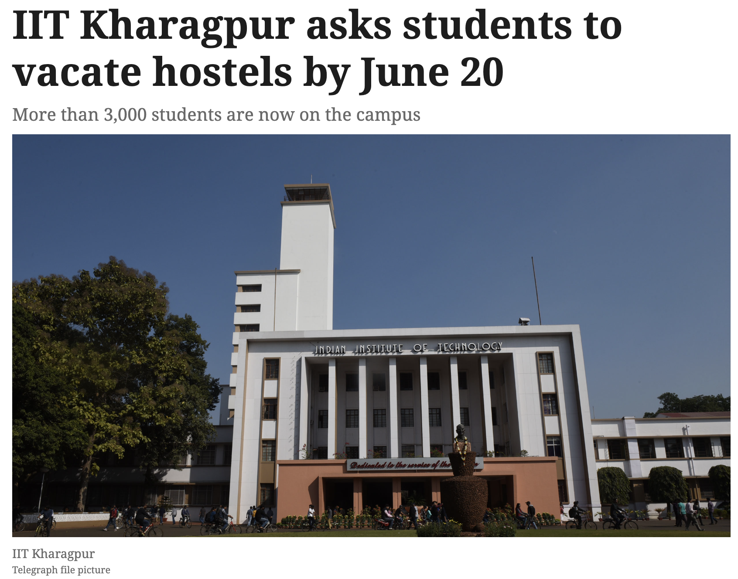
Last 2+ Years
CS21003/CS21203 / Algorithms - I | Introduction

Slide 3
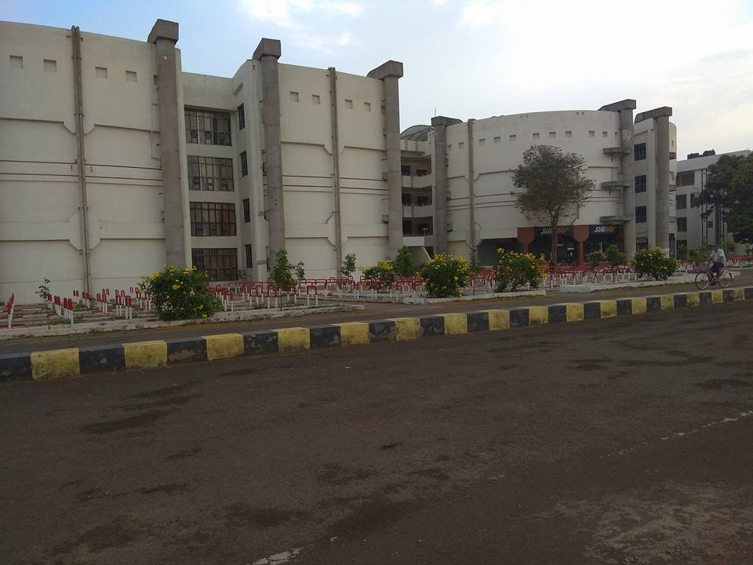
Welcome Back
Source: https://tinyurl.com/3rtxr6as
CS21003/CS21203 / Algorithms - I | Introduction

Slide 4
Logistics
Course Name and code: Algorithms - I, CS21003/CS21203
Time: Wednesday (10:00-10:55 am), Thursday (09:00-09:55 am), Friday (11:00am-12:55 pm)
Venue: NC243 (Roll no.s ending with odd digits), NC341 (Roll no.s ending with even digits)
Course website: https://cs21203au22.github.io/
Prerequisites: PDS
CS21003/CS21203 / Algorithms - I | Introduction

Slide 5
Logistics
Moodle Classroom: https://moodlecse.iitkgp.ac.in/moodle/ and then the class name is – Algorithms - I Theory (CS21003/CS21203)
Login to moodle -> In Home, scroll down to ‘Course categories->Autumn Semester (2022-23)’. Search with code ‘ALGOTH-A22-23’
Enrollment key: ATHSTU2223
TAs: Kothapalli Dileep (kothapallidileep10122000@gmail.com), Pankaj Kumar Agarwal (pankaj08072000@gmail.com).
One more will be added soon.
CS21003/CS21203 / Algorithms - I | Introduction

Slide 6
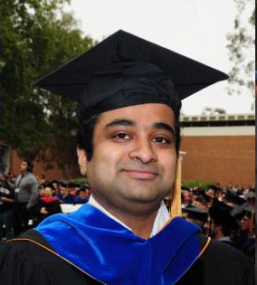
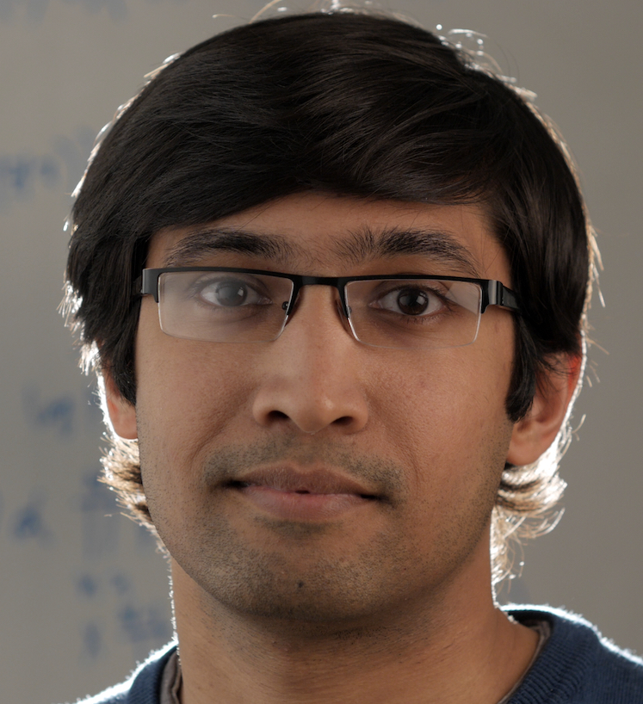


The Team
Instructors
Teaching Assistants
Abir Das
Ayan Chaudhury
Pankaj K.
Agarwal
Kothapalli
Dileep
And YOU!!
CS21003/CS21203 / Algorithms - I | Introduction

Slide 7
Course Information
Books and References:
Thomas H Cormen, Charles E Lieserson, Ronald L Rivest and Clifford Stein, Introduction to Algorithms. (3rd Edition)
Jon Kleinberg and Éva Tardos, Algorithm Design, Pearson, 2005.
Sanjoy Dasgupta, Christos H. Papadimitriou and Umesh V. Vazirani, Algorithms, Tata McGraw-Hill, 2008.
Jeff Erickson, Algorithms, 2019.
Mark Allen Weiss, Data Structures and Algorithm Analysis in C.
More references specific to the lectures will be added in the course website as and when needed.
CS21003/CS21203 / Algorithms - I | Introduction

Slide 8
Course Information
Evaluation: ClassTest (20%) – 2; Mid Sem (30%); End Sem (50%). [Tentative]
ClassTests and Semester Exams:
They will have a combination of Mathematical, Analytical and short coding based problems.
Tentative class test dates: I. Aug end/Sept start II. Oct end/Nov start
Will be taken outside class timings (evening is most likely)
Practice homeworks will be given in moodle. These will not be graded.
CS21003/CS21203 / Algorithms - I | Introduction

Slide 9
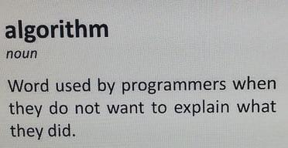

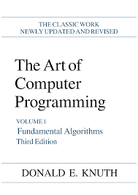
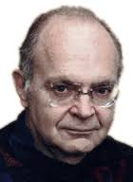
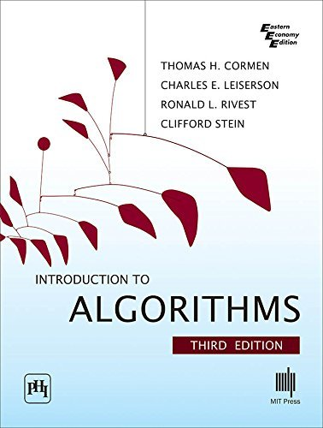
What are algorithms?
Source: http://redd.it/b5mtc7
Dictionary definition: A procedure for solving a mathematical problem (as of finding the greatest common divisor) in a finite number of steps that frequently involves repetition of an operation.
By Donald E Knuth: An algorithm is a finite, definite, effective procedure, with some input and some output.
By Cormen et al.: An algorithm is a sequence of computational steps that transform the input into the output.

Slide 10
Why is the study of algorithms worthwhile?
Especially, modern computers are pretty fast and memory cost is low
(If for no other reason) – show that your algorithm produces the right answer always
Different algorithms for the same problem often differ dramatically in terms of efficiency
Before showing an example, lets step into the practical world!

Slide 11
Why is the study of algorithms worthwhile?
typical job interview process, e.g., Google’s software developer [Source: Link]
Round 1: online assessment (~90 Minutes)
Two data structures and algorithms questions you have to complete
Write your own test cases and must pass all test cases that you cannot see
You can use any IDE of your choice
The recruiter will not review your resume if you do not pass the OA
Round 2: Technical phone interview
Solve data structure and algorithm questions
Write code (usually in txt/cloud doc) and explain the correctness/time complexity
Additional behavioral questions that are usually not decisive

Slide 12
Why is the study of algorithms worthwhile?
typical job interview process, e.g., Google’s software developer [Source: Link]
Round 3: Onsite interviews (May not be applicable in India)
Spend a full day at a Google office and do four to six interviews.
Topics asked are usually data structure and algorithm and system design
You are expected to do extremely well in coding interviews
Of course algorithms are also important for doing research in all CS areas

Slide 13
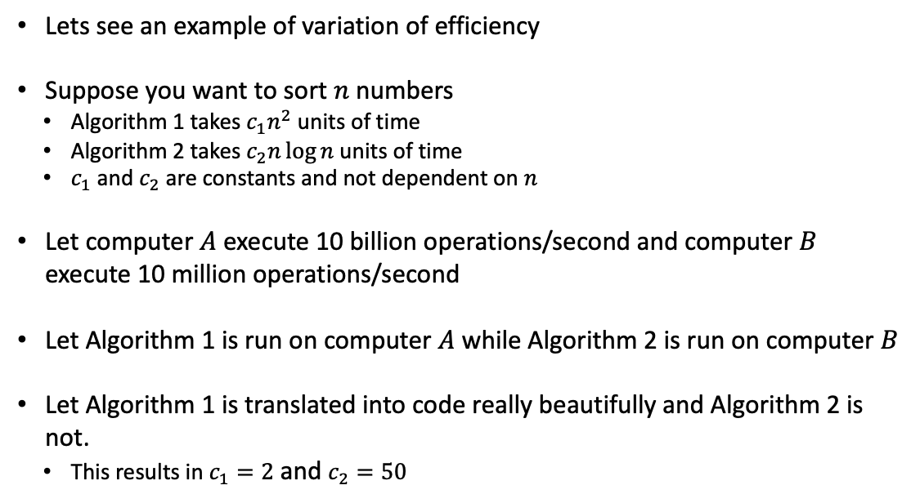
Why is the study of algorithms worthwhile?
Lets see an example of variation of efficiency
Suppose you want to sort $n$ numbers
Algorithm 1 takes $c_{1}n^{2}$ units of time
Algorithm 2 takes $c_{2}n\log{n}$ units of time
$c_{1}$ and $c_{2}$ are constants and not dependent on $n$
Let computer $A$ execute 10 billion operations/second and computer $B$ execute 10 million operations/second
Let Algorithm 1 is run on computer $A$ while Algorithm 2 is run on computer $B$
Let Algorithm 1 is translated into code really beautifully and Algorithm 2 is not.
This results in $c_{1}=2$ and $c_{2}=50$

Slide 14
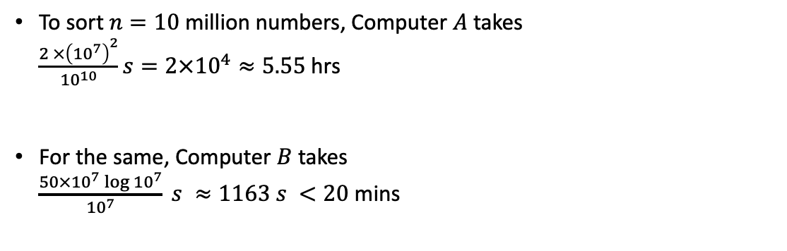
Why is the study of algorithms worthwhile?
To sort$n=10$ million numbers, Computer $A$ takes $\frac{2 ×{\left({10}^{7}\right)}^{2}}{{10}^{10}}s=2×{10}^{4}≈5.55$hrs
For the same, Computer $B$ takes $\frac{50×{10}^{7}\log{{10}^{7}}}{{10}^{7}} s ≈1163 s <20$ mins

Slide 15
First Algorithm: Insertion Sort
key
5
2
4
6
1
3
1
2
4
5
6
1
3
2
5
2
4
6
1
3
1
2
4
5
6
6
3
2
5
5
4
6
1
3
1
2
4
5
5
6
3
2
2
5
4
6
1
3
1
2
4
4
5
6
3
4
2
5
4
6
1
3
1
2
2
4
5
6
3
4
2
5
5
6
1
3
1
1
2
4
5
6
3
4
2
4
5
6
1
3
3
1
2
4
5
6
3
3
1
2
4
4
5
6
6
2
4
5
6
1
3
3
1
2
4
5
6
6
3
1
2
3
4
5
6
6
2
4
5
6
1
3
3
1
2
4
5
5
6

Slide 16
First Pseudocode: Insertion Sort
Let us write a pseudocode describing this process
But before that – what is a pseudocode and how is it different from a real code?
Pseudocode does not bother much about language specific synatxes
Whatever helps to express the idea is used
Is not concerned with issues of software engineering

Slide 17
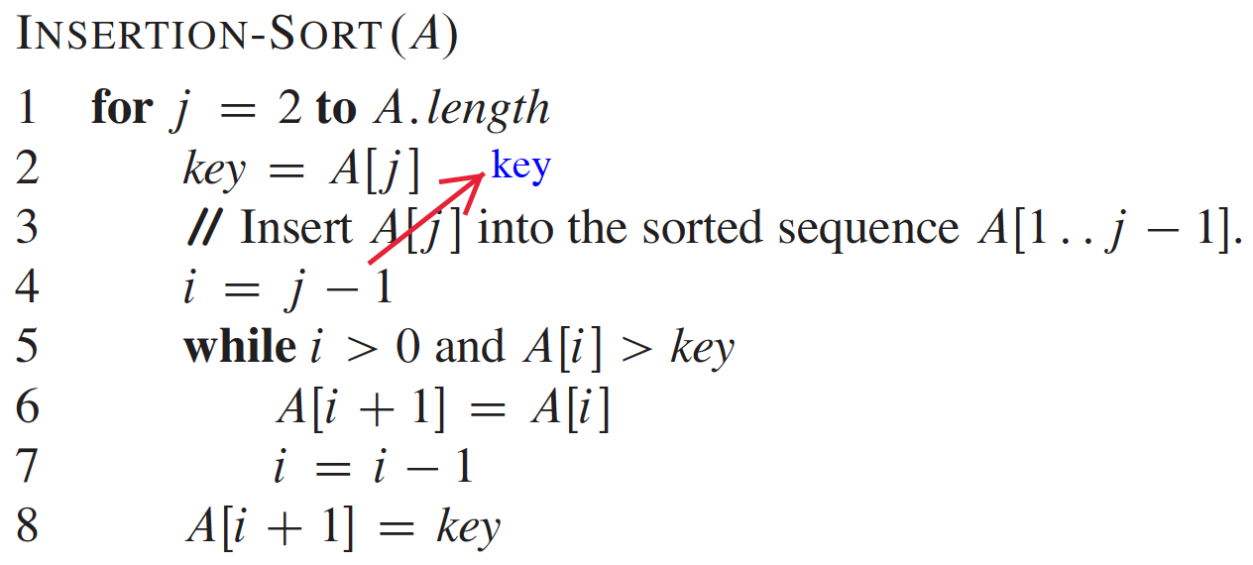
First Pseudocode: Insertion Sort

Slide 18
Thank You!!

