Slide 1
Algorithms – I (CS29003/203)
Autumn 2022, IIT Kharagpur
Analysis of Algorithms

Slide 2
Analyzing Algorithms
Predict how your algorithm performs in practice
By analyzing several candidate algorithms for a problem we can identify efficient ones
Criteria
Running time
Space usage
Cache I/O
Main memory I/O
Lines of codes
CS21003/CS21203 / Algorithms - I | Analysis of Algorithms

Slide 3
Analyzing Running Time
Random Access Machine (RAM) model
Every operation including memory access, arithmetic operations etc. takes same amount of time.
Is it precise?
Not really. But precise model would be tedious – would yield very little insight into algorithm design and analysis
However, we should be careful not to abuse it
We only care about “Order of the cost”, i.e., we omit
Lower order terms
Constants
Asymptotic Analysis
CS21003/CS21203 / Algorithms - I | Analysis of Algorithms

Slide 4
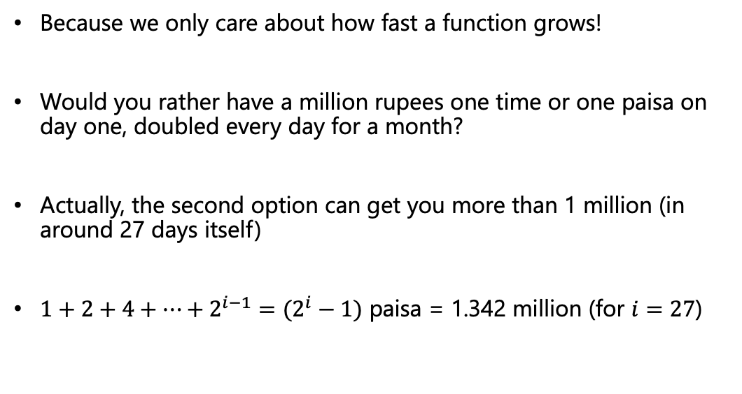
Why Asymptotic Analysis
Because we only care about how fast a function grows!
Would you rather have a million rupees one time or one paisa on day one, doubled every day for a month?
Actually, the second option can get you more than 1 million (in around 27 days itself)
$1+2+4+…+2^{i−1}=(2^{i}−1)$ paisa = 1.342 million (for $i=27$)
CS21003/CS21203 / Algorithms - I | Analysis of Algorithms

Slide 5
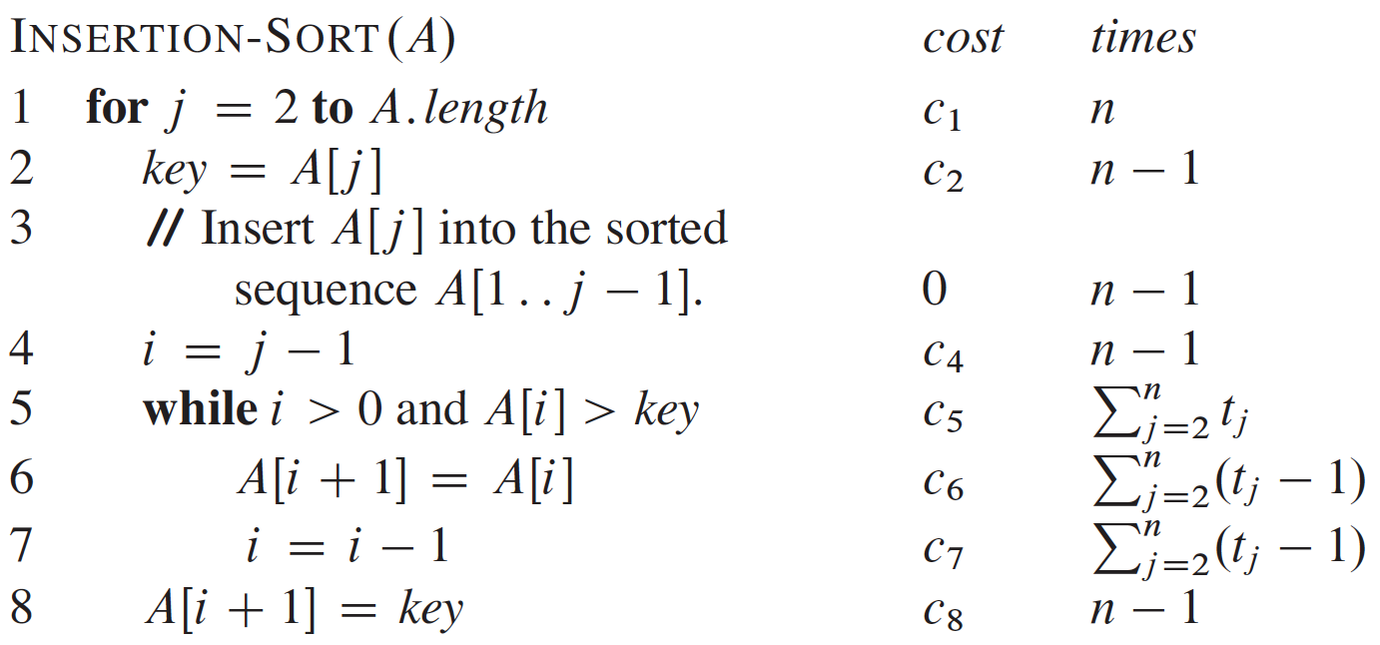
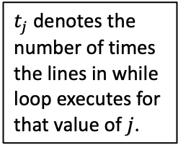
Running Time Analysis of Insertion Sort
Lets go back to insertion sort and see its running time
Our expression will evolve from a messy formula that assumes each line of the code takes a constant amount of time
$t_{j}$ denotes the number of times the lines in while loop executes for that value of $j$.
CS21003/CS21203 / Algorithms - I | Analysis of Algorithms

Slide 6
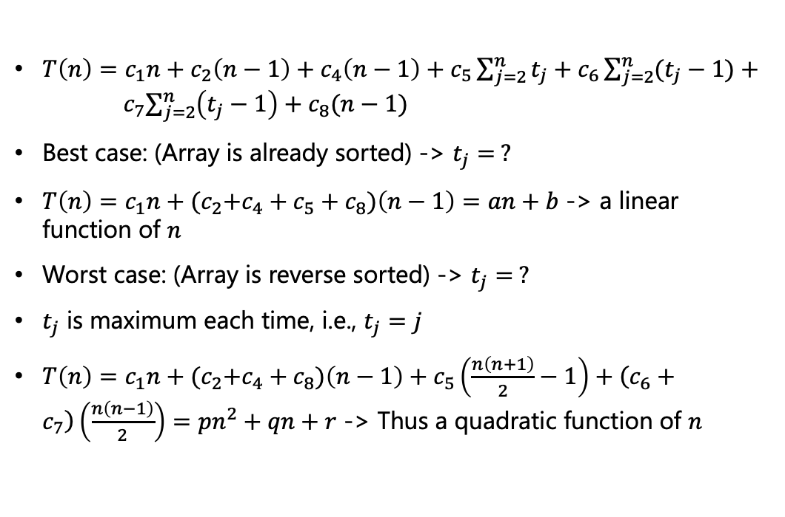
Running Time Analysis of Insertion Sort
$T\left(n\right)=c_{1}n+c_{2}\left(n−1\right)+c_{4}\left(n−1\right)+c_{5}\sum_{j=2}^{n}{t_{j}}+c_{6}\sum_{j=2}^{n}{(t_{j}−1)}+{ c}_{7}\sum_{j=2}^{n}{\left(t_{j}−1\right)+c_{8}(n−1)}$
Best case: (Array is already sorted) -> $t_{j}= ?$
$T\left(n\right)=c_{1}n+{(c}_{2}+c_{4}+c_{5}+c_{8})\left(n−1\right)=an+b$ -> a linear function of $n$
Worst case: (Array is reverse sorted) -> $t_{j}= ?$
$t_{j}$ is maximum each time, i.e., $t_{j}=j$
$T\left(n\right)=c_{1}n+{(c}_{2}+c_{4}+c_{8})\left(n−1\right)+c_{5}\left(\frac{n\left(n+1\right)}{2}−1\right)+\left(c_{6}+c_{7}\right)\left(\frac{n\left(n−1\right)}{2}\right)=pn^{2}+qn+r$ -> Thus a quadratic function of $n$
1
CS21003/CS21203 / Algorithms - I | Analysis of Algorithms

Slide 7
Best/Average/Worst Case Analysis
We looked at both `best case’ (input array was already sorted) and `worst case’ (input array was reverse sorted)
In this course, we shall usually concentrate on worst-case running time
Major reasons
Gives an upper bound on the running time for any input
For some algorithms, worst case occurs fairly often, e.g., searching
Average case is often roughly as bad as the worst case.
CS21003/CS21203 / Algorithms - I | Analysis of Algorithms

Slide 8
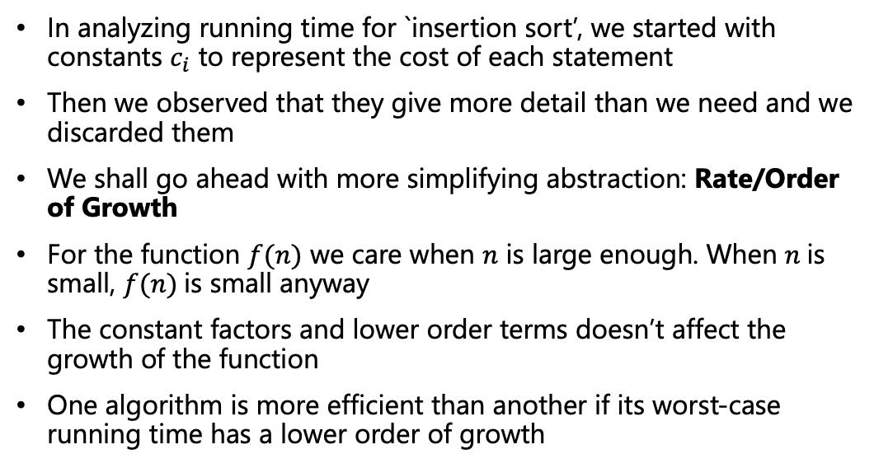
Order of Growth
In analyzing running time for `insertion sort’, we started with constants $c_{i}$ to represent the cost of each statement
Then we observed that they give more detail than we need and we discarded them
We shall go ahead with more simplifying abstraction: Rate/Order of Growth
For the function $f(n)$ we care when $n$ is large enough. When $n$is small, $f(n)$is small anyway
The constant factors and lower order terms doesn’t affect the growth of the function
One algorithm is more efficient than another if its worst-case running time has a lower order of growth
CS21003/CS21203 / Algorithms - I | Analysis of Algorithms

Slide 9
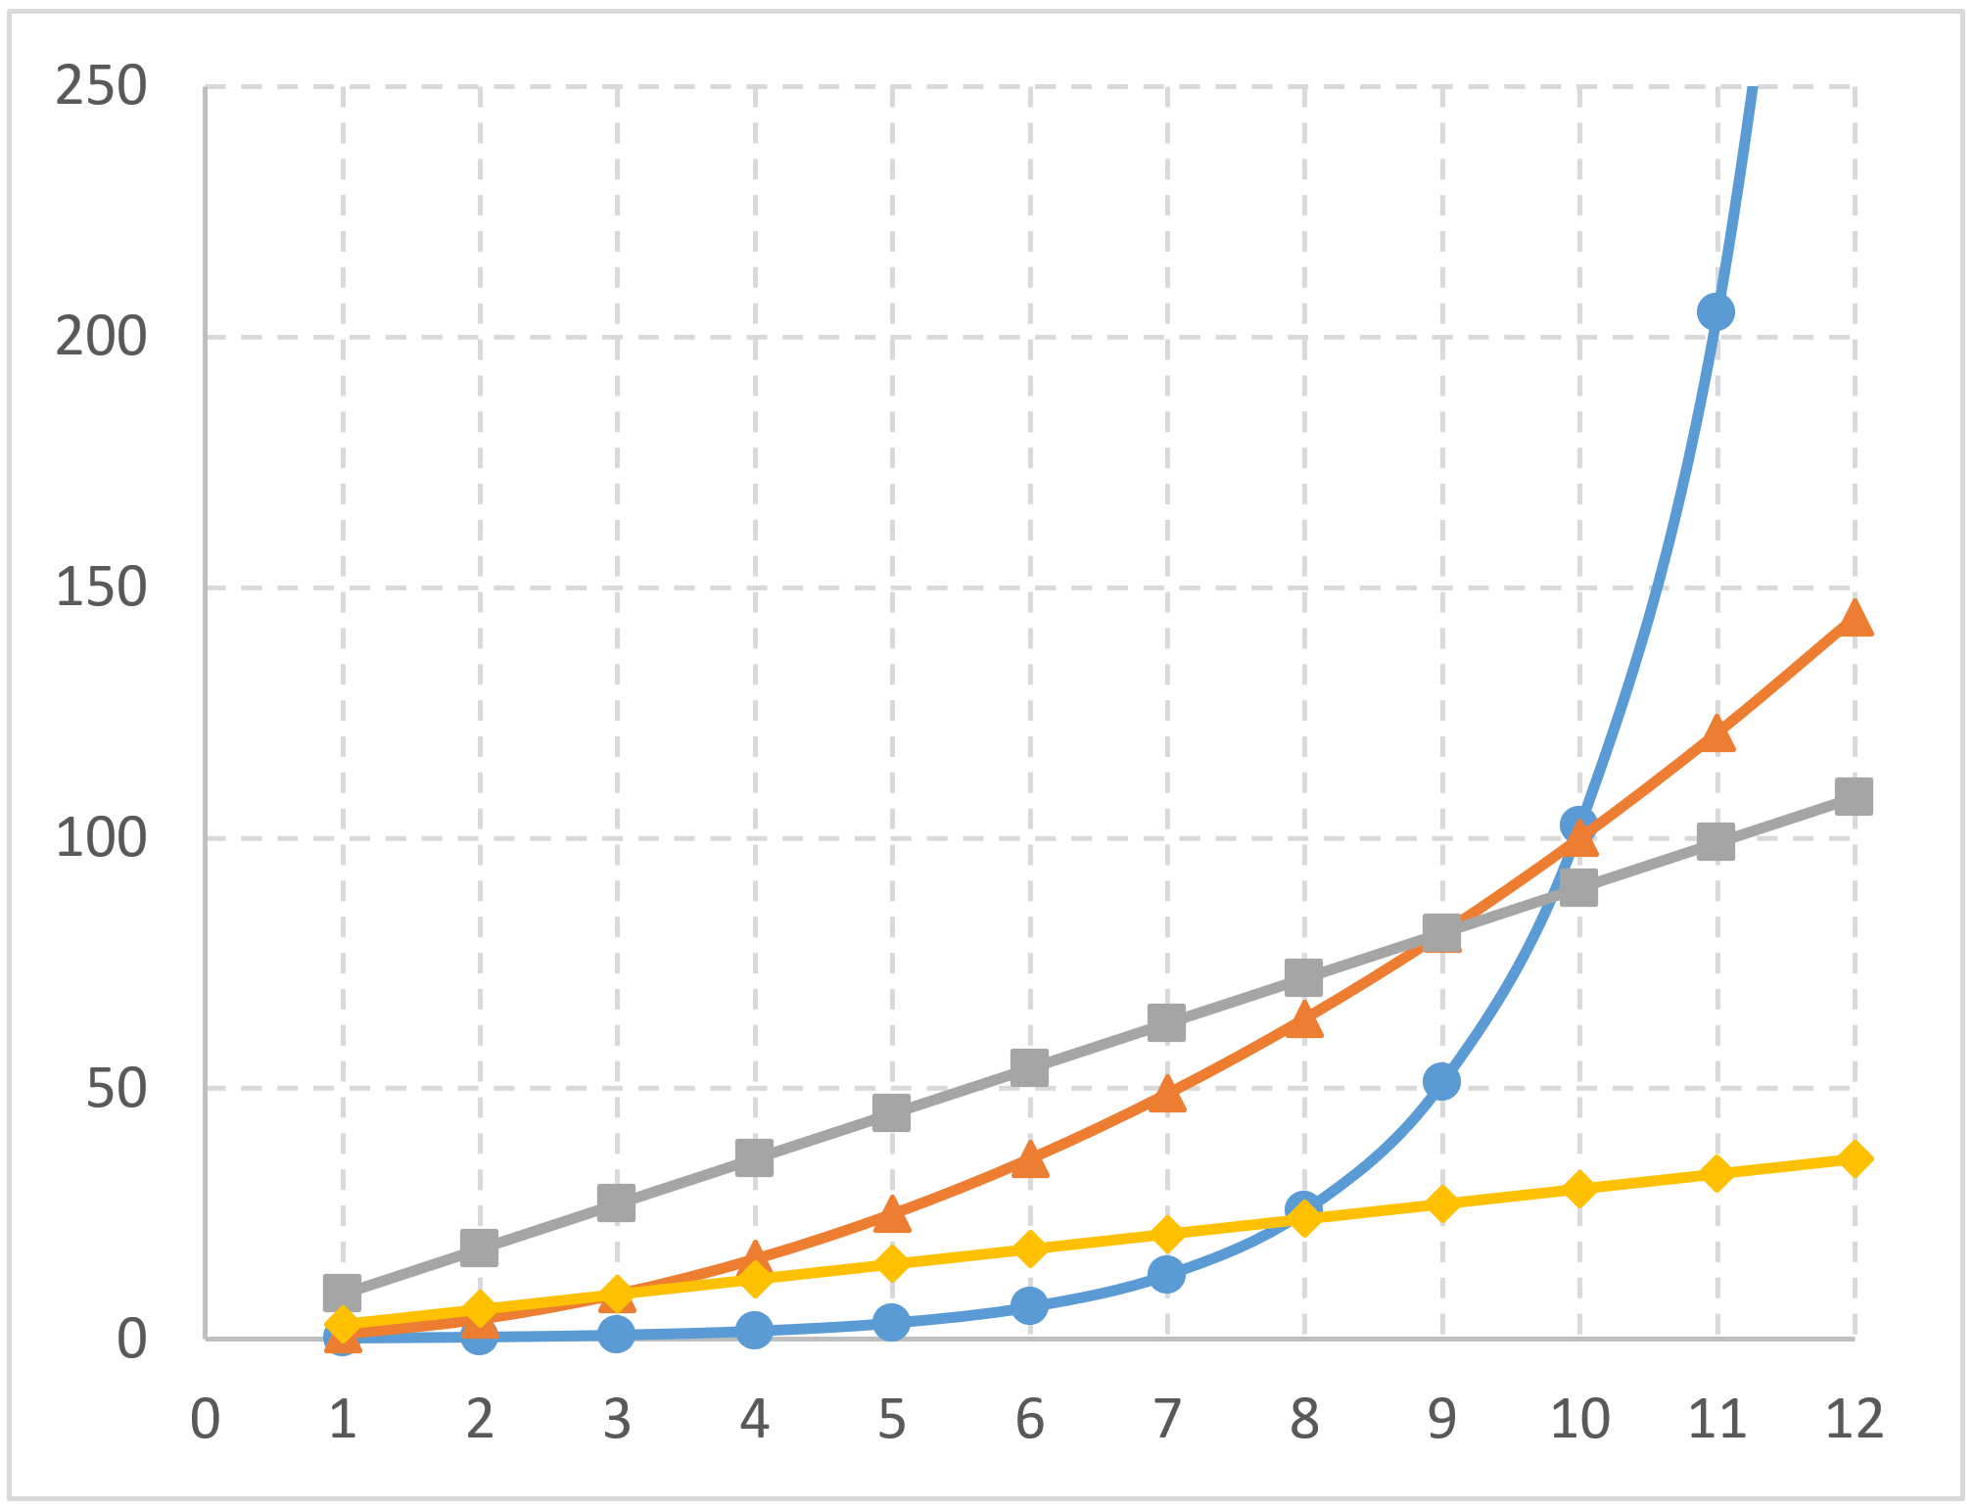





Order of Growth
$$g_{2}\left(n\right)=0.1×2^{n}$$
$$g_{1}\left(n\right)=n^{2}$$
$$f_{2}\left(n\right)=9n$$
$$f_{1}\left(n\right)=3n$$
Omit the constant factors
When $n$ is large enough, $g_{1}\left(n\right)$ will be much larger than $f_{1}\left(n\right)$ or $f_{2}\left(n\right)$
$f_{1}\left(n\right)$ and $f_{2}\left(n\right)$ will have similar growth trend
CS21003/CS21203 / Algorithms - I | Analysis of Algorithms

Slide 10
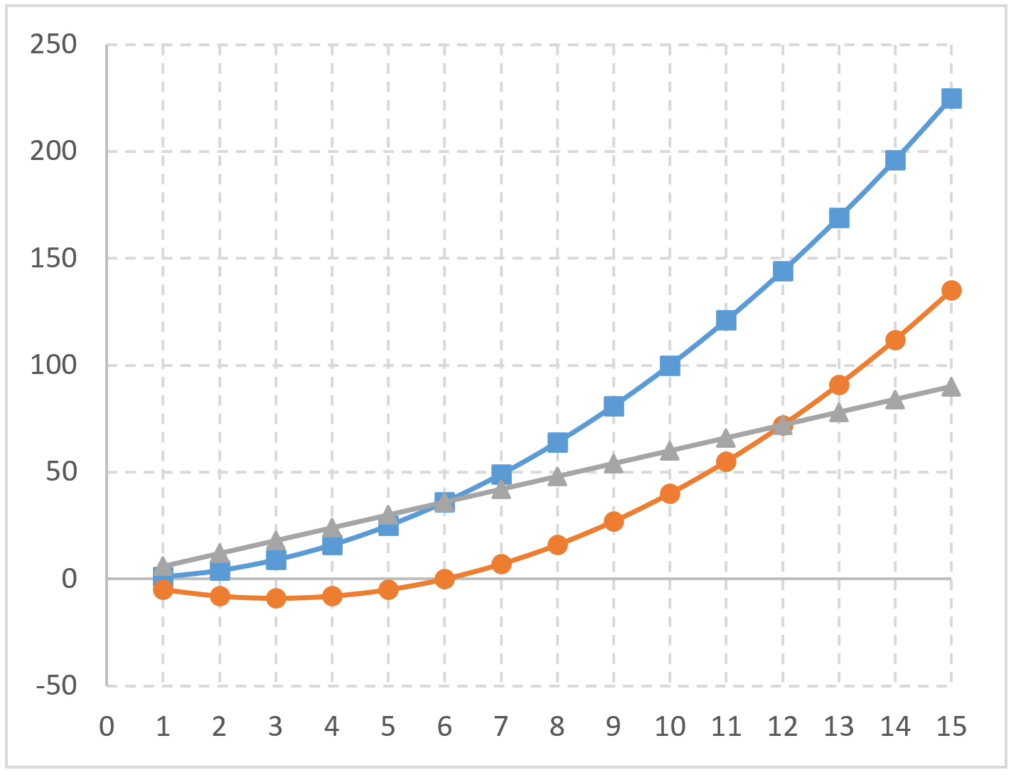
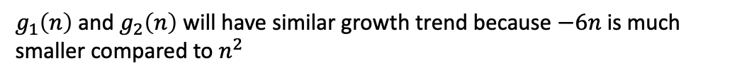



Order of Growth
$$g_{1}\left(n\right)=n^{2}$$
$$g_{2}\left(n\right)=n^{2} −6n$$
$$f\left(n\right)=6n$$
Omit the lower-order terms
When $n$ is large enough, $g_{1}\left(n\right)$ or $g_{2}\left(n\right)$ will still be much larger than $f\left(n\right)$
$g_{1}\left(n\right)$ and $g_{2}\left(n\right)$ will have similar growth trend because $−6n$ is much smaller compared to $n^{2}$
CS21003/CS21203 / Algorithms - I | Analysis of Algorithms

Slide 11
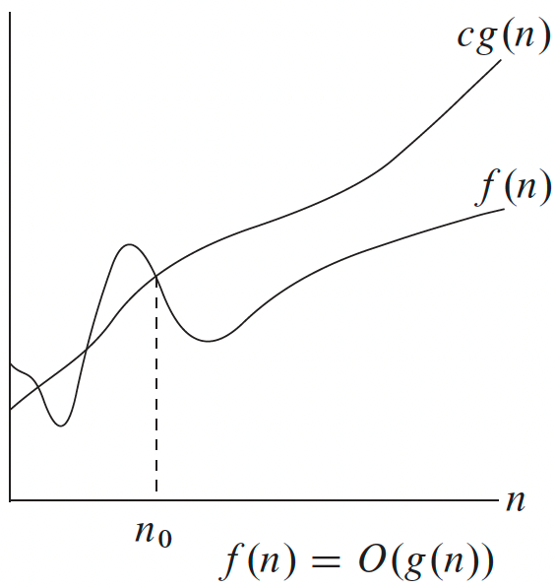

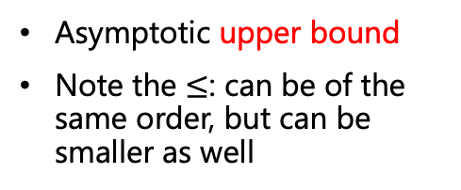


Asymptotic Notations
These notations are used to describe the asymptotic running time of an algorithm
However, asymptotic notations can apply to other functions that have nothing to do whatsoever with algorithms
O (Big-O)
$$O\left(g\left(n\right)\right)=\{f\left(n\right): ∃ c>0, n_{0}>0, such that 0≤f(n)≤cg\left(n\right)∀ n≥n_{0}\}$$
After some constant $n_{0}$
Asymptotic upper bound
Note the $≤$: can be of the same order, but can be smaller as well
$$f\left(n\right)≤cg(n)$$
$n=O\left(n^{2}\right), n^{2}=O\left(n^{2}\right), n^{3}≠O(n^{2})$
CS21003/CS21203 / Algorithms - I | Analysis of Algorithms
Notes:
After n_0 cg(n) is always an upper bound to f(n)
f(n) = O(n) means f(n) is a member of the set

Slide 12
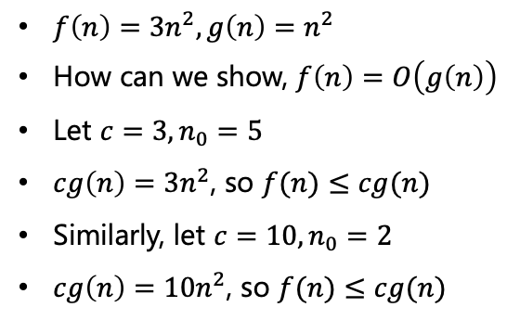
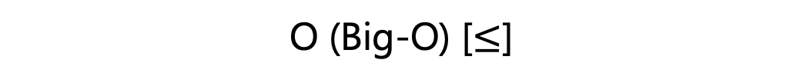



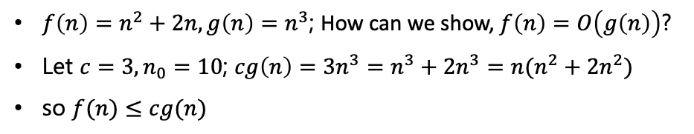
O (Big-O) [$≤$]
$$O\left(g\left(n\right)\right)=\{f\left(n\right): ∃ c>0, n_{0}>0, such that 0≤f(n)≤cg\left(n\right)∀ n≥n_{0}\}$$
$f\left(n\right)=3n^{2}, g\left(n\right)=n^{2}$
How can we show, $f\left(n\right)=O\left(g\left(n\right)\right)$
Let $c=3, n_{0}=5$
$cg\left(n\right)=3n^{2}$, so $f(n)≤cg(n)$
Similarly, let $c=10, n_{0}=2$
$cg\left(n\right)=10n^{2}$, so $f(n)≤cg(n)$
After some constant $n_{0}$
$$f\left(n\right)≤cg(n)$$
Always larger than
$$n^{2}+2n$$
$f\left(n\right)=n^{2}+2n, g\left(n\right)=n^{3}$; How can we show, $f\left(n\right)=O\left(g\left(n\right)\right)$?
Let $c=3, n_{0}=10$; $cg\left(n\right)=3n^{3}=n^{3}+2n^{3}=n(n^{2}+2n^{2})$
so $f(n)≤cg(n)$
CS21003/CS21203 / Algorithms - I | Analysis of Algorithms

Slide 13
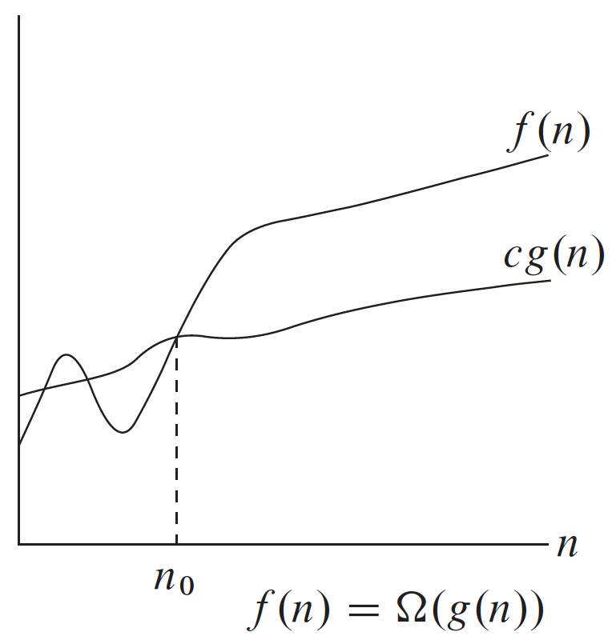

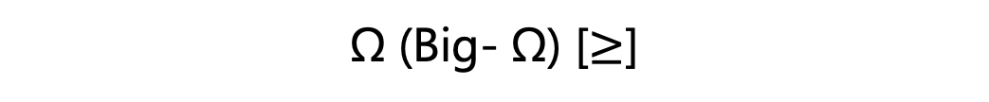


Ω (Big- Ω) [$≥$]
$$Ω\left(g\left(n\right)\right)=\{f\left(n\right): ∃ c>0, n_{0}>0, such that 0≤cg(n)≤f(n) ∀ n≥n_{0}\}$$
After some constant $n_{0}$
$$f\left(n\right)≥cg(n)$$
Asymptotic lower bound
can be of the same order, but can be larger as well
$n≠Ω\left(n^{2}\right), n^{2}=Ω\left(n^{2}\right), n^{3}=Ω(n^{2})$
CS21003/CS21203 / Algorithms - I | Analysis of Algorithms

Slide 14
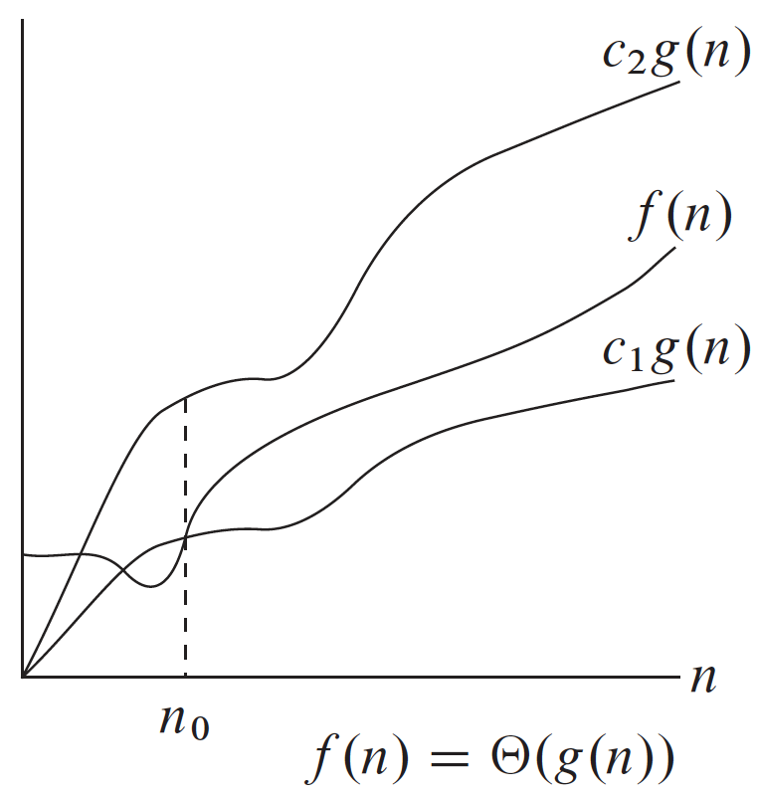

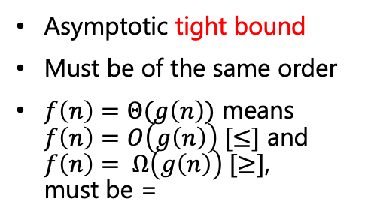
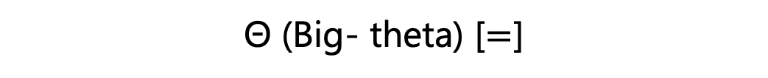

Θ (Big- theta) [$=$]
$$Θ\left(g\left(n\right)\right)=\{f\left(n\right): ∃ c_{1},c_{2}>0, n_{0}>0, s.t. 0≤c_{1}g(n)≤f(n)≤c_{2}g\left(n\right) ∀ n≥n_{0}\}$$
After some constant $n_{0}$
Asymptotic tight bound
Must be of the same order
$f\left(n\right)=Θ(g\left(n\right))$ means $f\left(n\right)=O\left(g\left(n\right)\right) [≤]$ and $f\left(n\right)= Ω\left(g\left(n\right)\right) [≥]$, must be =
$f\left(n\right)$ must be
within this range
$n≠Θ\left(n^{2}\right), n^{2}=Θ\left(n^{2}\right), n^{3}≠Θ(n^{2})$
CS21003/CS21203 / Algorithms - I | Analysis of Algorithms

Slide 15
What This also Means
O(g(n)): class of functions f(n) that grow no faster than g(n)
Θ(g(n)): class of functions f(n) that grow at same rate as g(n)
Ω(g(n)): class of functions f(n) that grow at least as fast as g(n)
CS21003/CS21203 / Algorithms - I | Analysis of Algorithms

Slide 16
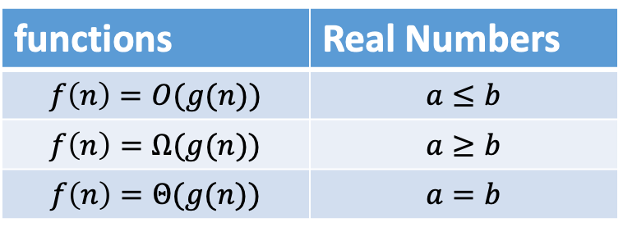
Analogy to Real Numbers
functions | Real Numbers
$$f\left(n\right)=O(g(n))$$ | $$a≤b$$
$$f\left(n\right)=Ω(g(n))$$ | $$a≥b$$
$$f\left(n\right)=Θ(g(n))$$ | $$a=b$$
CS21003/CS21203 / Algorithms - I | Analysis of Algorithms

Slide 17
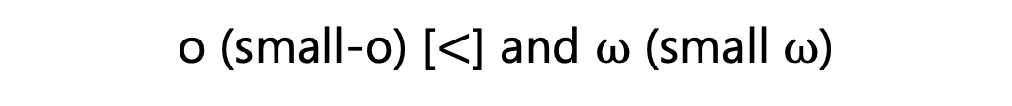
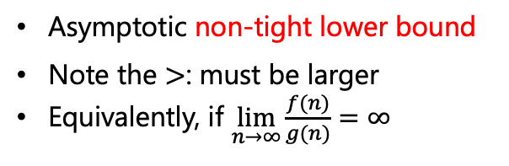
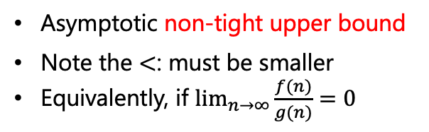
o (small-o) [$<$] and ⍵ (small ⍵)
$$o\left(g\left(n\right)\right)=\{f\left(n\right):for any c>0, ∃ n_{0}>0, such that 0≤f(n)<cg\left(n\right)∀ n≥n_{0}\}$$
Asymptotic non-tight upper bound
Note the $<$: must be smaller
Equivalently, if $\lim_{n→∞}{\frac{f(n)}{g(n)}=0}$
By analogy,
$$ω\left(g\left(n\right)\right)=\{f\left(n\right):for anyc>0,∃n_{0}>0, such that 0≤cg(n)<f(n) ∀ n≥n_{0}\}$$
Asymptotic non-tight lower bound
Note the $>$: must be larger
Equivalently, if $\lim_{n→∞}{\frac{f(n)}{g(n)}=∞}$
CS21003/CS21203 / Algorithms - I | Analysis of Algorithms
Notes:
Ask, if the first limit is true – can we write f(n) is big O of g(n): Yes we can as O includes both < and = while o already is <
Ask what if the limit is a constant?

Slide 18
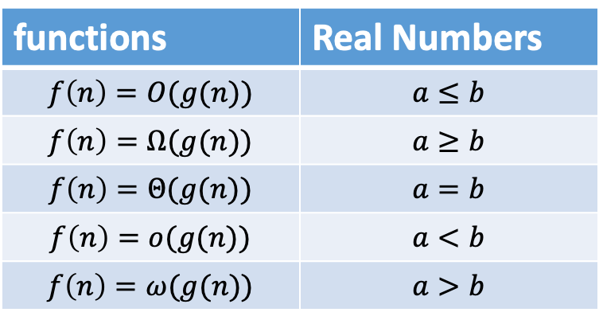
Analogy to Real Numbers
functions | Real Numbers
$$f\left(n\right)=O(g(n))$$ | $$a≤b$$
$$f\left(n\right)=Ω(g(n))$$ | $$a≥b$$
$$f\left(n\right)=Θ(g(n))$$ | $$a=b$$
$$f\left(n\right)=o(g(n))$$ | $$a<b$$
$$f\left(n\right)=ω(g(n))$$ | $$a>b$$
CS21003/CS21203 / Algorithms - I | Analysis of Algorithms

Slide 19

Time Complexity
Consider an $Θ(2^{n})$ algorithm running on a computer that can execute ${10}^{8}$ ops/sec
For $n=50$, what amount of time will be required?
CS21003/CS21203 / Algorithms - I | Analysis of Algorithms

Slide 20

Subset Sum Selection Problem
Given a set $𝒮$ of integers and a target $T$, determine if $𝒮$ has a subset that sums to $T$ exactly.
$𝒮=\{1, 2, 5, 9, 10\}$ and $T=22$?
What about $T=23$?
CS21003/CS21203 / Algorithms - I | Analysis of Algorithms

Slide 21



Complexity of Parts to Whole
Suppose you have 3 sections of an algorithm for which you know the complexities are like this.
What can you tell about the complexity of the overall algorithm?
$$Θ(n^{2})$$
$$O(n^{2})$$
$$O(n^{2})$$
CS21003/CS21203 / Algorithms - I | Analysis of Algorithms
Notes:
Also ask if first part is O(n^2)?
Also ask if first part remains THETA (n^2), but the second part is O(n^3)?
Also ask if first, second and third part are O(n), O(n^2) and O(n^3) respectively?

Slide 22
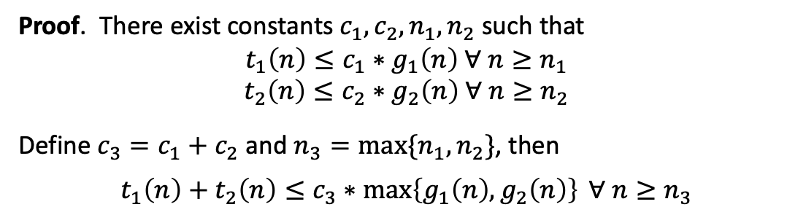
Theorem
If t₁(n) = O(g₁(n)) and t₂(n) = O(g₂(n)), then t₁(n) + t₂(n) = O(max{g₁(n), g₂(n)})
The algorithm’s overall efficiency will be determined by the part with a larger order of growth, i.e., its least efficient part.
For example, 5n² + 3nlogn = O(n²)
Proof. There exist constants $c_{1}, c_{2}, n_{1}, n_{2}$ such that
$$t_{1}\left(n\right)≤c_{1}∗g_{1}\left(n\right) ∀ n≥n_{1}$$
$$t_{2}\left(n\right)≤c_{2}∗g_{2}\left(n\right) ∀ n≥n_{2}$$
Define $c_{3}=c_{1}+c_{2}$ and $n_{3}=\max_{}{\{n_{1},n_{2}\}}$, then
$$t_{1}\left(n\right)+t_{2}\left(n\right)≤c_{3}∗\max_{}\left\{g_{1}\left(n\right),g_{2}\left(n\right)\right\} ∀ n≥n_{3}$$
CS21003/CS21203 / Algorithms - I | Analysis of Algorithms

Slide 23
Thank You!!

