Slide 1
Algorithms – I (CS29003/203)
Autumn 2022, IIT Kharagpur
Hashing

Slide 2
Resources
Apart from the book
UC Davis ECS 36C Course by Prof. Joël Porquet-Lupine

Slide 3
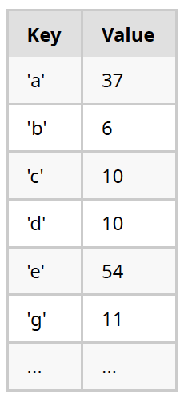
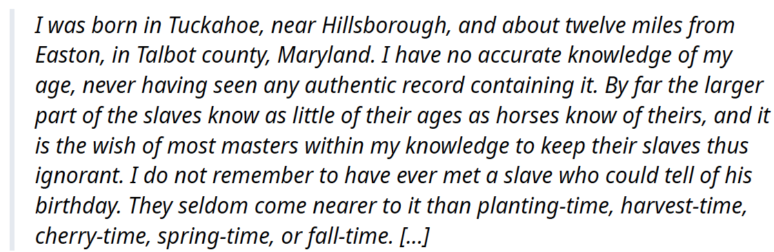
Introduction
Symbol table
Association of a value with a key
table[key] = value
Typical operations
Insert(), Remove(), Contains()/Get()
Other possible operations
Min(), Max(), Rank(), SortedList(), etc.
Example #1: frequency of letters
Compute the frequency of all the (alphabetical) characters in a text
Source: UC Davis, ECS 36C course, Spring 2020

Slide 4
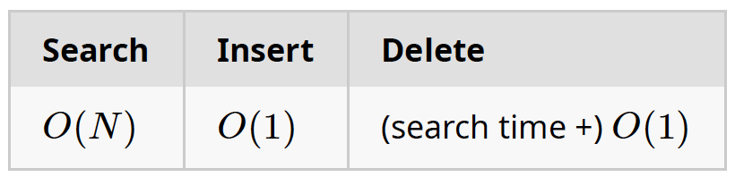
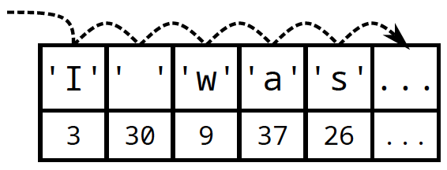
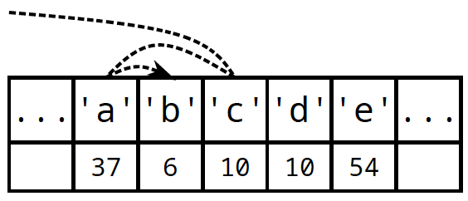
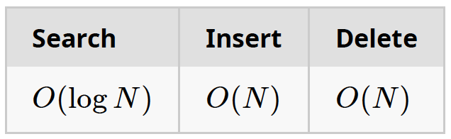
Naïve Implementations
Unordered array
Linear search: Sequentially check each item until match is found
Ordered/sorted array
Binary search: Can perform binary search to find item
Source: UC Davis, ECS 36C course, Spring 2020

Slide 5
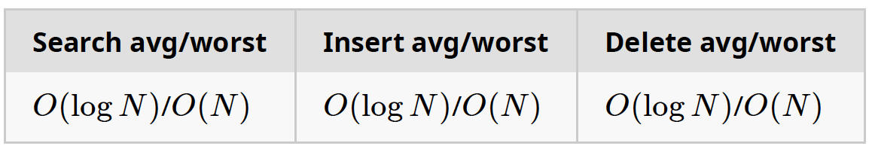
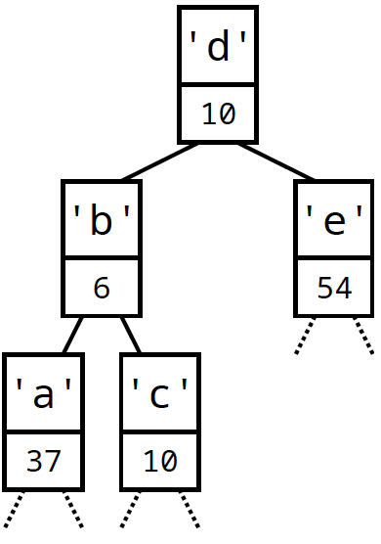
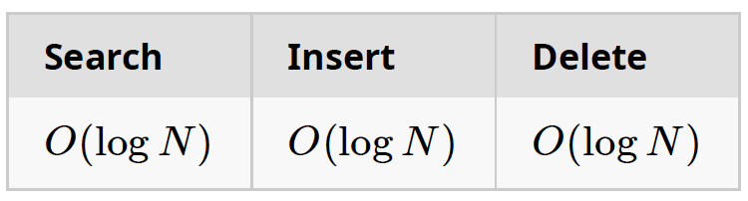
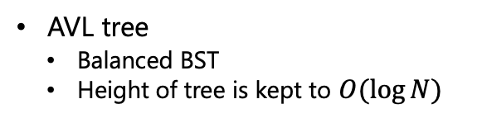
Advanced Implementations
Binary search tree: Organization of data items in BST, following certain order
Any node's key is greater than all keys in its left subtree
Any node's key is smaller than all keys in its right subtree
At most, explore height of tree
AVL tree
Balanced BST
Height of tree is kept to $O(\log{N})$
Source: UC Davis, ECS 36C course, Spring 2020

Slide 6
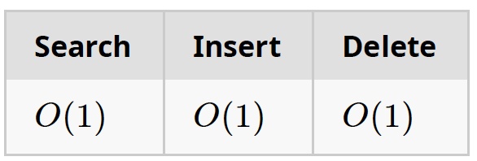
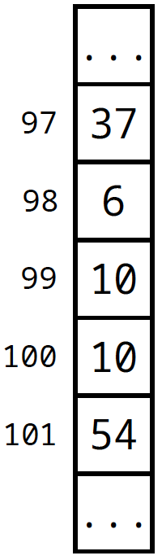
Ideal Data Structure
Can we achieve constant time on all three main operations?
Using data as index
Keys are small integers
ASCII is 128 characters
Can directly be used as index
table[key] = value
Limitations
Doesn't (efficiently) support other operations – min(),max() etc.
Wasted memory for unused keys – e.g., ASCII defines about 30 control characters
What if the key is not a small integer?
Source: UC Davis, ECS 36C course, Spring 2020

Slide 7
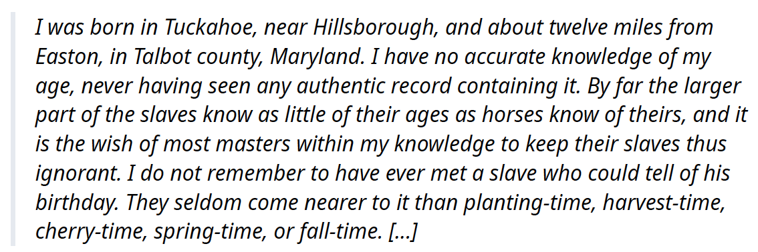
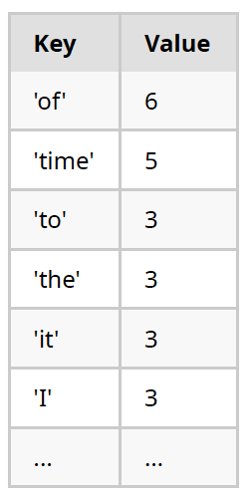
Example #2: frequency of words
Compute the frequency of all the words in a text
Issues
Very large number of words in English
Would need a huge table to index by word
int table[171476];
Cannot index an array with a string
table["time"] is not a proper C construct
Can only index arrays with an integer
Source: UC Davis, ECS 36C course, Spring 2020

Slide 8
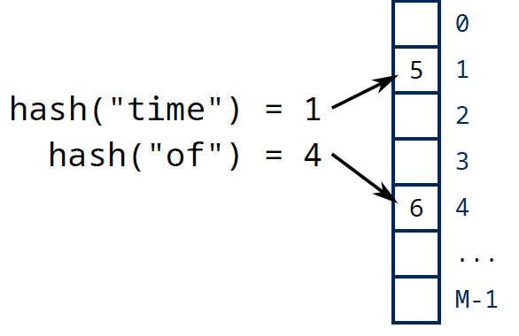
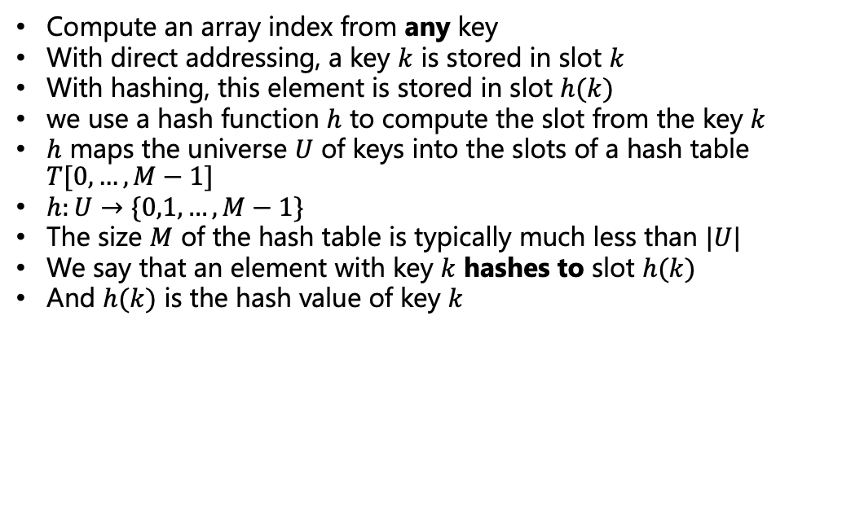
Hashing
Compute an array index from any key
With direct addressing, a key $k$ is stored in slot $k$
With hashing, this element is stored in slot $h(k)$
we use a hash function $h$ to compute the slot from the key $k$
$h$ maps the universe $U$ of keys into the slots of a hash table $T[0,…,M−1]$
$h:U→\{0,1,…,M−1\}$
The size $M$ of the hash table is typically much less than $|U|$
We say that an element with key $k$ hashes to slot $h(k)$
And $h(k)$ is the hash value of key $k$

Slide 9
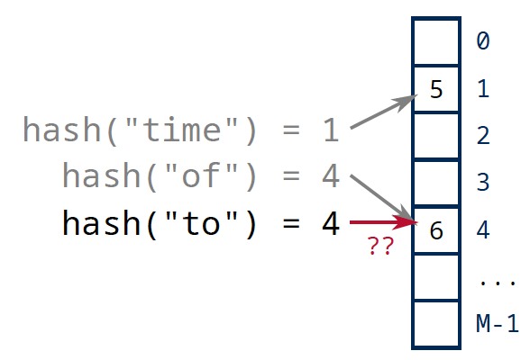
Hashing
We will see how to provide hashing for any type of key, e.g., Boolean, integers, floating-point numbers, strings, user-defined objects, etc.
Two keys may hash to the same slot. Such a situation is called a collision
How to resolve potential collisions properly?
Source: UC Davis, ECS 36C course, Spring 2020

Slide 10
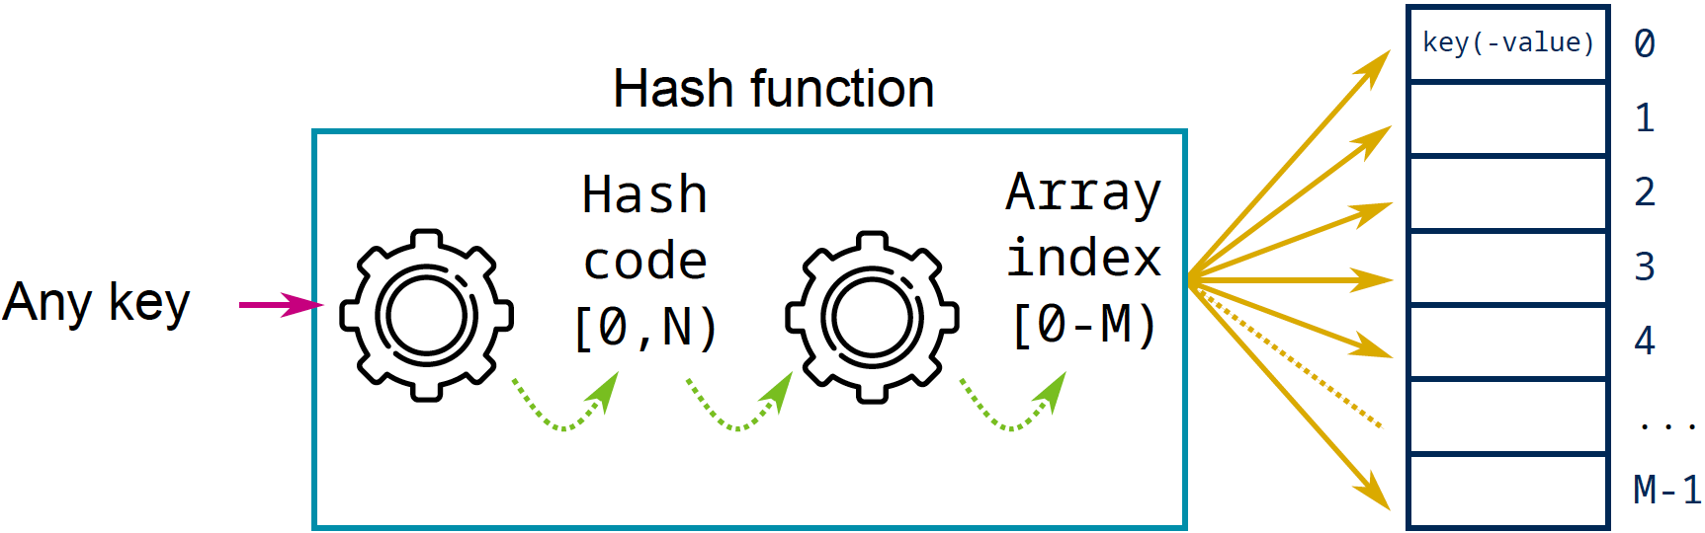
Hashing
Before going to collisions, lets discuss some hashing techniques
Required properties:
Simple to compute and fast
Hash of a key has to be deterministic
Equal keys must produce the same hash value
assert(a == b && hash(a) == hash(b));
Uniform distribution of the keys across the index range
Two implicit steps:
Transform any potentially non-integer key into an integer hash code
Reduce this hash code to an index range
Source: UC Davis, ECS 36C course, Spring 2020
Notes:
Note [0, N) has comma while [0-M) has hyphen

Slide 11

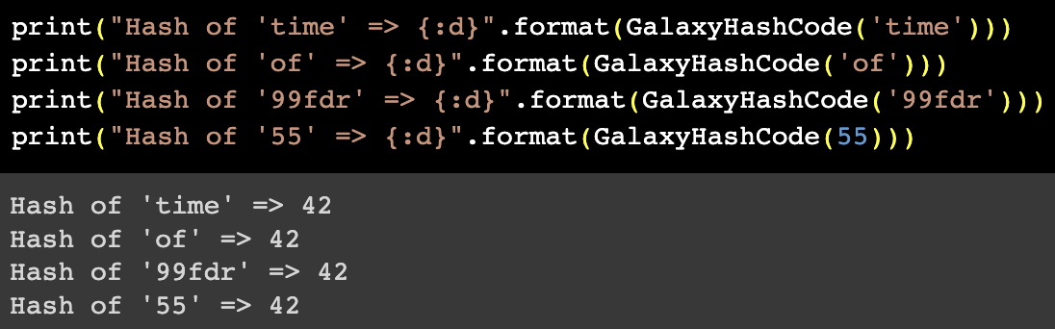
Some Pitfalls
Worse (yet functional) hash function
Problem
Can only insert one key
All the following keys will collide, regardless of their value
Solution
Need to distinguish keys by value
Source: UC Davis, ECS 36C course, Spring 2020

Slide 12
Key Subset Selection
Possible scenario
Keys are phone numbers: e.g., (530) 752-1011
Hash table is of size 1000
Idea: use first three digits as a direct index?
hash("(530) 752-1011") = 530
Problem
Phone numbers with same area code will collide
Solution
Select another set of 3 digits that shows better "random" properties (e.g., the last three)
Or consider the entire phone number instead
Source: UC Davis, ECS 36C course, Spring 2020

Slide 13
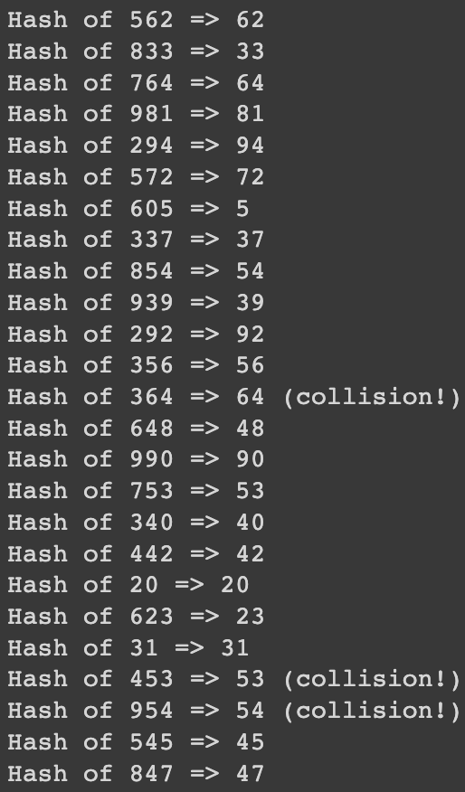

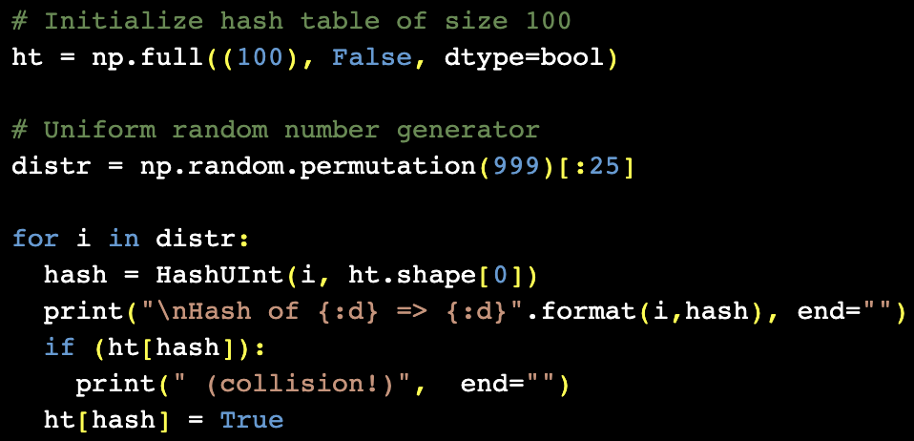
Hashing Positive Integers
Key is a simple unsigned integer in the range 0..K-1
Array index is always an unsigned integer in the range 0..M-1
Hashing is done via modulo operation
Source: UC Davis, ECS 36C course, Spring 2020

Slide 14
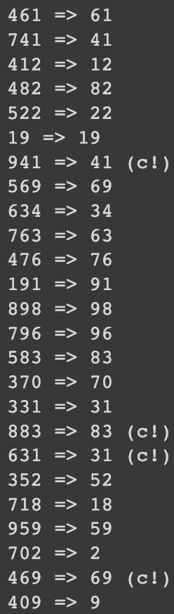
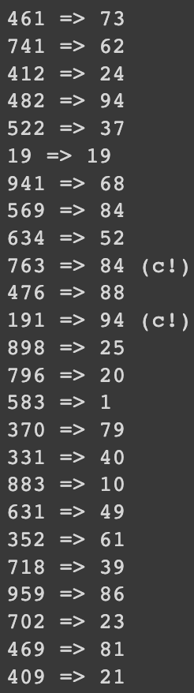
Consideration about table size (1/2)
Does the size of the hash table matter?
Same scenario as previous slide
Keys are random numbers between 0 and 999
Distribution of keys is uniform
Hashing of 25 keys
But hash table can either be of size 100 or size 97
Conclusion
Table size is not critical
If distribution of keys is uniform
100
97
Source: UC Davis, ECS 36C course, Spring 2020

Slide 15
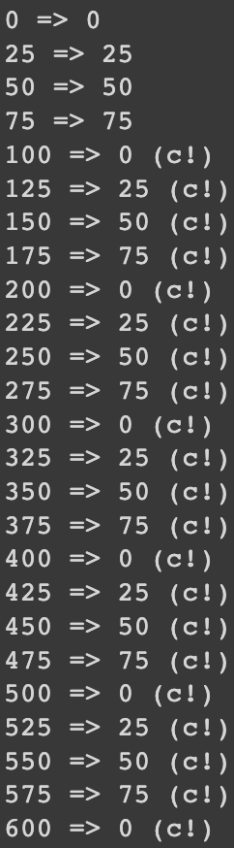
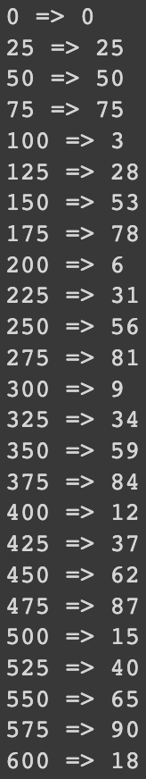
Consideration about table size (2/2)
Does the size of the hash table matter?
Same scenario as previous slide
Keys are random numbers between 0 and 999
Distribution of keys is non-uniform
Hashing of 25 keys
But hash table can either be of size 100 or size 97
Conclusion
Table size becomes critical
If distribution of keys is non-uniform
Prime numbers exhibit good properties
100
97
Source: UC Davis, ECS 36C course, Spring 2020
Notes:
100 is a multiple of 25, but 97 is not a multiple of anything

Slide 16
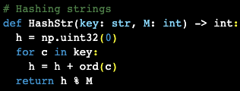
Hashing Strings
Naïve approach: Sum ASCII value of each character and then reduce to table size
Observations:
Average word length is 4.5. 4.5*127 = 576
Longest word is 45 letters long. 45*127 = 5715
Issues:
Assuming a hash table of size 10,000
Indices up to 500 will be crowded
Indices above 5000 will never be used
Source: UC Davis, ECS 36C course, Spring 2020

Slide 17
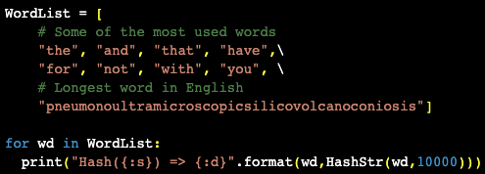
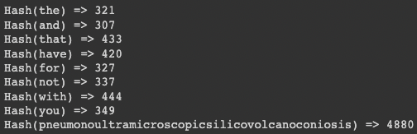
Hashing Strings
Experiment
Source: UC Davis, ECS 36C course, Spring 2020

Slide 18
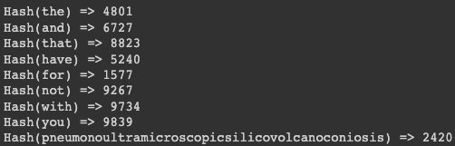
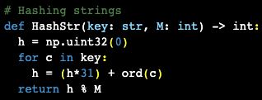
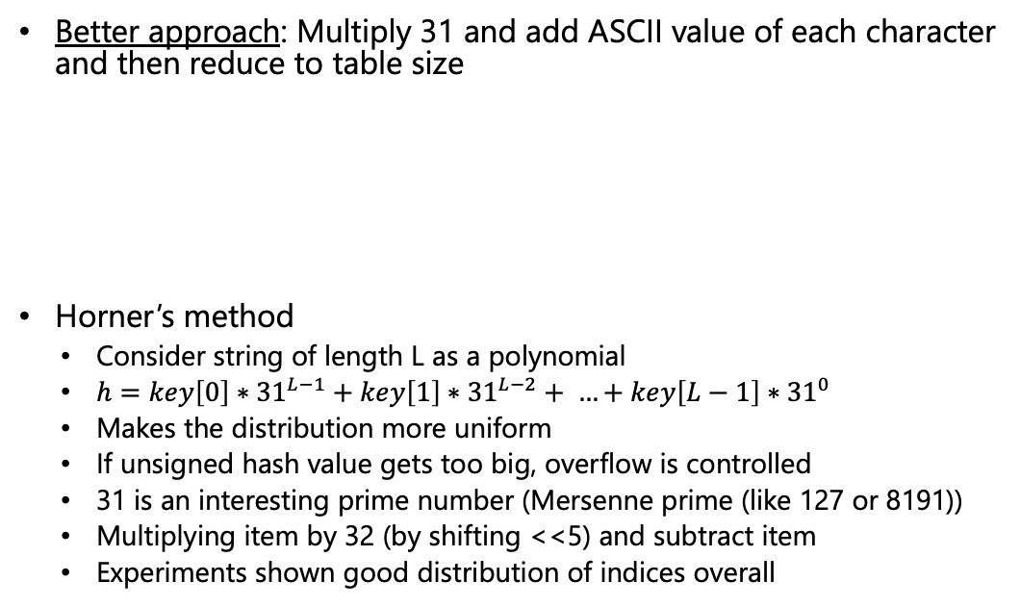
Hashing Strings
Better approach: Multiply 31 and add ASCII value of each character and then reduce to table size
Horner’s method
Consider string of length L as a polynomial
$h=key\left[0\right]∗{31}^{L−1}+key\left[1\right]∗{31}^{L−2}+ …+key\left[L−1\right]∗{31}^{0}$
Makes the distribution more uniform
If unsigned hash value gets too big, overflow is controlled
31 is an interesting prime number (Mersenne prime (like 127 or 8191))
Multiplying item by 32 (by shifting <<5) and subtract item
Experiments shown good distribution of indices overall
Source: UC Davis, ECS 36C course, Spring 2020

Slide 19
Collisions
Uniform Hashing:
We assume that the hash function has a uniform distribution
Keys are mapped as evenly as possible over the index range
Collision Probability:
Assuming an array index in the range 0..M-1
After how many hashed keys will there be the first collision?
Experiments:
Example:- Output range of 97
10 hashes to observe the first collision
Now, what is the output range was 223?
Need to restart a simulation.
Or need for better mathematical tools!
10
Source: UC Davis, ECS 36C course, Spring 2020

Slide 20
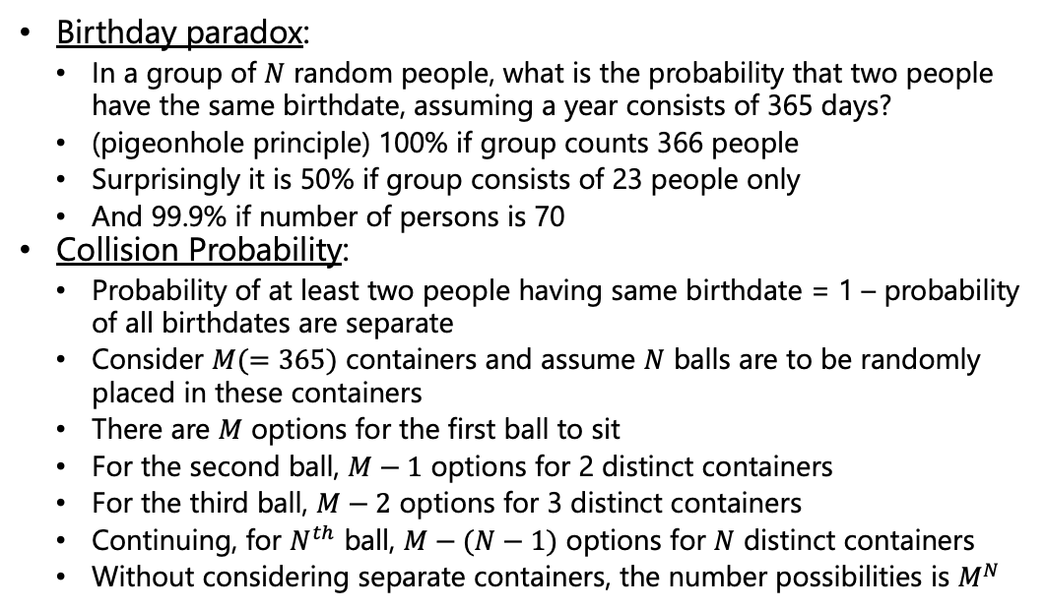
Collisions
Birthday paradox:
In a group of $N$ random people, what is the probability that two people have the same birthdate, assuming a year consists of 365 days?
(pigeonhole principle) 100% if group counts 366 people
Surprisingly it is 50% if group consists of 23 people only
And 99.9% if number of persons is 70
Collision Probability:
Probability of at least two people having same birthdate = 1 – probability of all birthdates are separate
Consider $M(=365)$ containers and assume $N$ balls are to be randomly placed in these containers
There are $M$ options for the first ball to sit
For the second ball, $M−1$ options for 2 distinct containers
For the third ball, $M−2$ options for 3 distinct containers
Continuing, for $N^{th}$ ball, $M−(N−1)$ options for $N$ distinct containers
Without considering separate containers, the number possibilities is $M^{N}$

Slide 21
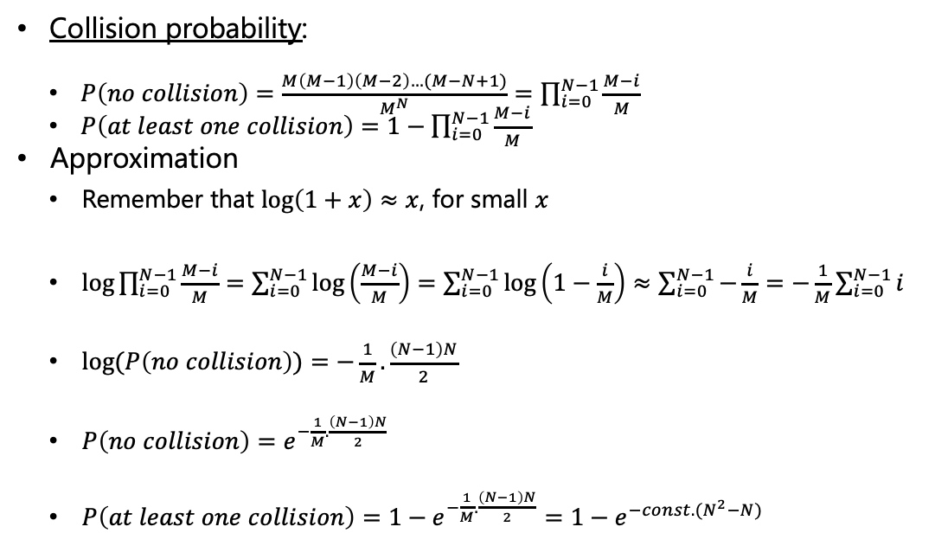
Collisions
Collision probability:
$P\left(no collision\right)=\frac{M\left(M−1\right)\left(M−2\right)…(M−N+1)}{M^{N}}=\prod_{i=0}^{N−1}{\frac{M−i}{M}}$
$P\left(at least one collision\right)=1−\prod_{i=0}^{N−1}{\frac{M−i}{M}}$
Approximation
Remember that $\log\left(1+x\right)≈x$, for small $x$
$\log{\prod_{i=0}^{N−1}{\frac{M−i}{M}}}=\sum_{i=0}^{N−1}{\log\left(\frac{M−i}{M}\right)}=\sum_{i=0}^{N−1}{\log\left(1−\frac{i}{M}\right)≈\sum_{i=0}^{N−1}{−\frac{i}{M}=−}}\frac{1}{M}\sum_{i=0}^{N−1}{i}$
$log⁡(P\left(no collision\right))=−\frac{1}{M}.\frac{\left(N−1\right)N}{2}$
$P\left(no collision\right)=e^{−\frac{1}{M}.\frac{\left(N−1\right)N}{2}}$
$P\left(at least one collision\right)=1−e^{−\frac{1}{M}.\frac{\left(N−1\right)N}{2}}=1−e^{−const.(N^{2}−N)}$

Slide 22
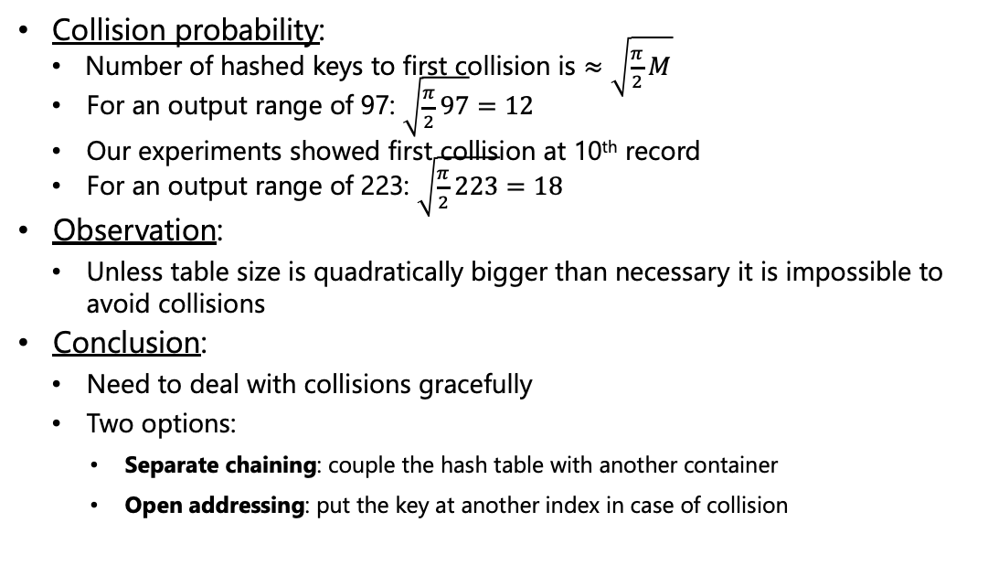
Collisions
Collision probability:
Number of hashed keys to first collision is $≈\sqrt{\frac{π}{2}M}$
For an output range of 97: $\sqrt{\frac{π}{2}97}=12$
Our experiments showed first collision at 10th record
For an output range of 223: $\sqrt{\frac{π}{2}223}=18$
Observation:
Unless table size is quadratically bigger than necessary it is impossible to avoid collisions
Conclusion:
Need to deal with collisions gracefully
Two options:
Separate chaining: couple the hash table with another container
Open addressing: put the key at another index in case of collision
Source: UC Davis, ECS 36C course, Spring 2020

Slide 23
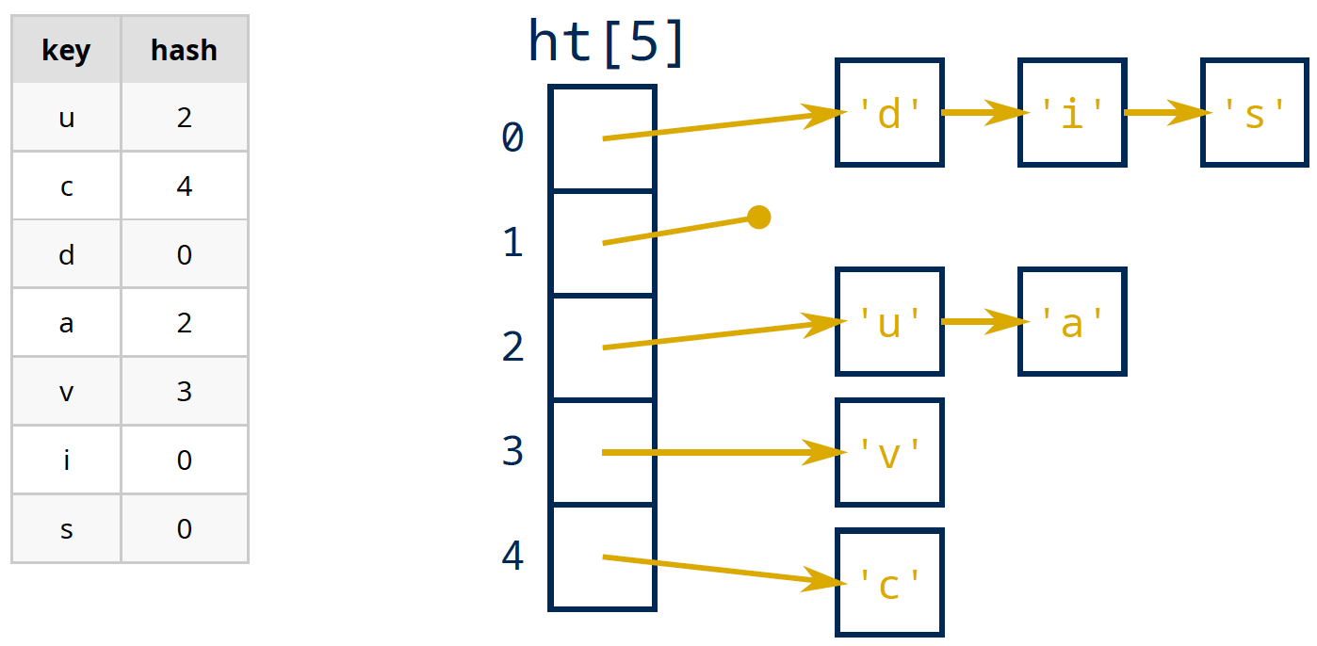

Separate Chaining
Principle:
Hash table is an array of linked-lists
Keys are still hashed to array index in the range 0..M-1
Insertion: key pushed in the $i^{th}$ chain
Search: only need to search key in the $i^{th}$ chain
Source: UC Davis, ECS 36C course, Spring 2020

Slide 24
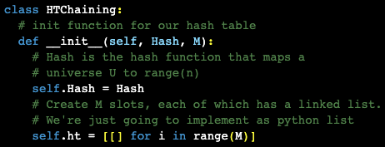




Separate Chaining
Hash table of chains, as a list of lists in python
Python’s internal hash functionality

Slide 25


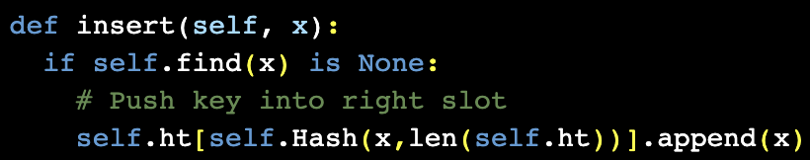
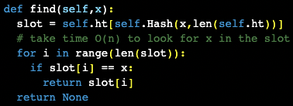
Separate Chaining
Defining a custom hash function
Attaching it to the Hash Table object
Inserting a key
Finding a key

Slide 26
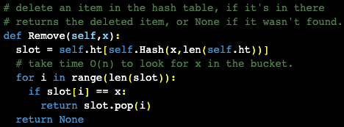
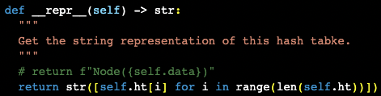
Separate Chaining
Deleting a key from the hash table
Helper code to print the hash table

Slide 27
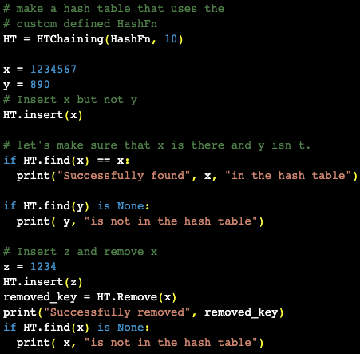

Separate Chaining
Driver code (1/2)

Slide 28
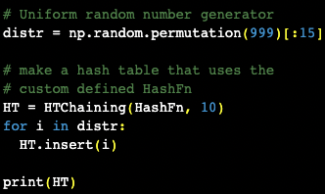
Separate Chaining
Driver code (2/2)

Slide 29
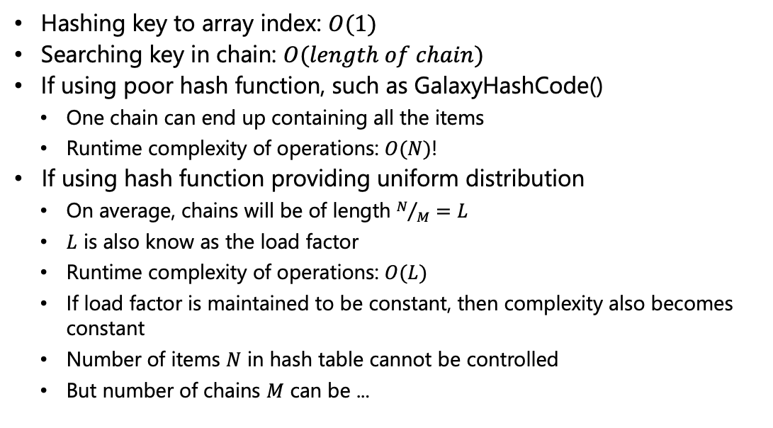
Separate Chaining - Performance analysis
Hashing key to array index: $O(1)$
Searching key in chain: $O(length of chain)$
If using poor hash function, such as GalaxyHashCode()
One chain can end up containing all the items
Runtime complexity of operations: $O(N)$!
If using hash function providing uniform distribution
On average, chains will be of length $N/M=L$
$L$ is also know as the load factor
Runtime complexity of operations: $O(L)$
If load factor is maintained to be constant, then complexity also becomes constant
Number of items $N$ in hash table cannot be controlled
But number of chains $M$ can be ...
Source: UC Davis, ECS 36C course, Spring 2020

Slide 30
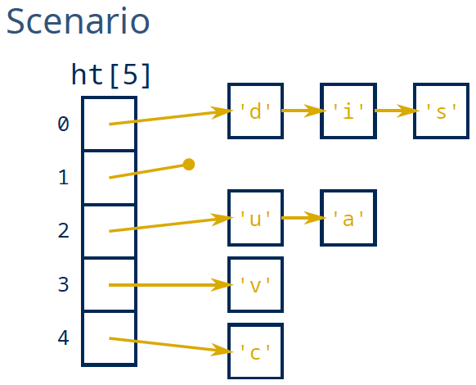
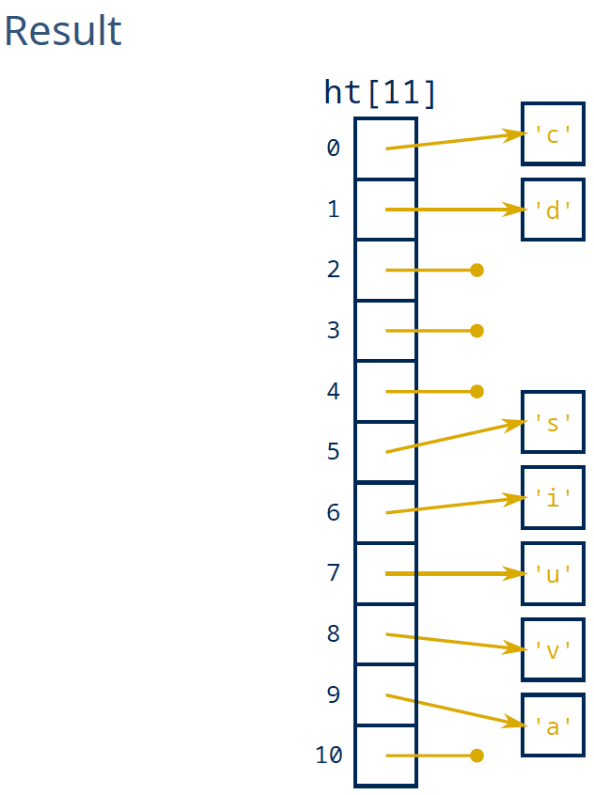
Separate Chaining - Resizing
Resizing - Rehashing
Increase the size of hash table
Rehash every item into new table
Load factor = 7/5=1.4
Load factor = 7/11=0.63
Source: UC Davis, ECS 36C course, Spring 2020

Slide 31
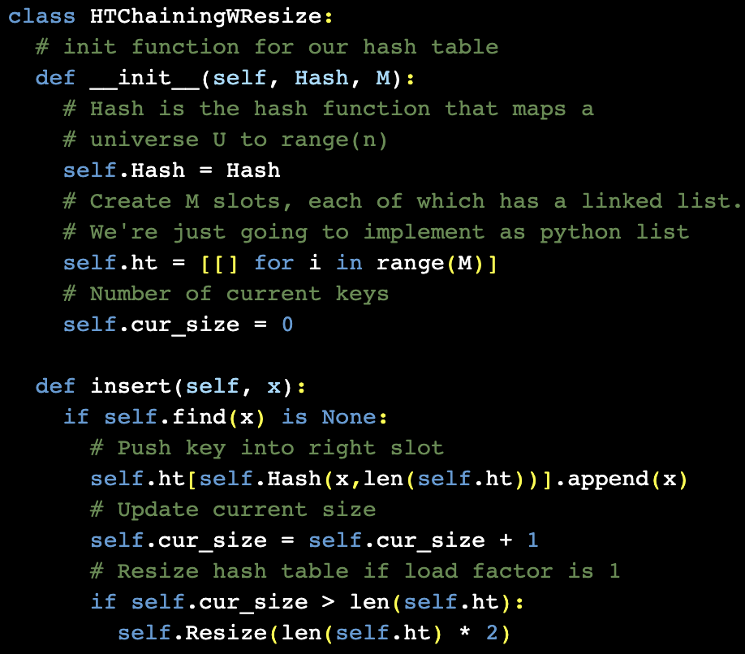
Separate Chaining - Resizing
Implementation

Slide 32
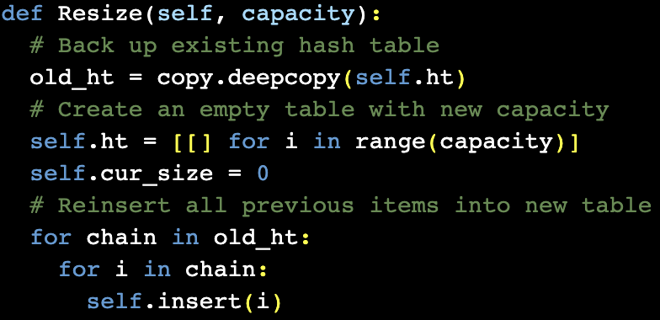
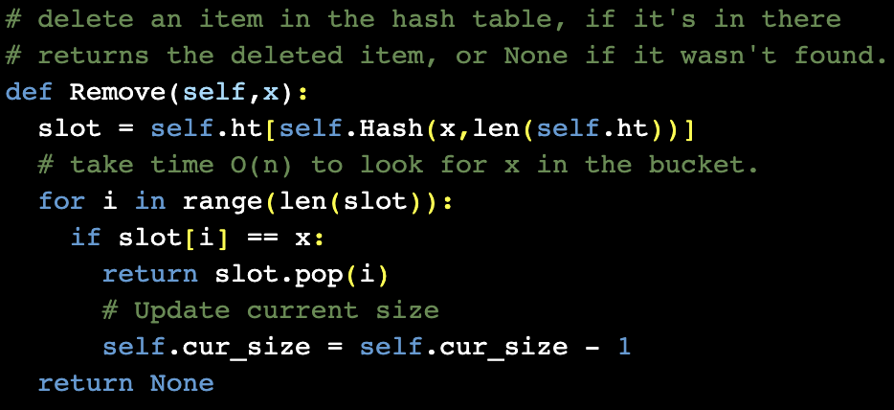
Separate Chaining - Resizing
Implementation
Complexity
Resizing happens infrequently
Amortized time complexity: O(1)
Ideally, resize to another prime number

Slide 33
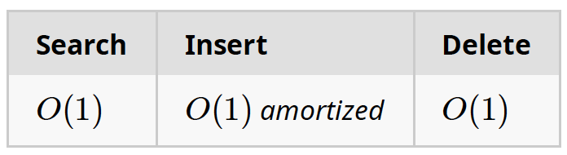
Separate Chaining - Conclusion
Complexity
Proportional to load factor. Typically load factor is maintained at 1.0
Pros
Very effective if keys are uniformly distributed
Cons
Rely on another data structure, such as lists, to implement the chains
Note that the chains could also be implemented with balanced trees!
Cost associated to this additional data structure
Memory management, traversal, etc.
Source: UC Davis, ECS 36C course, Spring 2020

Slide 34
Thank You

