Slide 1
Exam Review Session
CS 224R
1

Slide 2
Reminders
80-minute closed-book exam on Friday, May 15 at 9:30 am
A reference sheet is provided - no other notes permitted
Covers material up until May 8th:
Imitation Learning
Policy Gradients
Actor-Critic Methods
Off-Policy Actor Critic Methods
Q-learning
Offline RL
Reward Learning
Model-Based RL
Multi-Task and Goal-Conditioned RL

Slide 3
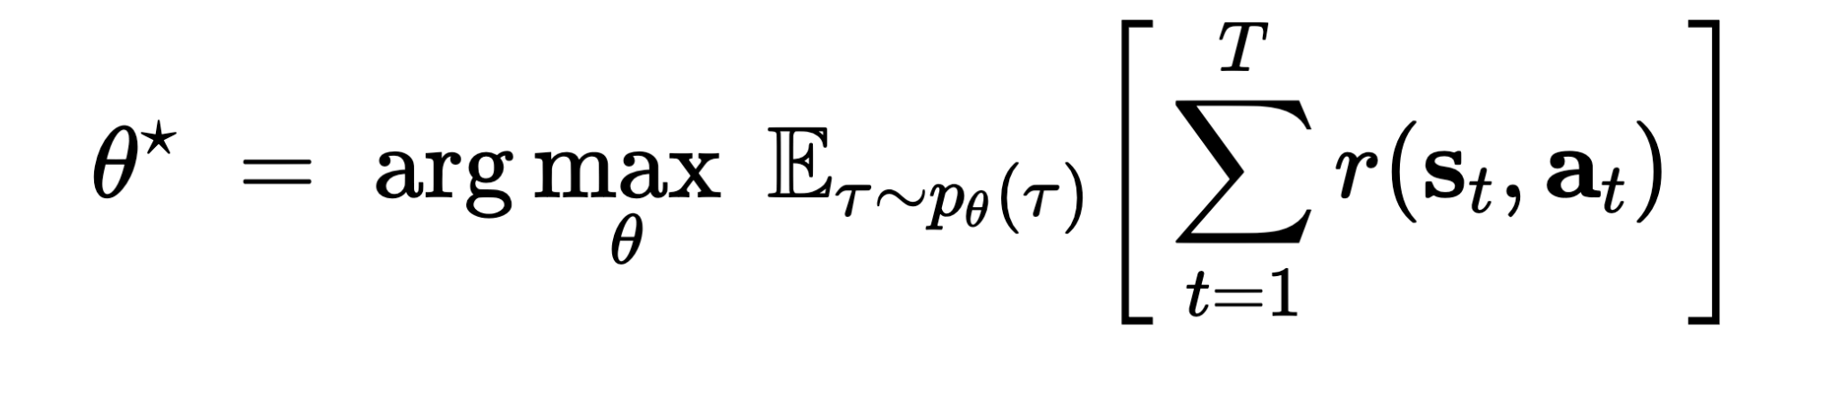
Definitions
state s_{t​} — the state of the “world” at time t
action a_{t​} — the decision taken at time t
trajectory — sequence of states/observations and actions, (s₁​ , a_{1​} , s_{2​} , a₂​ , … , s_{T ​} , a_{T} ​ )
reward function r(s, a) — how good is (s, a)?
policy π_{θ} ​ (a ∣ s) or π_{θ} ​ (a ∣ o) — behavior, usually what we are trying to learn
Goal: learn policy π_{θ} ​ that maximizes expected sum of rewards:

Slide 4
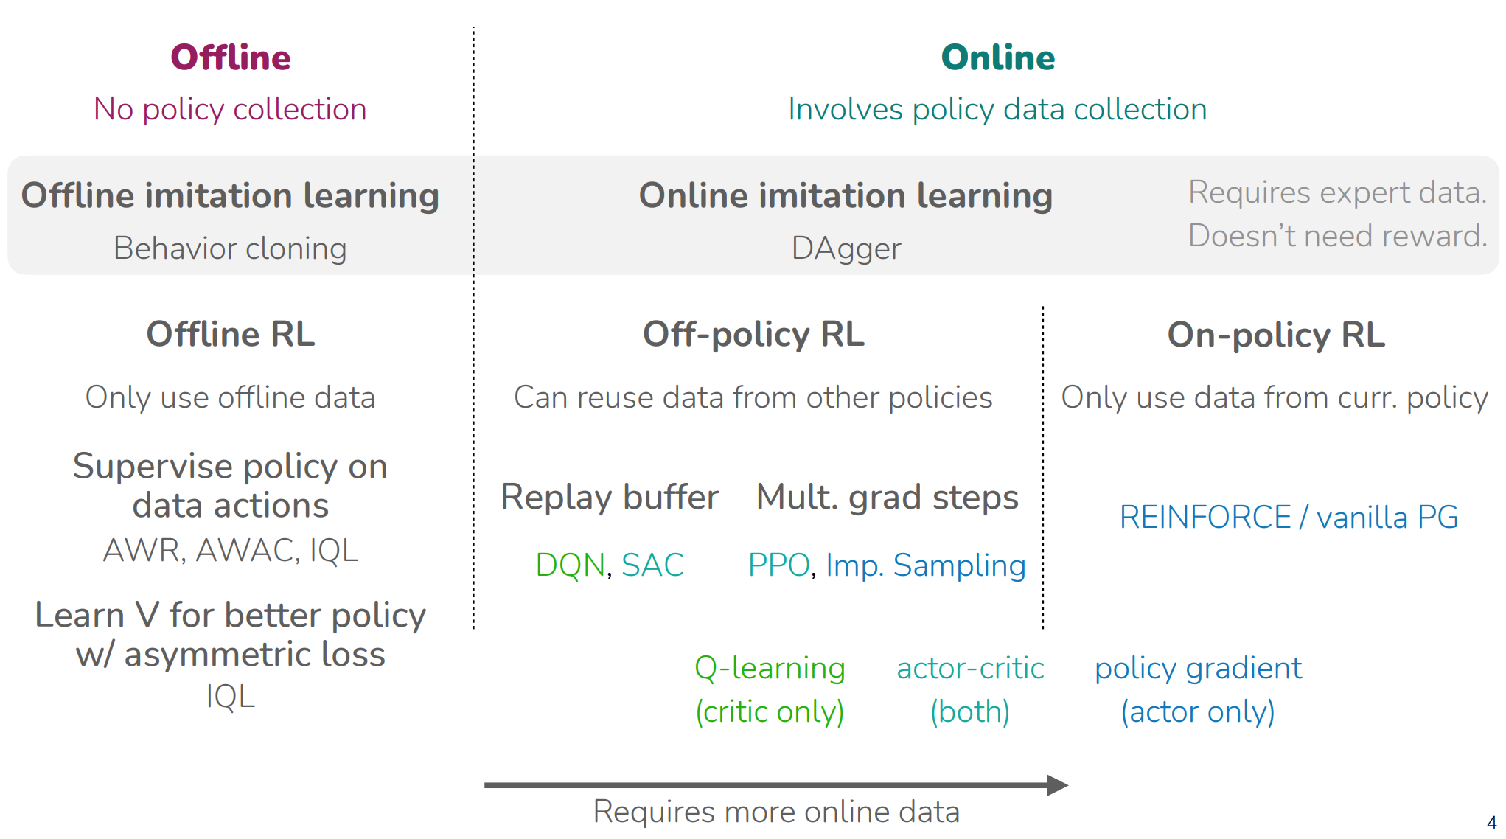

Slide 5
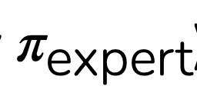
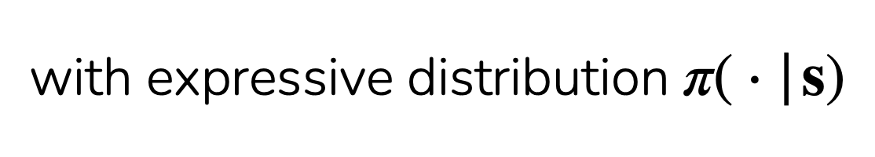
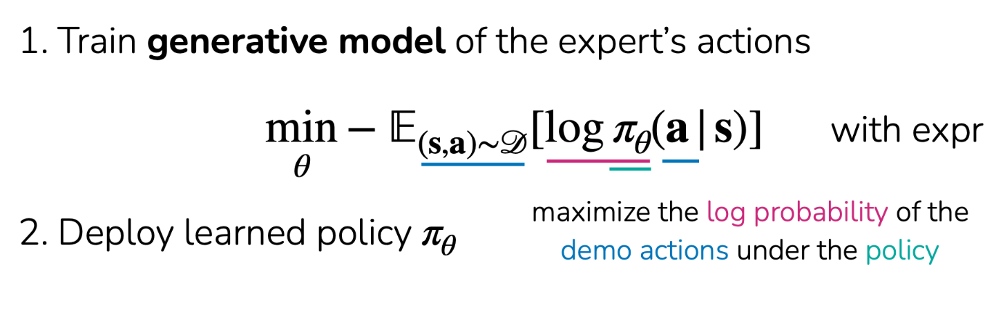
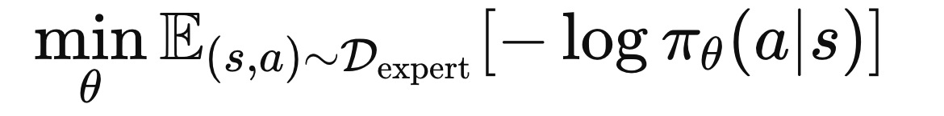
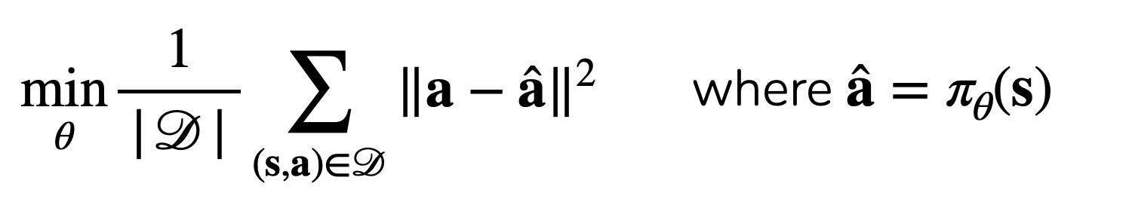
Recap: Imitation Learning
Data: Given trajectories collected by an expert “demonstrations”
𝒟 := {(s₁, a₁, . . . , s_{T})}
(sampled from some unknown policy ) )
Regression-Based Policies
Generative Policies
For deterministic policy, supervised regression to the expert’s actions
(predict a single action with regression)

Slide 6
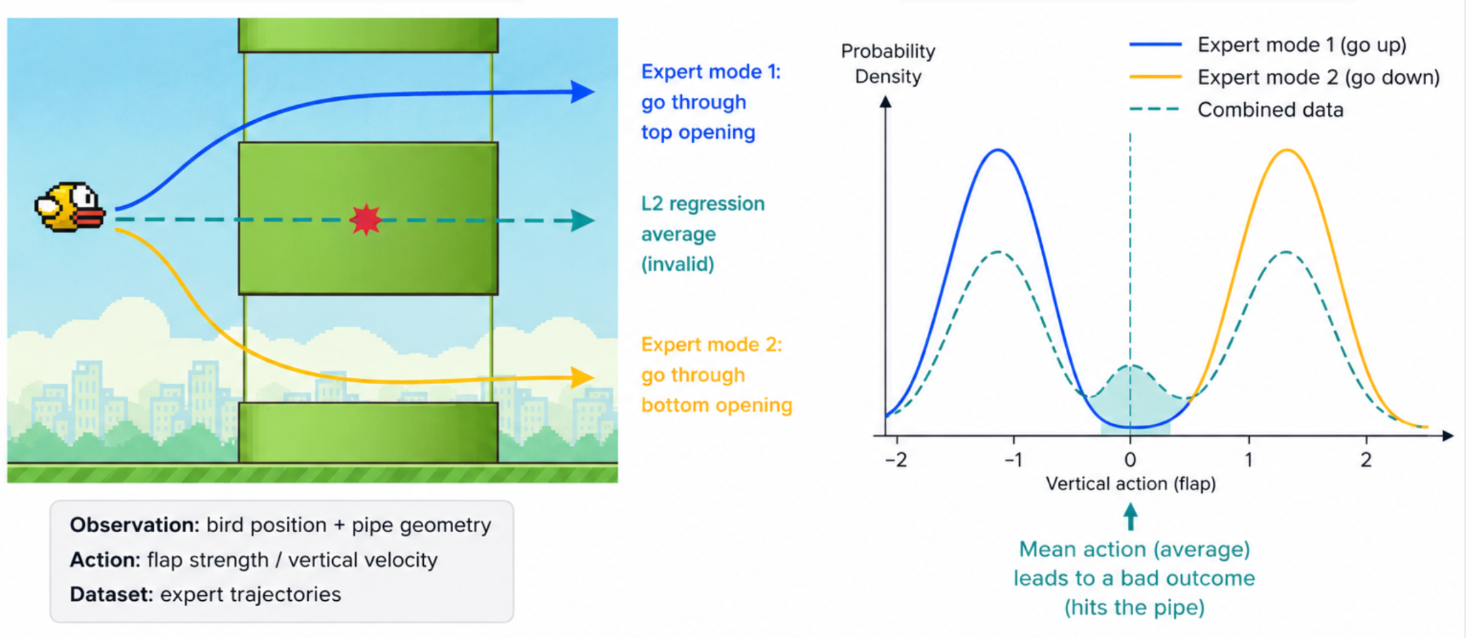
Why Regression Fails for Multimodal Actions (as seen in HW1)
Example
How often does this happen in practice? All the time! Esp. when data collected by multiple people.

Slide 7
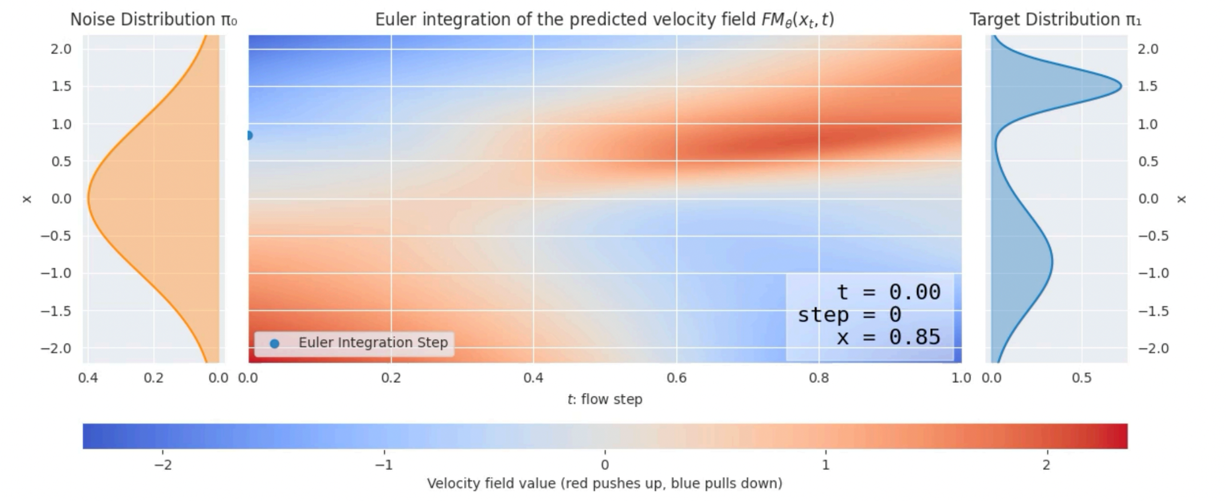
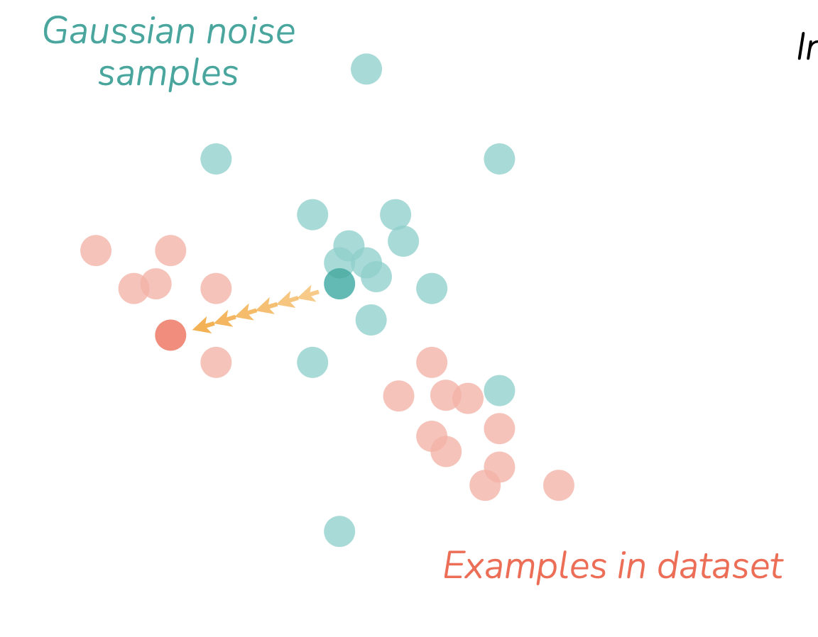








Flow Matching Refresher
simple distribution
know how to sample from this
complex distribution
don’t know how to sample from this
We know how to sample from a simple distribution (Gaussian noise), but not directly from the action distribution
Key idea: learn to transform noise into samples from the data distribution (here, expert actions)
Instead of predicting a single action, learn a vector field that iteratively denoises toward a valid action
Training: sample action , noise ​ , interpolate ​ , and predict direction
Sampling: start from noise and repeatedly denoise to generate an action
Different noise samples → different valid actions → captures multimodal behavior
-

Slide 8
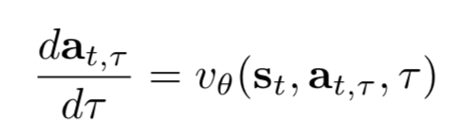
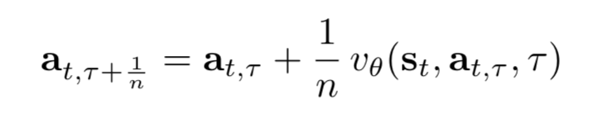
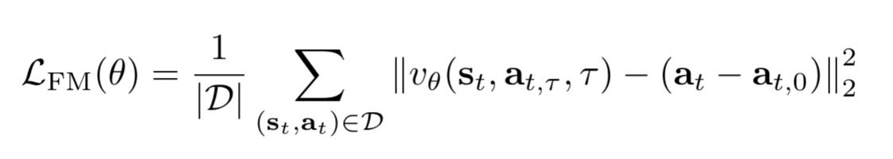
Flow Matching Refresher
ODE for Flow Matching:
Flow matching Euler integration update rule (for n steps):
the rate of change of the action as we remove noise
learned network that predicts which direction to denoise
the state we're taking action in
the partially denoised action at noise level τ
timestep: how much noise is left (τ=0 is pure noise)
output: action at next denoising step (τ+1/n = slightly less noisy)
input: current noisy action (at noise level τ)
step size: we take n total steps from pure noise → clean action, so each step moves 1/n of the way
velocity: network predicts velocity vector from starting noise to target clean action
Flow matching loss:
average loss over the full dataset
expert state-action demonstrations
ground-truth velocity from noisy action → expert action
squared error between predicted and true denoising velocity

Slide 9
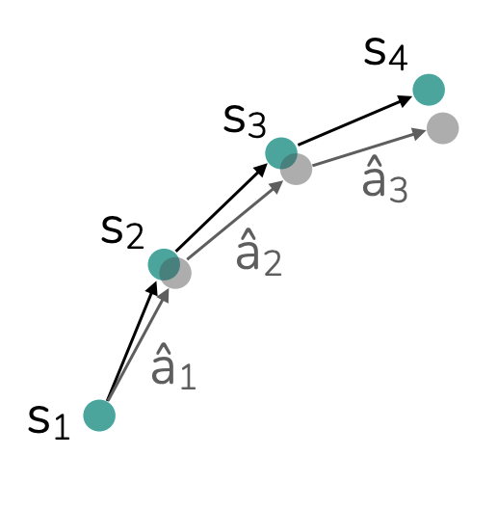
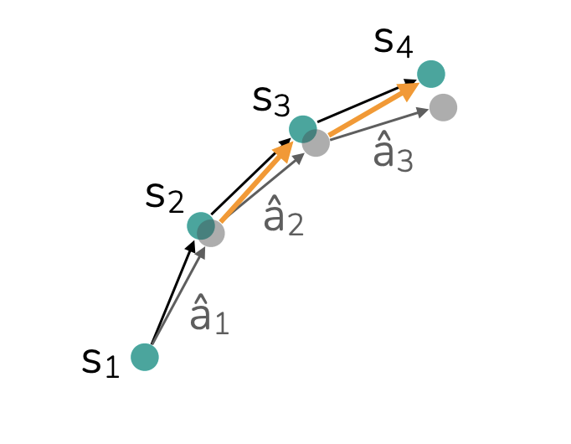
What can go wrong in imitation learning?
Supervised learning of behavior
Solutions:
Collect A LOT of demo data & hope for the best.
Collect corrective behavior data
Predicted actions affect next state.
Errors can lead to drift away from the data distribution:
Errors can then compound
p_{expert}(s) ≠ p_{π}(s)
Expert labels AFTER the fact (offline labeling): “What SHOULD the action have been at each state?”
Human-gated DAgger (intervention): Expert intervenes DURING execution

Slide 10
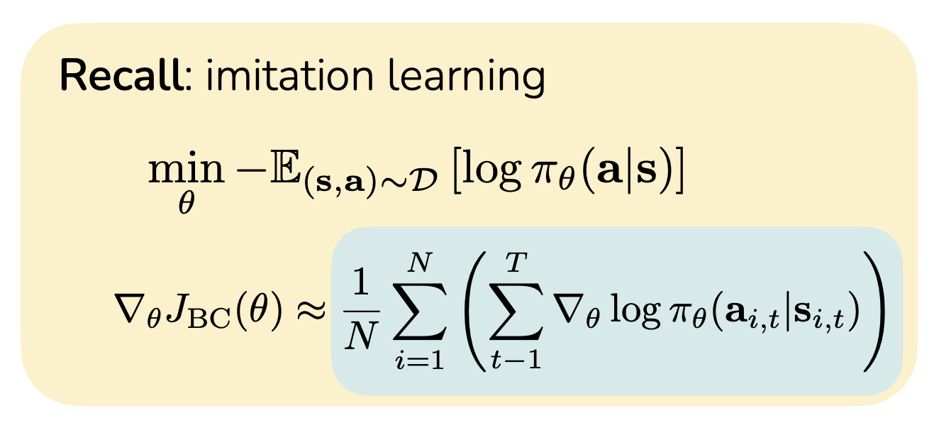
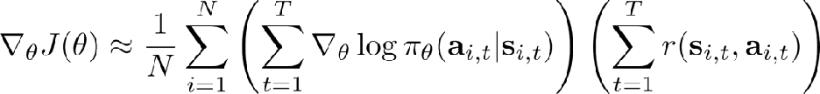
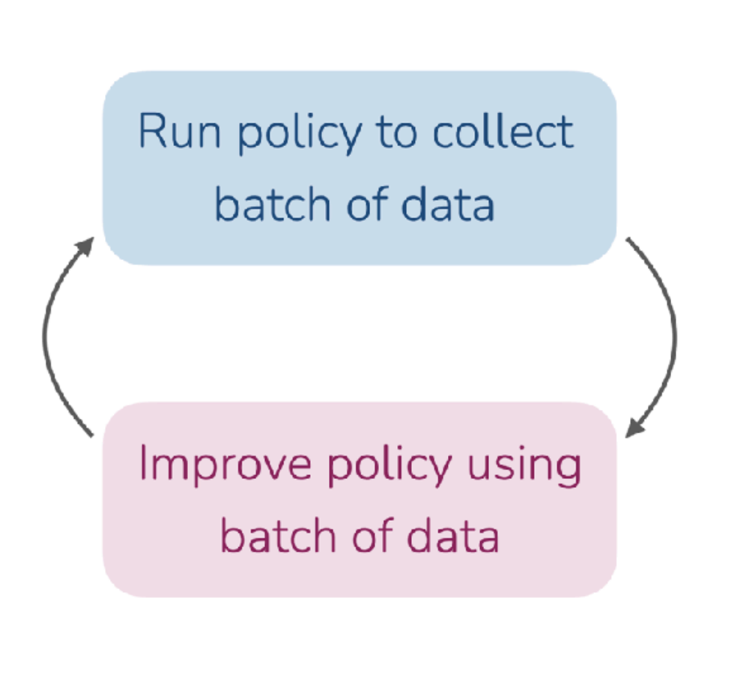
Policy Gradients
(how should we change the likelihood of those actions)
(how good was the outcome)
Imitation gradient, but weighted by reward
Improve policy by applying gradient
Intuition:
Increase likelihood of actions you took in high reward trajectories.
Decrease likelihood of actions you took in negative reward trajectories
8

Slide 11

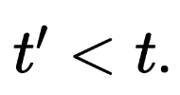
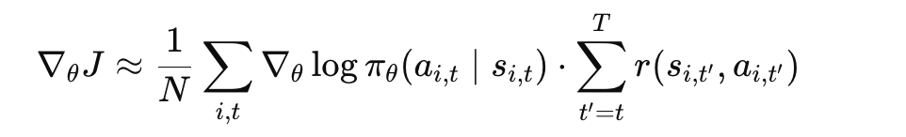
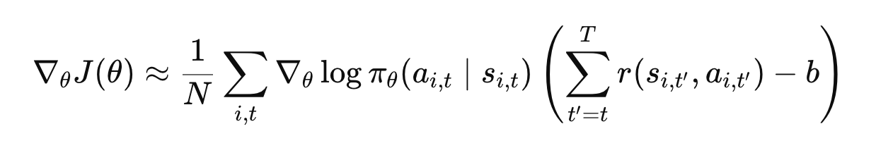
Improving REINFORCE: Causality + Baselines
IMPORTANT: Subtracting a baseline does NOT change the expected gradient — only reduces variance.
Causality: Policy behavior at time does not affect rewards at
Baseline: subtract expected reward to get relative performance (advantage)
Only future rewards (t′ ≥ t) should influence the action at time t
Prevents reinforcing actions for outcomes they didn’t cause
Makes credit assignment local in time (who actually contributed)
Same action can receive very different returns depending on future randomness → noisy gradient updates (high variance)
If we subtract average reward, we get negative gradients for below-average behavior.
Turns reward into a comparison signal (good vs typical)
Stabilizes updates by removing common offset in rewards
can be state dependent but not action dependent
8

Slide 12
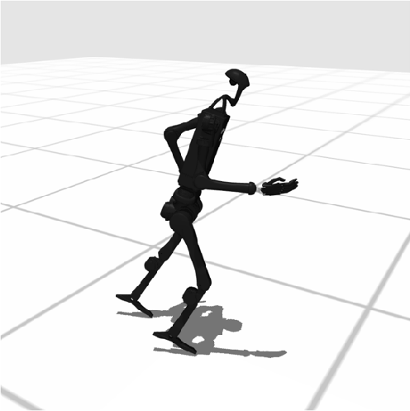
Improving the Gradient: Causality + Baselines
IMPORTANT: Subtracting a baseline does NOT change the expected gradient — only reduces variance.
Causality: Policy behavior at time does not affect rewards at
Baseline: subtract expected reward to get relative performance (advantage)
All rewards are positive → we would increase probability of every trajectory
Robot walking attempt:
t=1: step forward
t=2: wobble
t=3: fall backwards
Example trajectories (same robot):
𝜏₁: falls early → +1
𝜏₂: wobbles forward → +2
𝜏₃: walks smoothly → +3
Every action is weighted by the same total return (−5), regardless of when it happened
Rewards: [+5, 0, -10)
Rewards: [+1, +2, +3)
Average (baseline) = (1+2+3) / 3 = 2
Total return = -5
Reward to go:
t=1: +5+0−10 = −5
t=2: 0−10 = −10
t=3: −10
[t=1,t=2,t=3]→[−5,−5,−5]
Rewards: [+1, +2, +3)
After subtracting baseline = [-1, 0, +1]
→ Each action is updated using only the rewards that happen after it.
Baseline reveals which behaviors are better than typical, not just positive.
8

Slide 13
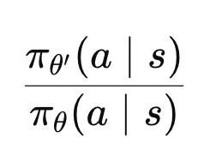
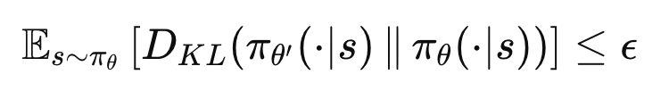
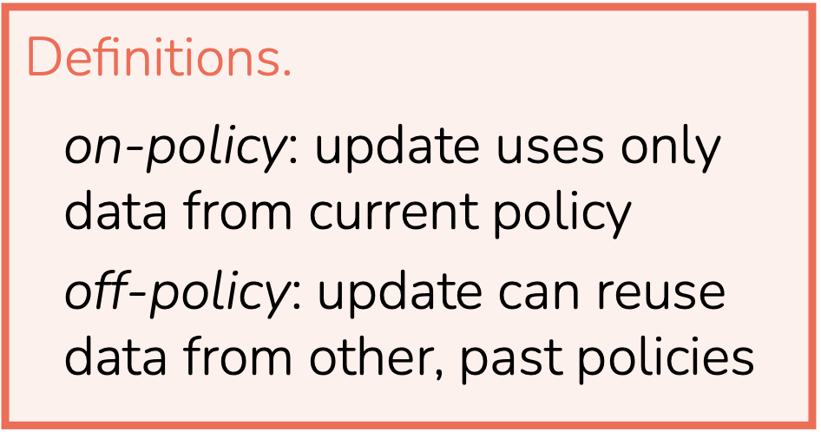
Practical Challenges & Extensions of Policy Gradients
Why vanilla policy gradients struggle:
How we address this:
1. High variance gradients
Gradient depends on sampled trajectories
Same action can get very different returns
Sensitive to reward scale and rare outcomes
→ leads to unstable / noisy updates
1. Off-policy correction (importance sampling)
Reweight old data using:
Allows reuse of past trajectories
Corrects for distribution mismatch
Problem:
Ratios can become very large or very small
Especially over long trajectories
→ Introduces instability
2. On-policy limitation
Gradient assumes data from current policy π_{θ}​
After updating θ, old data is no longer valid
→ must collect new data every step
→ sample inefficient
2. KL constraint (stabilizing updates)
Constrain policy updates:
Prevents large changes in policy
Keeps new policy close to old one
→ more stable learning

Slide 14
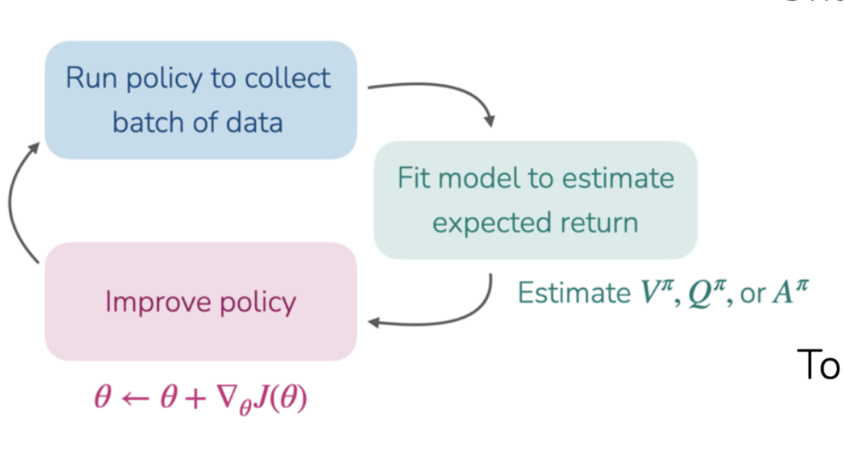
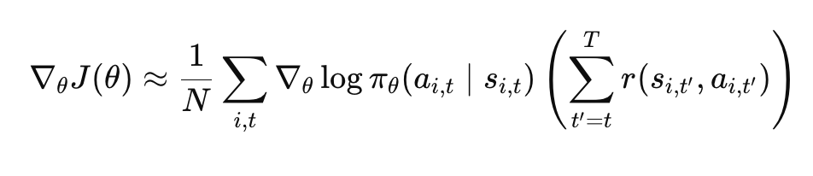
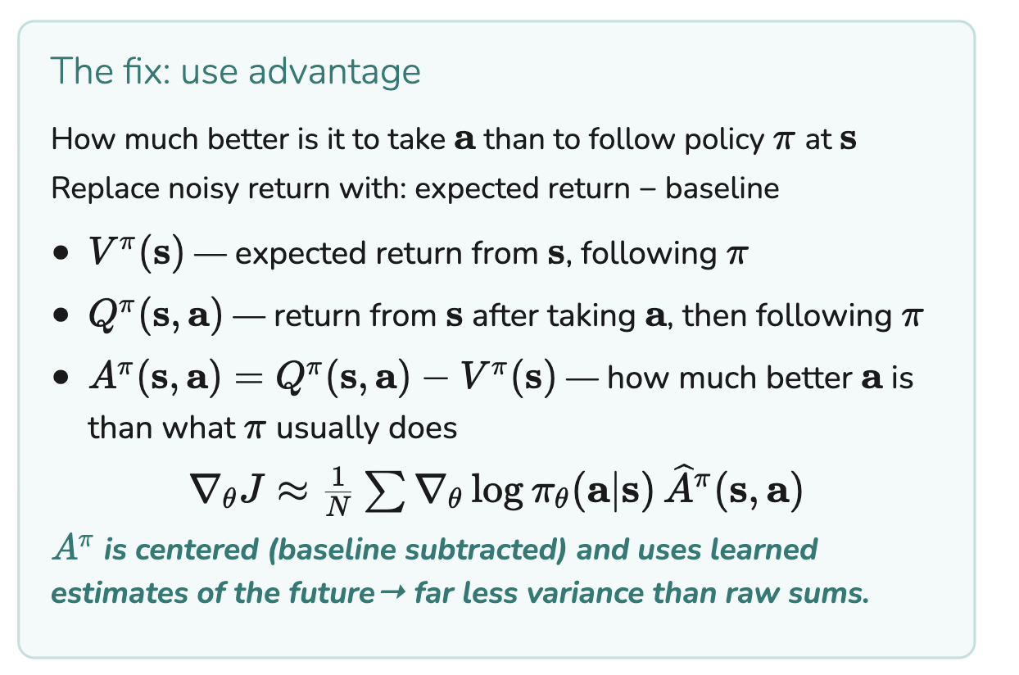
Why Actor-Critic Exists
Reward-to-go in vanilla policy gradients struggles:
We need a signal that depends on the action - not on randomness after it:
Same action → opposite updates (because of future randomness)
Must wait until episode ends to know if actions were good
trajectory | same action at t=1 | future randomness | return
A | step forward | lucky balance | +10
B | step forward | random fall | -10
Same action → different returns → conflicting gradient updates:
“increase this action” (trajectory A)
“decrease this action” (trajectory B)
Reward-to-go only removes past noise, but:
future randomness still dominates the signal
same action can get very different returns

Slide 15
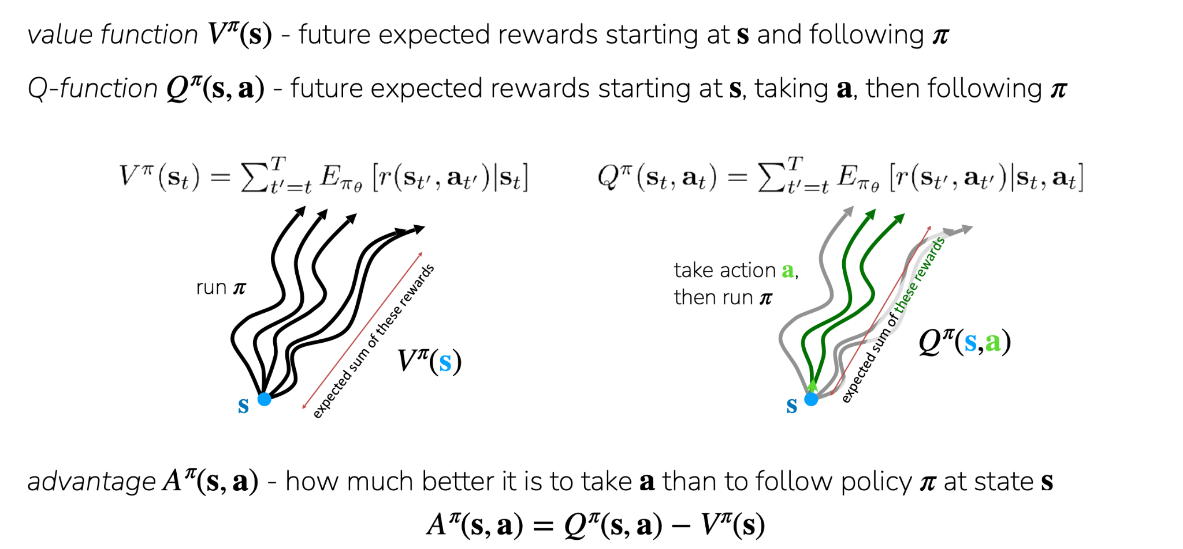
Recap: Actor Critic Methods

Slide 16
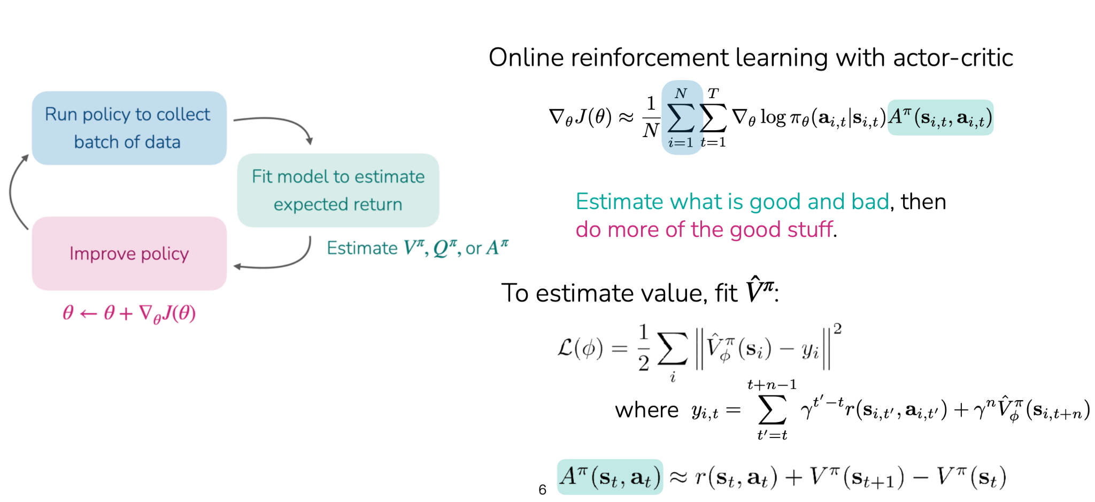
Recap: Actor Critic Methods

Slide 17
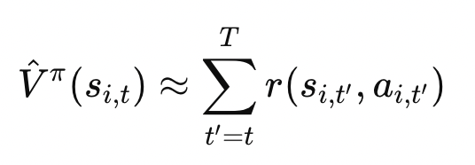
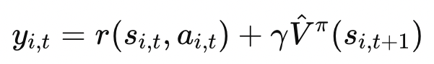
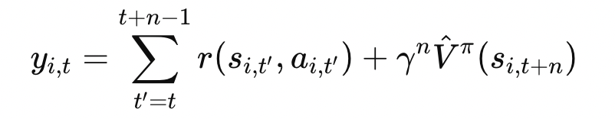
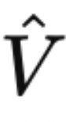
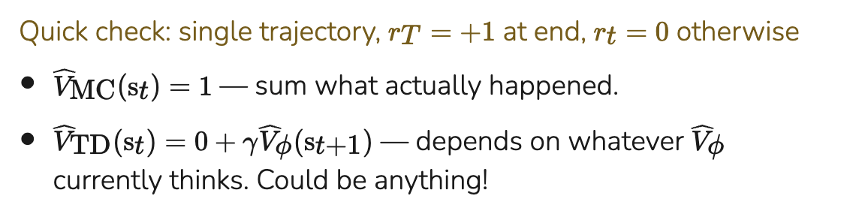
Estimating V_{π}: Monte Carlo vs Bootstrapping vs n-step
Monte Carlo
Bootstrap (TD)
N-step returns
Supervise with roll-out’s summed rewards
Supervise using reward + value estimate
Use n real rewards, then bootstrap
Intuition:
Update immediately using one real step, then rely on your current guess
→ “Take one step in the real world, then trust your model”
Intuition:
Follow the real trajectory for a bit, then switch to your estimate
→ “Trust the world for n steps, then trust yourself”
Intuition: Wait until the episode ends, then use the actual outcome as the label
→ “What really happened from here?”
+ Low variance — short horizon
− Biased — errors in propagate
Key idea:
n controls the tradeoff between real data and learned estimates
+ Unbiased — true returns − High variance — depends on full trajectory randomness

Slide 18
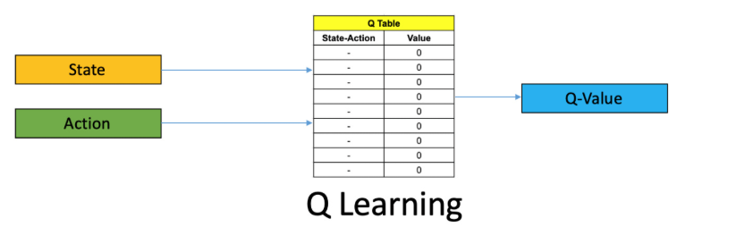
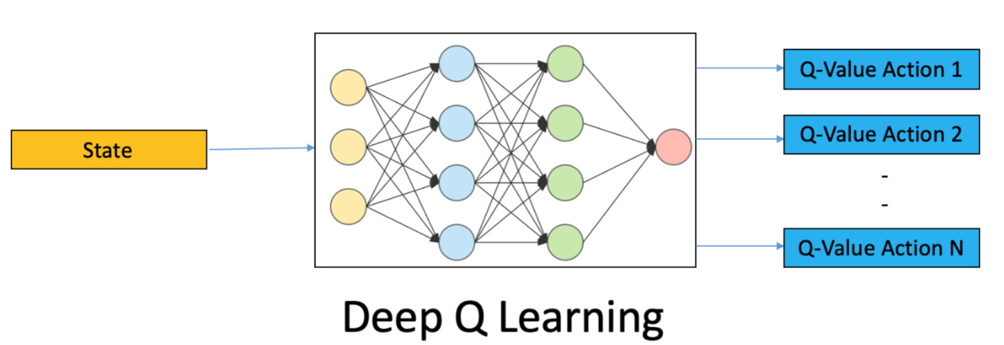
Recap: Q-Learning
Goal
Bellman Optimality Equation
DQN
Key idea: Learn the optimal Q-function Q*(s,a) directly, without a policy — then act greedily:
Important: Q-learning is off policy!
Iterate this to convergence → Q* (tabular setting)
L(ϕ)=E[(Q_{ϕ}​(s,a)−(r+γmax_{a′​}Q_{ϕ′​}(s′,a′)))²]
φ′ = target network (frozen copy, periodically updated)
Stability Tricks
Replay buffer: break correlation between consecutive samples
Target network: stabilize regression targets (don't chase a moving target)
Double Q: use one network to select action, another to evaluate — reduces overestimation

Slide 19
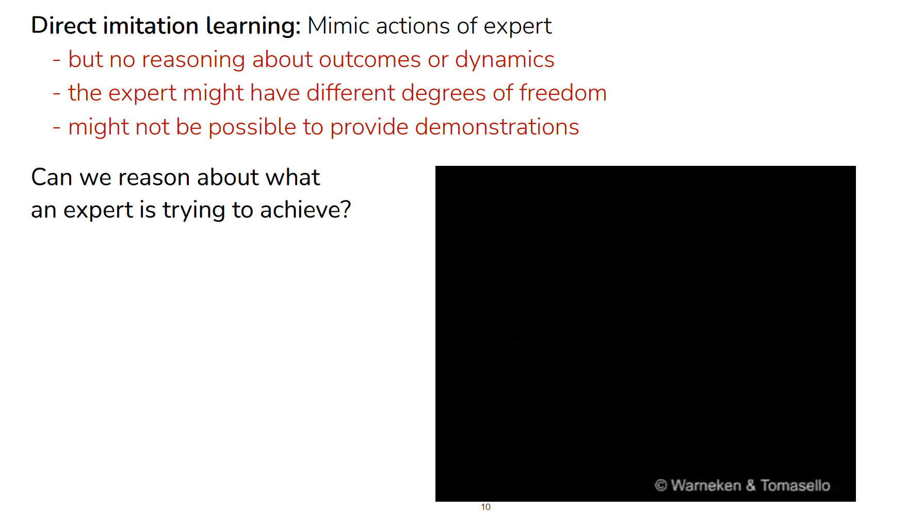
Recap: Reward Learning

Slide 20
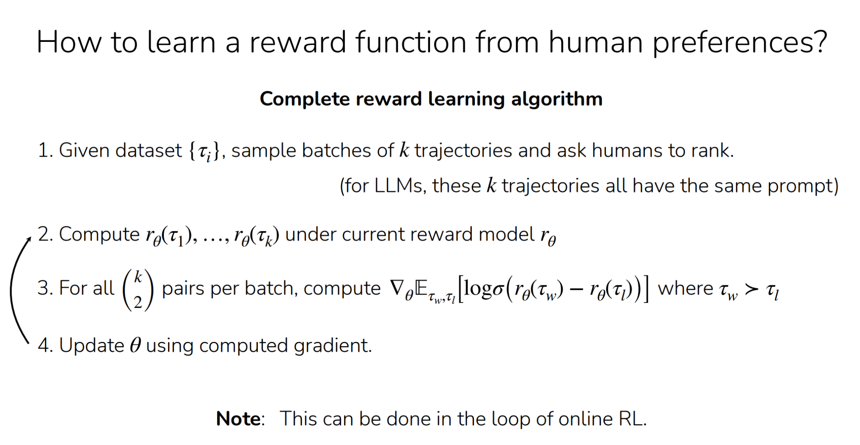

Slide 21
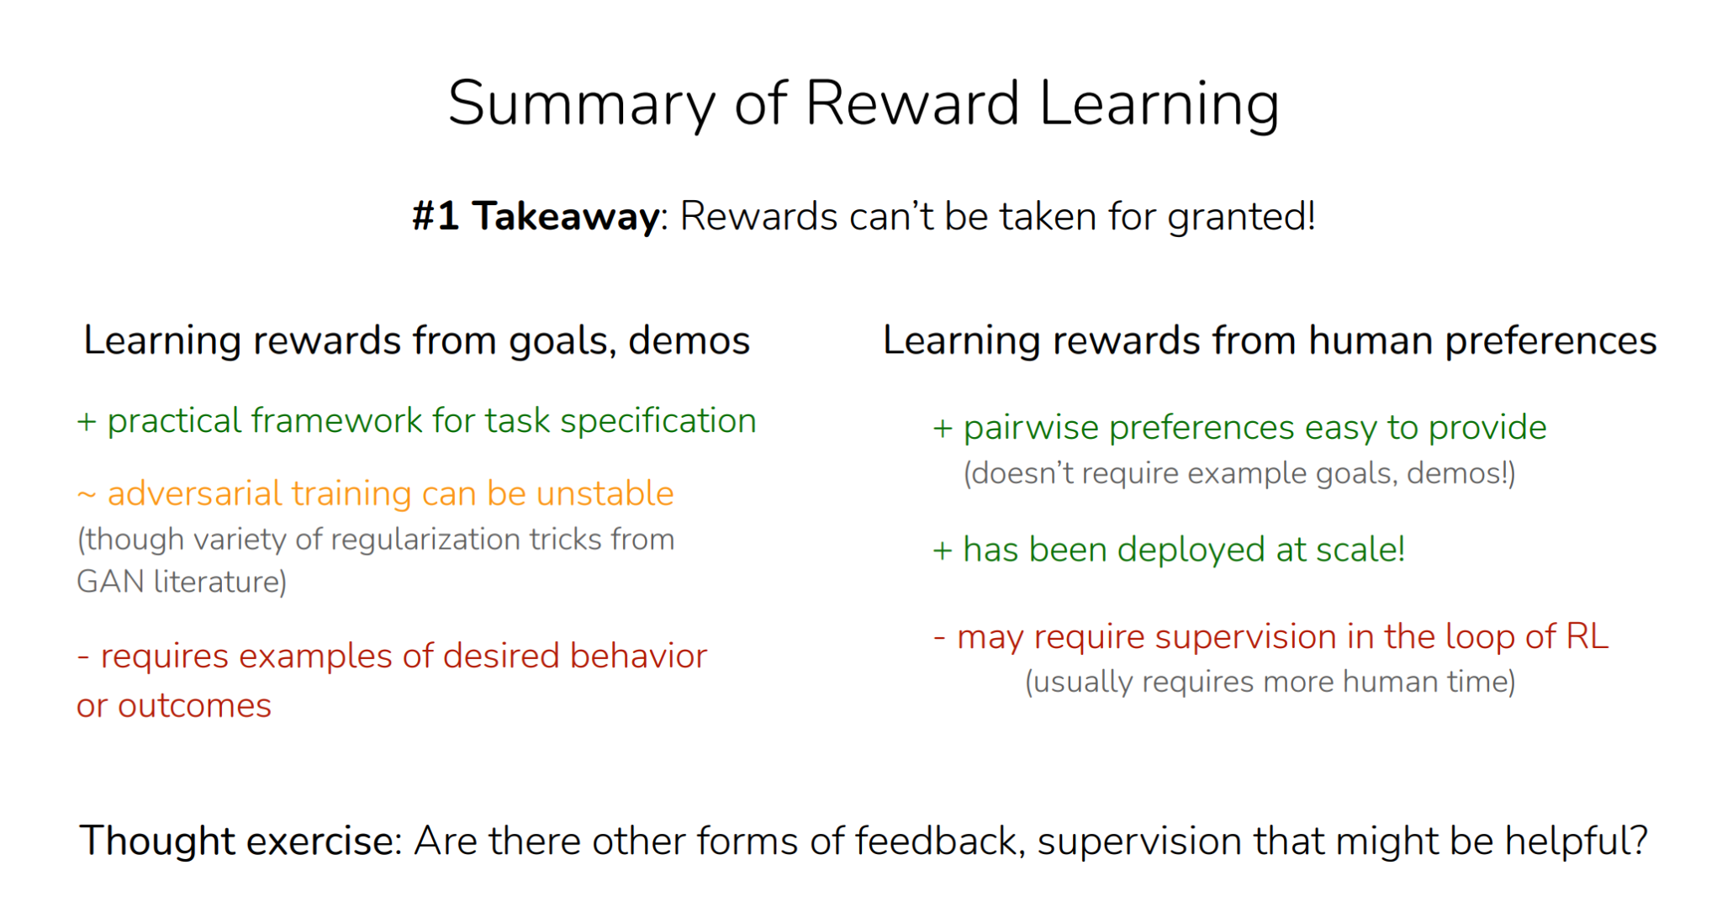

Slide 22
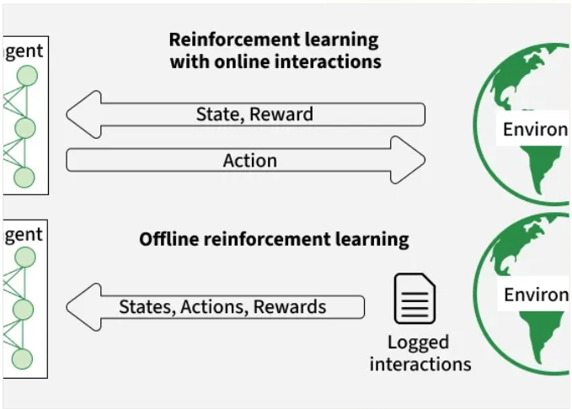
Recap: Offline RL
The Challenge: Distribution Shift
Standard RL assumes we can query the environment for any action. In Offline RL, we only have a fixed dataset D.
Extrapolation Error: When evaluating a policy, the Q-function may overestimate Out-of-Distribution (OOD) actions because it never saw them during training.
The agent "hallucinates" high rewards for actions it cannot verify, leading to catastrophic failure during deployment.

Slide 23
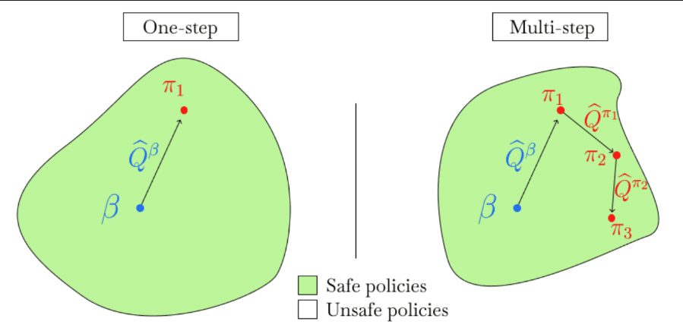
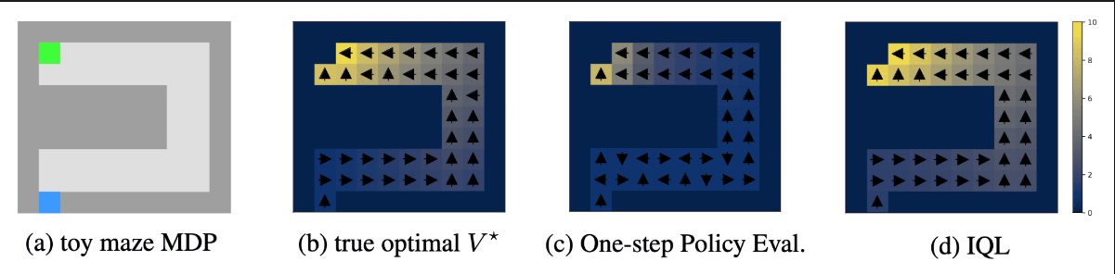
IQL
What does it achieve?
Expectile Loss
Steps:
Key idea: IQL avoids the overestimation problem by never evaluating actions outside the dataset. It treats policy improvement as a statistical estimation problem.
By fitting an "upper expectile" of the value distribution, IQL identifies the best available performance within the given data without extrapolation.
L_{λ}(V) = E_{a~πβ}[ℓ_{λ}(Q(s,a) − V(s))]
Step 1: Fit V_{ψ(s)} using asymmetric L₂ loss. A low λ (e.g., < 0.5) pushes V toward more conservative estimates within the dataset.
Step 2: Extract π using Advantage-Weighted Regression (AWR), which is essentially behavioral cloning weighted by the advantage: exp(A/β).
Notes:
Use lambda instead of tao and less than 0.5 (render equations in latex)

Slide 24
Sparse Rewards / Goal Conditioned RL
Issues:
Goal Conditioned RL
Example
Two Major Issues:
The first is the “needle in the haystack” problem. Without intermediate feedback, Q(s, a) estimates remain near zero for most of the trajectory, making gradients uninformative.
The next issue is if successful trajectories are rare in the dataset, the value function will struggle to differentiate "good" failures from "bad" ones.
Reward: r(s, a, g) = −‖s − g‖ (or sparse: 1[s ≈ g])
Policy: π(a | s, g) — goal g is part of the input
In the image below what would the sparse rewards be? How could we do GCRL to make it perform better?
Notes:
Include reward learning + model based RL, add a high level overview of everything (couples slides from lecture, offline RL lecture 3rd slide) model based rl slide 4 (examples of high level picture of how everything connects, try adding reward learning and model based in there

Slide 25
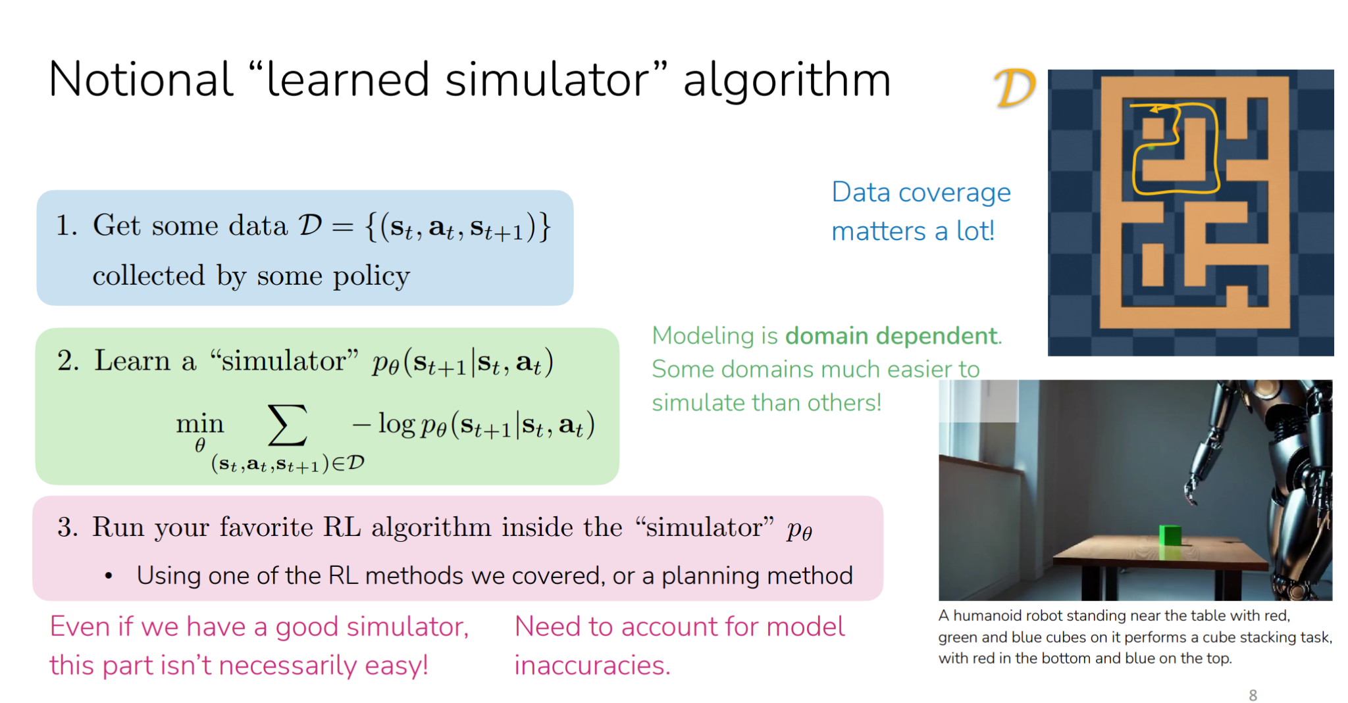

Slide 27
Important Things to Remember for Exam
How to calculate loss for different approaches (Given Examples)
Advantages and disadvantages depending on situations for different methods
What each part of the equation actually does and the impacts of changing different terms

