Slide 1
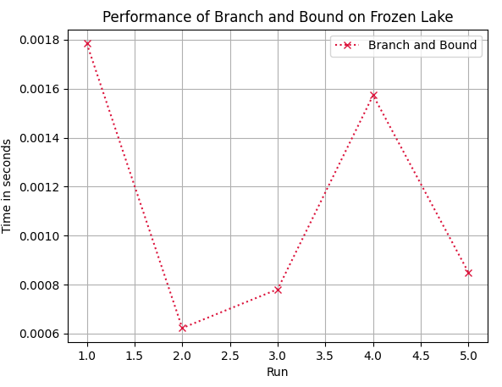
Branch and Bound on Frozen Lake
No heuristic used in BnB. Bnb Tries to find optimal goal inside the given upper bound.

Slide 2
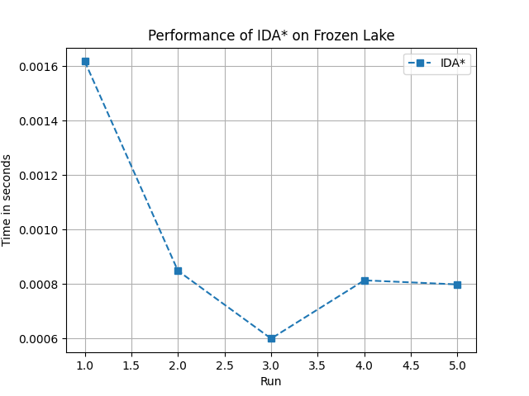
IDA* on Frozen Lake
Heuristic Function : Manhattan distance
f(n) = g(n)+ h(n) g(n) distance from start to node n
h(n) heuristic distance from node n to goal

Slide 3
Frozen Lake
IDA*
Takes less time relatively
The heuristic (manhattan distance) helps it avoid bad paths early on.
Complete if goal is finite distance.
Deterministic.
Branch and Bound
Takes more time relatively
often goes deep into wrong paths before realizing it needs to backtrack.
Not complete if state space is infinite.
Given same input and tie breaks gives same result (deterministic)

Slide 4
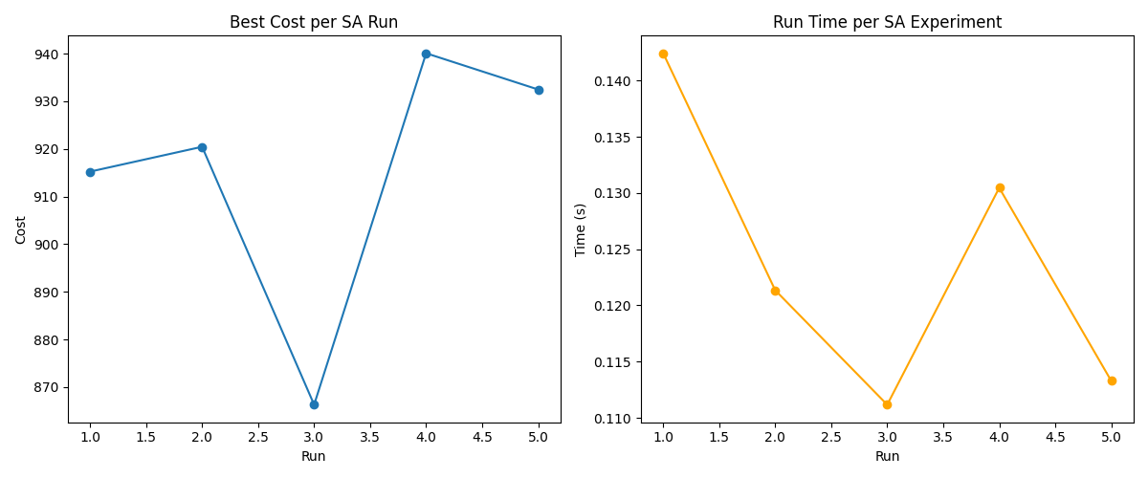
Simulated Annealing for Traveling Salesman Problem
Escaping Local Minima: Unlike purely greedy methods, SA incorporates a temperature parameter that gradually decreases, allowing the algorithm to accept suboptimal moves initially and thus escape local minima.
Cooling Schedule:The cooling schedule governs the transition from exploration (high temperature, higher probability of accepting worse solutions) to exploitation (low temperature, focusing on refining the best solution).
Heuristic Function: Total tour length

Slide 5
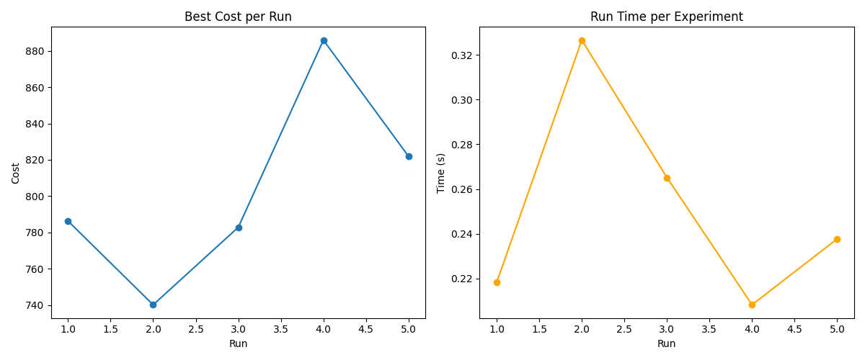
Hill CLimbing for Traveling Salesman Problem
For HC & SA - used ant_colony_opt_TSP\problems\eil76.tsp - with 76 cities
Heuristic Function:
The heuristic function used is the total tour length (i.e., sum of the Euclidean distances between consecutive cities).
The objective is to minimize this value.
This choice is natural for TSP as it directly correlates with the quality of the tour.

Slide 6
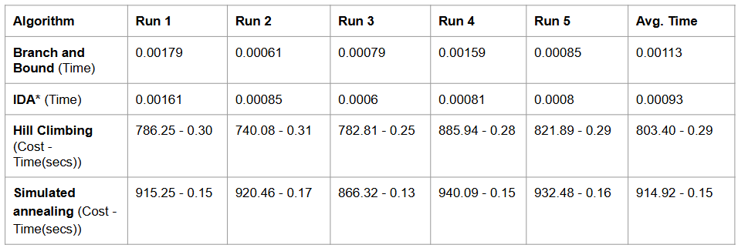
Results
Aspect | Hill Climbing | Simulated Annealing
Local Minima | Easily gets stuck in local minima | Can escape local minima by occasionally accepting worse solutions
Acceptance of Worse Moves | Does not accept worse moves once in a local optimum | Accepts worse moves probabilistically (based on “temperature”)
Cooling/Temperature | Not applicable | Uses a cooling schedule to gradually reduce the probability of worse moves
Search Strategy | Greedy improvement; stops if no better move is found | Continues to explore even non-improving solutions early on
Performance | Generally faster but may produce suboptimal sols | Slower but often finds better-quality (near-optimal) solutions
Implementation Complexity | Relatively simple | Slightly more complex due to temperature scheduling
Github Link - https://github.com/cs24m111/AI_Asn2.git
CS24M101 - A Sai Jagadeesh CS24M111 - G Kavyasri

