Slide 1
Emotion & Environmental Dynamics in Classic Literature
4 public-domain books
28 GoEmotions labels → selected non-neutral emotion analysis
6 environmental topic categories
Sentence-flow + paragraph-level results
ModernBERT + GoEmotions • Project Gutenberg • Results Analysis • 1
ModernBERT + GoEmotions • Project Gutenberg • Results Analysis • 1

Slide 2
Study design
What was analyzed and how
Input: Project Gutenberg plain-text editions of four classic books.
Segmentation: book → paragraphs → sentences.
Emotion model: cirimus/modernbert-base-go-emotions with 28 GoEmotions labels.
Paragraph results: sentence emotion probabilities aggregated to paragraph level; dominant selected emotion summarized.
Environmental detection: lexicon-based matching across six topic groups.
Sentence-flow plots: two sampled sets of 20 paragraphs per book to visualize local emotion transitions.
ModernBERT + GoEmotions • Project Gutenberg • Results Analysis • 2

Slide 3
Dataset & processing scale
The experiments cover 13,000+ analyzed sentences
Book | Gutenberg ID | Paragraphs | Sentences | Sentence-flow samples
Alice's Adventures in Wonderland | 11 | 797 | 1,524 | 52 sentences + 64 sentences
Frankenstein | 84 | 749 | 3,344 | 118 sentences + 91 sentences
Pride and Prejudice | 1342 | 2,116 | 6,051 | 81 sentences + 84 sentences
The Adventures of Sherlock Holmes | 1661 | 2,308 | 6,479 | 62 sentences + 96 sentences
Total: 3,964 paragraphs and 13,398 sentences across the four books.
The notebooks use the same modeling and visualization pipeline for cross-book comparison.
ModernBERT + GoEmotions • Project Gutenberg • Results Analysis • 3

Slide 4
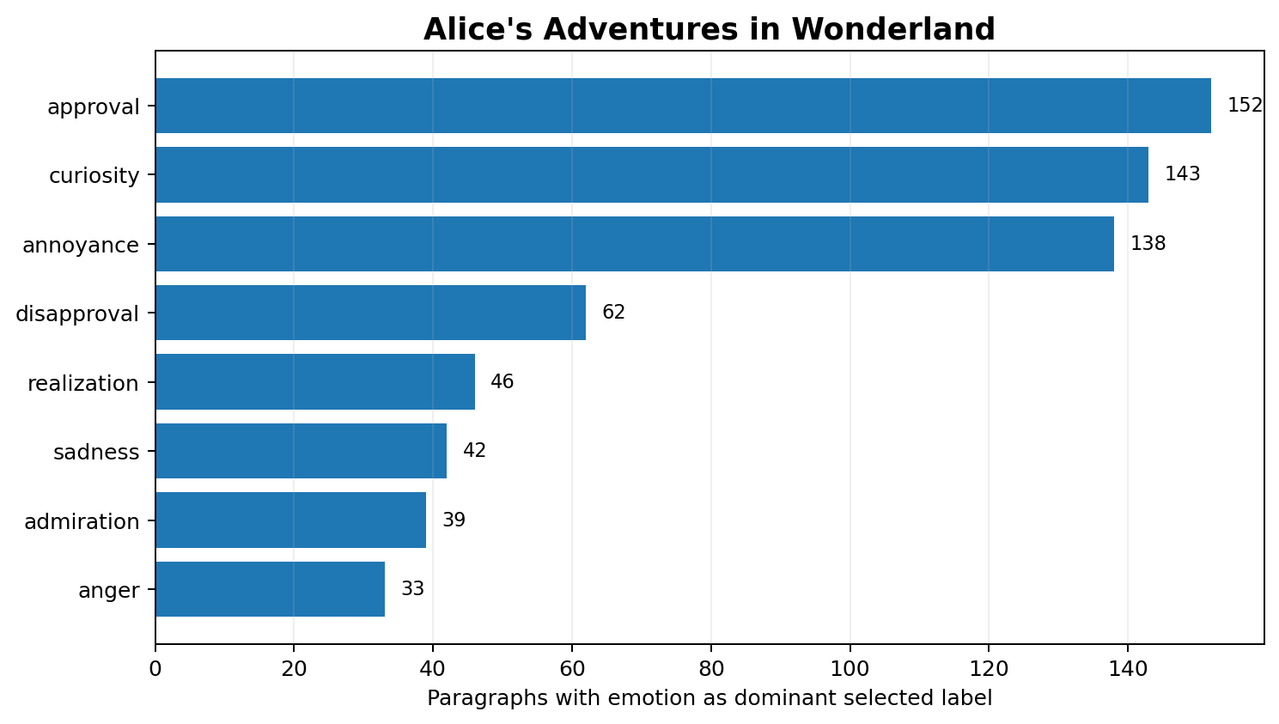
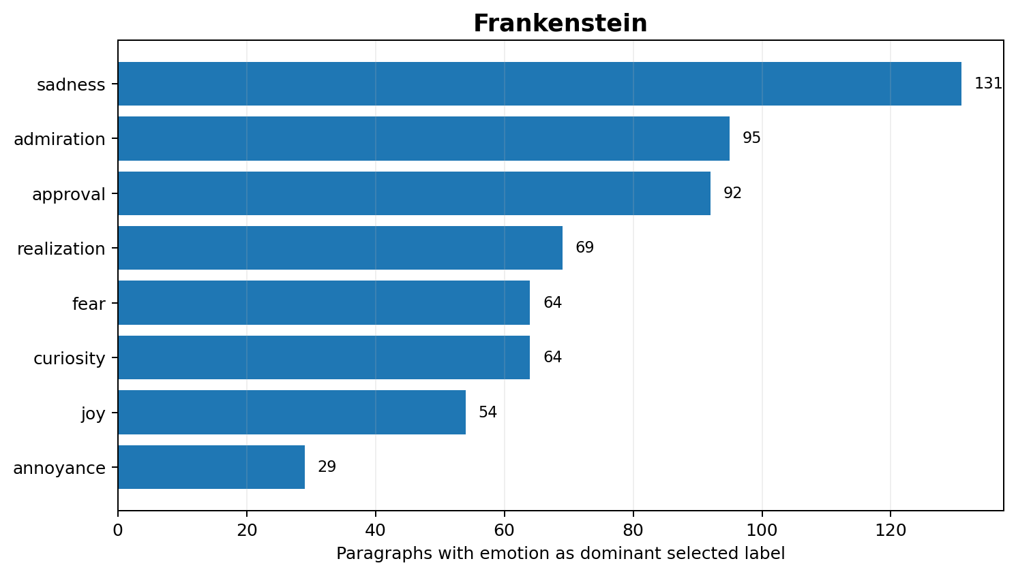
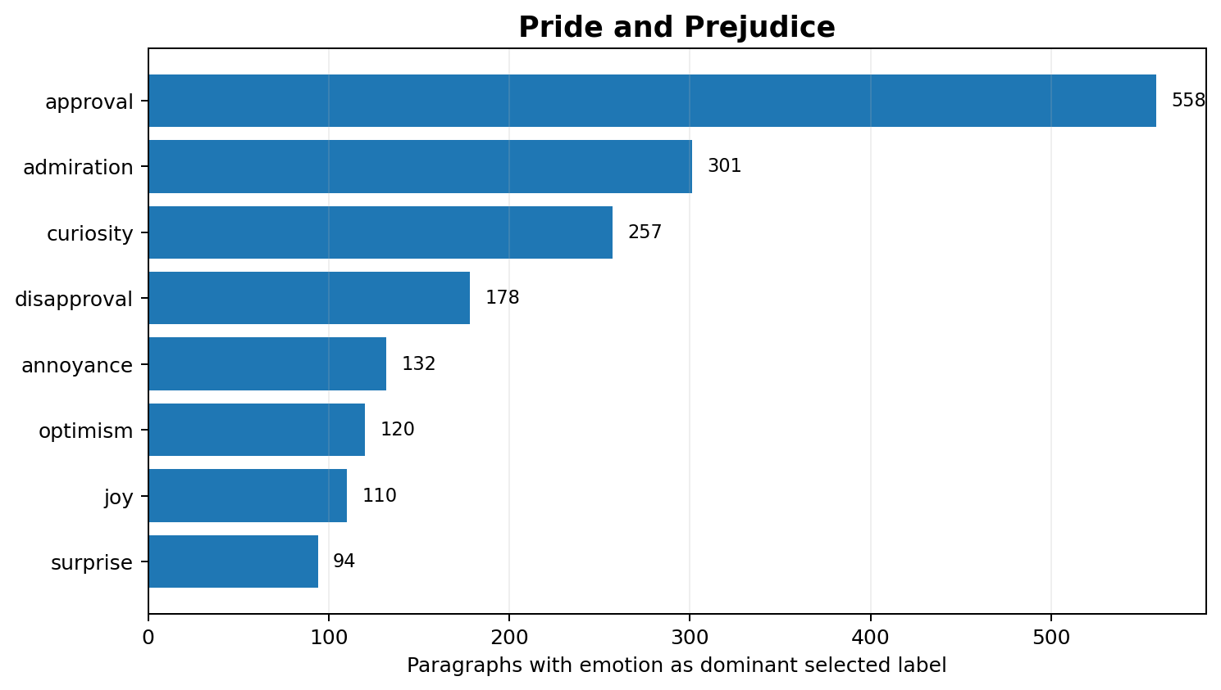
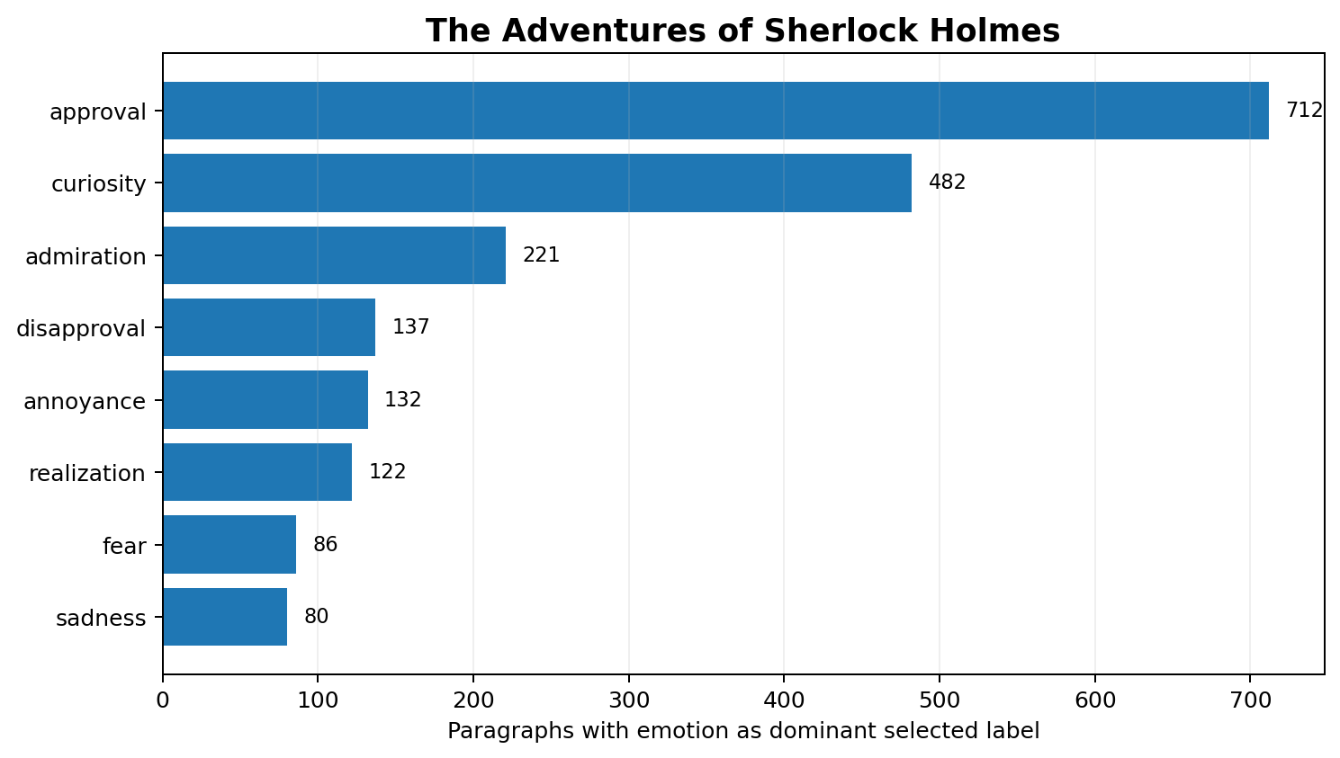
Emotion results by book
Top selected dominant emotions at paragraph level
ModernBERT + GoEmotions • Project Gutenberg • Results Analysis • 4

Slide 5
Key emotion findings
What changes across the four narratives
Alice: approval (152), curiosity (143) and annoyance (138) dominate the selected paragraph labels.
Frankenstein: sadness (131) is the leading selected emotion, followed by admiration (95), approval (92) and realization (69).
Pride and Prejudice: approval (558) is especially prominent, with admiration (301), curiosity (257) and disapproval (178) also frequent.
Sherlock Holmes: approval (712) and curiosity (482) dominate, consistent with a strongly investigative narrative profile.
The distributions show that the same model can expose markedly different emotional signatures across literary styles.
ModernBERT + GoEmotions • Project Gutenberg • Results Analysis • 5

Slide 6
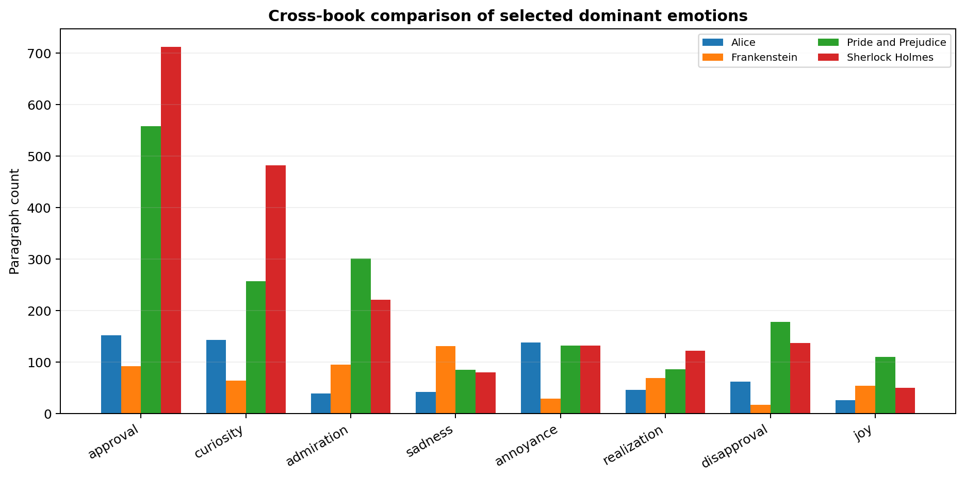
Cross-book emotion comparison
Selected dominant emotions
ModernBERT + GoEmotions • Project Gutenberg • Results Analysis • 6

Slide 7
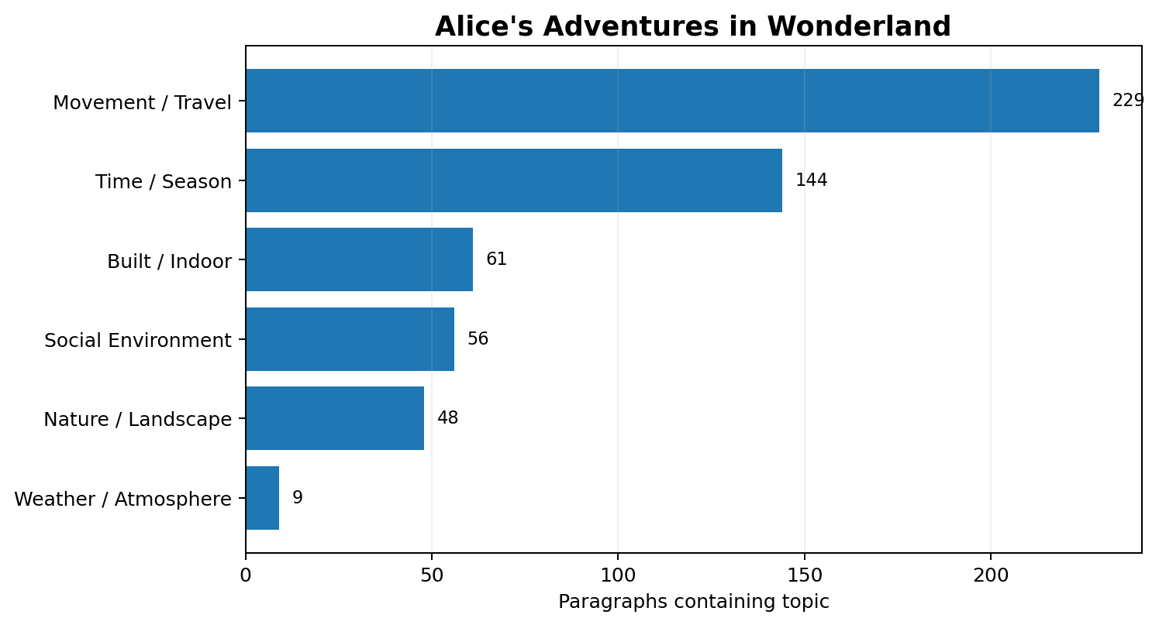
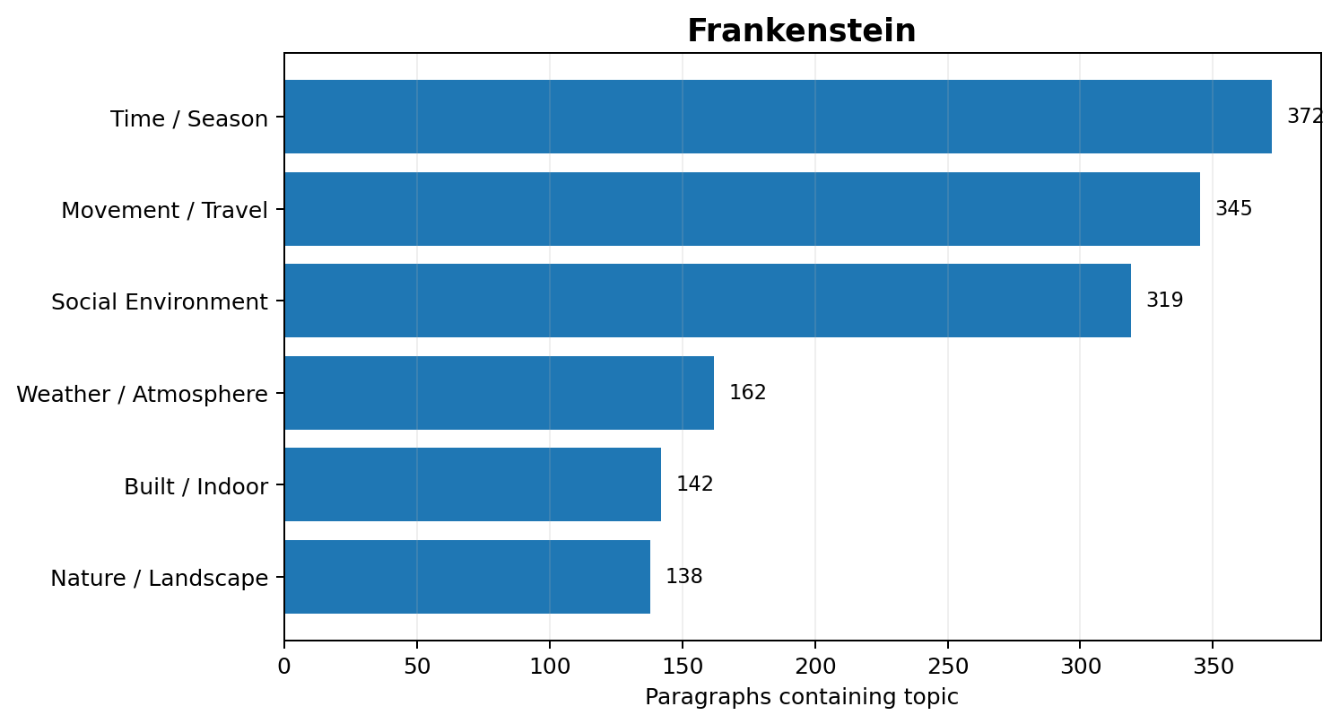
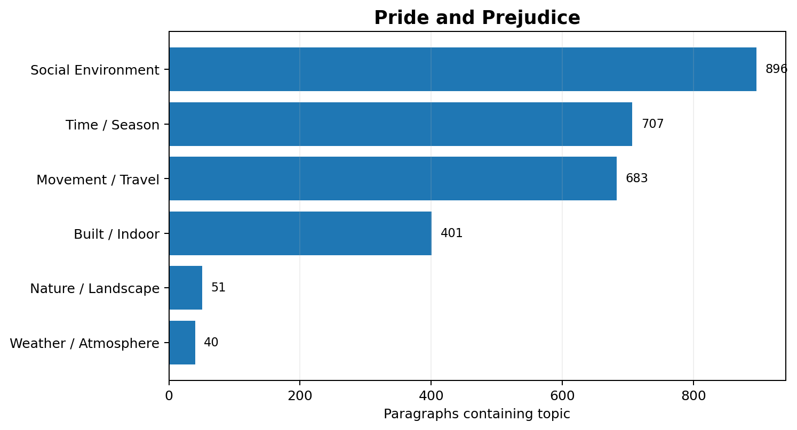
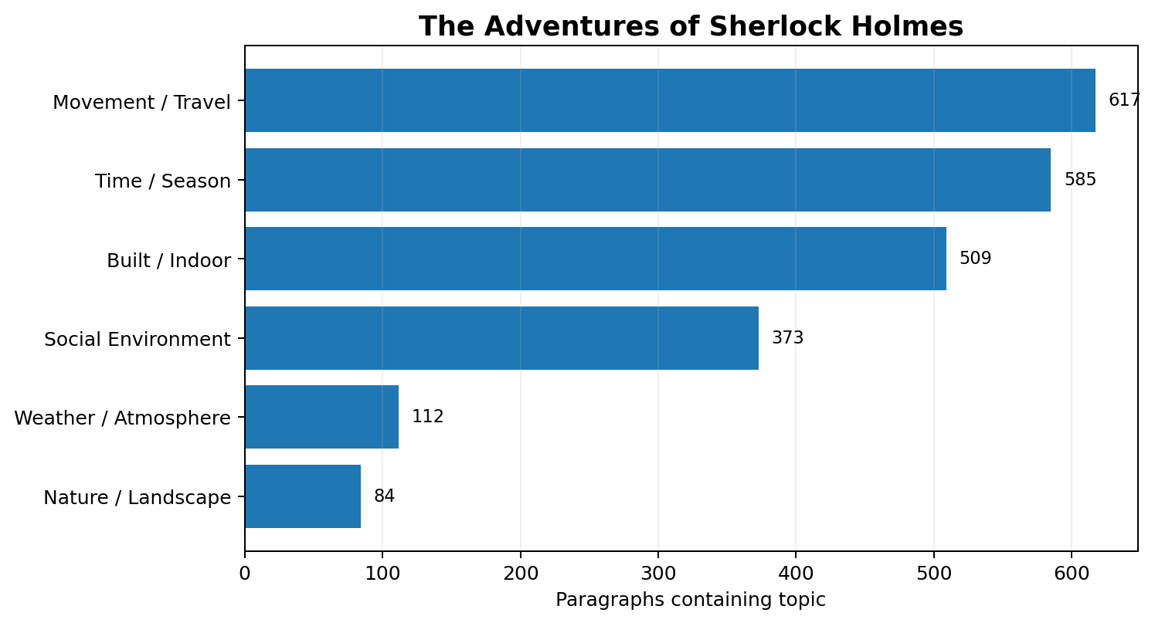
Environmental-topic results
Topic presence detected in paragraphs
ModernBERT + GoEmotions • Project Gutenberg • Results Analysis • 7

Slide 8
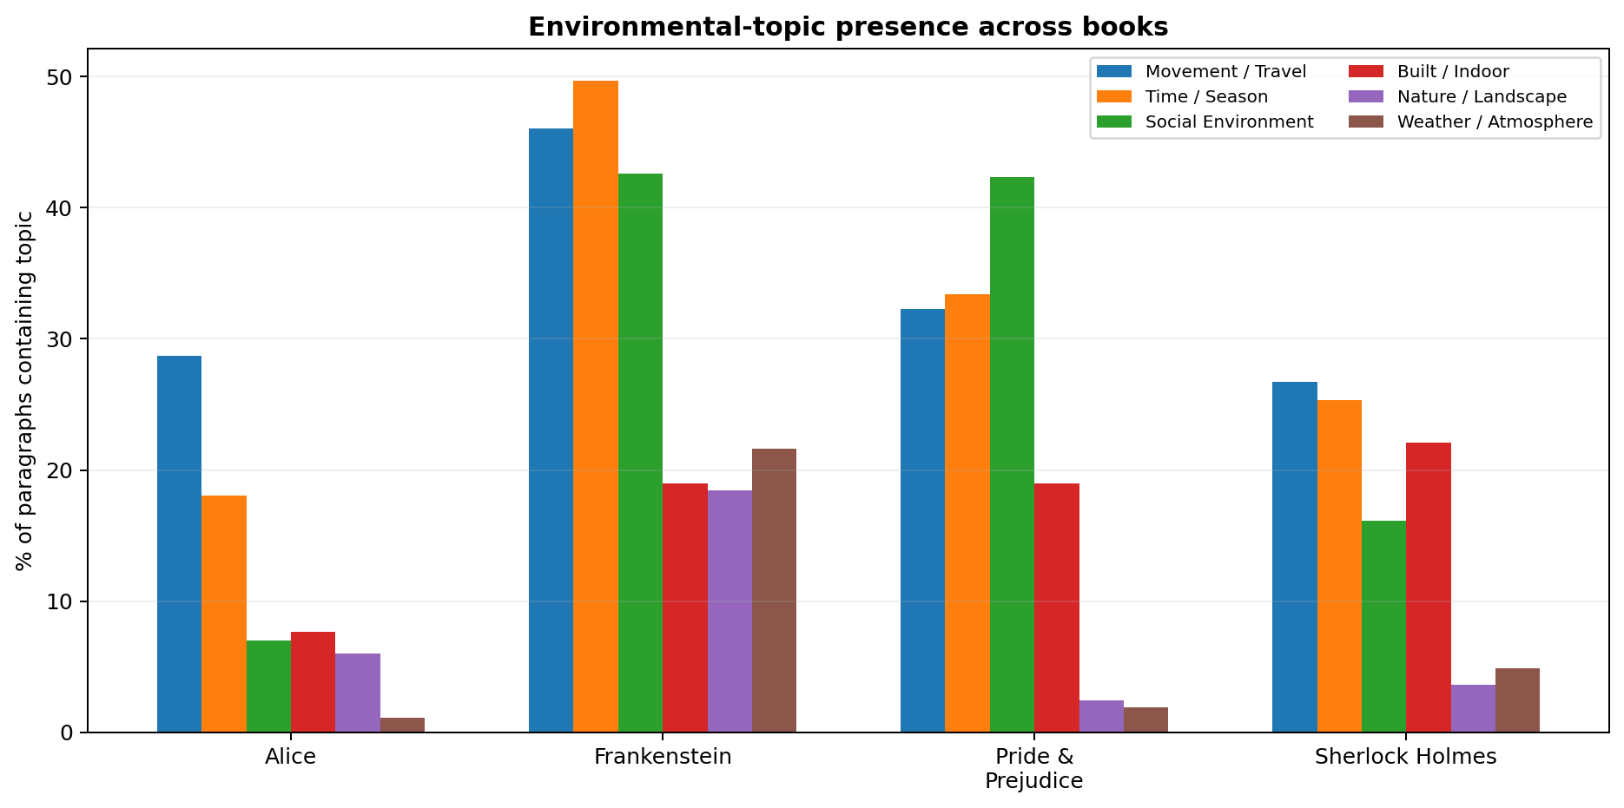
Environmental patterns across books
Percentage of paragraphs containing each topic
ModernBERT + GoEmotions • Project Gutenberg • Results Analysis • 8

Slide 9
Key environmental findings
How narrative settings differ
Alice: movement/travel is the most frequent detected context (28.7%), followed by time/season (18.1%).
Frankenstein: time/season (49.7%), movement/travel (46.1%) and social environment (42.6%) are strongly represented.
Pride and Prejudice: social environment is dominant (42.3%), followed by time/season (33.4%) and movement/travel (32.3%).
Sherlock Holmes: movement/travel (26.7%), time/season (25.3%) and built/indoor settings (22.1%) are prominent.
Weather/atmosphere is comparatively sparse in all four, except for a stronger presence in Frankenstein.
ModernBERT + GoEmotions • Project Gutenberg • Results Analysis • 9

Slide 10
Integrated interpretation
Emotion and environment together
Narrative emotion is not uniform: each book has a distinct concentration of selected emotions.
Pride and Prejudice and Sherlock Holmes show especially high approval-related paragraph counts, while Frankenstein is characterized by a stronger sadness/fear/realization profile.
Environmental context also differs: social settings are particularly prominent in Pride and Prejudice, while travel/time and indoor context are important in Sherlock Holmes and Frankenstein.
Sentence-level plots complement aggregate counts by revealing rapid local shifts between neighboring emotional states.
Together, the two analyses provide a computational view of how narrative affect and setting evolve over the course of a book.
ModernBERT + GoEmotions • Project Gutenberg • Results Analysis • 10

Slide 11
Interpretation notes & limitations
The emotion results are model predictions, not human-annotated ground truth for these books.
The paragraph percentages/counts summarize dominant selected labels and should not be interpreted as exact emotional truth.
Environmental categories are lexicon-based topic detection; a detected word does not guarantee that the topic is narratively central.
Project Gutenberg formatting occasionally produces chapter-heading artifacts in segmentation; sentence/paragraph totals are therefore the more reliable scale measures.
The sentence-level plots use sampled 20-paragraph sets, so they illustrate local dynamics rather than serving as full-book estimates.
ModernBERT + GoEmotions • Project Gutenberg • Results Analysis • 11

Slide 12
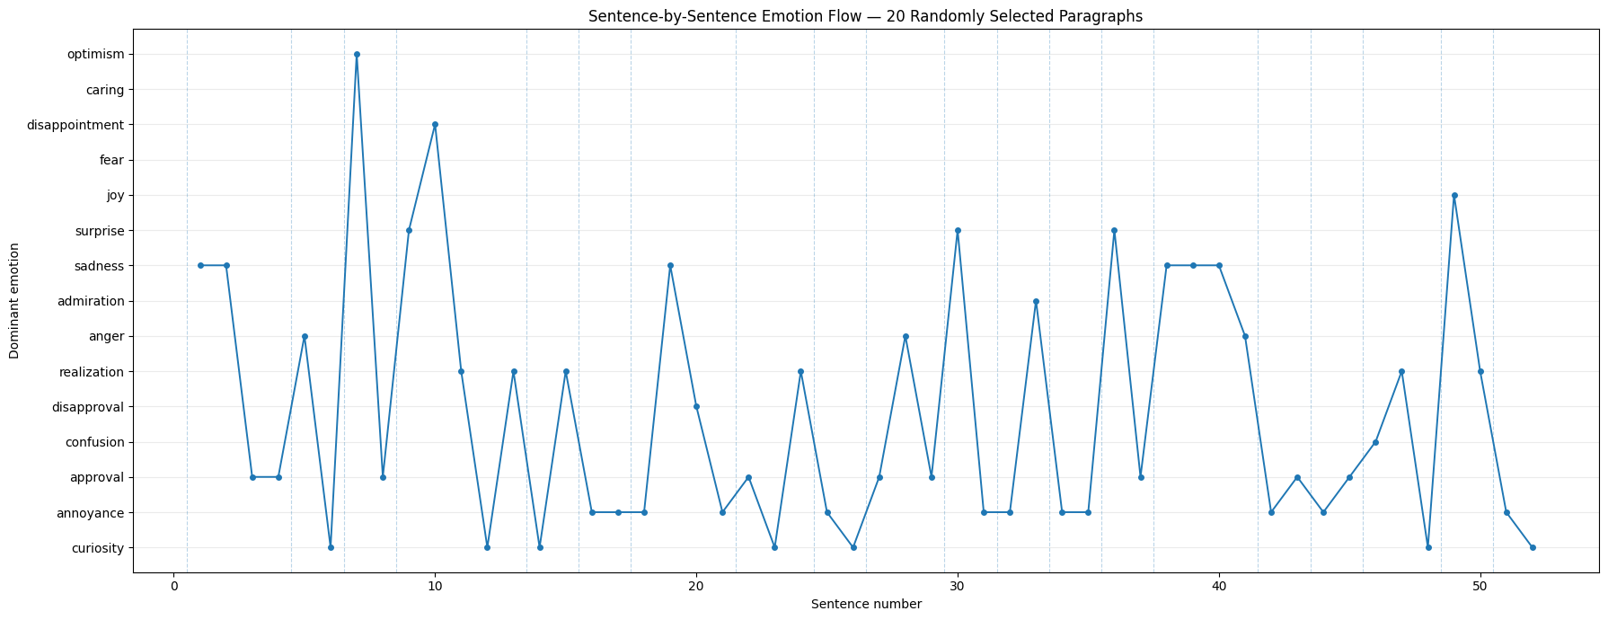
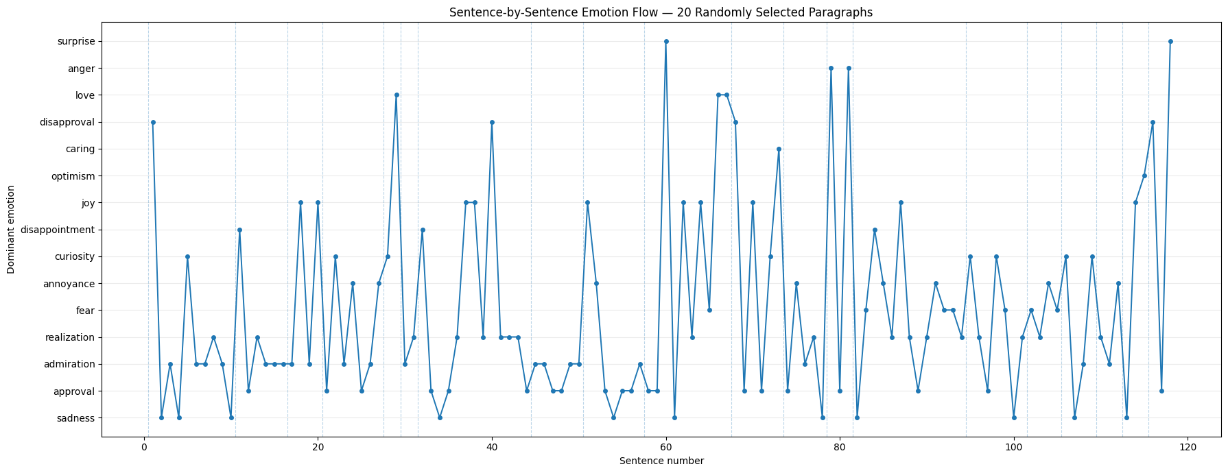
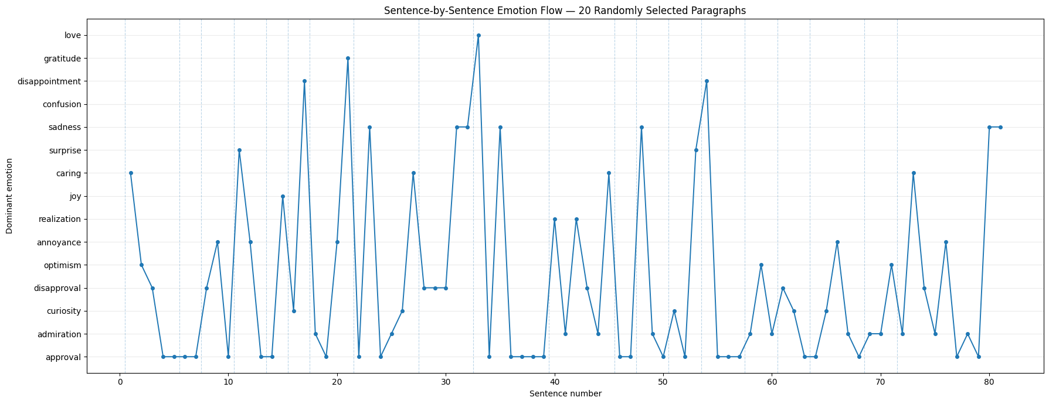
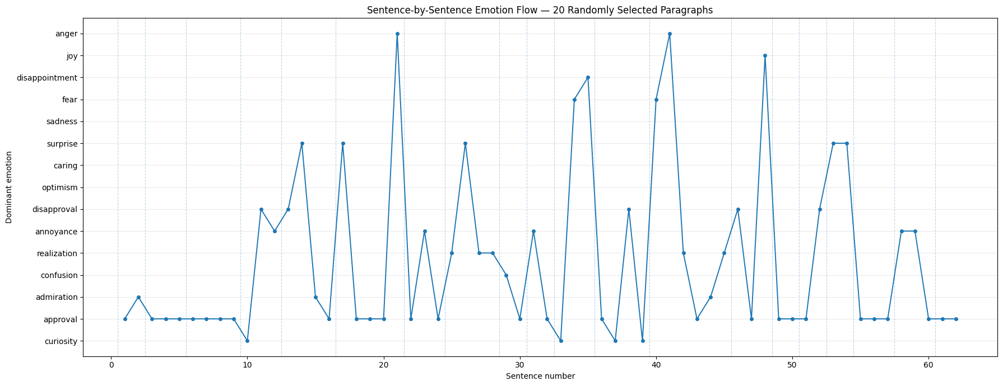
Actual sentence-level emotion flow — Plot 1
One sampled set of 20 paragraphs from each book
Alice's Adventures in Wonderland
Frankenstein
Pride and Prejudice
The Adventures of Sherlock Holmes
ModernBERT + GoEmotions • Project Gutenberg • Results Analysis • 13

Slide 13
Actual sentence-level emotion flow — Plot 1
One sampled set of 20 paragraphs from each book
Alice's Adventures in Wonderland
Frankenstein
Pride and Prejudice
The Adventures of Sherlock Holmes
ModernBERT + GoEmotions • Project Gutenberg • Results Analysis • 13

Slide 14
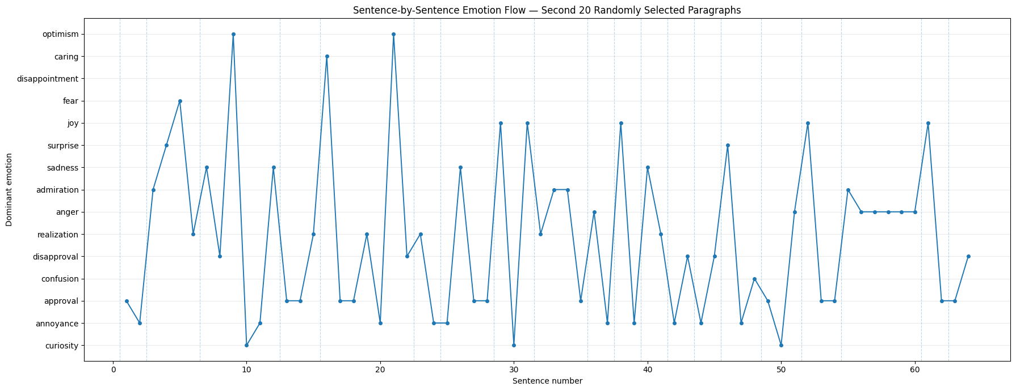
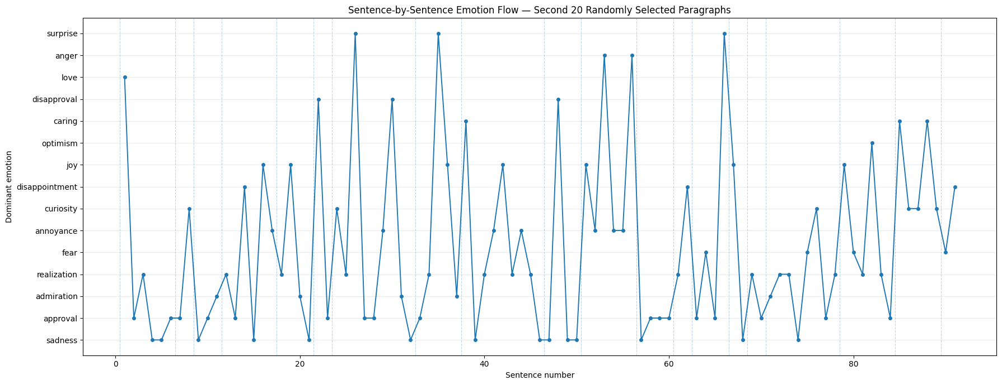
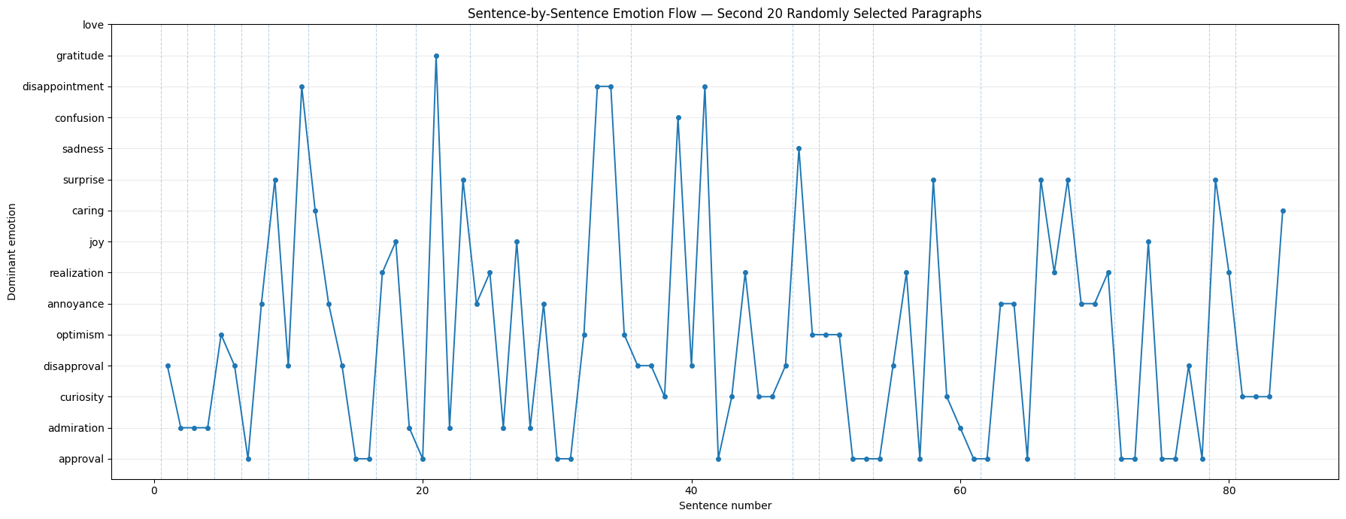
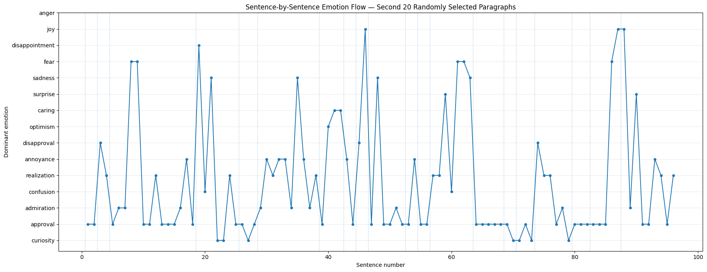
Actual sentence-level emotion flow — Plot 2
A different sampled set of 20 paragraphs from each book
Alice's Adventures in Wonderland
Frankenstein
Pride and Prejudice
The Adventures of Sherlock Holmes
ModernBERT + GoEmotions • Project Gutenberg • Results Analysis • 14

