Slide 1
Recursive functions

Slide 2

Substitution Method
The substitution method for solving recurrences entails two steps:
1. Guess the form of the solution.
2. Use mathematical induction to find the constants and show that the solution works.
This method is powerful, but it obviously can be applied only in cases when it is easy to guess the form of the answer.
The substitution method can be used to establish either upper or lower bounds on a recurrence.
Let us consider the following recurrence:
Notes:
The name comes from the substitution of the guessed answer for the function when the inductive hypothesis is applied to smaller values.

Slide 3




Guess that the solution is T (n) = O(n lg n)
We need to prove that T (n) ≤ cn lg n for an appropriate choice of the constant c > 0
Assuming that this bound holds for
i.e,
Substitute in the recurrence,
This holds as long as C ≥ 1

Slide 4
Mathematical induction is used to find the boundary conditions.
Let us assume, that T (1) = 1 is the sole boundary condition of the recurrence.
Then for n = 1,
the bound T (n) = cn lg n yields
T (1) = c1 lg 1 = 0,
which is at odds with T (1) = 1
to prove T (n) = cn lg n for n >= n0, where n0 is a constant
for n > 3, the recurrence does not depend directly on T(1).
replace T (1) by T (2) and T (3) as the base cases in the inductive proof, letting n0 = 2.

Slide 5



Making good guess
Guess an upperbound ,gradually lower the upper bound and increase the lower bound till we converge, to get a tight solution.
Subtleties
If we guess he solution is O(n) and we try to show that C(n) <=cn
It does not possible for any choice of c

Slide 6
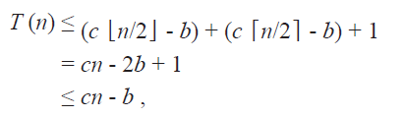
substitution Method
We will try to guess o(n2) but our guess is correct.
Mathematical induction does not work unless we prove the exact form of the inductive hypothesis.
As long as b>=1

Slide 7
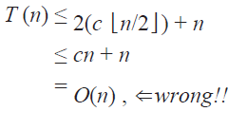
Avoiding pitfalls
Changing the variables

Slide 8


Recurssion tree method
In a recursion tree, each node represents the cost of a single sub-problem somewhere in the set of recursive function invocations.
A recursion tree is best used to generate a good guess, which is then verified by the substitution method.
Consider the recurrence
T(n)=
Let us assume that ‘n’ is a power of 4.

Slide 9
The cn² term at the root represents the cost at the top level of
recursion, and the three sub-trees of the root represent the costs incurred by the sub-problems of size n/4.
T(n)
cn²
T(n/4) T(n/4) T(n/4)

Slide 10
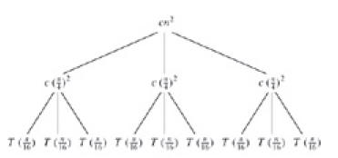

Slide 11
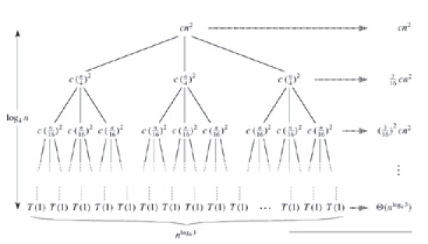

Slide 12
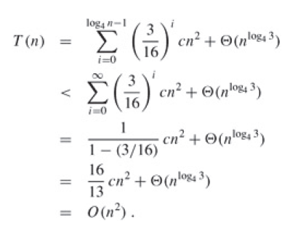

Slide 13
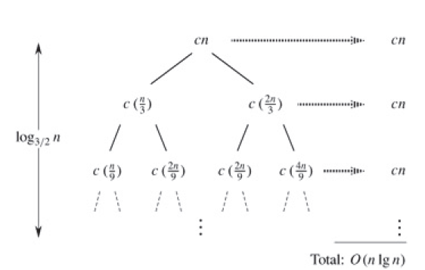

Slide 14

use the substitution method to verify that O(n lg n) is an upper bound for the solution to the recurrence.
Show that T (n) <= dn lg n, where d is a suitable positive constant.

Slide 15



Draw the recursion tree for the following recursion and provide the tight asymptotic bound on its solution and verify it using substitution method

